Slide 1
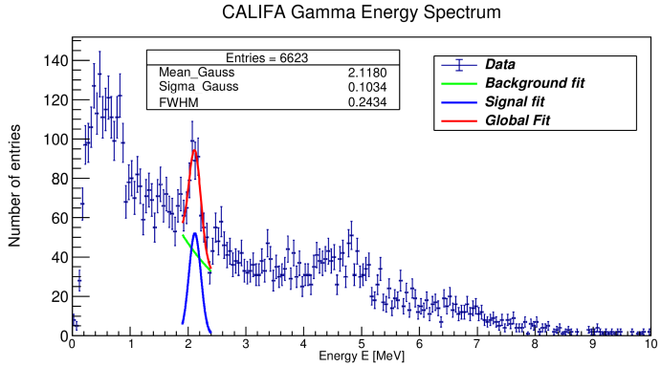

12C(p,2p)11B Analysis:
Beam energy: 400 AMeV
Beamtype: 12C
Beam Time: 3 hours
Target: CH2 (12.29mm)
Tracking Detectors: MWPC 1,2,3
ToF measurement: START to ToFW
Charge measurement: TWIM Music
Event selection criteria CALIFA:
→ two hits with E_{hit} > 30 MeV
¹¹B level scheme:
2.1 MeV (½ ⁻) p-hole state of ¹¹B
11B Analysis with S455 Setup, Feb. 2020
Tobias Jenegger

