Slide 1
S444 experiment – update 3
03.09.2024

Slide 2
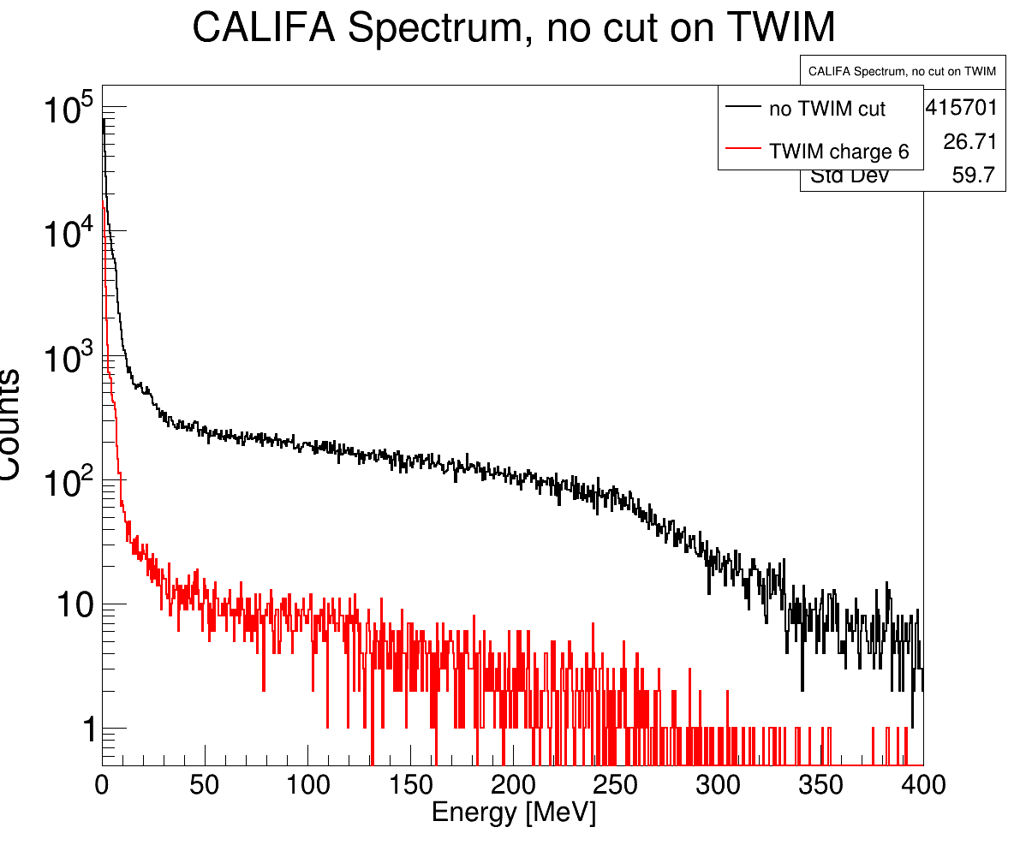
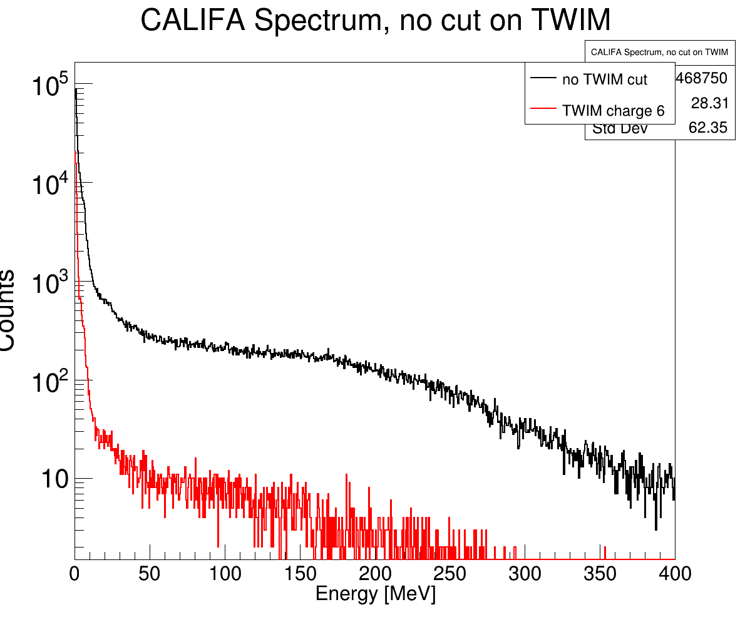
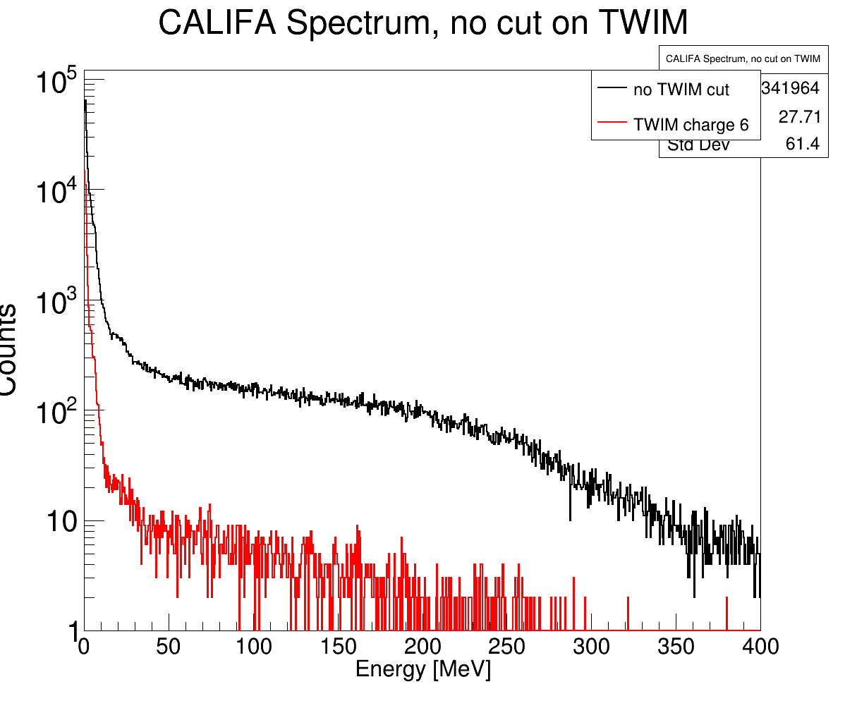
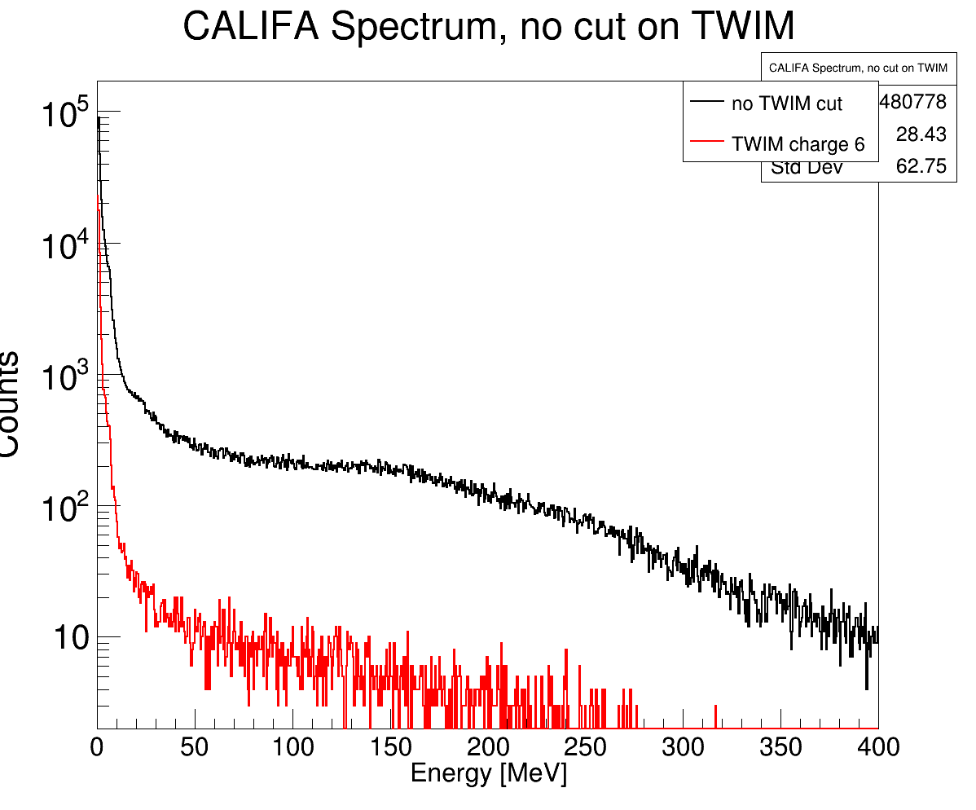
Look at CALIFA (high energy) hits – target runs
650 AMeV
400 AMeV
800 AMeV
550 AMeV

Slide 3
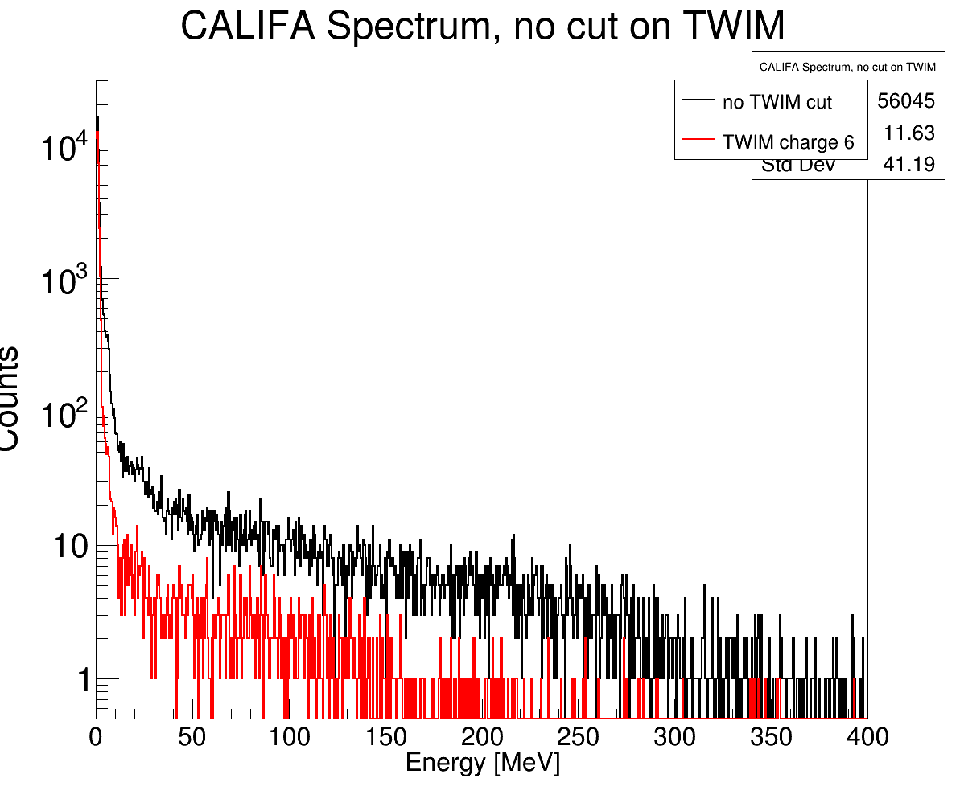
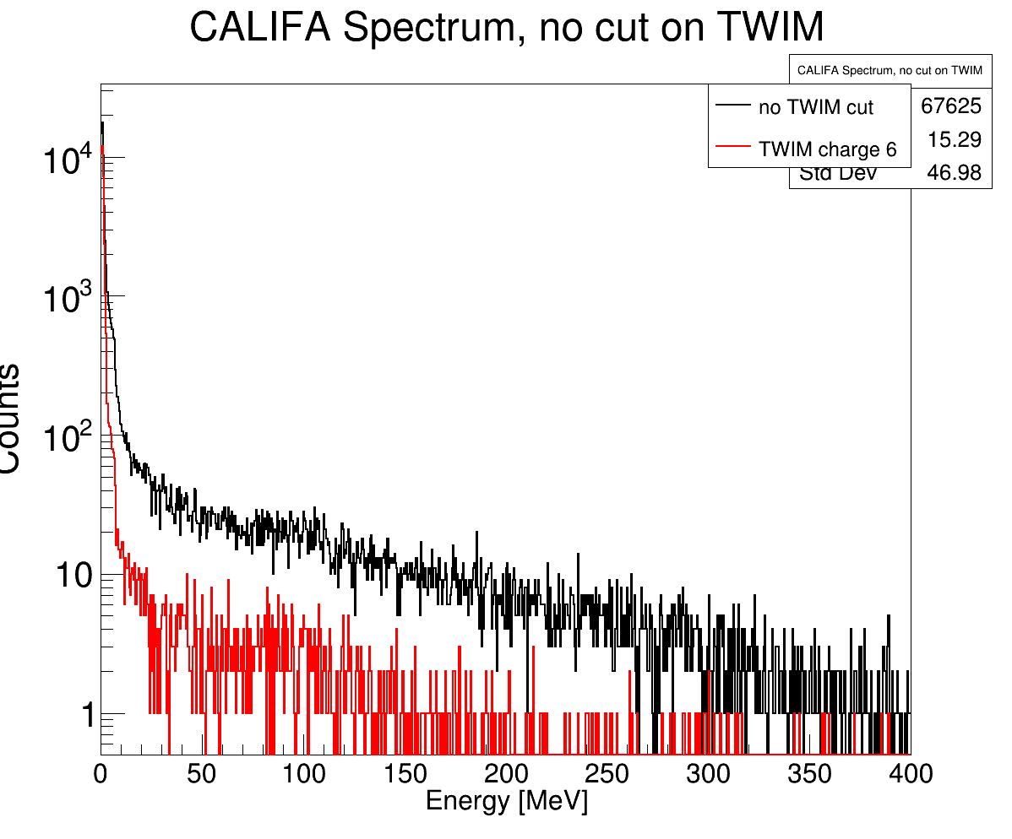
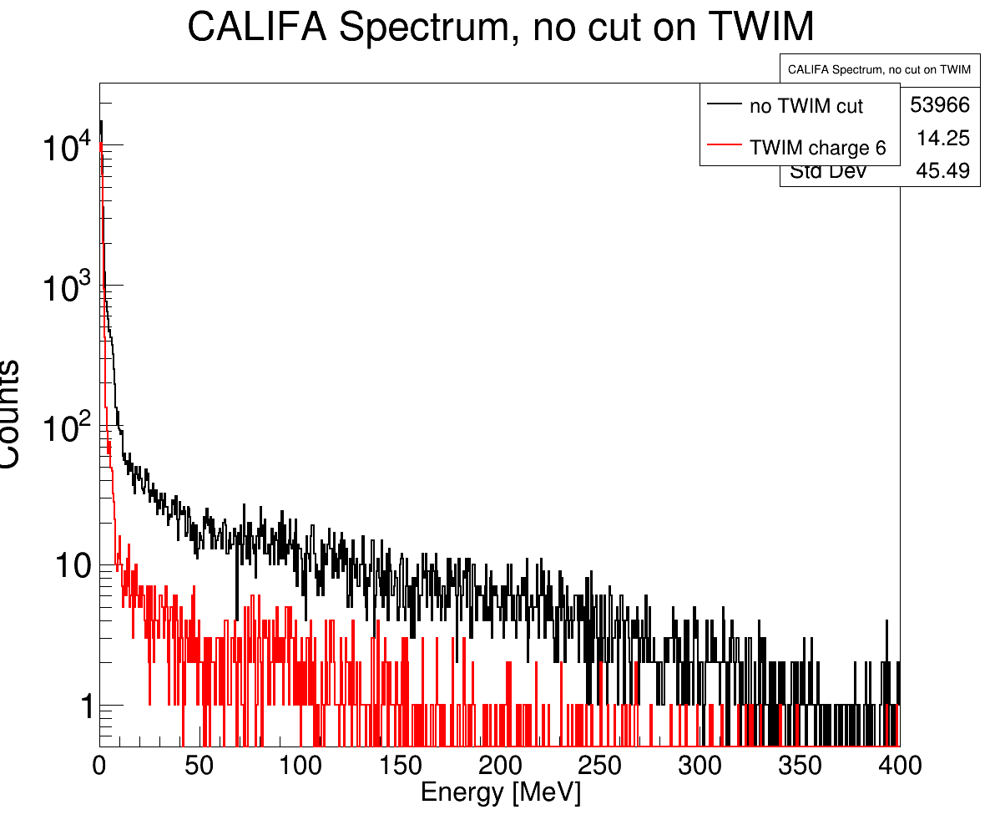
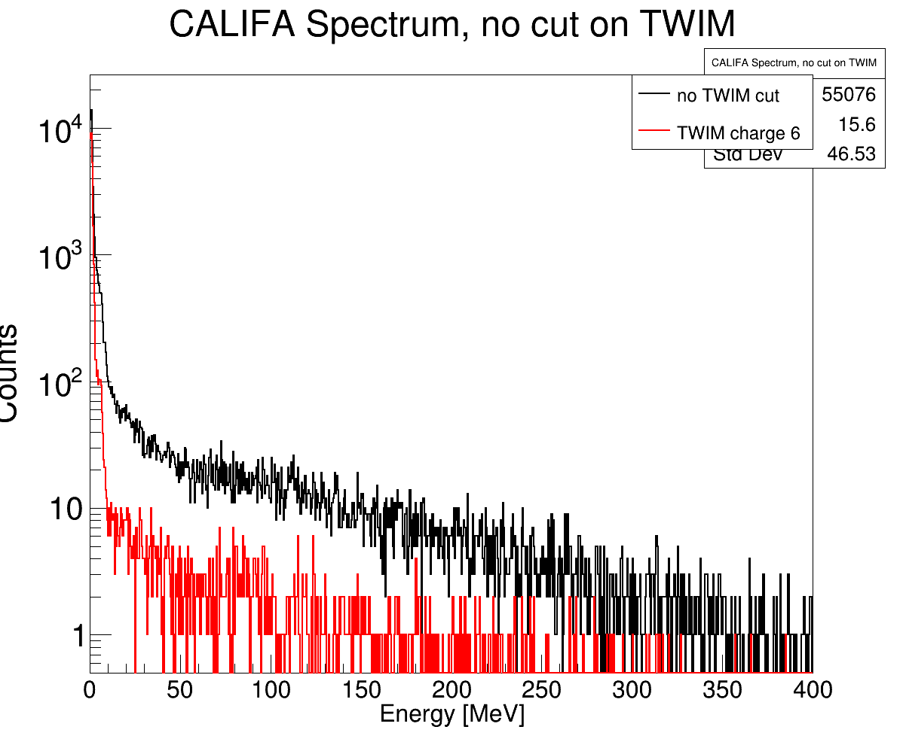
Look at CALIFA (high energy) hits – empty runs
650 AMeV
400 AMeV
800 AMeV
550 AMeV

Slide 4
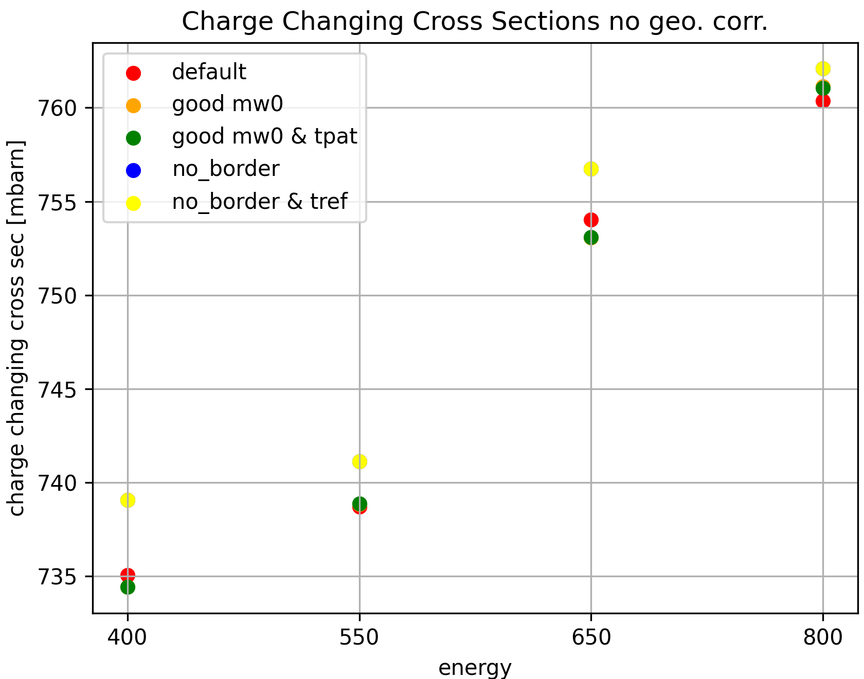
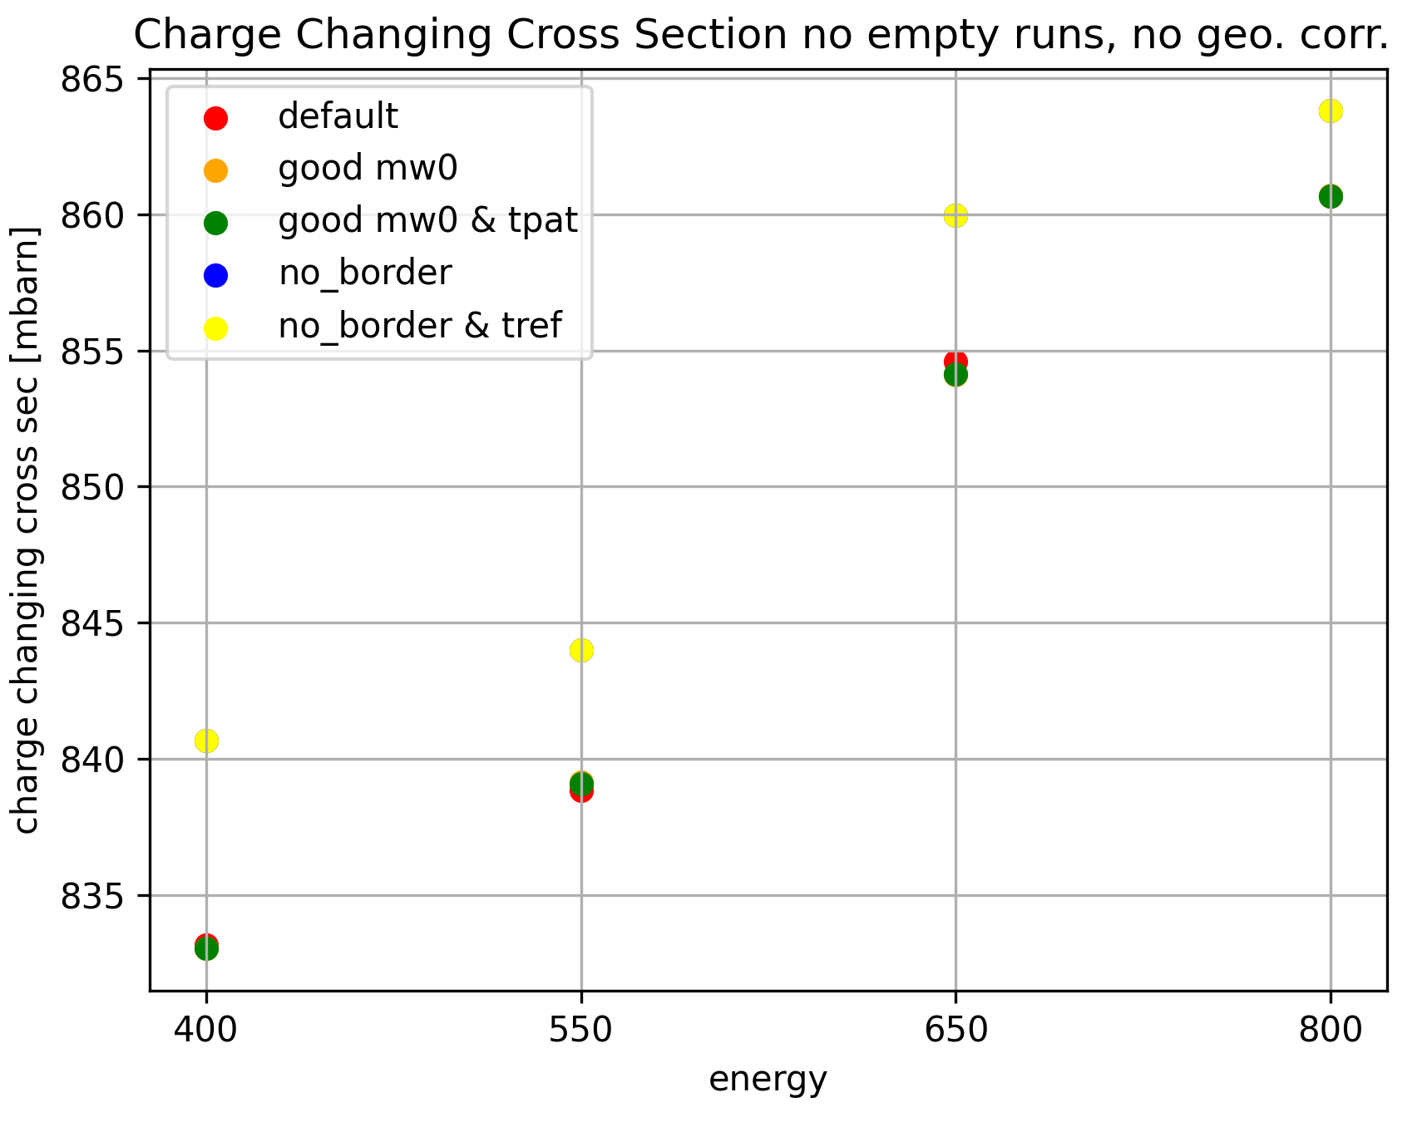
Cross Sections without empty runs

Slide 5
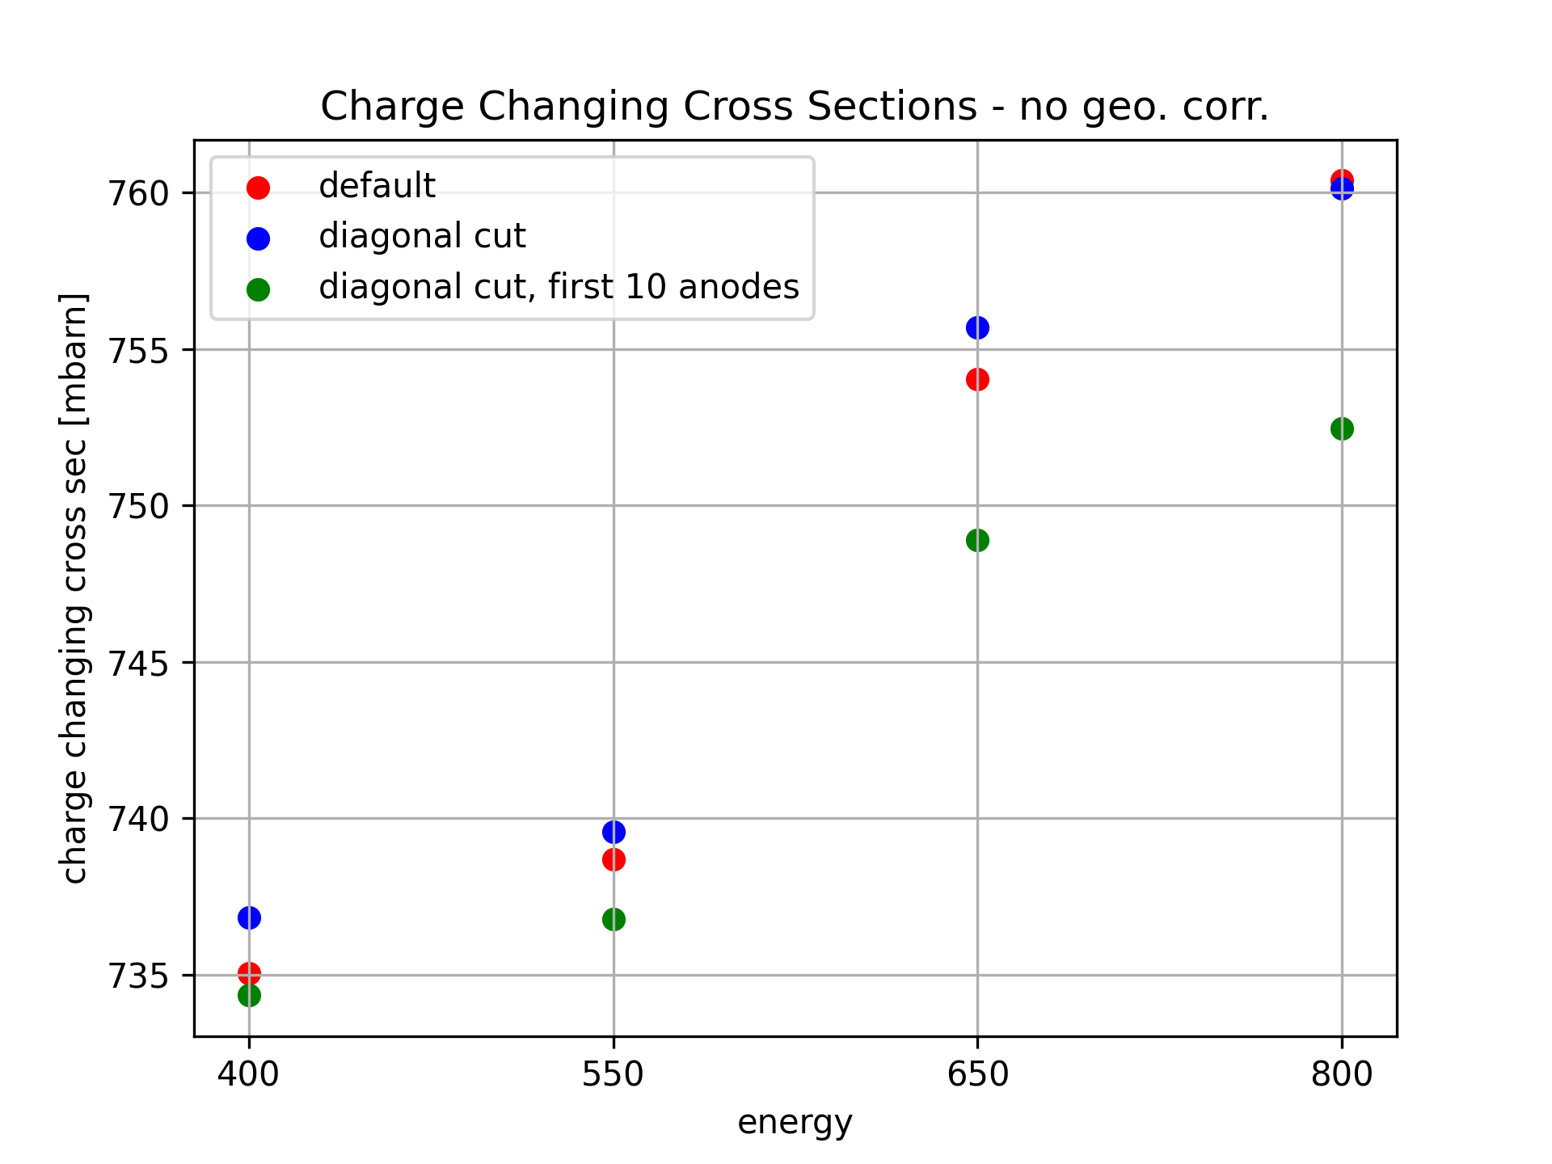
Charge changing cross section using only first 10 TWIM Anodes

Slide 6
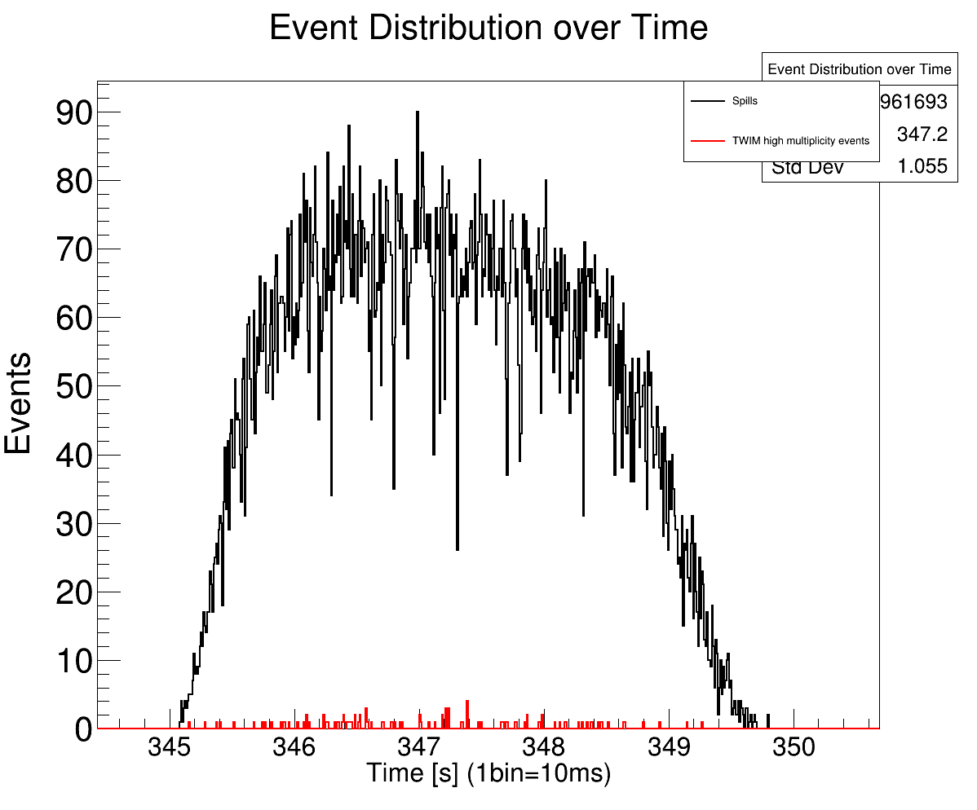
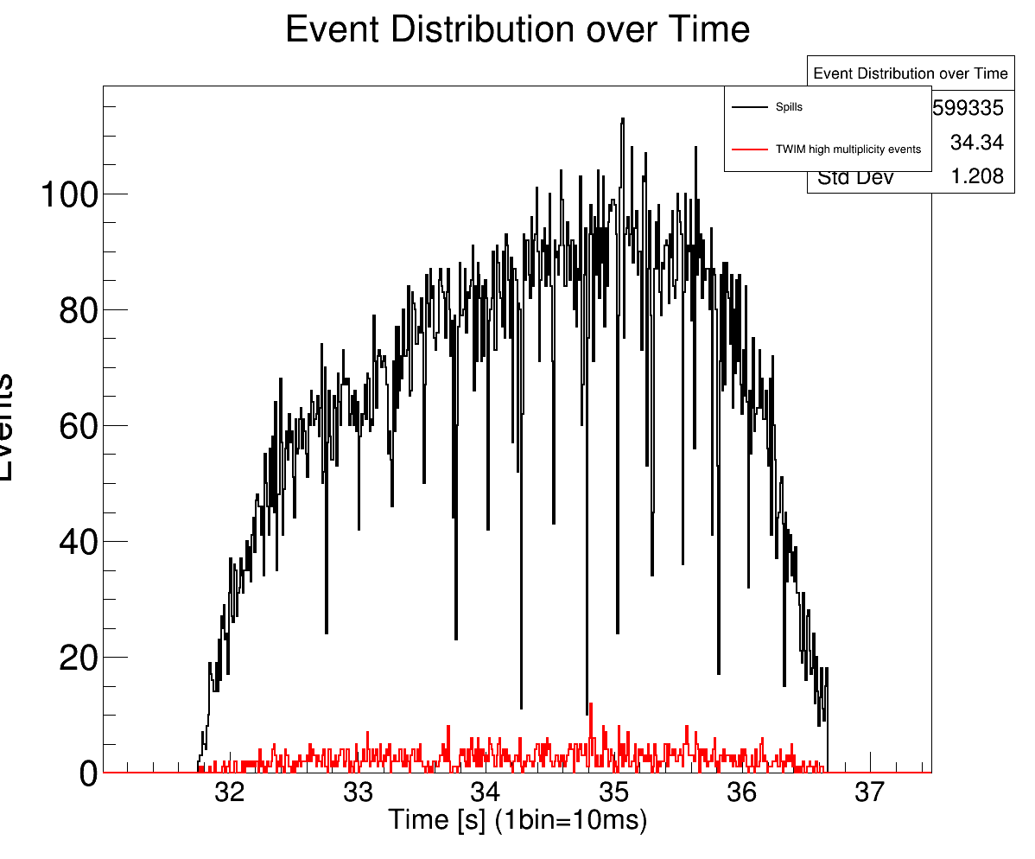
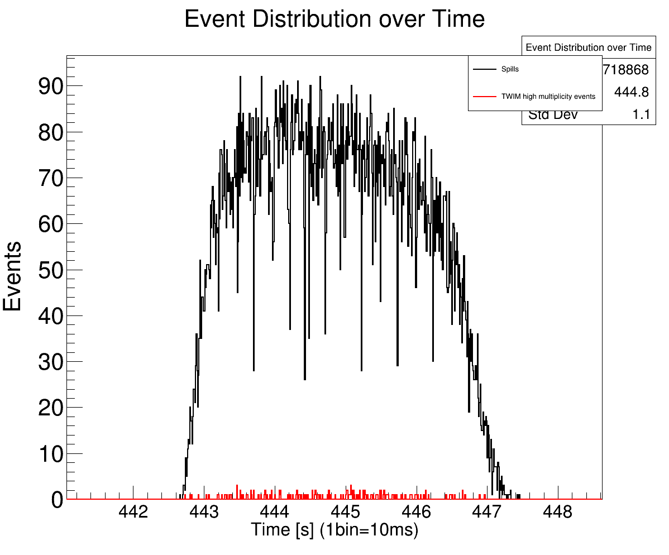
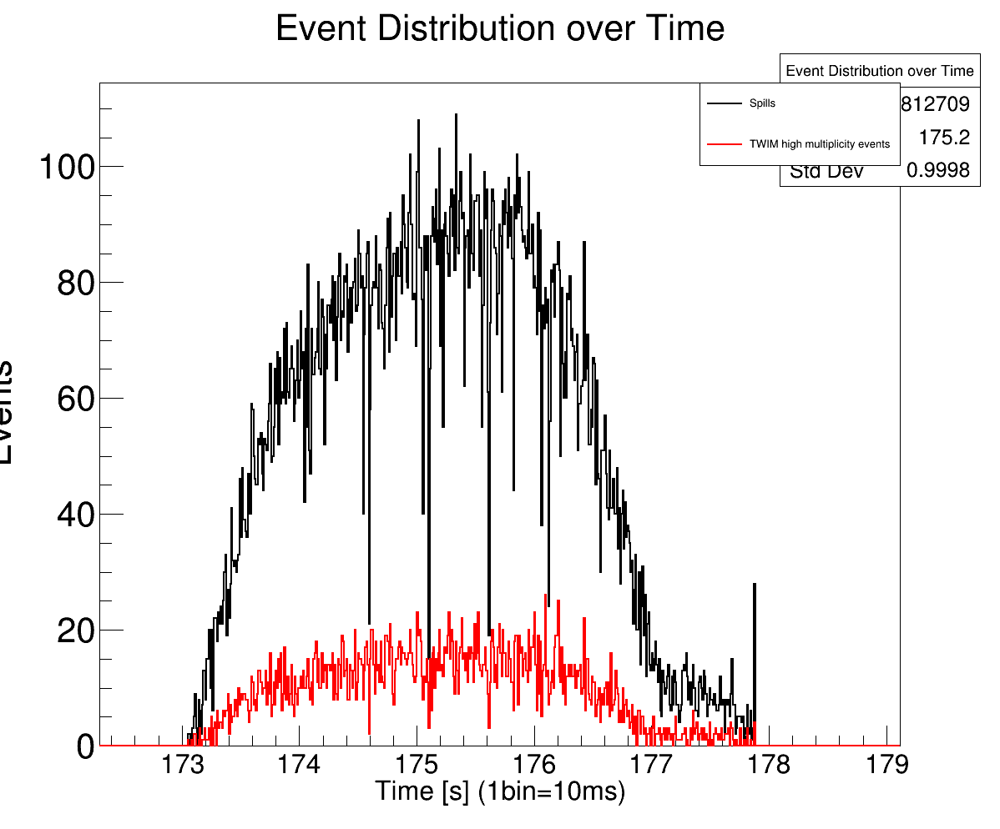
Spill structure vs TWIM multihit events – target runs
400 AMeV
650 AMeV
#events with high mult. in TWIM
550 AMeV
800 AMeV

Slide 7
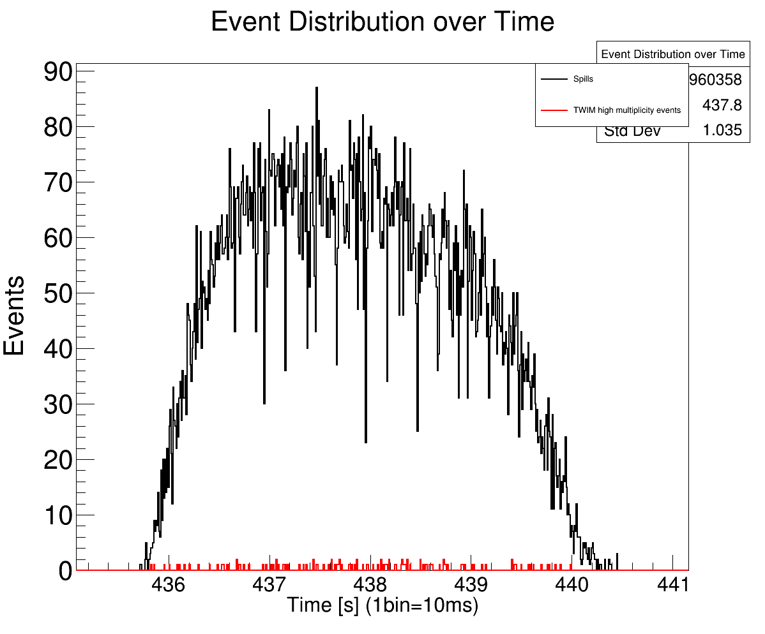
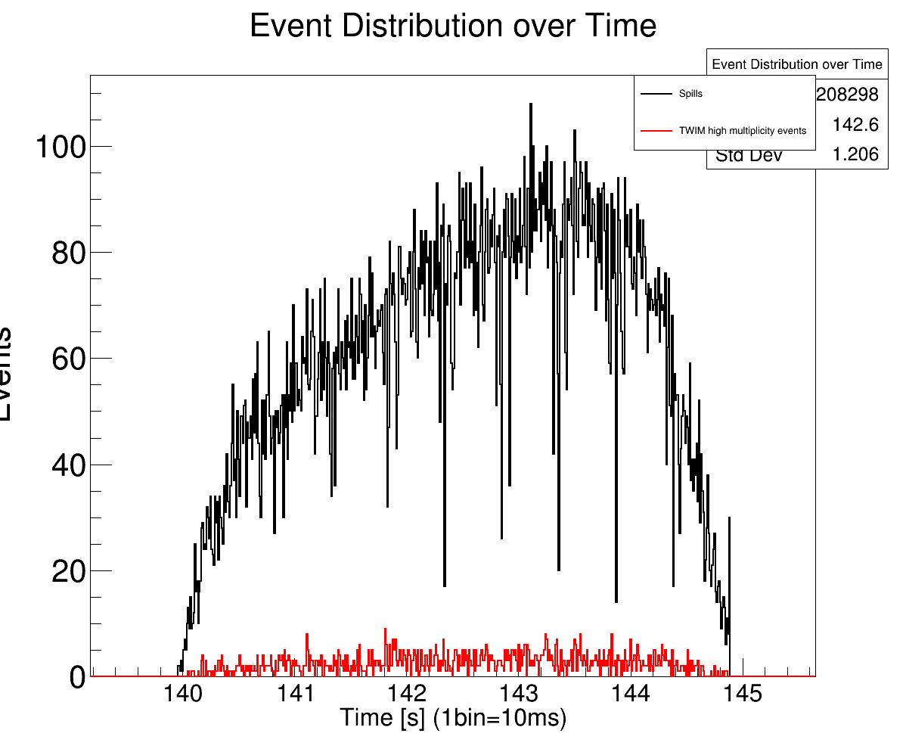
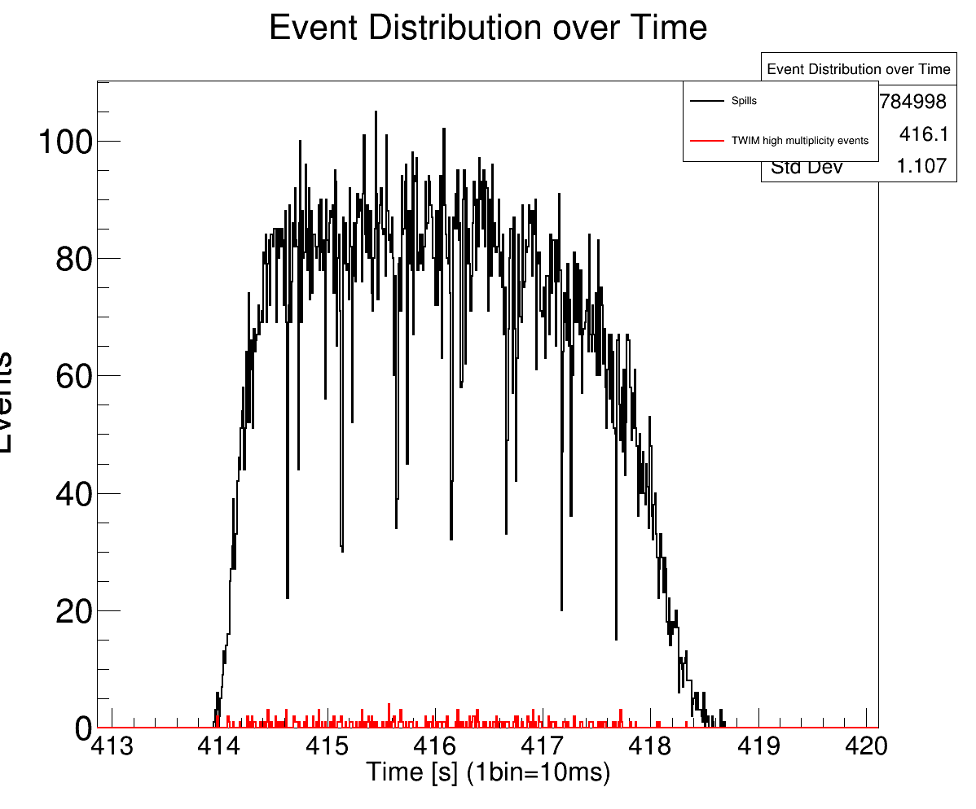
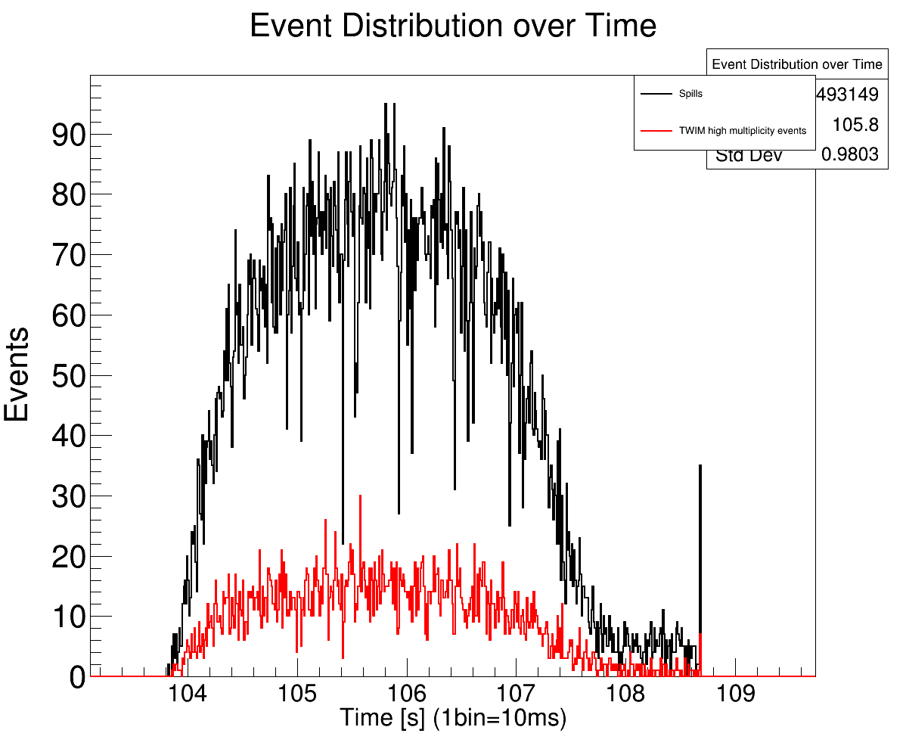
Spill structure vs TWIM multihit events – empty runs
400 AMeV
650 AMeV
#events with high mult. in TWIM
550 AMeV
800 AMeV

Slide 8
Do we have other 800 AMeV runs?
NO!
We started with 400 AMeV, went up to 800 AMeV (last run was on the 17.02.2020 at 22:10). Next day( 18.02.2020 at 6:20) we started again at 400 AMeV. There several tests runs were done with fixed beam energy of 400 AMeV.

Slide 9
Backup

Slide 10
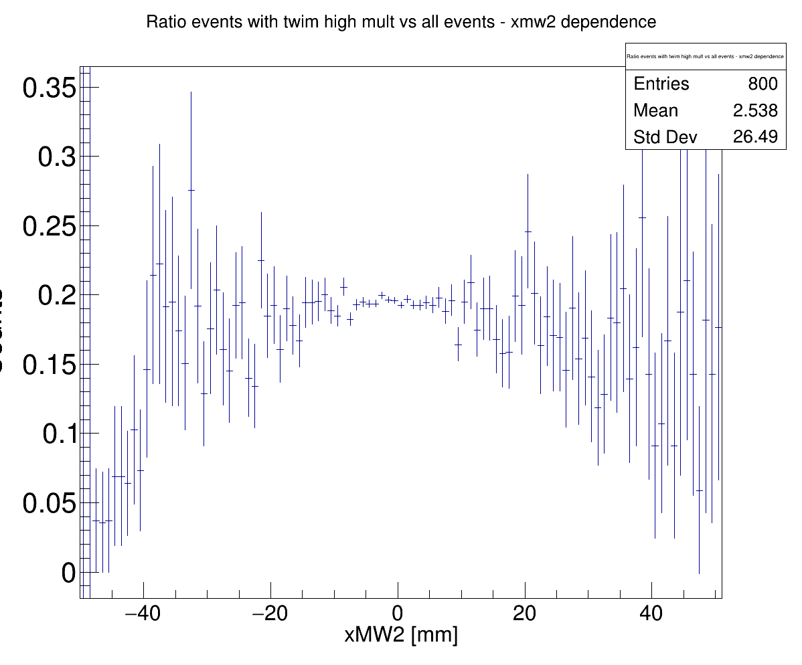
Does the TWIM Multiplicity depend on the x-MW2 position ?

