Slide 1
S444 Reaction cross section – Discussion during R3BWeek

Slide 2
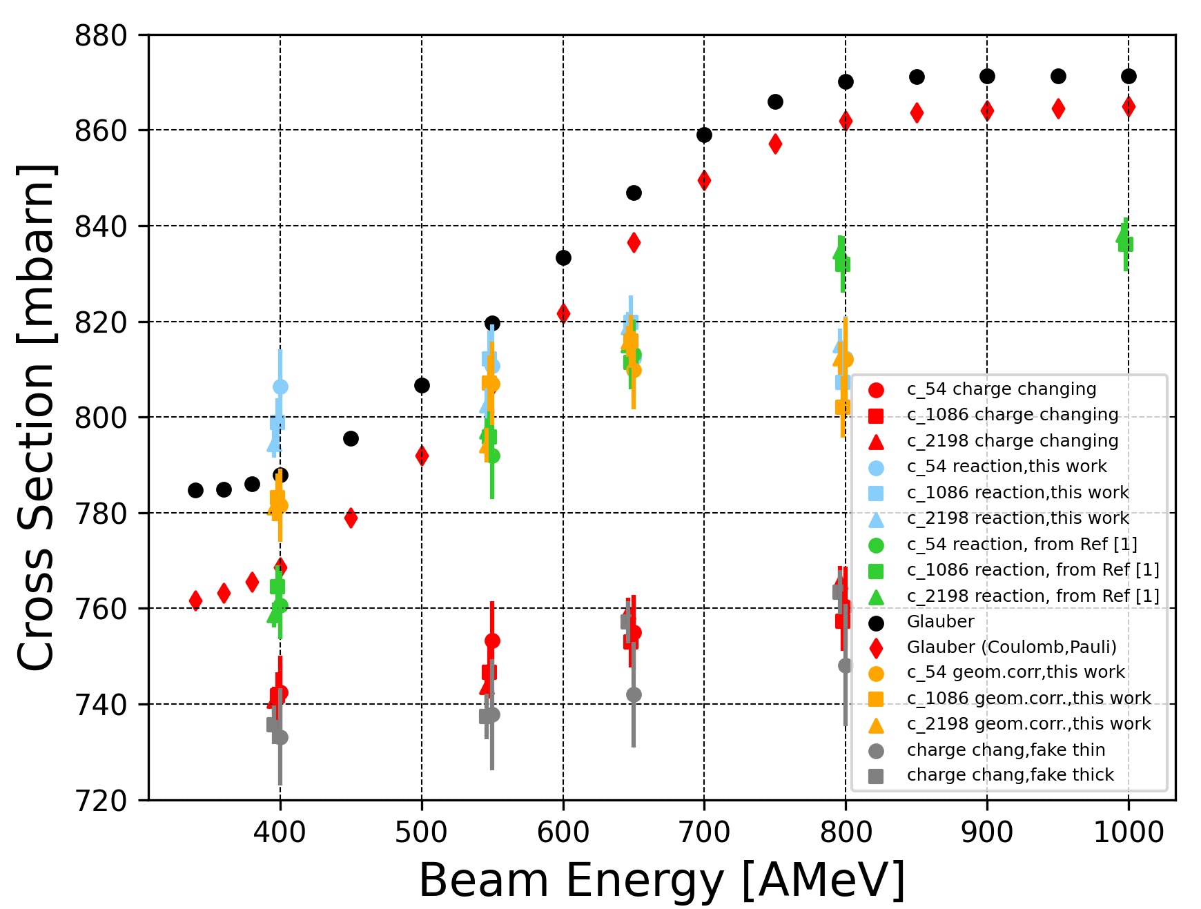
Q1: In S467 empty runs were problematic. How about substracting different target runs?
New “empty” runs = runs with 5.4mm carbon target
New “thin” target = 0.534 cm
New “thick” target = 1.6477 cm
Consistent with the measurements when using “true” empty runs, slightly lower values.
Larger error bars. This may be because of higher statistics in the “true” empty runs

Slide 3
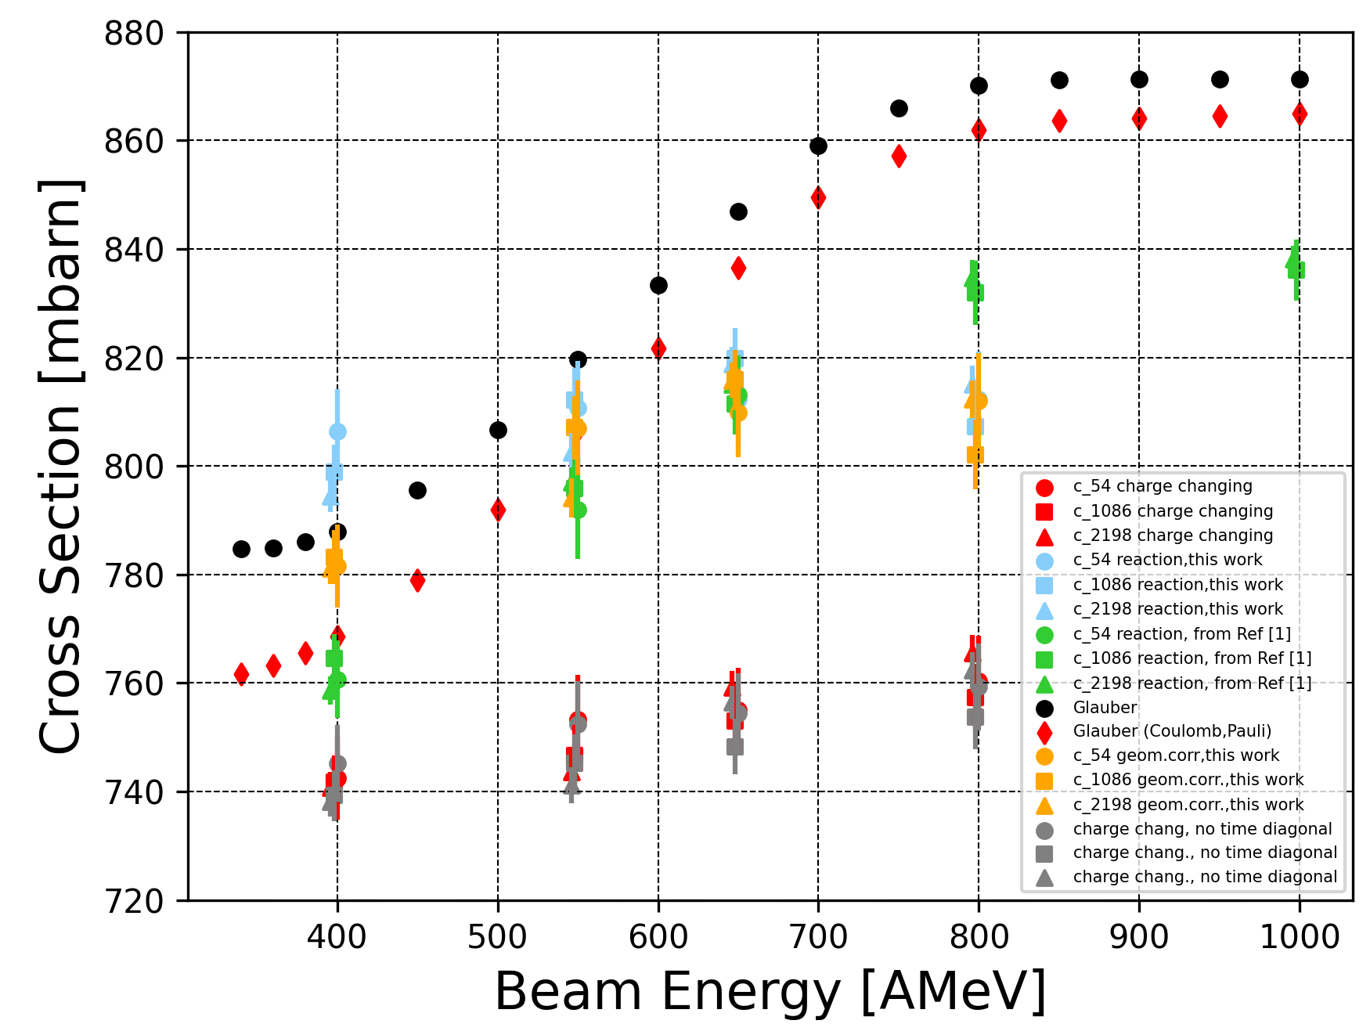
Q2: You use the same sigma cut (3.5) sigma for all beam energies. What if you use a dynamic cut?

