Slide 1







Reaction Measurements ¹²C + ¹²C
Experiment S444 (2020)
Tobias Jenegger
R³B Collaboration Meeting 2024
S444/S467 - Detector Setup
¹²C + ¹²C Reaction Channels
Reaction Cross Section Measurement
Summary & Outlook
Funded by the Deutsche Forschungsgemeinschaft (DFG, German Research Foundation)
under Germany’s Excellence Strategy – EXC-2094 – 390783311,
BMBF 05P19WOFN1, 05P21WOFN1
and the FAIR Phase-0 program
Roman Gernhäuser,Lukas Ponnath,Philipp Klenze,Tobias Jenegger

Slide 2
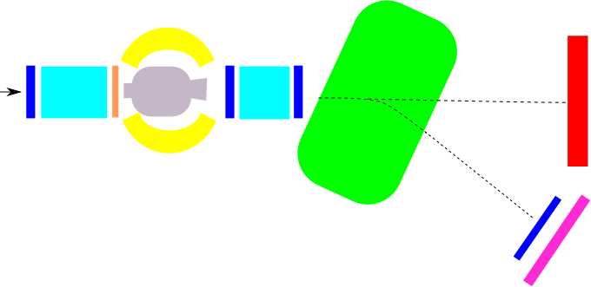

S444 Commissioning Experiment 2020
GLAD magnet
CALIFA
NeuLAND
R³B Music
MWPC1
beam
TWIM Music
MWPC0
START
MWPC2
(no tprev /tnext)
MWPC3
Time of Flight Wall
Identification of incoming beam
Complete kinematic measurement of reaction channels
Measurement of γ/target-like particles
Beam energy: 400/550/650/800 AMeV
Projectile: ¹²C
Target: C and CH₂

Slide 3
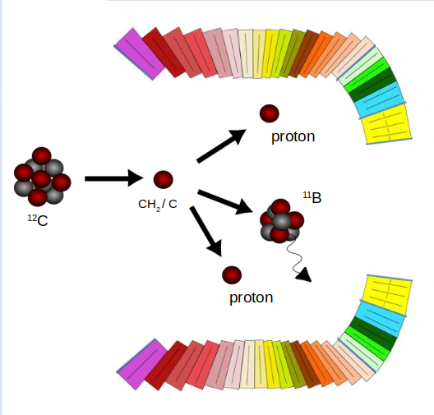
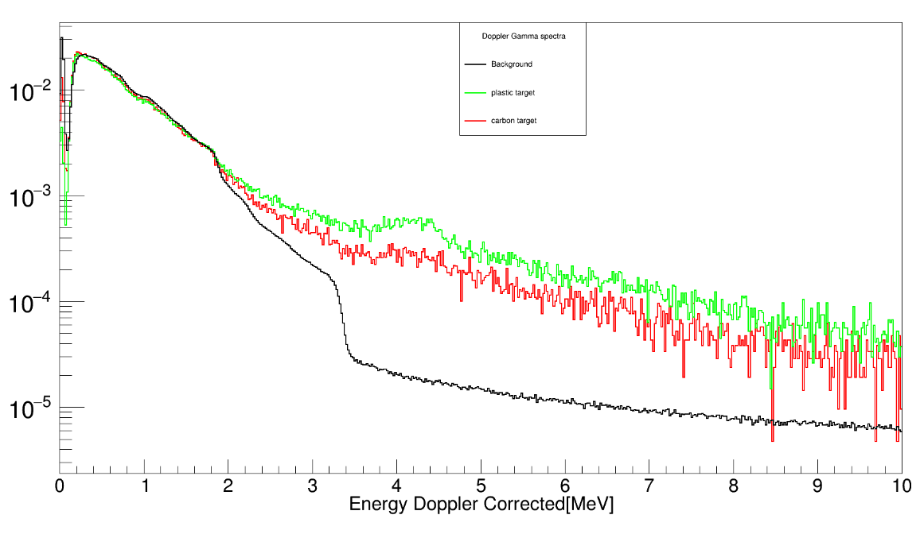
Reaction Processes ¹²C + ¹²C
TODO: put in something about AmBe study, Philipp
Contributions to the total reaction cross section:
Projectile is excited to bound state. No nucleon is removed
is small at high beam energies & suppressed due to Pauli blocking
4.4 MeV ¹²C first excited state
¹²C
- CH₂ target
- C target
- background

Slide 4
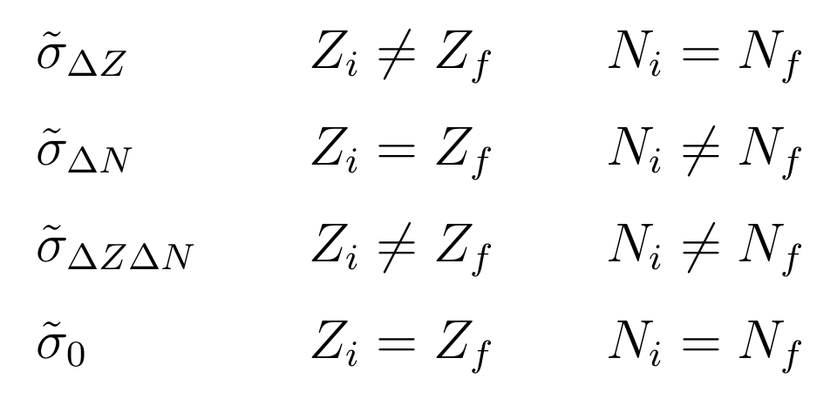
Reaction Processes ¹²C + ¹²C
p
Interaction Cross Section
¹²C
Projectile changes its identity.
At least one nucleon is removed.
n
¹²C
charge changing
pure neutron removal
charge changing
Pure neutron removal

Slide 5
Reaction Processes ¹²C + ¹²C
p
Interaction Cross Section
¹²C
Projectile changes its identity.
At least one nucleon is removed.
n
¹²C
charge changing
pure neutron removal
Access to quasi-free scattering (p,2p) reactions with CALIFA
charge changing
Two body scattering can be approximated by the identical process for free particles
Qfs- reactions give access to single particle properties inside nucleus
¹²C(p,2p)¹¹B
Pure neutron removal
¹²C

Slide 6

Reaction Cross Section Measurement ¹²C + ¹²C
clean incoming ions:
unreacted/survived ions:
N₁
N₂
N₂ for charge changing cross section
target
Transmission method:
Z (TWIM)
reactions Inside setup
N_{t}:
#scattering centers
volume
N₂ for total reaction cross section
Correct for reactions inside exp. setup
Z (TWIM)

Slide 7
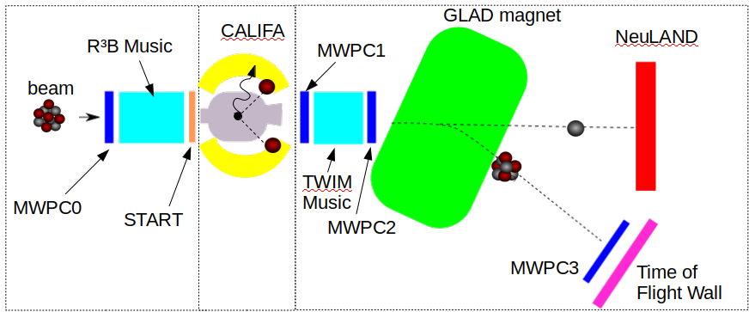
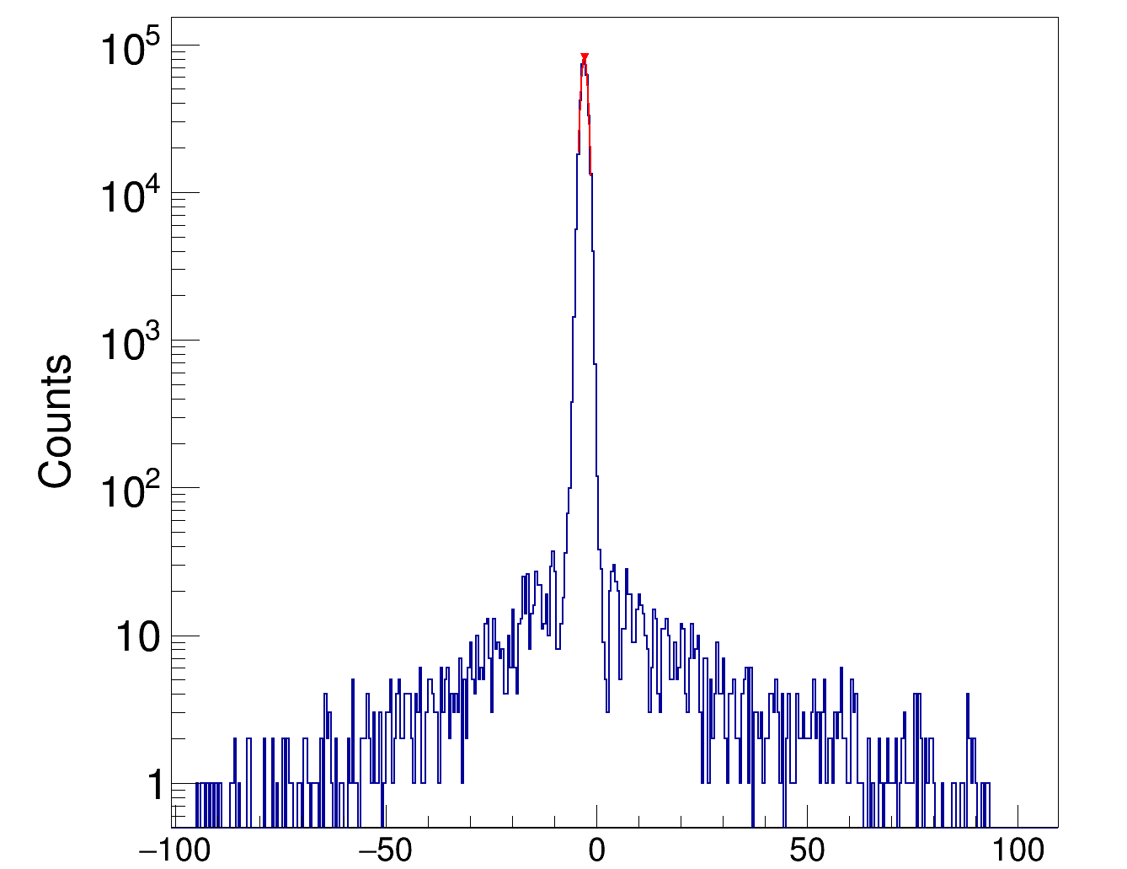
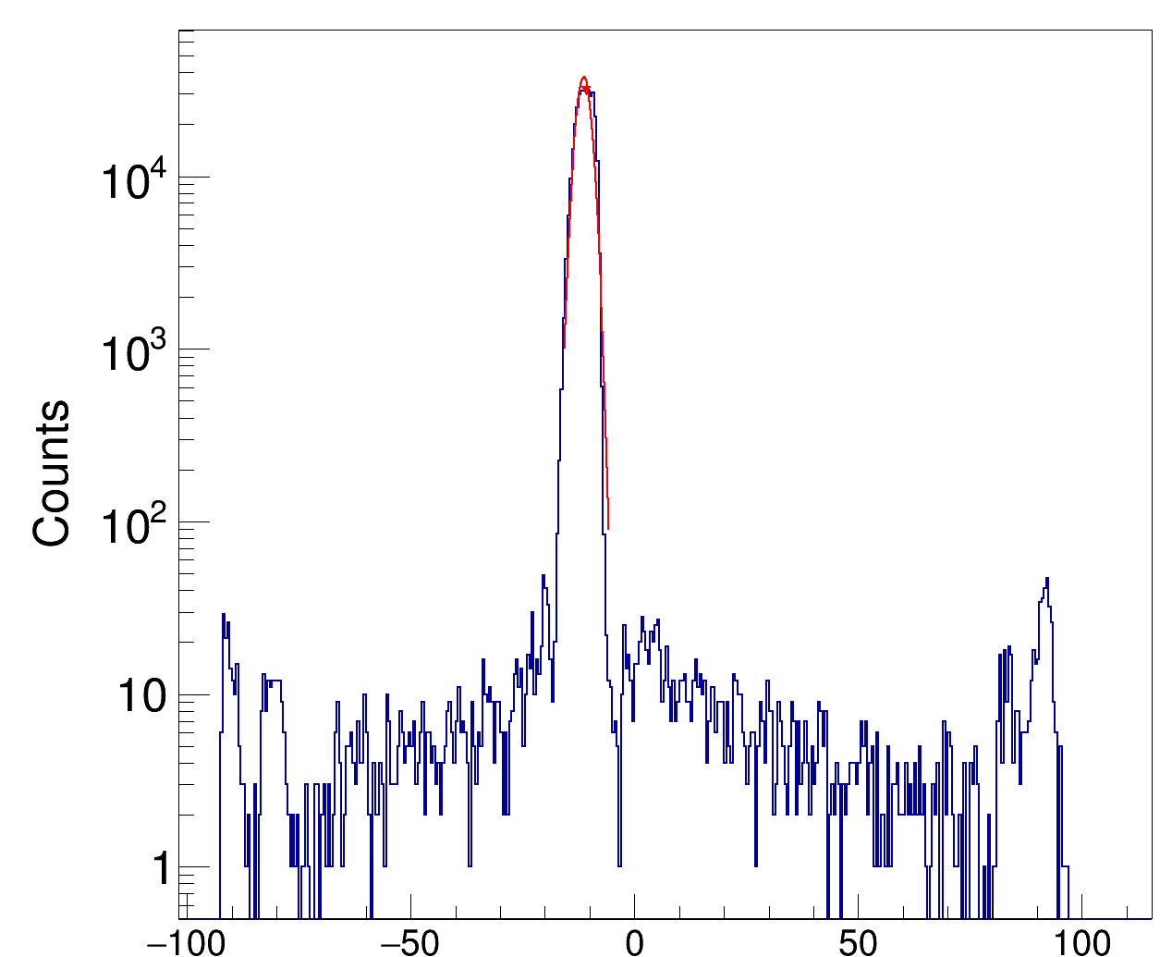
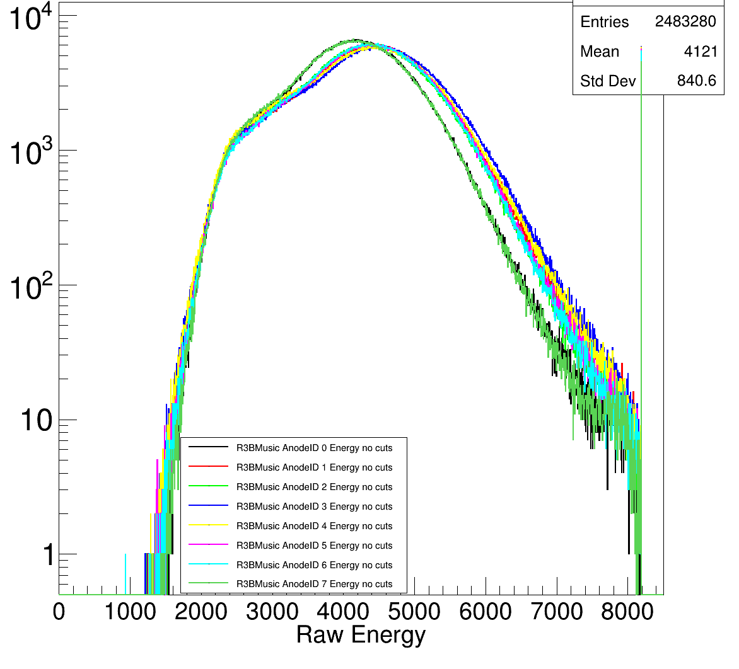
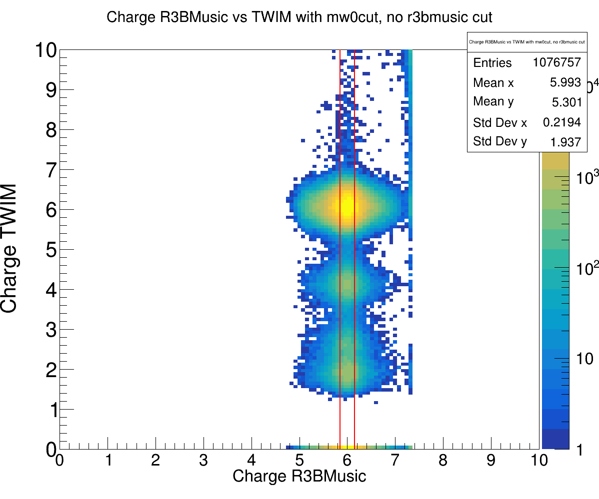
Identification of the Incoming Ions
one σ cut on x-y MW0 position
X position [mm] MW0
Y position [mm] MW0
Raw ADC R3BMusic
R3BMusic cut one σ

Slide 8
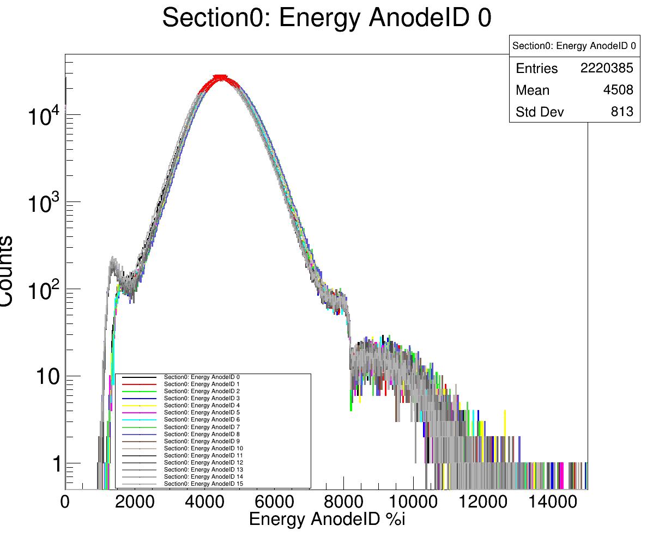
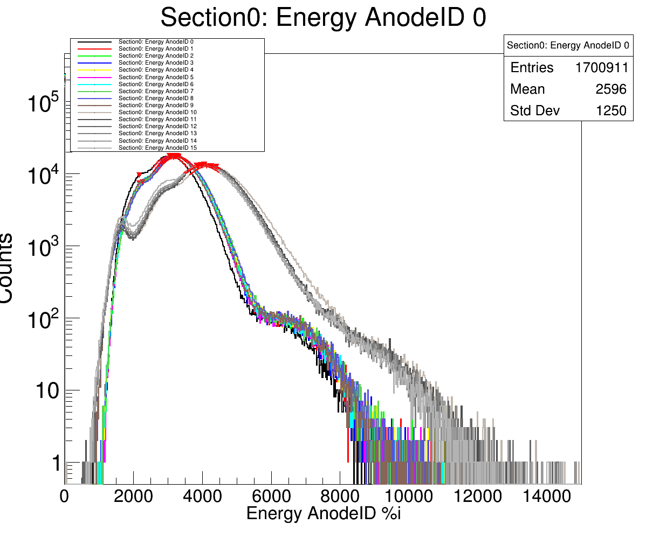
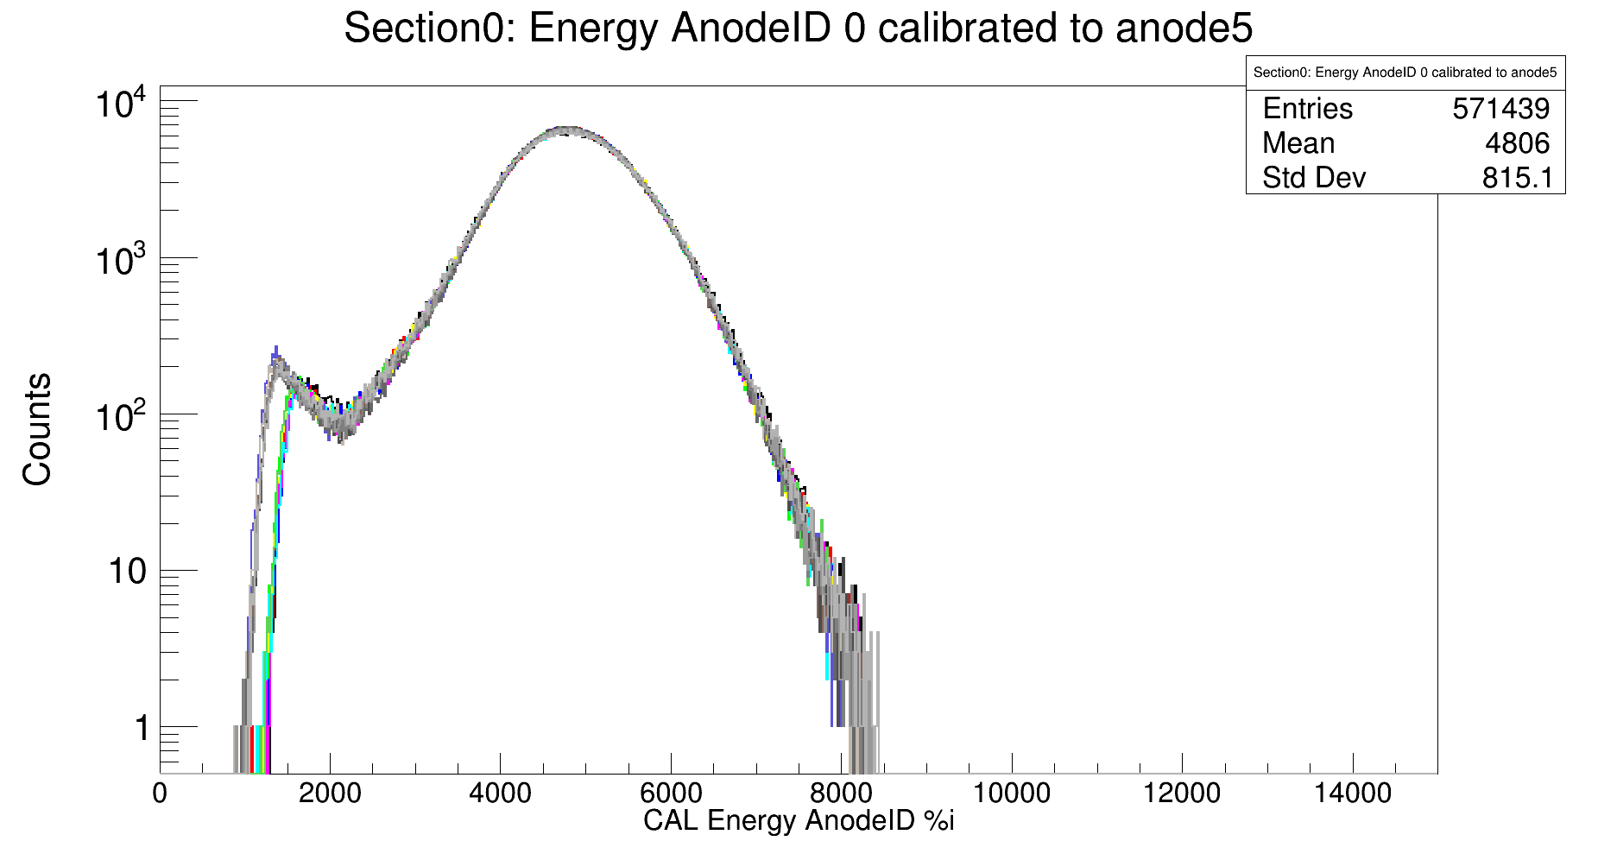
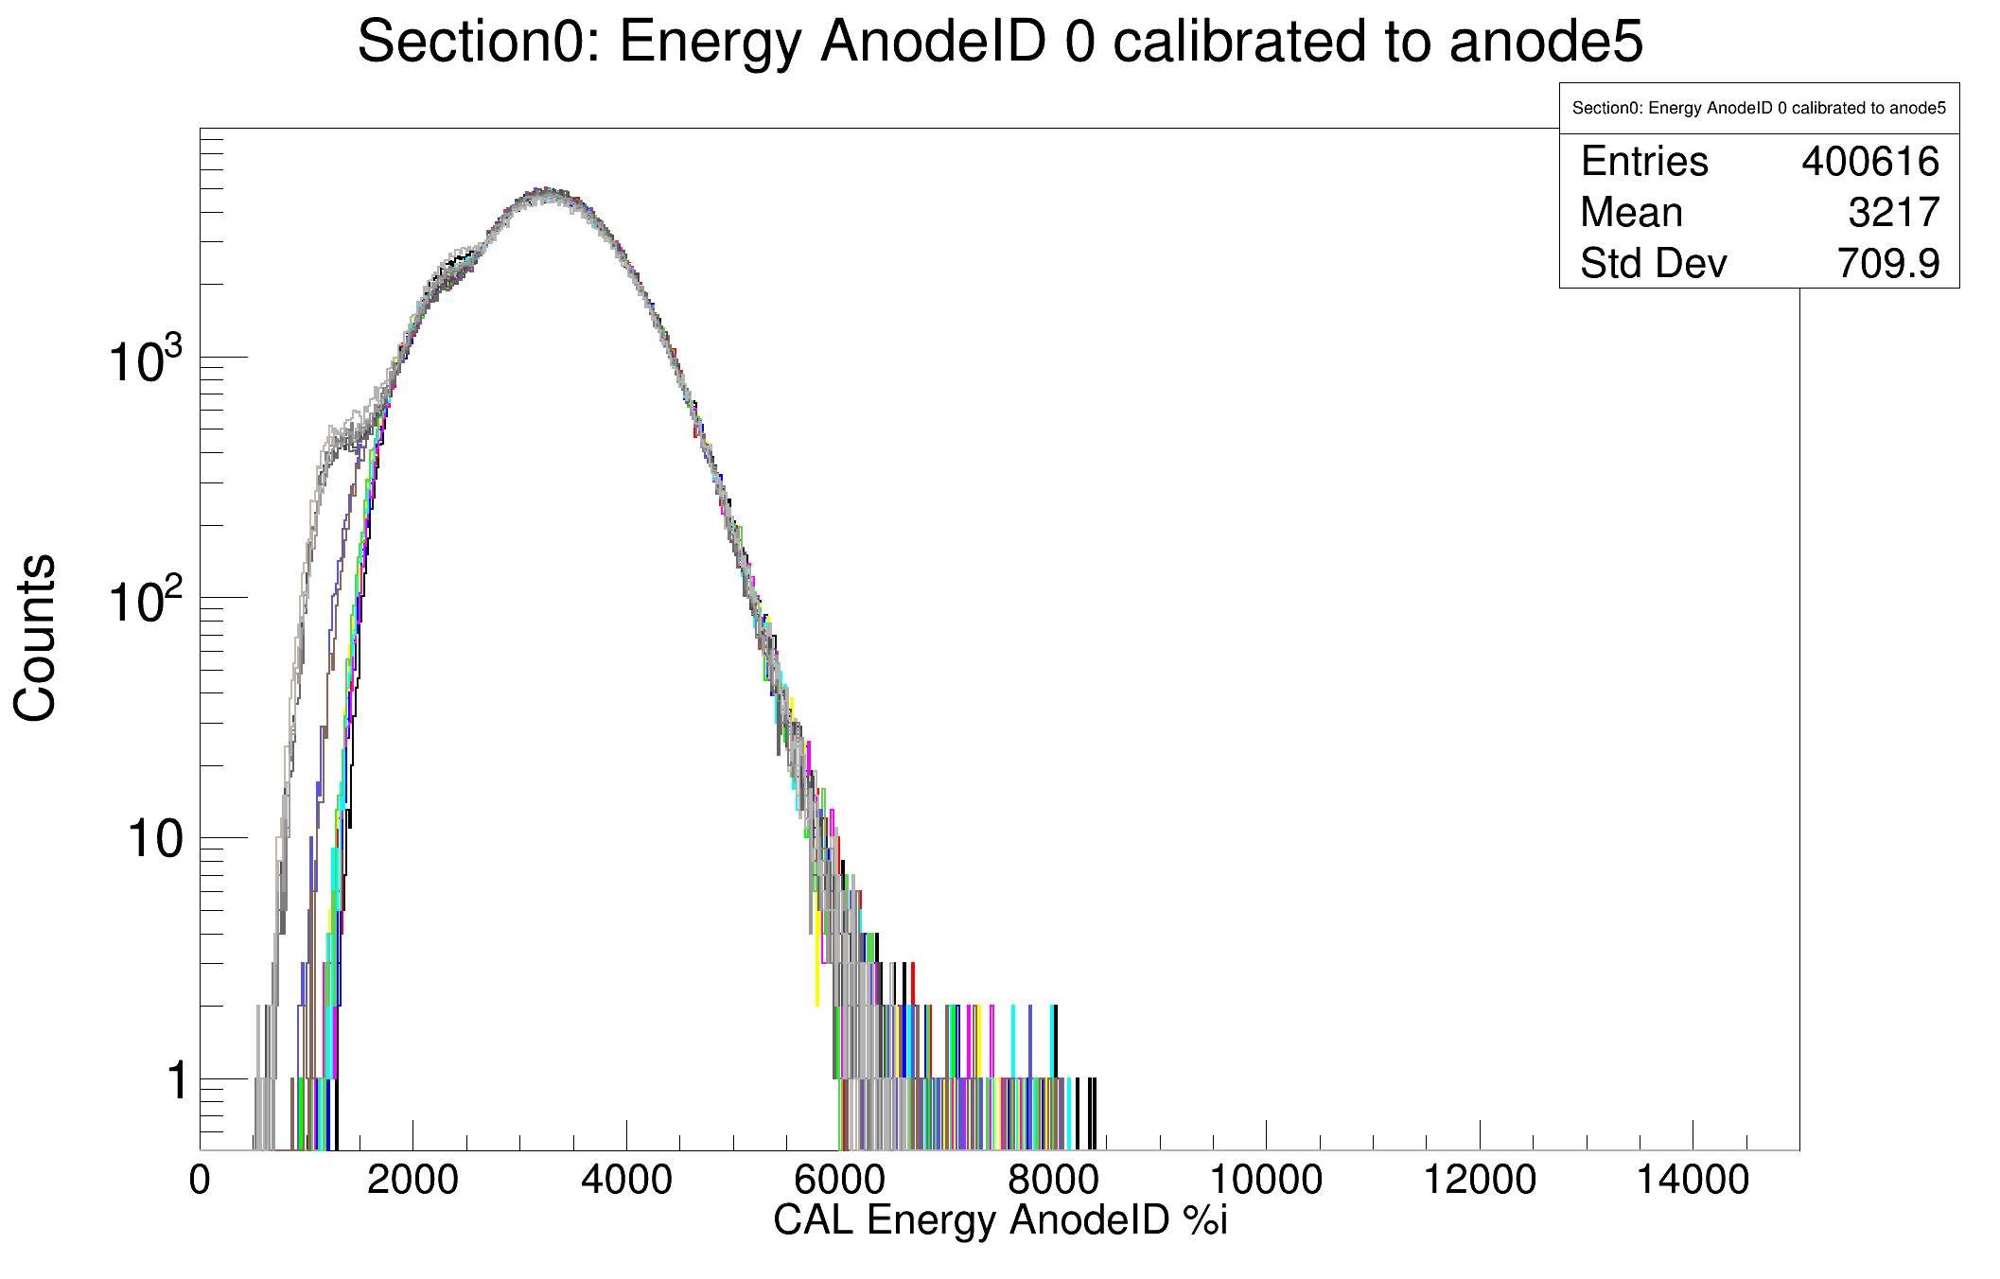
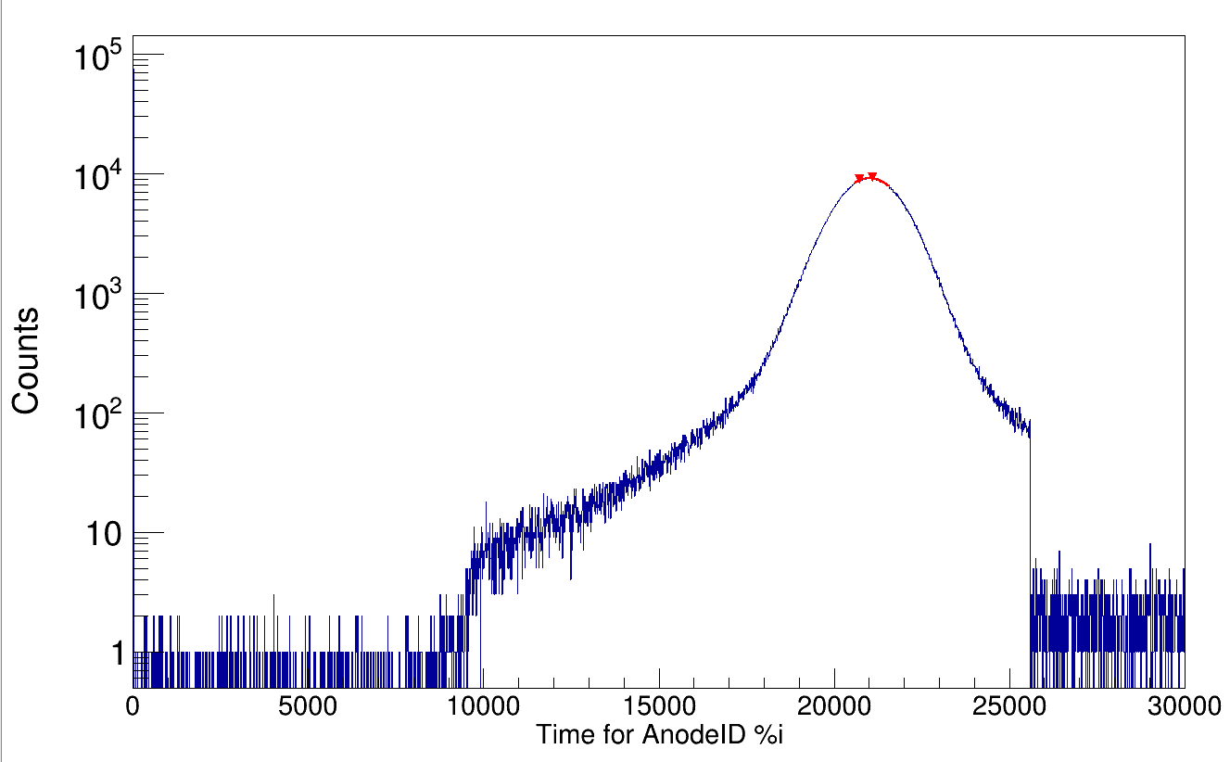
Charge Measurement in TWIM Music
400 AMeV
800 AMeV
Calibrate Energies (using ref. anode)
Look at raw tdc time of each anode, discart anode hit if below 10000 or above 25500 raw tdc channel
For events with multiple hits in one anode:
select hit which is the closest to the mean raw tdc time
calibration
400 AMeV
800 AMeV
Raw TDC time for Anode i

Slide 9
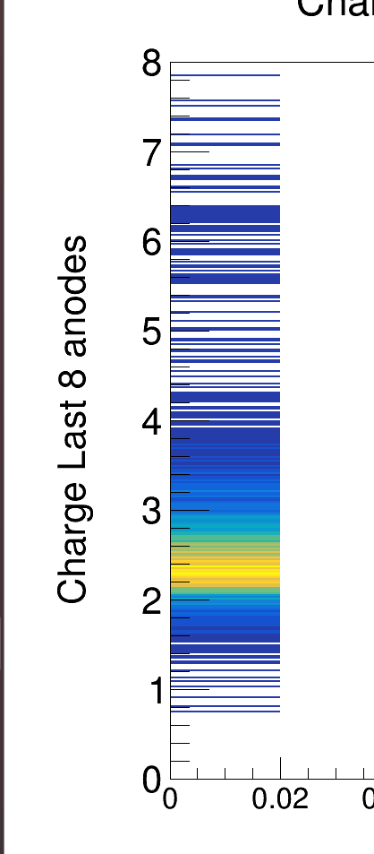
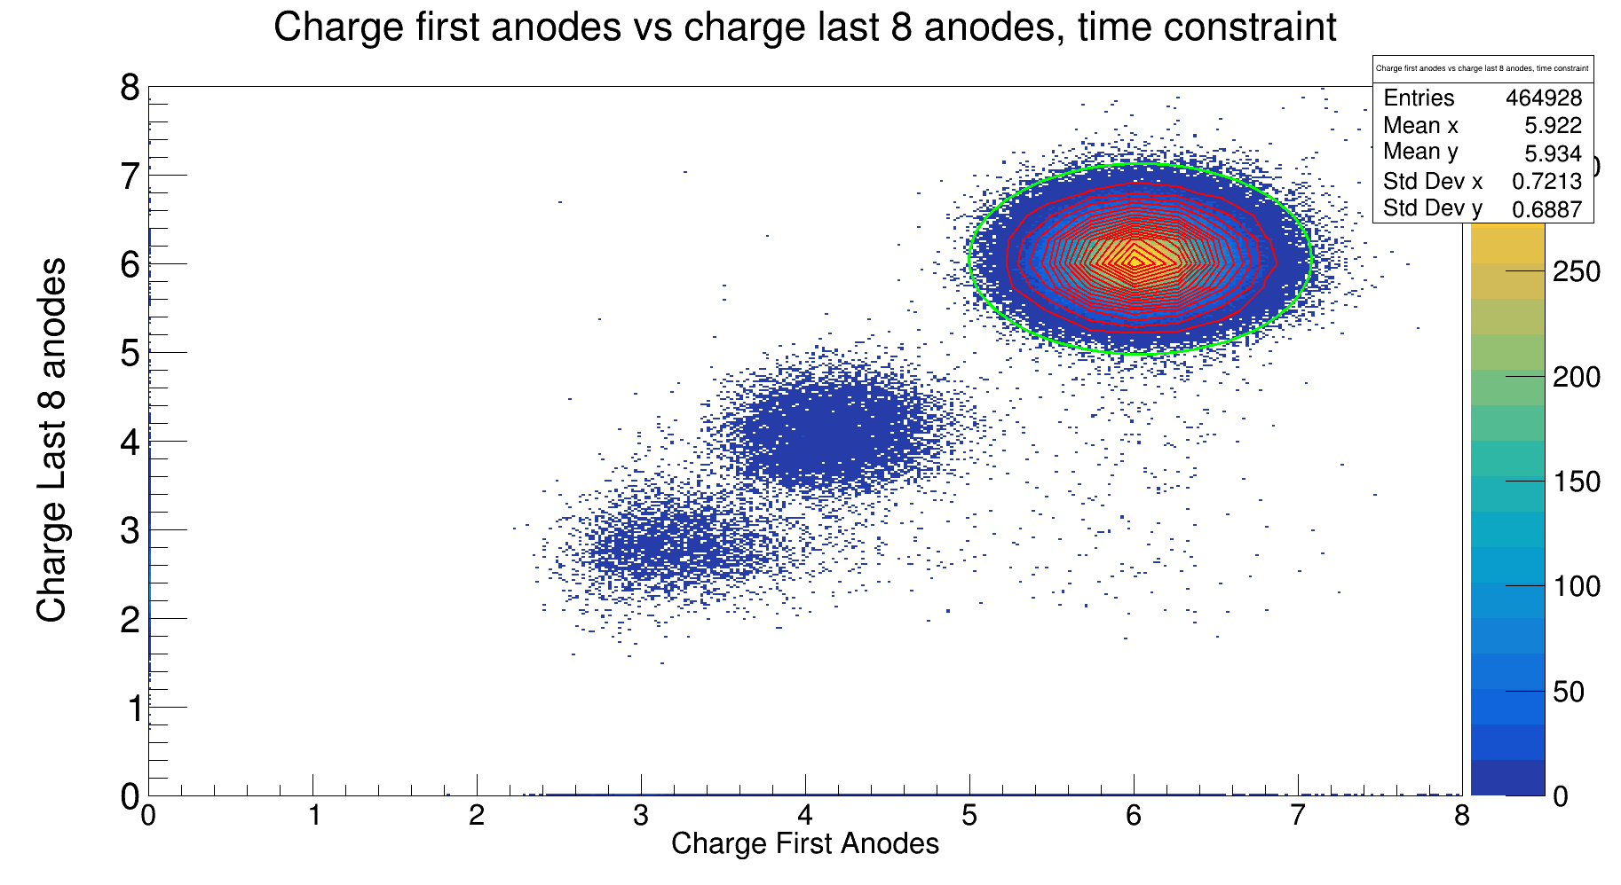
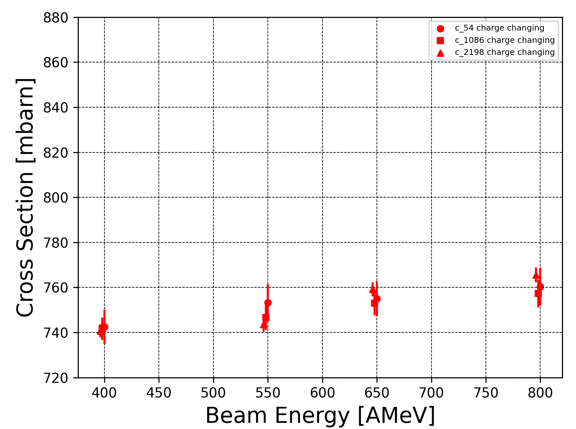
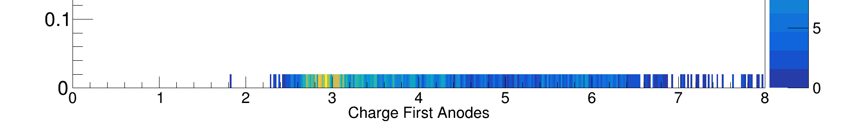
Charge Changing Cross Section
+-3.5σ
where N₂ = carbon isotopes detected in TWIM
* statistical errors only

Slide 10
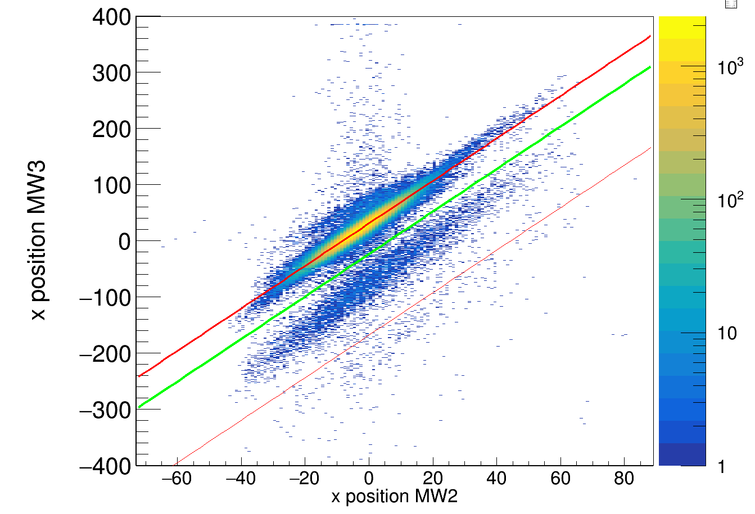
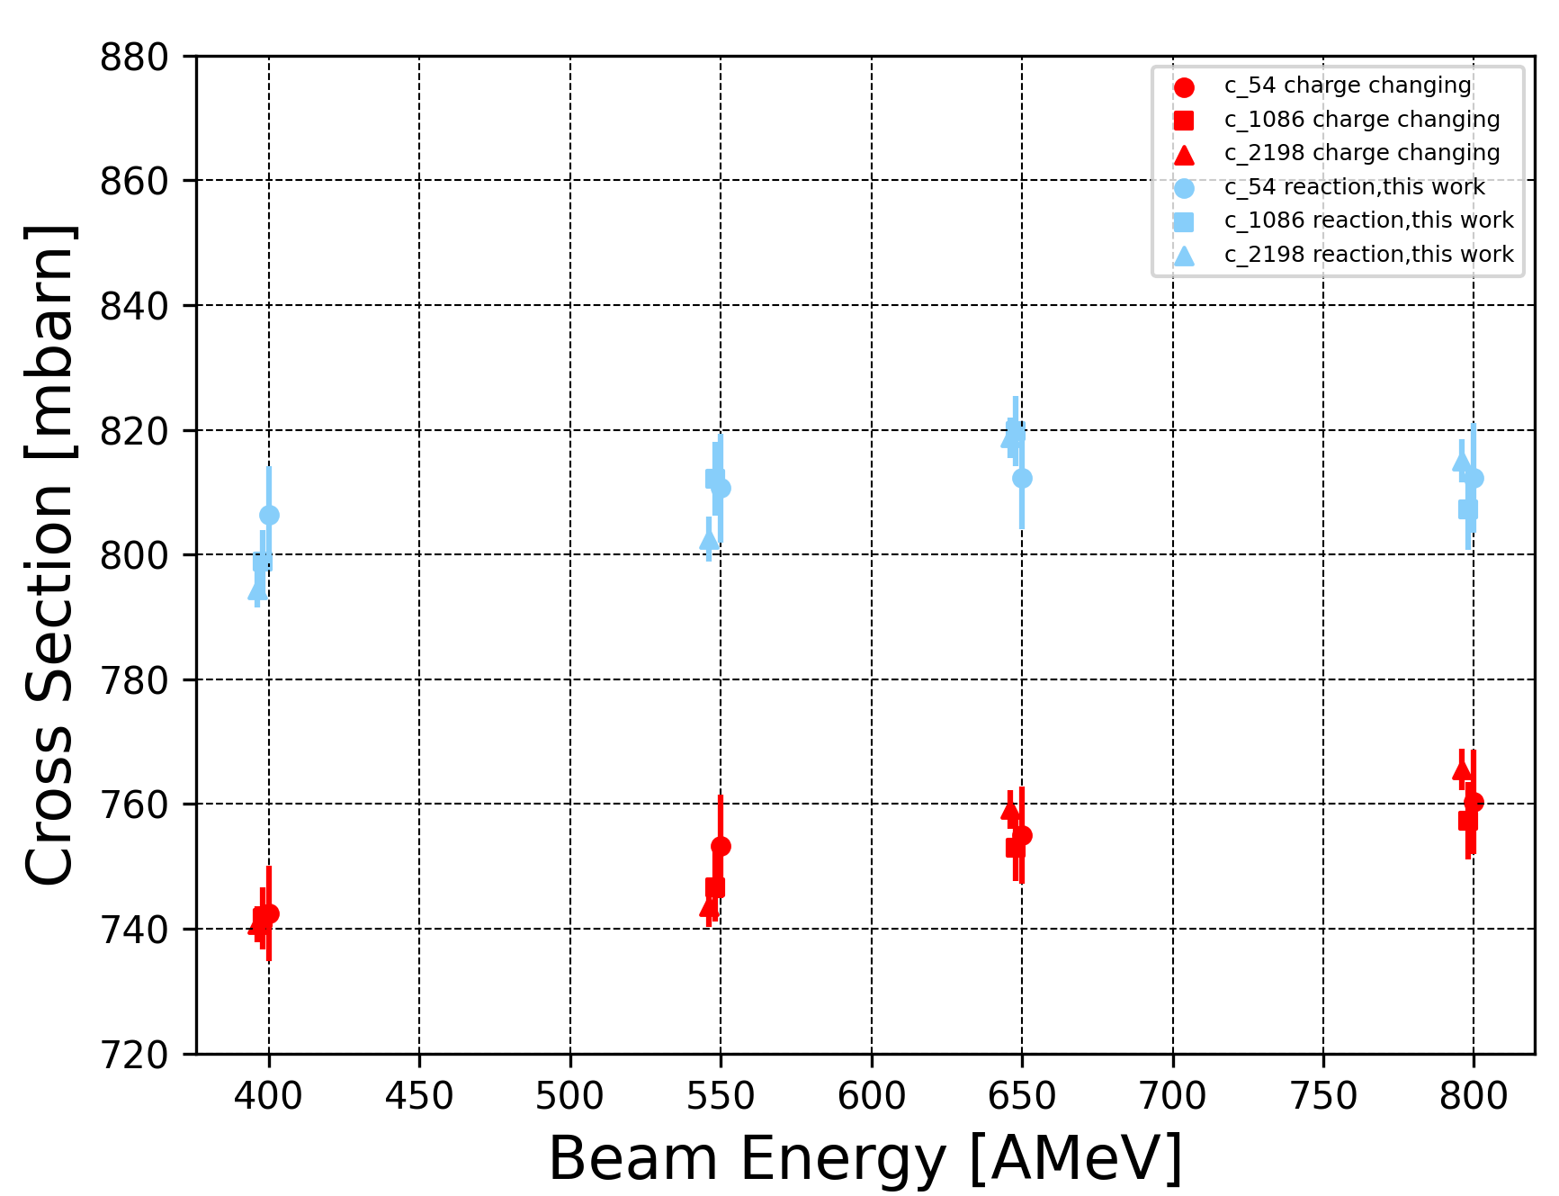
¹²C/¹¹C disentanglement
Use R³B Setup as Mass Spectrometer:
¹²C
¹¹C
.
.
* statistical errors only

Slide 11
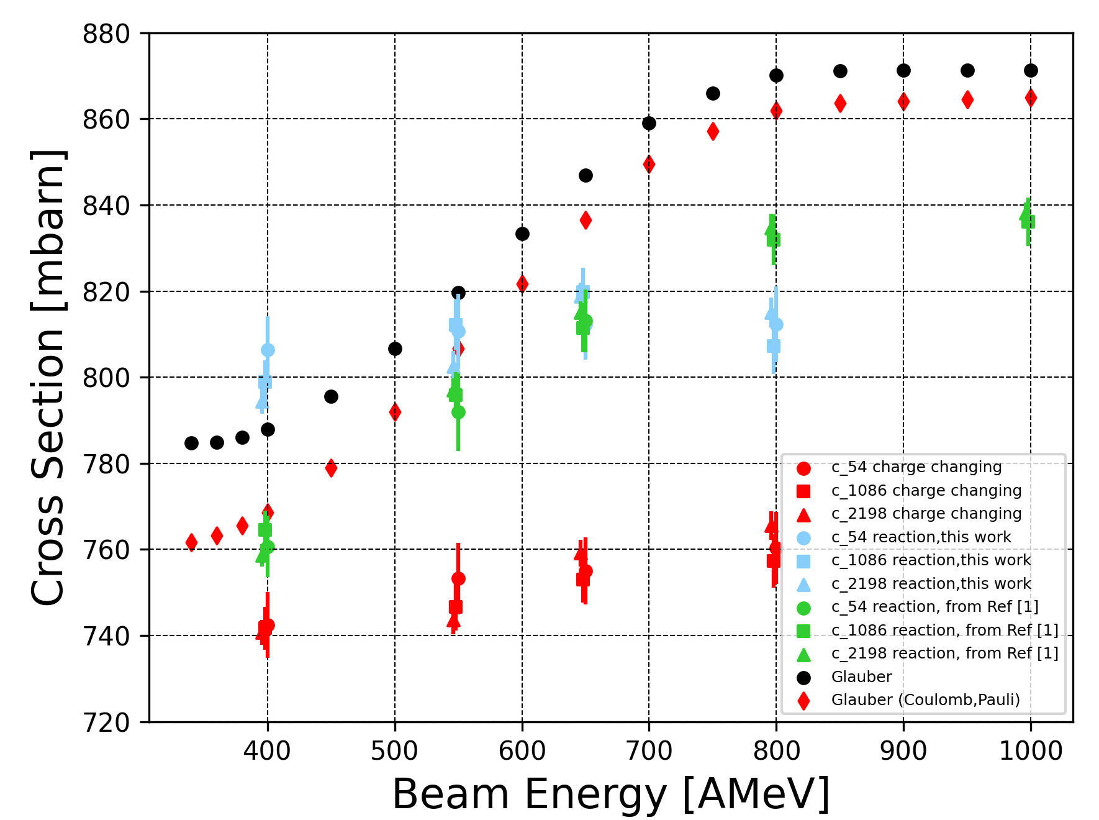
Reaction Cross Section Measurement
σ_{I} measured in this analyis seems to be almost constant for a broad energy range
Did we miss out something?
,Ref [2]
,Ref [2]
[1] L.Ponnath et al., “Measurement of nuclear interaction cross sections towards neutron-skin thickness determination”,Physics Letters B, Vol 855, August 2024
[2] E. Teixeira, T. Aumann, C. Bertulani, and B. Carlson, “Nuclear fragmentation reactions as a probe of neutron skins in nuclei,” The European Physical Journal A, vol. 58, no. 10, pp. 1–16, 2022

Slide 12
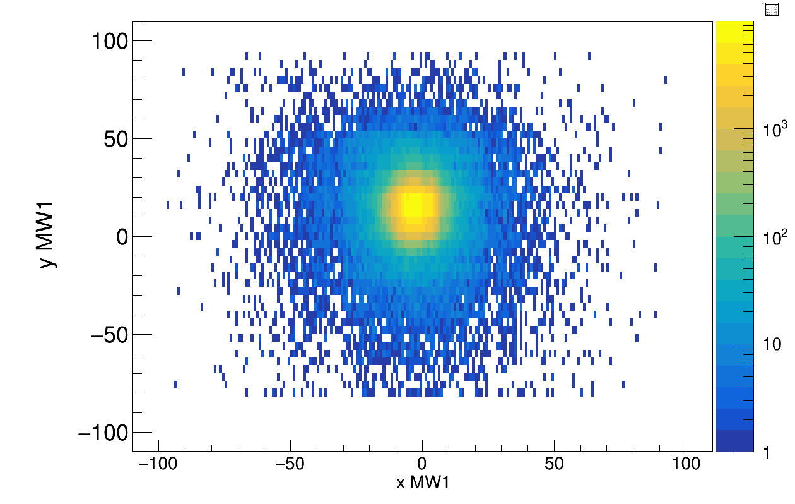
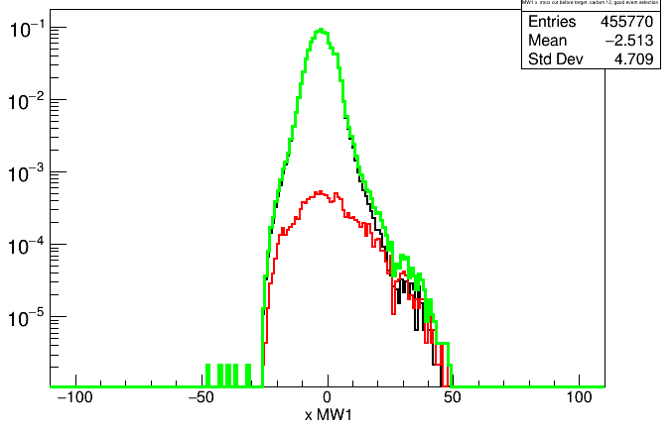
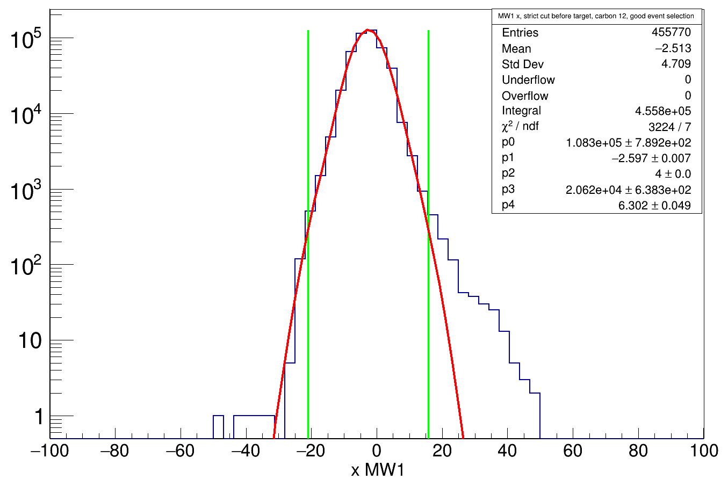
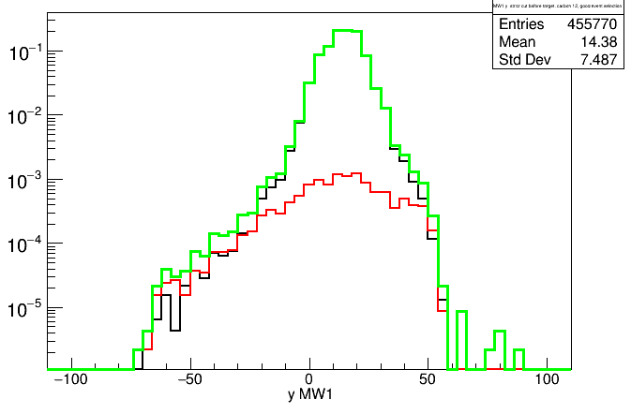
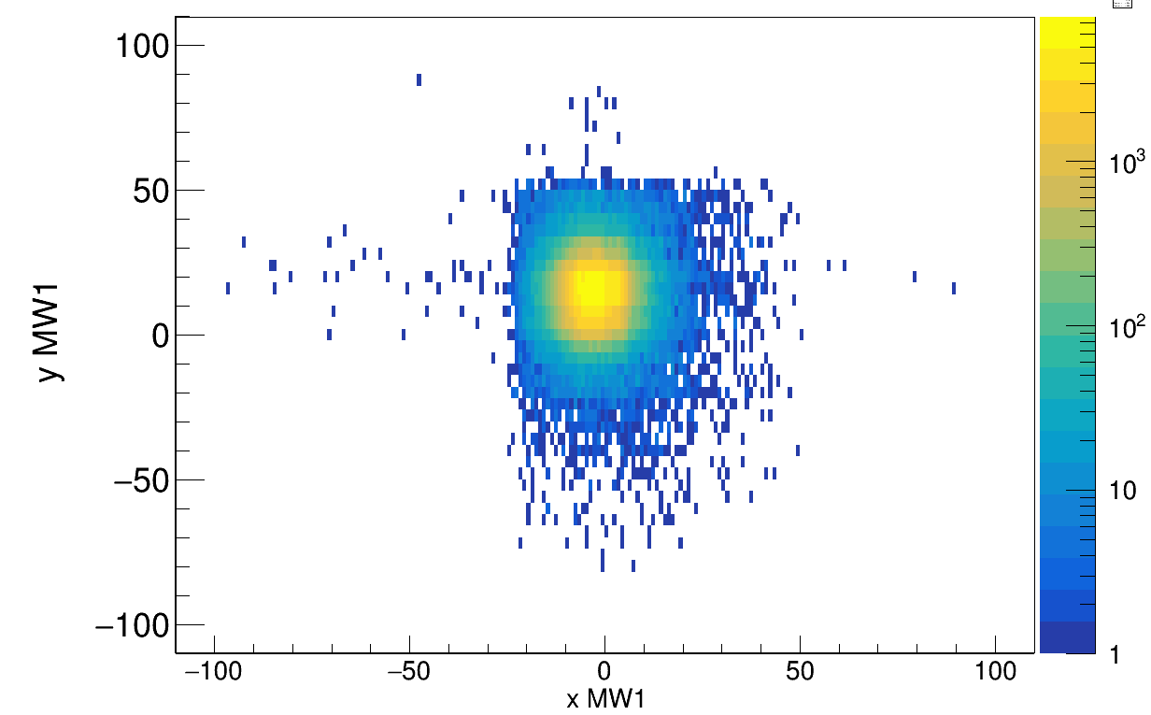
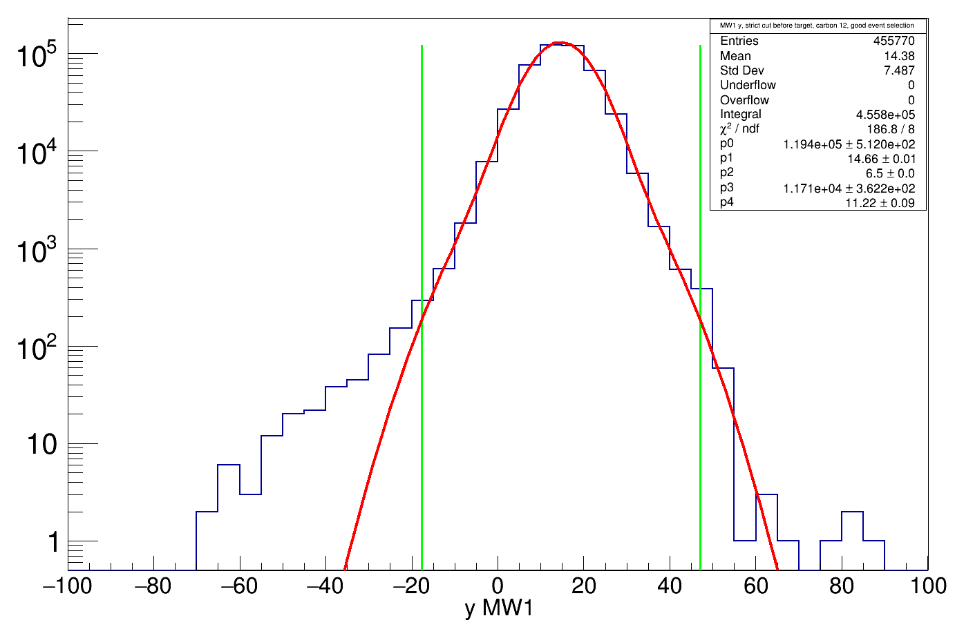
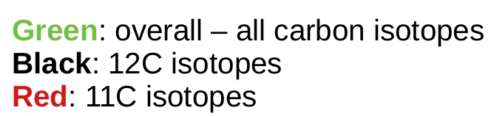
TWIM Geometric Acceptance - Correction
Reconstruction of ¹²C
MW1 xy-distribution no cut after target
x projection
y projection
double gaussian function fit
With cut TWIM charge = 6

Slide 13
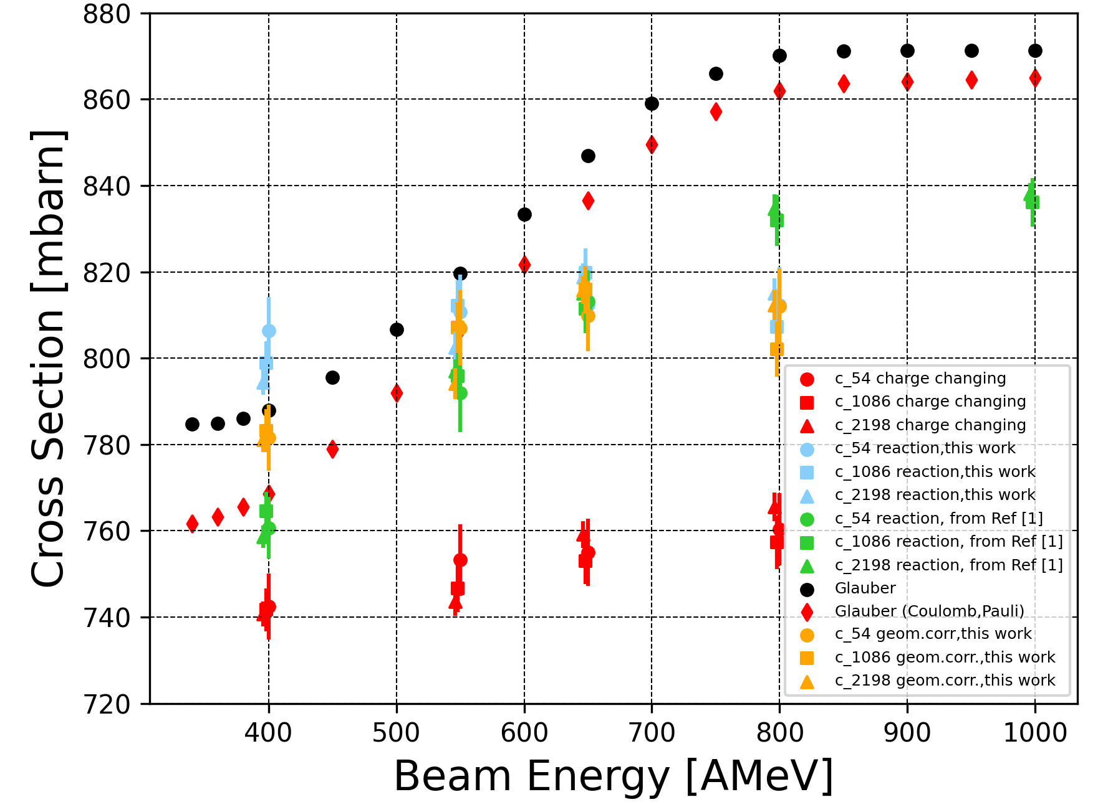
Preliminary Results & Outlook
,Ref [2]
,Ref [2]
[1] L.Ponnath et al., “Measurement of nuclear interaction cross sections towards neutron-skin thickness determination”,Physics Letters B, Vol 855, August 2024
[2] E. Teixeira, T. Aumann, C. Bertulani, and B. Carlson, “Nuclear fragmentation reactions as a probe of neutron skins in nuclei,” The European Physical Journal A, vol. 58, no. 10, pp. 1–16, 2022

Slide 14



CALIFA @ Technical University of Munich (TUM)
Roman Gernhäuser, Lukas Ponnath, Philipp Klenze, Tobias Jenegger
Thank you!

Slide 15
BACKUP

