Slide 1
S444 experiment - update2
28.08.2024

Slide 2
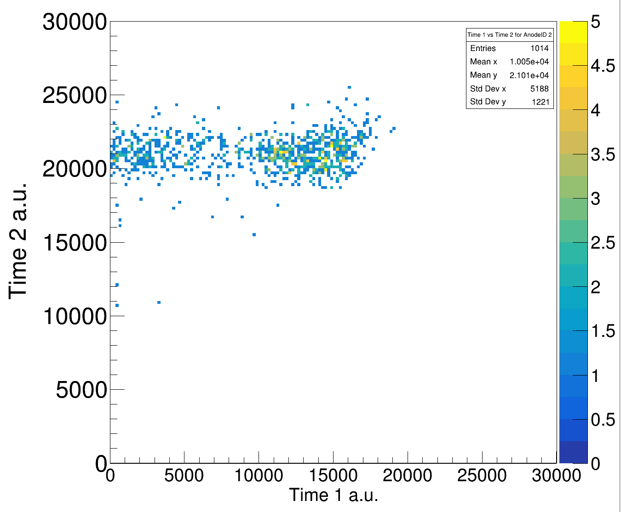
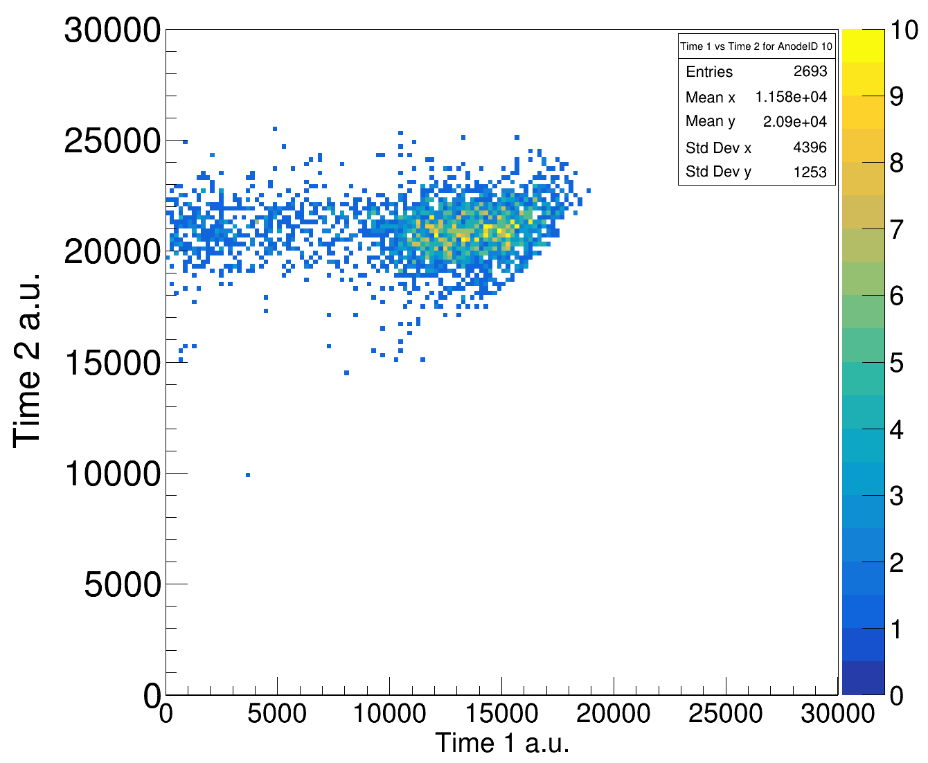
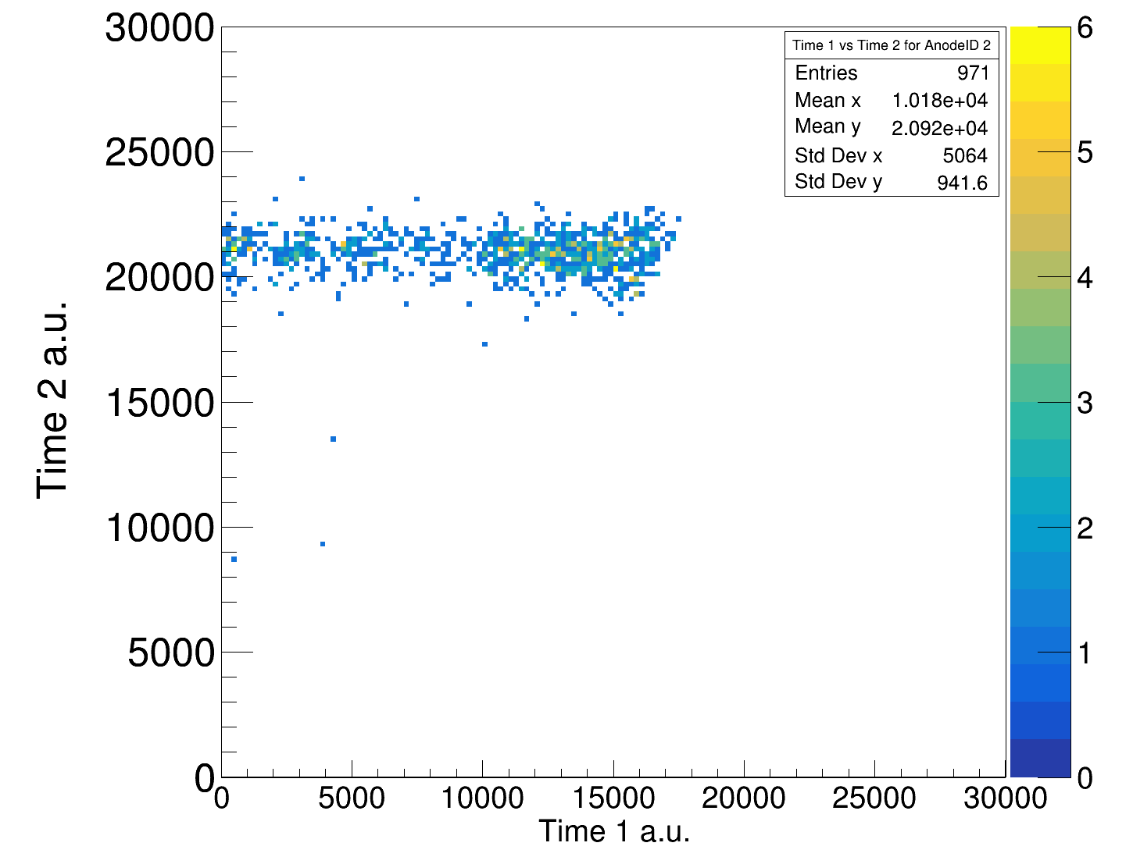
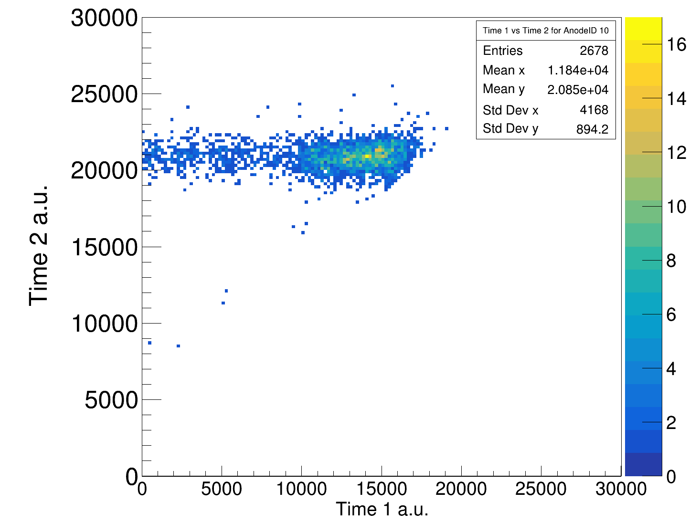
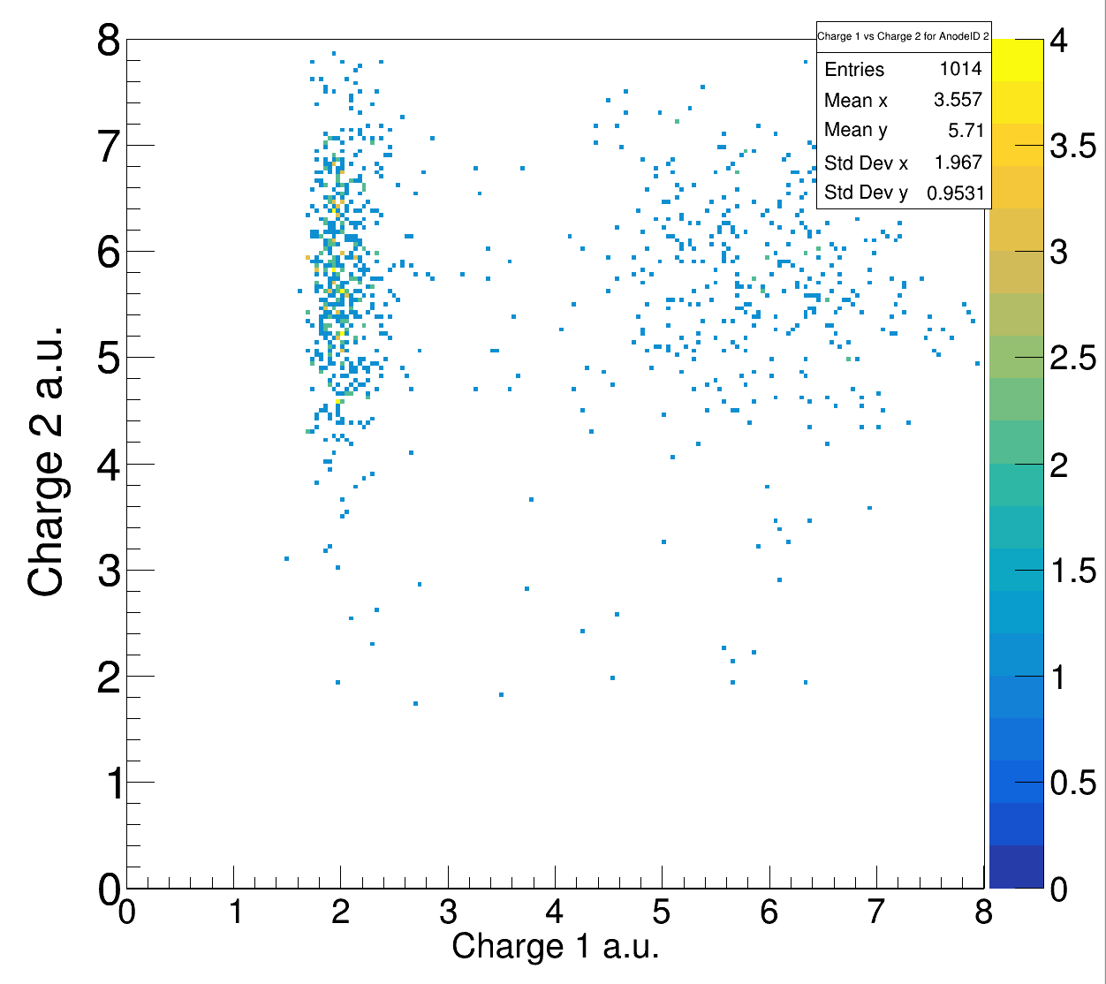
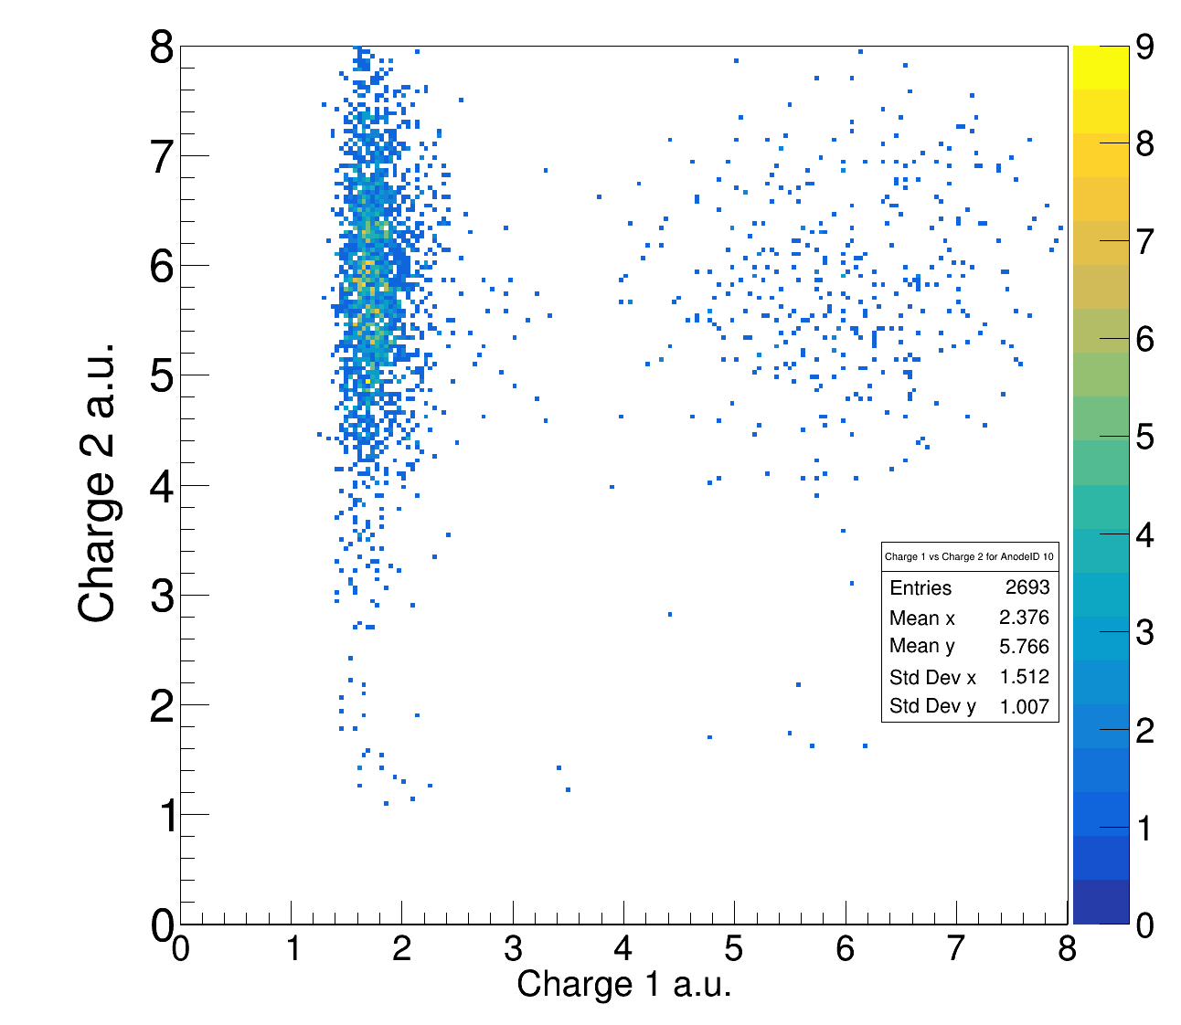
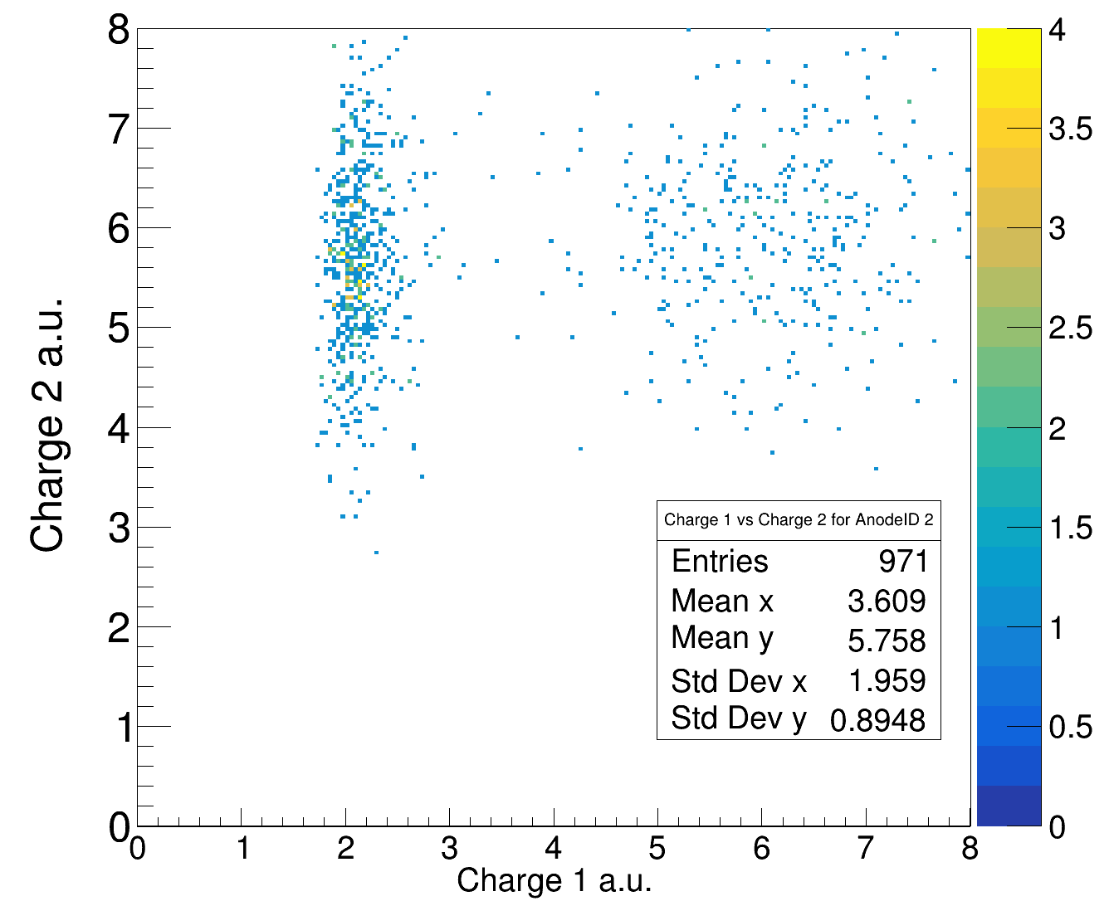
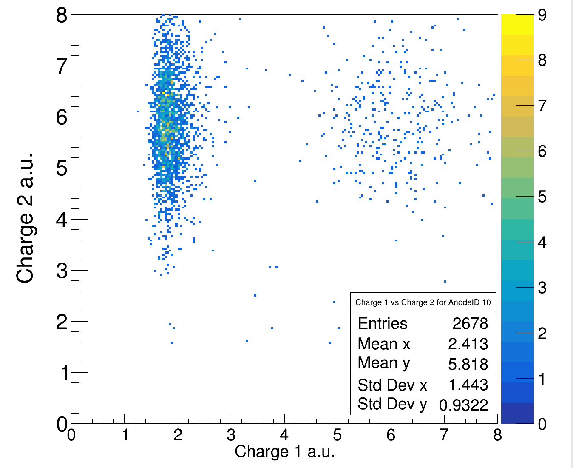
Time1 vs Time2 in TWIM – no cut on charge 400 AMeV
Carbon Target
Empty Target
anodenr. 2
anodenr. 10
anodenr. 2
anodenr. 10

Slide 3
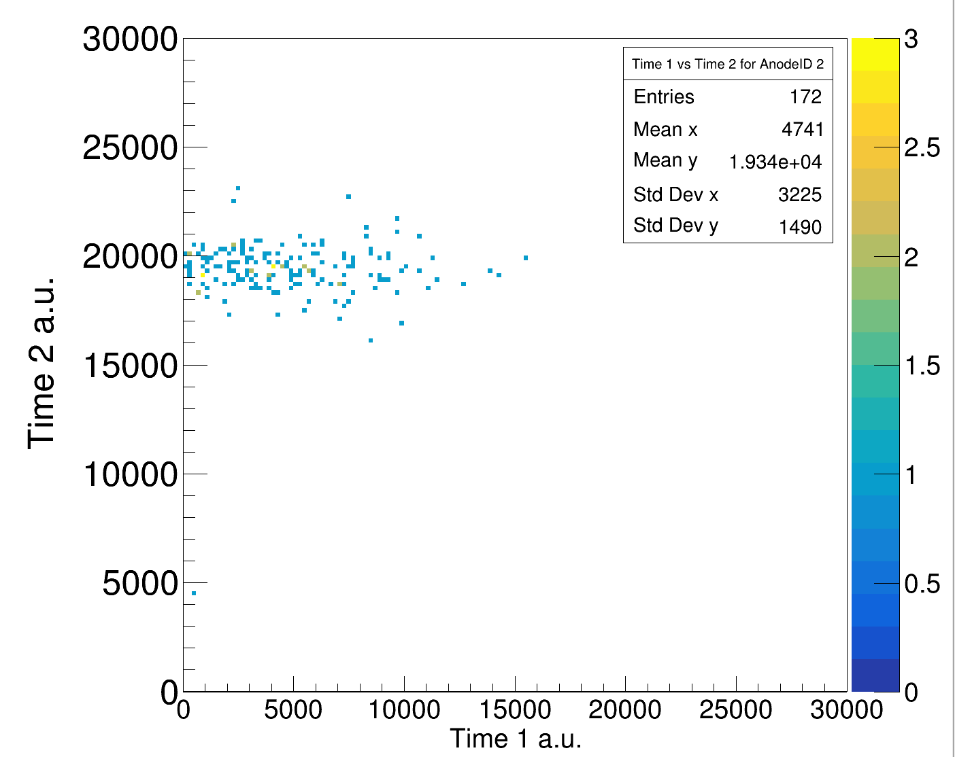
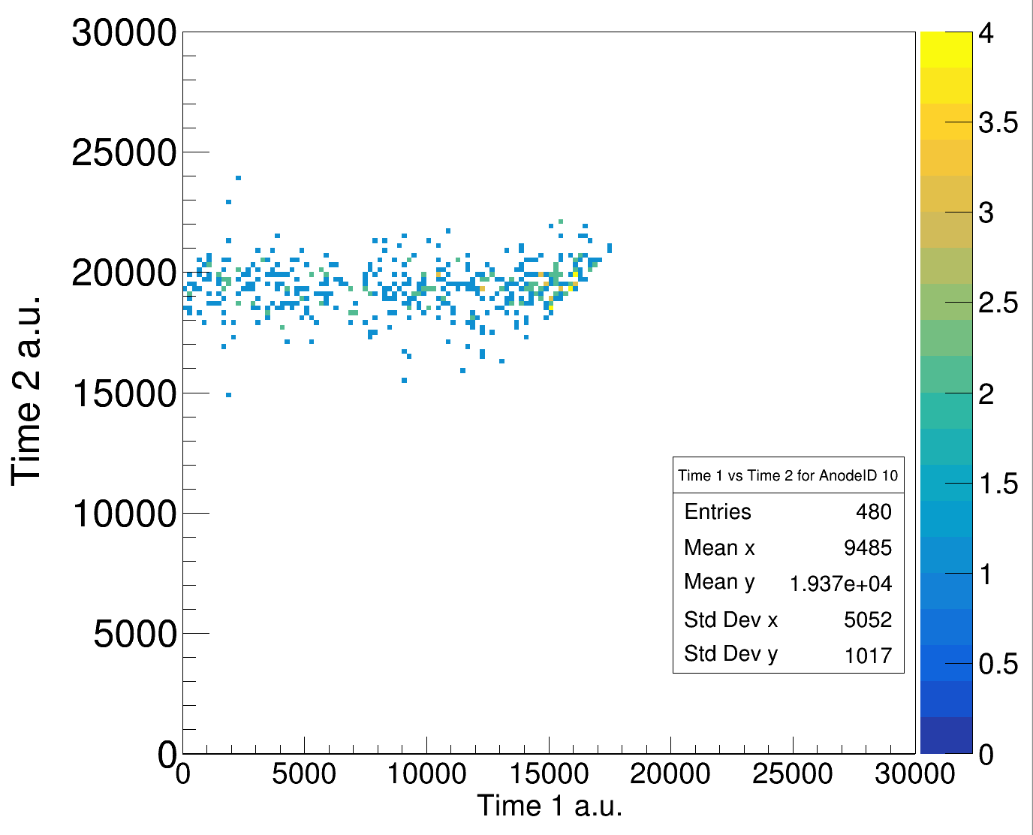
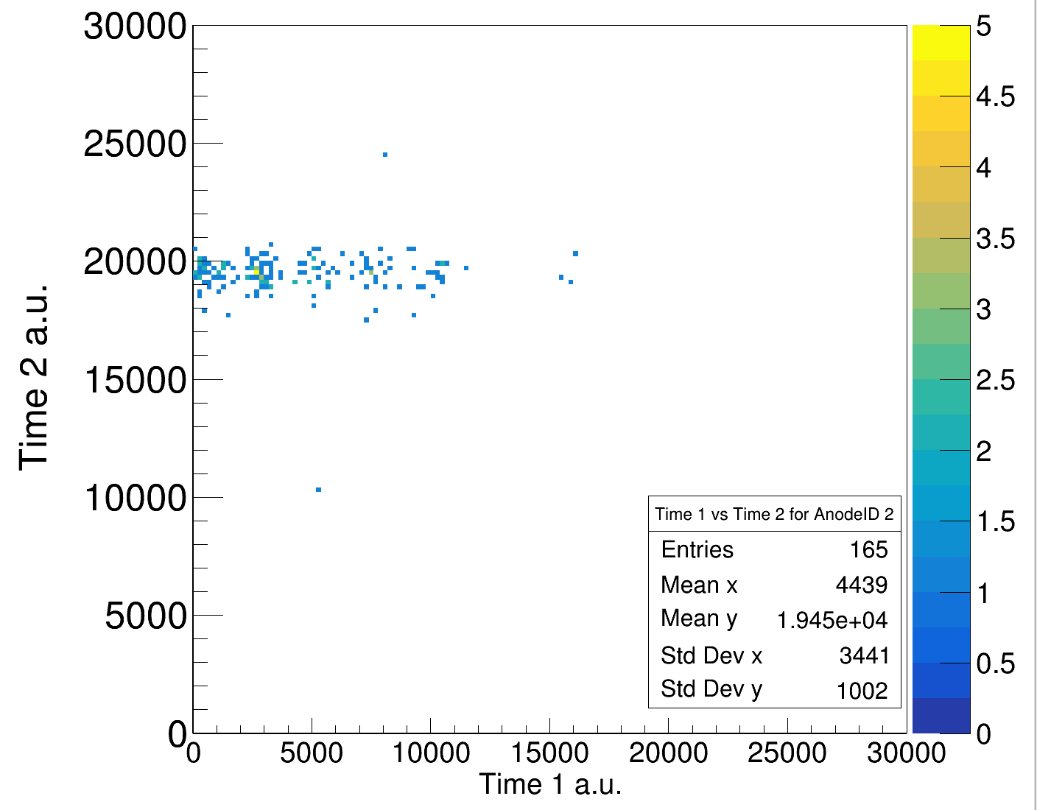
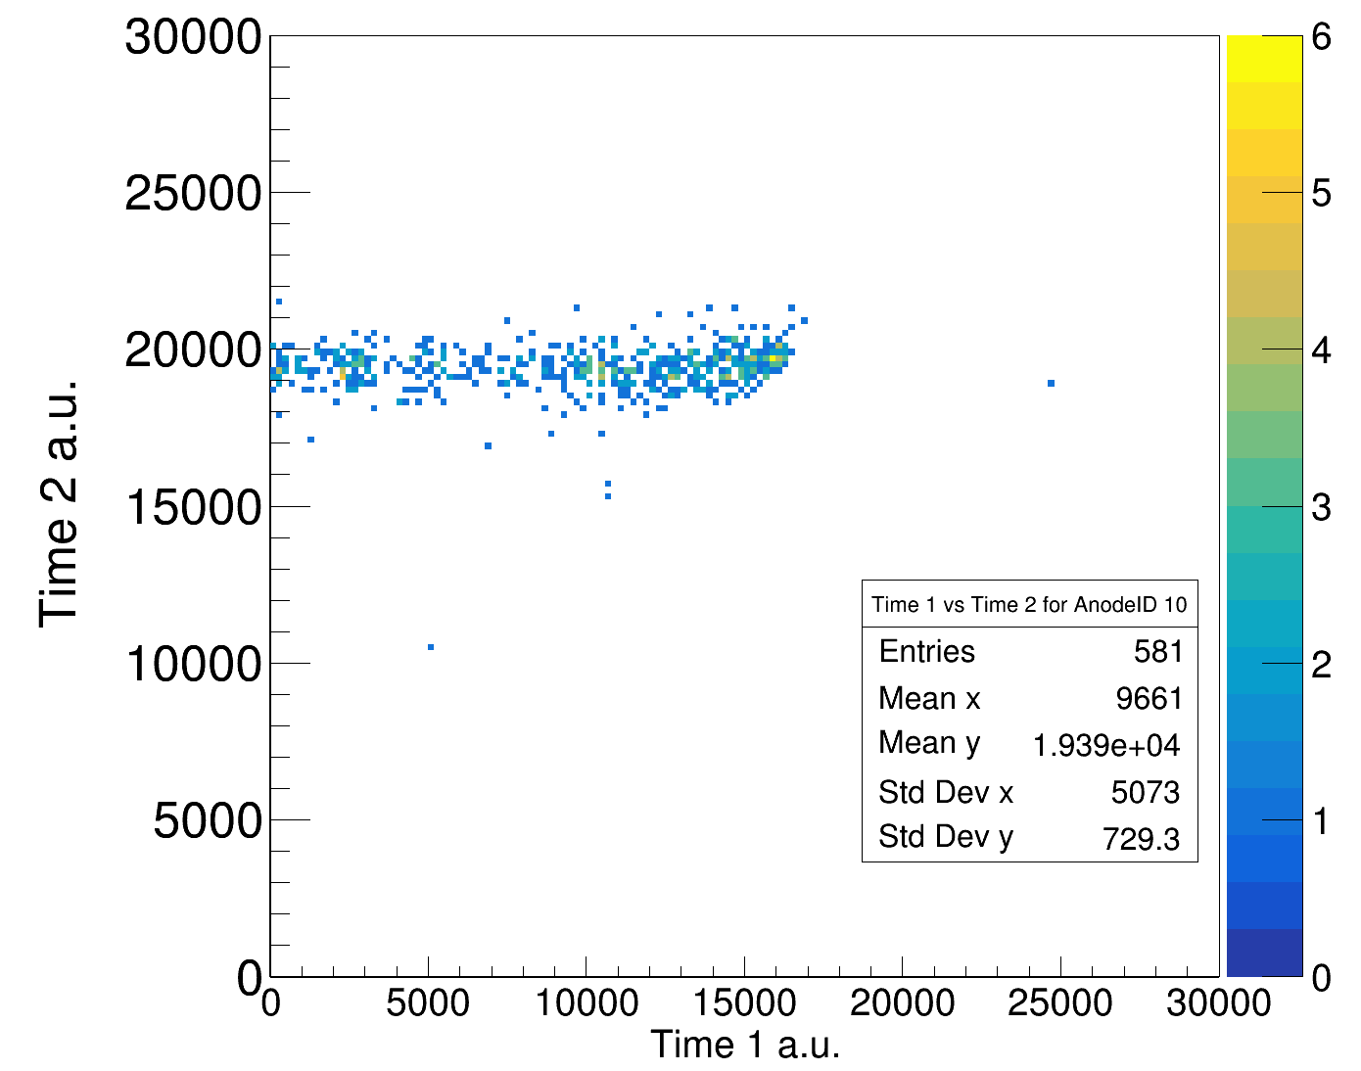
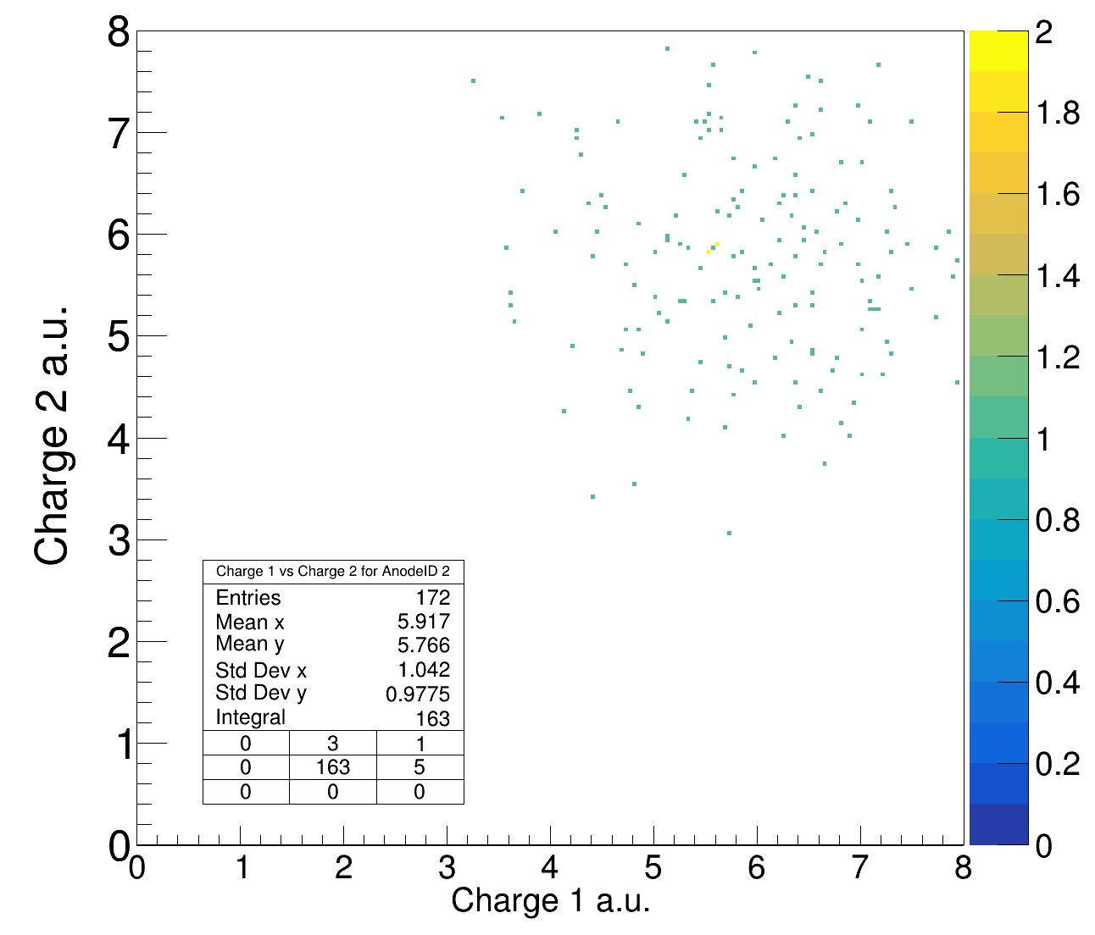
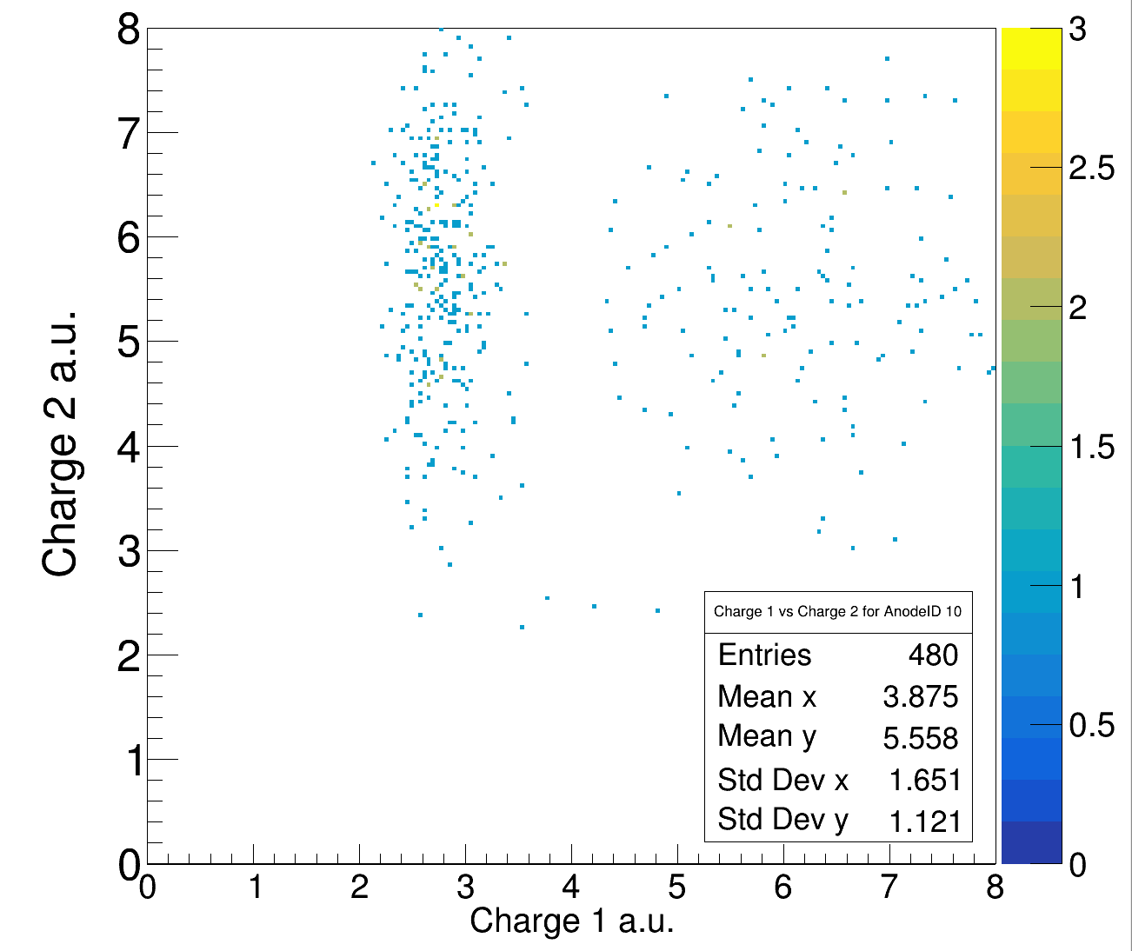
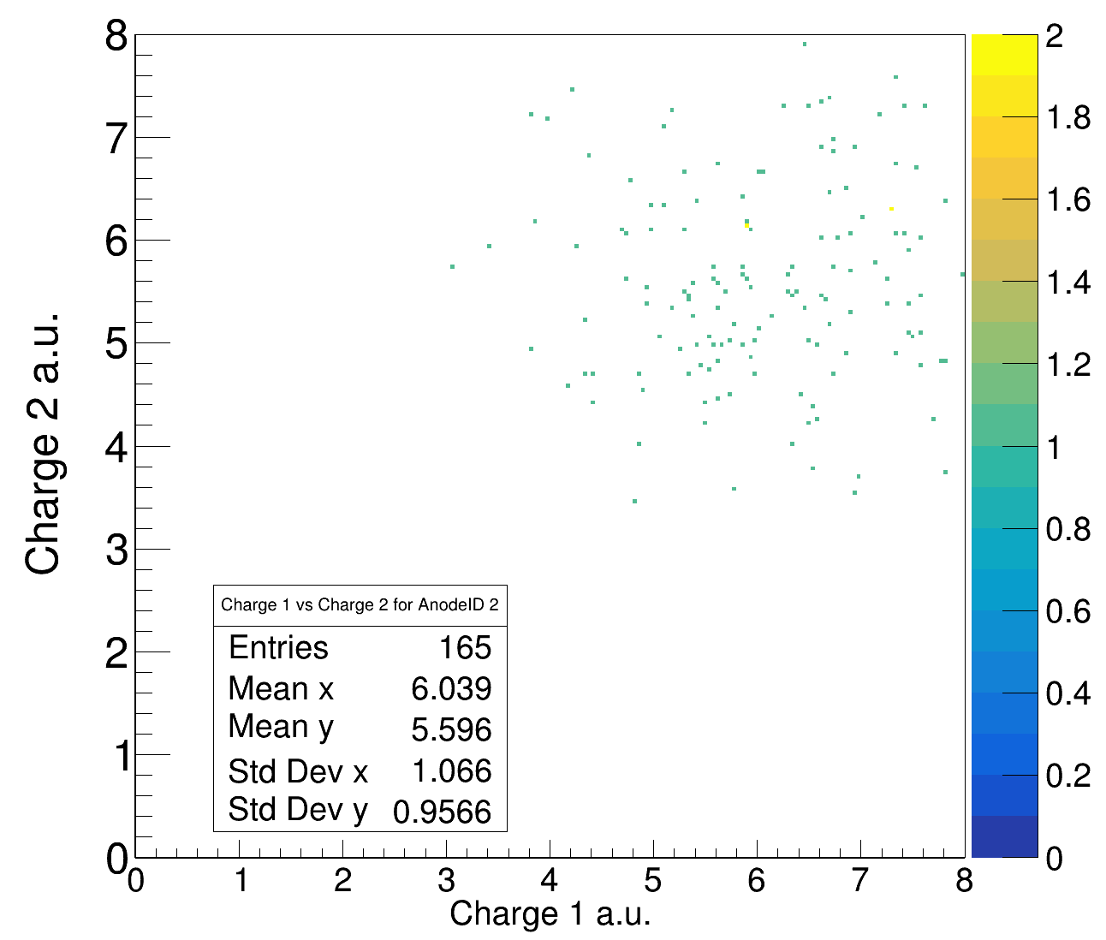
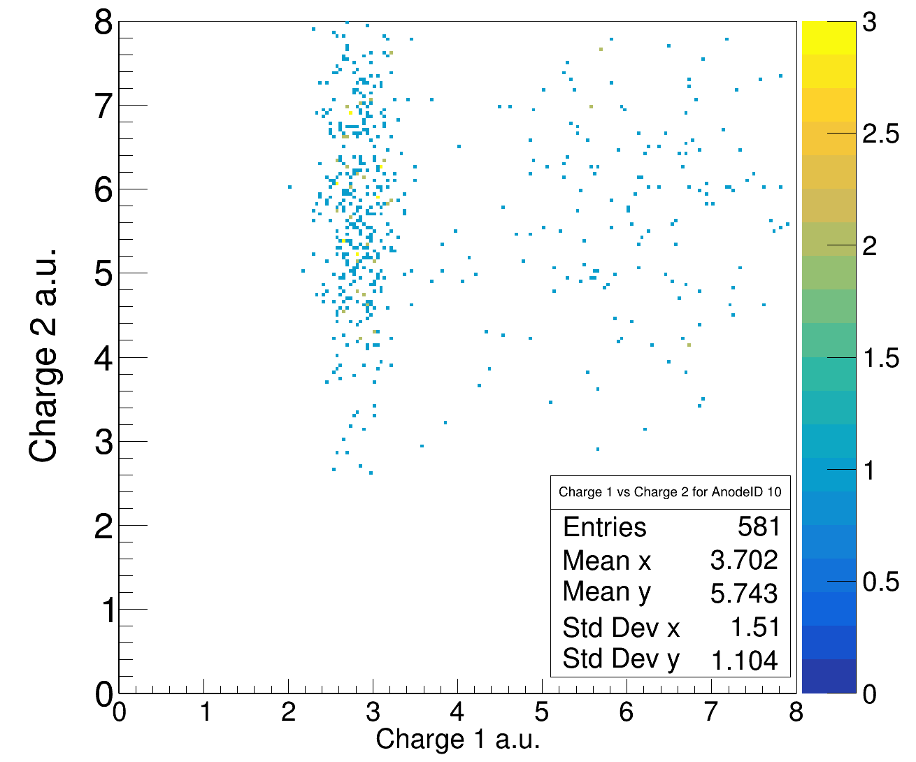
Time1 vs Time2 in TWIM – no cut on charge 550 AMeV
Carbon Target
Empty Target

Slide 4
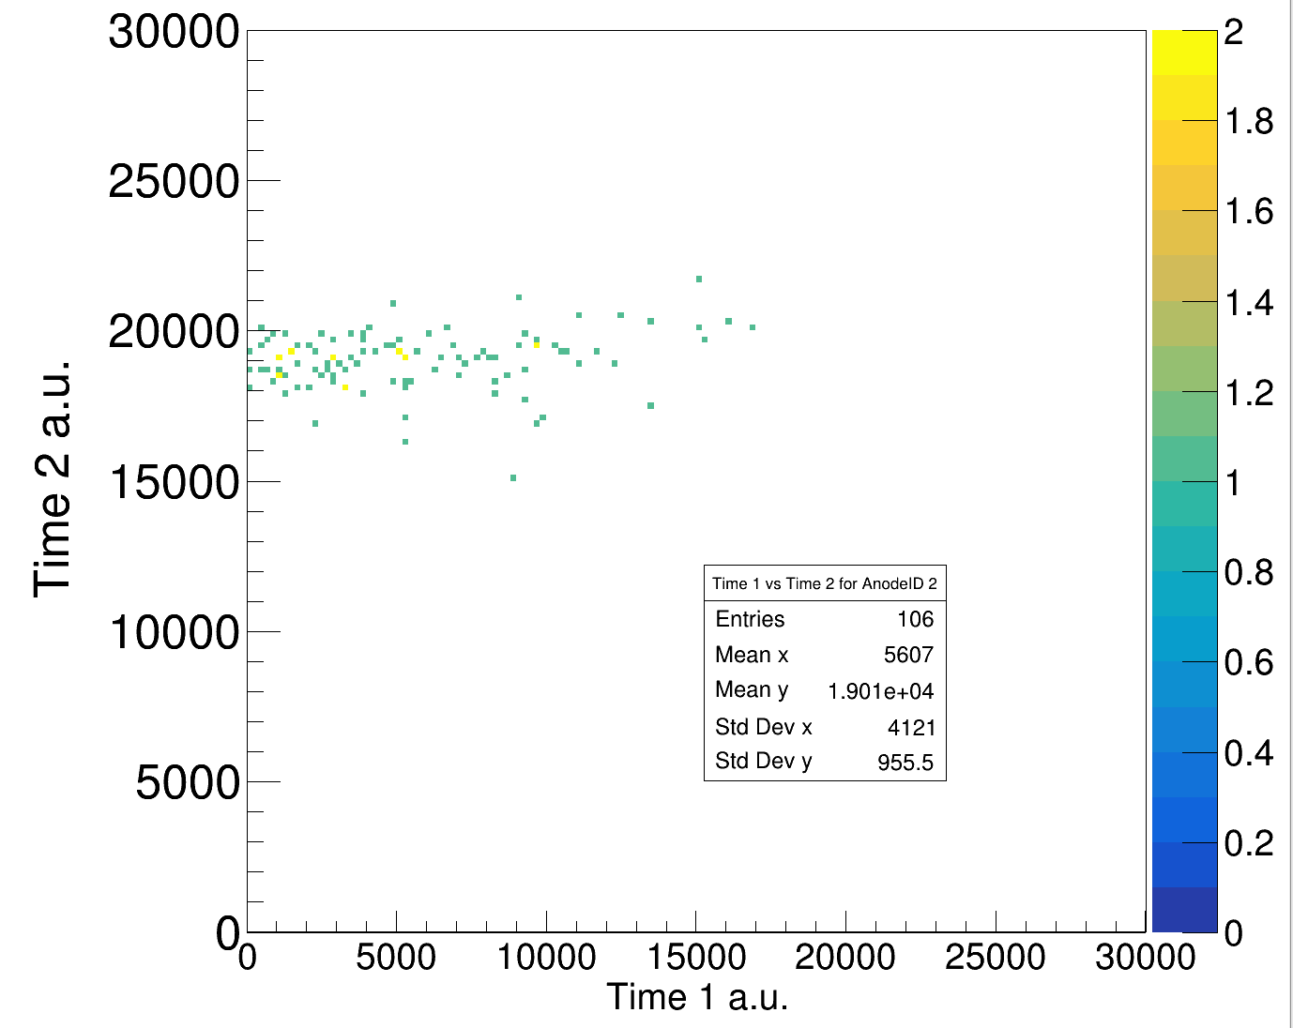
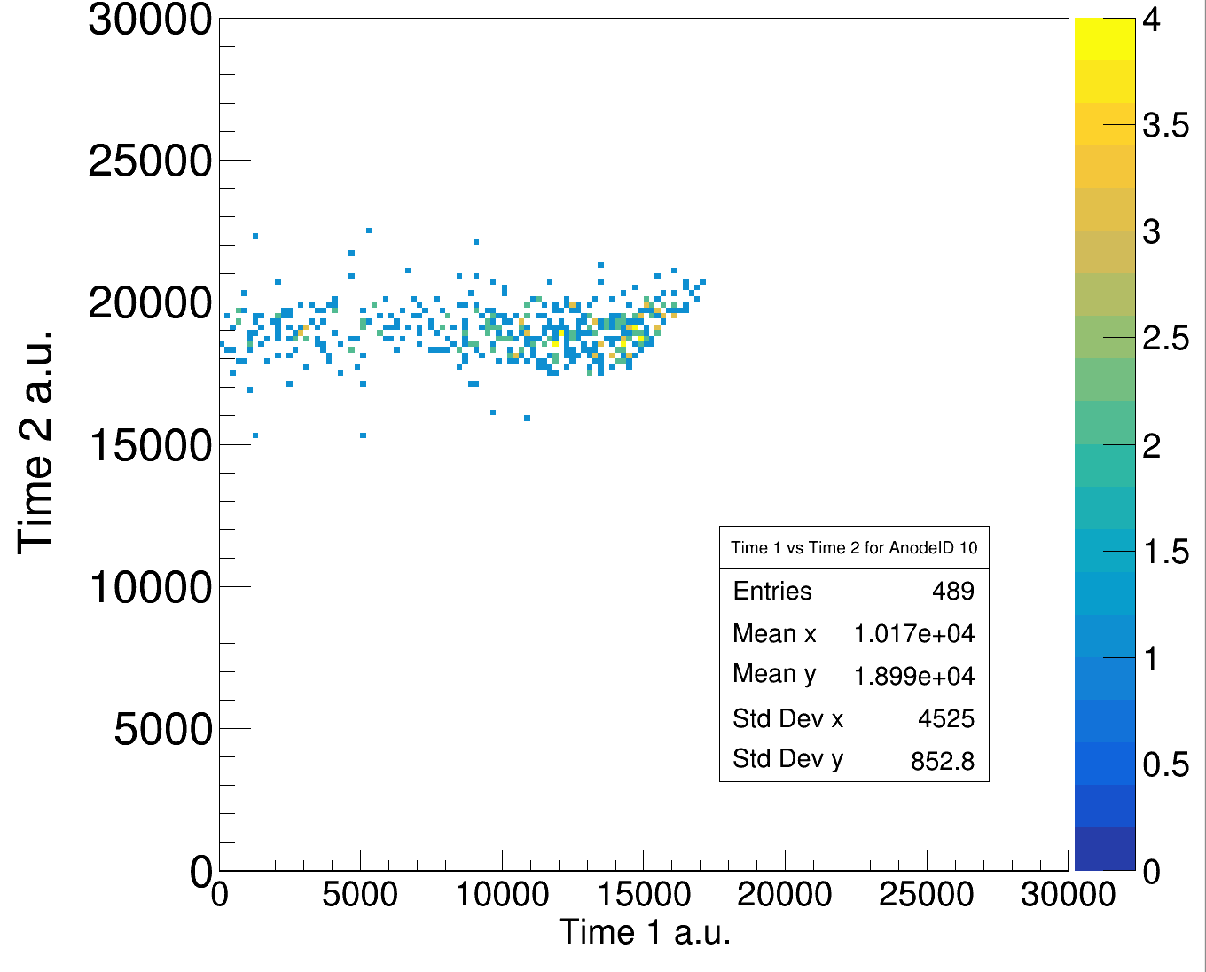
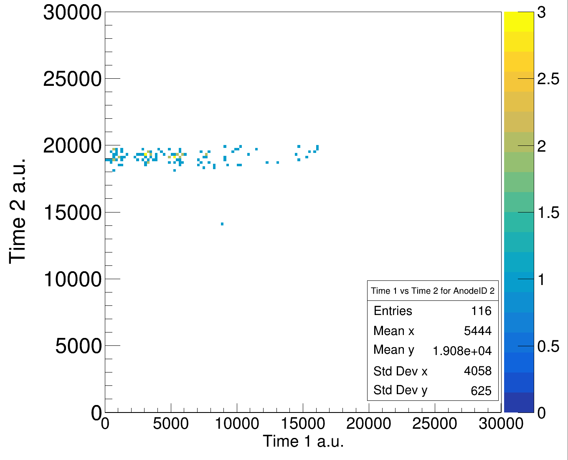
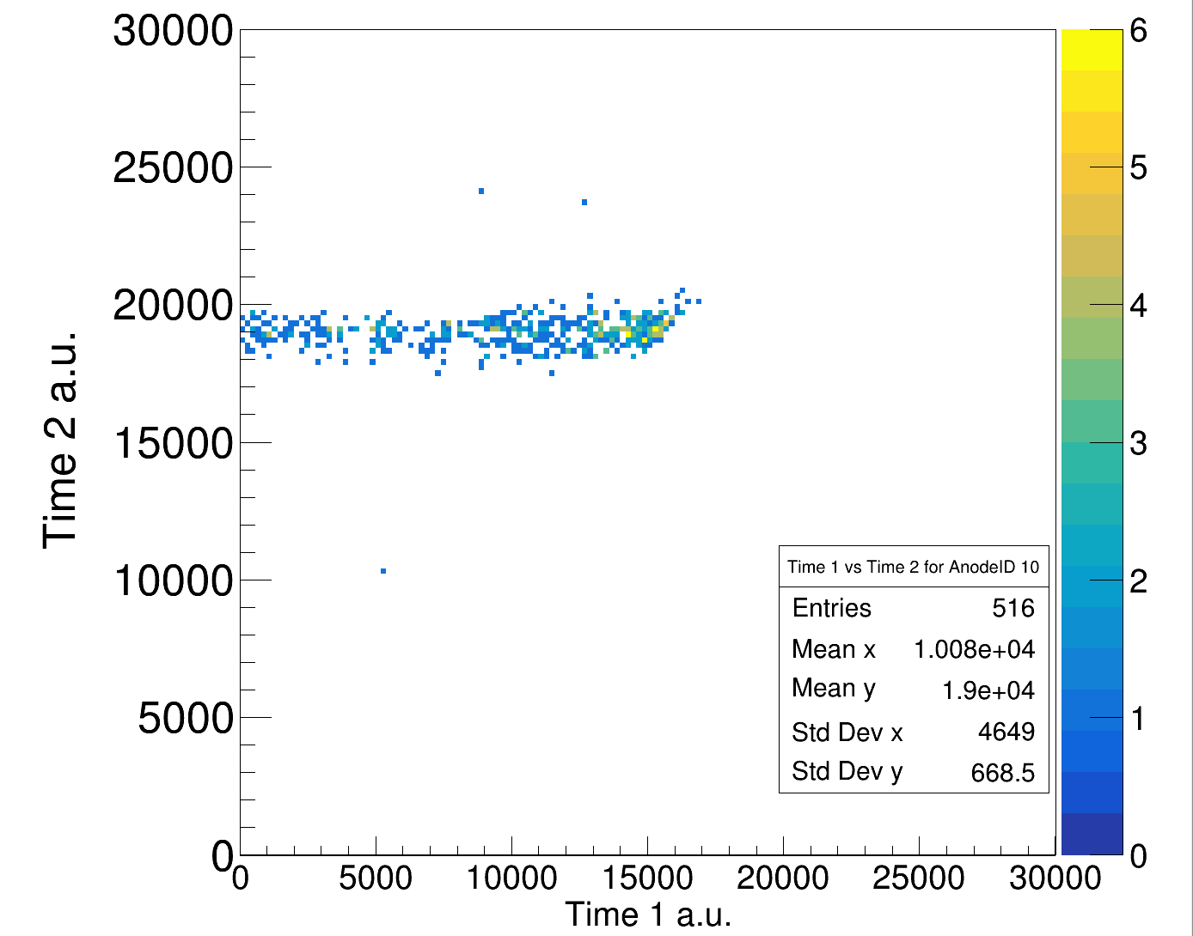
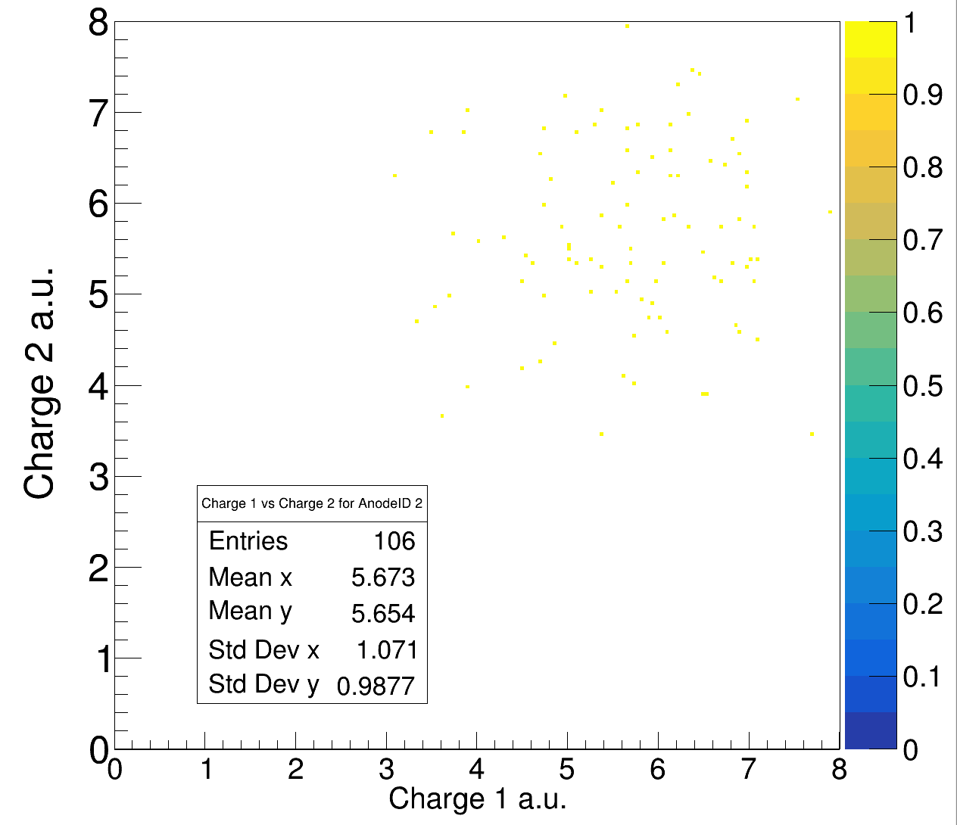
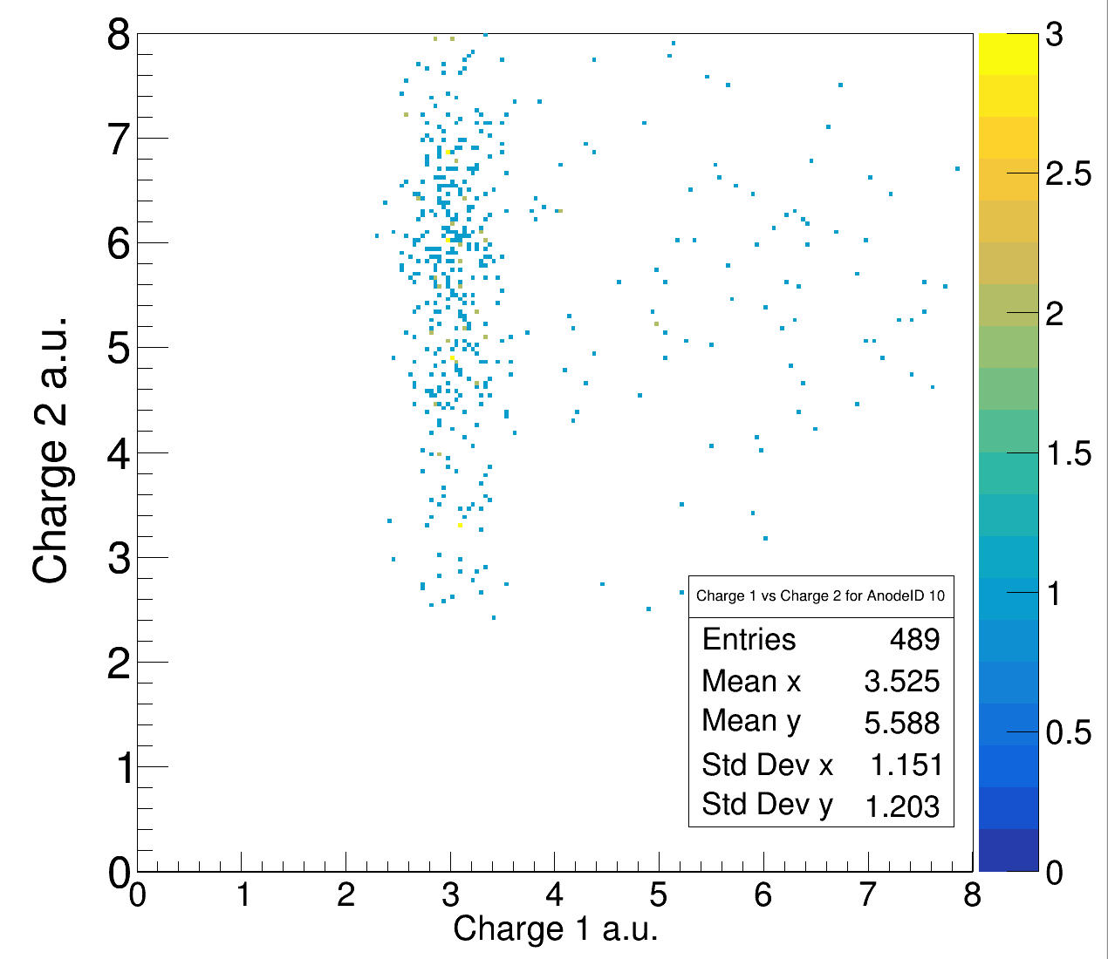
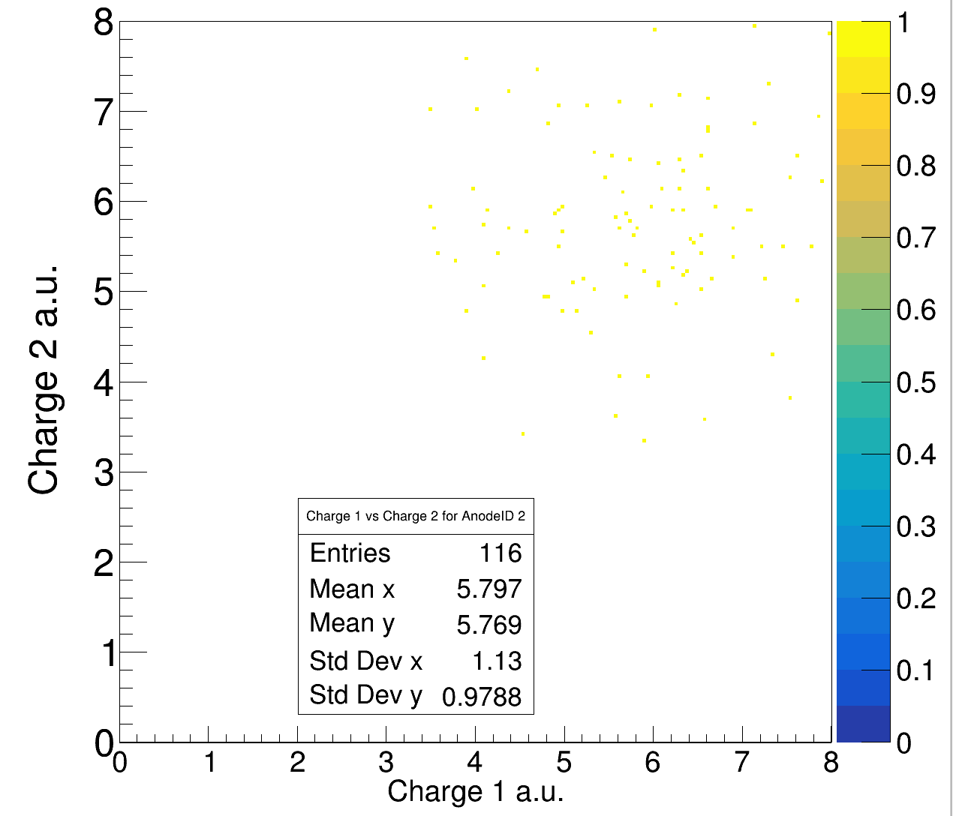

Time1 vs Time2 in TWIM – no cut on charge 650 AMeV
Carbon Target
Empty Target

Slide 5
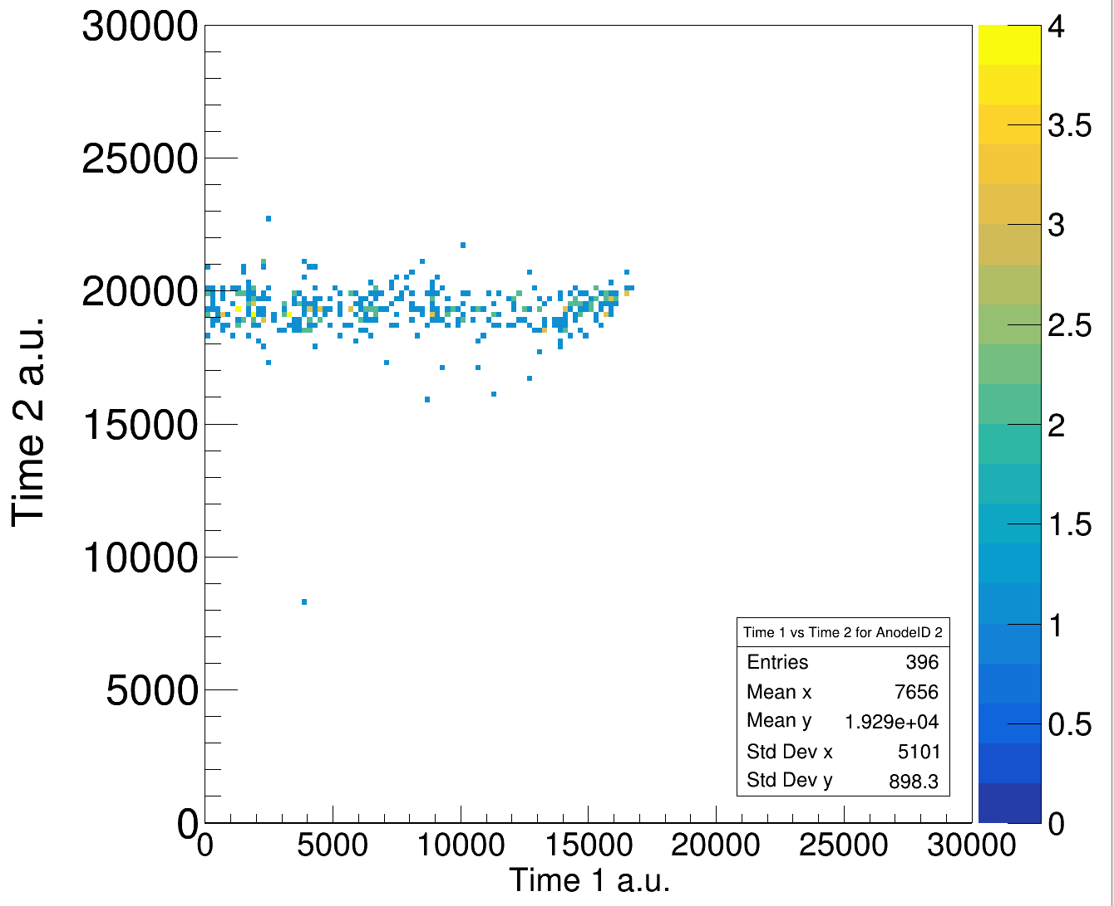
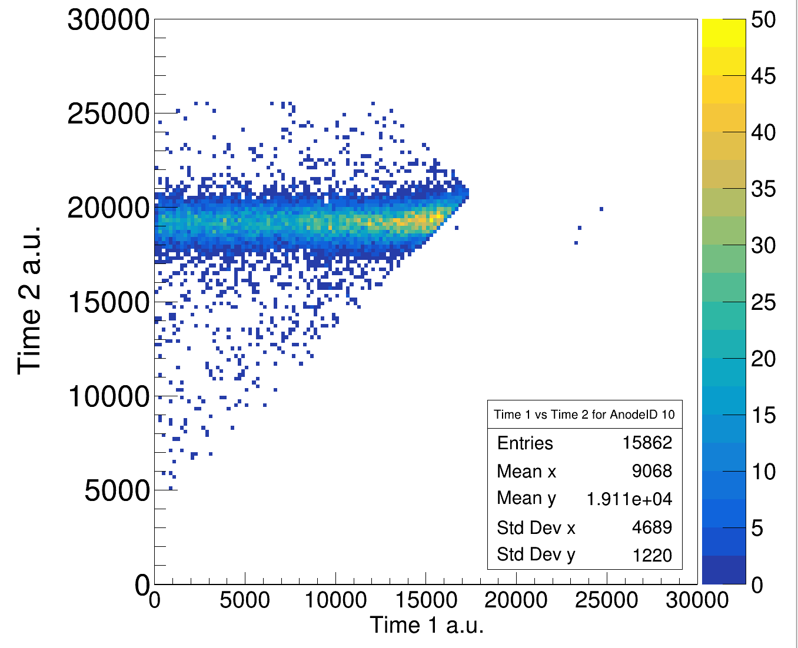
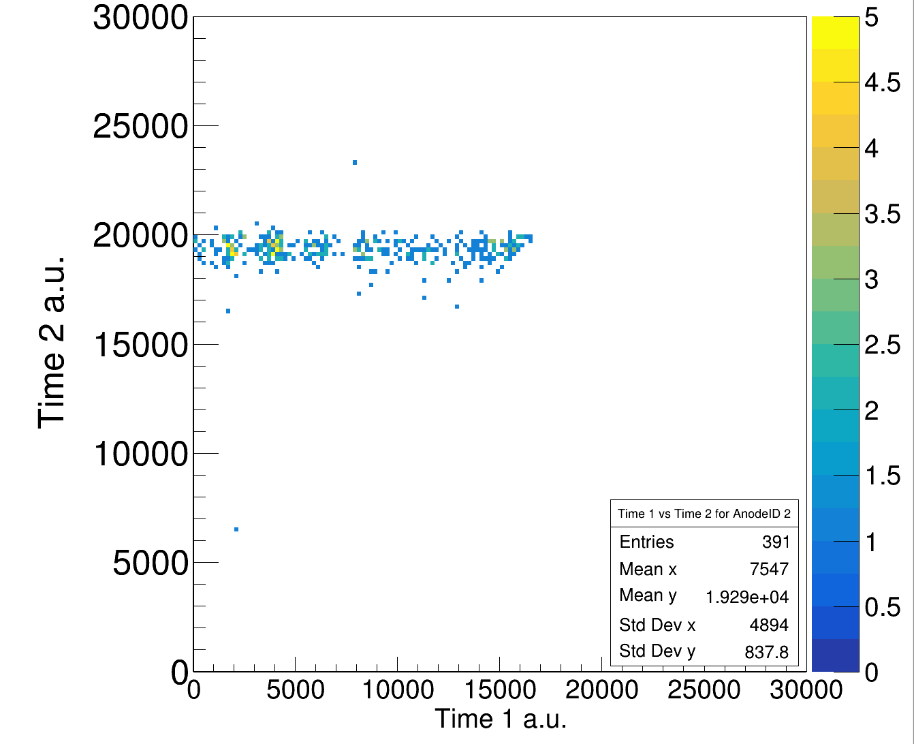
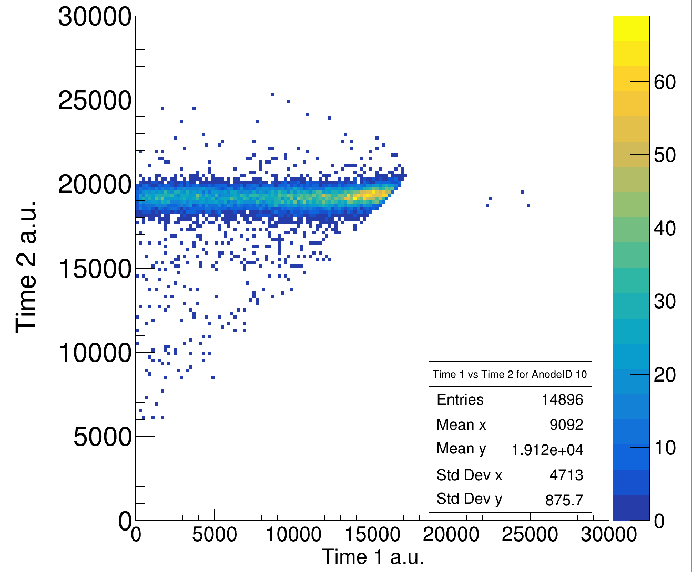
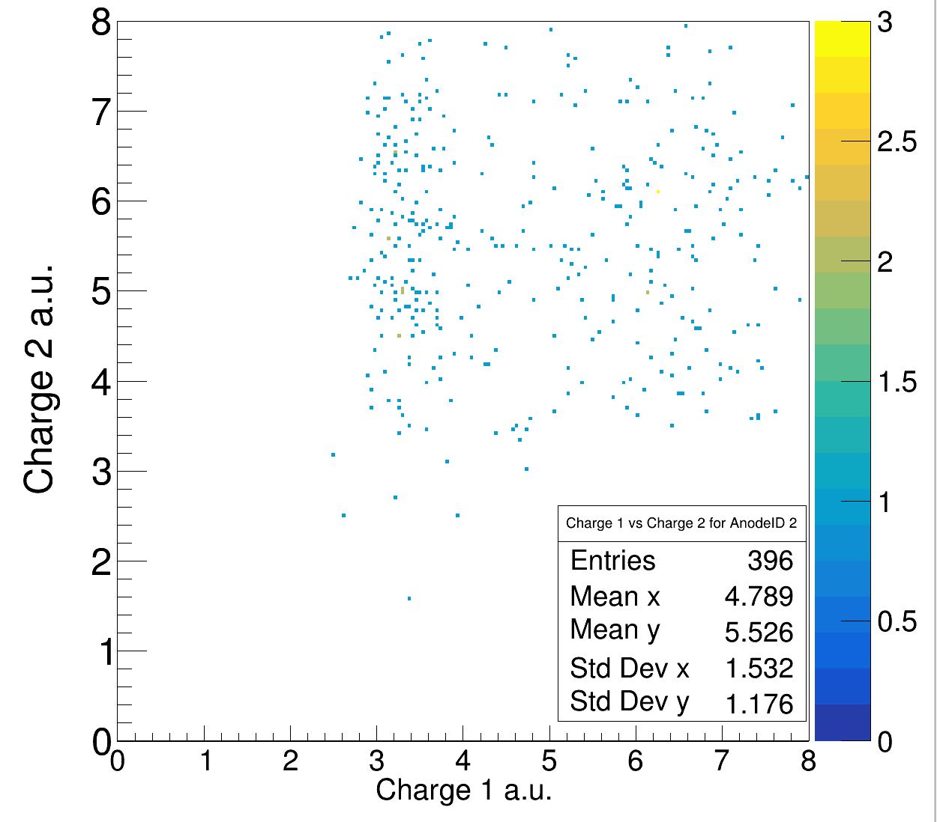
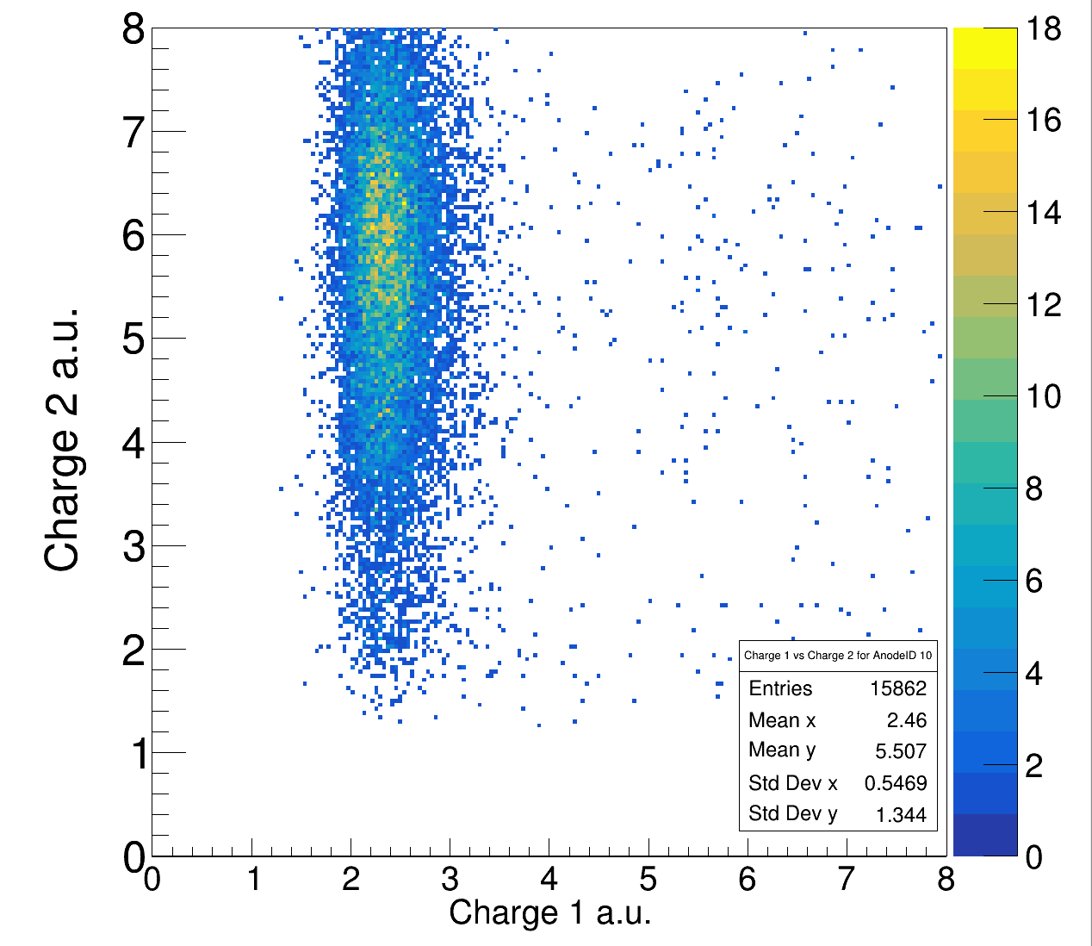
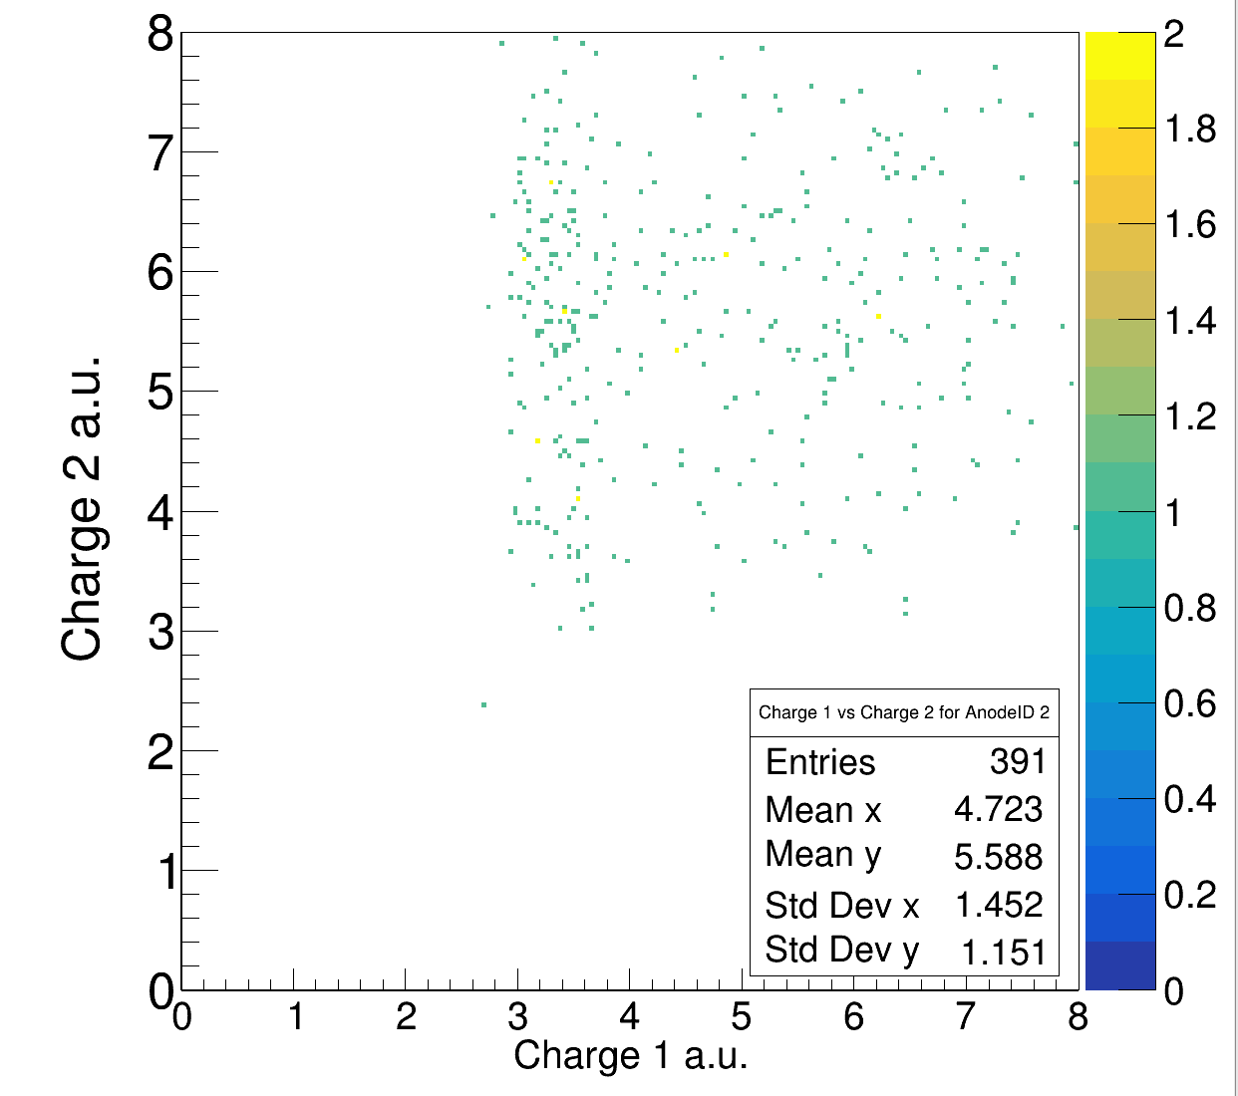
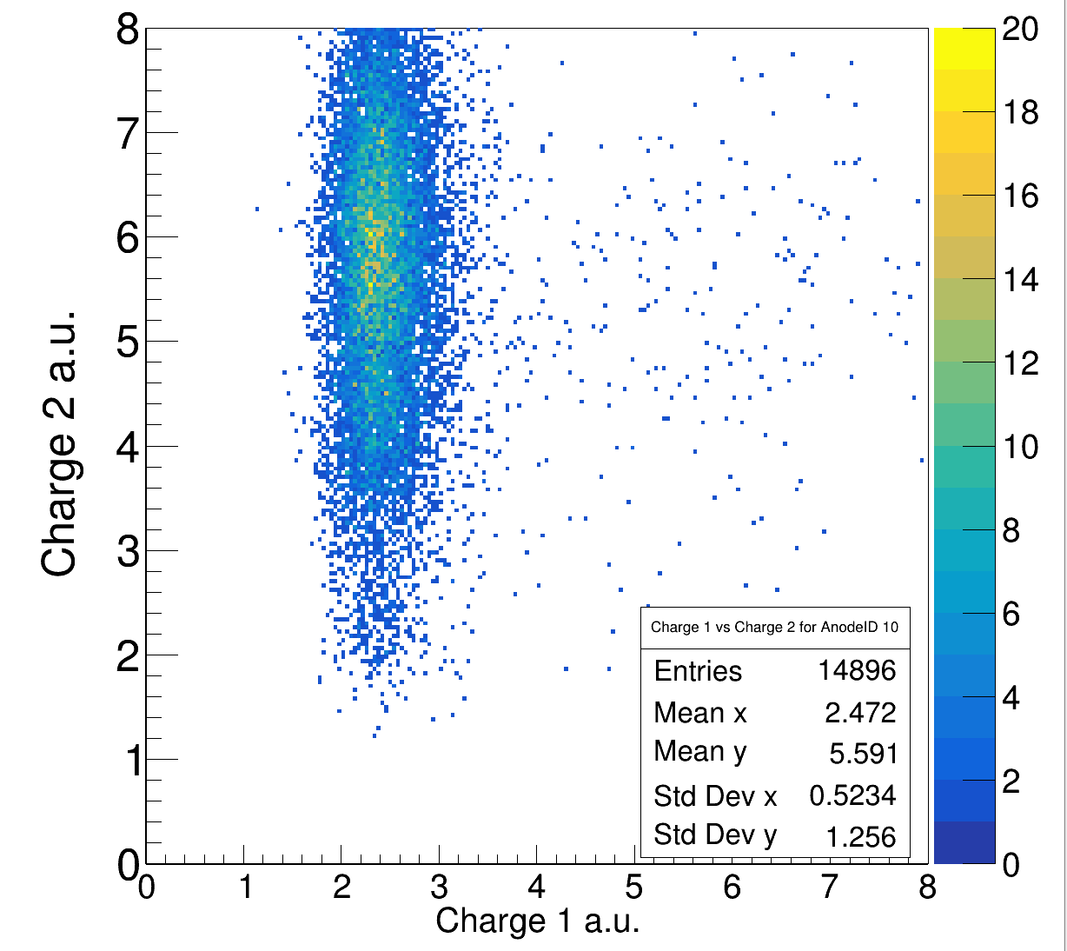
Time1 vs Time2 in TWIM – no cut on charge 800 AMeV
Carbon Target
Empty Target

Slide 6
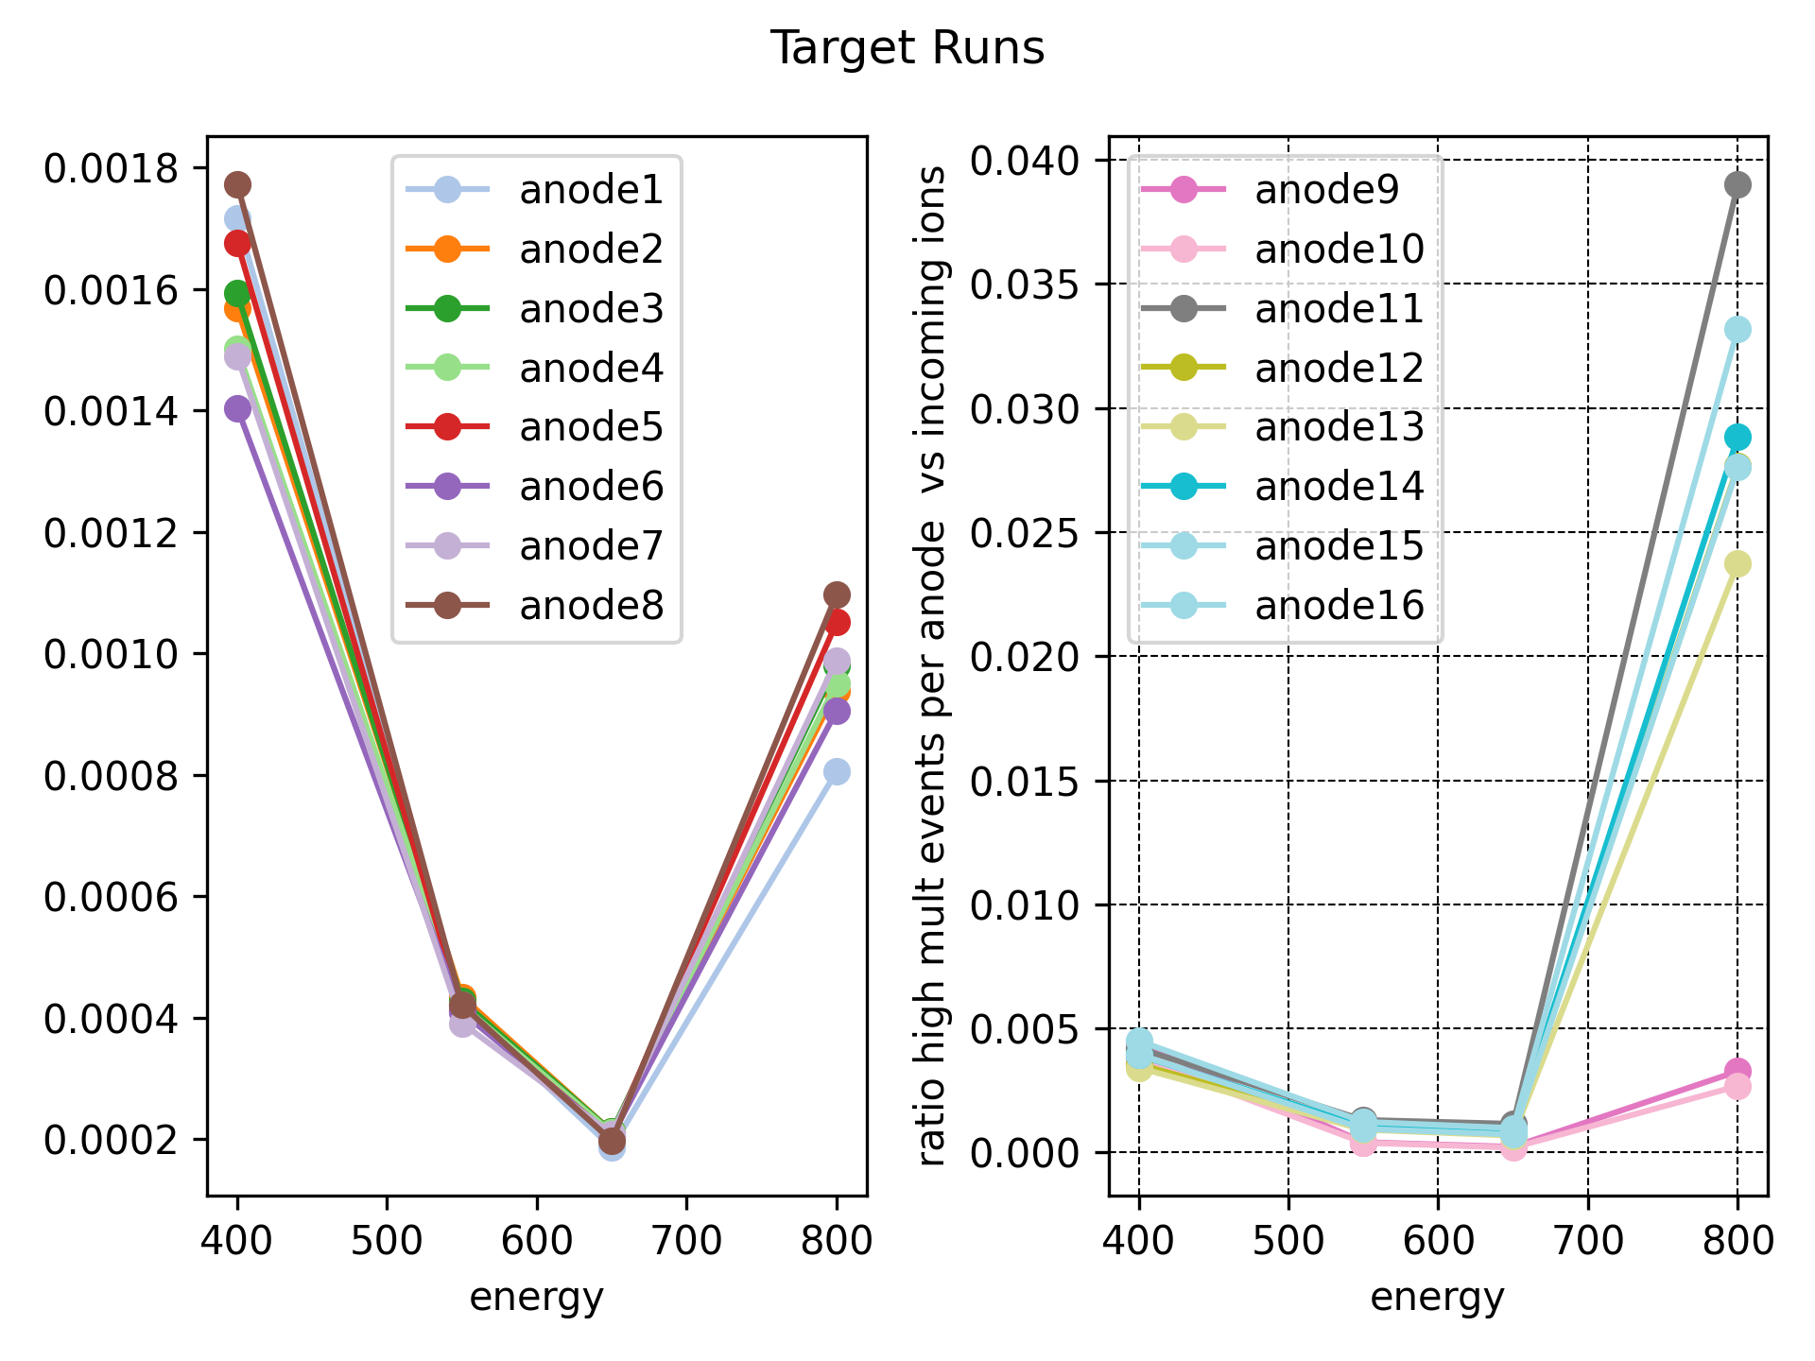
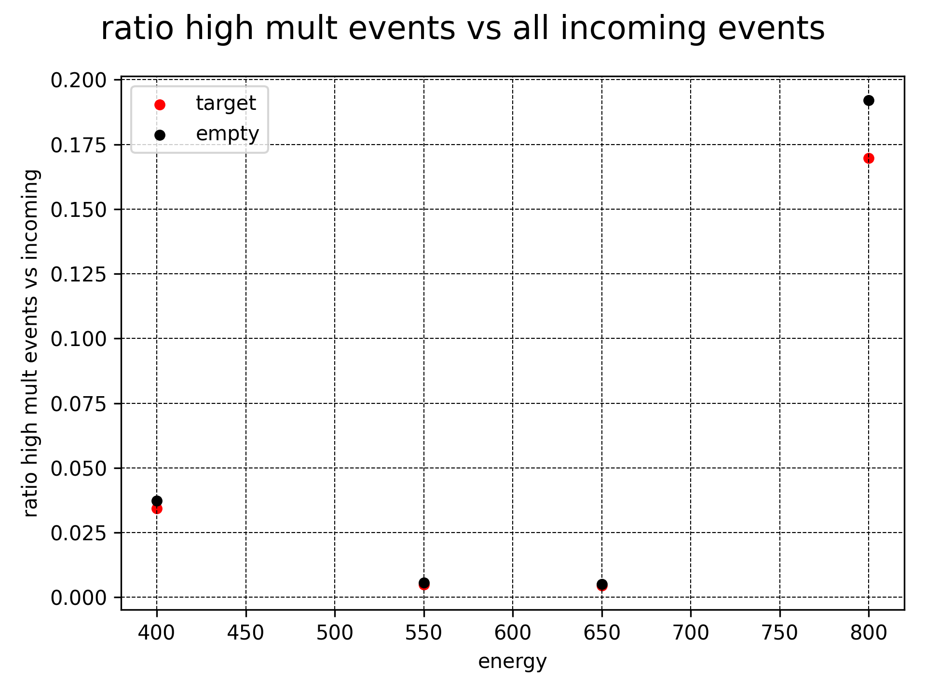
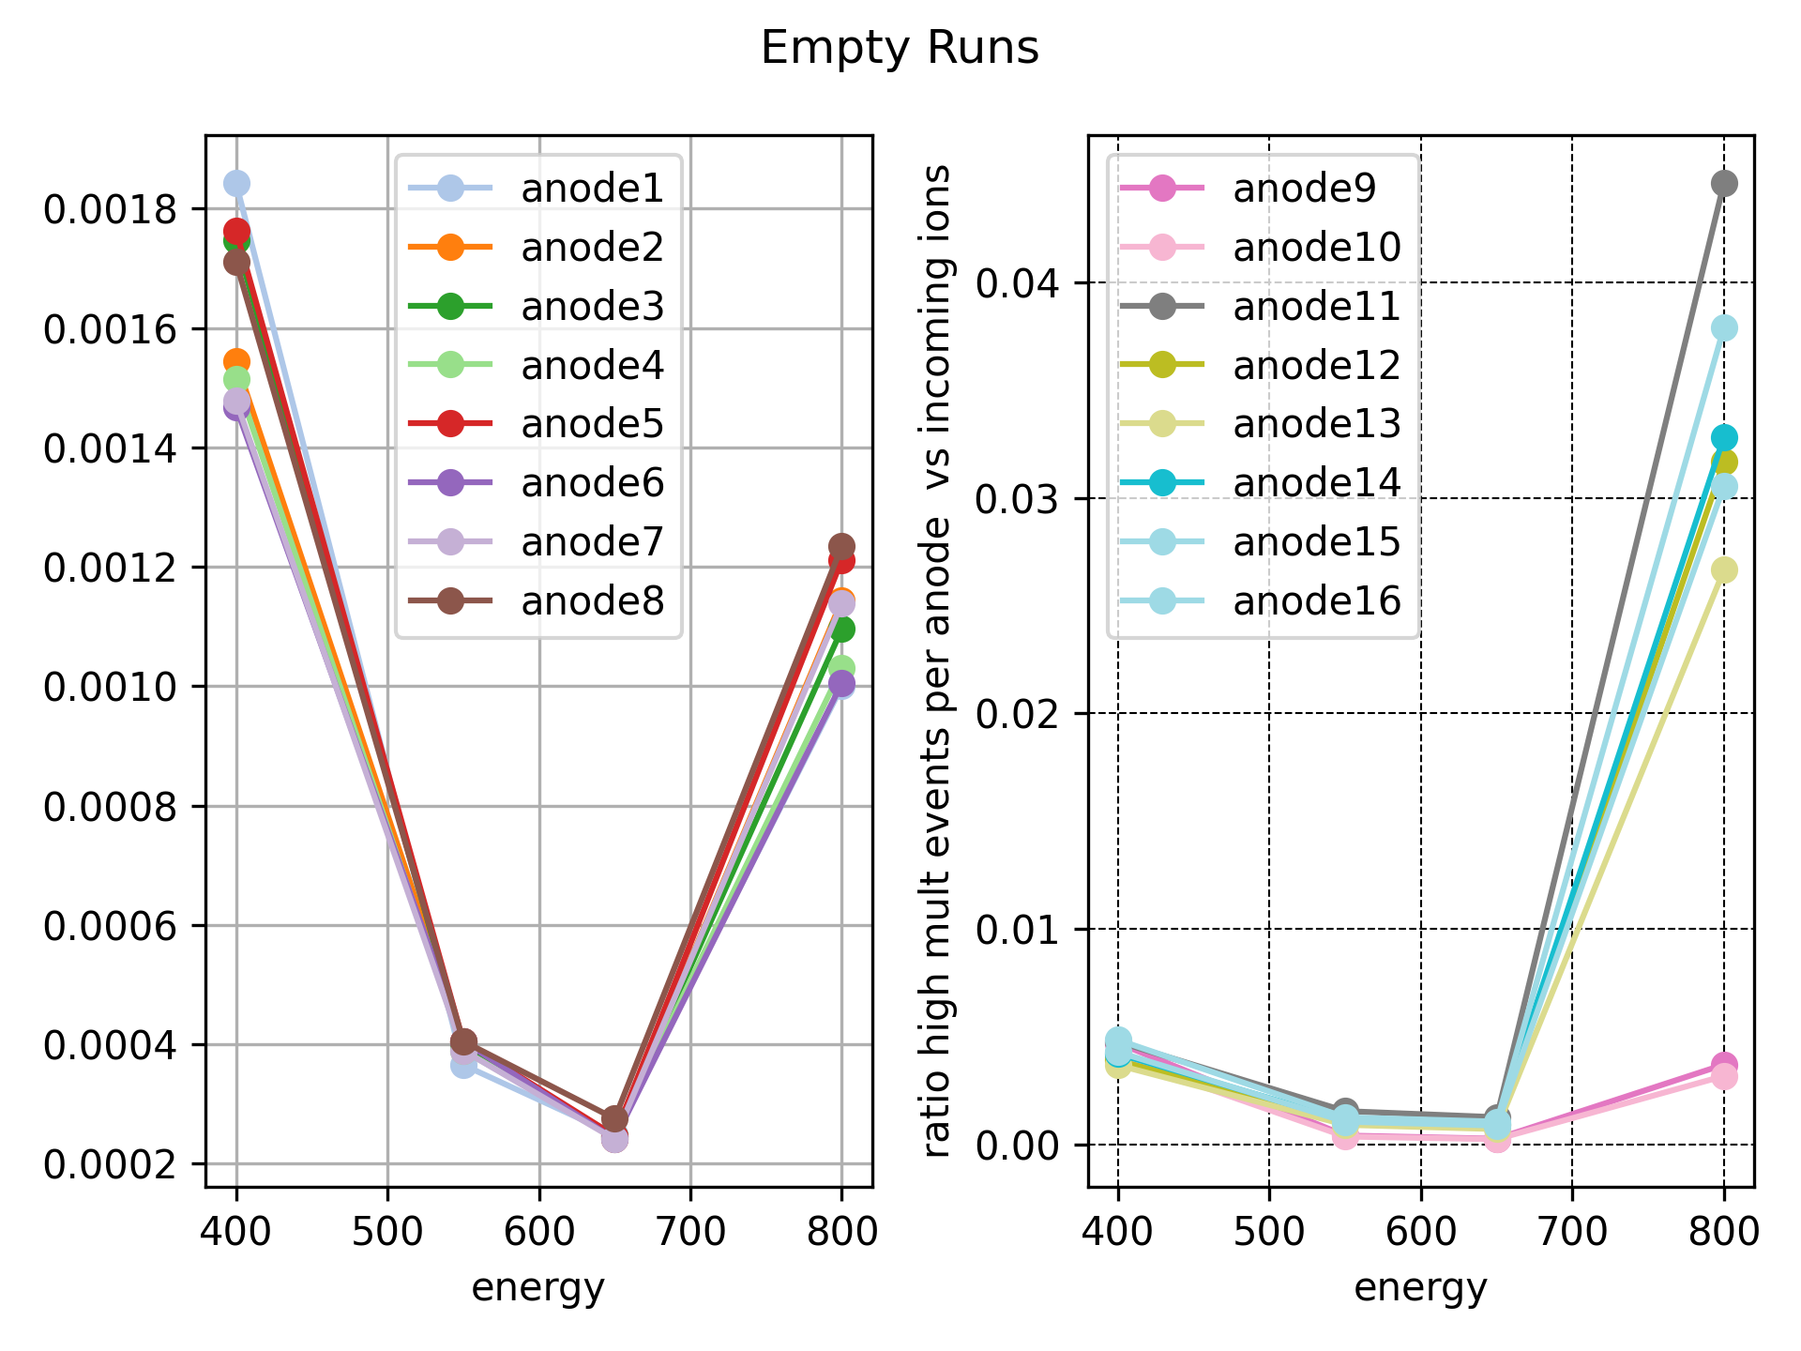
TWIM Multiplicities

Slide 7
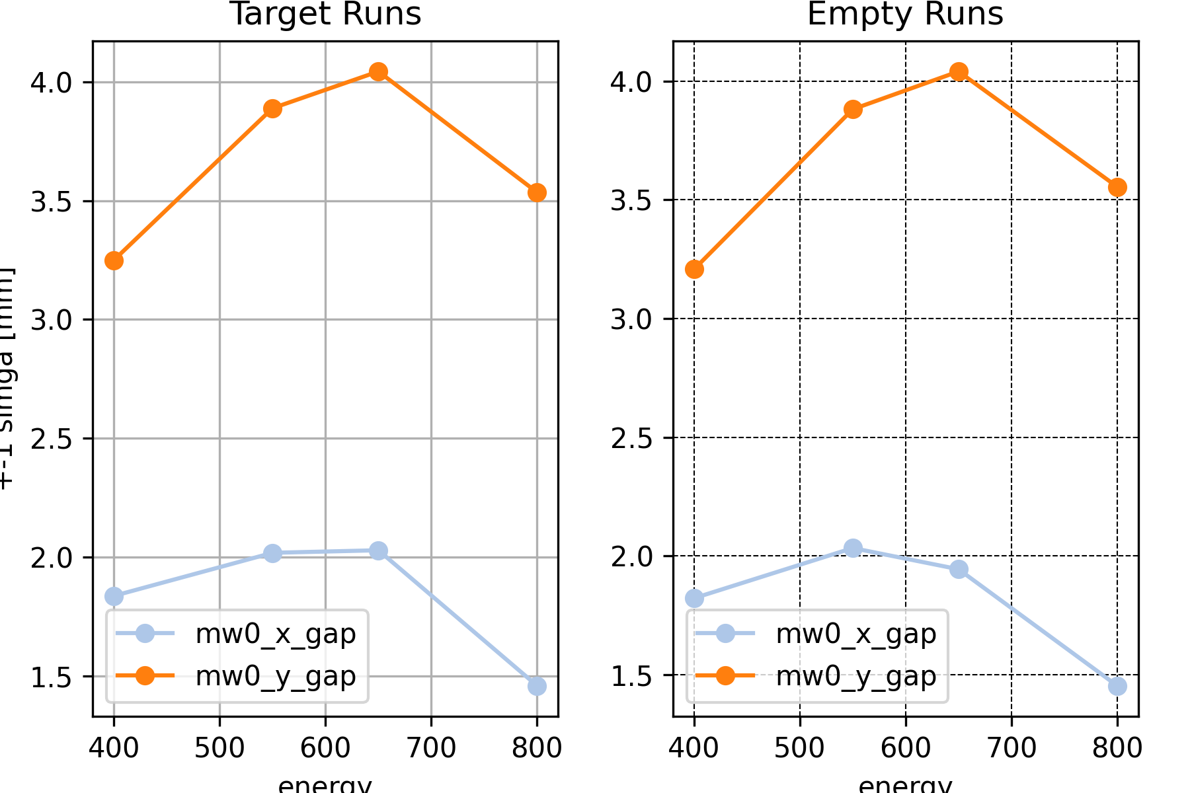
MW0 openign gaps (+-sigma cut condition for x and y)

Slide 8
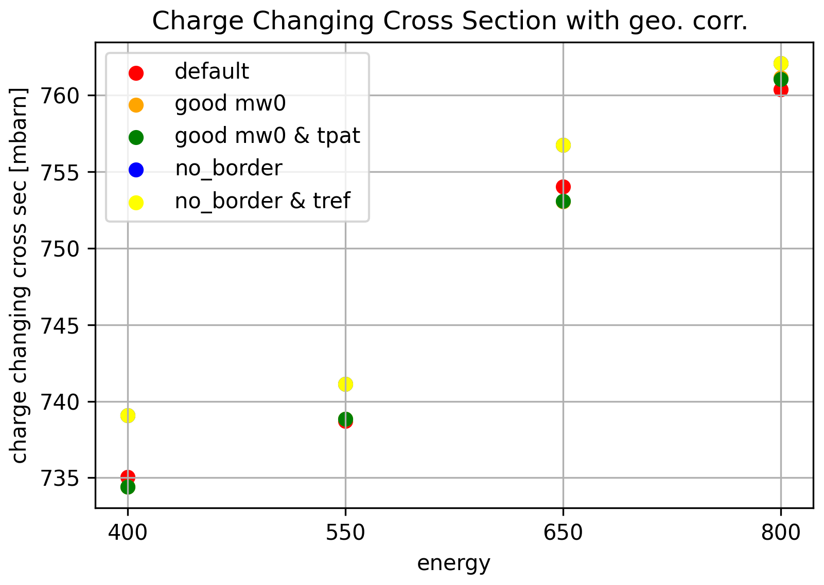
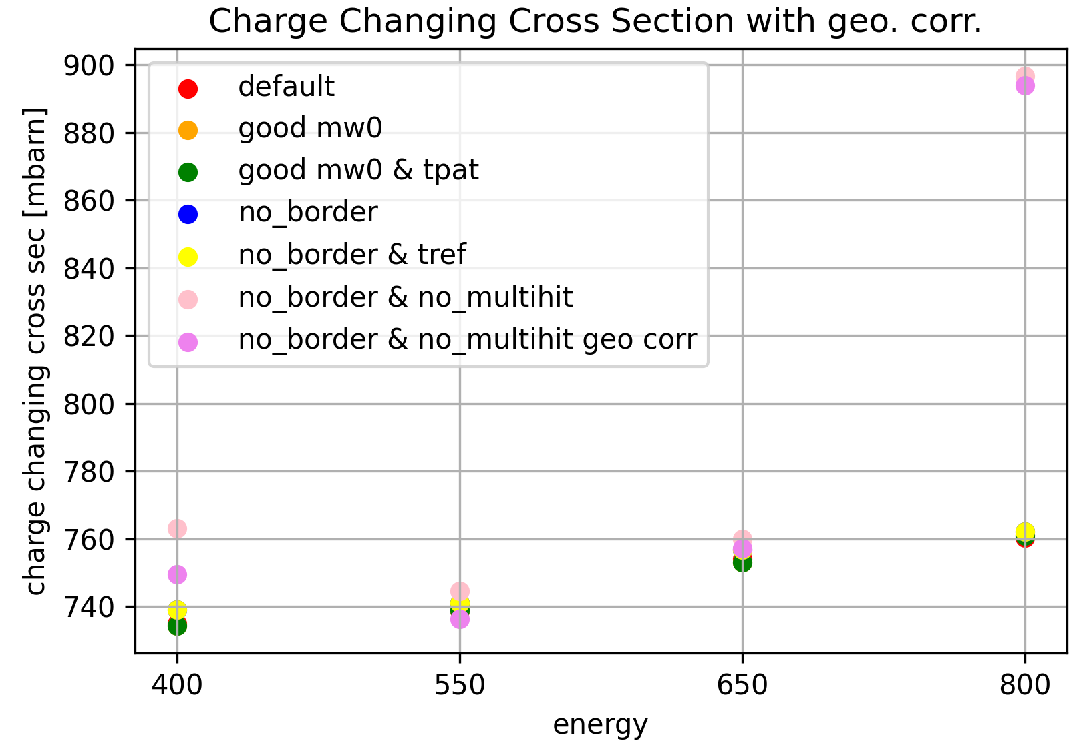
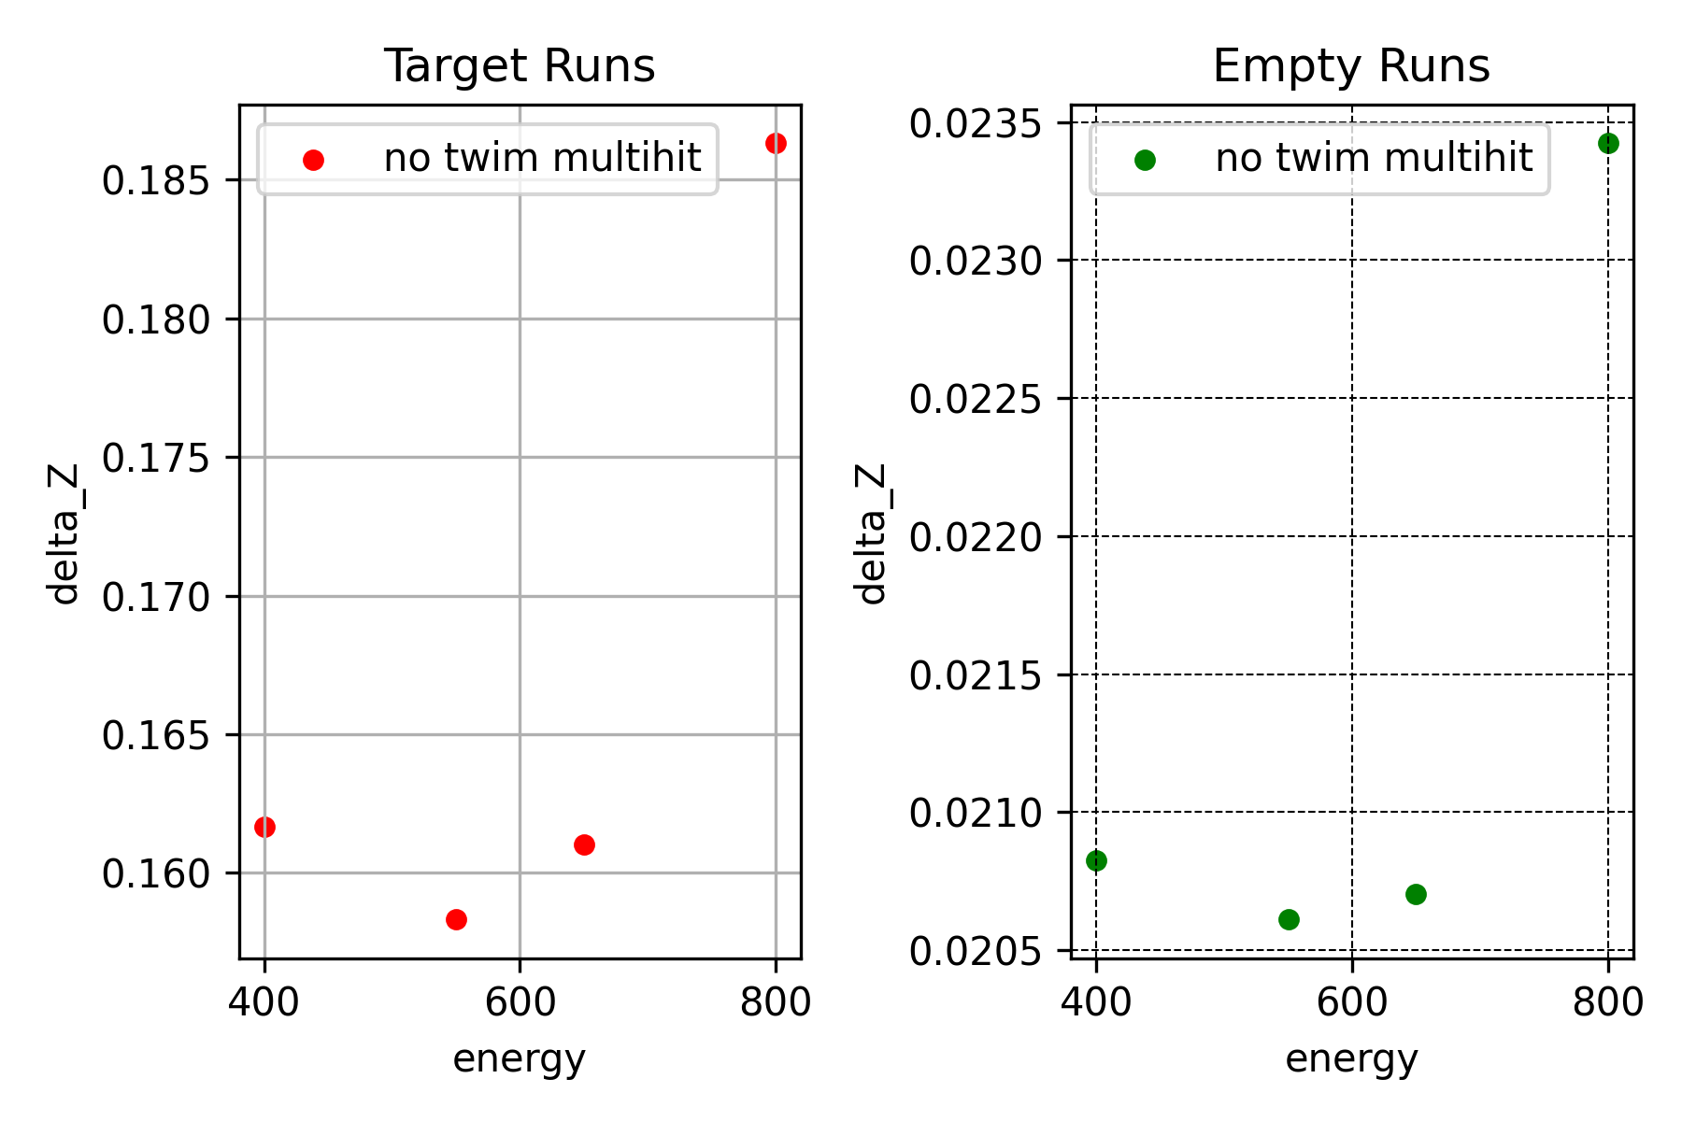
Cross Sections for different conditions
Now applying multiplicity cut on TWIM:
Only select events with no high multiplicity hits in TWIM anodes

Slide 9
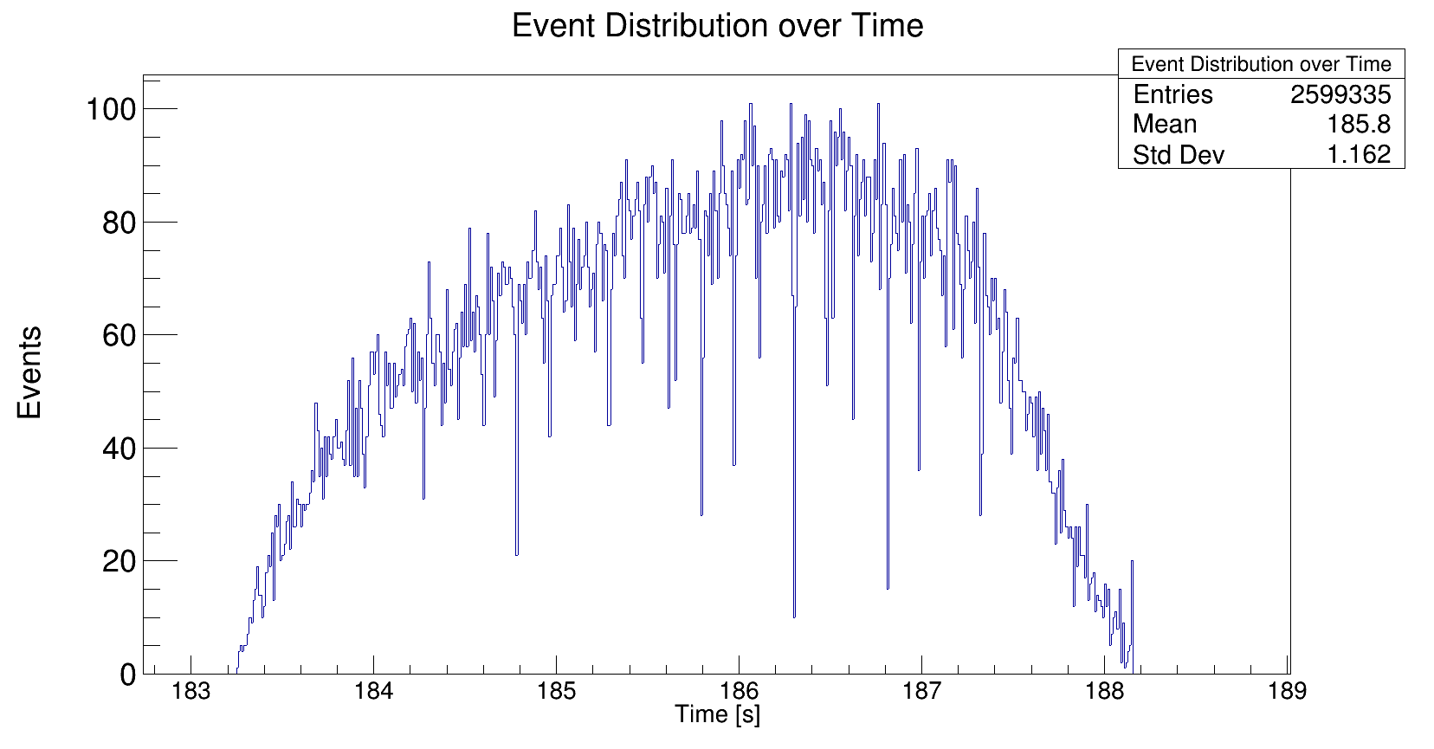
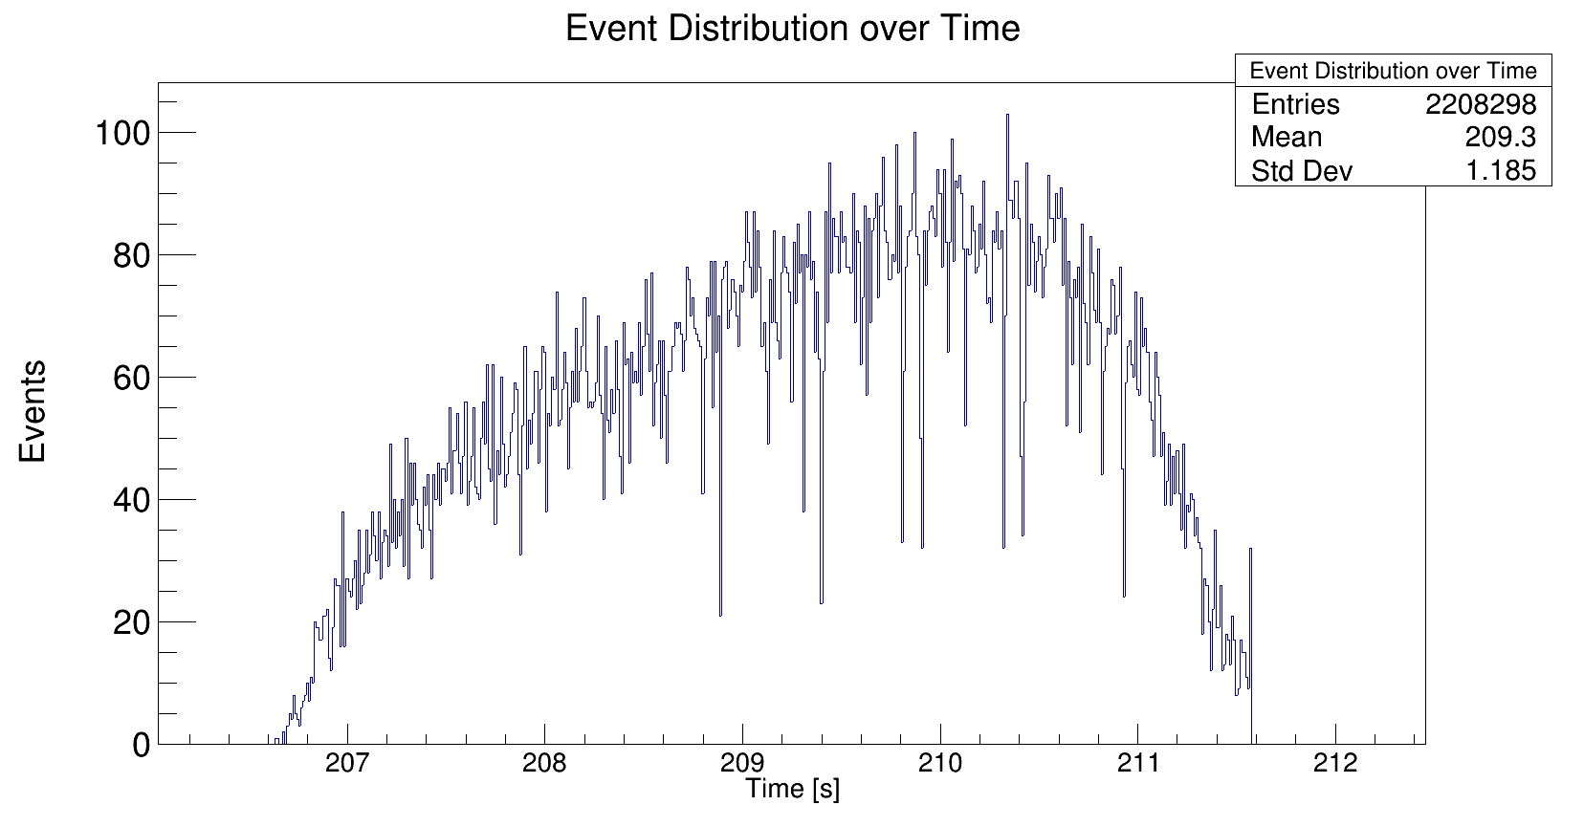
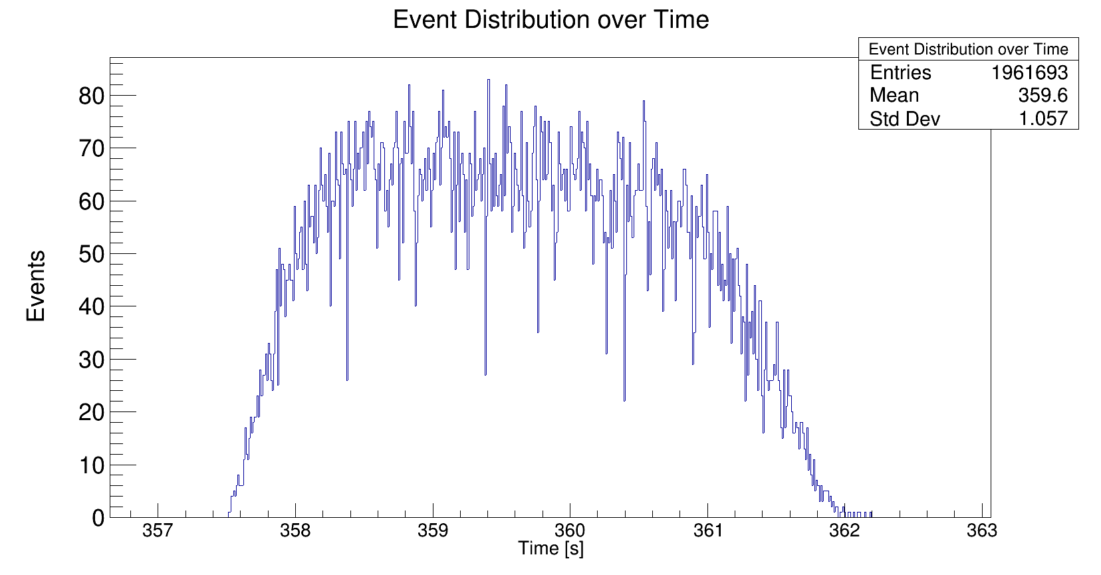
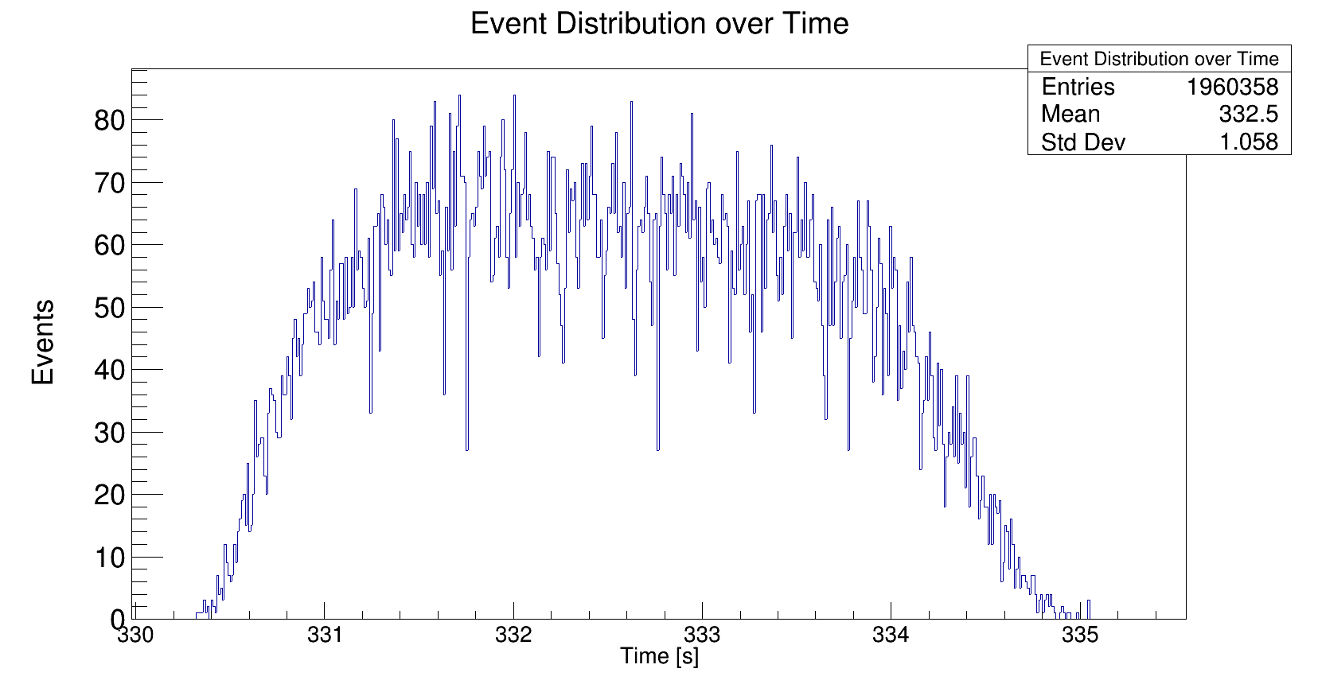
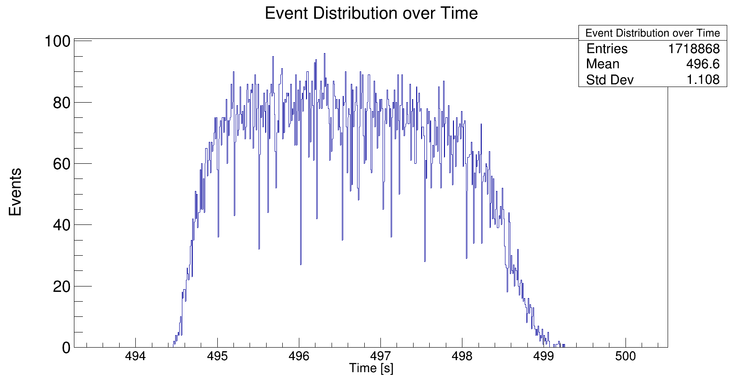
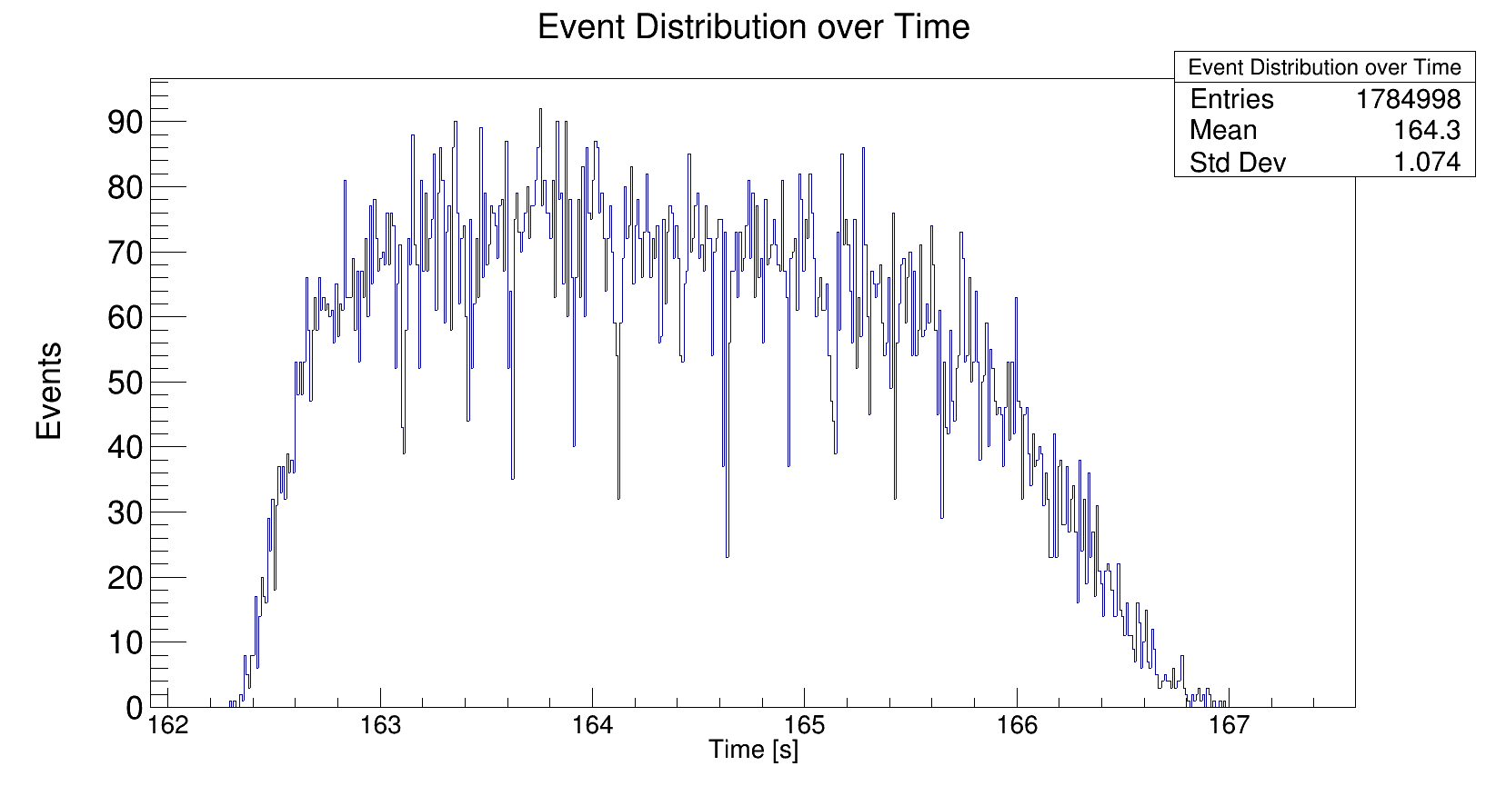
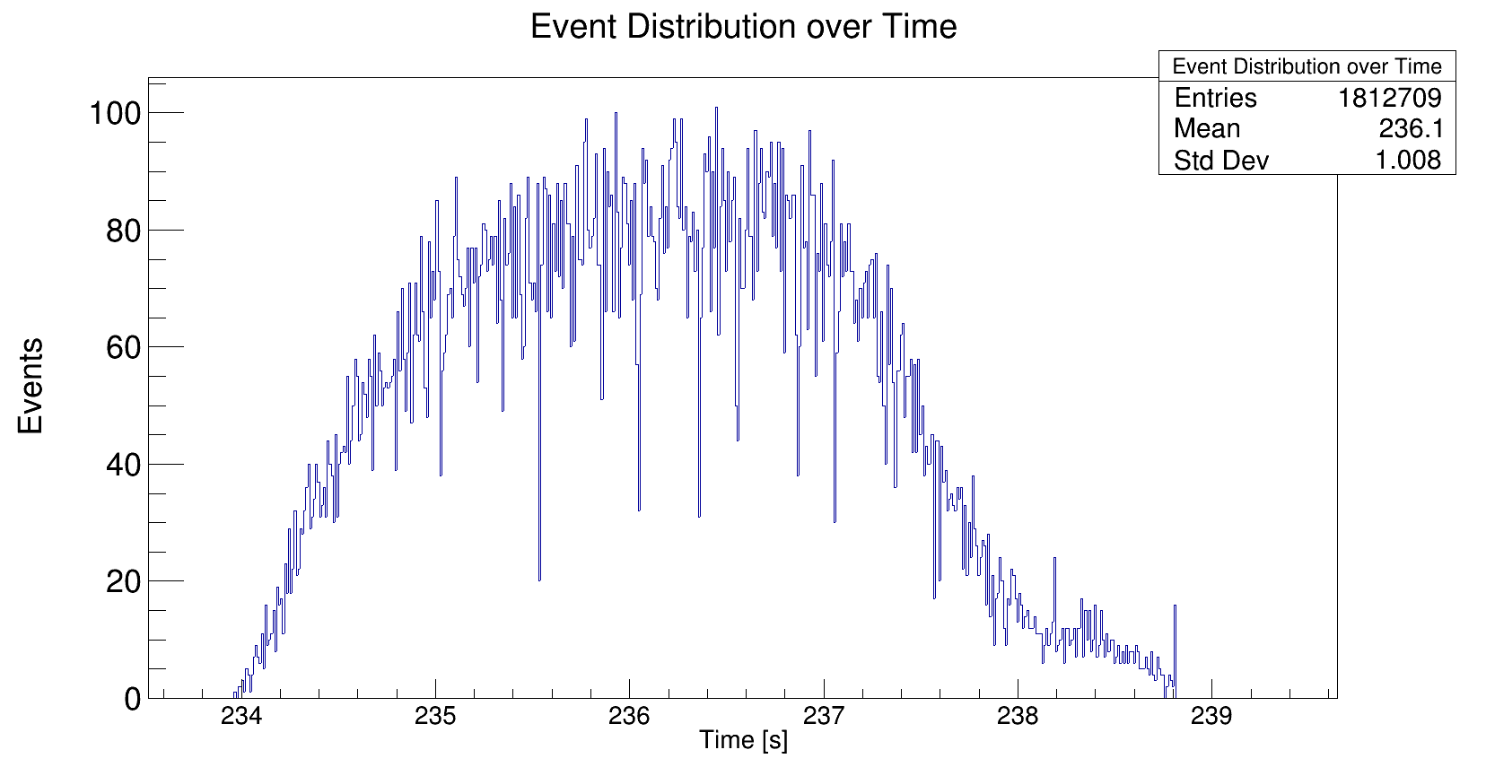
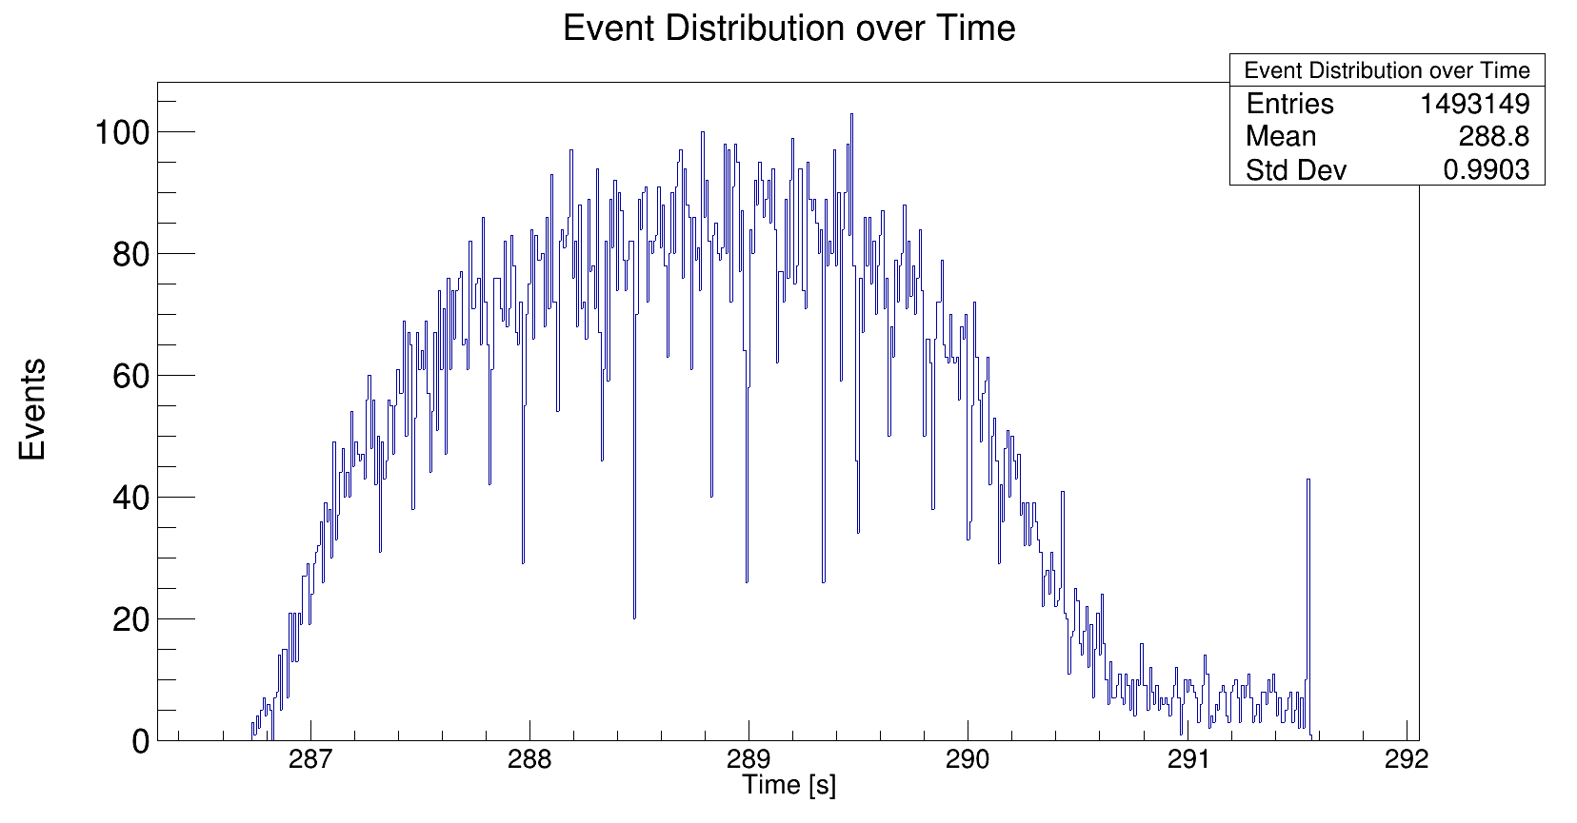
Shape of beam spills
400 AmeV carbon
400 AmeV empty
650 AmeV carbon
650 AmeV empty
550 AmeV carbon
550 AmeV empty
800 AmeV carbon
800 AmeV empty

Slide 10
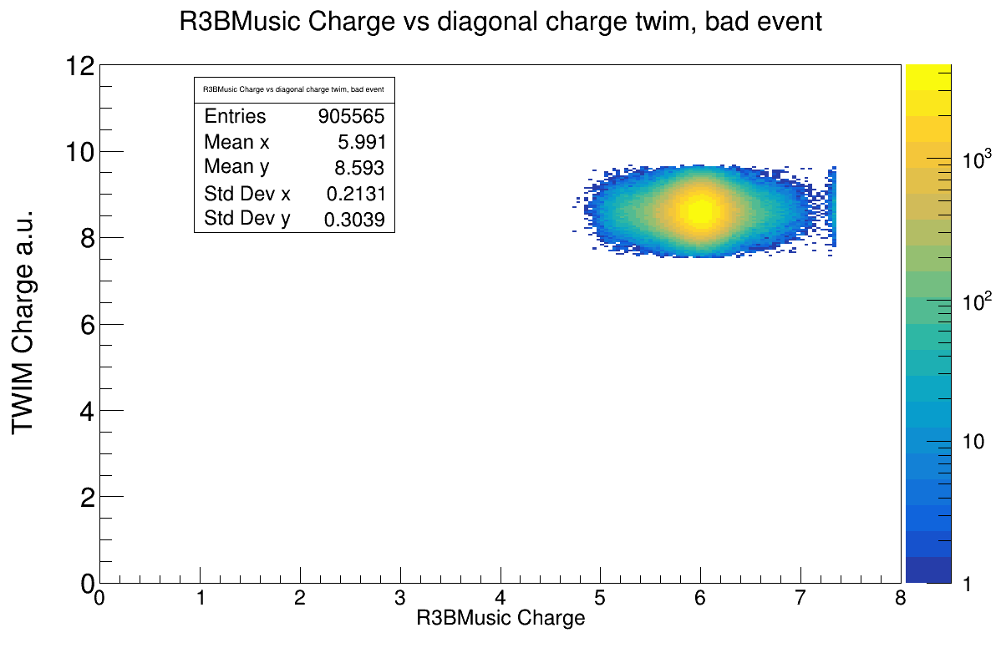
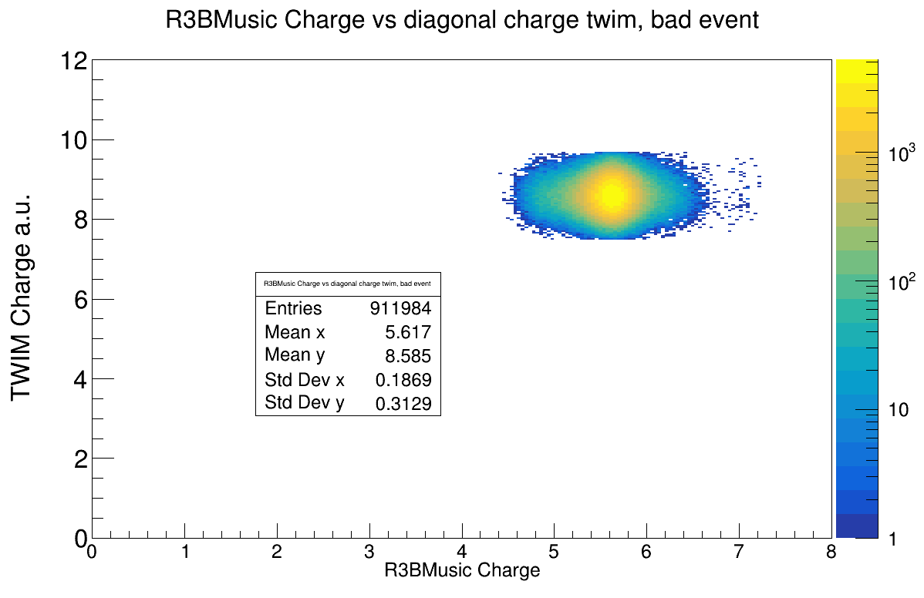
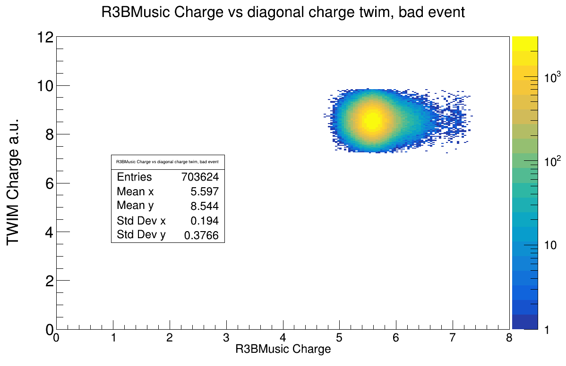
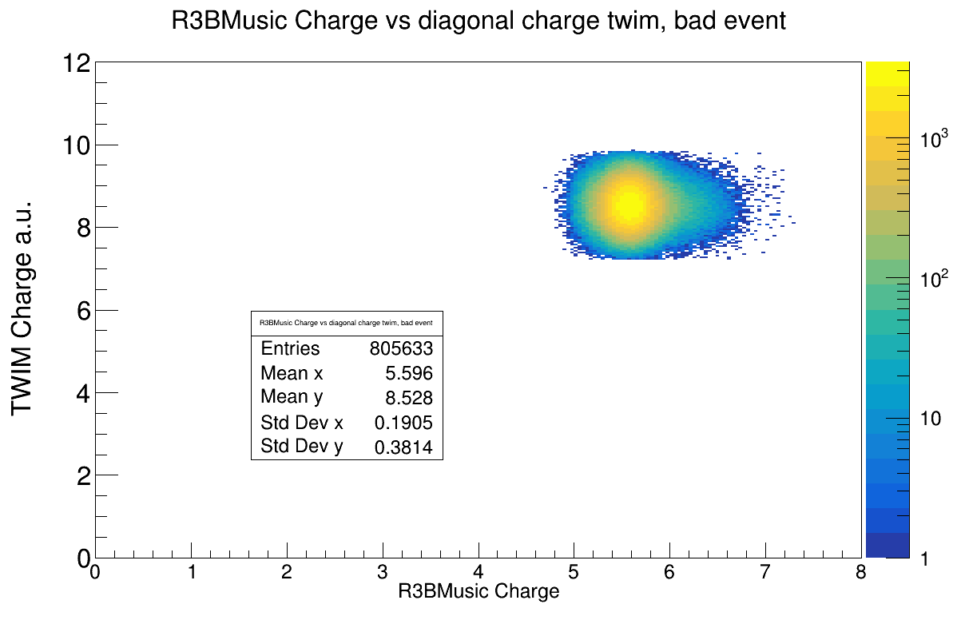




Applied cuts:
+-1sigma MW0 x-y
Charge cut = 6 in TWIM
R3BMusic vs Twim Charge
Carbon target, 400 AMeV
Empty target, 400 AMeV
Carbon target, 650 AMeV
Empty target, 650 AMeV
Carbon target, 550 AMeV
Emtpy target, 550 AMeV
Carbon target, 800 AMeV
Empty target, 800 AMeV

Slide 11








Efficiency of MW3 depening on MW2 x-position
400 AmeV carbon
400 AmeV empty
650 AmeV carbon
650 AmeV empty
550 AmeV carbon
550 AmeV empty
800 AmeV carbon
800 AmeV empty

Slide 12








Efficiency of MW2 depening on MW3 x-position
400 AmeV carbon
400 AmeV empty
650 AmeV carbon
650 AmeV empty
550 AmeV carbon
550 AmeV empty
800 AmeV carbon
800 AmeV empty

