Slide 1







Reaction Measurements on ¹²C at R³B
Tobias Jenegger
DPG Gießen 2024
R³B Experiment @FAIR
S444 - Detector Setup
¹²C Reaction Channels
Summary
Funded by the Deutsche Forschungsgemeinschaft (DFG, German Research Foundation)
under Germany’s Excellence Strategy – EXC-2094 – 390783311,
BMBF 05P19WOFN1, 05P21WOFN1
and the FAIR Phase-0 program
Roman Gernhäuser,Lukas Ponnath,Philipp Klenze,Tobias Jenegger

Slide 2
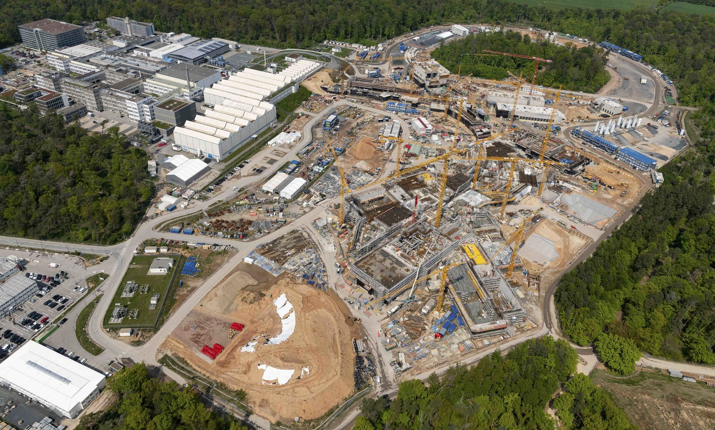
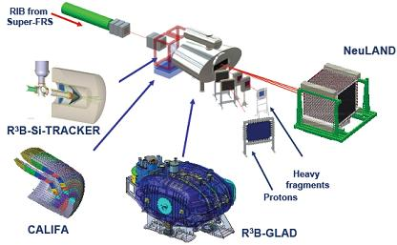
R³B Experiment at FAIR
R³B as part of the
Facility of Antiproton and Ion Research (FAIR) in Darmstadt
Reactions with Radioactive Relativistic Beams
Broad physics progam:
From investigation of the dynamics & structure of exotic nuclei to studies of astrophysical reactions

Slide 3
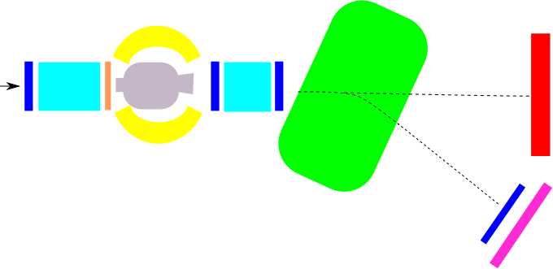
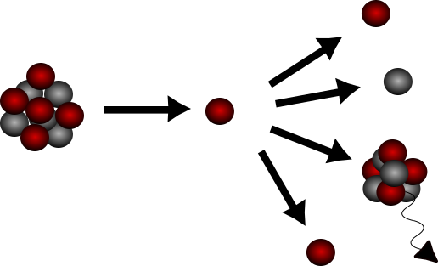
S444 Commissioning Experiment 2020
GLAD magnet
CALIFA
NeuLAND
R³B Music
MWPC1
beam
TWIM Music
MWPC0
START
MWPC2
MWPC3
Time of Flight Wall
Identification of incoming beam
Complete kinematic measurement of reaction channels
Measurement of γ/target-like particles
Beam energy: 400/550/650/800 AMeV
Projectile: ¹²C
Target: C and CH₂

Slide 4
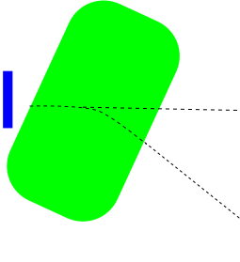
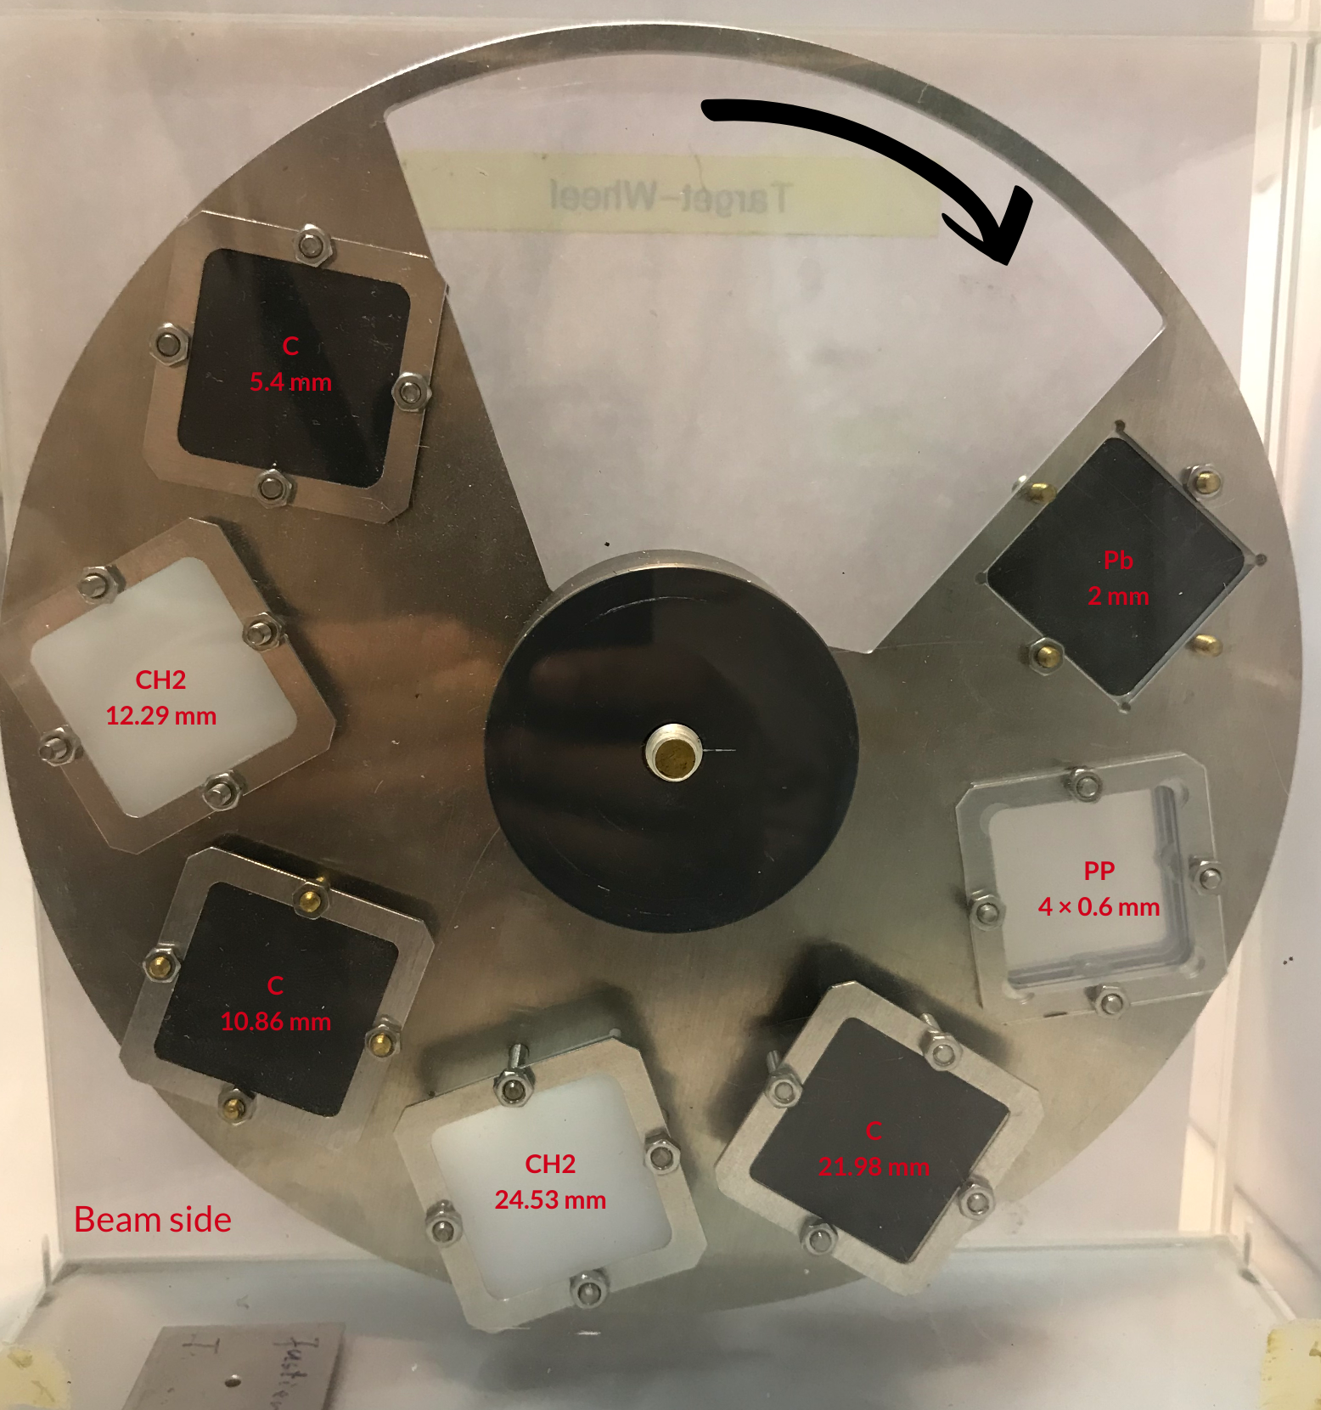
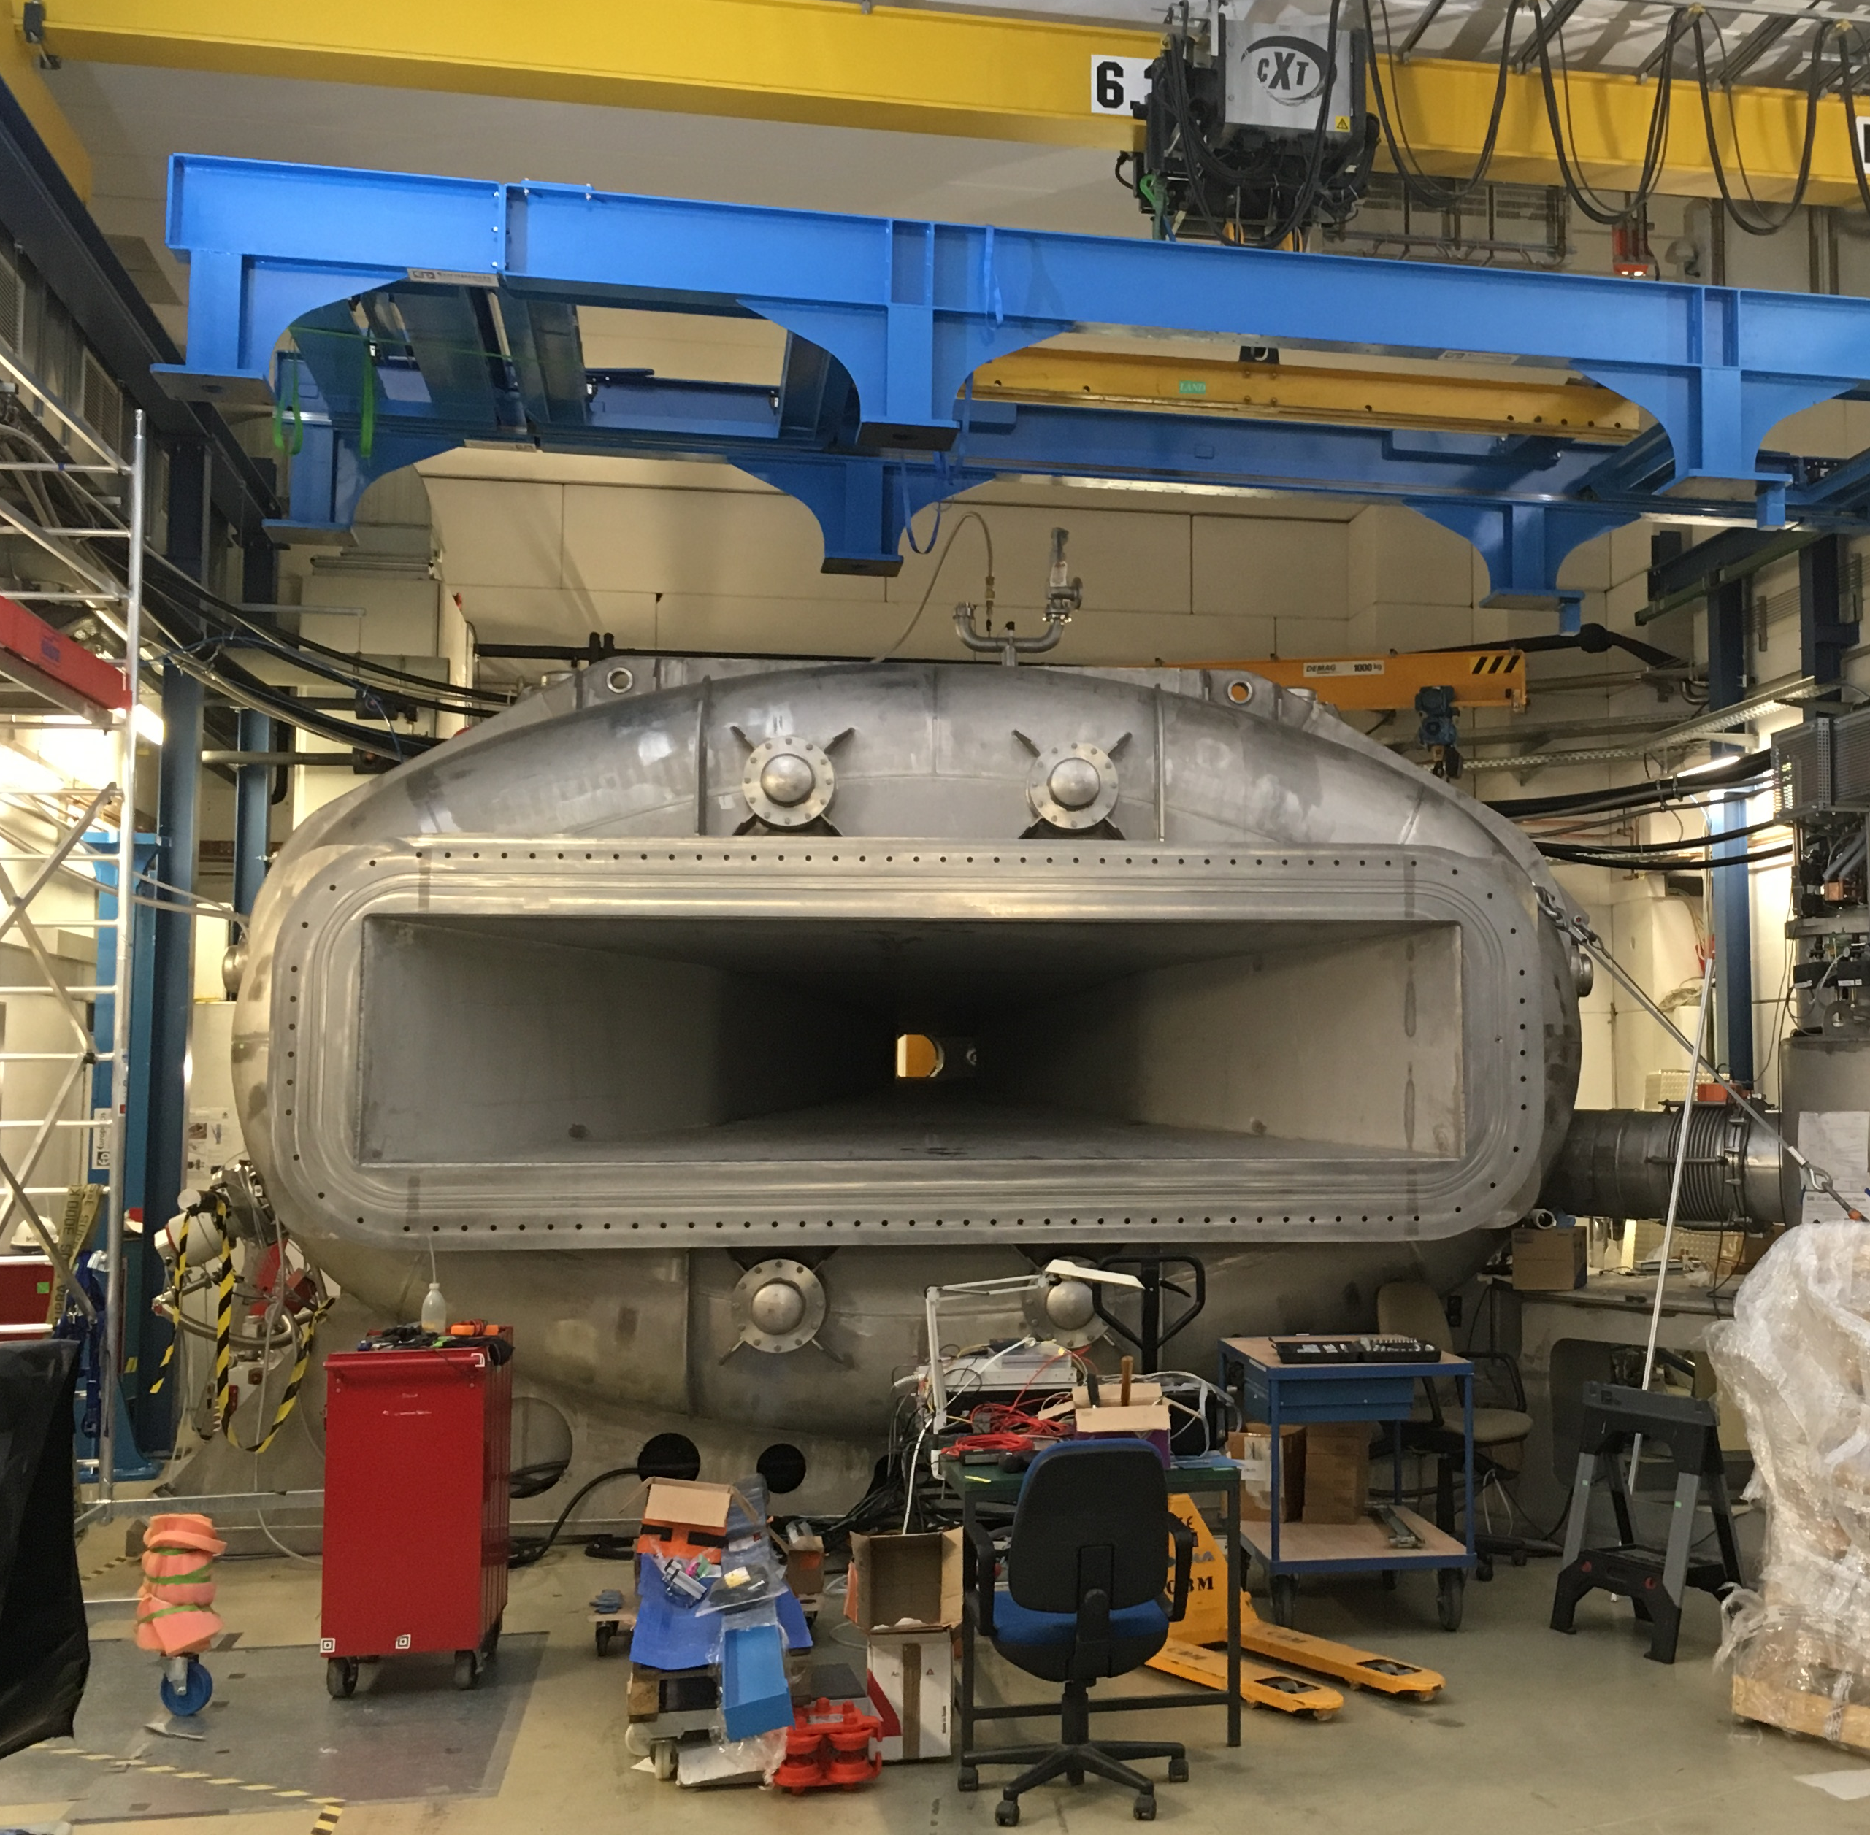
GLAD Superconducting Dipole Magnet … and the Targets
ion beam
reaction products
fragments
neutrons
target
charged fragments
Target Wheel:
→ C: 5.4 / 10.86 / 21.98 mm
→ CH₂: 12.29 / 24.53 / 24 mm
(Pb: 2 mm)

Slide 5
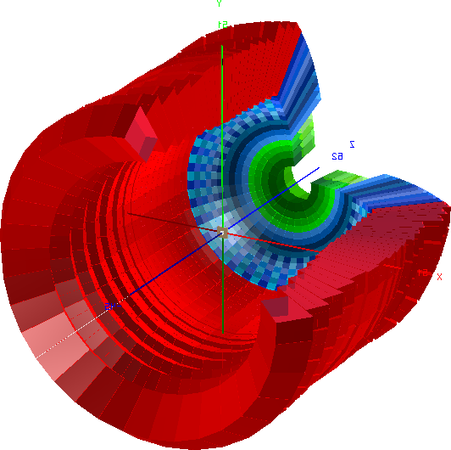
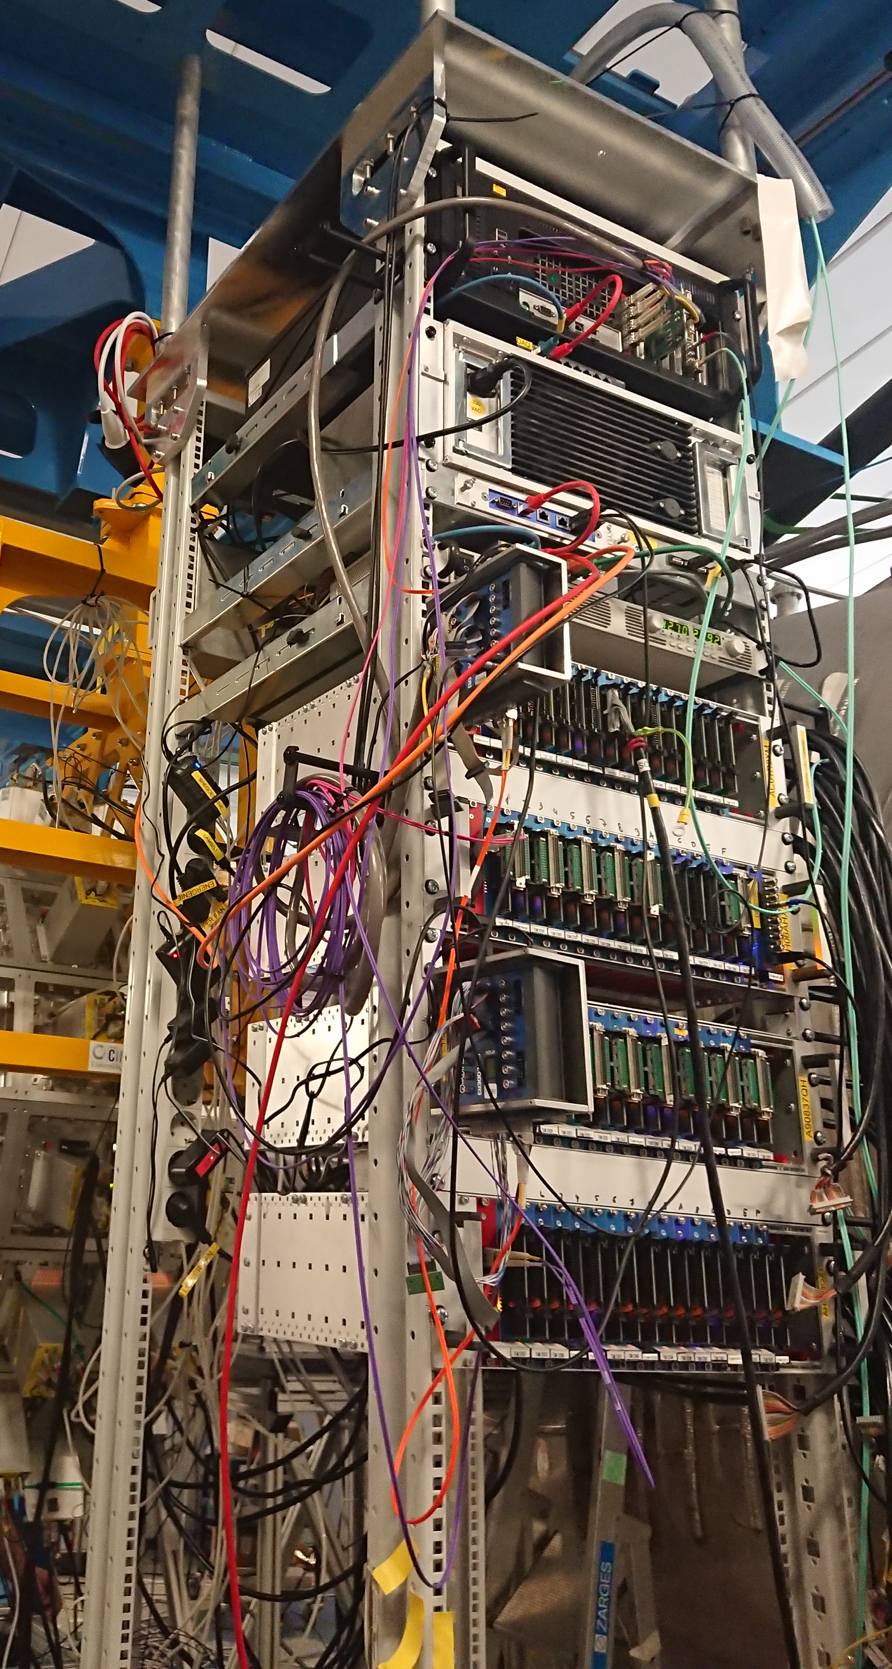
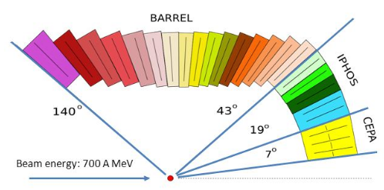
CALIFA -Detection of gammas an light charged particles
iPhos:
480 CsI(Tl) crystals
CEPA:
96 CsI(TI)
crystals
Highly segmented detector:
good angular reconstruction/
doppler correction
Broad calorimetric energy measurements:
From 100 keV γ-rays up to high energetic charged particles
Flexible running mode:
self/external triggering mode
Barrel:
1952 CsI(Tl) crystals
BEAM
dead-time free DAQ
time synchronized via the global White Rabbit time stamping system
beam

Slide 6
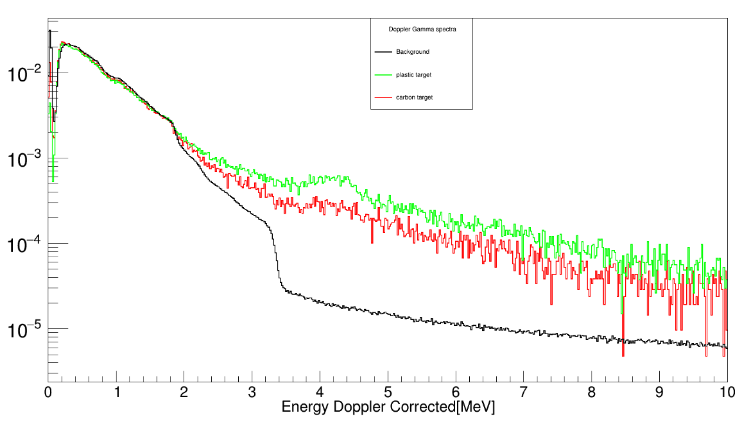
Reaction Processes ¹²C + ¹²C / CH₂
Contributions to the total reaction cross section:
Projectile is excited to bound state. No nucleon is removed
is small at high beam energies & suppressed due to Pauli blocking
4.4 MeV ¹²C first excited state
- CH₂ target
- C target
- background

Slide 7
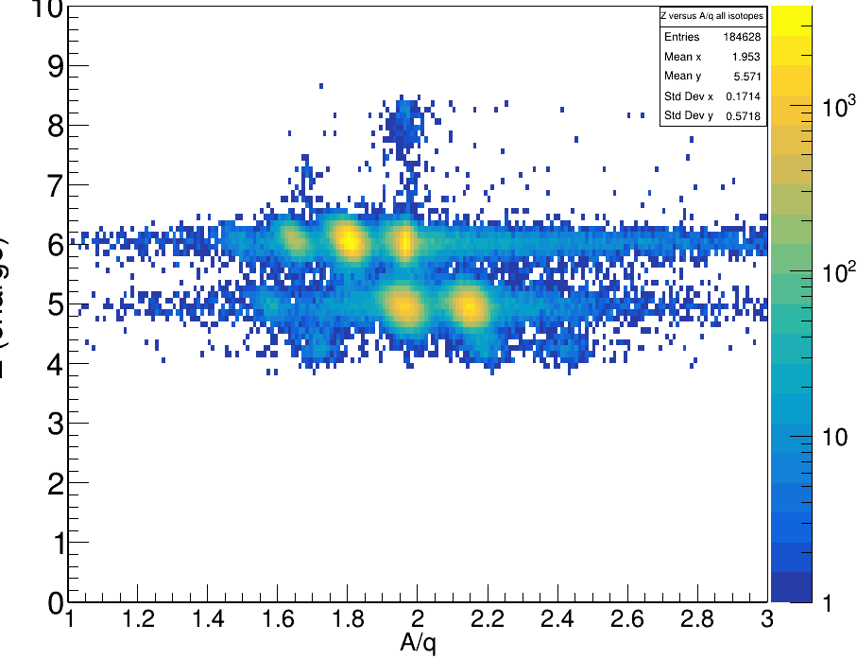
Reaction Processes ¹²C + ¹²C / CH₂
p
Interaction Cross Section
¹²C / CH₂
Projectile changes its identity.
At least one nucleon is removed.
n
¹²C
non-interacted 12C projectile
Z (TWIM)

Slide 8
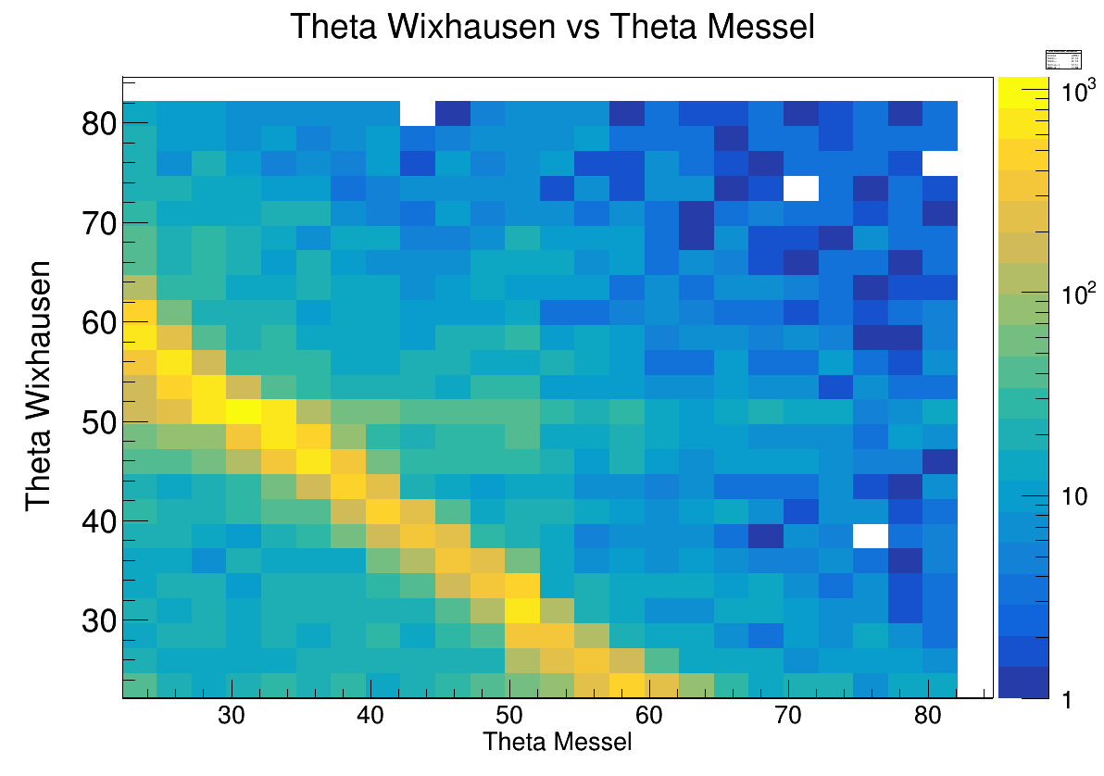
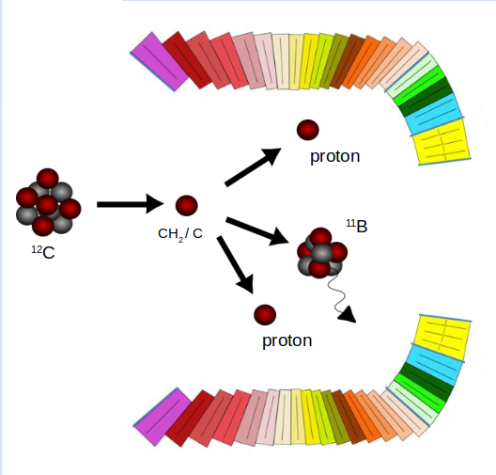
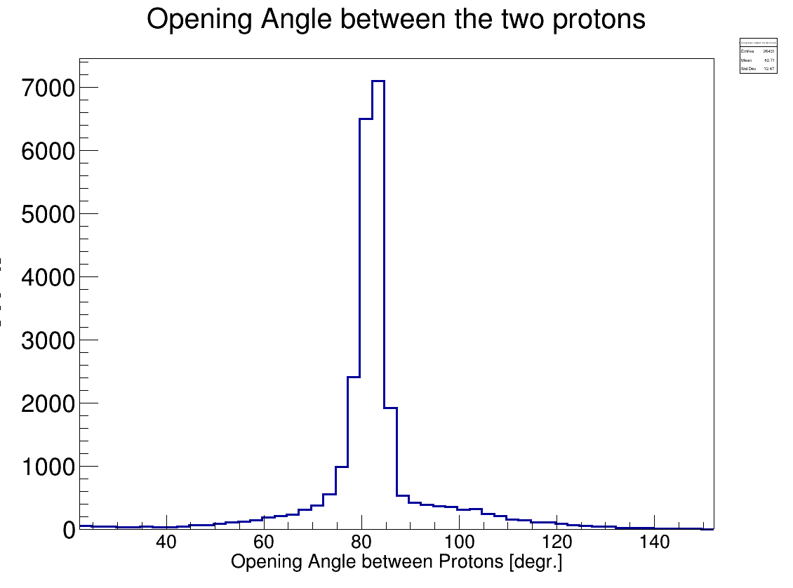
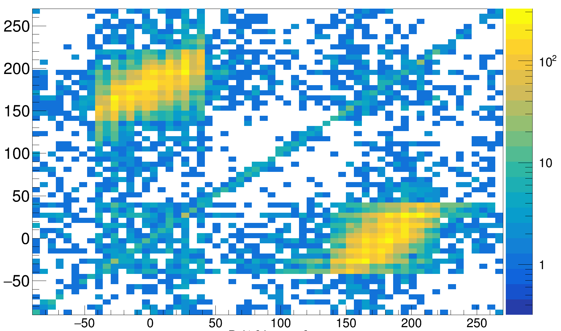
Access to quasi-free scattering (p,2p) reactions with CALIFA
Assumption:
Two body scattering can be approximated by the identical process for free particles
¹¹B acts only as spectator
¹²C(p,2p)¹¹B
CH₂
Δφ = 180°
φ₂[degrees]
Opening Angle between Protons [°]
Qfs- reactions give access to single particle properties inside nucleus
φ₁[degrees]

Slide 9
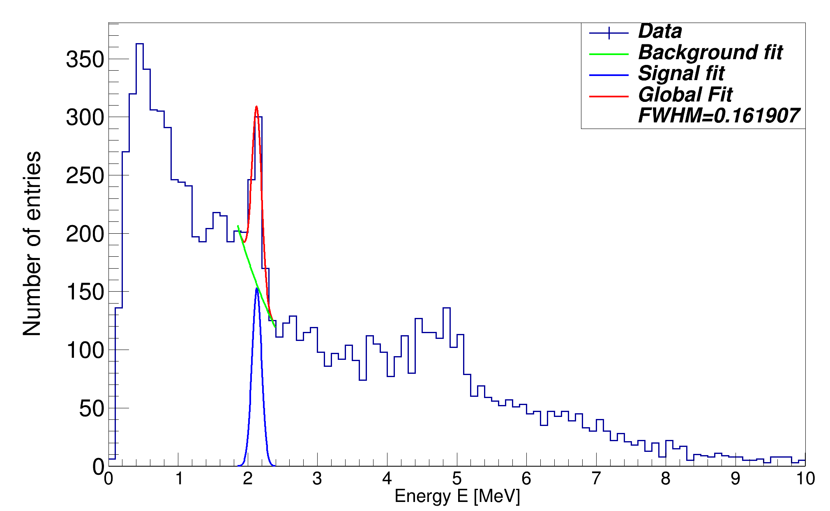
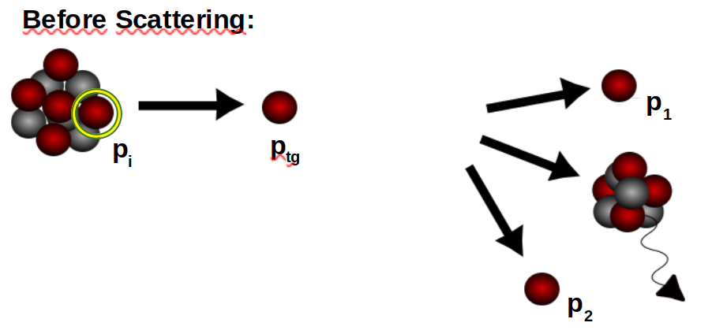
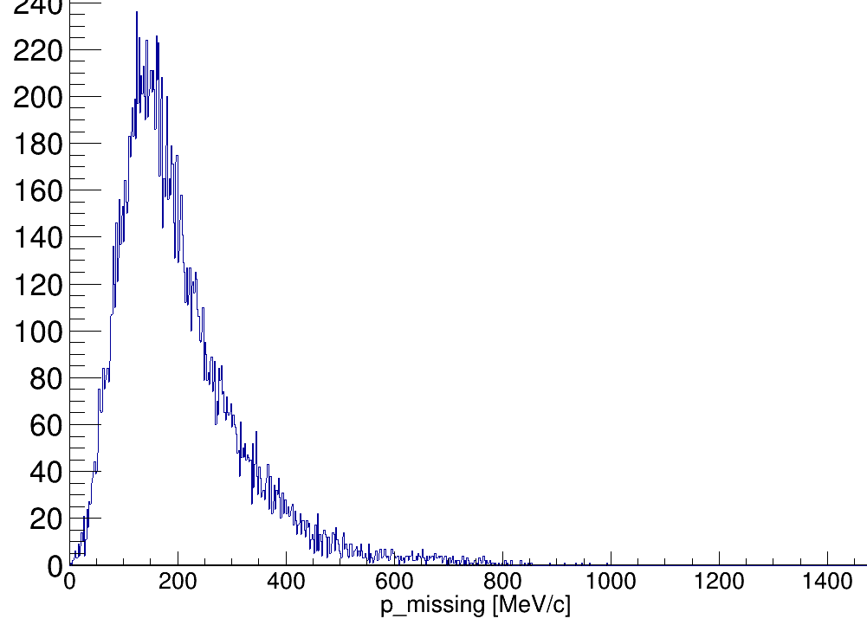
Quasi-Free Scattering – Single Particle Nuclear States
Reconstruction of Inner Momenta:
Doppler Corrected Gamma Spectrum
1/2 ⁻
(Four-)Momentum conservation relation:
assuming QE scattering in mean field potential:
3/2 ⁻
After Scattering:
Event Selection Criteria:
¹¹B fragment identification
Two hits (protons) with E_{hit} > 30 MeV
θ1 + θ2 < 90°
Δφ = 180° +- 40°
nucleon momentum inside ¹²C

Slide 10
Cross Section Measurement ¹²C + ¹²C
Survived projectiles N2 :
N₁
N₂
Correct for reactions inside exp. setup
reactions Inside setup
N₂ for charge changing cross section
N₂ for total reaction cross section
Z (TWIM)
Z (TWIM)
N_{t}:
#scattering centers
volume

Slide 11
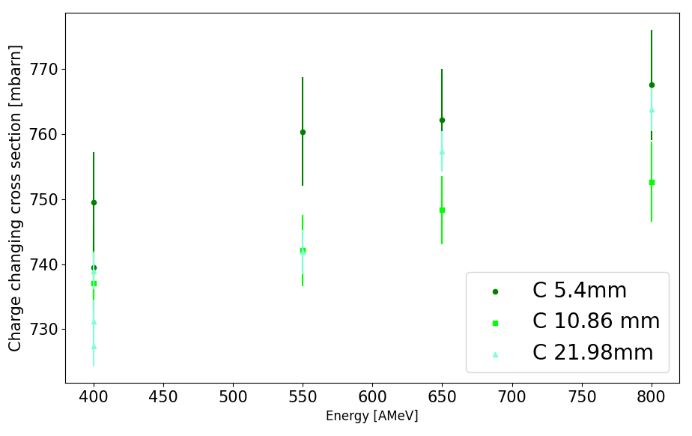
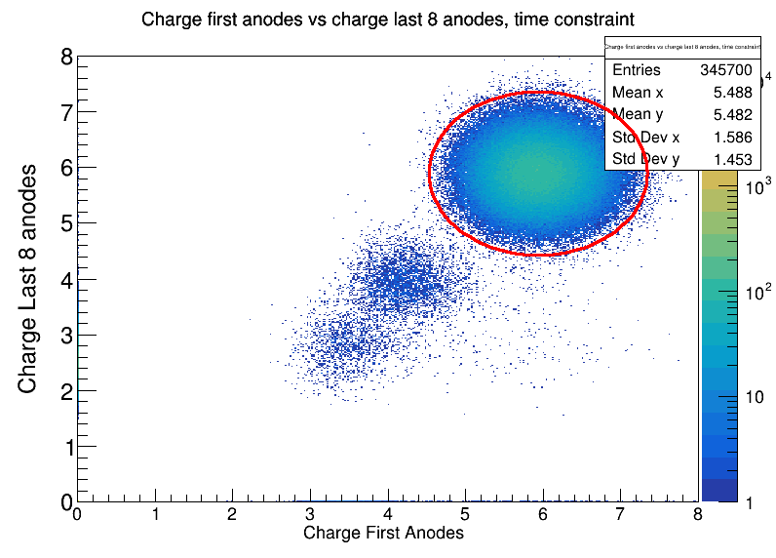
Charge Changing Cross Section ¹²C + ¹²C
¹²C + ¹²C
N1
N2
preliminary
target
+-3.5 sigma
*statistical error-bars only

Slide 12
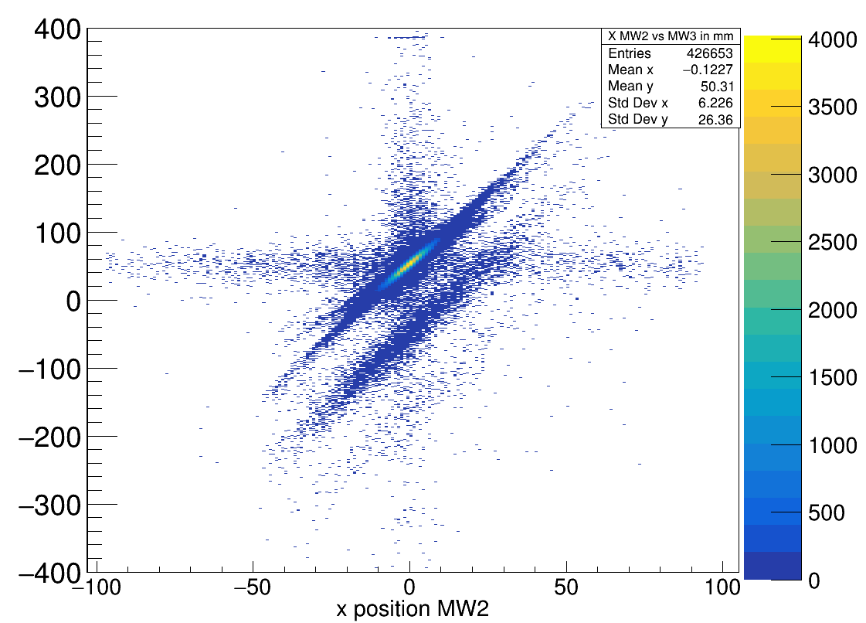
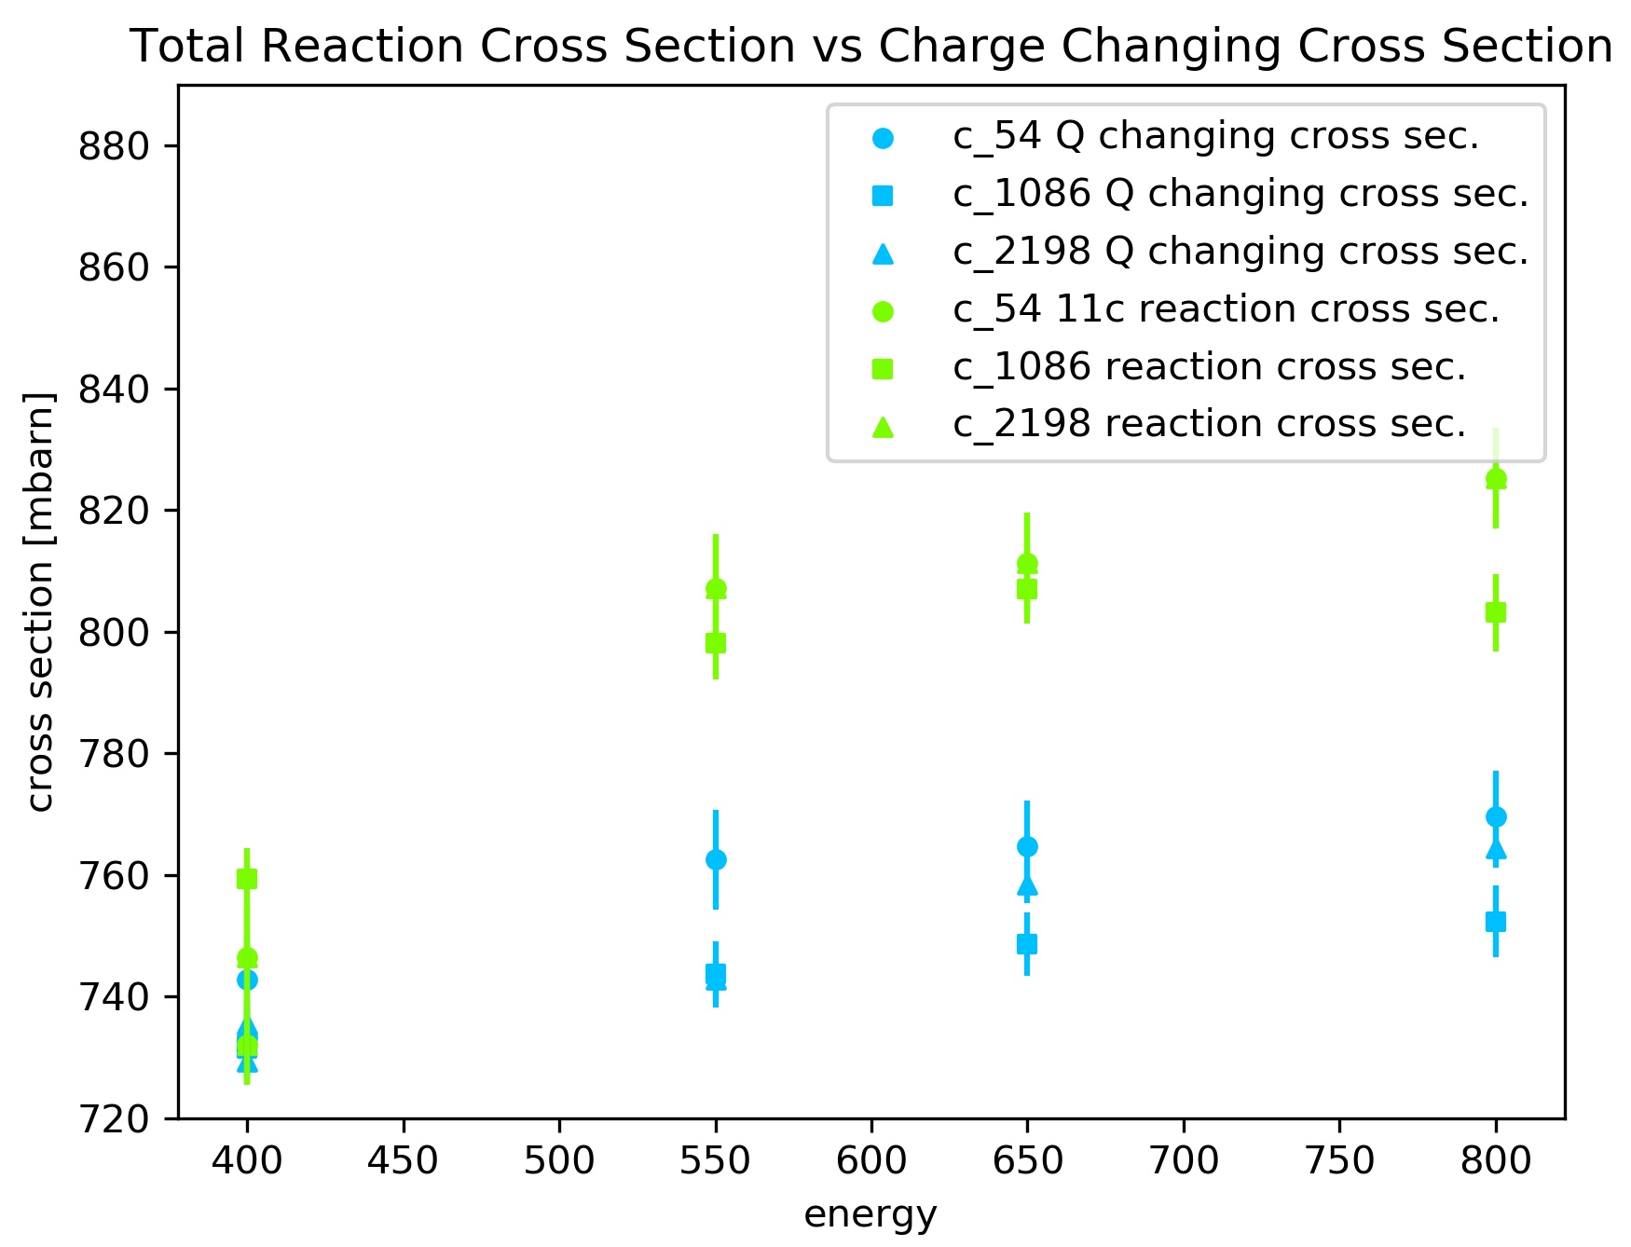
Total Reaction Cross Section ¹²C + ¹²C
+-3.5 sigma
MW2
x position MW3
N1
N2
MW3
target
preliminary

Slide 13
Summary & Outlook
4.4 MeV ¹²C first excited state
- CH₂ target
- C target
- background
Quasi-free scattering 12C(p,2p)11B reaction
Doppler Corrected Gamma Spectrum

Slide 14



CALIFA @ Technical University of Munich (TUM)
Roman Gernhäuser, Lukas Ponnath, Philipp Klenze, Tobias Jenegger
Thank you!

Slide 15
BACKUP

Slide 16
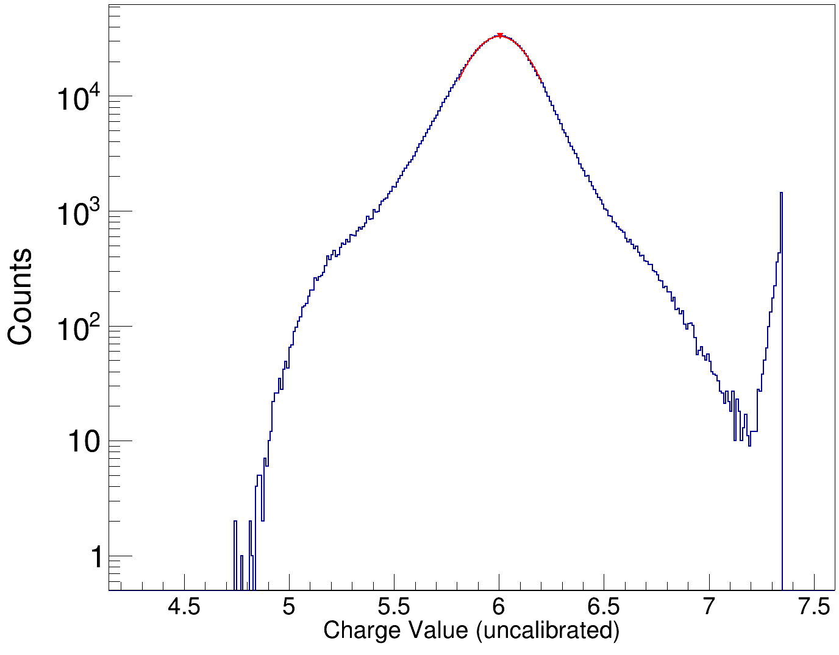
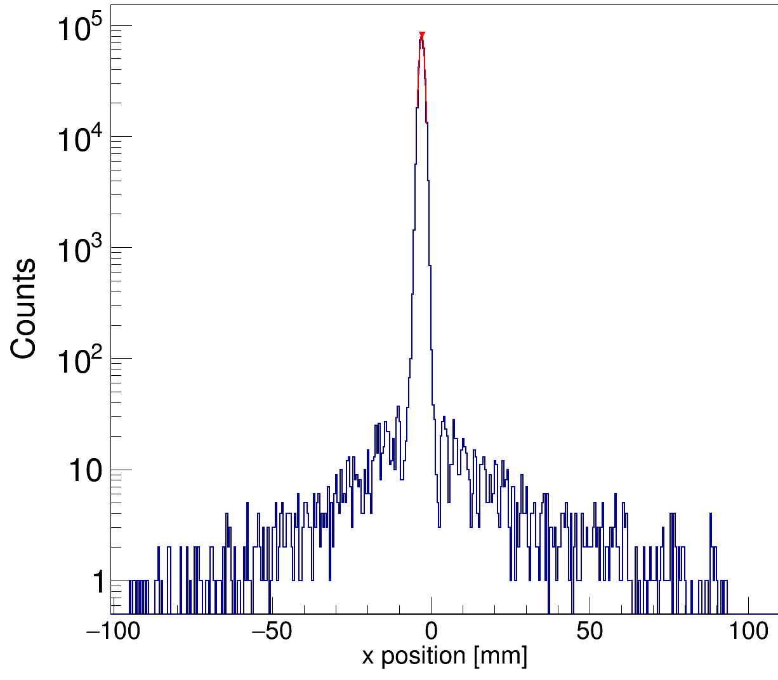
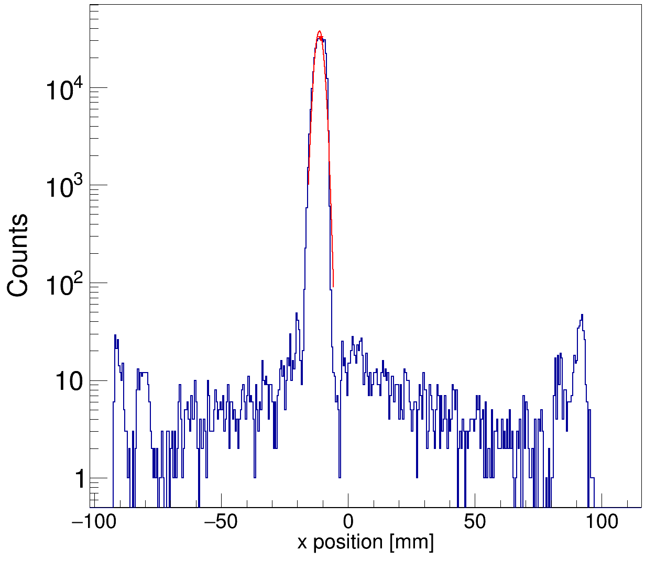
Incoming Ions – Event Selection
Strict cuts in front of the target:
N1
N2
MW0: x-pos. cut
MW0: y-pos. cut
target
+- 2 sigma
+-sigma
+-sigma
N1
N2
target
R3BMusic Charge Cut
y position [mm]

