Slide 1
S444 analysis -update 4
11.09.2024

Slide 2
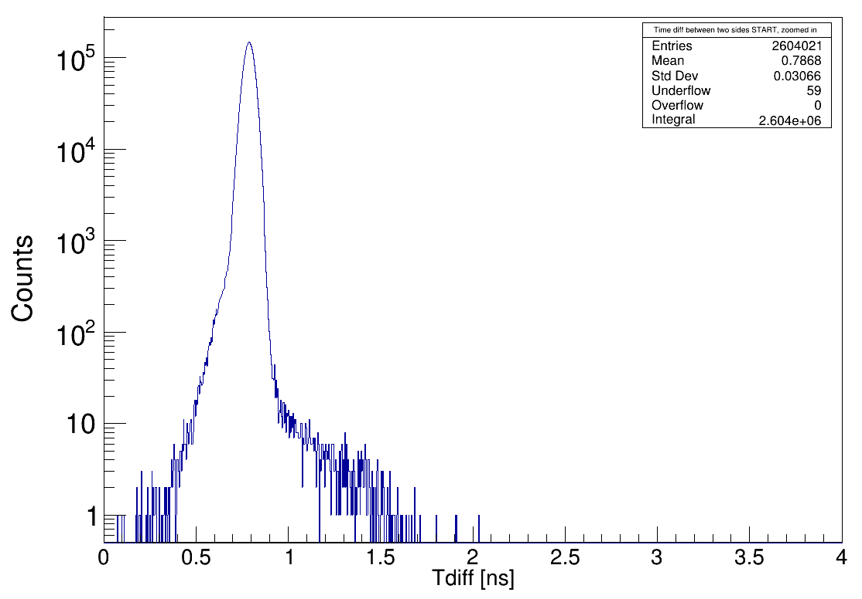
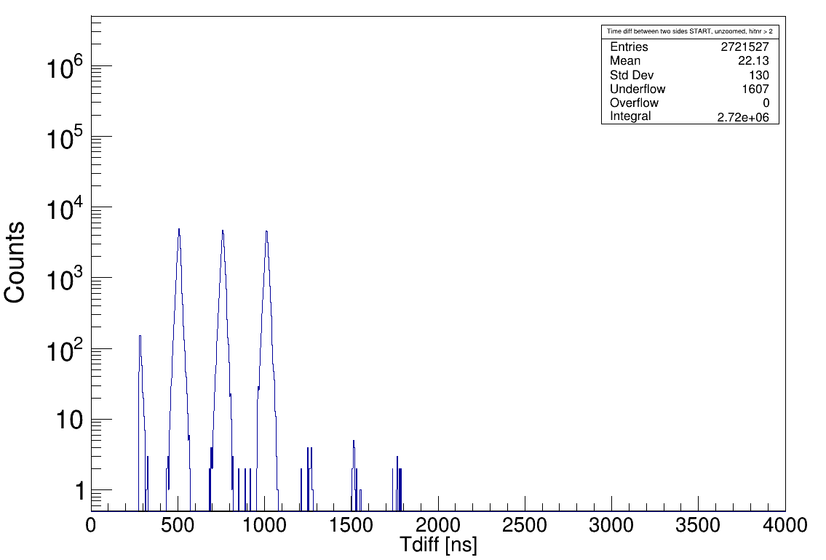
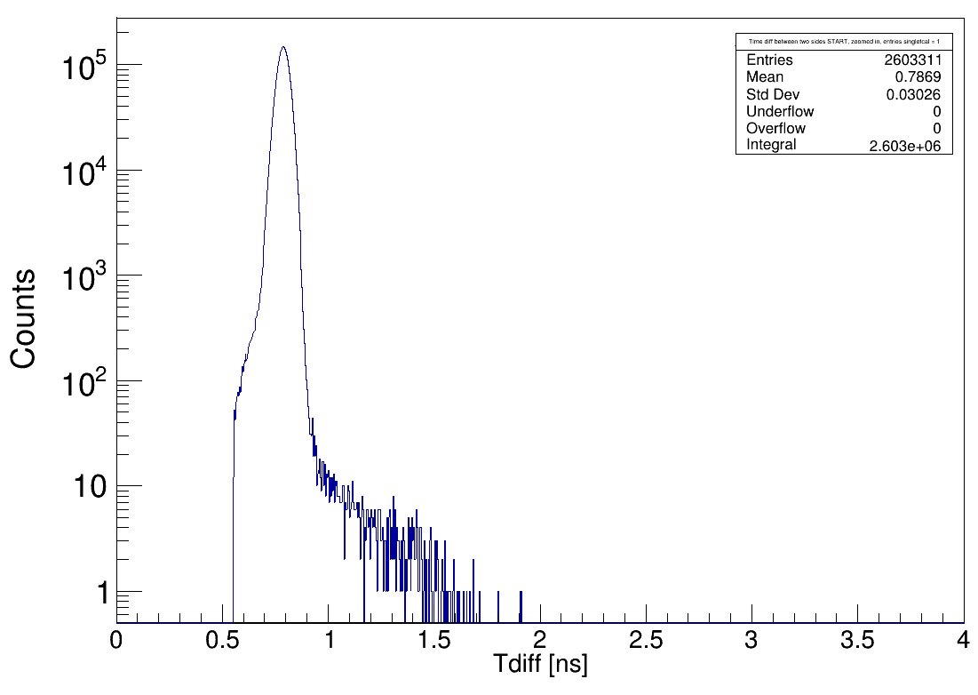
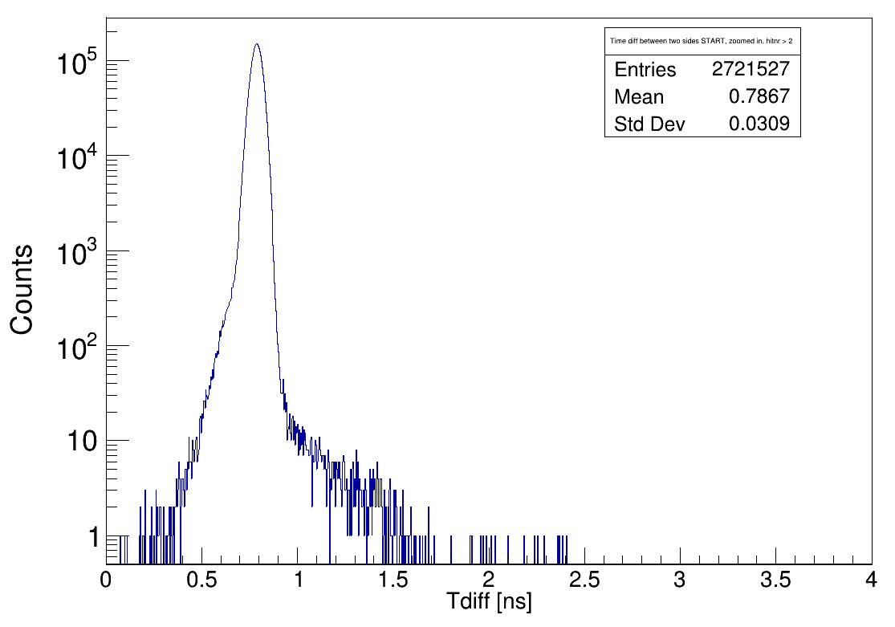
Start Detector
Multi-hit-capable, 2 PMTs,left,right
Cut:
iTraw[iDet * nChs + iCh][mult[iDet * nChs + iCh]] = hit→GetRawTimeNs();
// RawPos = TrawRIGHT - TrawLEFT corresponds to x increasing from RIGHT to LEFT
iRawPos = iTraw[0][multR] – iTraw[1][multL];
if (iRawPos < fRawPosPar->GetParam(0))
continue;
if (iRawPos > fRawPosPar->GetParam(1))
Hitnr = 2
Hitnr > 2
Going to singleTcal level
(making constrain to t_diff)
Between 0.555 and 1.946
zoom in

Slide 3
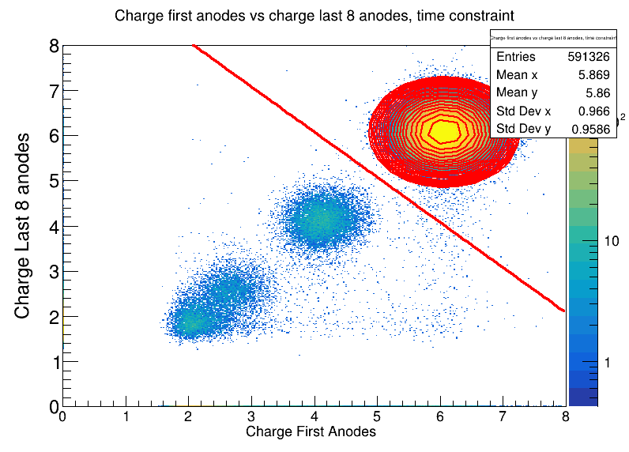
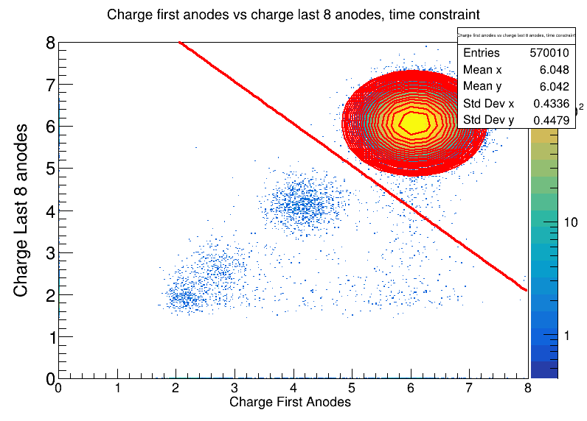
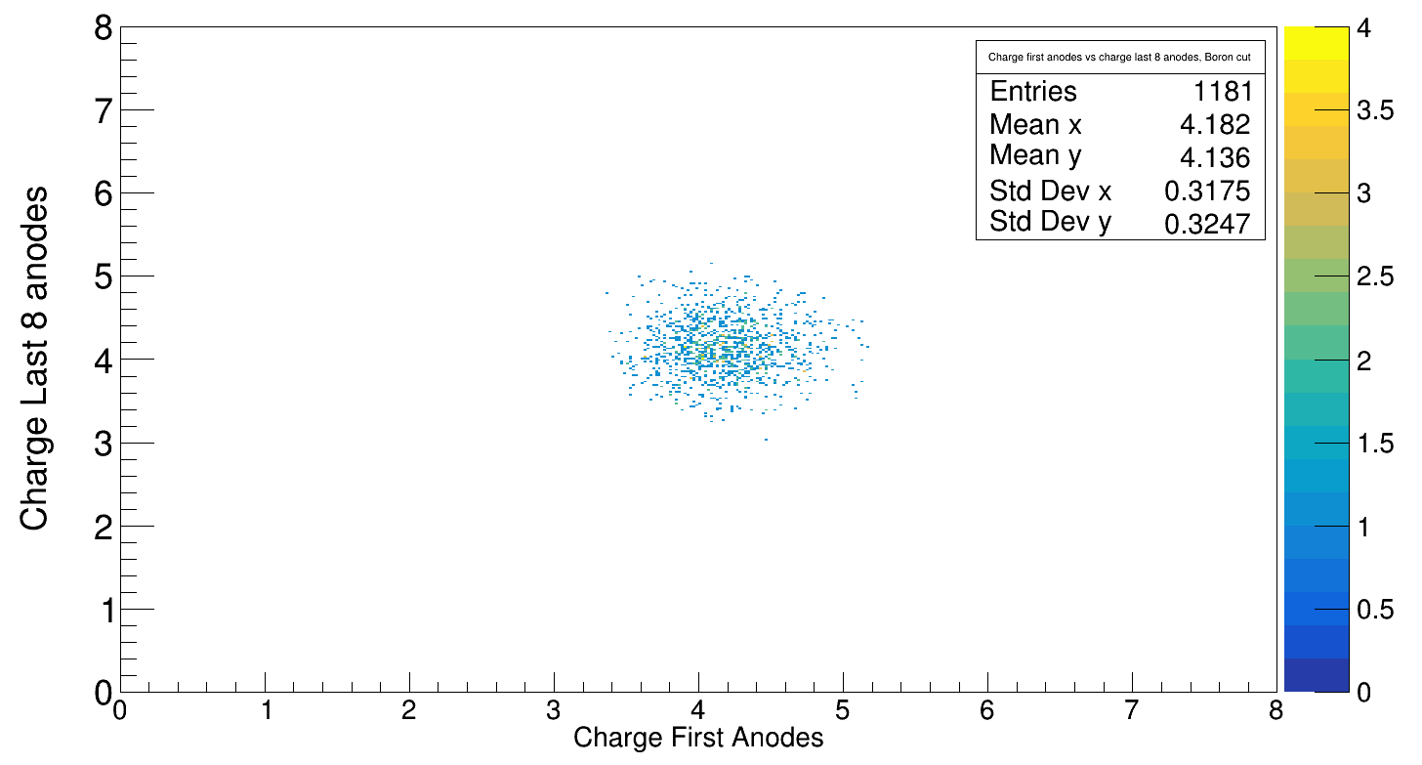
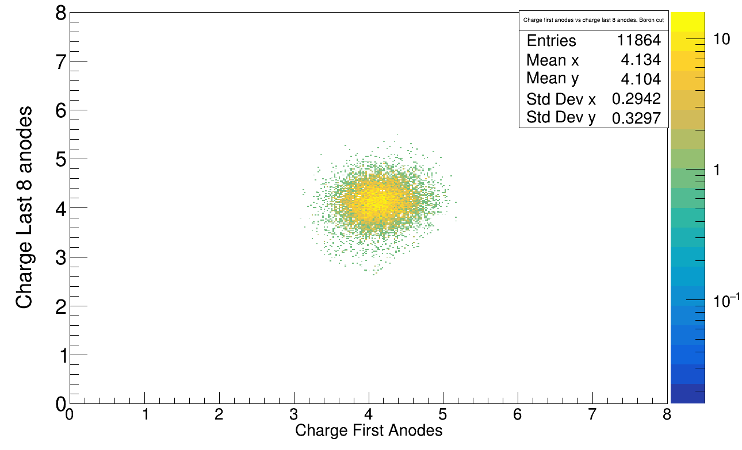
Reaction cross section Z → 5 (Boron)
400 AMeV
Empty
Target

Slide 4
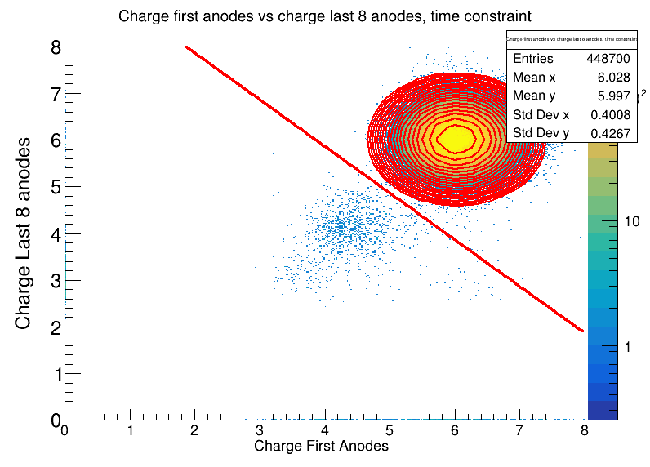
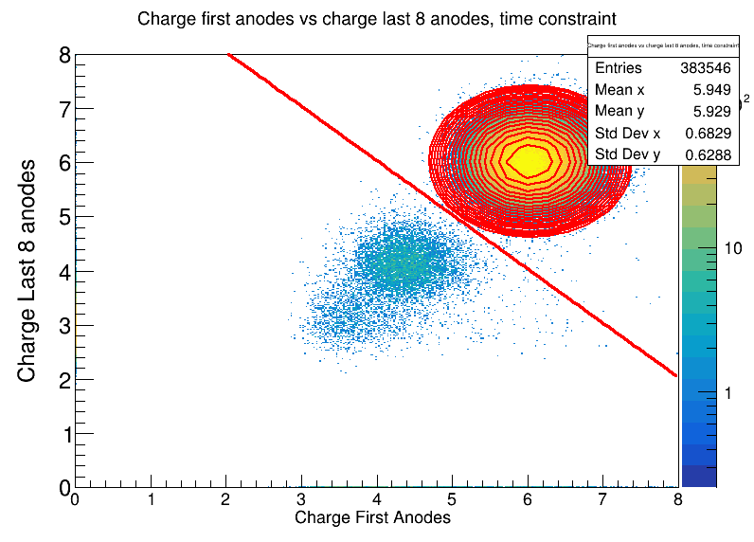
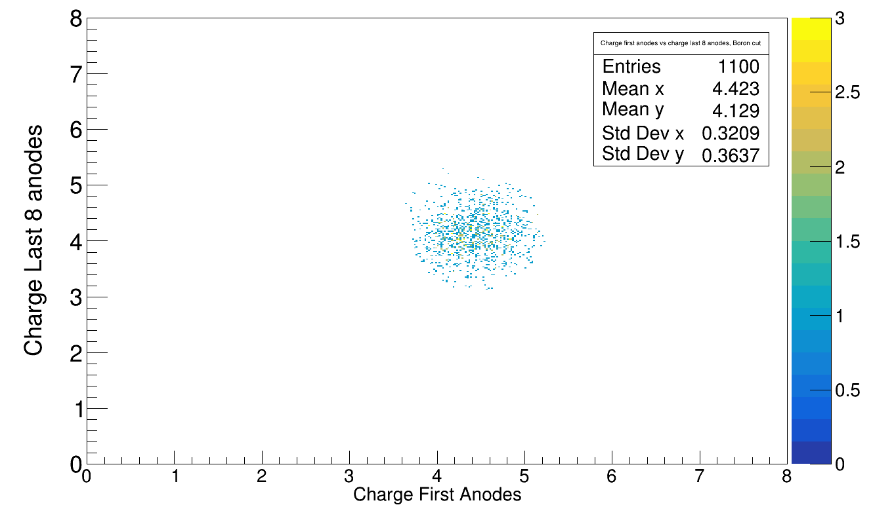
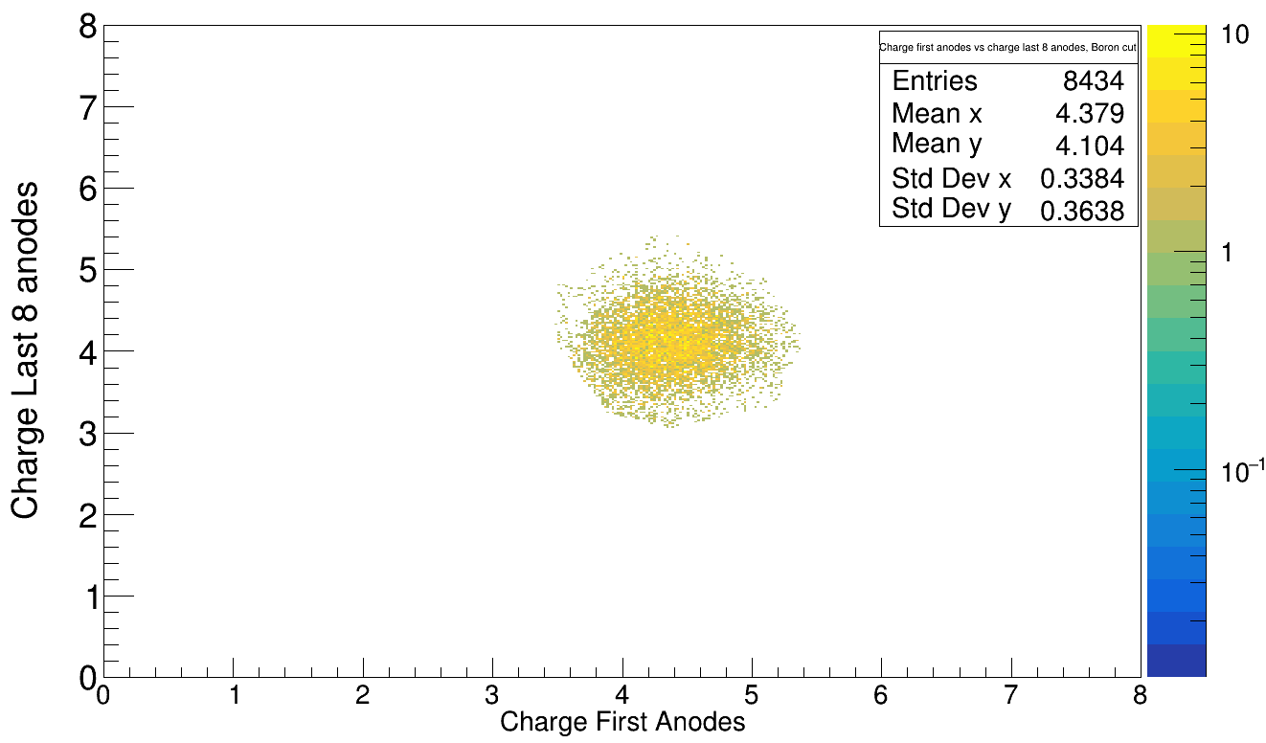
550 AMeV
Target
Empty

Slide 5
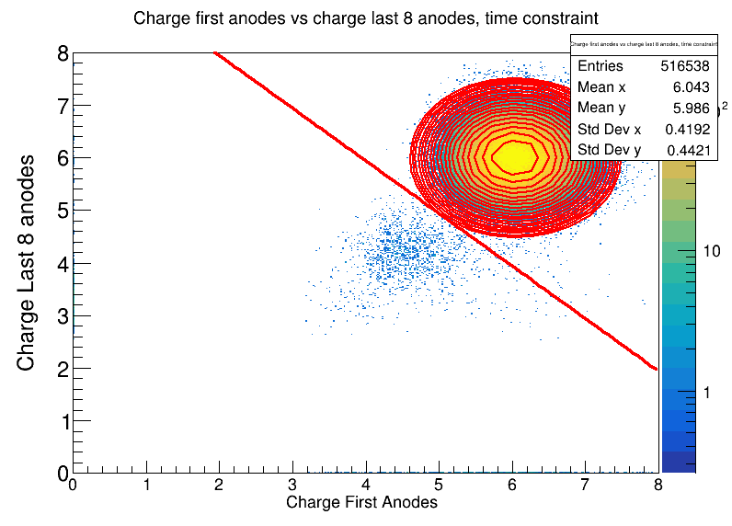
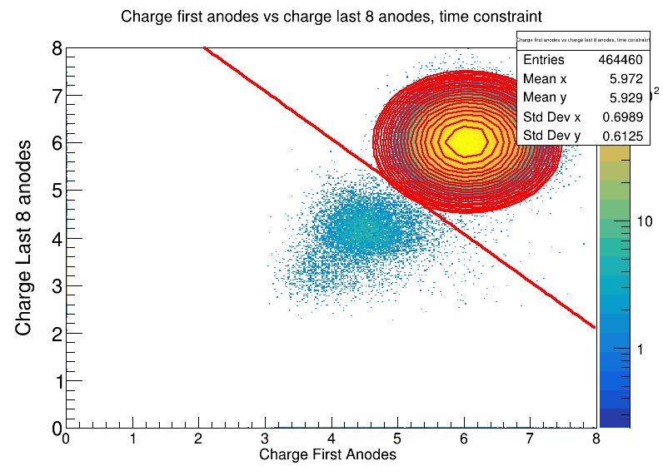
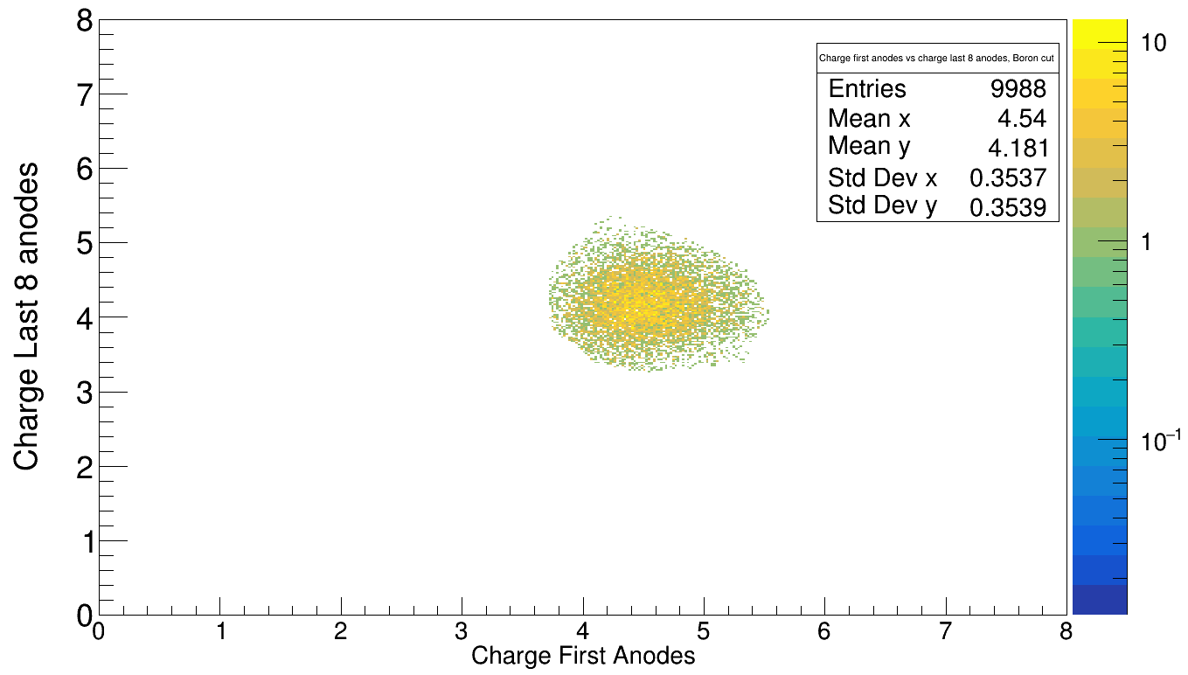
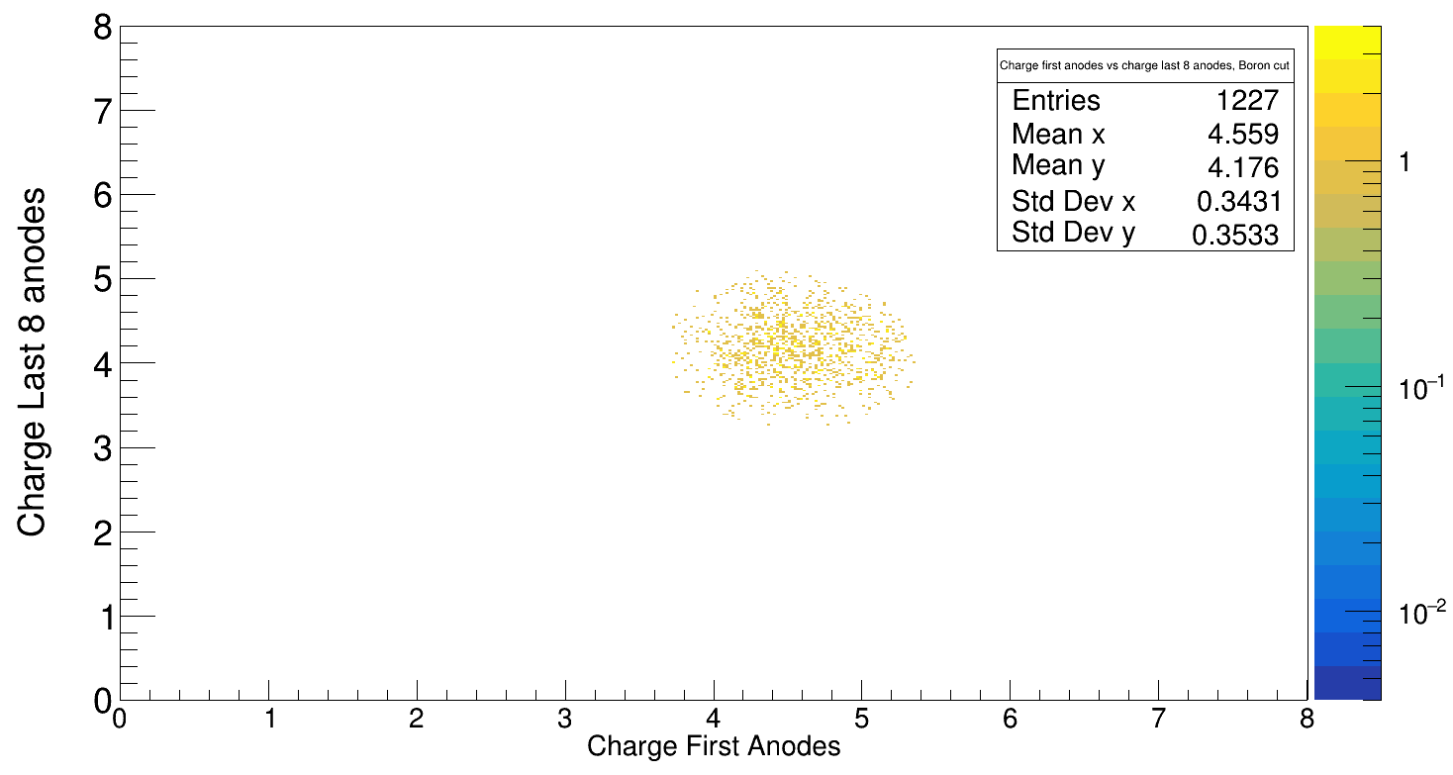
650 AMeV
Empty
Target

Slide 6
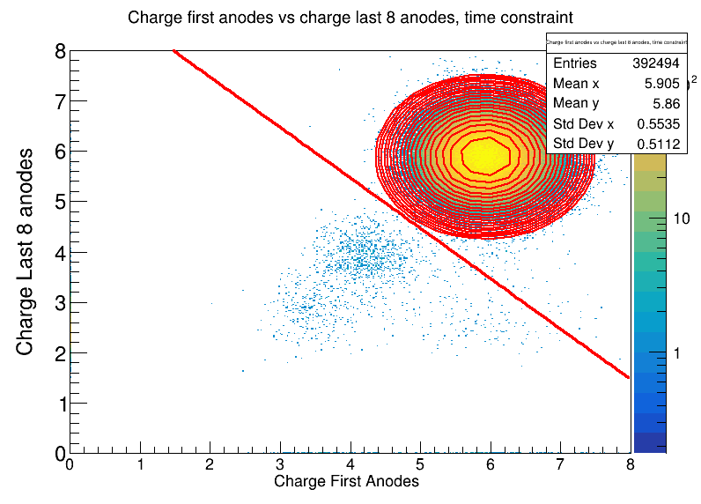
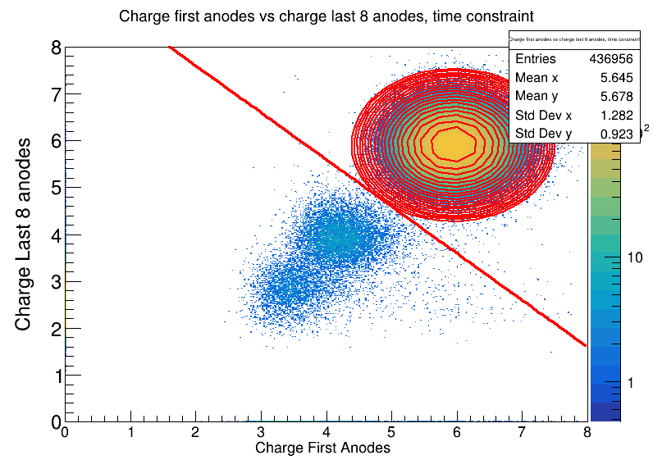
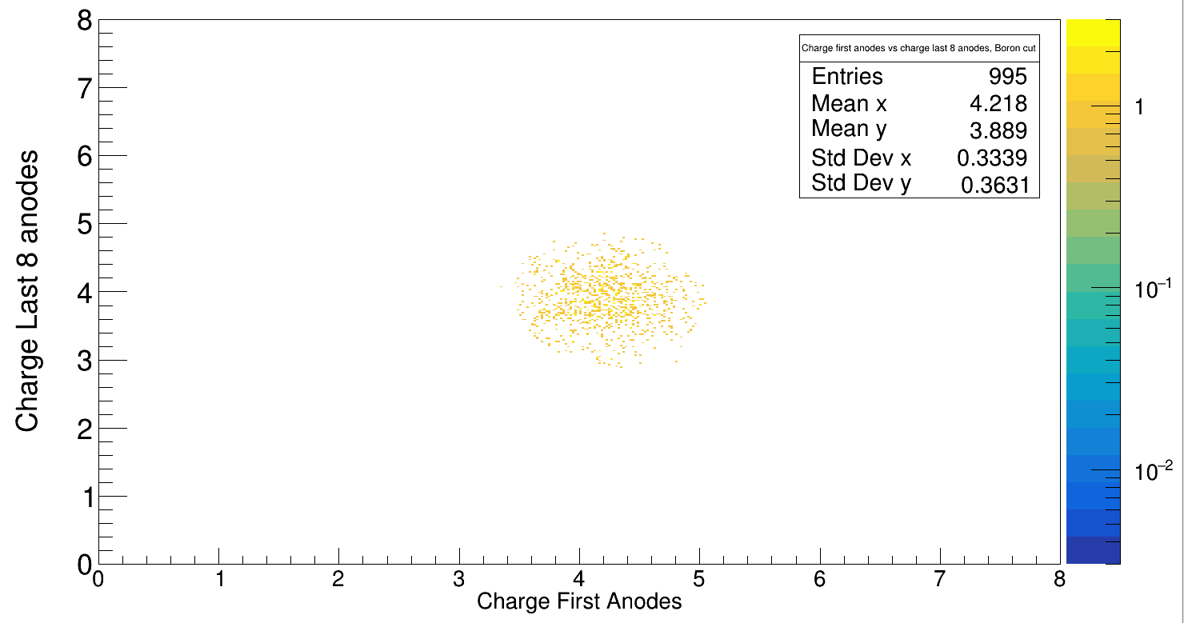
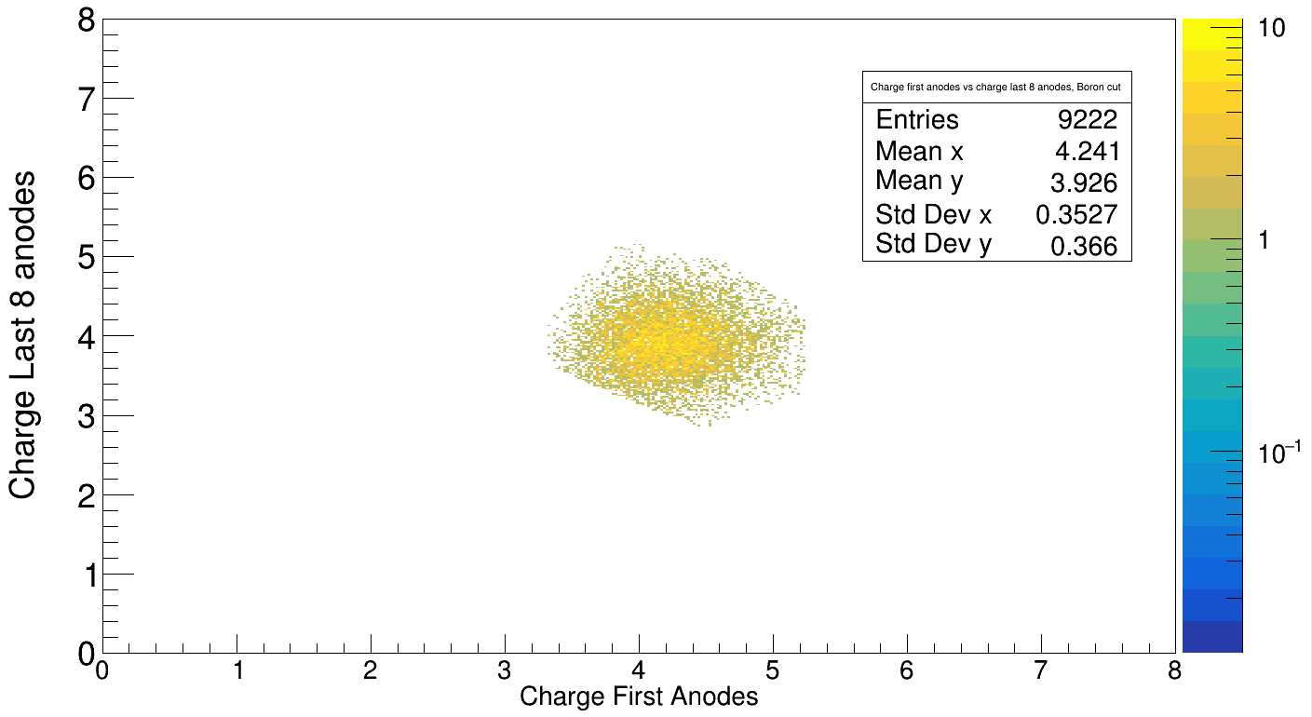
800 AMeV
Empty
Target

Slide 7
Cross section results Z= 6 → Z = 5
Without empty target substraction:
Energy : Cross section: mbarn
400 79.5
550 83.9
650 81.7
800 83.0
Energy : Cross section: mbarn
400 89.6
550 95.9
650 93.3
800 95.4

Slide 8
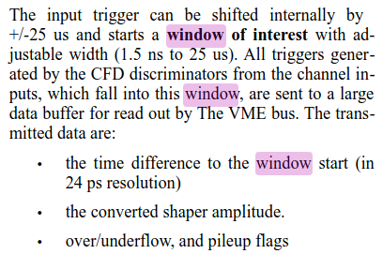
Drift Times in TWIM MUSIC
Calibration of x position in TWIM Music done by:
Interpolate x position on anode by x_MW1 &2
Plot x_pos_anode vs drift time
Fit with x_pos = v*drift_time + c
TWIM
MW1
MW2
e⁻ drift velocity ~ 0.005-0.006cm /ns
Why don’t we have negative values of twim times? Or why are they limited by around 32k?
Timining concept - “window of interest”,see : https://www.mesytec.com/products/datasheets/MDPP-16_SCP-RCP.pdf

Slide 9
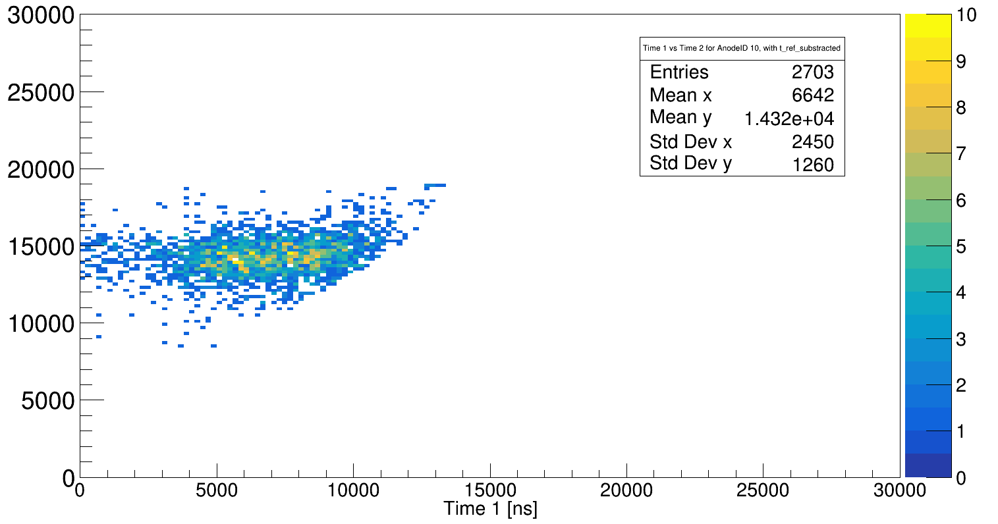
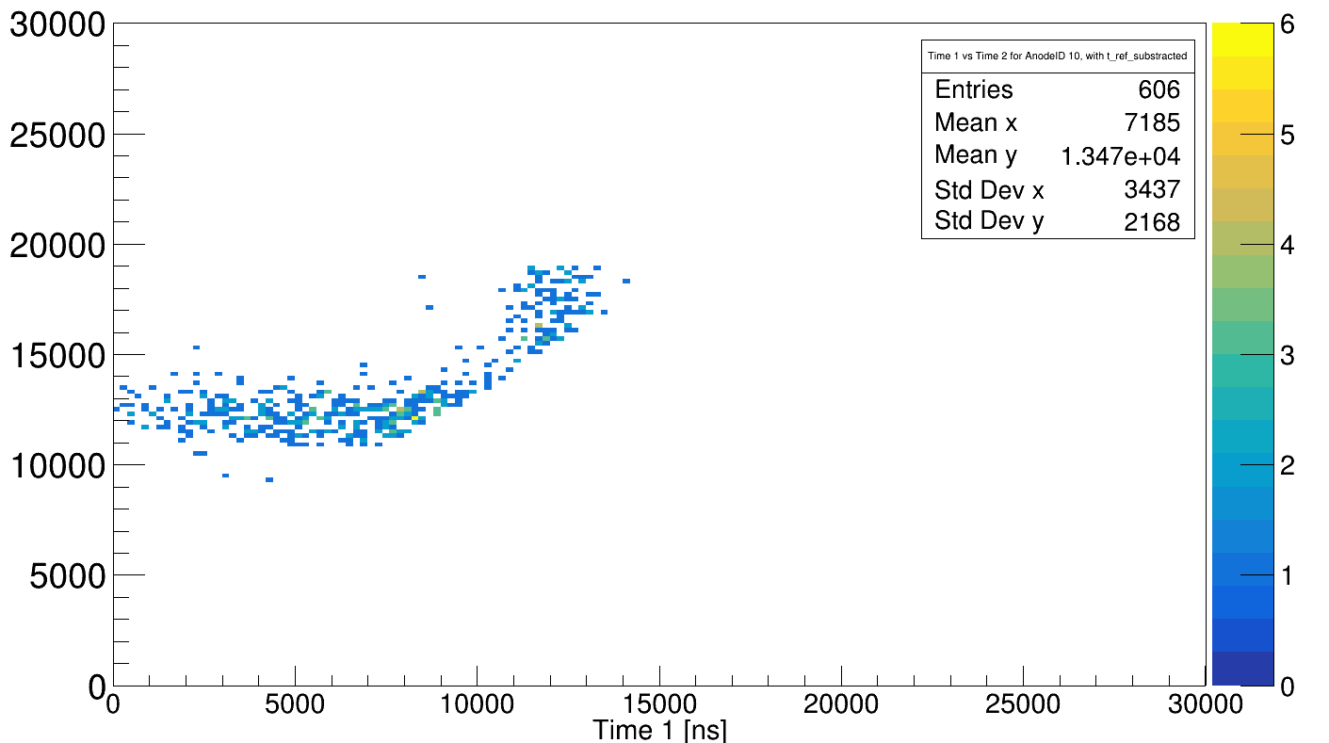
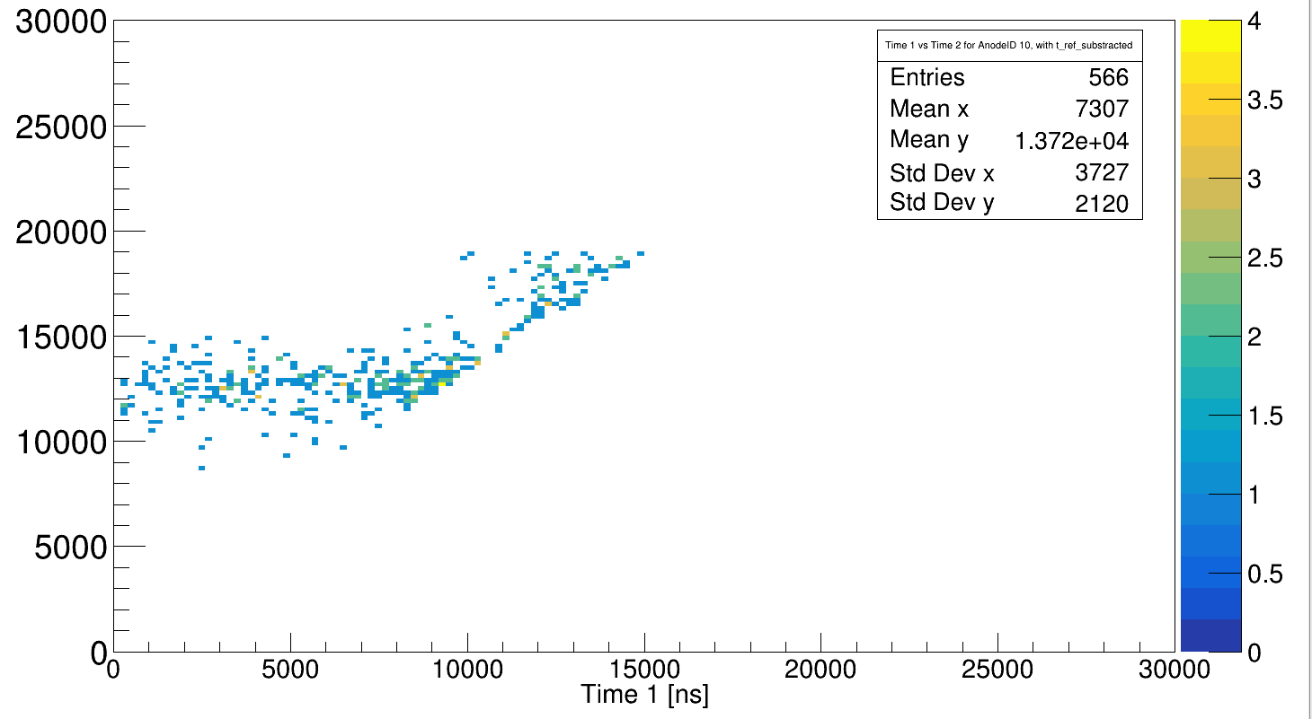
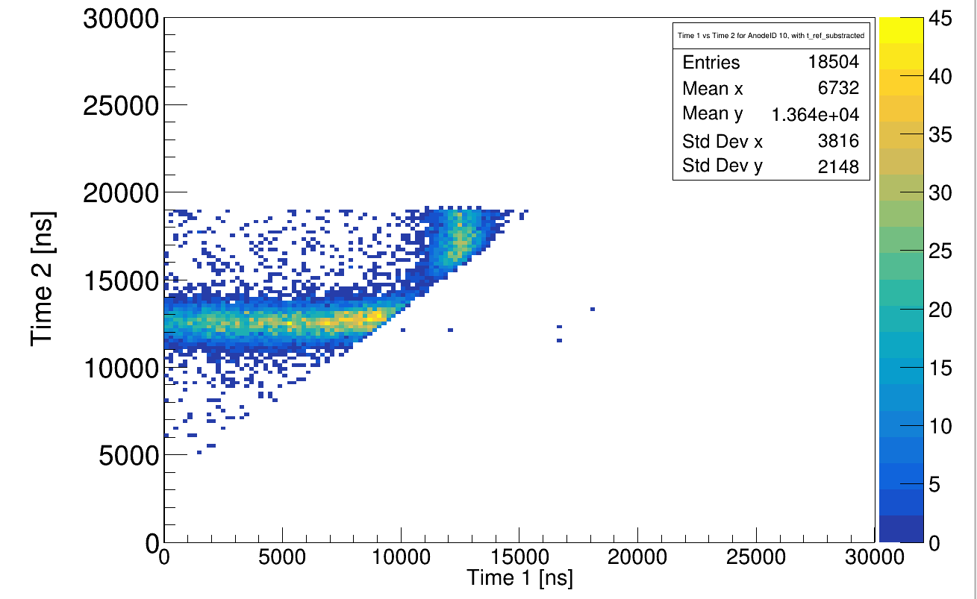
Time diff between two hits in anodenr = 10 vs overall meas. Charge (a.u.!)
400 AMeV
650 AMeV
550 AMeV
800 AMeV

Slide 10
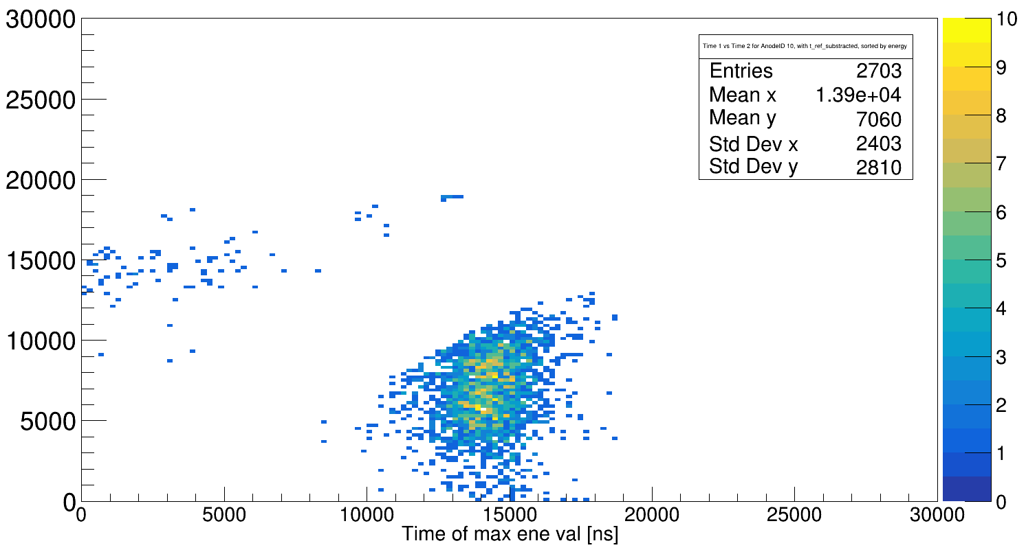
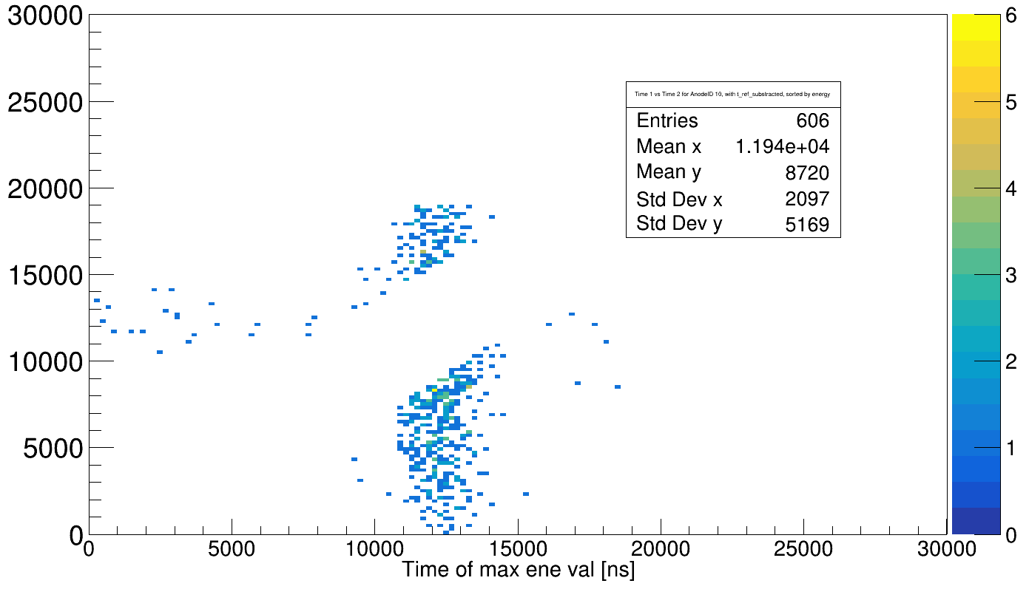
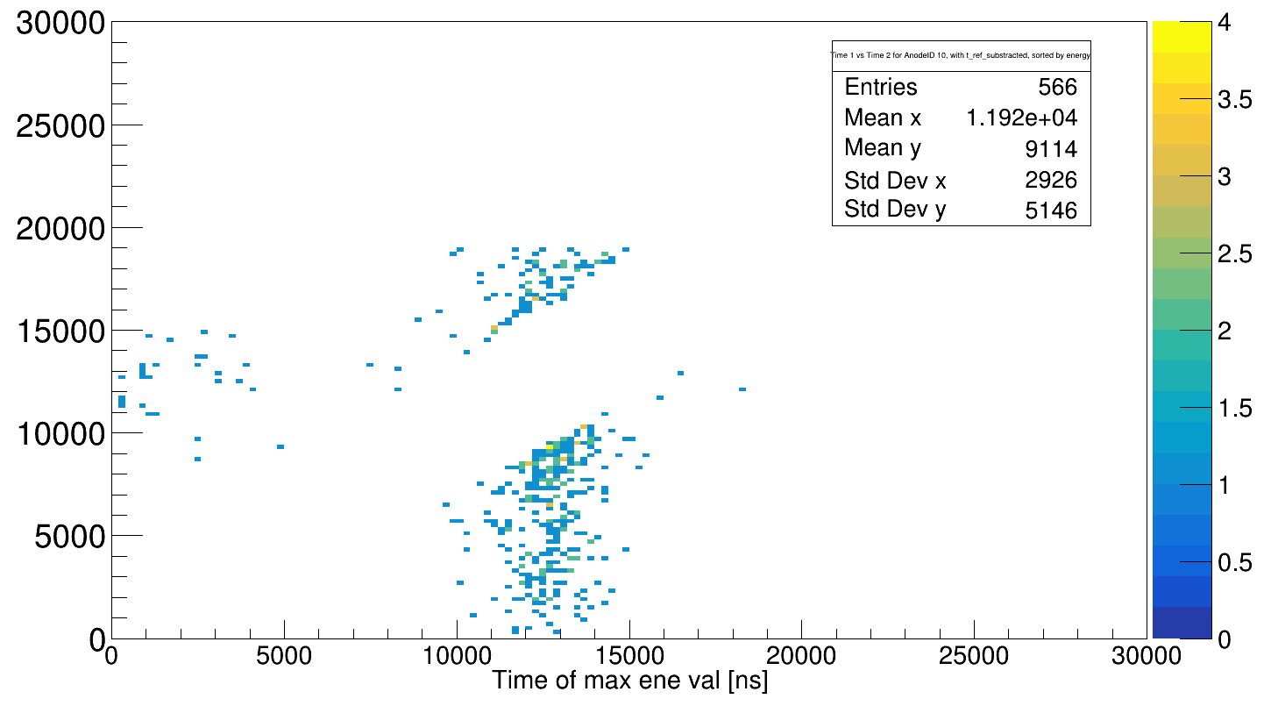
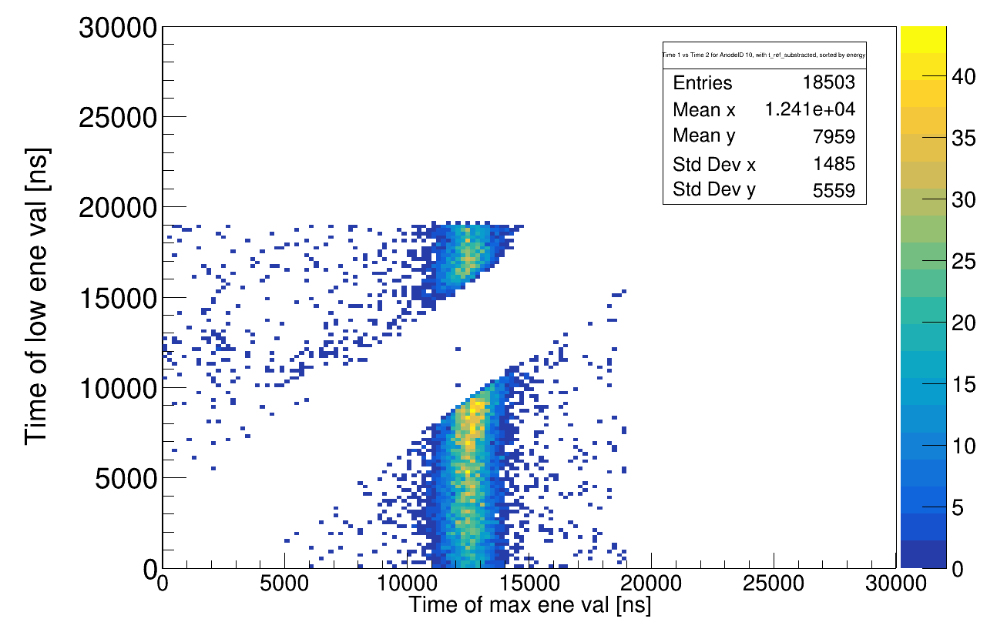
Time diff between two hits in anodenr = 10 vs overall meas. Charge (a.u.!)
Cut: E1 > E2
Sorting by energy
400 AMeV
650 AMeV
550 AMeV
800 AMeV

Slide 11
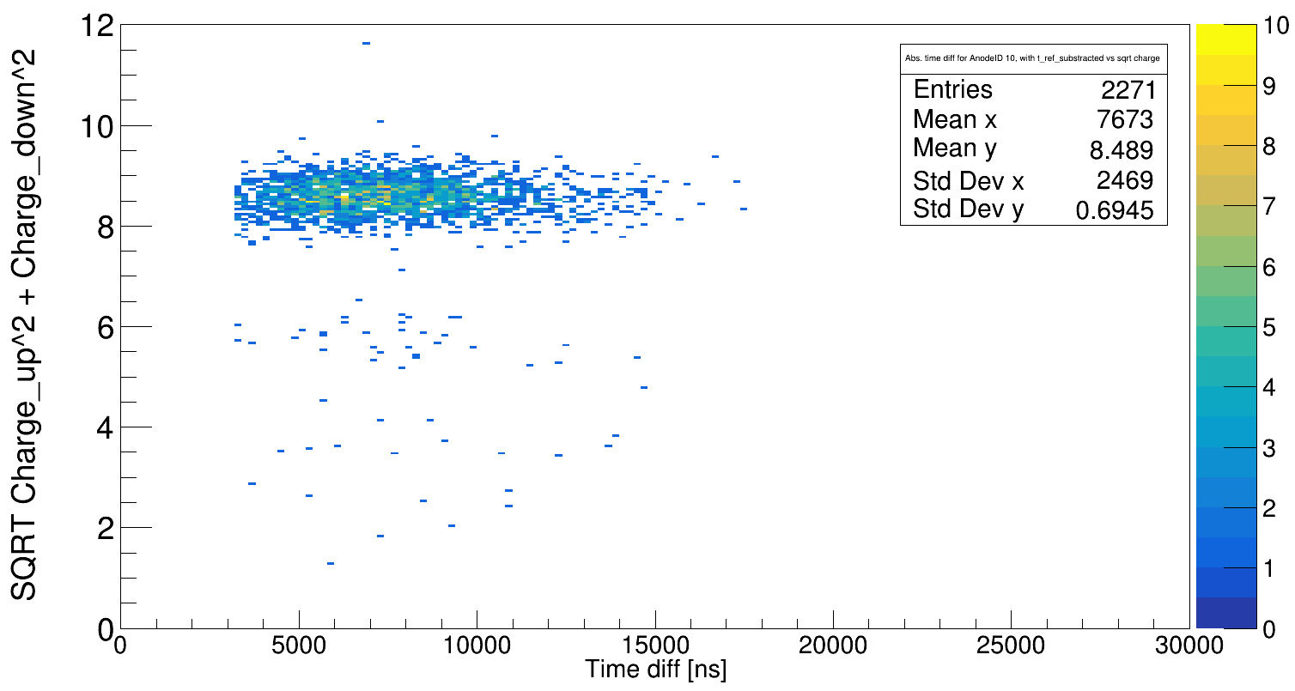
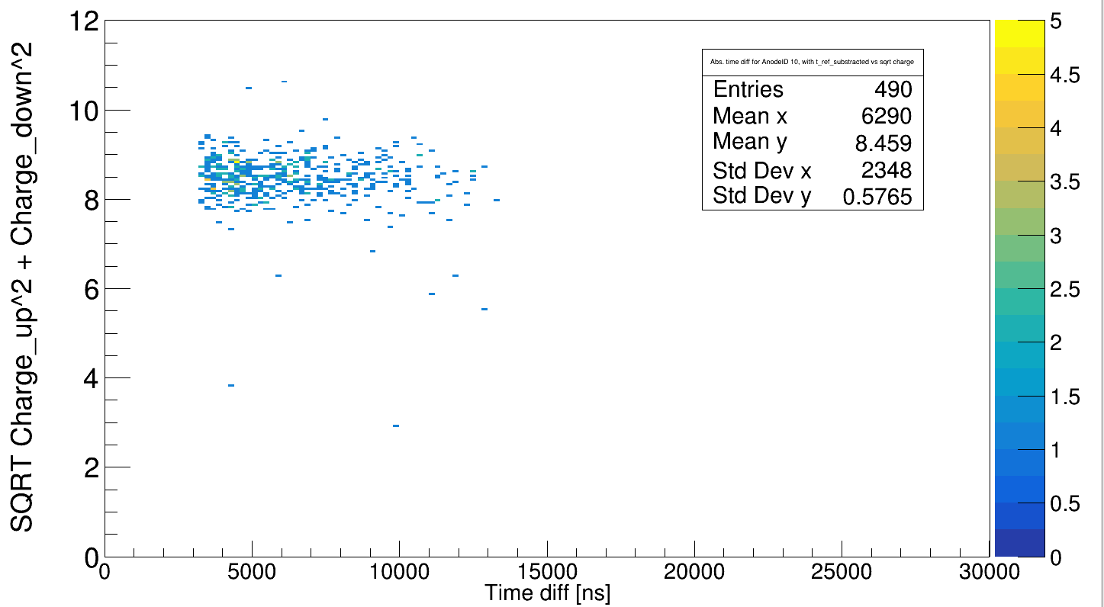
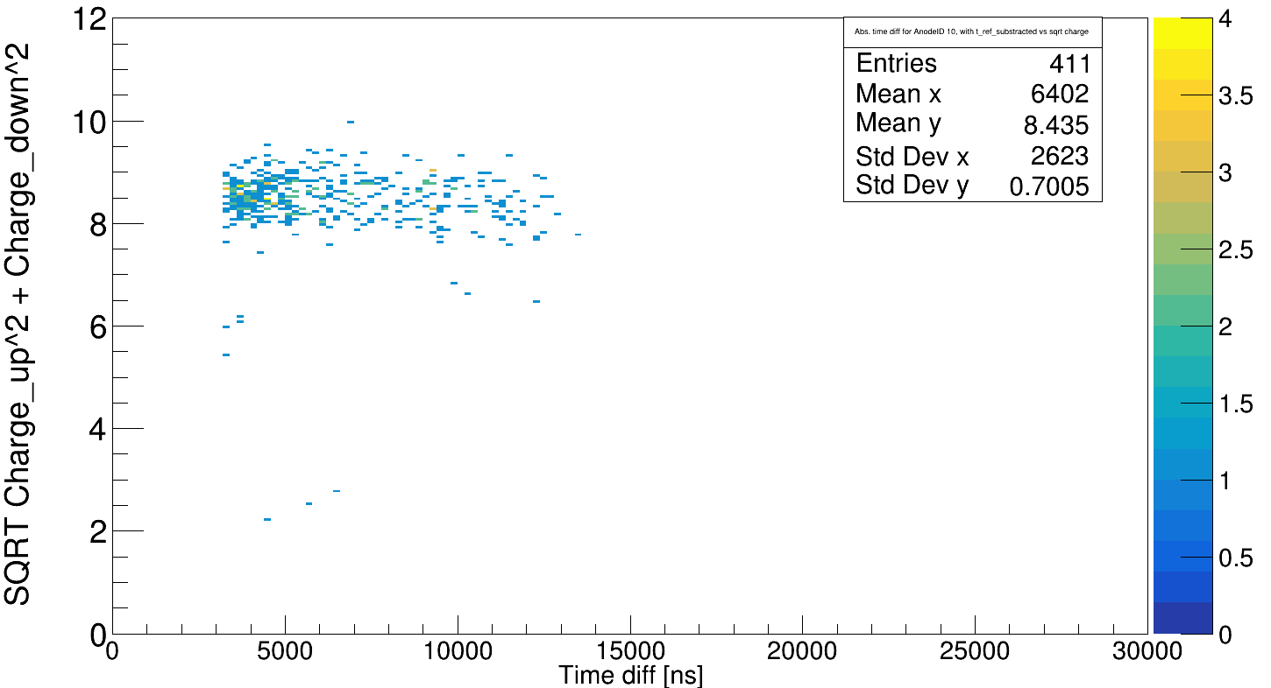
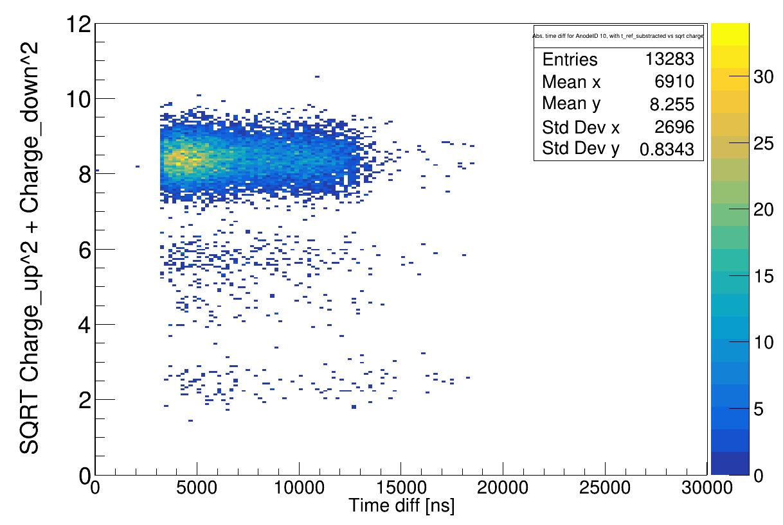
Overall charge (a.u.) vs abs(t_diff), for anode = 10
400 AMeV
650 AMeV
550 AMeV
800 AMeV

Slide 12
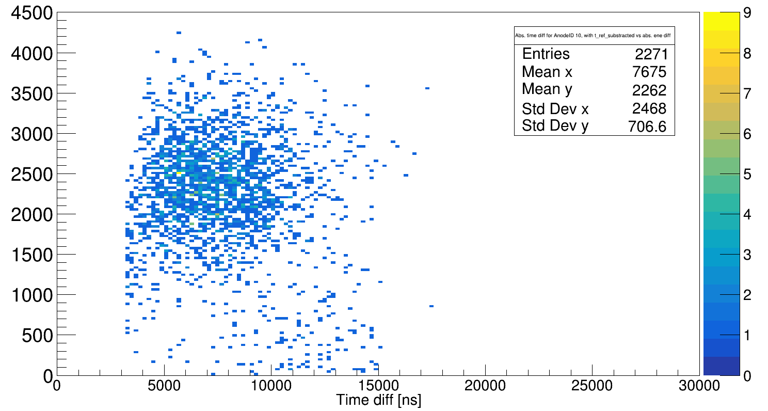
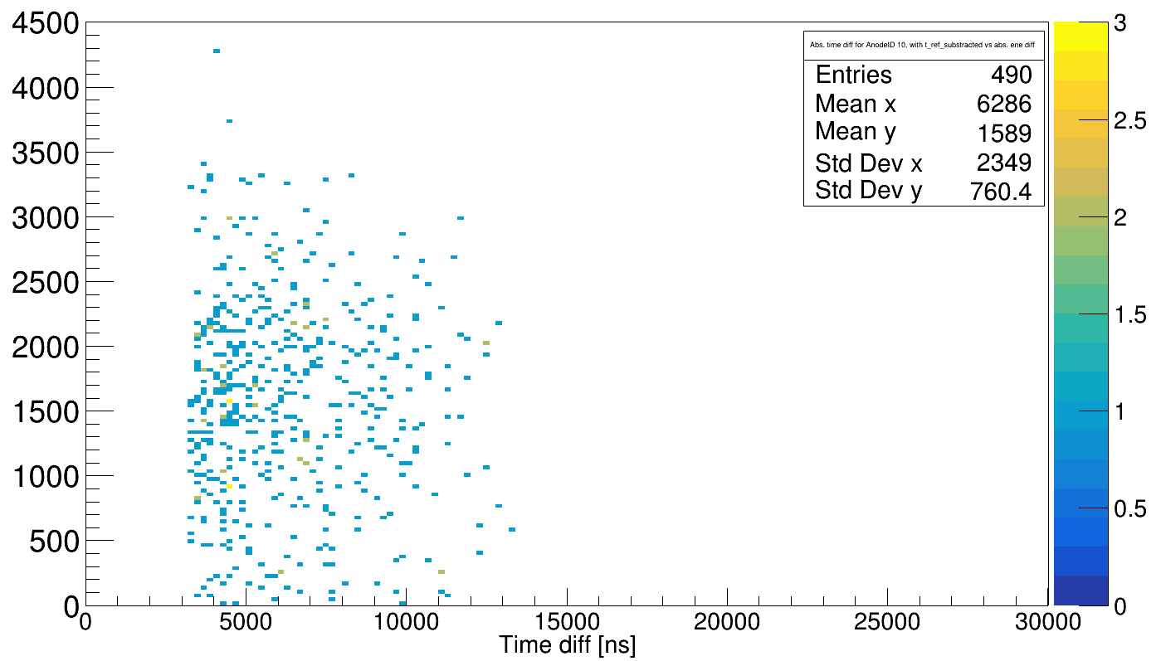
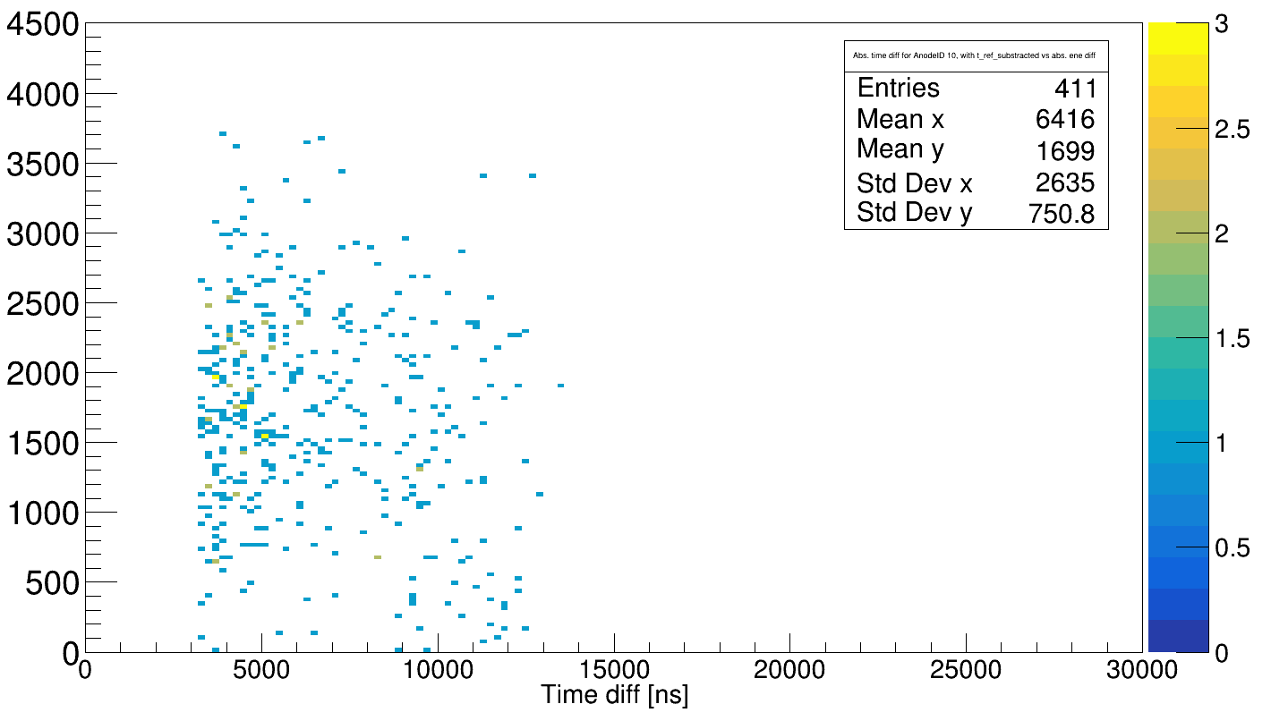
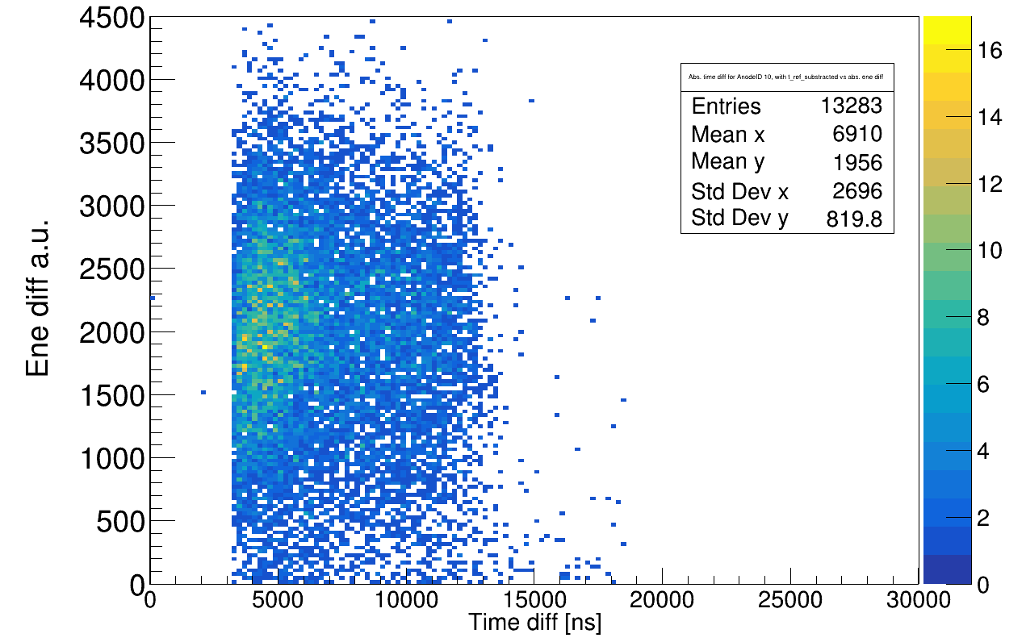
abs(energy_diff) vs abs(t_diff), for anode = 10
400 AMeV
650 AMeV
550 AMeV
800 AMeV

Slide 13
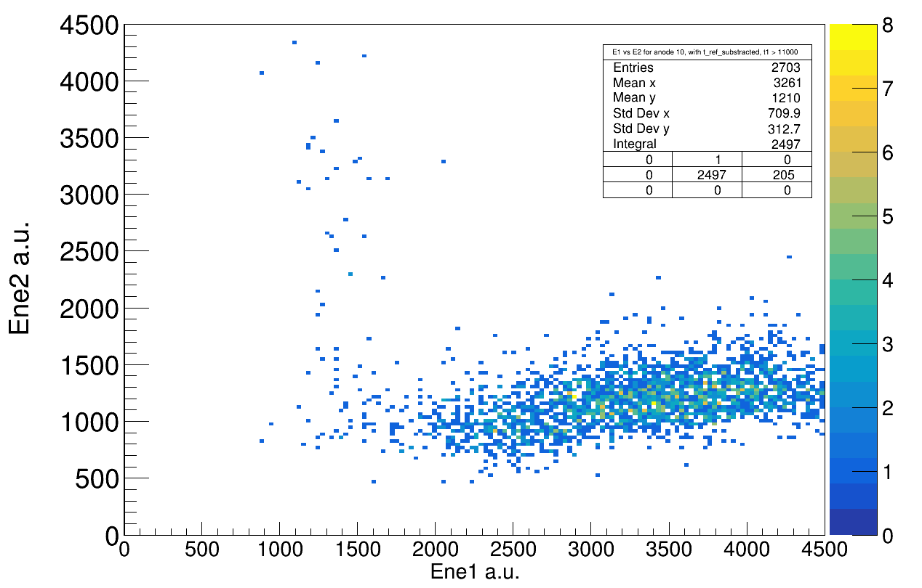
How does the energy distribution look here?
800 AMeV
You should select E1, not E2 (noise, delta electrons...)

Slide 14
How can I have events with t_ref/t_trig in TWIM, but no energy deposition?
Old E-Mail from Julien:
This is something which can happen if an ion came just befor your window of interest. It internally triggers the MDPP-16, which treats the data.until 2 x shaping times. during that time period, the module get unavailable and cannot operate anymore. Thus, there is a slight change to miss the good guy which woulld come in the time interval when the module is in actual dead time.

