Slide 1







12C(p,2p)11B Quasi Free Scattering in Inverse Kinematics at R3B
Tobias Jenegger
R3B Collaboration Meeting 2022
Setup Experiment S444
12C(p,2p)11B reaction
Analysis
Summary & Outlook
Funded by the Deutsche Forschungsgemeinschaft (DFG, German Research Foundation)
under Germany’s Excellence Strategy – EXC-2094 – 390783311,
BMBF 05P19WOFN1, 05P21WOFN1
and the FAIR Phase-0 program
Physics with R³B
CALIFA – Design
TUM Members:
Roman Gernhäuser,Lukas Ponnath,Philipp Klenze,Tobias Jenegger

Slide 2
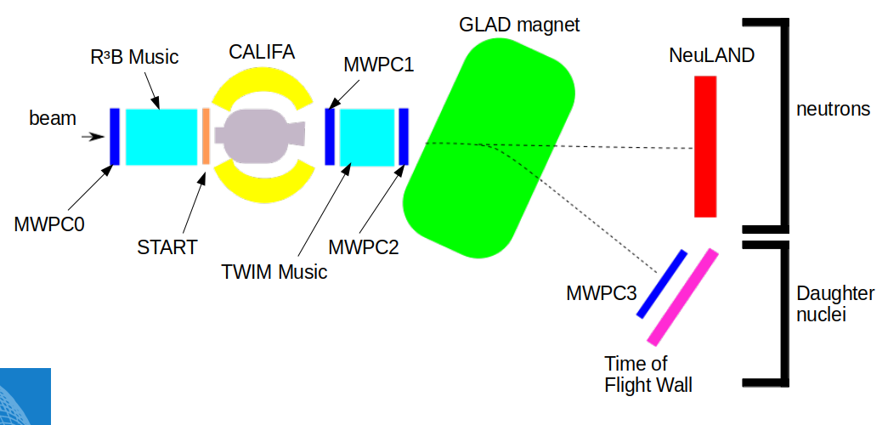
Quasi Free Scattering Analysis with Experiment S444/467 (2020)
SETUP:
Beam energy: 400 AMeV
Beamtype: ¹²C
Target: CH₂
Tobias Jenegger
<Foliennummer>

Slide 3


12C(p,2p)11B reaction
¹²C beam
proton like target
2 protons
¹¹B fragment
(spectator)
proton
¹¹B
proton
Tobias Jenegger
<Foliennummer>

Slide 4

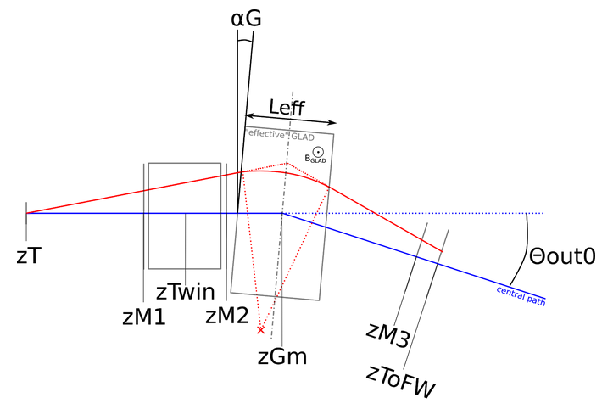
Fragment Particle Identification
Time Measurement (START & TOFW)
Charge Measurement (TWIM Music)
¹²C
Flightpath Reconstruction:
¹¹C
¹⁰B
¹¹B
Tobias Jenegger
<Foliennummer>

Slide 5

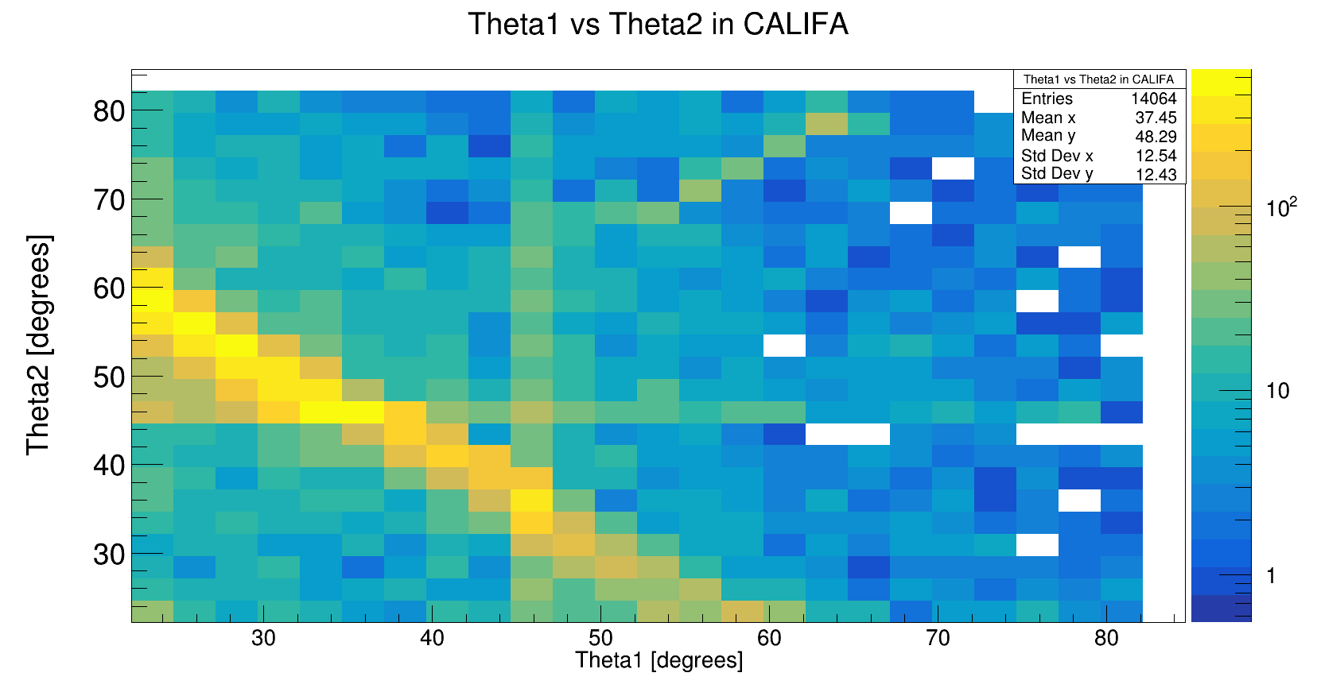

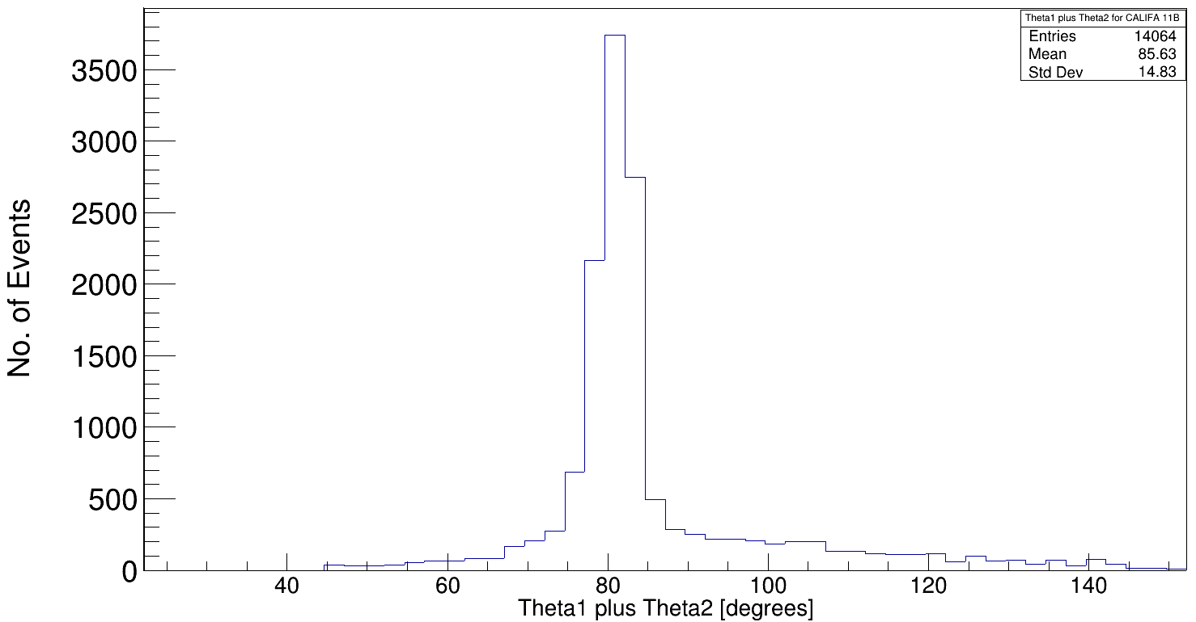
Identification of the two correlated Protons
proton
proton
φ₂[degrees]
Tobias Jenegger
<Foliennummer>
φ₁[degrees]

Slide 6
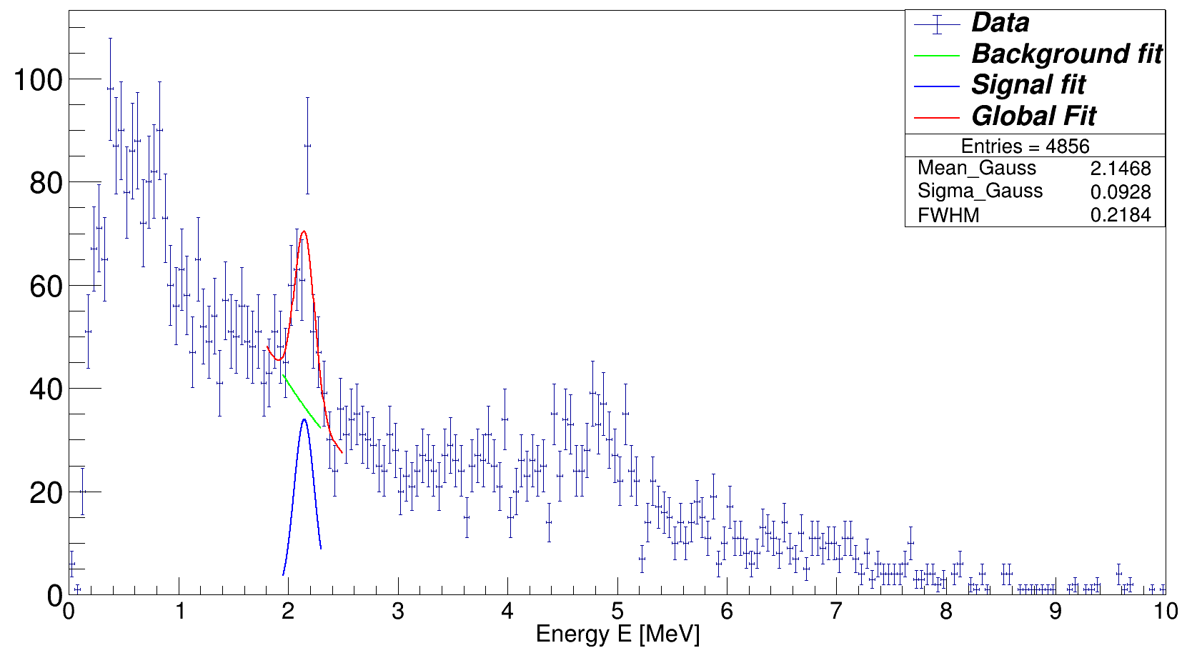
Gamma Spectrum of 11B
Doppler Corrected Gamma Spectrum
Event Selection Criteria:
¹¹B fragment identification
Two hits (protons) with E_{hit} > 30 MeV
θ1 + θ2 < 90°
Δφ = 180° +- 40°
Tobias Jenegger
<Foliennummer>

Slide 7



Thank you!
Special Thanks to:
GENP-USC Group (J. Benlliure, G. Garcia, A. Gonzalez, J. L. Rodriguez Sanchez, et. al. )
SOFIA Group (A. Chatillon, J. Taieb, et. al.)

