Slide 1







¹²C(p,2p)¹¹B Quasi Free Scattering in Inverse Kinematics at R³B
Setup Experiment S444
¹²C(p,2p)¹¹B reaction
Analysis
Summary & Outlook
Tobias Jenegger
For the R3B Collaboration
DREB 2022
Funded by the Deutsche Forschungsgemeinschaft (DFG, German Research Foundation)
under Germany’s Excellence Strategy – EXC-2094 – 390783311,
BMBF 05P19WOFN1, 05P21WOFN1
and the FAIR Phase-0 program
Physics with R³B
CALIFA – Design
TUM Members:
Roman Gernhäuser,Lukas Ponnath,Philipp Klenze,Tobias Jenegger

Slide 2
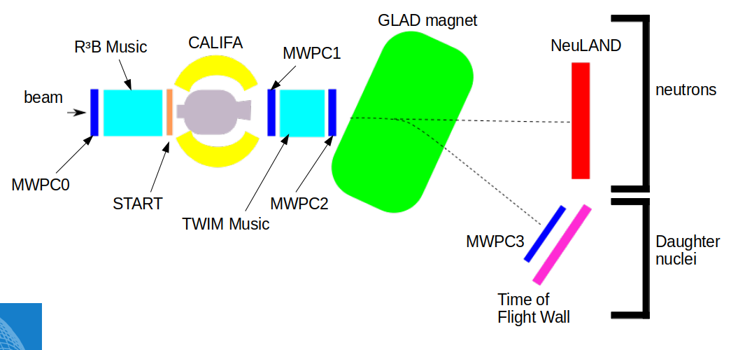
Quasi Free Scattering Analysis with Experiment S444/467 (2020)
For this Analysis:
Beam energy: 400 AMeV
Beamtype: ¹²C
Beamtime: 3 hours
Intensities: 1kHz - 1MHz
Target: CH₂ (12.29 mm)
Tobias Jenegger
<Foliennummer>

Slide 3


¹²C(p,2p)¹¹B reaction
¹²C beam
proton like target
2 protons
¹¹B fragment
(spectator)
proton
¹¹B
proton
Tobias Jenegger
<Foliennummer>

Slide 4

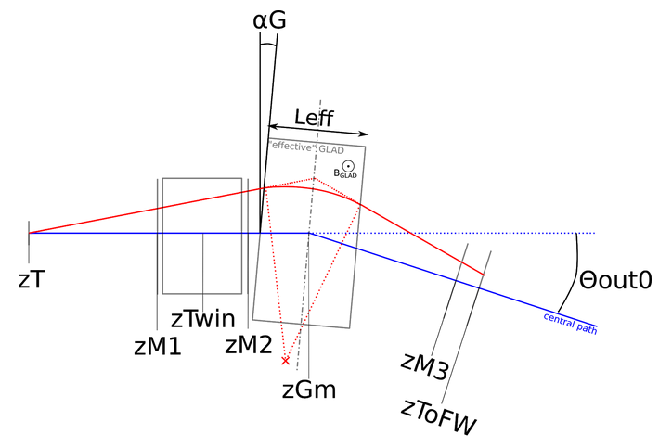
Fragment Particle Identification
Time Measurement (START & TOFW)
Charge Measurement (TWIM Music)
¹²C
Flightpath Reconstruction:
¹¹C
Z (TWIM)
¹⁰B
¹¹B
Tobias Jenegger
<Foliennummer>

Slide 5
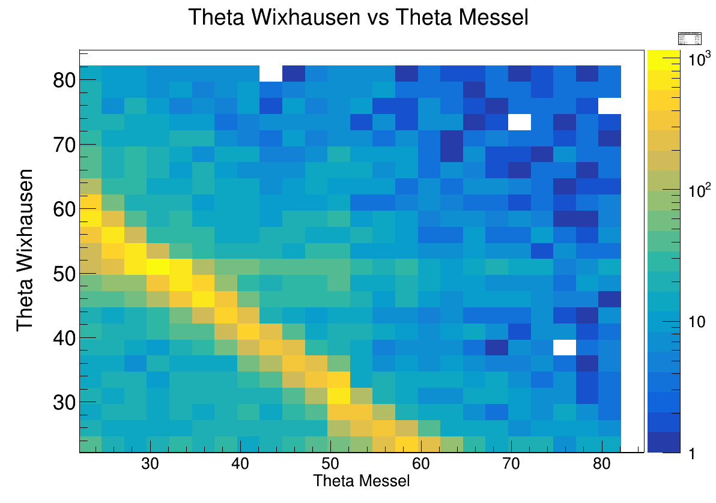
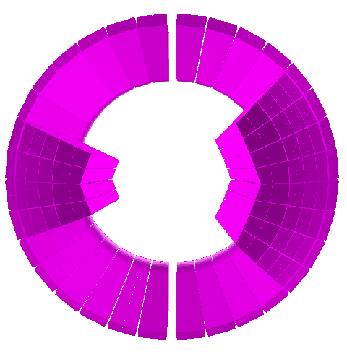

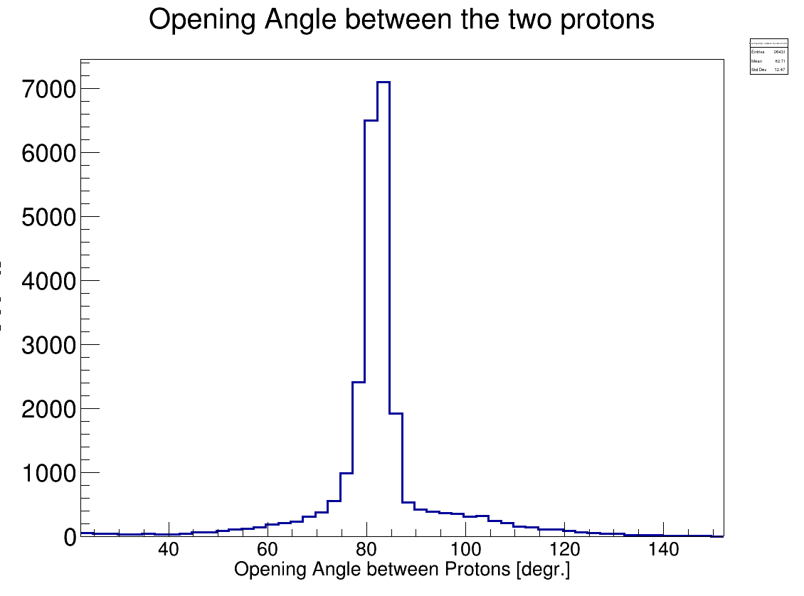

Identification of the two correlated Protons
CALIFA Front View
CALIFA Side View
Polar Angle Protons Messel-Wixhausen
Azimuthal Angle Proton 1 vs Proton2
φ₂[degrees]
Tobias Jenegger
<Foliennummer>
φ₁[degrees]

Slide 6
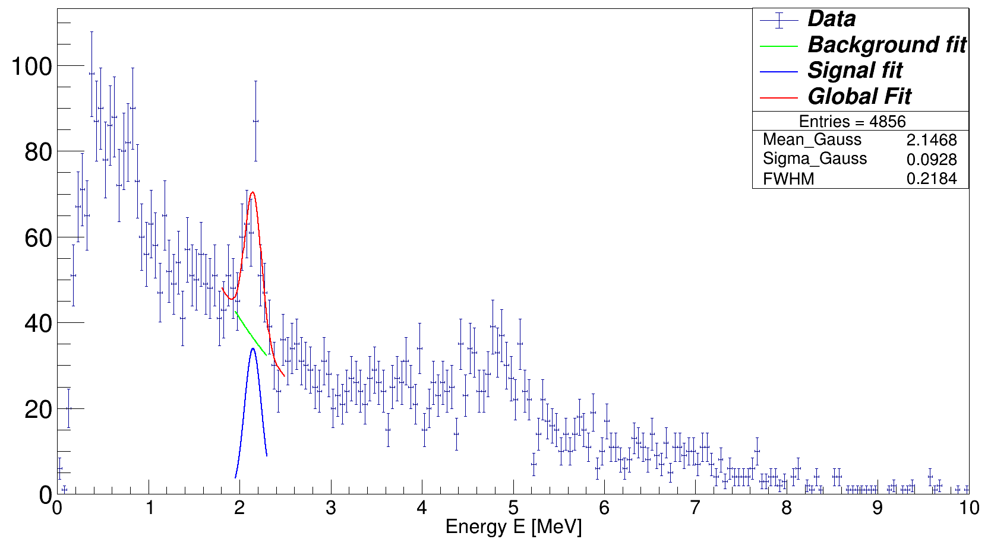
Gamma Spectrum of ¹¹B
Doppler Corrected Gamma Spectrum
Event Selection Criteria:
¹¹B fragment identification
Two hits (protons) with E_{hit} > 30 MeV
θ1 + θ2 < 90°
Δφ = 180° +- 40°
Tobias Jenegger
<Foliennummer>

Slide 7
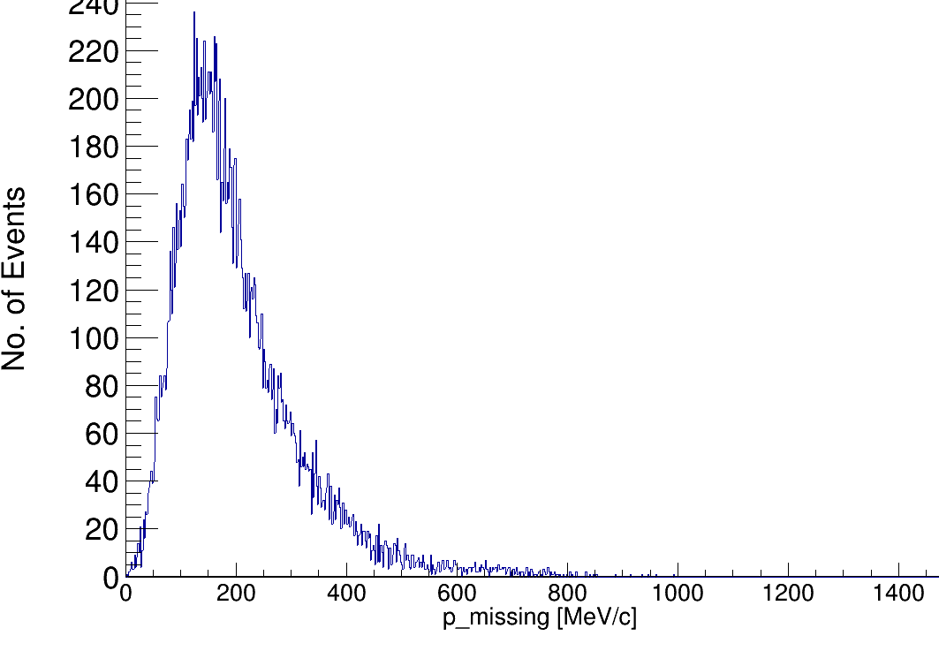
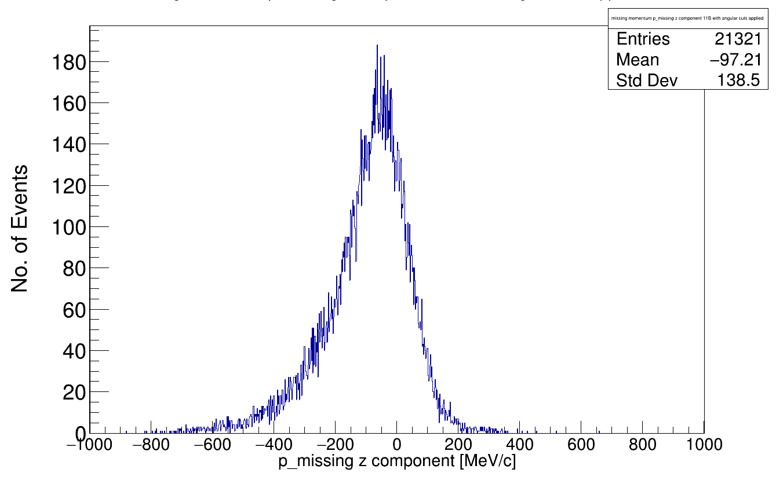
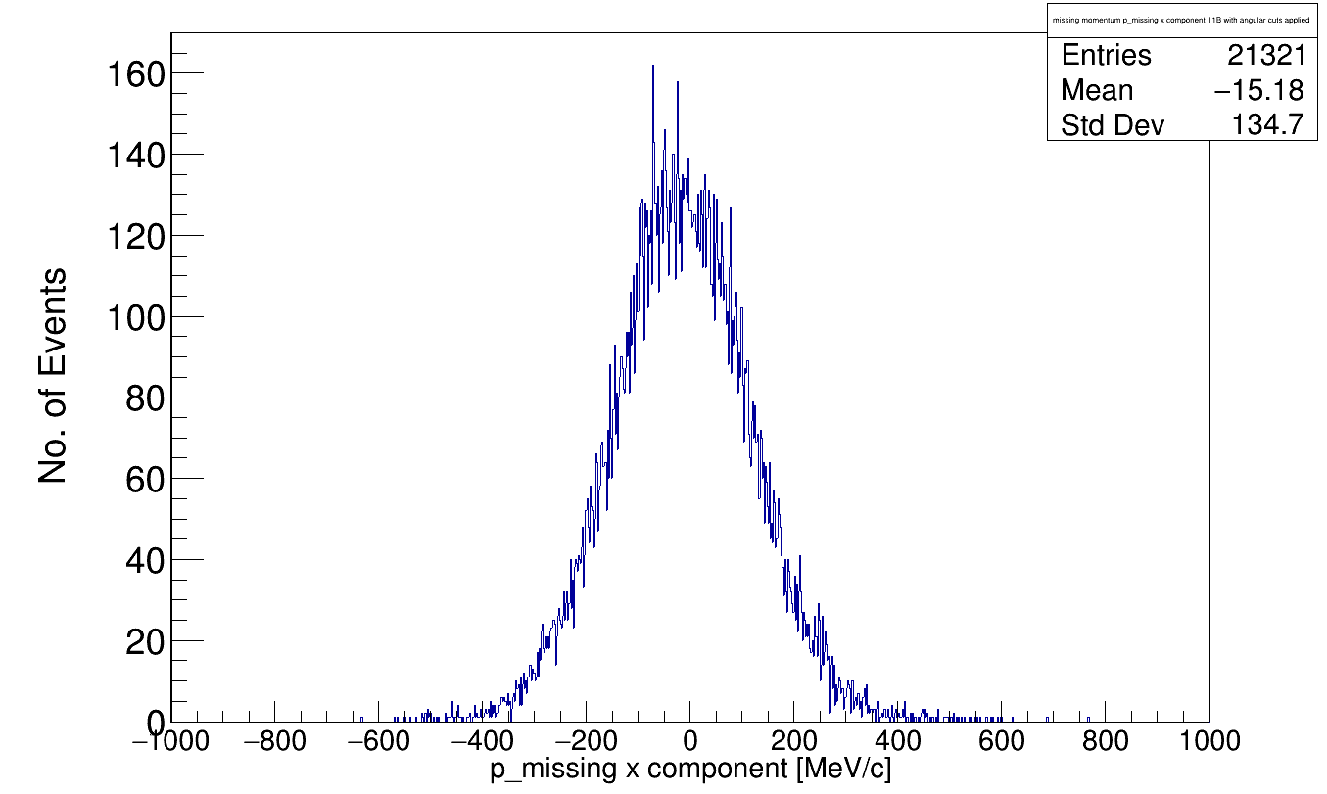
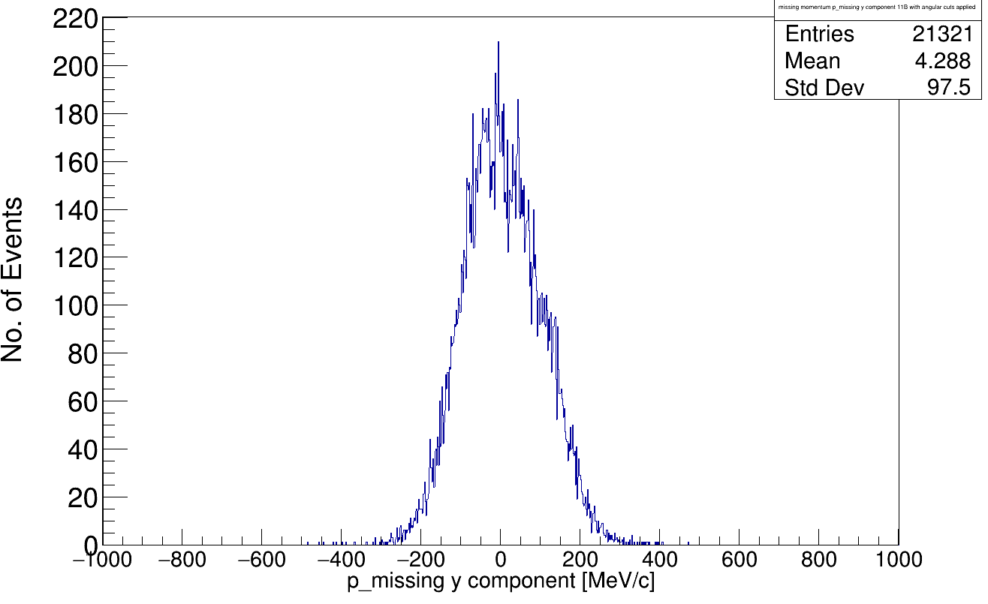
Reconstruction of Inner Momenta
Before Scattering:
After Scattering:
(Four-)Momentum conservation relation:
p₁
p_{i}
p_{tg}
assuming QE scattering in mean field potential:
p₂
nucleon momentum inside ¹²C
z-comp.
x-comp.
y-comp.
z-comp.
<Foliennummer>

Slide 8
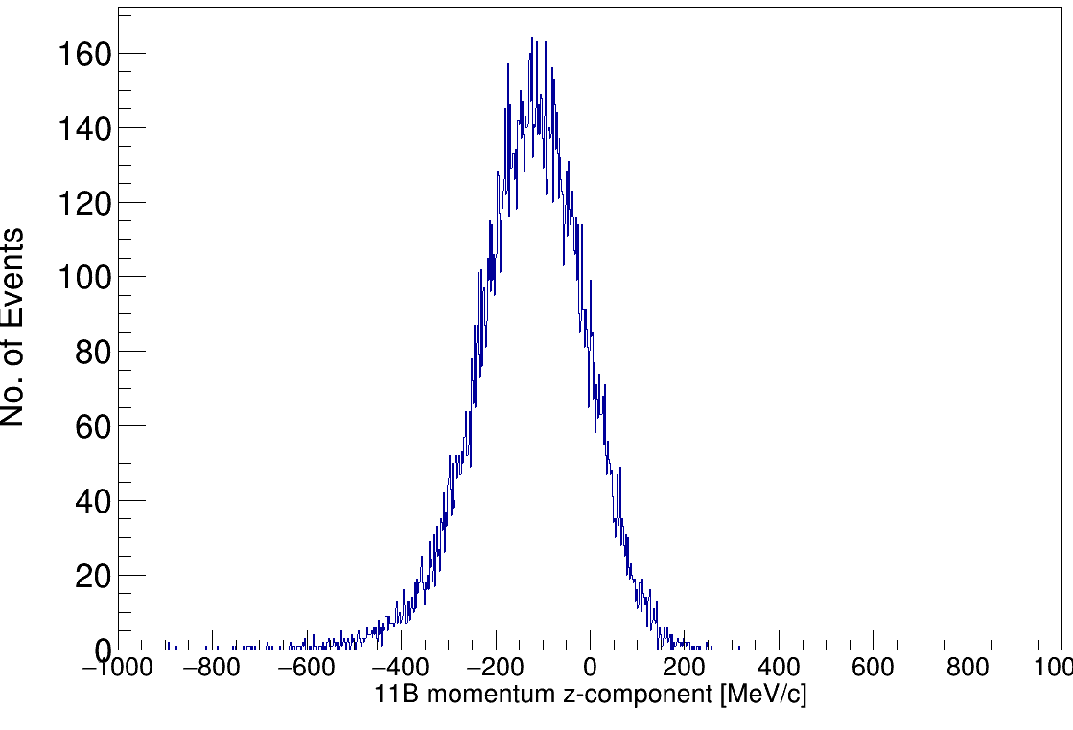
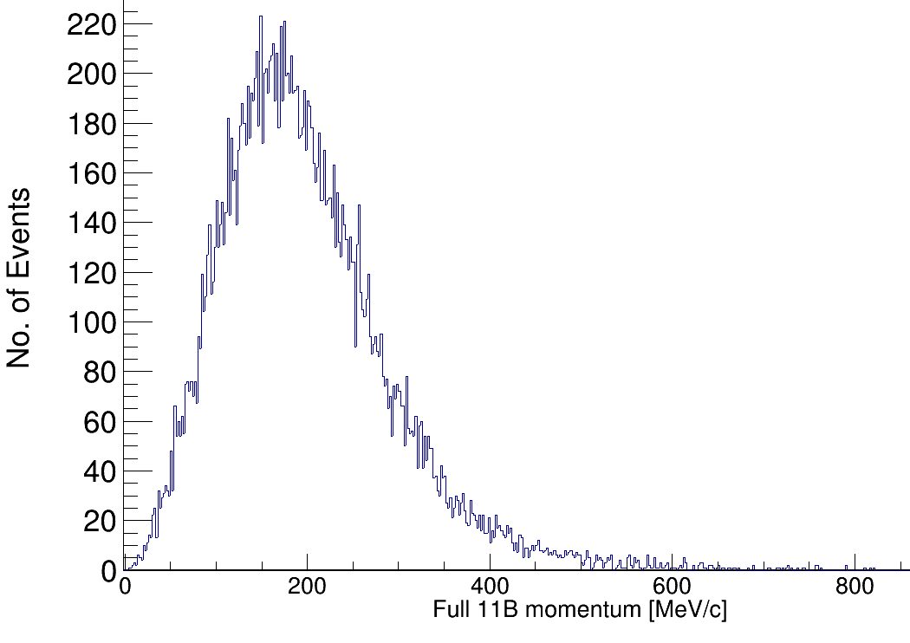
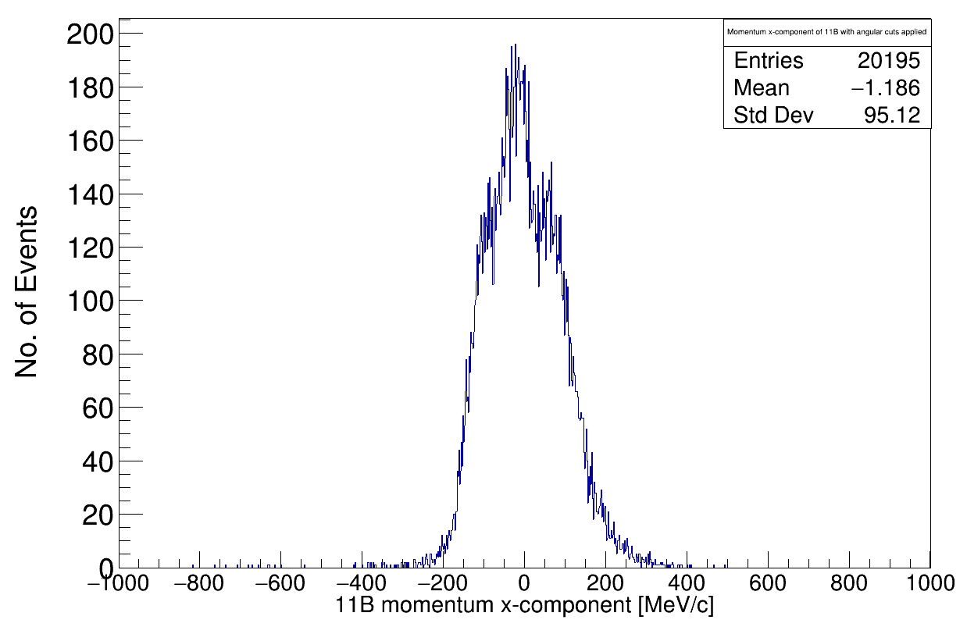
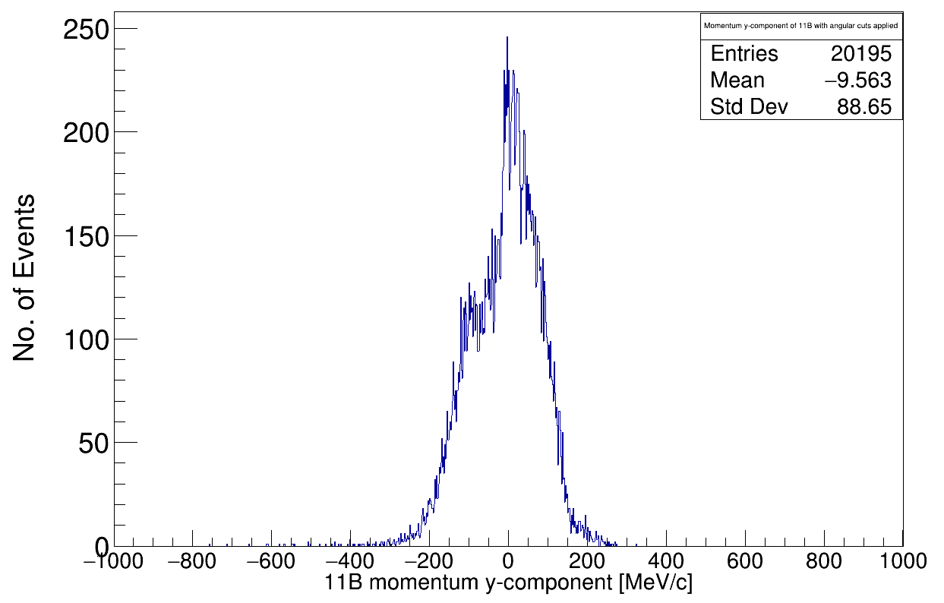
Momentum reconstruction of 11B
Before Scattering:
After Scattering:
z-component
p₁
p_{i}
p_{tg}
Spectator!
p_{11B}
x-component
y-component
¹¹B Fragment Momentum [MeV/c]
Tobias Jenegger
<Foliennummer>

Slide 9
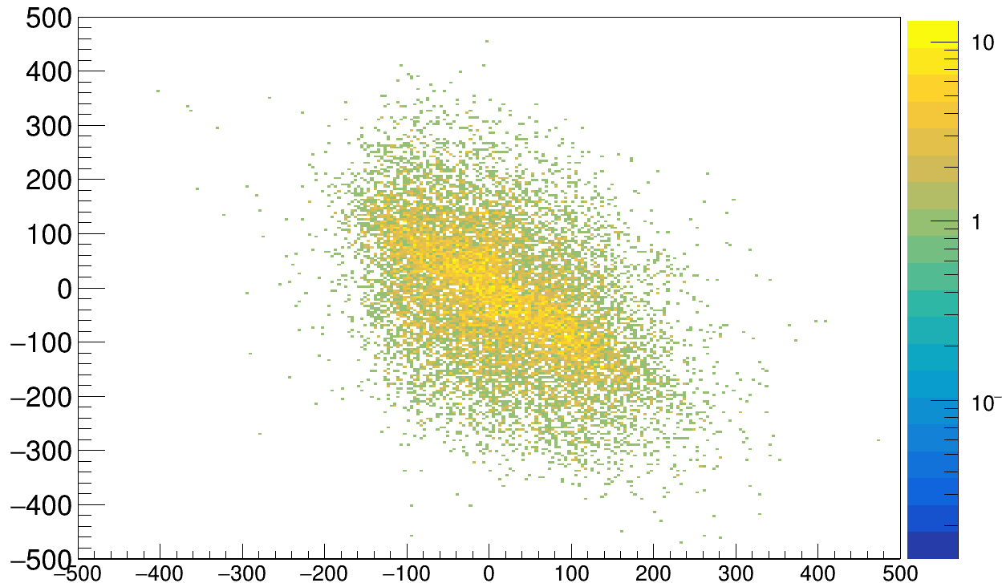
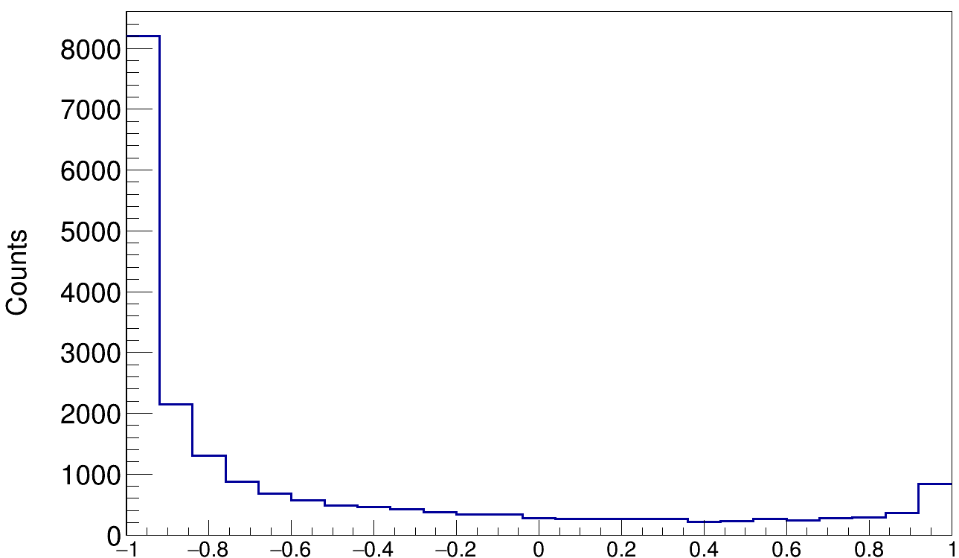
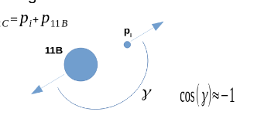
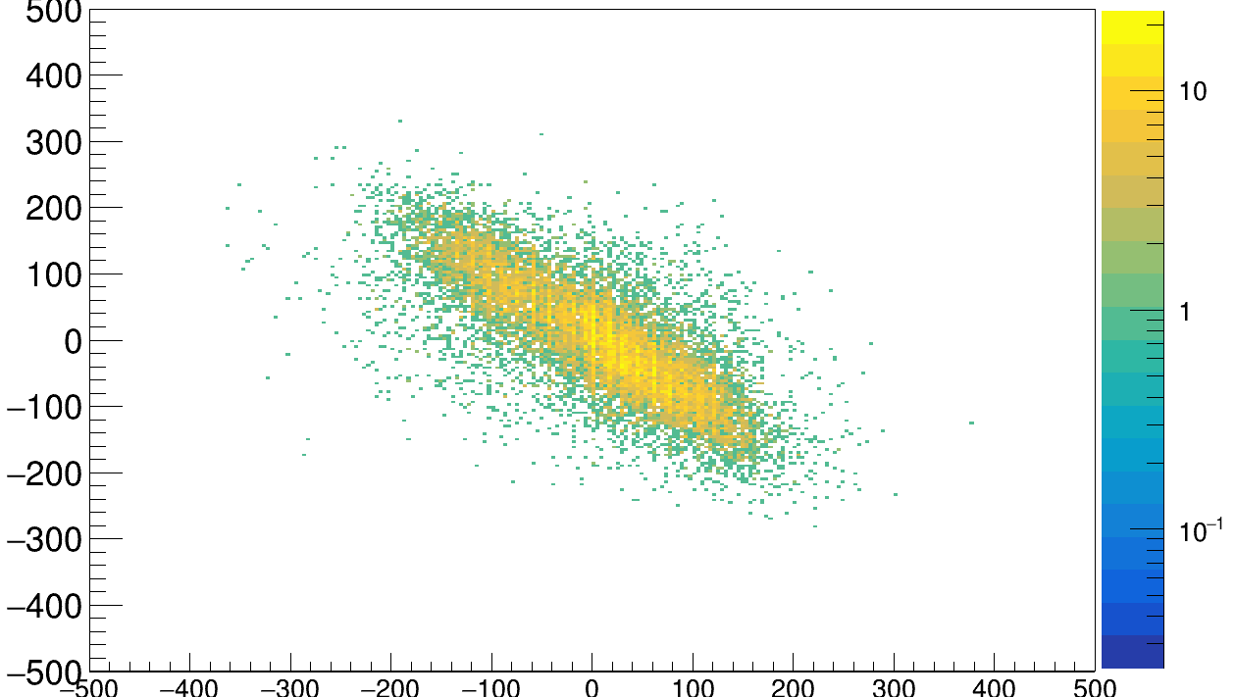
Correlations between Fragment and Proton Pair
x-component correlations
(p₁+p₂)_{x} in lab system
(p¹¹B)_{x} in lab system
y-component correlations
(p₁+p₂)_{y} in lab system
cos( γ )
Tobias Jenegger
<Foliennummer>
(p¹¹B)_{y} in lab system

Slide 10
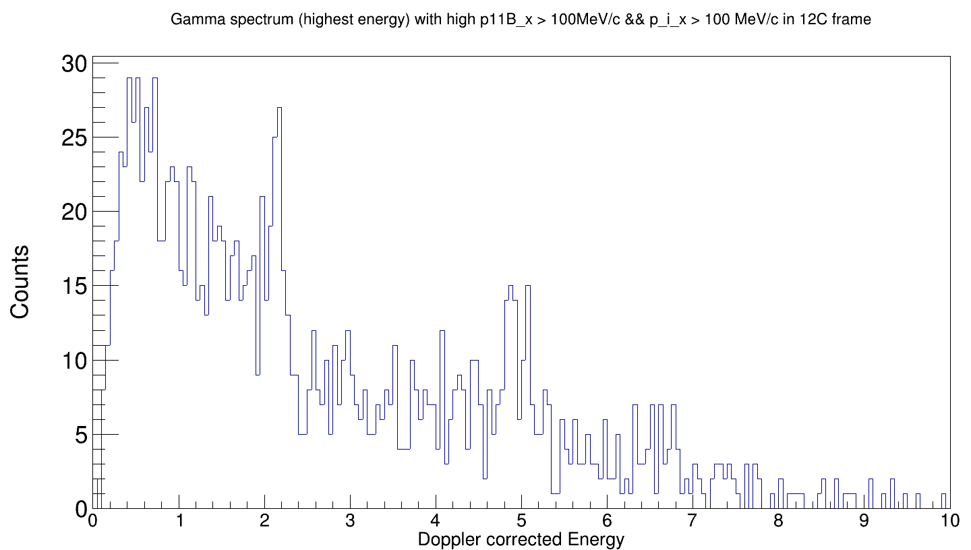
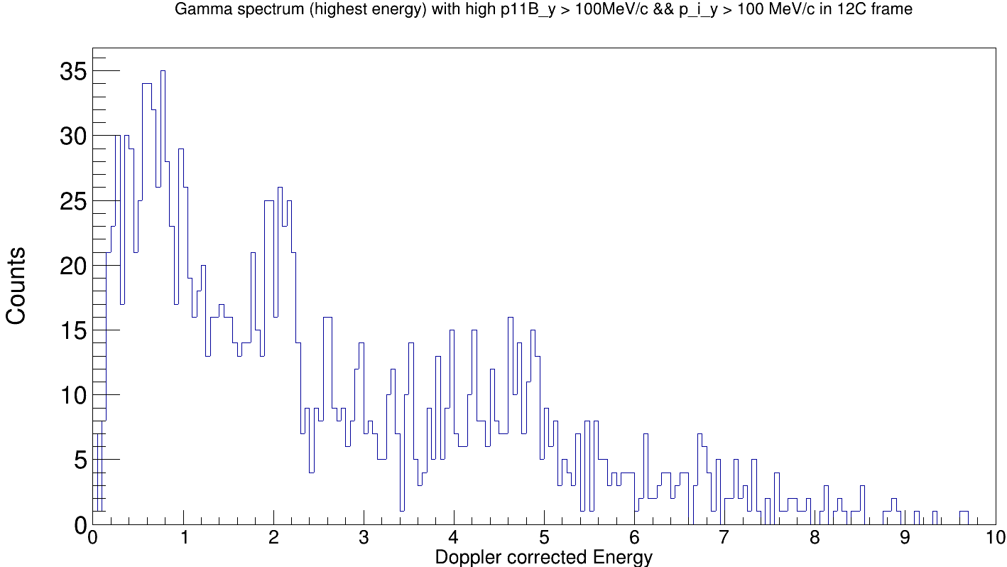
What if we cut on the events with high inner proton momentum?
1/2-
x-momentum cut
2/3-
7/2-
y-momentum cut
1/2-
2/3-
No 5/2- population (4.4 MeV)
7/2-
Tobias Jenegger
<Foliennummer>

Slide 11
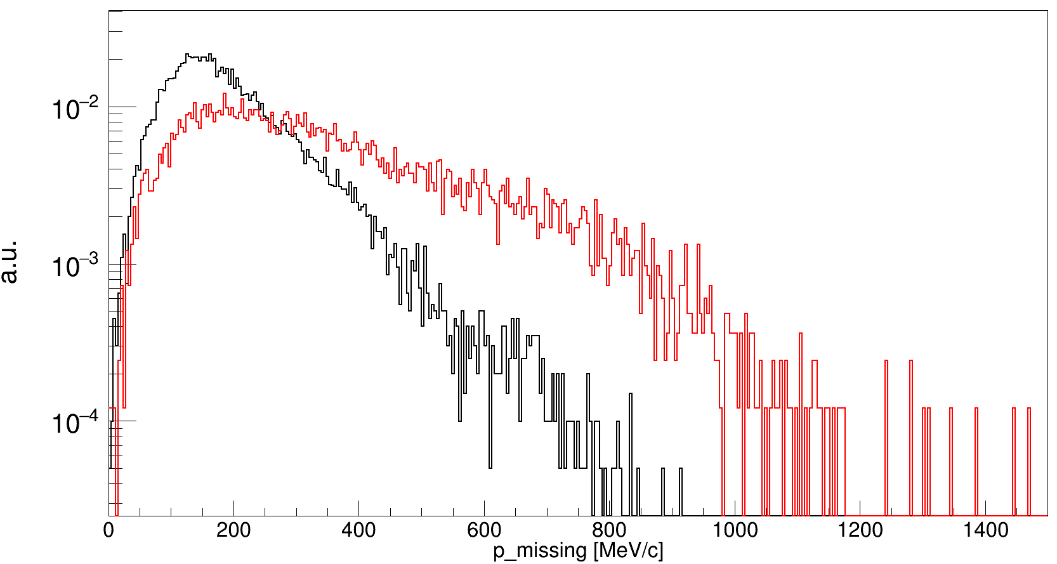
Momentum Reconstruction for Inclusive 12C(p,2p)
¹²C(p,2p)¹¹B
¹²C(p,2p)¹⁰B
Z (TWIM)
¹⁰B
¹¹B
Reaction Channels for ¹²C(p,ppn)¹⁰B:
Multiple scattering
Neutron evaporation
SRC breakup reactions
Tobias Jenegger
<Foliennummer>

Slide 12
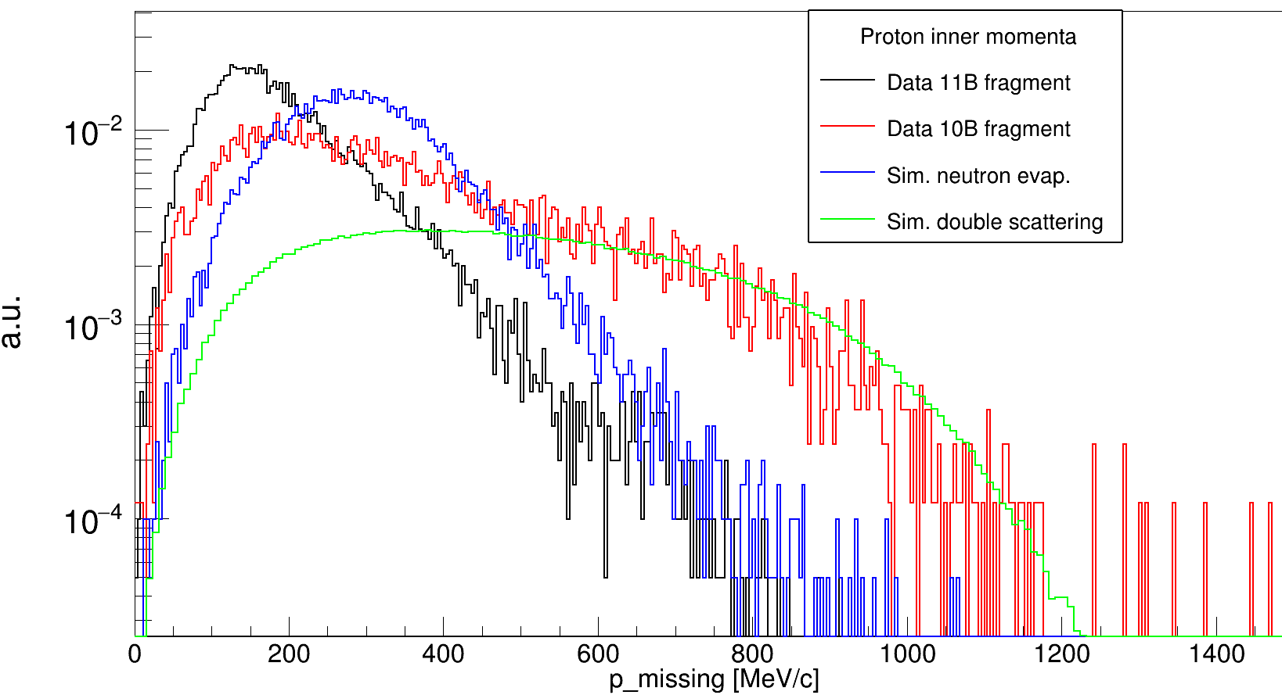
Momentum Reconstruction for Inclusive 12C(p,2p)
Z (TWIM)
¹⁰B
¹¹B
Simulation neutron evaporation:
Simulation double scattering:
p → pn → pnp
or
p → pp → ppn
Tobias Jenegger
<Foliennummer>

Slide 13
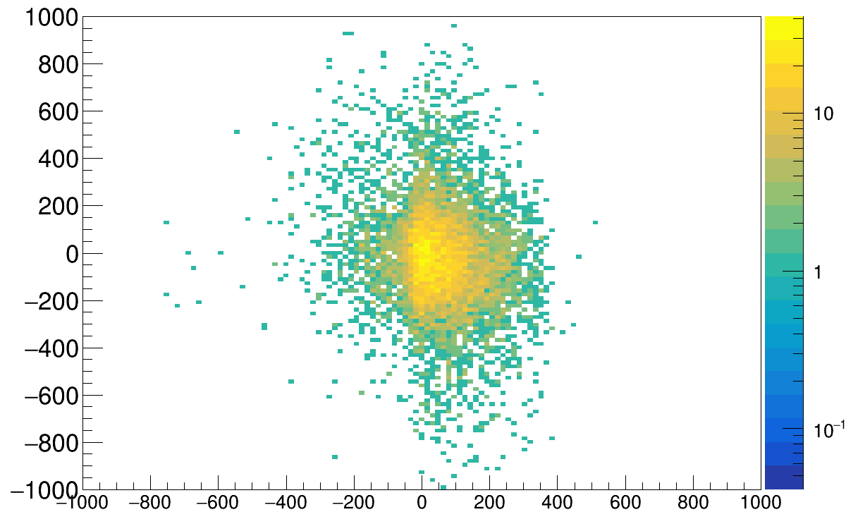
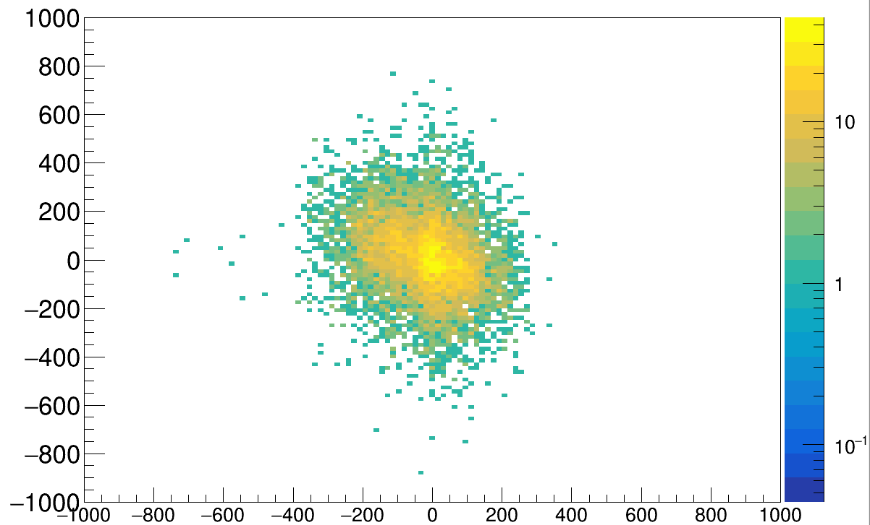
Momentum Component Correlations
¹²C(p,2p)¹¹B
¹²C(p,2p)¹⁰B
x-component correlations
x-component correlations
(p₁+p₂)_{x} in lab system
(p₁+p₂)_{x} in lab system
(p¹⁰B)_{x} in lab system
(p¹⁰B)_{x} in lab system
y-component correlations
y-component correlations
(p₁+p₂)_{y} in lab system
(p₁+p₂)_{y} in lab system
Tobias Jenegger
<Foliennummer>
(p¹⁰B)_{y} in lab system
(p¹⁰B)_{y} in lab system

Slide 14
Summary
Identification of the QFS-process:
¹¹B Fragment
Polar Angles of two protons
Gamma Spectrum of ¹¹B
Z(TWIM)
¹¹B
Inclusive ¹²C(p,2p) Momentum Reconstruction
Inner Momenta and according correlation plots:
nucleon momentum
inside ¹²C
Tobias Jenegger
<Foliennummer>
cos( γ )

Slide 15
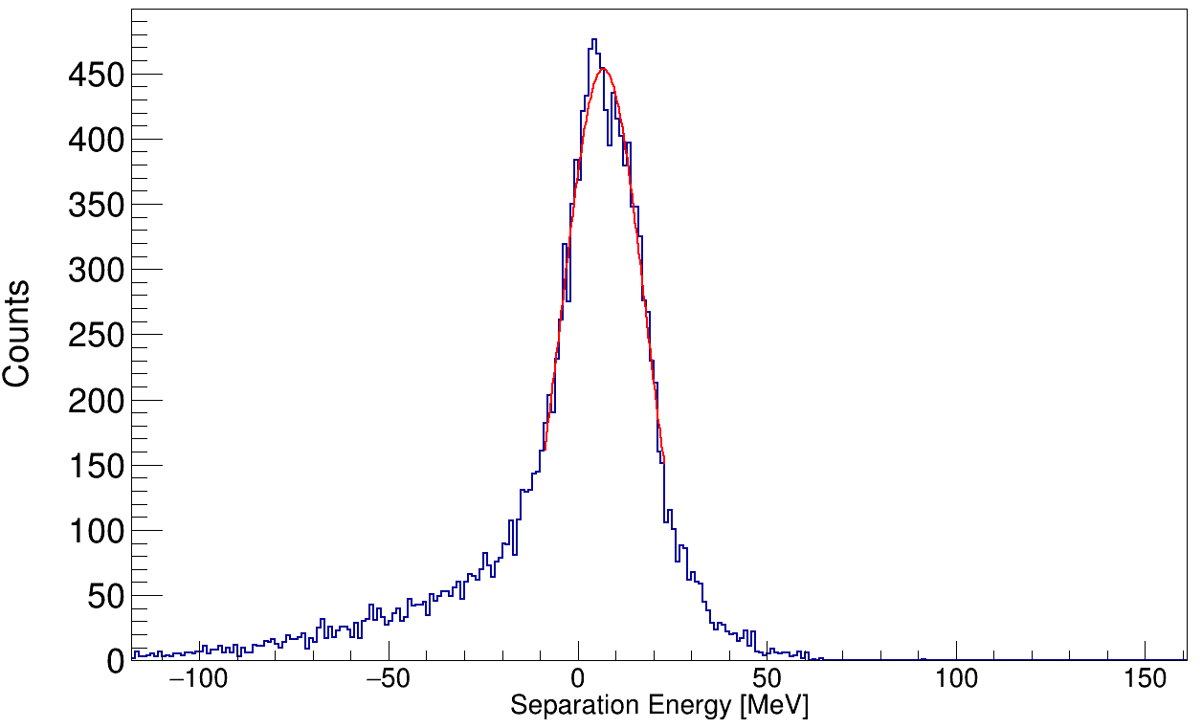
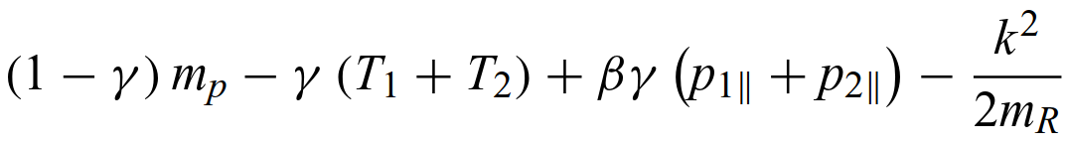
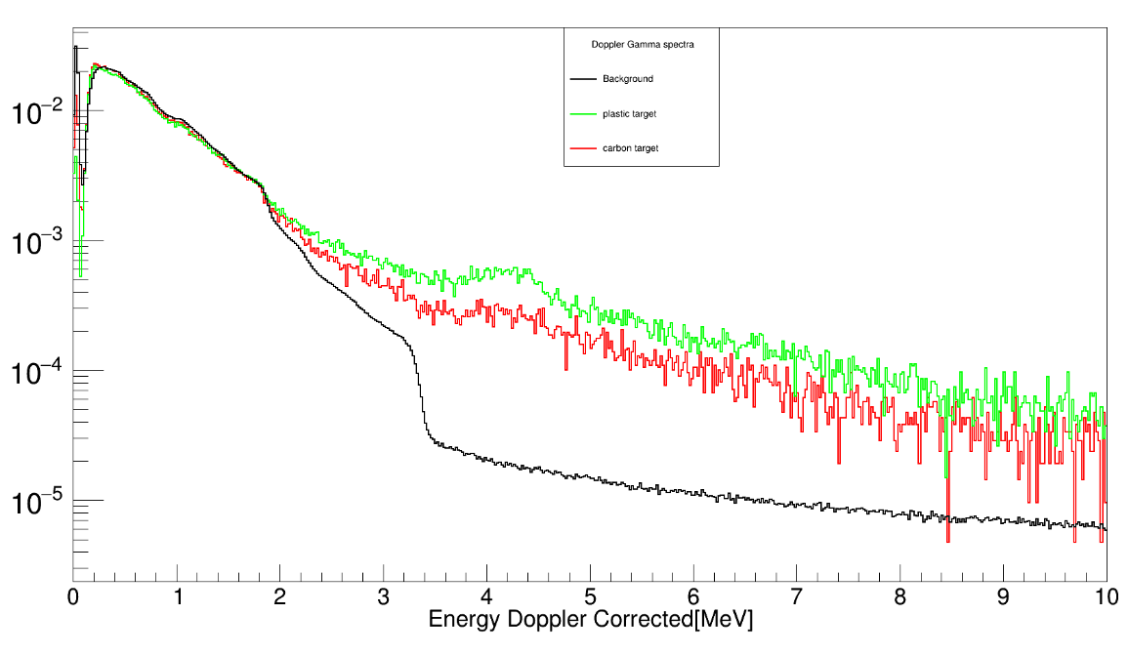
Outlook
Analyze data with other CH₂ target lengths (24.53/24 mm)
Background subtraction with carbon target (5.4/10.86/21.98 mm)
→ Get cross section for QFS-process
Further investigations of nuclear properties, eg. proton separation energy
S_{p} = T_{tg} -T_{p1} -T_{p2} -T_{11B} =
S444 Comissioning Experiment can also be used for 12C – 12C inelastic scattering analysis
<S_{p}> ≈ 6.7 MeV/c²
¹¹B
4.4 MeV ¹²C first excited state
- CH₂ target
- C target
- background
Tobias Jenegger
<Foliennummer>

Slide 16



Thank you!

