Slide 1







Energy Reconstruction with CALIFA
Tobias Jenegger
Funded by the Deutsche Forschungsgemeinschaft (DFG, German Research Foundation)
under Germany’s Excellence Strategy – EXC-2094 – 390783311,
BMBF 05P19WOFN1, 05P21WOFN1
and the FAIR Phase-0 program
Physics with R³B
CALIFA – Design
TUM Members:
Roman Gernhäuser,Lukas Ponnath,Philipp Klenze,Tobias Jenegger

Slide 2
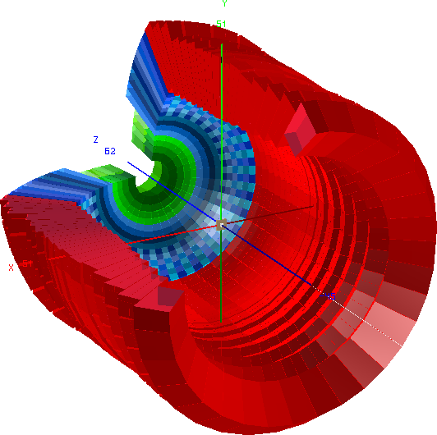
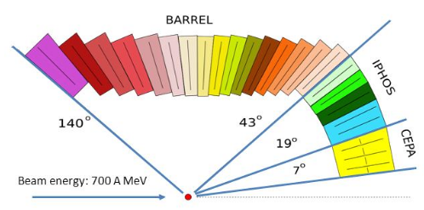
CALIFA Detector @ R³B
CALorimeter for the In Flight detection of γ-rays and light charged pArticles
Endcap:
iPhos:
512 CsI(Tl) crystals
CEPA:
96 LaBr3 &
LaCl3 crystals
Requirements:
-high dynamic range:
100 keV γ-rays – 700 AMeV charged particles
-high efficiency
-high granularity → Doppler correction
-particle identification
Barrel:
1952 CsI(Tl) scintillator crystals
BEAM
Over 2500 crystal channels!

Slide 3
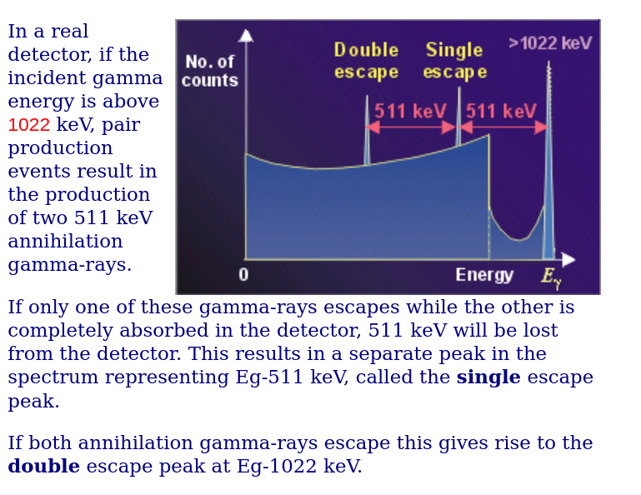
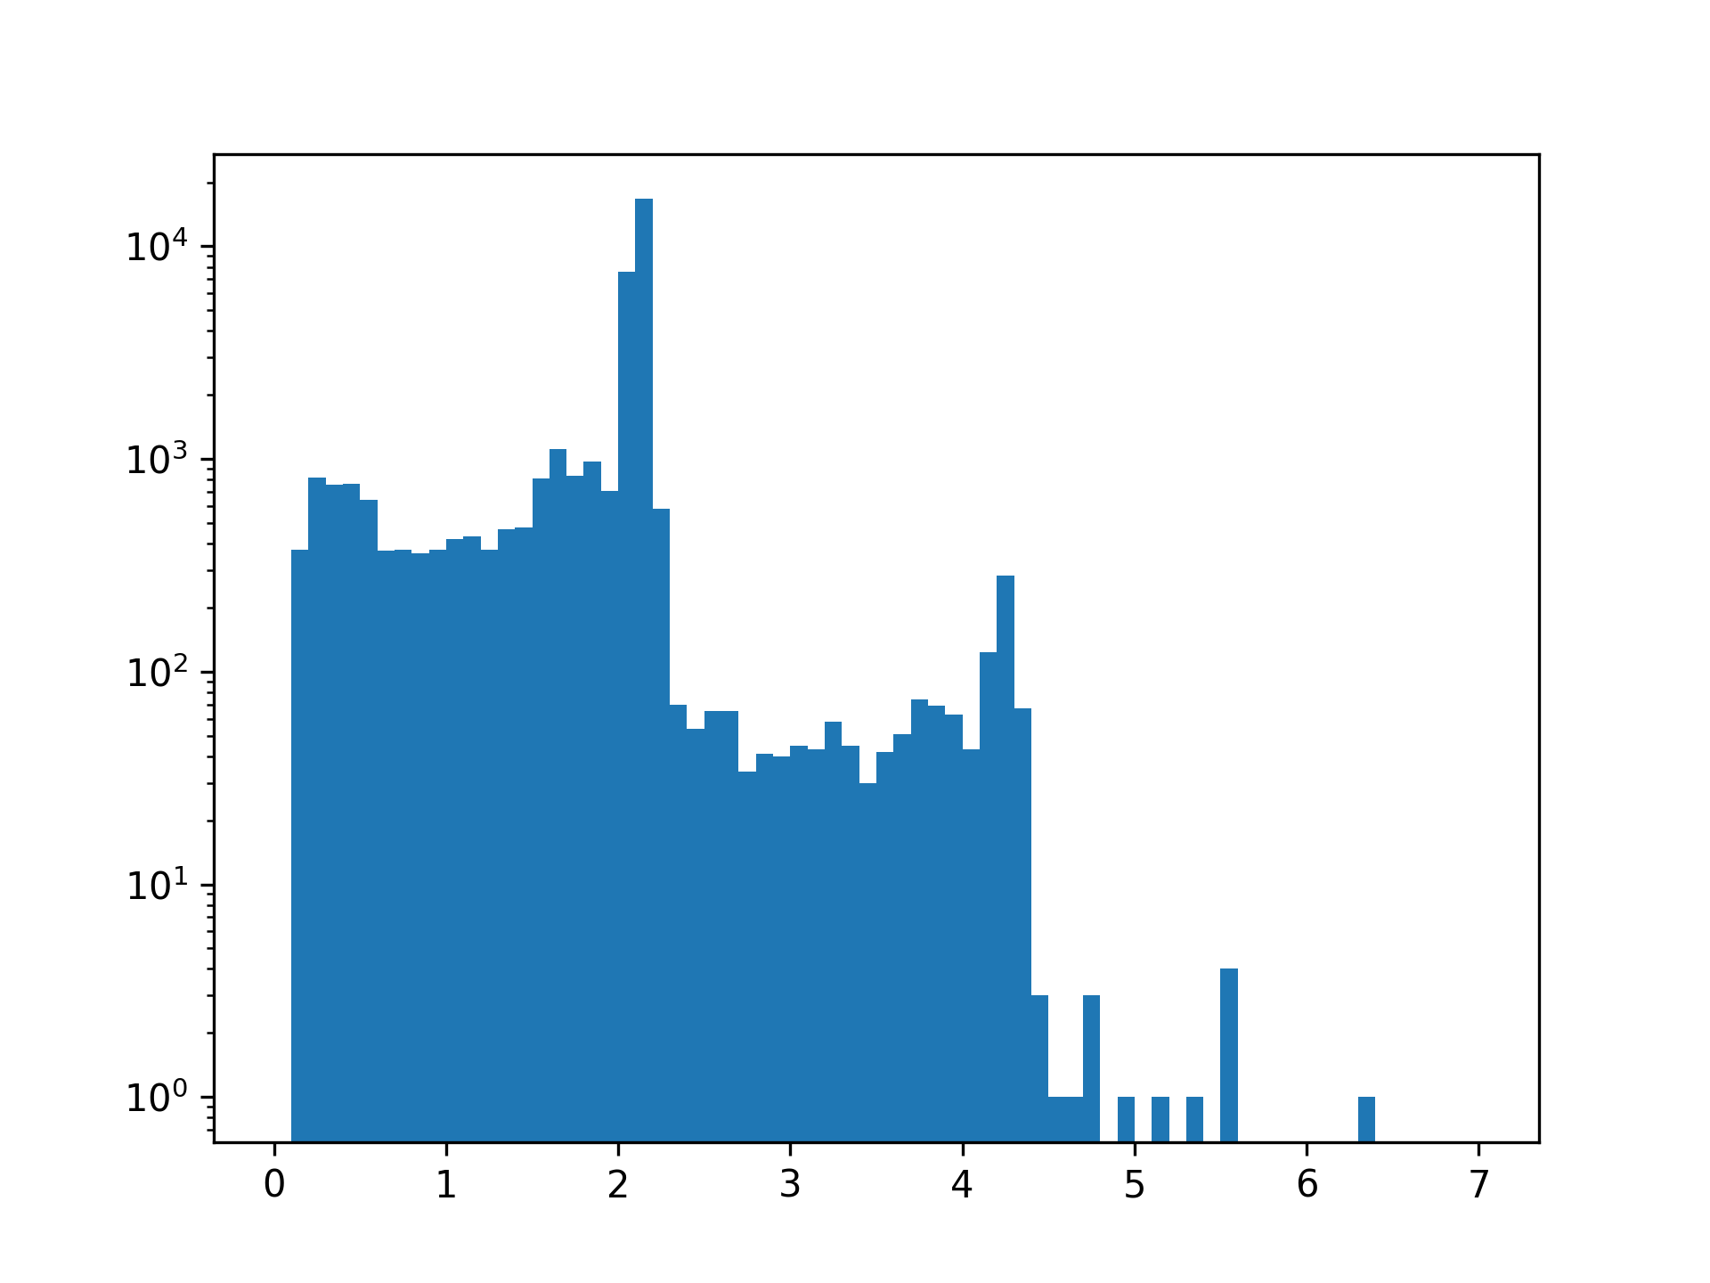
Observables
Energy
Hit Time
Spatial Position
Correlation with neighboring crystals
2.141 MeV
Customized Cluster
Energy [MeV]

Slide 4
Standard Cluster Algorithm
User defines shape and size of cluster:
(and set energy threshold for single crystals)
Sort the hit list according to their energy
30. MeV
1. create cluster centered around first hit
2. loop over all hits in list
→ if hit inside cluster add it and remove it from the list
3. Do this procedure until list is empty
22. MeV
10. MeV
5. MeV
3. MeV
2.5 MeV
0.7 MeV

Slide 5
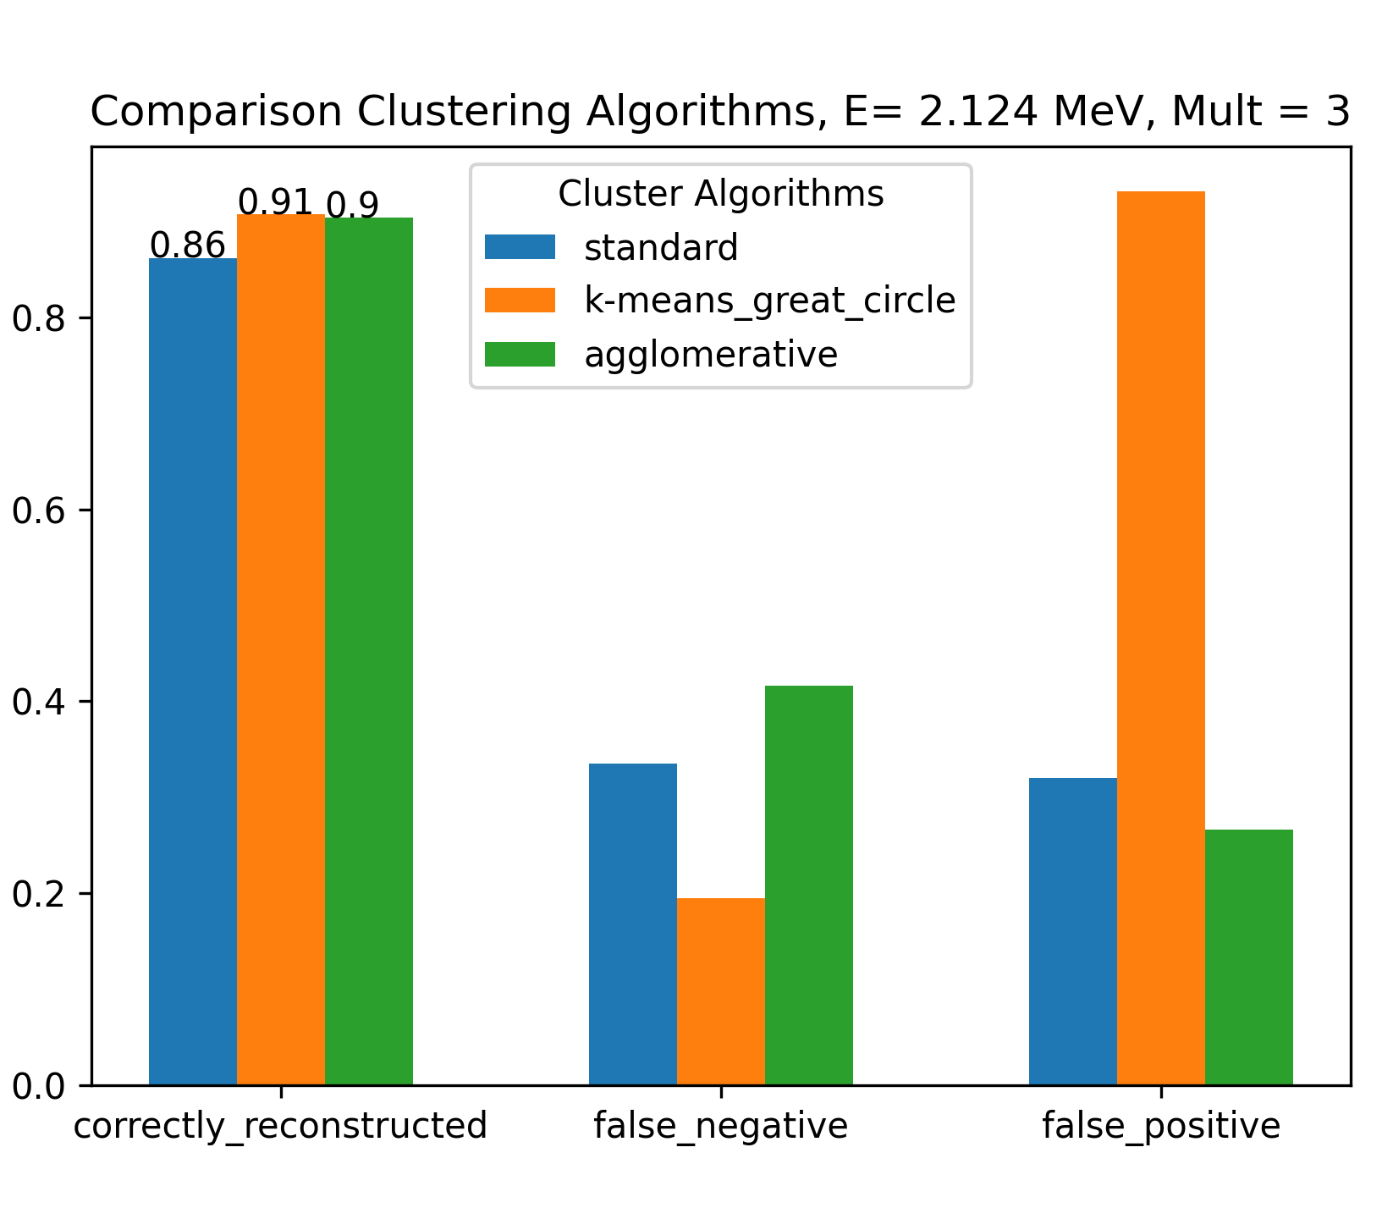
Summary Clustering Methods
false_negative:
true cluster
reconstructed cluster
1.2
0.8
0.124
1.2
0.8
0.511
false negative
=
false_positive:
true cluster
reconstructed cluster
1.2
0.8
0.124
1.2
0.8
0.511
false positive
=

Slide 6
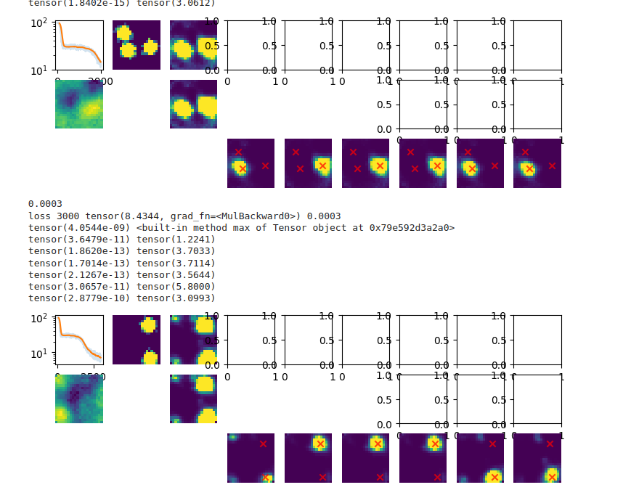
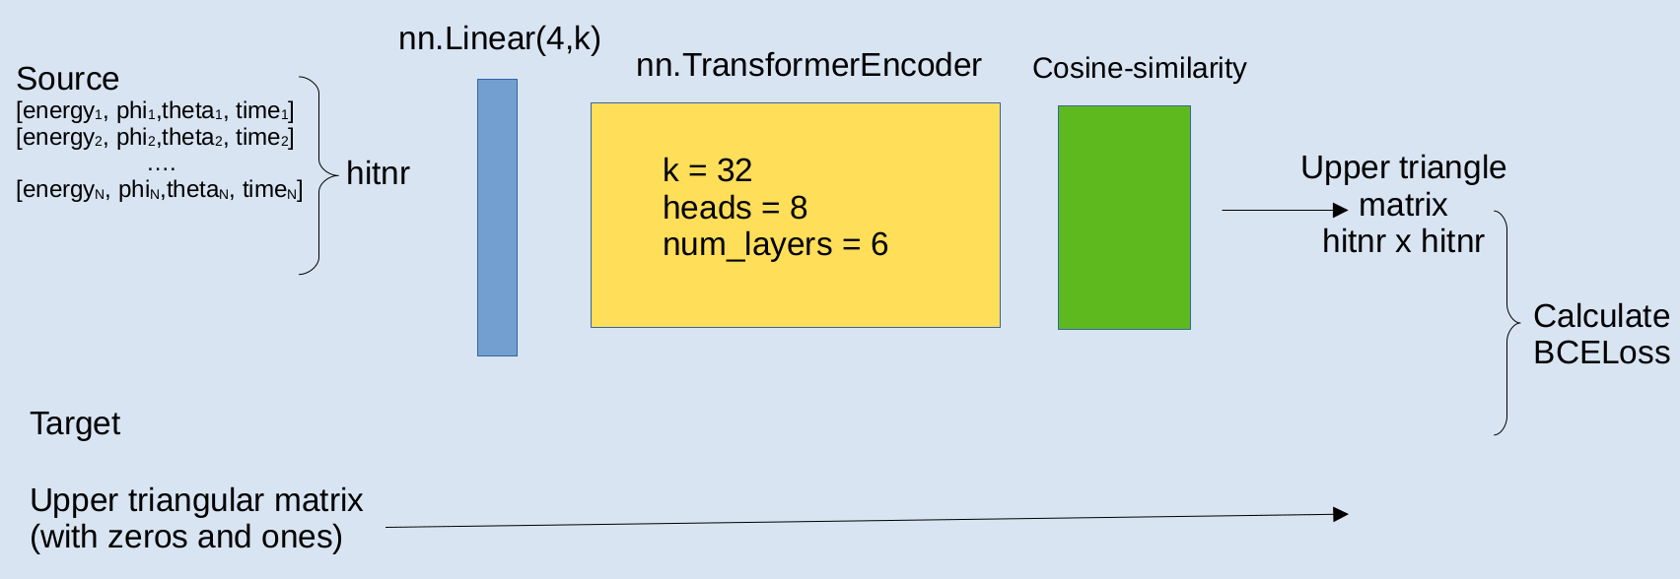
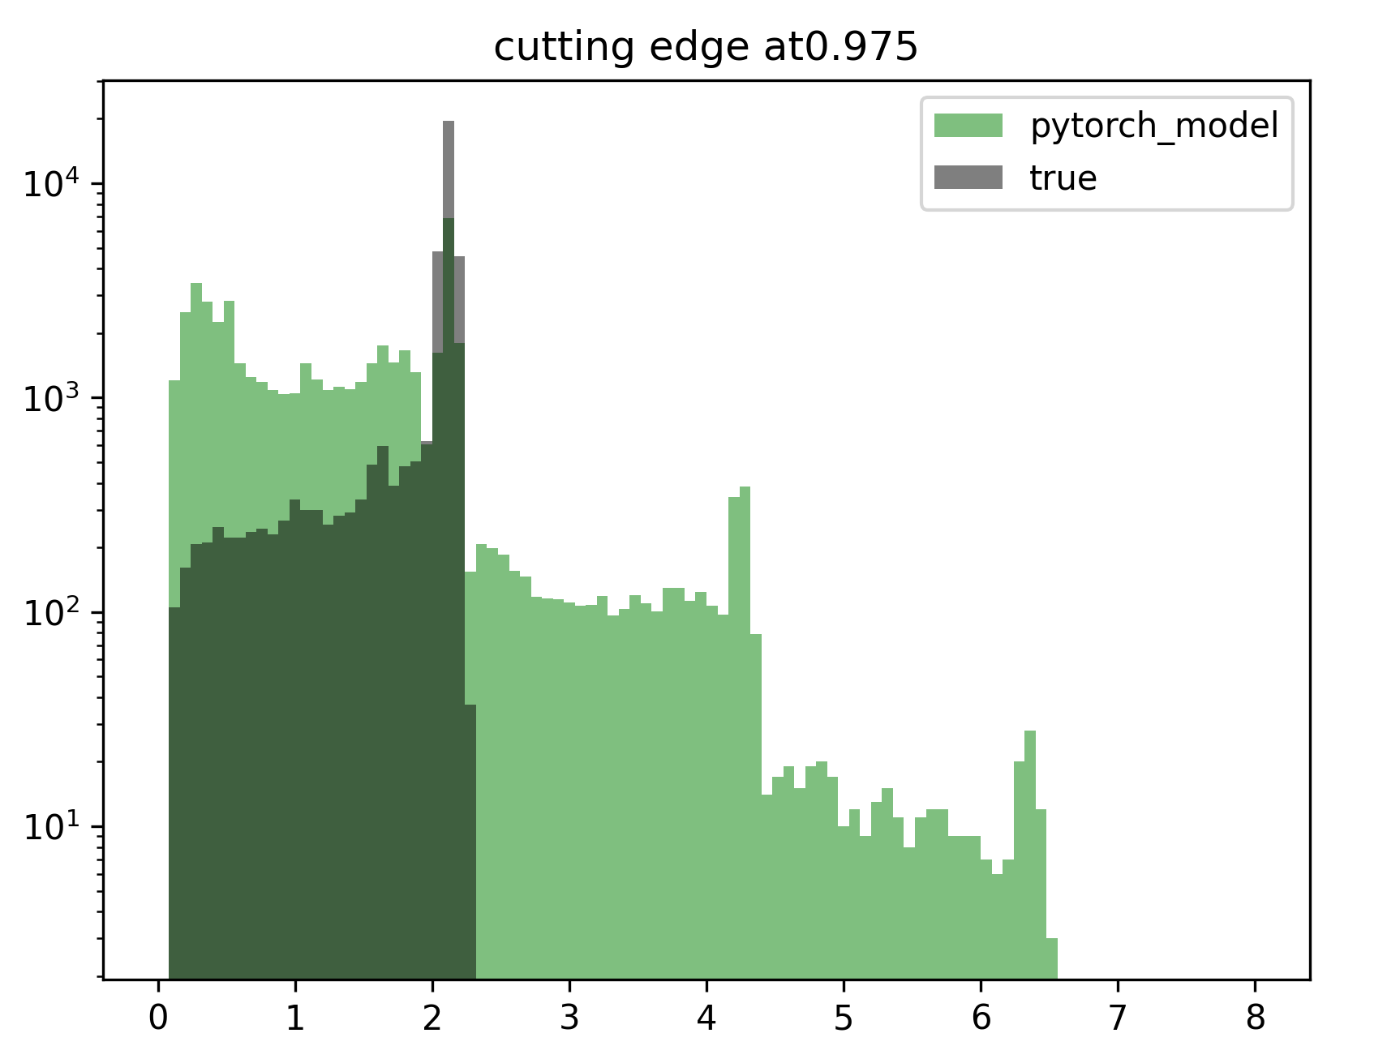
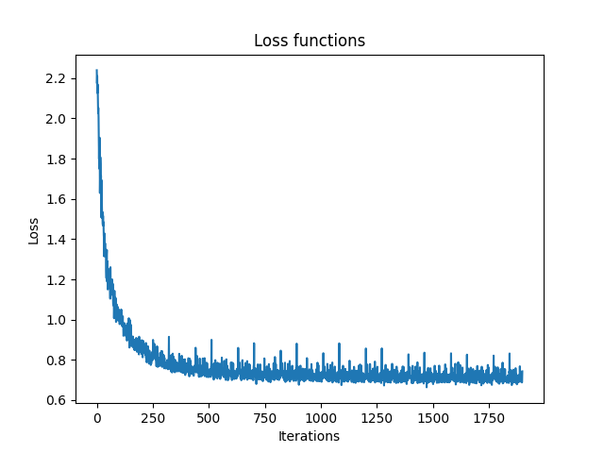
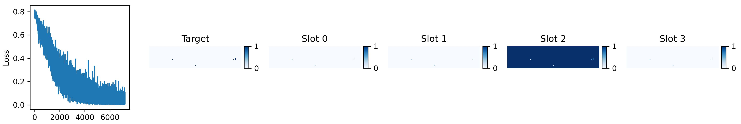
Implementation of Complex ML Models
slot_and_tspn_onenotebook from Lukas Heinrich
Transformer Model:
Invariant Slot Attention:
None of the models perfomed well / converged !!!

Slide 7
Next Step:
Agglomerative Model + Basic Feed Forward Model

Slide 8
Idea
Use first agglomerative method to cluster
Select events where we have too many clusters (false negative)
Feed the clusters to feed forward model (calculating cm of clusters)
x
x
x
Note:
All data you see next is a subset of the whole dataset. It corresponds to events where the agglomerative model has created too many clusters
x
x
x
x
This is one true red cluster. The agglomerative method reconstructed two
x
x
x
x

Slide 9
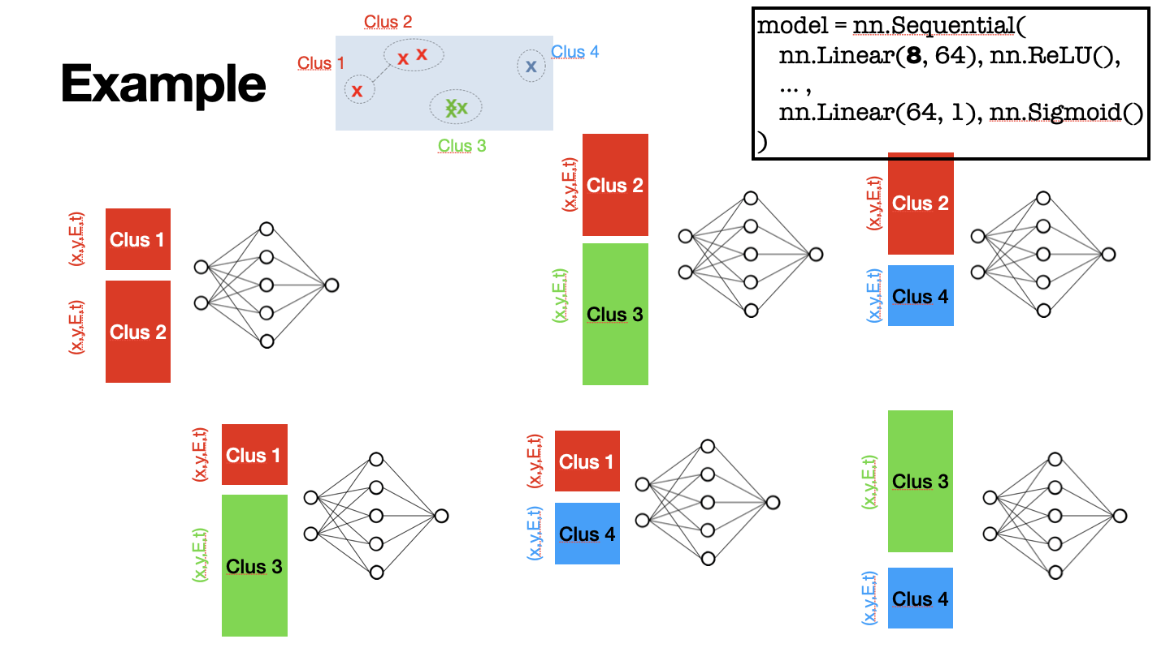
Tested Feed Forward Models
Basic Scheme:
Def init :
self.linear = torch.nn.Linear(8,64)
self.activation = torch.nn.ReLU()
self.linear_back = torch.nn.Linear(64,1)
….
Def forward:
output_tensor = self.linear(output_tensor)
output_tensor = self.activation(output_tensor)
output_tensor = self.linear_back(output_tensor)
output_tensor = torch.sigmoid(output_tensor)
output_tensor = torch.squeeze(output_tensor)
Input to model:
E1,θ1,φ1,t1,E2,θ2,φ2,t2
Tuning:
Lr
Feature size of hidden layer
Nr of hidden layers

Slide 10
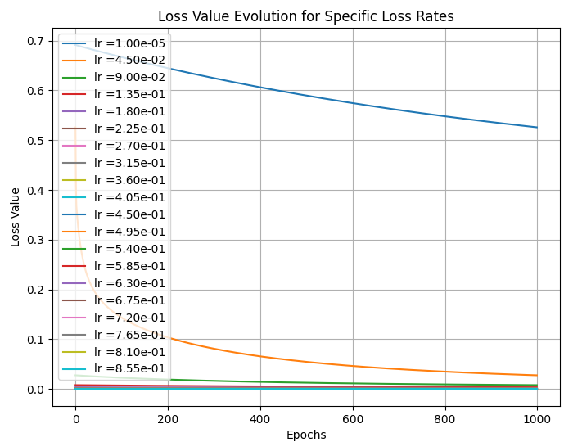
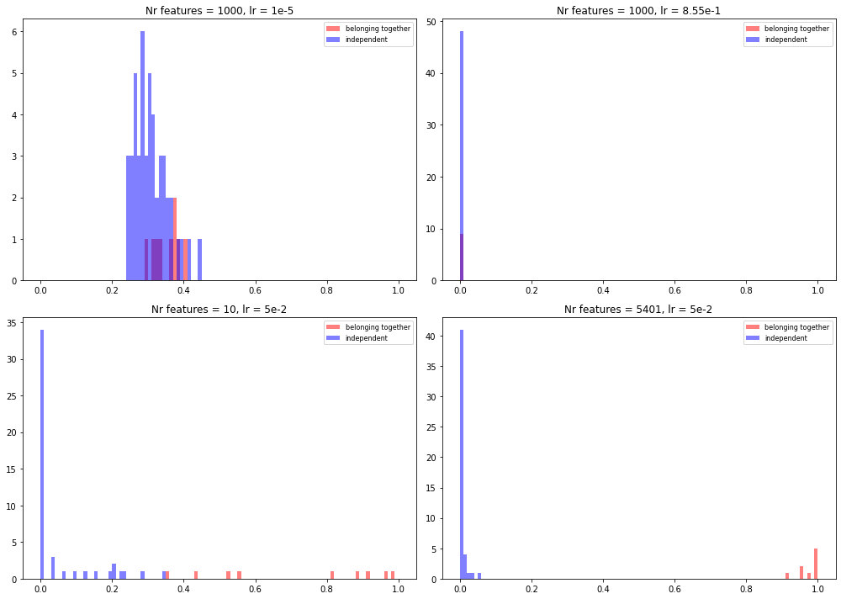
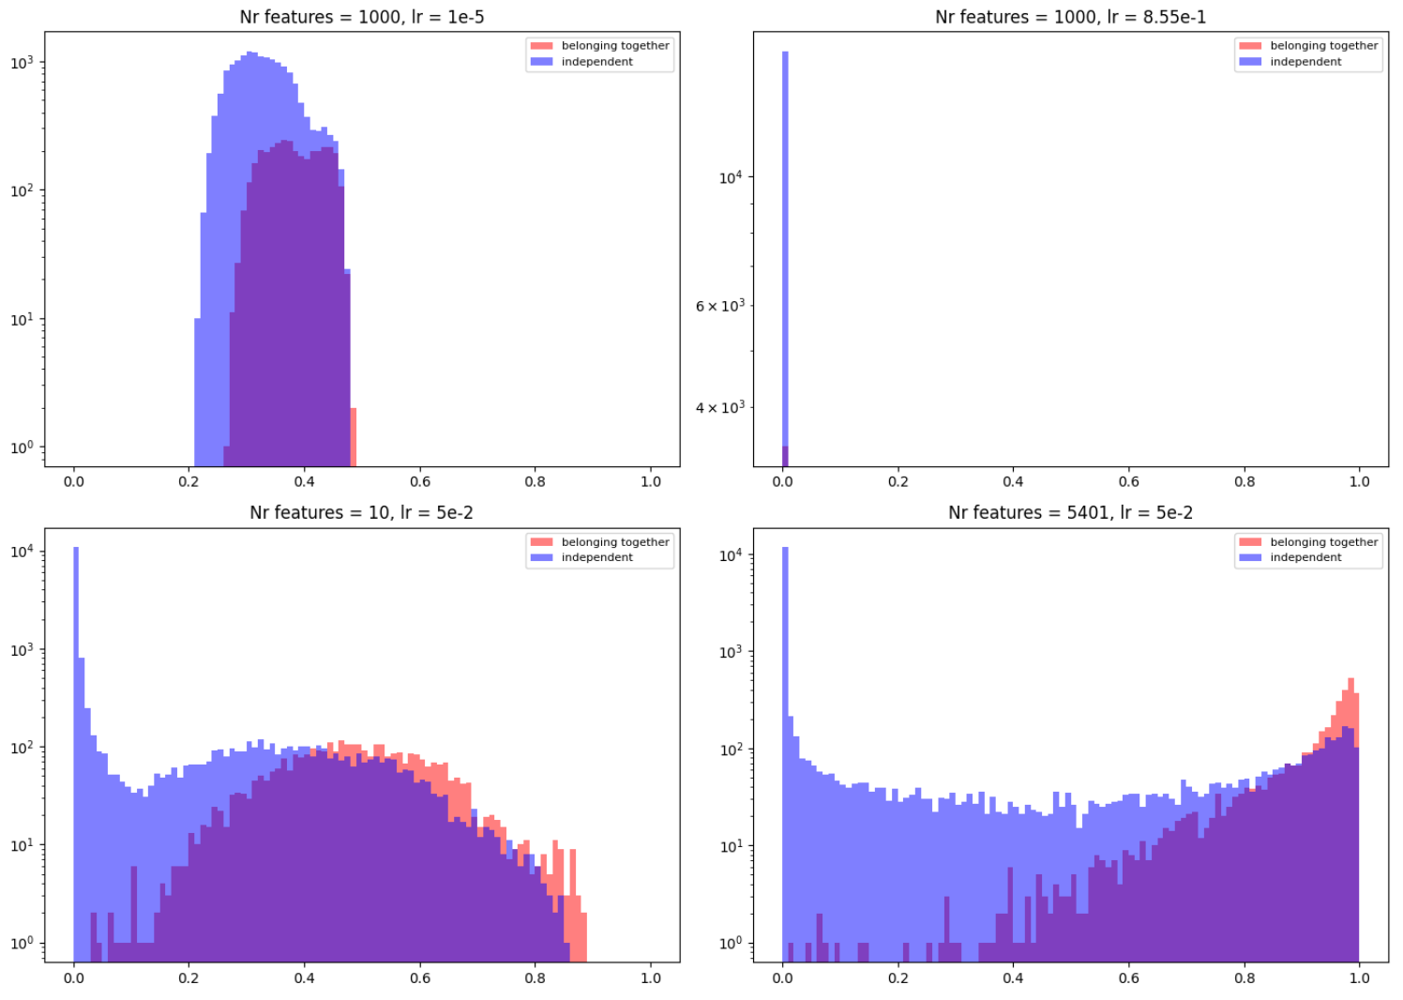
Tuning the Loss – Learning Rate
Prediction Distributions
Large data sample
Data size = 10 events
Overfit data to find out if we are in meaningful hyperparameter space

Slide 11
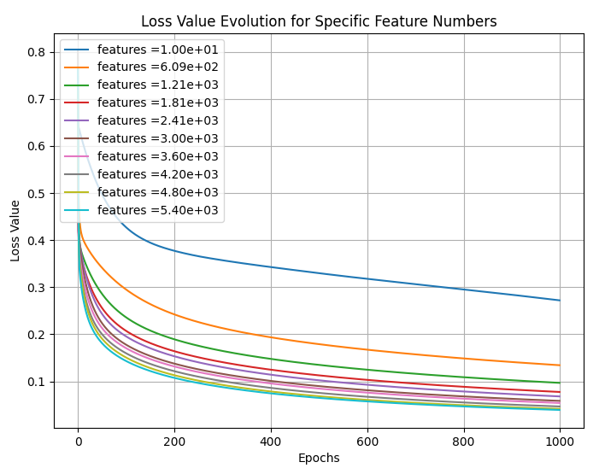
Tuning the Loss – Feature Size
Prediction Distributions
Large data sample
Data size = 10 events
Overfit data to find out if we are in meaningful hyperparameter space

Slide 12
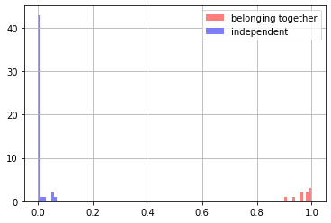
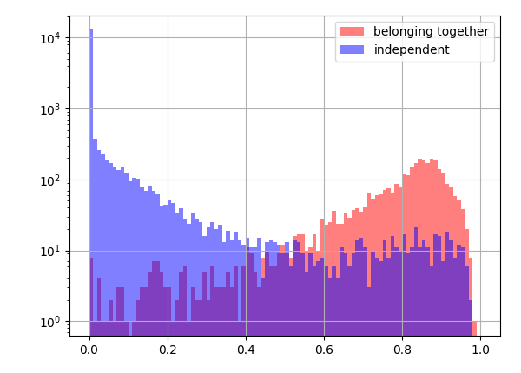
Tuning the Loss – Multiple Layer
Model:
First layer: 1000 features
Second layer: 100 features
Third layer: 100 features
Lr= 5e-3
10 events
Larger data size

Slide 13
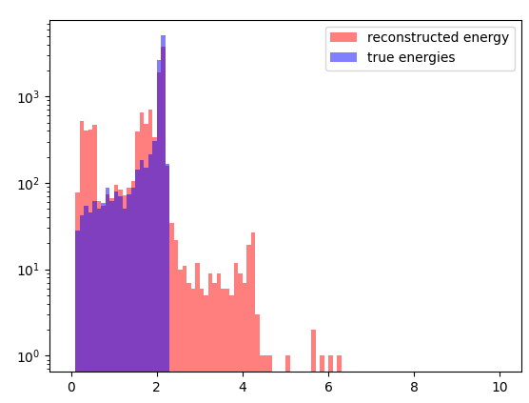
Tuning the Loss
Feature Size:
Learning Rate (lr):
Multiple Hidden Layers:
Model:
First layer: 1000 features
Second layer: 100 features
Third layer: 100 features
Lr= 5e-2
Energy Spectrum
Large feature size → low loss value!
Big Step size → low loss value!
Data size = 10 events
Overfit data to find out if we are in meaningful hyperparameter space

Slide 14
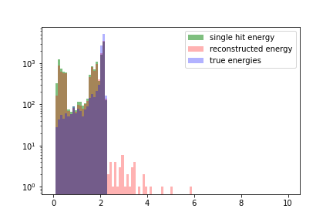
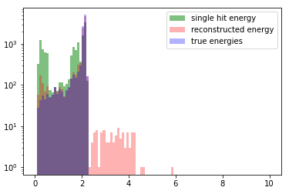
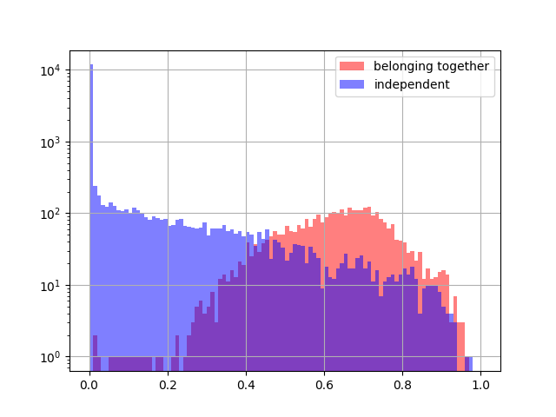
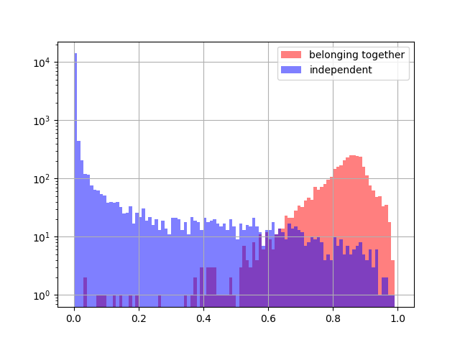
More features: Δt,ΔE,Δφ,Δθ
Only 8 features
Using 12 features
Energy [MeV]
Energy [MeV]
prediction value
prediction value
prediction value
In both cases same feed forward model !

Slide 15
Summary Agglomerative + Feed Forward
Basic Feed Forward Model implemented
Cluster recognition works quite well when using Δt,ΔE,Δφ,Δθ
Still to do:
Implement more features→ E1+E2,φ1+φ2,…
Use raw (not preclustered) data and only feed forward model
However:
→ NOT translation invariant ( maybe solved with geo. Algebra transformers GATs *)
→ does not focus on the whole event, but only looks at the single hit
→ only tested on training data → overfitting issue…
→ this model only works on simulated data, since for real data we do not have the cluster tags
→ as mentioned, only subset of preclustered dataset used!
Idea from my side:
→ Implement an autoencoder do extract hidden features of cluster recognition
→ implement this features in e.g. agglomerative model to clusterize hits
How to implement this?
*https://github.com/Qualcomm-AI-research/geometric-algebra-transformer

Slide 16
Agenda & Deadlines
Deadline for CALIFA ODSL Project:
→ end of February/beginning of March
→ what should we have at that point of time?
→ How much fine-tuning can be done later on?
→ Intentions to write paper or the like?
*** Latest point of thesis submission : 30.06.2025 (end of contract with TUM) ***

Slide 17

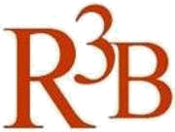

CALIFA @ Technical University of Munich (TUM)
Roman Gernhäuser, Lukas Ponnath, Philipp Klenze, Tobias Jenegger
Thank you!

Slide 18
Backup

Slide 19
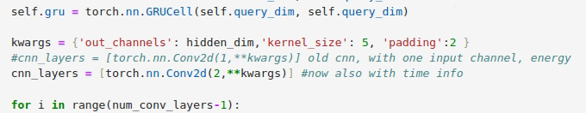
Invariant Slot Attention Model – also with time info
→ Dimension of mask: → same as before! 10 x 3 x 27 x 112
→ Dimension of evt_histogram_array : 10 x 2 x 27 x 112
#observables: time & energy
Lr = 5e-5
Loss function does not converge!

Slide 20
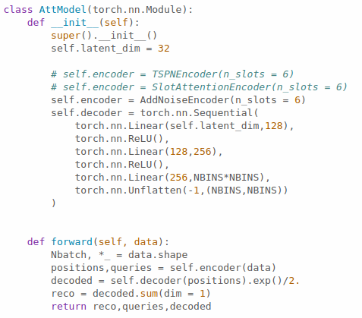
slot_and_tspn_onenotebook from Lukas Heinrich
https://gist.github.com/lukasheinrich/31d06bc4918e52d7ae3663a197b90d71
data
summed prediction
prediction for the k-slots

Slide 21
Transformer model
nn.Linear(4,k)
Source
[energy1, phi1,theta1, time1]
[energy2, phi2,theta2, time2]
….
[energyN, phiN,thetaN, timeN]
nn.TransformerEncoder
Cosine-similarity
hitnr
k = 32
heads = 8
num_layers = 6
Upper triangle matrix
hitnr x hitnr
Calculate BCELoss
Target
Upper triangular matrix
(with zeros and ones)

Slide 22
Transformer model – further parameters
Batchsize = 64
Feature number = 32
n_epochs = 10
Loss_rate = 2e-4
Loss function = nn.BCELoss()
Lossfunction = nn.BCELoss()

Slide 23
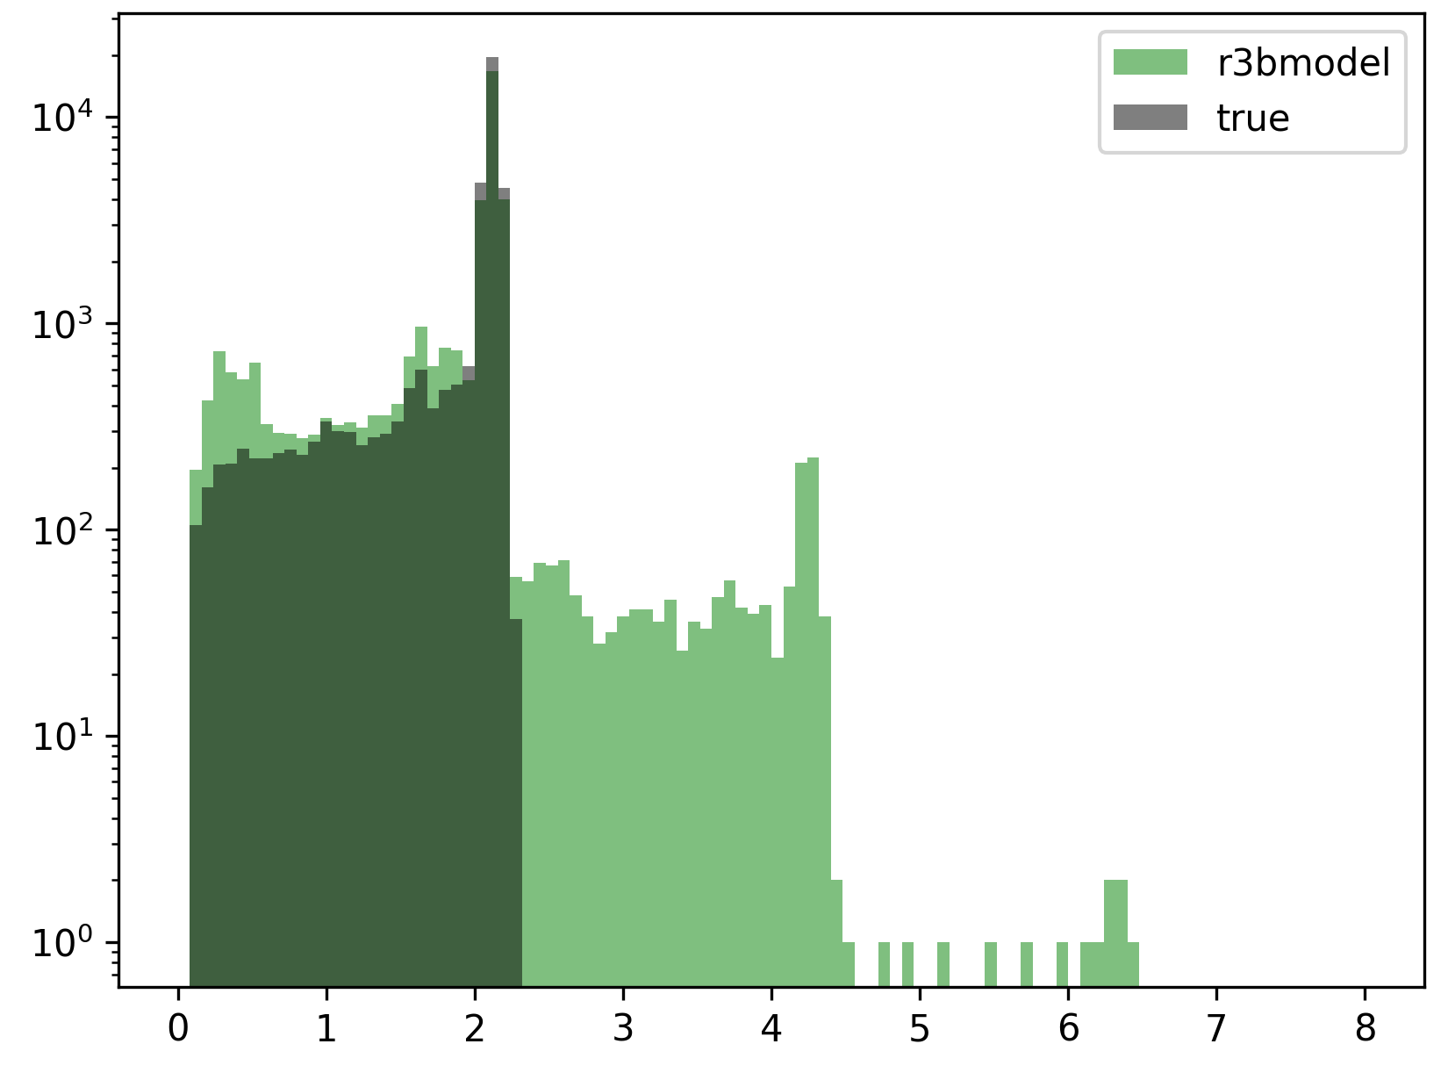
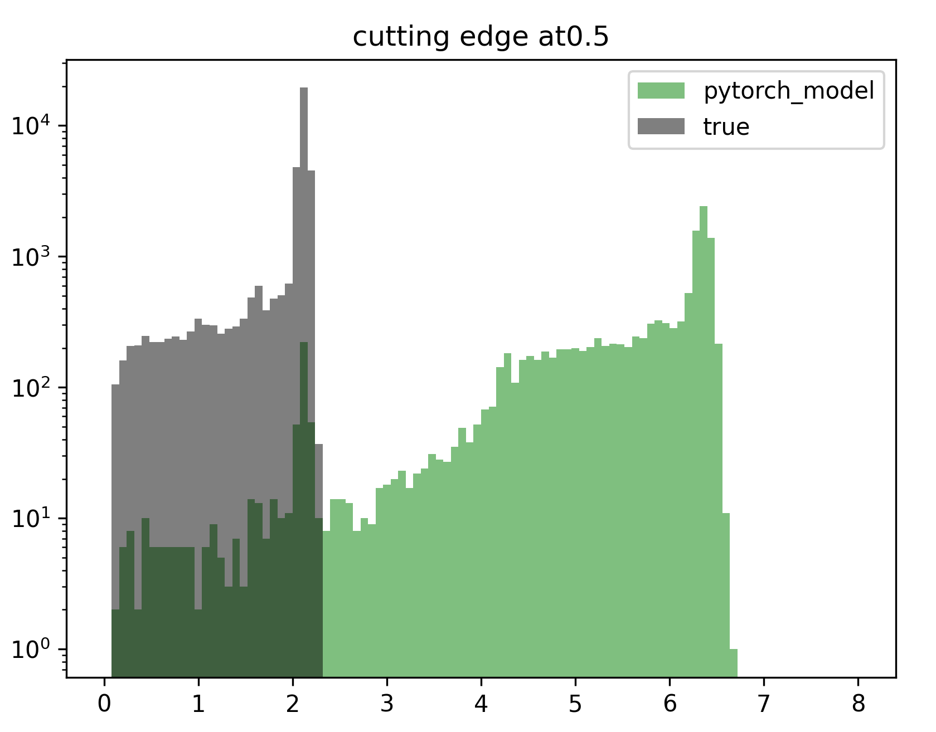
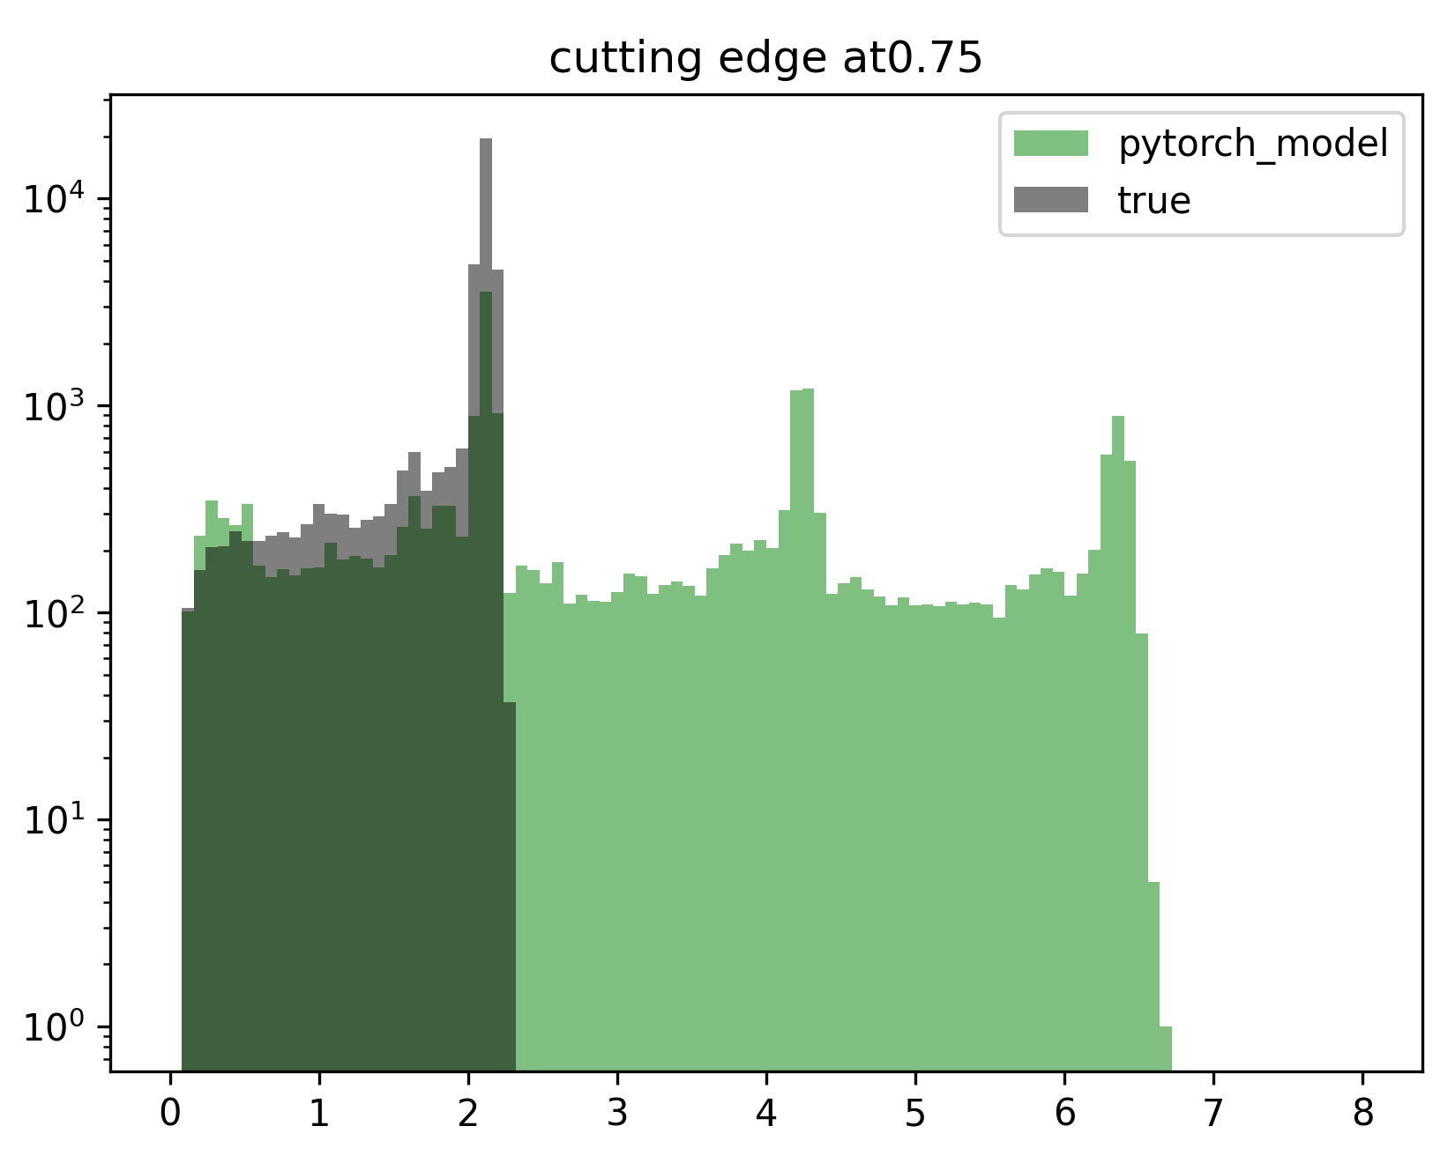
Standard Cluster vs True Clusters
How do the energy spectra look like?
How to clusterize hits from output of transformer model:
1) Take the upper triangular matrix tri[hitnr x hitnr]
2) set “merge cut”. If tri[i,j] > “merge_cut” → hits belong to same cluster
3) do this for all combinations and merge them appropriately
Energy [MeV]
Energy [MeV]
Energy [MeV]
Energy [MeV]

Slide 24
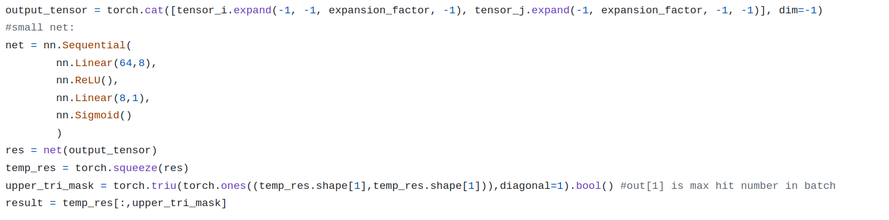
Why energy spectra so bad while loss function seems to decrease ?
Most entries in model output tensor ~0.5. This diminishes the loss BCELoss function!
How to improve?
Include some cut condition in the forward part of the transformer model
→ discontinuity of loss function → no learning!
Use linear net instead of cosine similarity
No improvements!

Slide 25
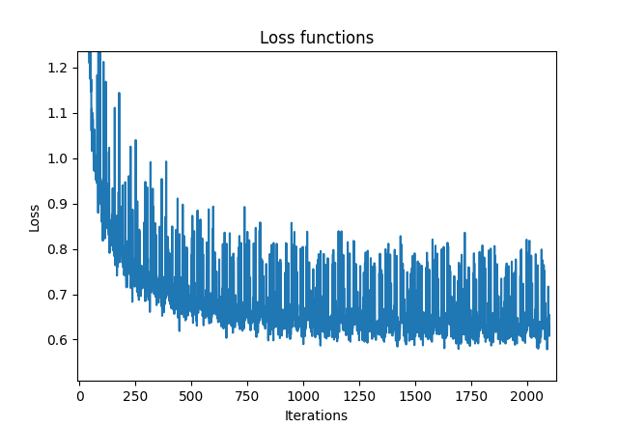
Agglomerative Model + Transformer Model
Idea:
Use first agglomerative method to cluster
Select events where we have too many clusters (false negative)
Feed the clusters to the transformer model (calculating cm of clusters)
x
x
x
x
x
x
x
This is one true red cluster. The agglomerative method reconstructed two
x
x
Transformer Model
x
x

Slide 26
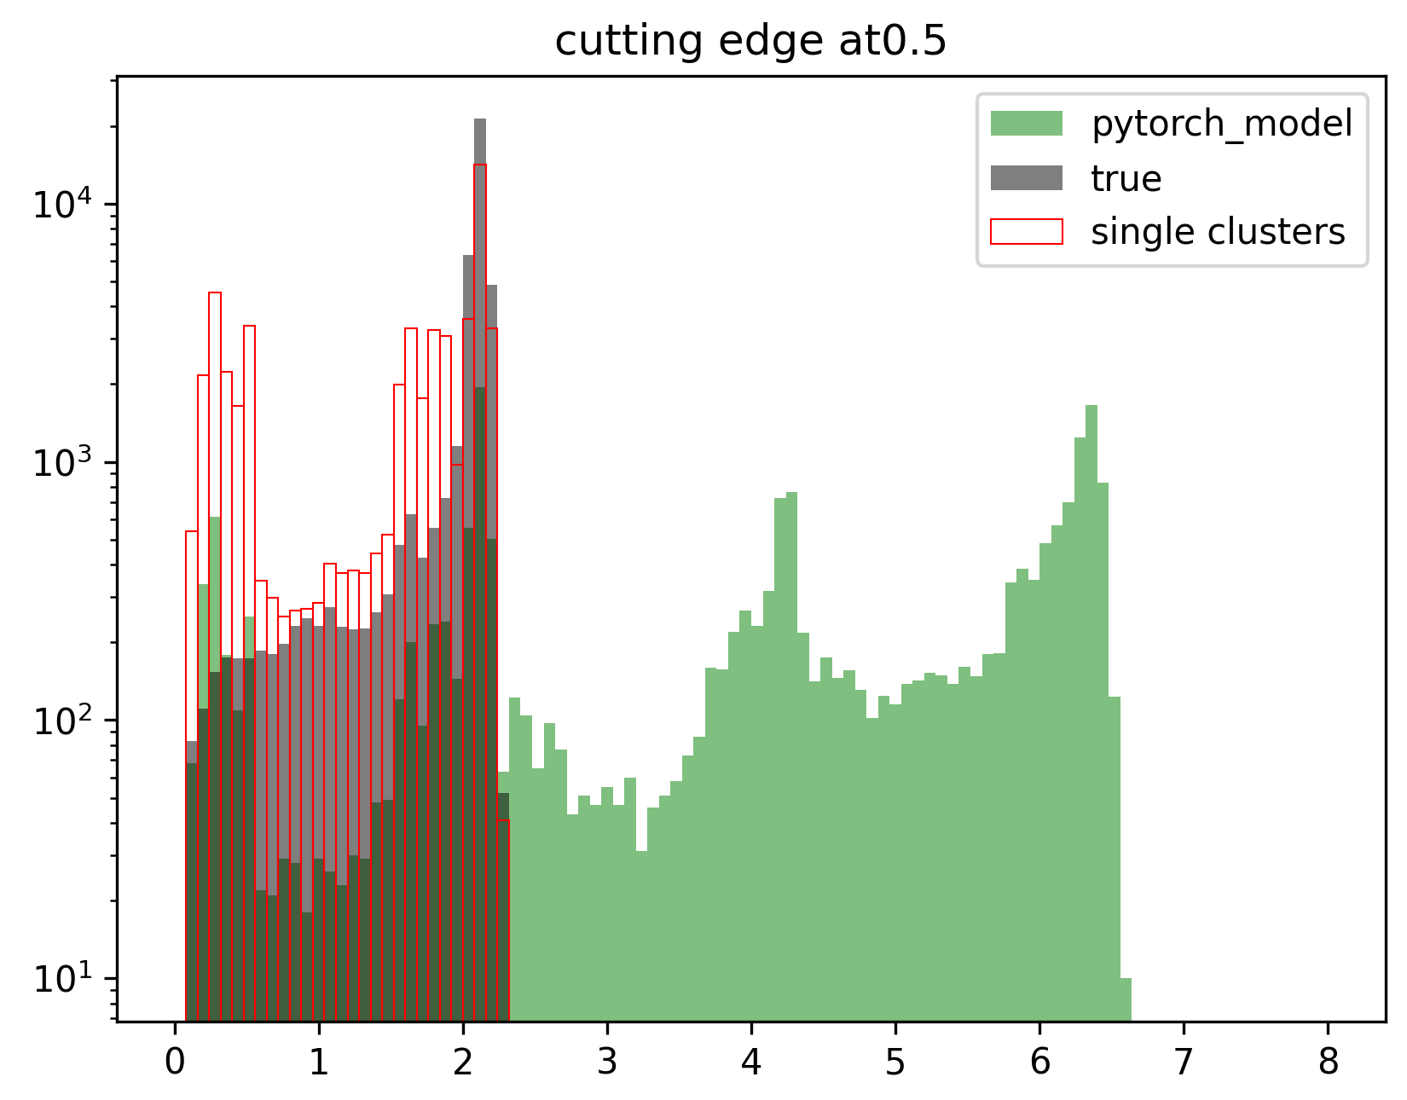
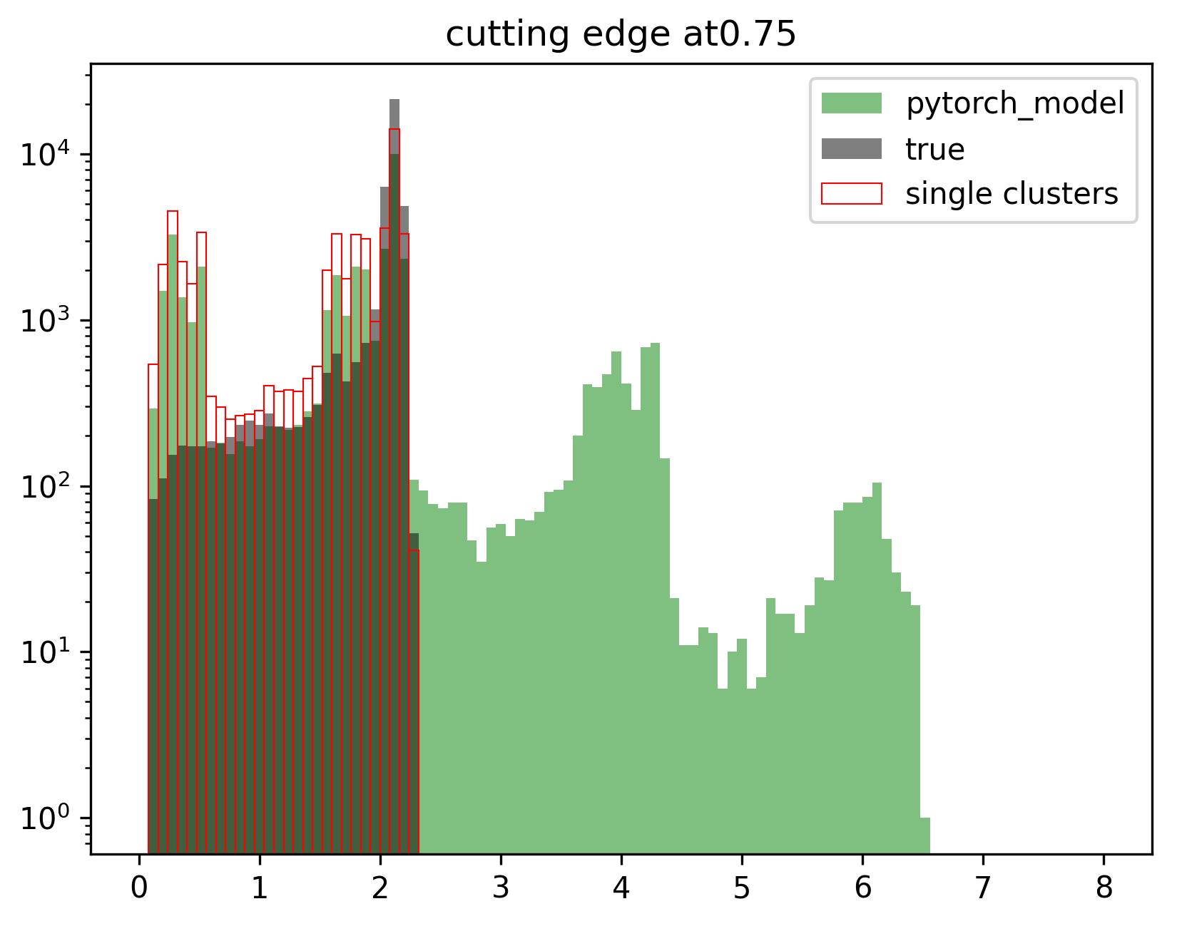
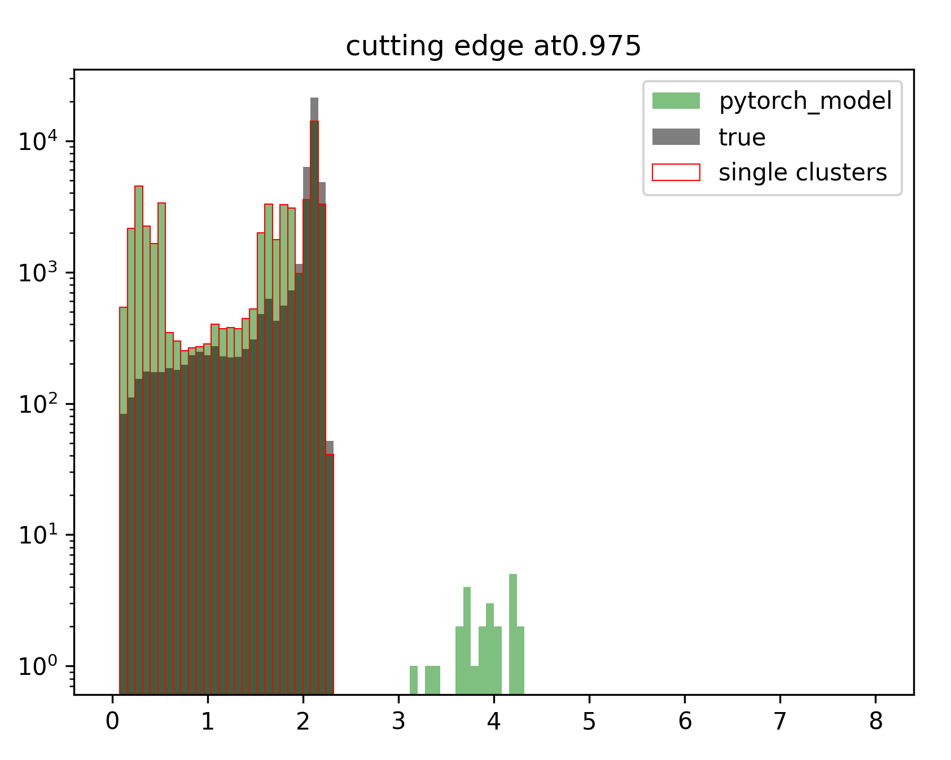
Reconstruction with transformer model (after application of agglomerative model)
Energy [MeV]
Energy [MeV]
Energy [MeV]
No improvement in reconstruction,
High cutting edge → = single clusters
Low cutting edge → too many clusters are merged
Cutting edge: model give output in range [0,1]. Cutting edge is threshold:
If cutting edge > pairwise cluster output → clusters do not belong together
If cutting edge < pairwise cluster output → clusters belong together

Slide 27
Single Feed Forward NN
Since transformer method not successful, start with basic model:
Def init :
self.linear = torch.nn.Linear(8,64)
self.activation = torch.nn.ReLU()
self.linear_back = torch.nn.Linear(64,1)
….
Def forward:
output_tensor = self.linear(output_tensor)
output_tensor = self.activation(output_tensor)
output_tensor = self.linear_back(output_tensor)
output_tensor = torch.sigmoid(output_tensor)
output_tensor = torch.squeeze(output_tensor)

Slide 28
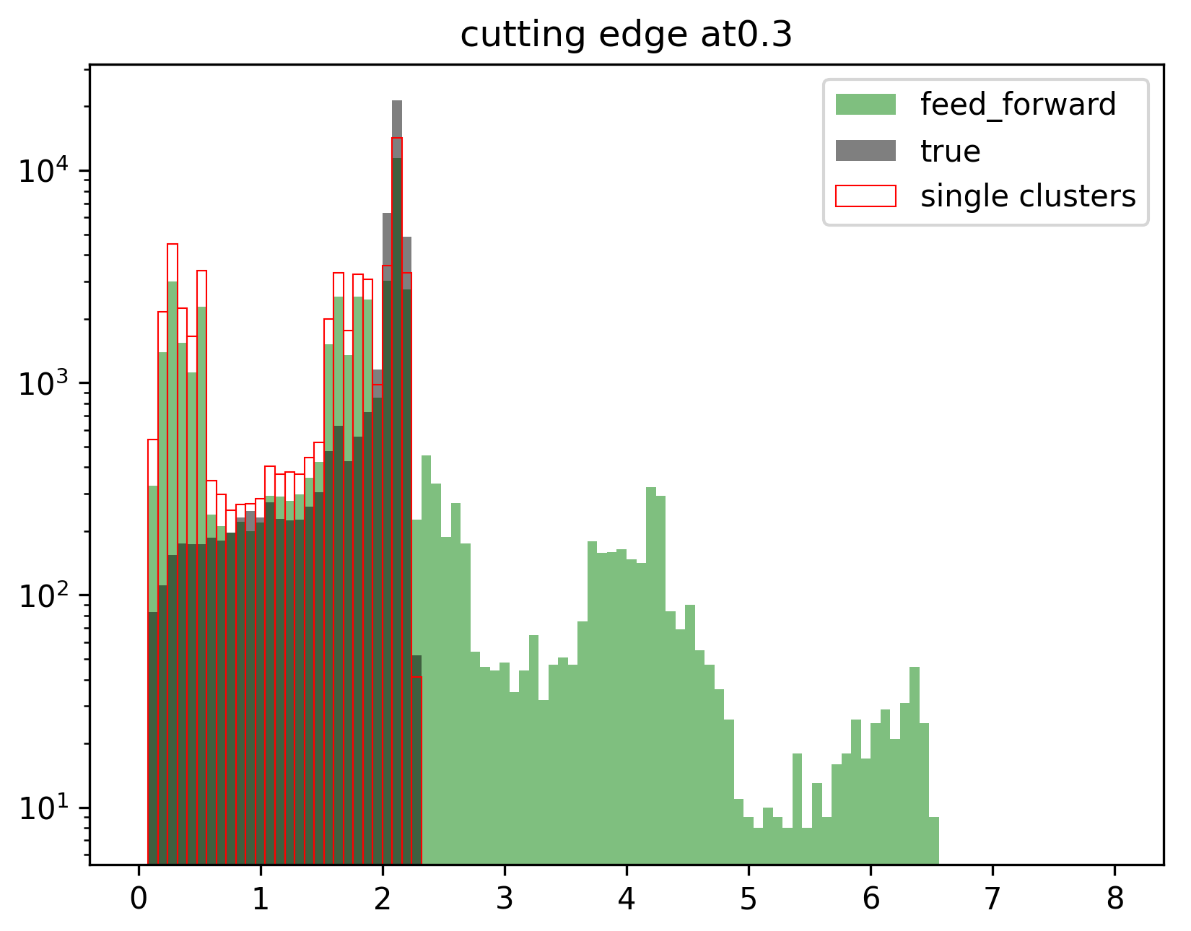
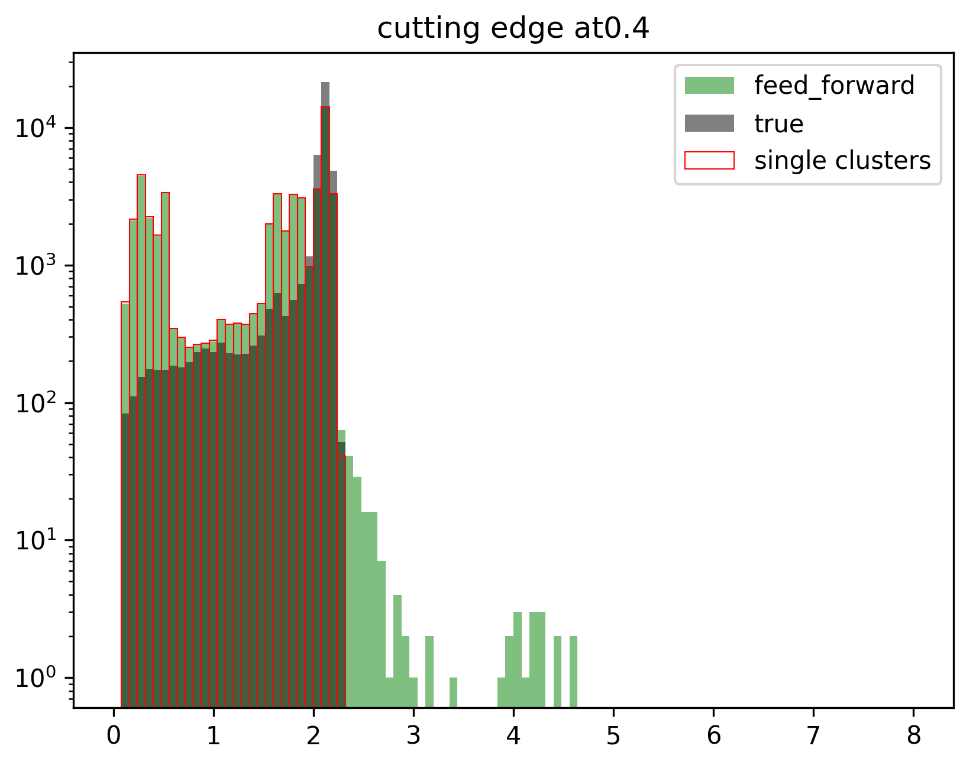
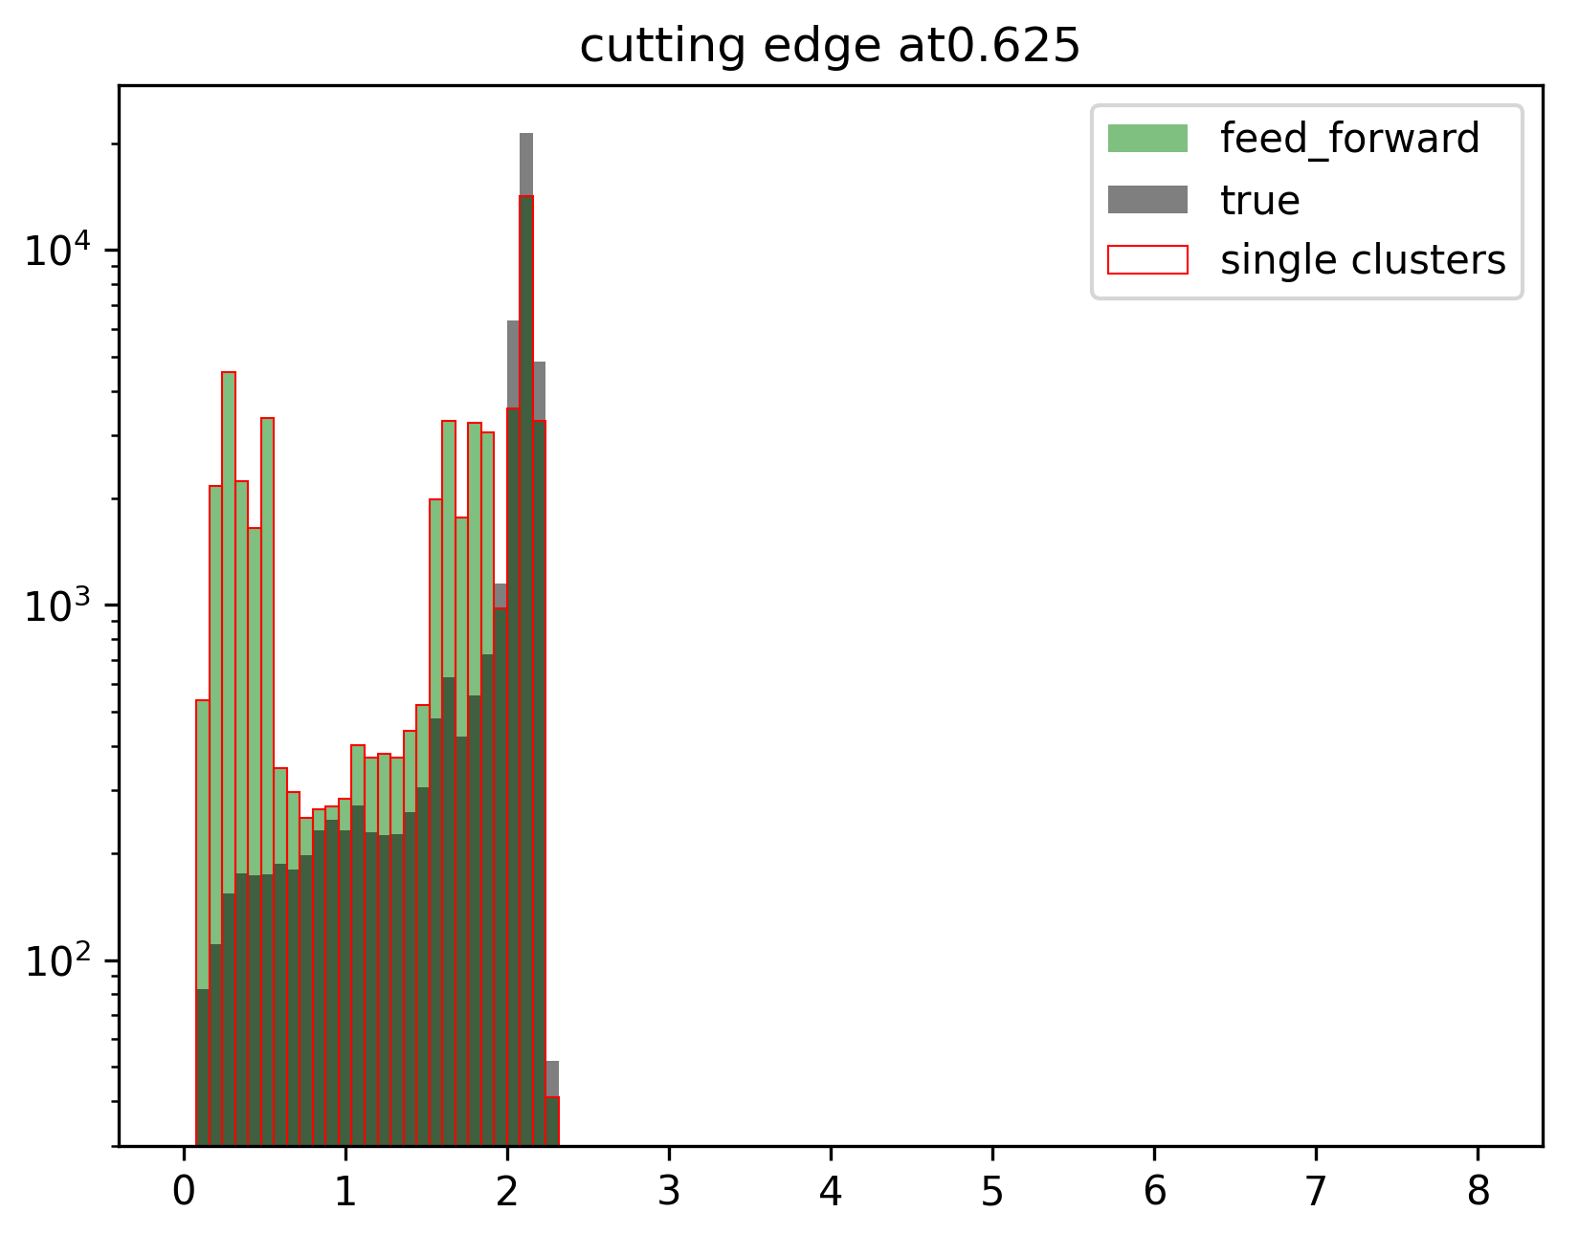
Reconstruction with feed forward (after application of agglomerative model)
Energy [MeV]
Energy [MeV]
Energy [MeV]
0: indep. hits
1: belonging together
8 features
[0,1]
10⁴ nodes
10⁴ nodes
No improvement in reconstruction!

Slide 29
Reconstruction with feed forward (after application of agglomerative model)
Reconstruction with feed forward (after application of agglomerative model)
Feature Size vs Loss Rate for Single Feed Forward Model:
Feed forward layer with n number of features
Preclustered input data
(8 features)
Output: [0,1]
Large feature size → low loss value!

Slide 30
Reconstruction with feed forward (after application of agglomerative model)
Reconstruction with feed forward (after application of agglomerative model)
Learning Rate vs Loss Rate for Single Feed Forward Model:
Feed forward layer with n number of features
Preclustered input data
(8 features)
Output: [0,1]
High learning rate → low loss value!

Slide 31
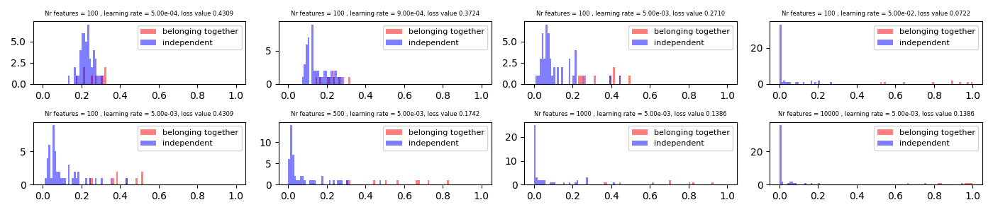
Prediction value distribution
Note: here I used only 10 events! Models should be over-determined….

Slide 32
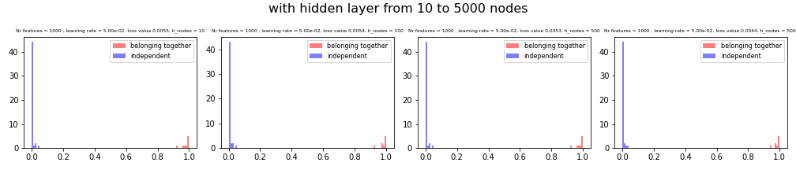
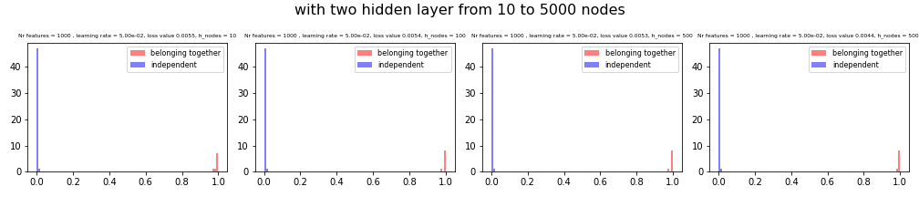
Using more hidden layers….
One hidden layer:
Features =1000
Preclustered input data
(8 features)
Output: [0,1]
Features: 10-5000
Two hidden layers:
Features =1000
Preclustered input data
(8 features)
Output: [0,1]
Features: 10-5000

Slide 33
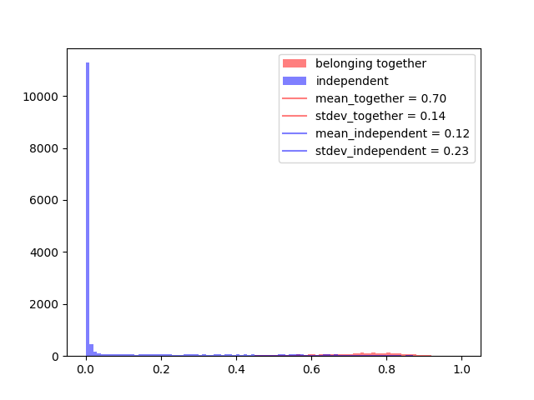
Applying Feed forward with two hidden layer on larger data...
Model:
First layer: 1000 features
Second layer: 100 features
Third layer: 100 features
Lr= 5e-2

Slide 34
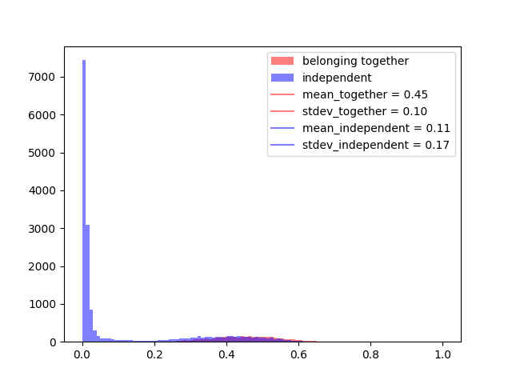
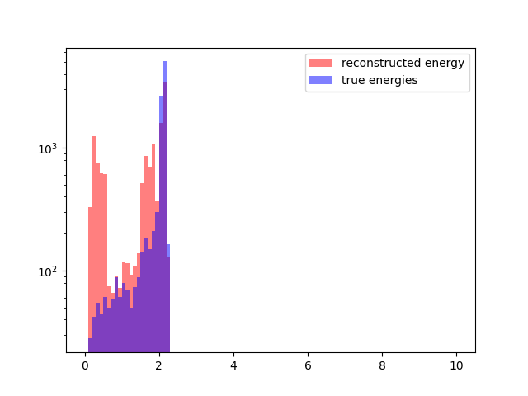
Using lower learning rate...
Model:
First layer: 1000 features
Second layer: 100 features
Third layer: 100 features
Lr= 5e-3

Slide 35
Using more features: delta_E, delta_theta, delta_phi, delta_t
Input features: 12 = (8+4)
Features =1000
Only 8 features
Preclustered input data
(12 features)
Output: [0,1]
Combine if output > 0.75
100 features
Lr = 5e-3
Bigger data sample used here
Using 12 features
Epochs = 10000
This is good!
But be aware: it’s training data,…
I have to provide validation data

Slide 36
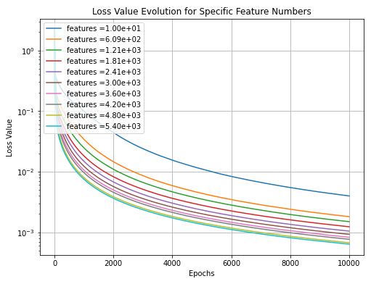

Loss: 8 vs 12 features
Here I use simple feed forward model, small data sample (10events)
Feed forward layer with n number of features
Preclustered input data
(8 features)
Output: [0,1]
8 input features
12 input features

Slide 37
Summary Feed Forward Model
Pros:
Cons:
→ does not reconstruct well the clusters
→ NOT translation invariant
→ does not focus on the whole event, but only looks at the single hit combinations per time
→ simple model, easy to deploy
Idea from my side:
→ Implement an autoencoder do extract hidden features of cluster recognition
→ implement this features in e.g. agglomerative model to clusterize hits
How to implement this?

Slide 38
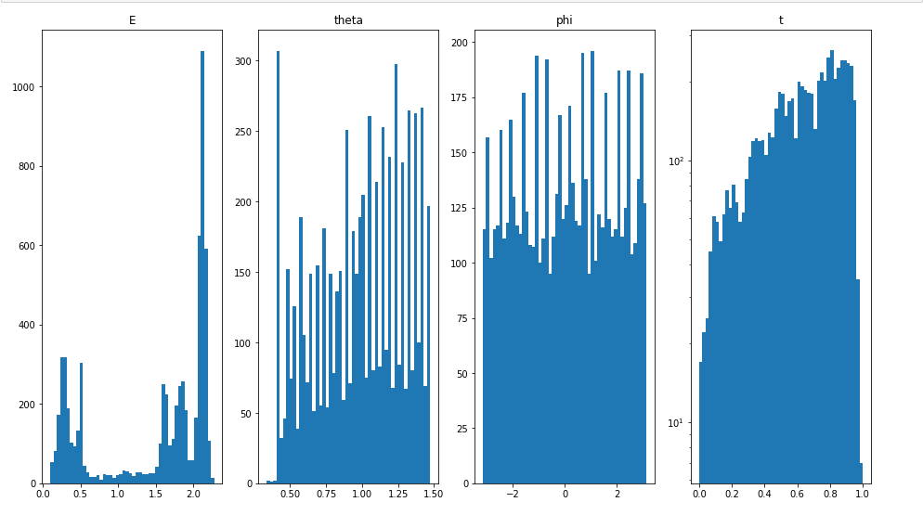
How data looks like we give to the feed forward NN
We applied agglomerative cluster
What you see here is already clustered data
BUT all events where you have too many clusters
Agglomerative clustering has also drawbacks:
Clustering is done using E,theta,phi,time where the time is taken as radius
→ time starts from 0 up to…
→ for time ~0 everything is clustered togeter!

Slide 39
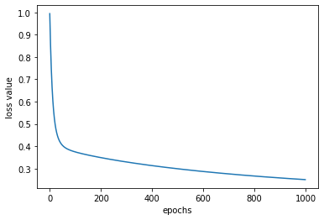
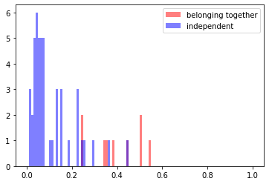
Selecting only 10 events (with 3 sub-events)
[ 0. 1.128016 0.913283 -2.69977 0.27121927]
[ 1. 0.952915 0.519144 0.878809 0.95261156]
[ 1. 0.434082 0.56767 -2.311936 0.93668561]
[ 2. 2.209619 1.105468 2.333682 0.52416023]
[ 3. 1.71197 1.189179 1.119164 0.78435412]
[ 3. 0.461599 0.777167 -0.144536 0.75403444]
[ 4. 2.029792 1.287946 1.30295 0. ]
[ 5. 0.756178 1.33176 -2.309371 0.68407621]
[ 6. 2.1872 0.476108 2.85122 0.8842718 ]
[ 7. 1.921325 1.287711 -2.407052 1. ]
[ 7. 0.24677 0.972258 1.512456 0.95922116]
[ 8. 2.12424 1.190137 0.532672 0.63181968]
[ 9. 2.165567 0.780356 1.333373 0.52338727]
[10. 1.927867 0.979187 -1.390222 0.83159162]
[10. 0.155214 1.058012 -2.217043 0.81032574]
[11. 2.17151 0.581699 -0.050691 0.75626808]
[12. 2.145626 0.444849 1.000789 0.69102447]
[13. 2.124236 0.907799 1.22338 0.93919196]
[14. 1.594131 0.931724 -0.470997 0.35572331]
[14. 0.518059 0.958237 1.420141 0.31123073]
[15. 1.55693 0.851083 -1.916148 0.3734817 ]
[15. 0.206072 1.377727 0.637334 0.43616126]
[16. 1.702479 1.014433 2.493843 0.51384286]
[17. 1.654359 1.057384 1.224166 0.95706616]
[18. 1.647063 1.212656 -0.142311 0.9388571 ]
[18. 0.479129 1.147077 2.998456 0.88034231]
[19. 0.887473 0.777098 -2.89615 0.68520254]
[20. 2.10968 0.773892 1.628614 0.85522686]
[21. 1.16823 1.331397 -1.120366 0.96468413]
[21. 0.287956 1.237488 -2.217654 0.97093477]
[22. 2.154496 0.828804 -0.161298 0.79557305]
[23. 1.302665 0.712428 -0.693234 0.61380342]
[24. 1.599256 0.952238 -2.448033 0.93131397]
[24. 0.505705 1.100893 -2.893951 0.92312015]
[25. 2.141112 0.839635 0.501495 0.51226942]
[26. 2.075262 1.398027 1.62944 0.71680964]
[27. 2.107771 1.101413 -2.803576 0.52078744]
[28. 2.133439 1.160672 0.212617 0.49220052]
[29. 0.432454 1.237877 -2.503905 0.94673509]
Lr = 9e-4
torch.nn.Linear(8,1000)
Prediction value distribution
i,i+1,i+2 belong together, in sets of 3

Slide 40
Generic Approach
Small grid (10x10)
Two (true clusters), with sparse data
Gaussian energy distribution of cluster hits
With machine learning tools we should get at least as good as with the standard clustering (even without considering time information)!

