Slide 1

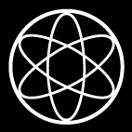
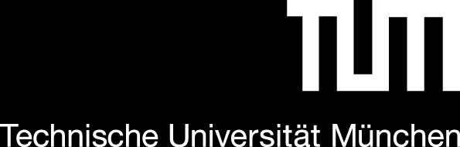




Energy Reconstruction with CALIFA
ODSL Meeting, 05.03.2025
Tobias Jenegger
Funded by the Deutsche Forschungsgemeinschaft (DFG, German Research Foundation)
under Germany’s Excellence Strategy – EXC-2094 – 390783311,
BMBF 05P19WOFN1, 05P21WOFN1
and the FAIR Phase-0 program
Physics with R³B
CALIFA – Design
TUM Members:
Roman Gernhäuser, Mrunmoy Jena, Tobias Jenegger

Slide 2
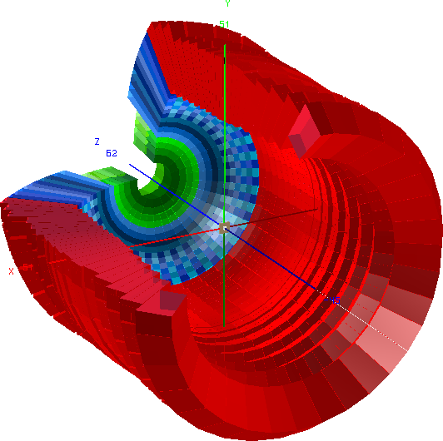

CALIFA Detector @ R³B
CALorimeter for the In Flight detection of γ-rays and light charged pArticles
Endcap:
iPhos:
512 CsI(Tl) crystals
CEPA:
96 LaBr3 &
LaCl3 crystals
Requirements:
-high dynamic range:
100 keV γ-rays – 700 AMeV charged particles
-high efficiency
-high granularity → Doppler correction
-particle identification
Barrel:
1952 CsI(Tl) scintillator crystals
BEAM
Over 2500 crystal channels!

Slide 3
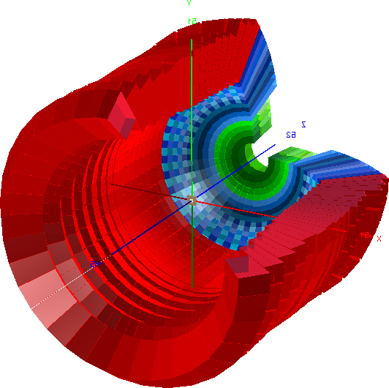
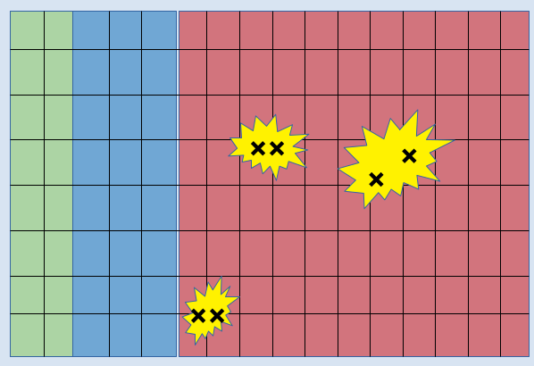
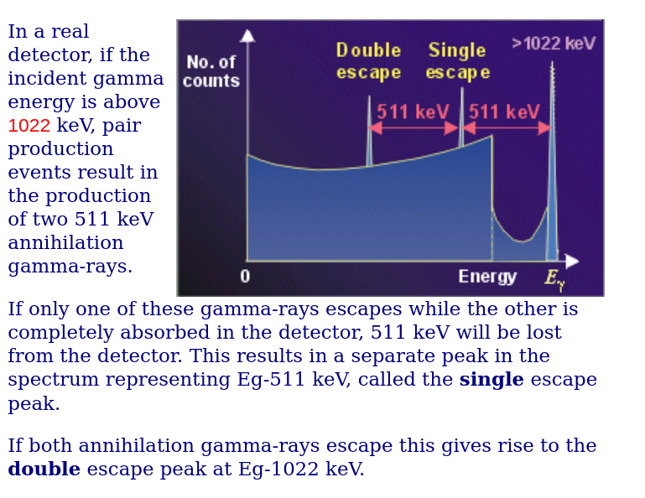
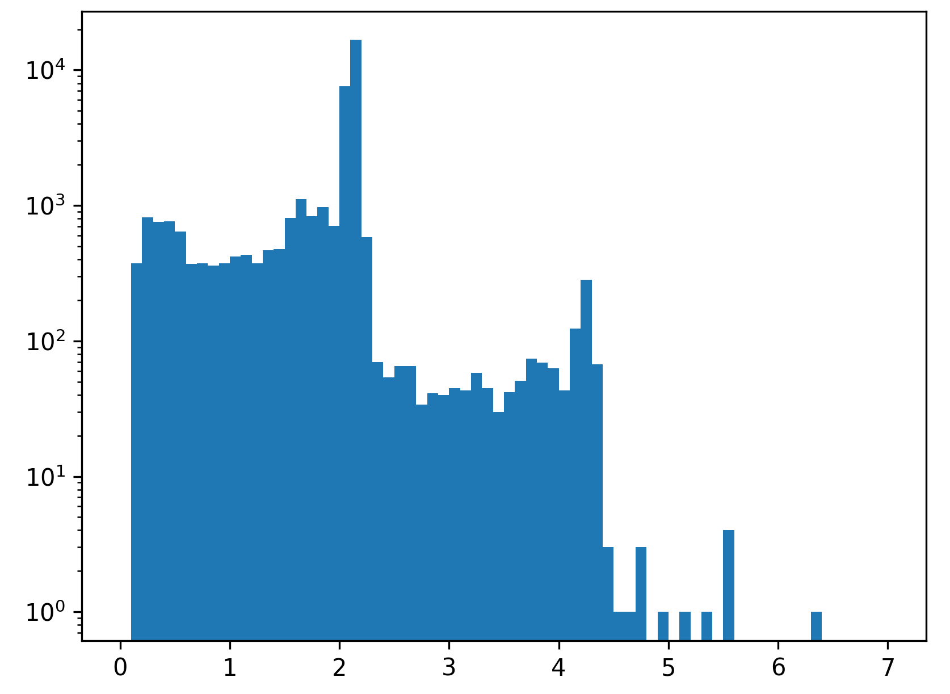
Observables
Energy
Polar Angle θ
Azimuthal Angle φ
Time (not used in Standard Algorithm)
2.141 MeV
Energy [MeV]

Slide 4
Standard Cluster Algorithm
User defines shape and size of cluster:
(and set energy threshold for single crystals)
Sort the hit list according to their energy
30. MeV
1. create cluster centered around first hit
2. loop over all hits in list
→ if hit inside cluster add it and remove it from the list
3. Do this procedure until list is empty
22. MeV
10. MeV
5. MeV
3. MeV
2.5 MeV
0.7 MeV

Slide 5
Metrics Definition & Datasets
True
Data Used:
Simulation with true labels
Each event has three true clusters
Time simulation: event:+-4us block
Cluster time uniformly distributed, σt of hit in cluster = 200 ns
False negative
1+ false clusters
False positive
1+ false clusters
Datasets:
False mixed
2.MeV Data
Training: 10 kEvents
Test: 4.5 kEvents
false_neg_agglo: 1.8 kEvents
false_neg_classic: 1.5 kEvents
Uniform (0.3-10MeV) Data
Training: 13 kEvents
Test: 7.1 kEvents
false_neg_agglo: 4 kEvents
false_neg_classic: 3.2 kEvents
2+ false clusters
Well reco:
#corr_reco_clusters
#total_clusters

Slide 6
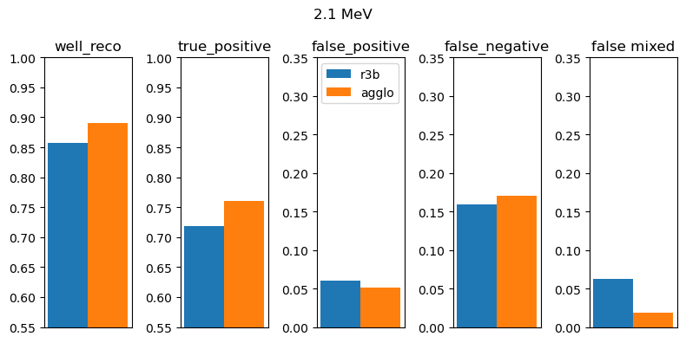
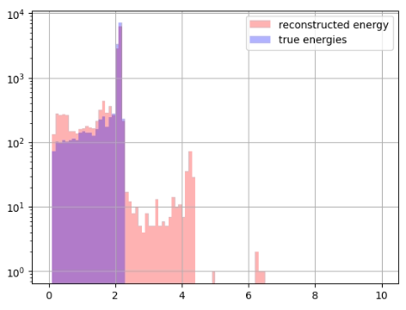
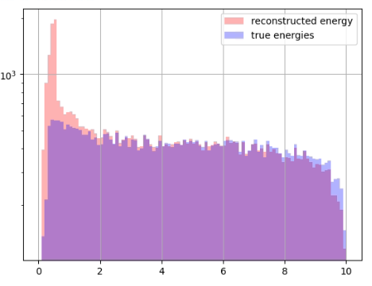
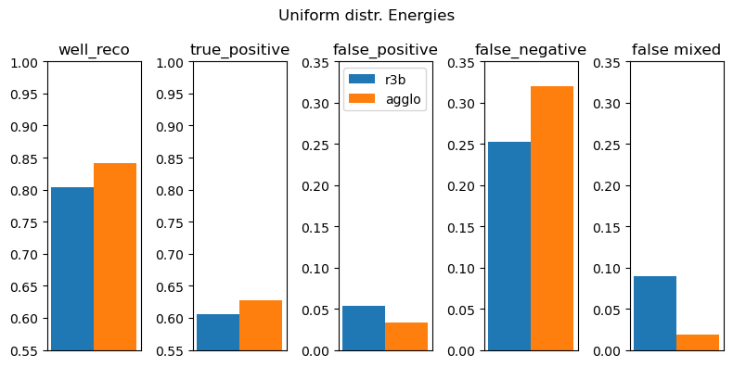
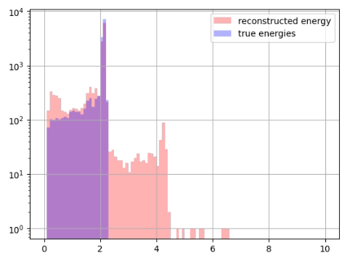
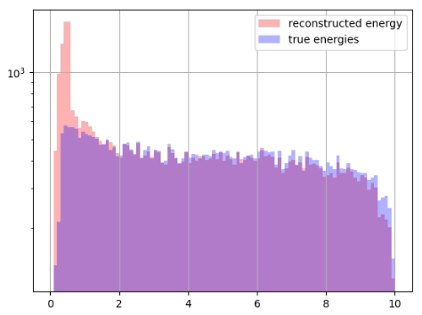
Agglomerative Model (with time info) vs Classical Clustering
Agglomerative Model
from scikit library
use time (+ offset) as radius → 3D clustering
Classical Clustering

Slide 7
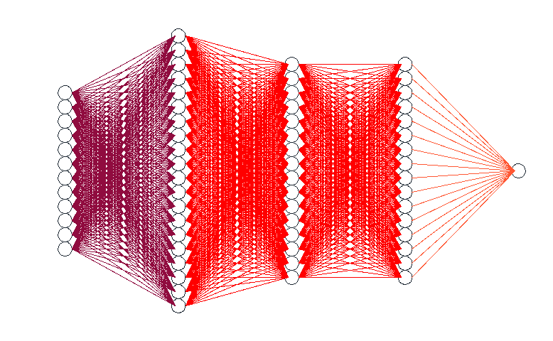
Edge Model
Pairwise comparison of all hits in event
Input Features: E1,θ1,φ1,t1,E2,θ2,φ2,t2, ΔE,Δθ,Δφ,Δt → 12 features
Two hidden layers:
1st layer: 1000 nodes
2nd layer: 100 nodes
3rd layer: 100 nodes
Learning rate: 5e-3
n_epochs: 50k
Output: [0,1]
Indep. hits
Hits belonging together
nn.RELU
nn.sigmoid
Lossfcn: nn.BCELoss
Optimizer: stochastic gradiend descent (SGD)
Prediction value cut: 0.75

Slide 8
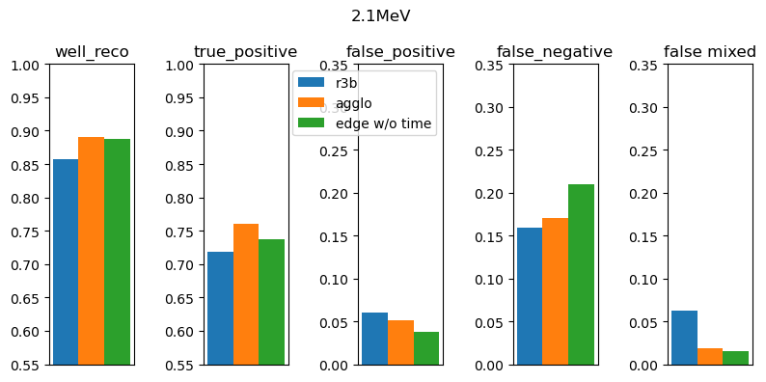
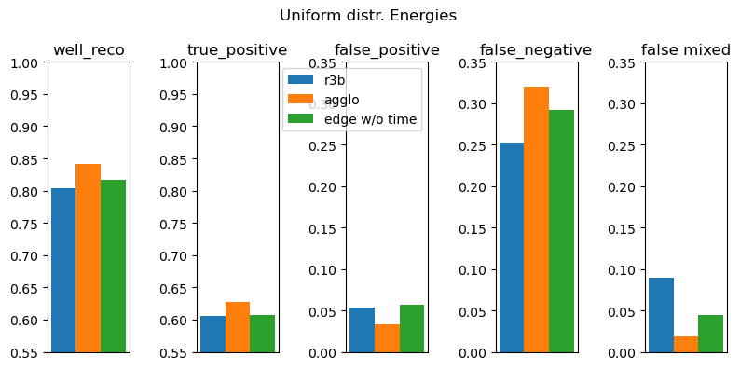
Results from Edge Model - no time info

Slide 9
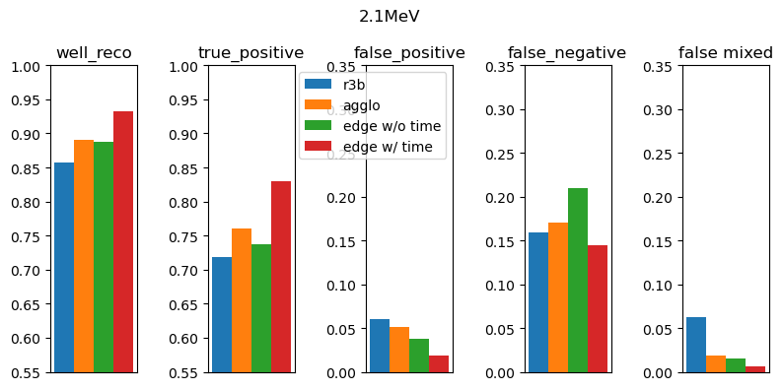
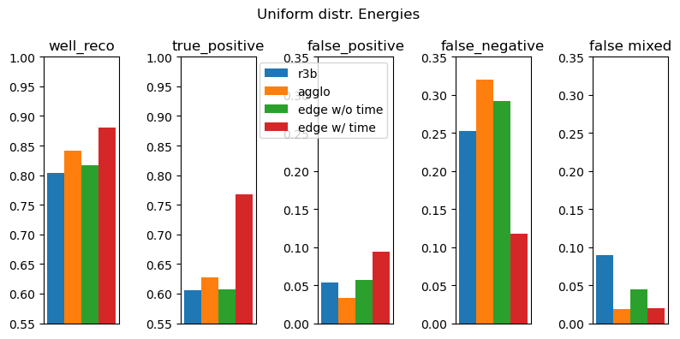
Results from Edge Model - with time info
Edge Model works well…
However relative large false_neg level
→ try to train on false_neg events!

Slide 10
Agglomerative + Edge Model
False negative events
Step 1:
Train edge model on false-negative events (when using agglo model)
Step 2:
Run agglo model on test dataset and save “preclustered dataset”
Create cm of clusters and save as “preclustered dataset
Step 3:
Run edge model on “preculstered dataset” with parameters from training (Step1)
params from training

Slide 11
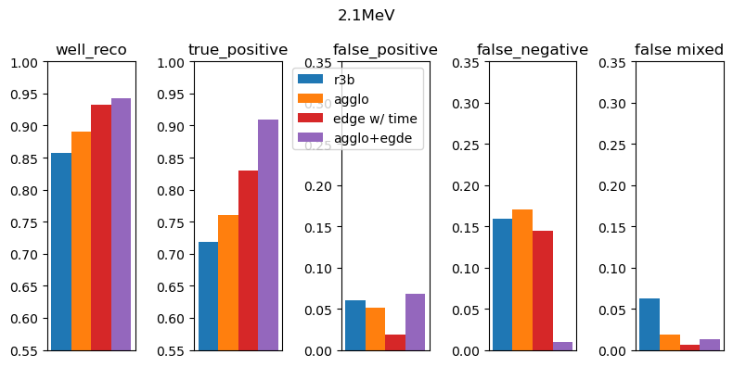
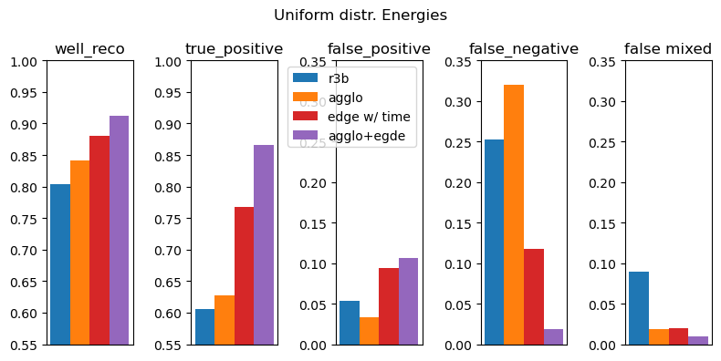
Results from Agglo + Edge Model

Slide 12
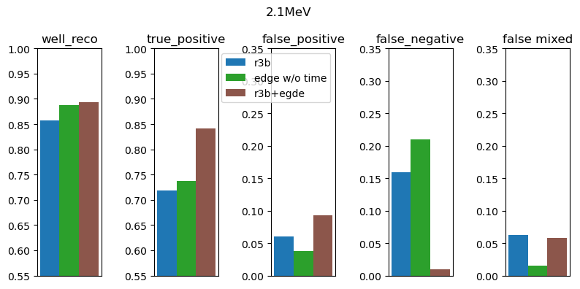
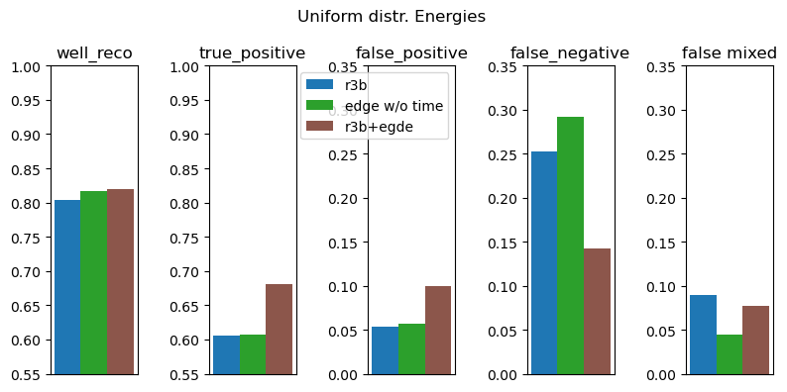
Classical Clustering + Edge (no time info)
For Classic Clustering + Edge I pushed a little bit more:
Lr: 5e-3 → 9e-2
n_epochs: 50k → 80 k
This could be applied directly to our real data, out of the box!
Well reco: ~ 2.5% better!
true_positive: ~ 12% better!

Slide 13
Outlook – Deep Sets
Input to the Model:
This model keeps track of the information of all hits inside each cluster
False positive events
https://arxiv.org/pdf/1810.05165
Pairwise checking all combinations in clusters, eg:
We could create: Agglo + Edge + Deep Sets…..

Slide 14
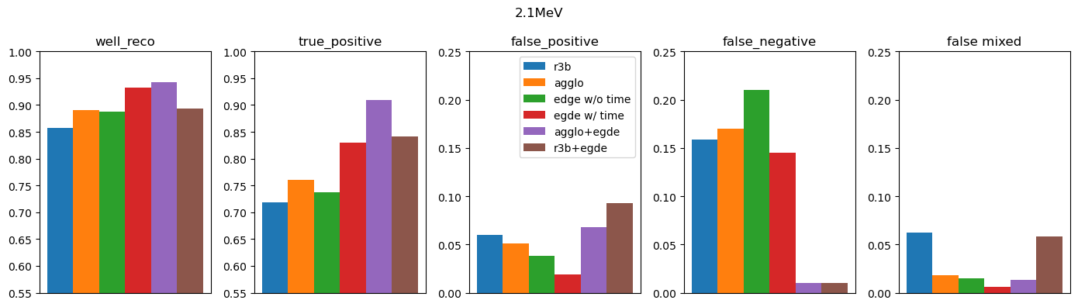
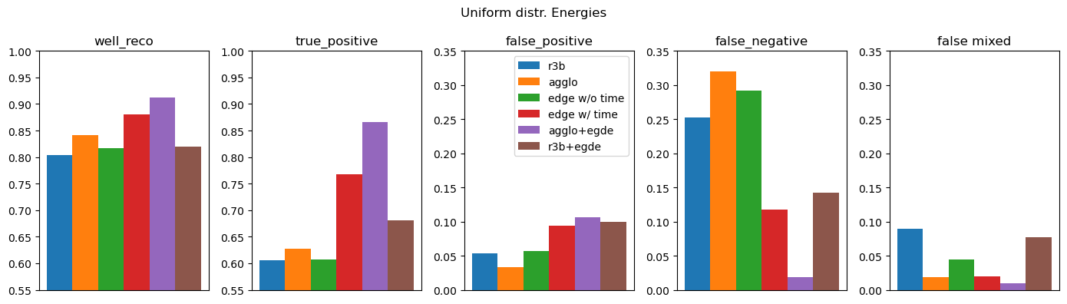
Results

Slide 15
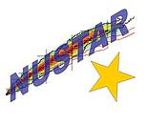
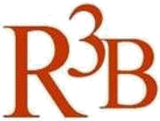

CALIFA @ Technical University of Munich (TUM)
Roman Gernhäuser, Lukas Ponnath, Philipp Klenze, Tobias Jenegger
Thank you!

Slide 16
Backup

Slide 17
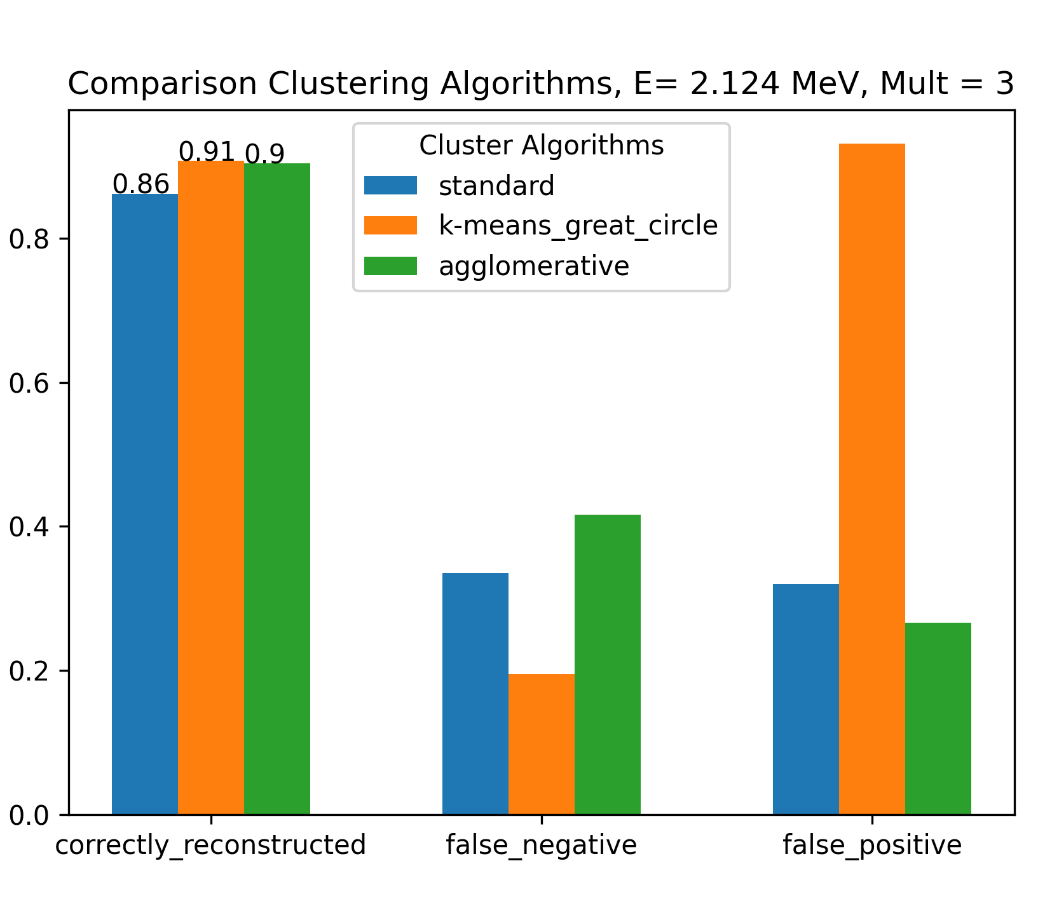
Summary Clustering Methods
false_negative:
true cluster
reconstructed cluster
1.2
0.8
0.124
1.2
0.8
0.511
false negative
=
false_positive:
true cluster
reconstructed cluster
1.2
0.8
0.124
1.2
0.8
0.511
false positive
=

