Slide 1
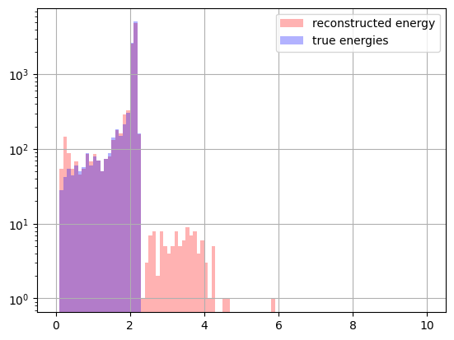
Using also t1+t2, theta1+theta2, E1+E2
Well reco :0.9488630517542957

