Slide 1
Notes
Select 3 events and try to get 0 loss (maybe with lr = 5e-3) → started, get almost 0 loss (we get not 0 loss, maybe hint that using only 8 features is not correct model)
Use 12 features (8 + 4 delta features) → try to increase number of nodes. Does this improve loss?
Create validation data → done
Test which of the Δfeatures is the relevant one
Add also mean features: E1+E1, theta1+theta2,ph1+phi2,time1+time2
→ does adding up angles make really sense? I doubt...
Cleanup of code → almost done
Plot Energy reconstruction with “Edge method”, classic califa clustering, agglomerative clustering, → done

Slide 2
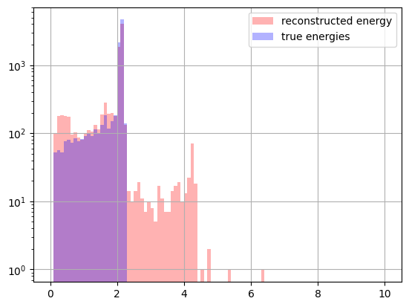
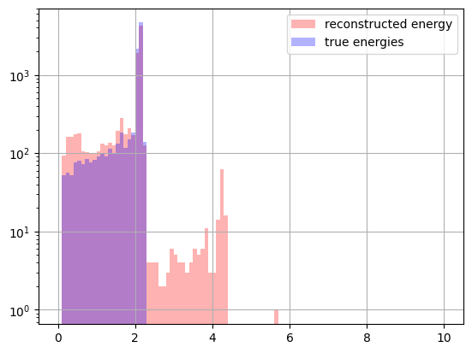
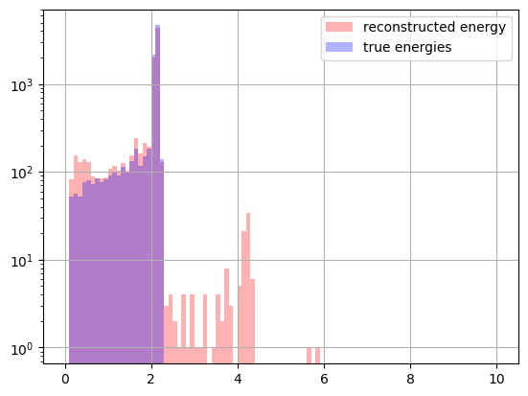
Comparison Clustering Models?
Standard R3B Clustering
Agglomerative Clustering
“Edge” Clustering
Well reco: 86.9 %
Well reco: 89.9 %
Well reco: 93.4 %

Slide 3
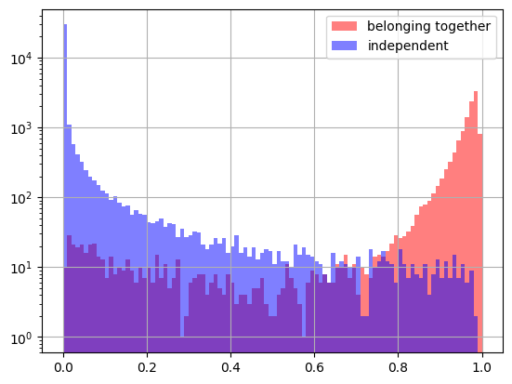
Prediction Values for “Edge” Clustering Model
Model:
First layer: 1000 features
Second layer: 100 features
Third layer: 100 features
Lr= 5e-3
0.75

Slide 4
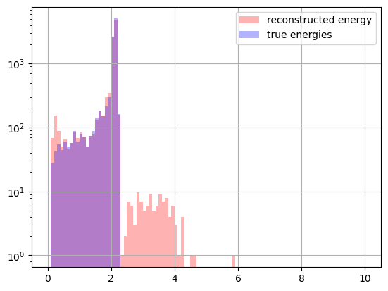

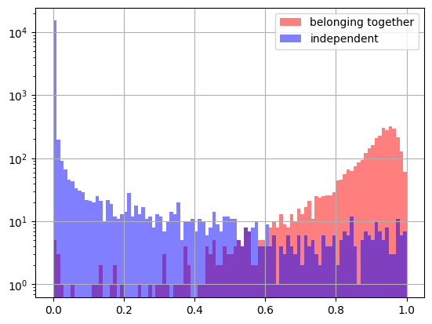

Back to False Negative Data
Well Reco: 94.6%
Well Reco: 94.7%
Model:
First layer: 1000 features
Second layer: 100 features
Third layer: 100 features
Lr= 5e-3
Model:
First layer: 1000 features
Second layer:500 features
Third layer: 500 features
Lr= 5e-3
0.75
0.75

Slide 5
What else?
Validation/Training data: now available for full dataset and for “false negative events”
Code was cleaned up with coherent procedures/methods for all three clustering methods → helpful in future, less error prone
Test to bring loss value to 0 (using only 3 events) → only tested using the 8 features
is not equal 0 event after 10e5 iterations, however it is monotonically decreasing
high lr (~10⁻1) are better
TODOS:
Add also mean features: E1+E1, theta1+theta2,ph1+phi2,time1+time2
Run “Edge Model” on validation data. Do I still get a reco rate of 93%?
Build “Split Model” to predict if preclustered data should be split apart or not
What about give transformer now a try with Δfeatures as input data?
Other?

