Slide 1







Energy Reconstruction with CALIFA
Tobias Jenegger
CALIFA Calorimeter
Funded by the Deutsche Forschungsgemeinschaft (DFG, German Research Foundation)
under Germany’s Excellence Strategy – EXC-2094 – 390783311,
BMBF 05P19WOFN1, 05P21WOFN1
and the FAIR Phase-0 program
Physics with R³B
CALIFA – Design
TUM Members:
Roman Gernhäuser,Lukas Ponnath,Philipp Klenze,Tobias Jenegger

Slide 2
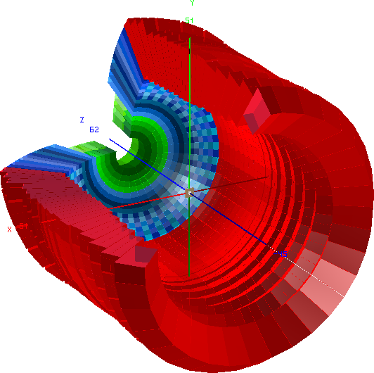

CALIFA Detector @ R³B
CALorimeter for the In Flight detection of γ-rays and light charged pArticles
Endcap:
iPhos:
512 CsI(Tl) crystals
CEPA:
96 LaBr3 &
LaCl3 crystals
Requirements:
-high dynamic range:
100 keV γ-rays – 700 AMeV charged particles
-high efficiency
-high granularity → Doppler correction
-particle identification
Barrel:
1952 CsI(Tl) scintillator crystals
BEAM
Over 2500 crystal channels!

Slide 3
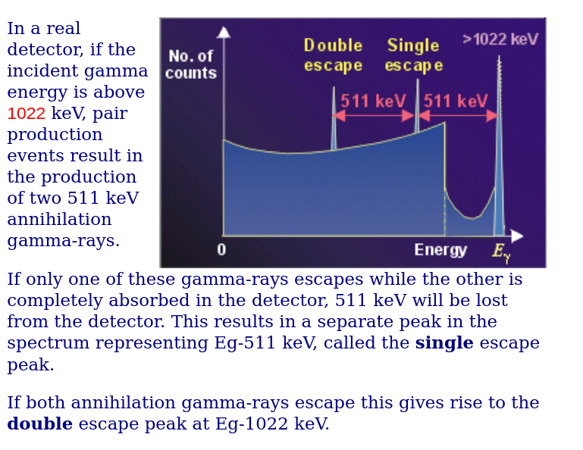
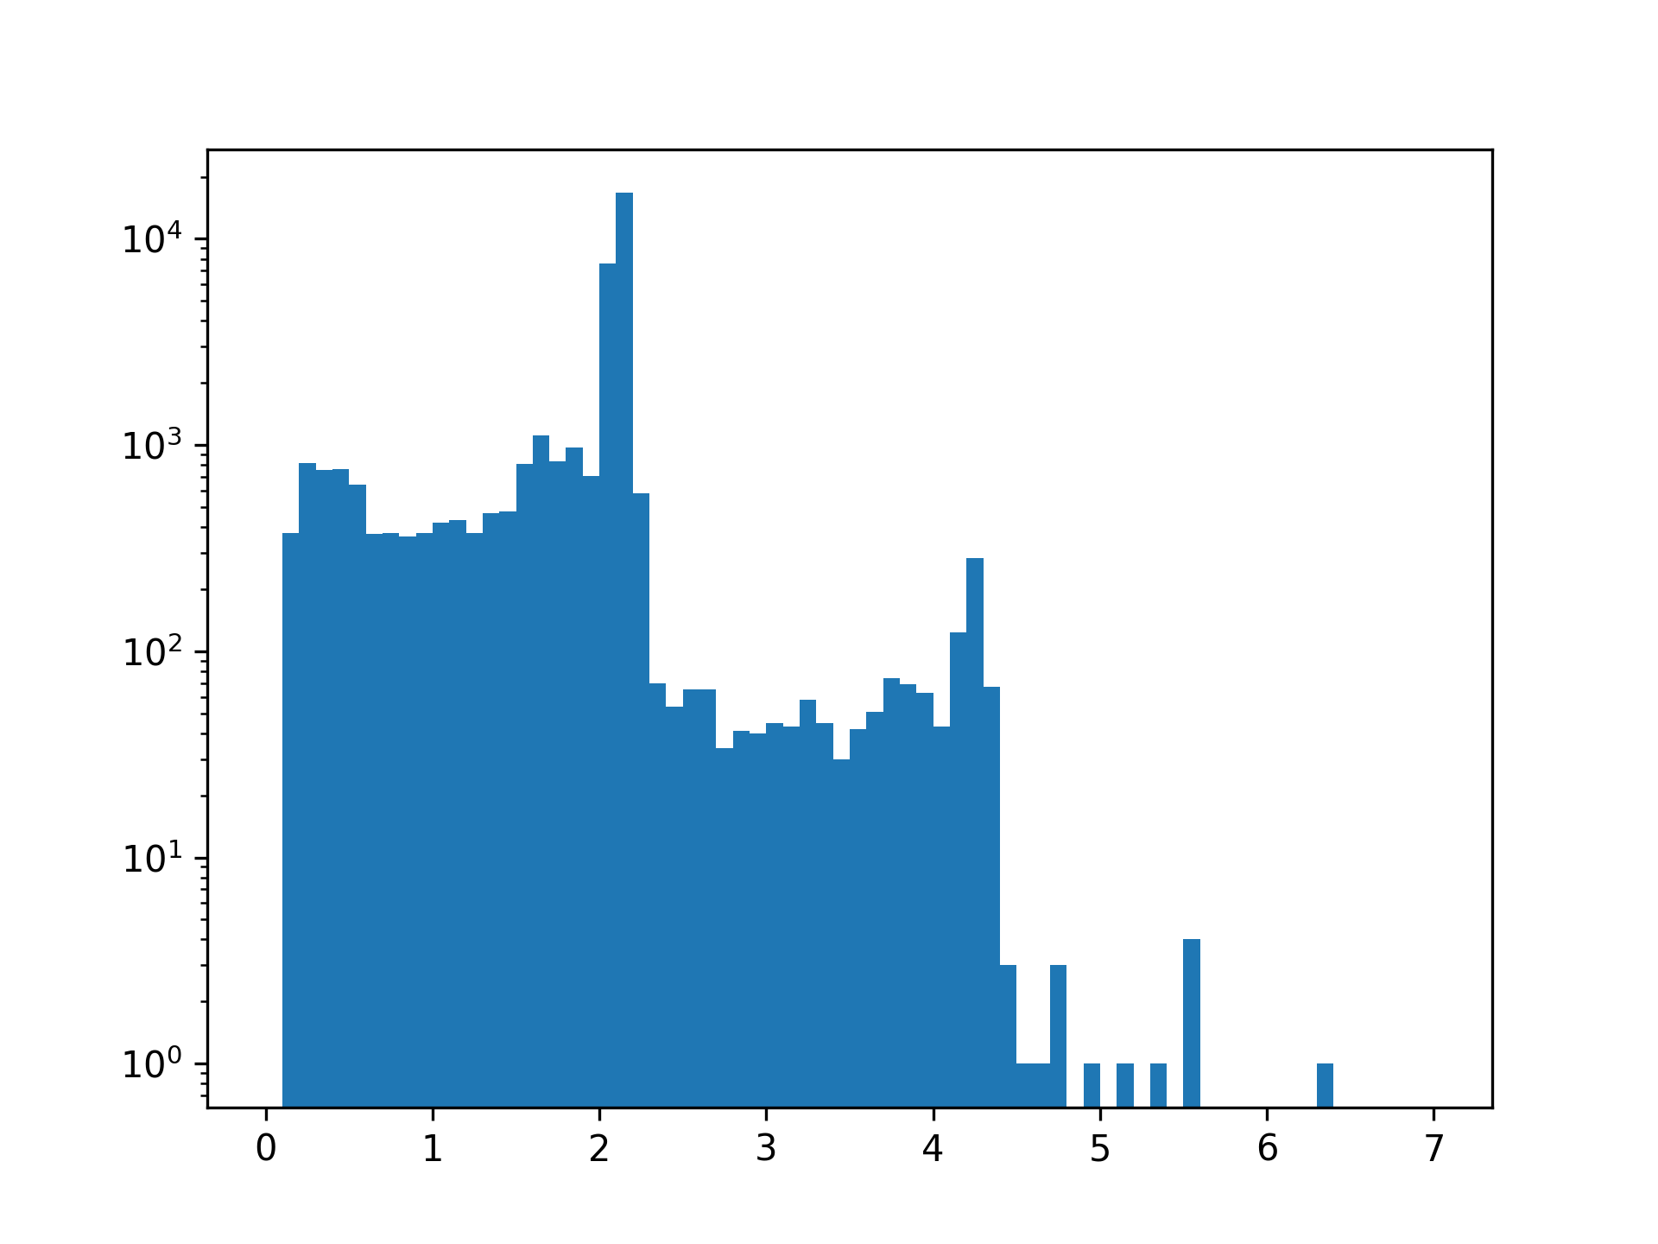
Observables
Energy
Hit Time
Spatial Position
Correlation with neighboring crystals
2.141 MeV
Customized Cluster
Energy [MeV]

Slide 4
Standard Cluster Algorithm
User defines shape and size of cluster:
(and set energy threshold for single crystals)
Sort the hit list according to their energy
30. MeV
1. create cluster centered around first hit
2. loop over all hits in list
→ if hit inside cluster add it and remove it from the list
3. Do this procedure until list is empty
22. MeV
10. MeV
5. MeV
3. MeV
2.5 MeV
0.7 MeV

Slide 5
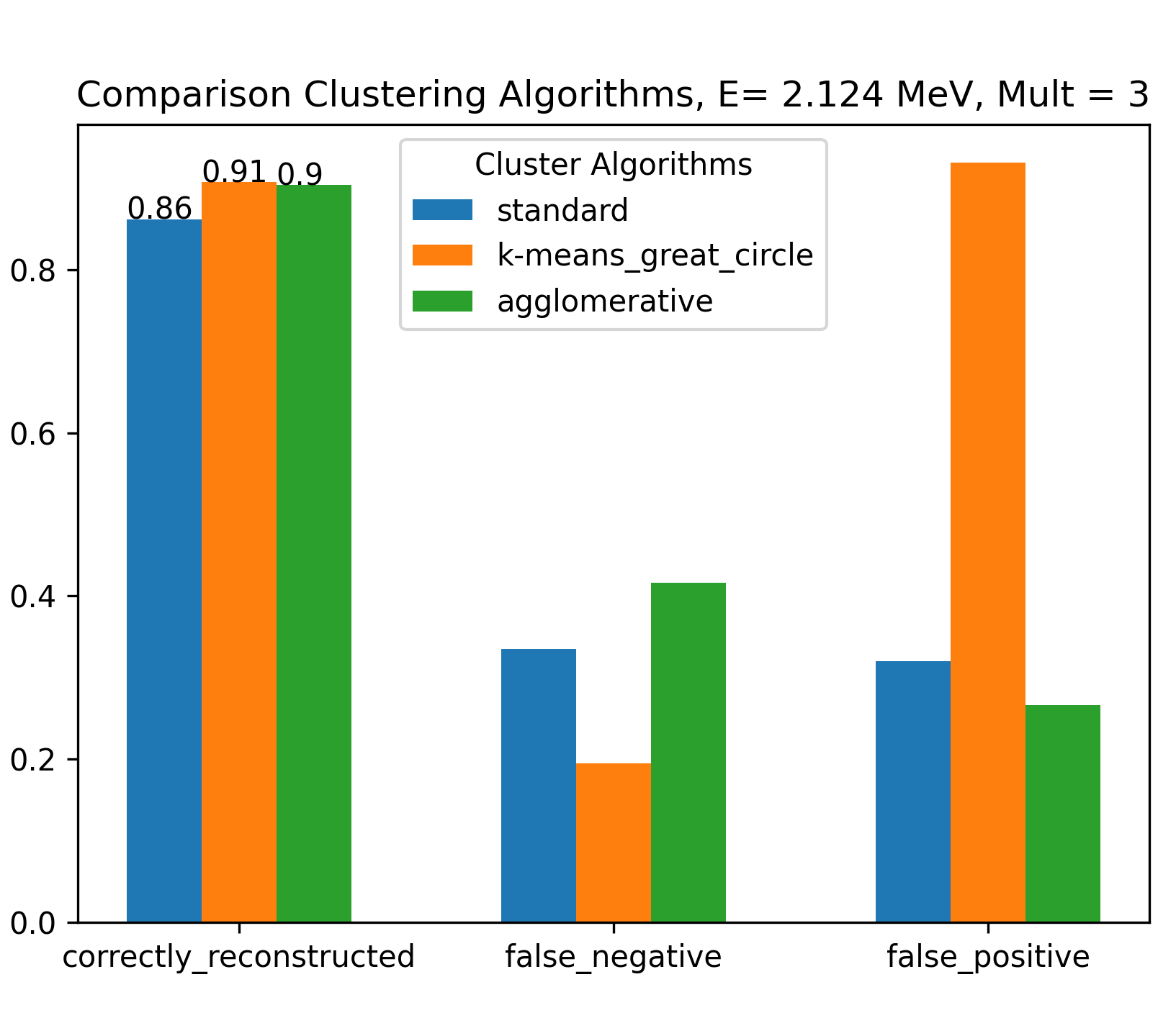
Summary Clustering Methods
false_negative:
true cluster
reconstructed cluster
1.2
0.8
0.124
1.2
0.8
0.511
false negative
=
false_positive:
true cluster
reconstructed cluster
1.2
0.8
0.124
1.2
0.8
0.511
false positive
=

Slide 6
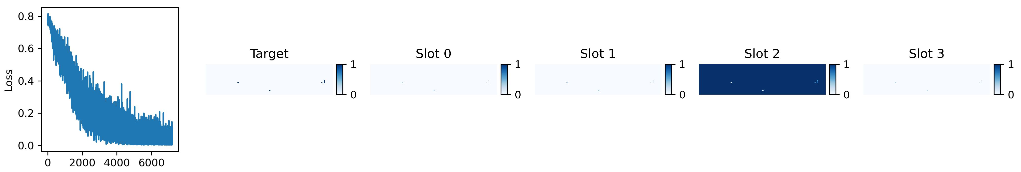
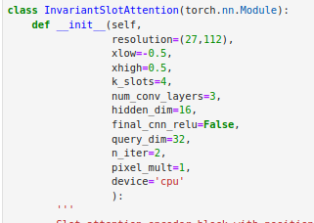
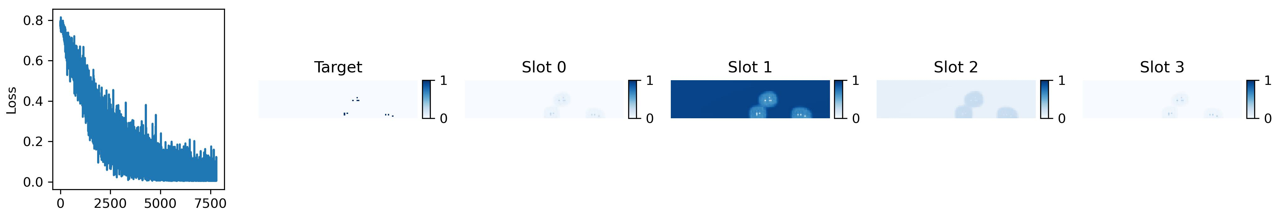
Invariant Slot Attention Model
Starting with energy and position information (no time):
iter 7250 , loss 0.009908747
3 clusters + bg
iter 7800 , loss 0.020807367
Parameters I tuned:
Learning rate: 1e-4 to 1e-5
hidden dim: 16 – 32
query_dim: 10 – 16 – 32 - 64

Slide 7
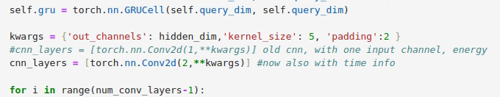
Invariant Slot Attention Model – also with time info
→ Dimension of mask: → same as before! 10 x 3 x 27 x 112
→ Dimension of evt_histogram_array : 10 x 2 x 27 x 112
#observables: time & energy
Lr = 5e-5
Loss function does not converge!

Slide 8
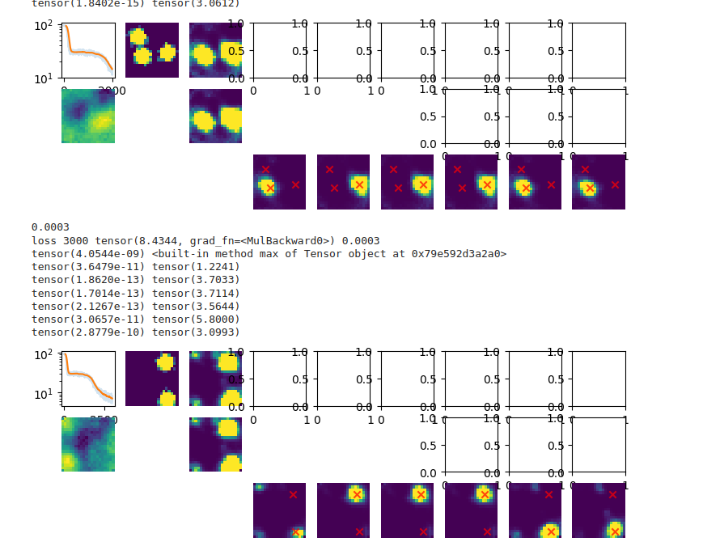
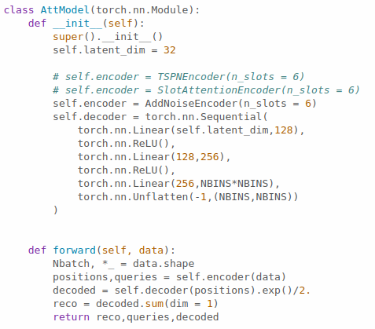
slot_and_tspn_onenotebook from Lukas Heinrich
https://gist.github.com/lukasheinrich/31d06bc4918e52d7ae3663a197b90d71
data
summed prediction
prediction for the k-slots

Slide 9
Transformer model
nn.Linear(4,k)
Source
[energy1, phi1,theta1, time1]
[energy2, phi2,theta2, time2]
….
[energyN, phiN,thetaN, timeN]
nn.TransformerEncoder
Cosine-similarity
hitnr
k = 32
heads = 8
num_layers = 6
Upper triangle matrix
hitnr x hitnr
Calculate BCELoss
Target
Upper triangular matrix
(with zeros and ones)

Slide 10
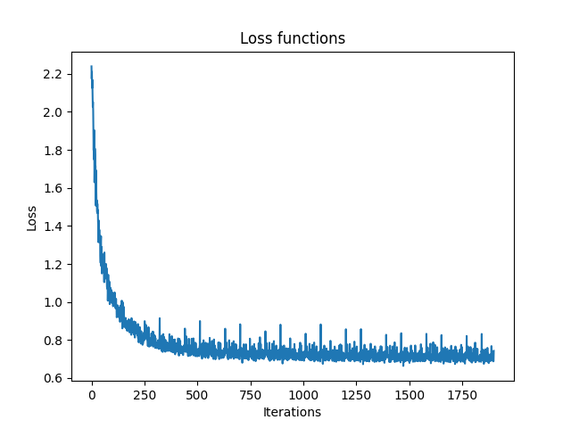
Transformer model – further parameters
Batchsize = 64
Feature number = 32
n_epochs = 10
Loss_rate = 2e-4
Loss function = nn.BCELoss()
Lossfunction = nn.BCELoss()

Slide 11
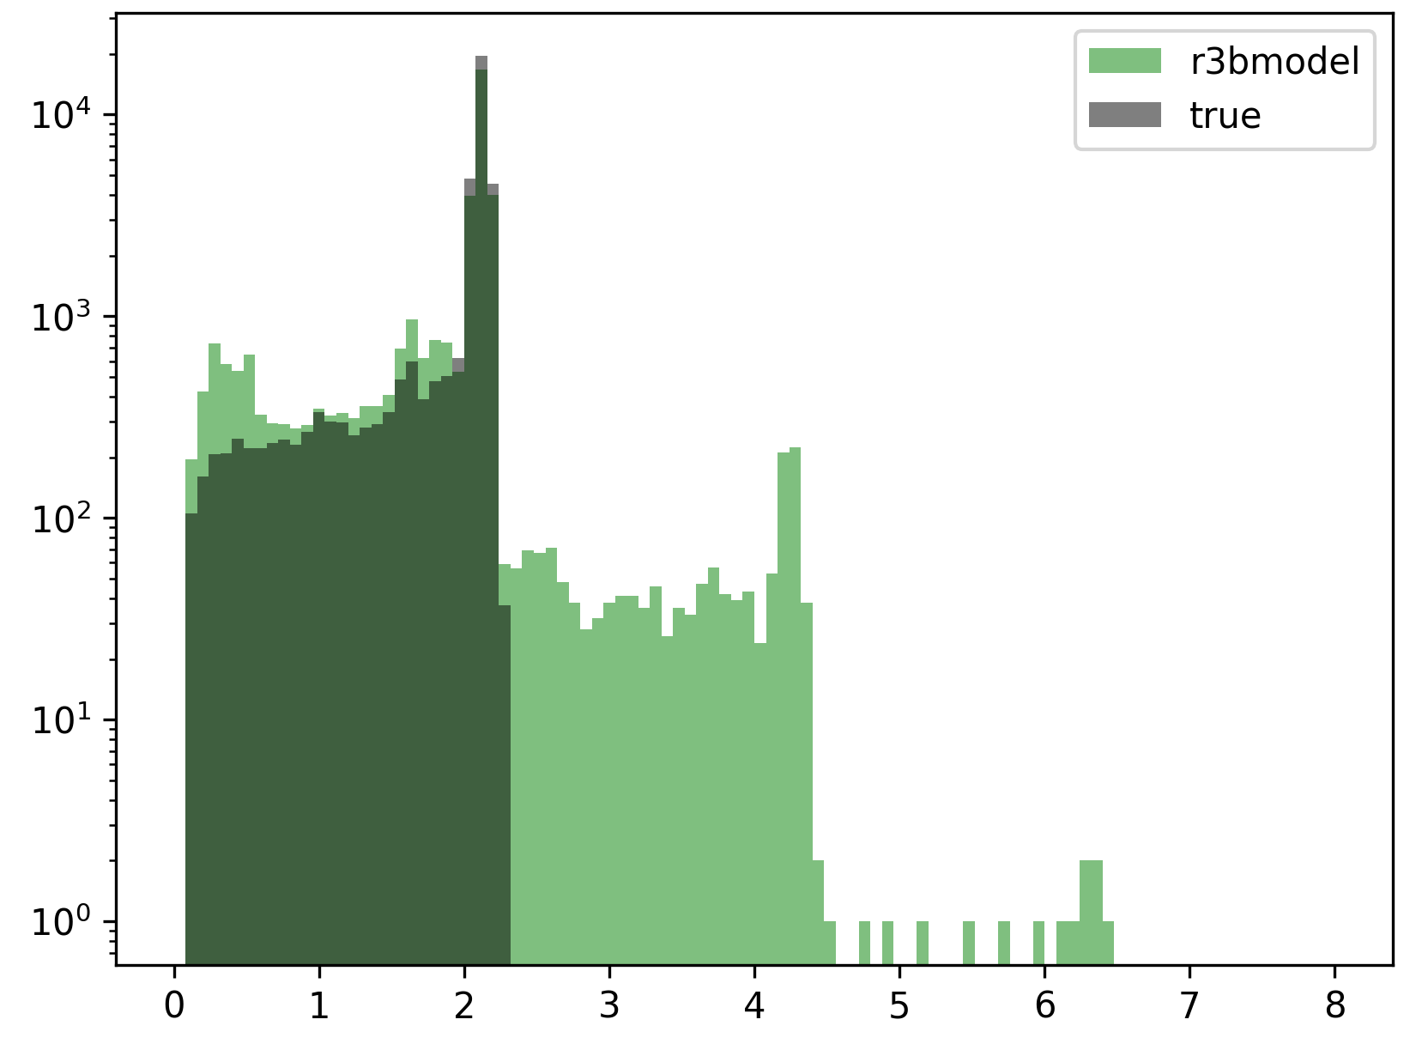
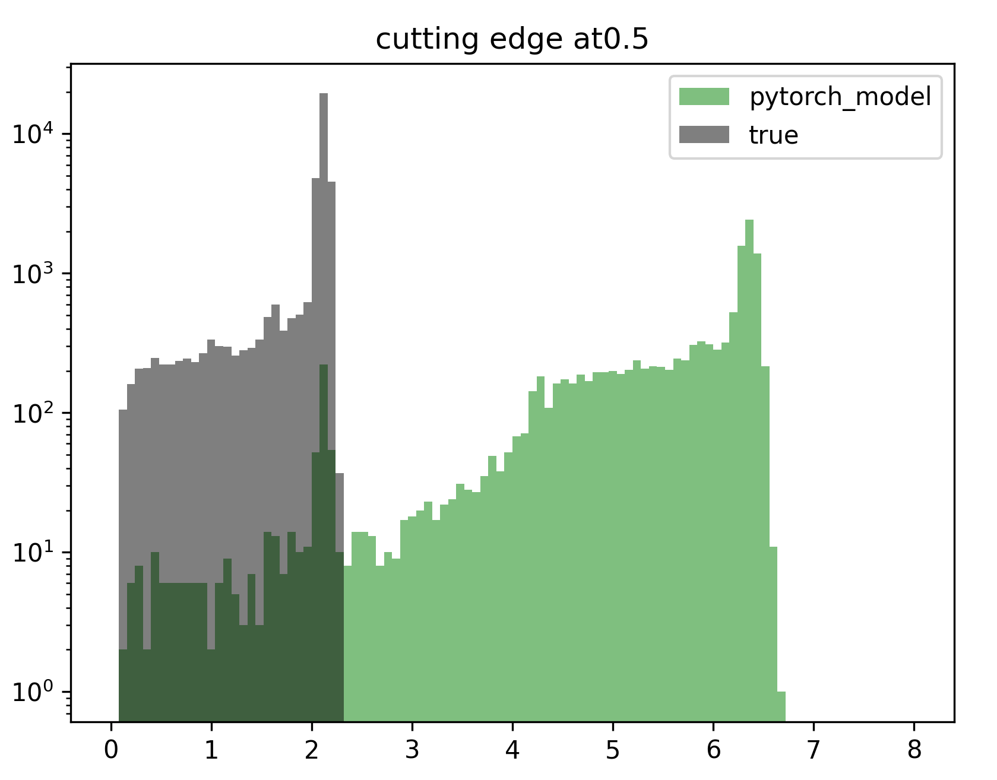
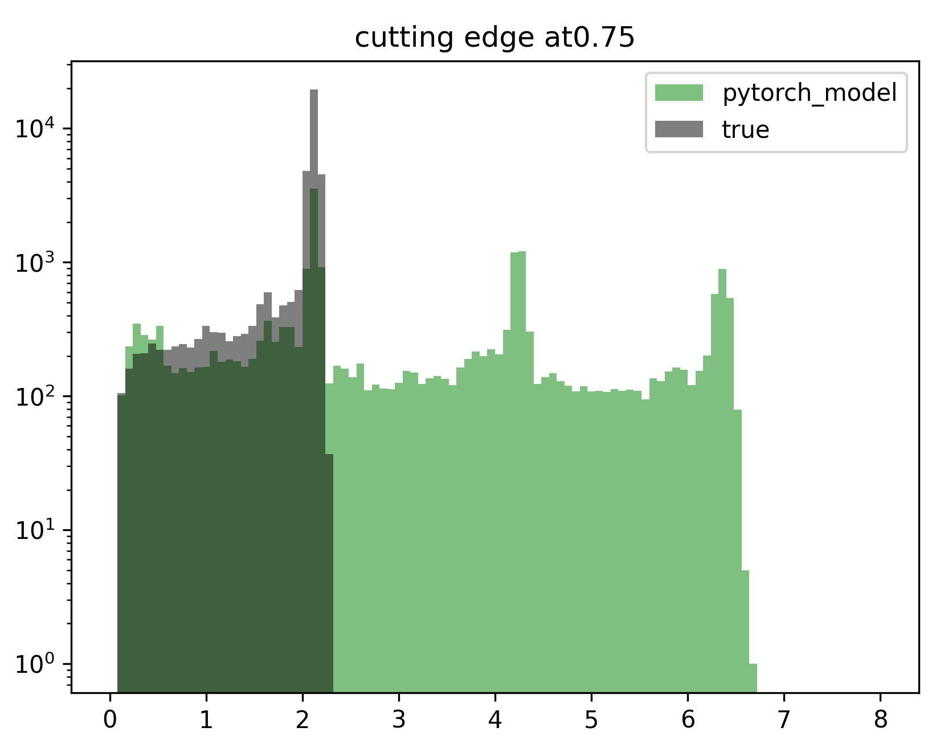
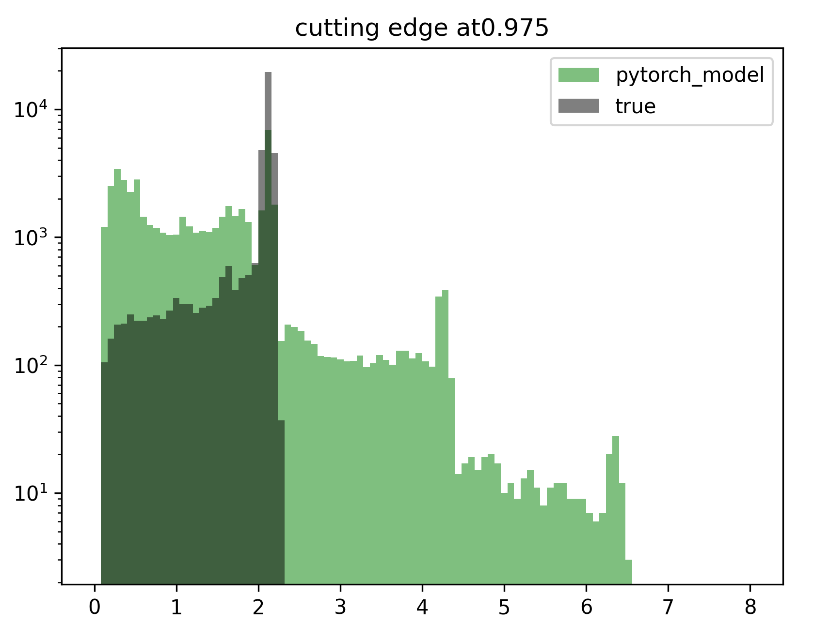
Standard Cluster vs True Clusters
How do the energy spectra look like?
How to clusterize hits from output of transformer model:
1) Take the upper triangular matrix tri[hitnr x hitnr]
2) set “merge cut”. If tri[i,j] > “merge_cut” → hits belong to same cluster
3) do this for all combinations and merge them appropriately

Slide 12
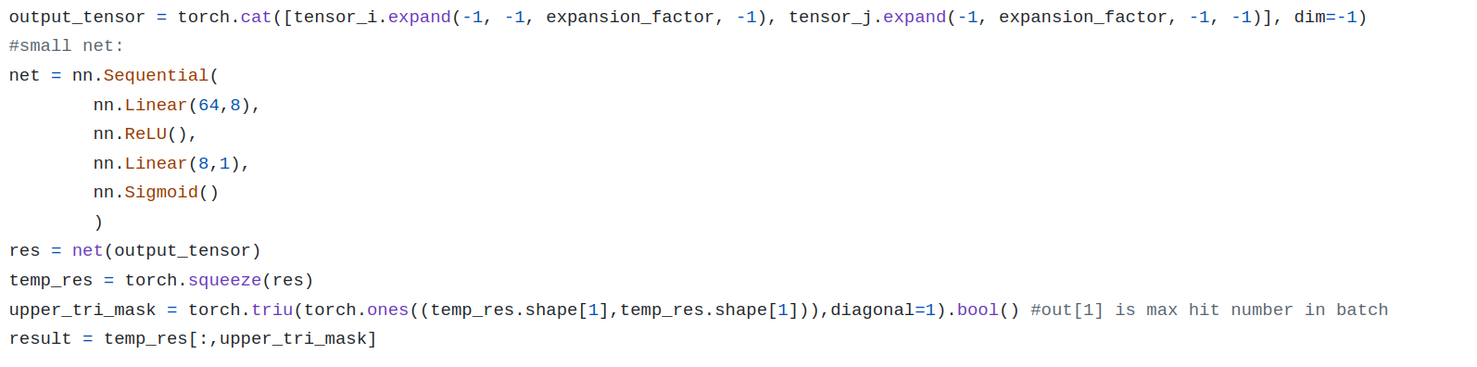
Why energy spectra so bad while loss function seems to decrease ?
Most entries in model output tensor ~0.5. This diminishes the loss BCELoss function!
How to improve?
Include some cut condition in the forward part of the transformer model
→ discontinuity of loss function → no learning!
Use linear net instead of cosine similarity
No improvements!

Slide 13
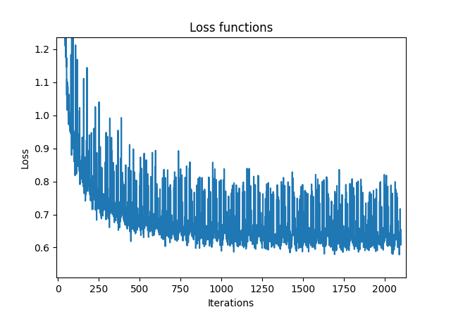
Agglomerative Model + Transformer Model
Idea:
Use first agglomerative method to cluster
Select events where we have too many clusters (false negative)
Feed the clusters to the transformer model (calculating cm of clusters)
x
x
x
x
x
x
x
x
x
Transformer Model
x
x

Slide 14
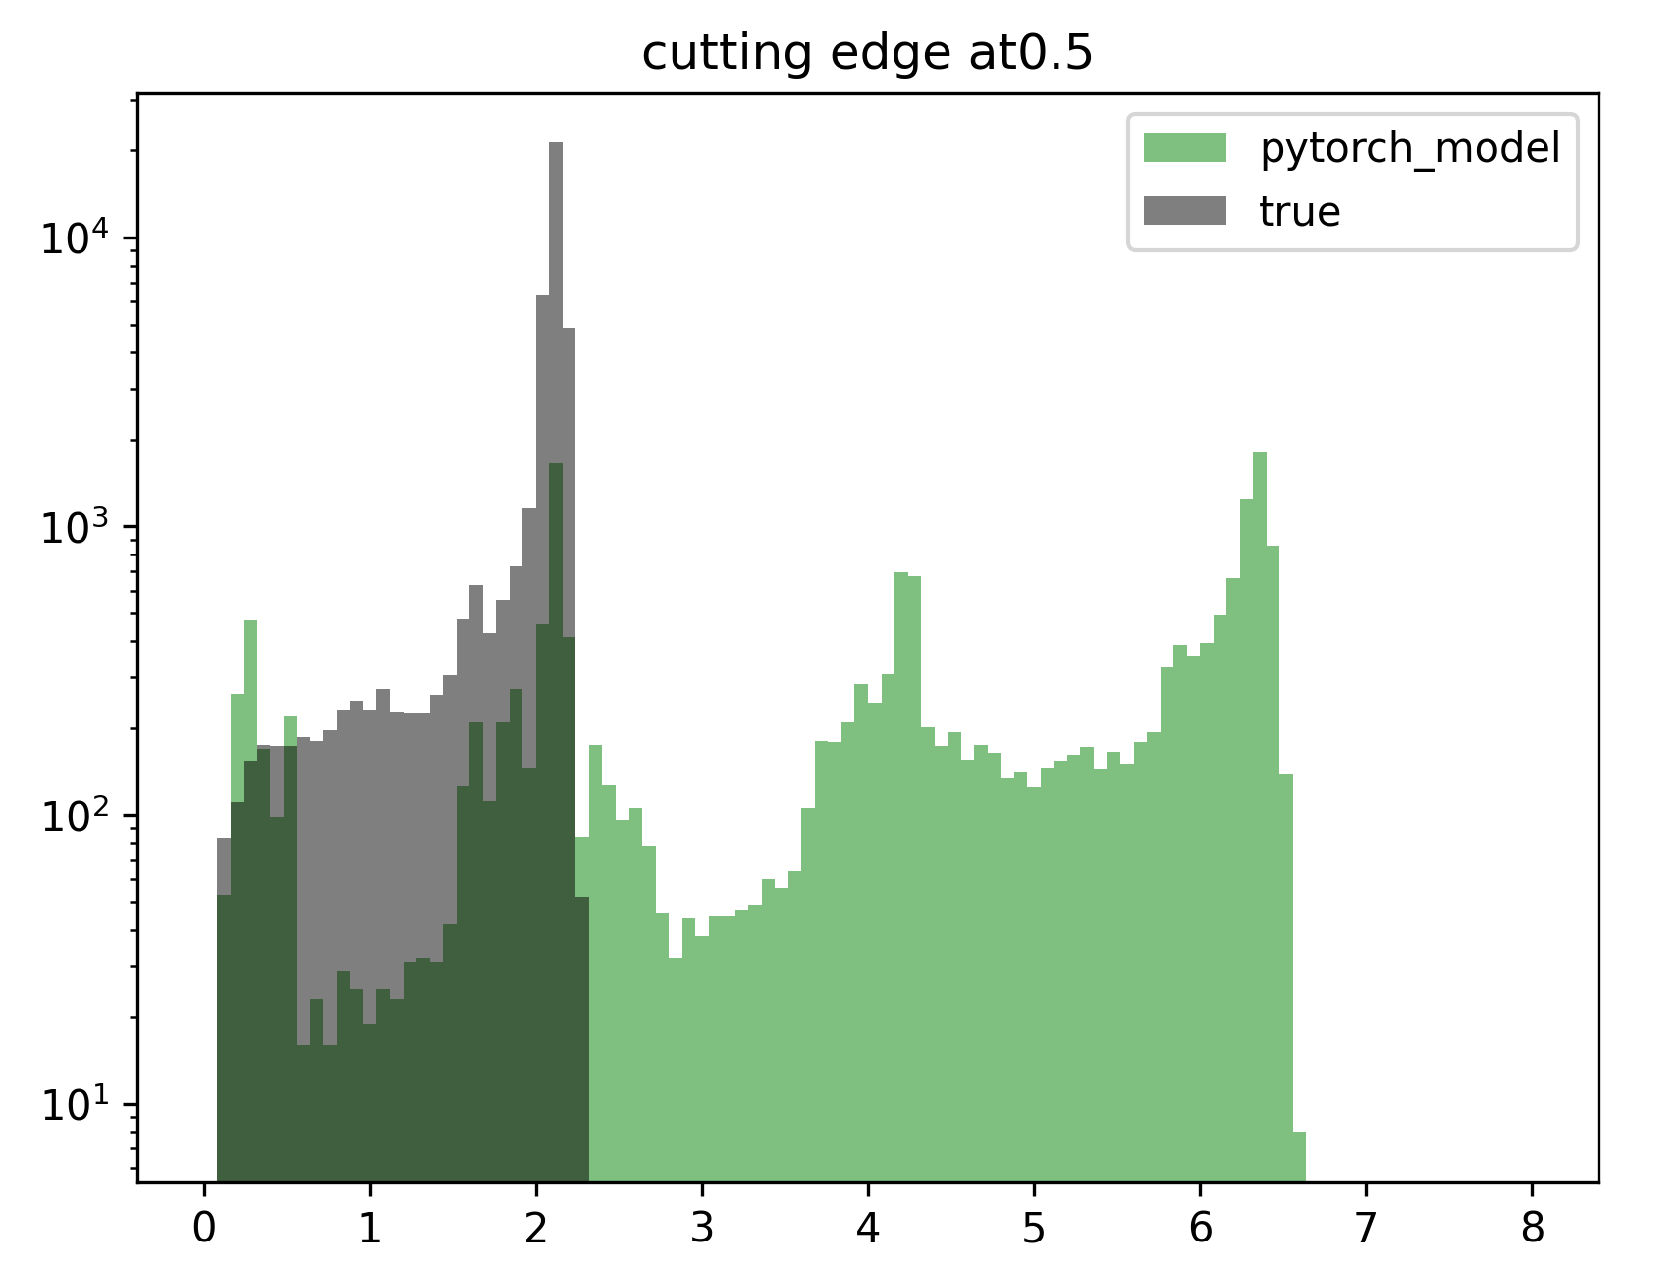
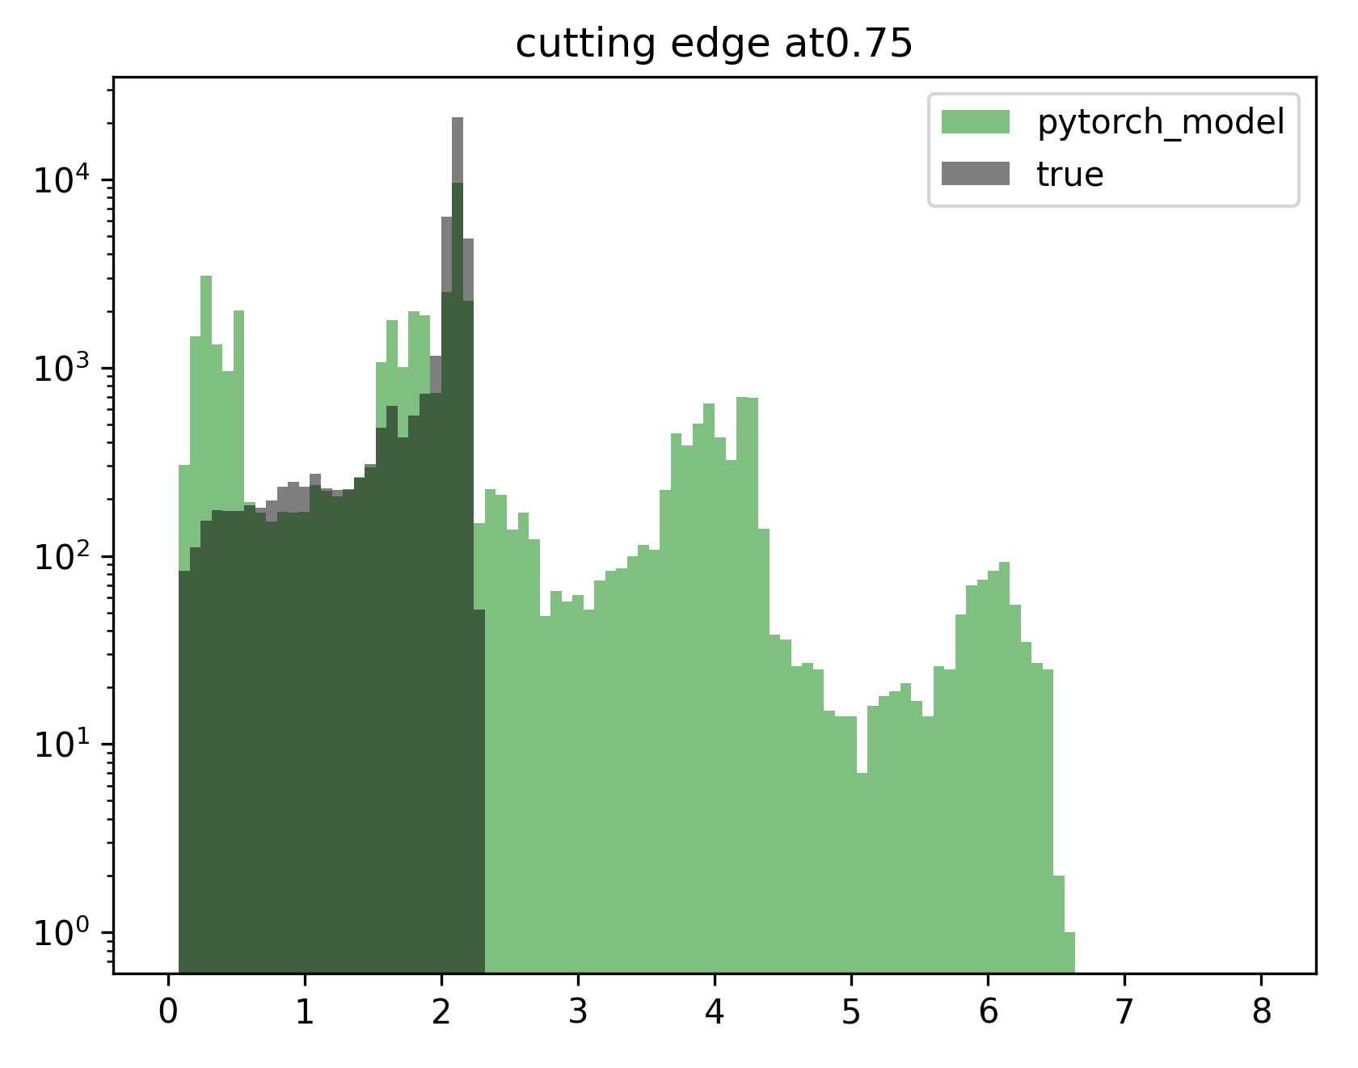
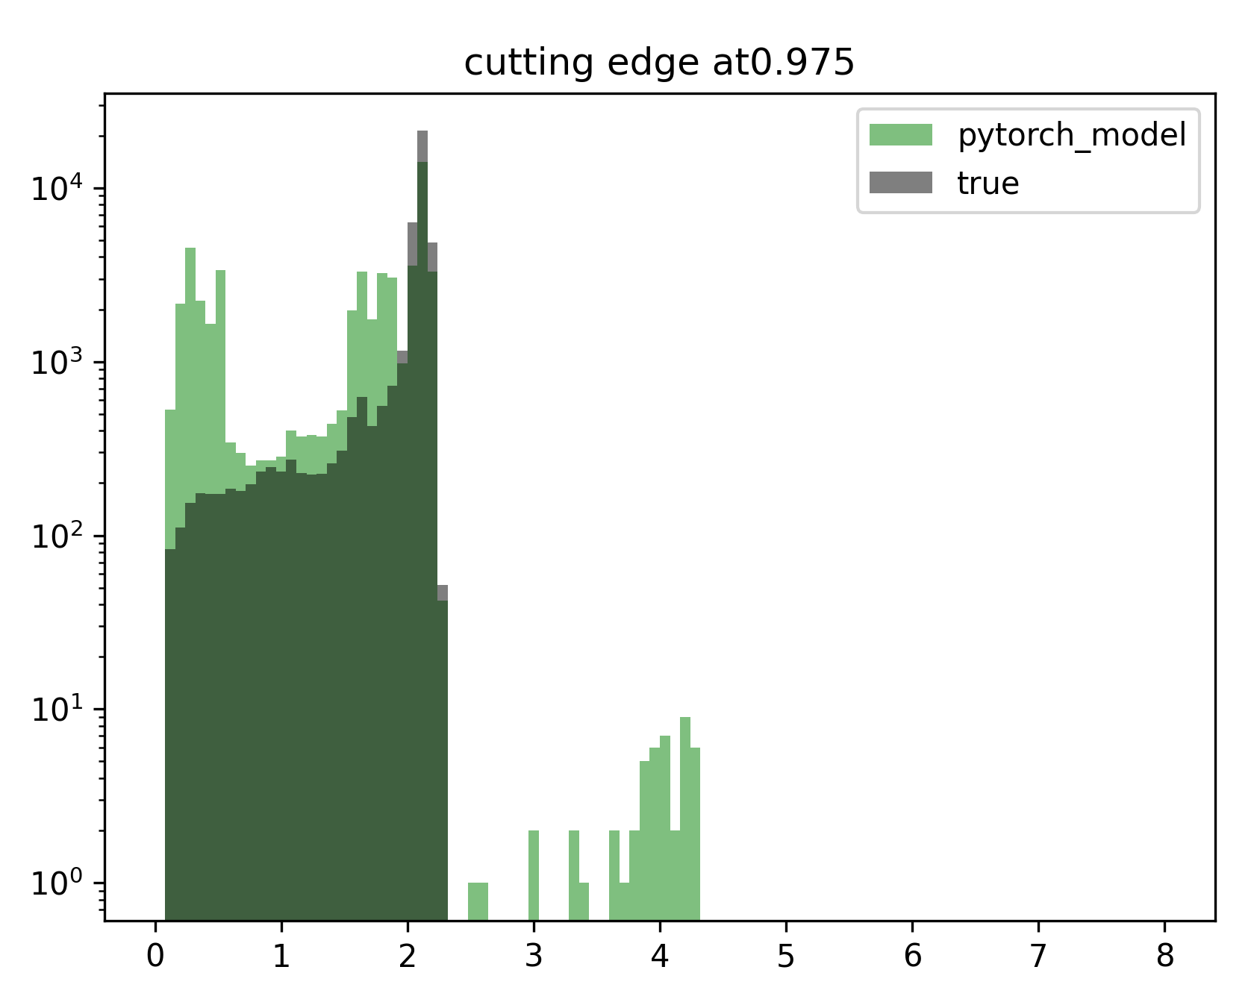
Agglomerative Model + Transformer Model - Spectra

Slide 15

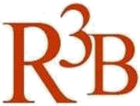

CALIFA @ Technical University of Munich (TUM)
Roman Gernhäuser, Lukas Ponnath, Philipp Klenze, Tobias Jenegger
Thank you!

