Slide 1
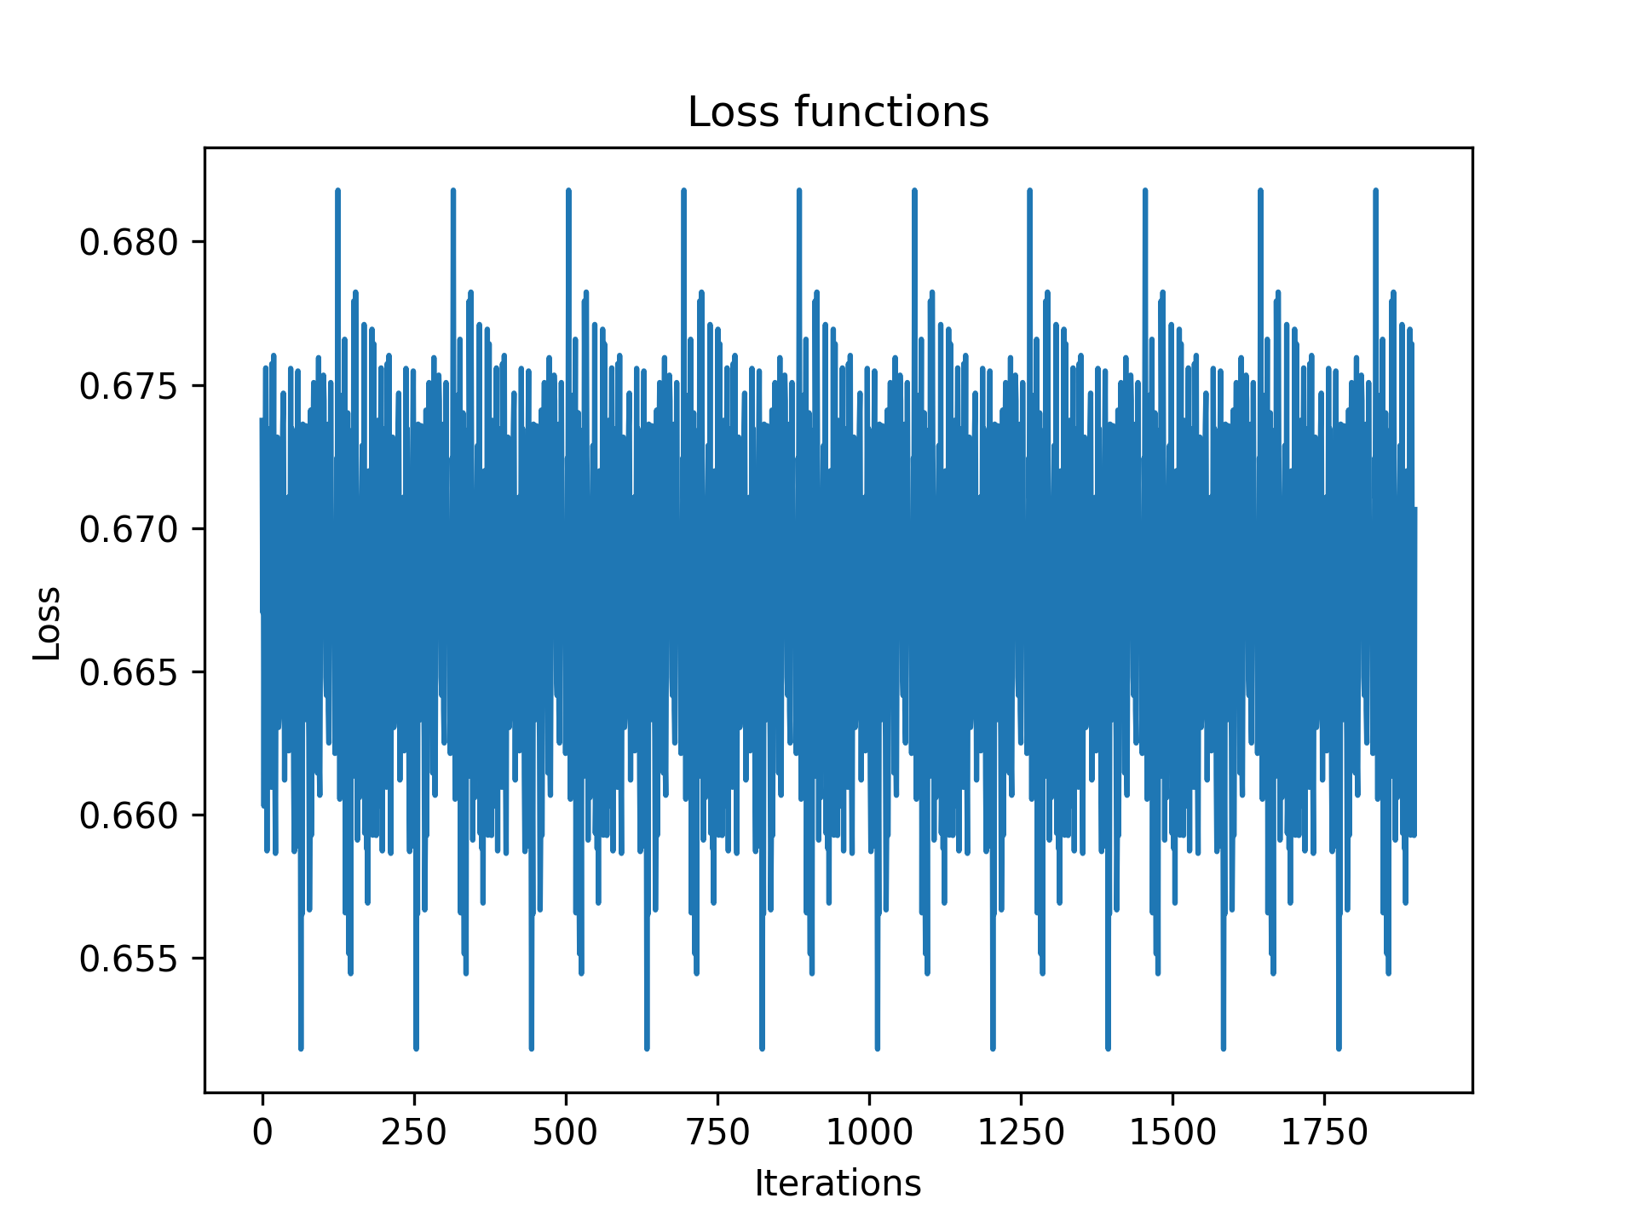
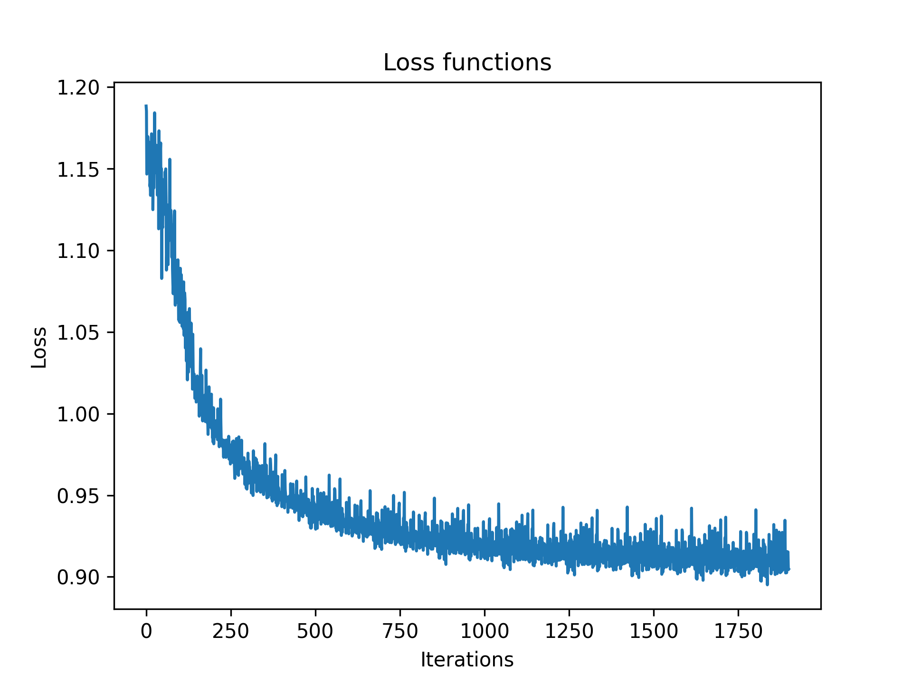
Using nn.BCEWithLogitsLoss()
Standard Clustering Model
Standard Clustering Model
Transformer Model

Slide 2
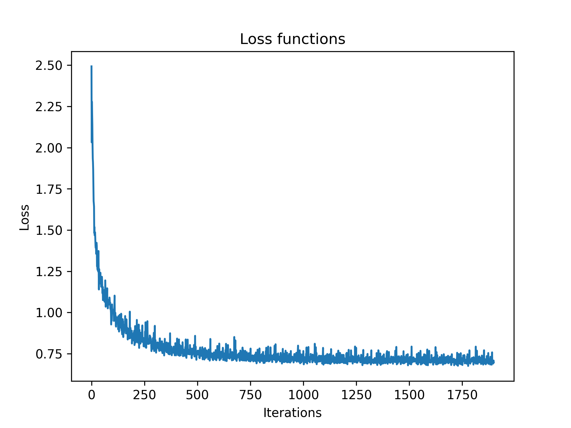
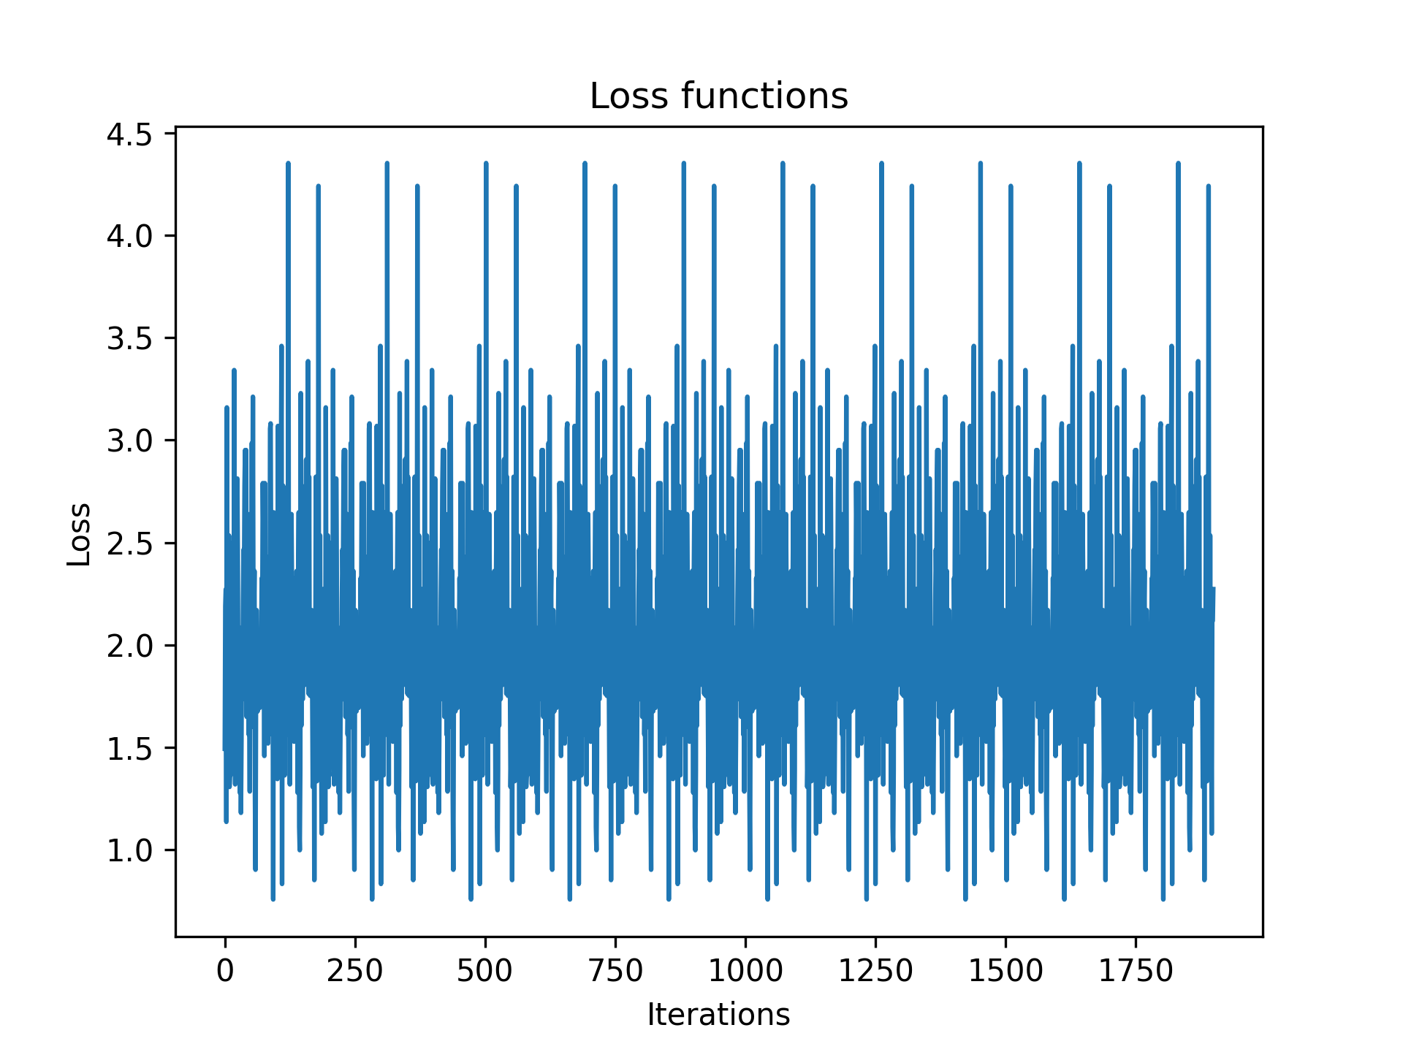
Using nn.BCELoss()
Standard Clustering Model
Standard Clustering Model
Transformer Model

