Slide 1
Transformer Model
https://github.com/jenegger/transformer_model

Slide 2
Default Settings:
Batch size = 64
Epochs = 10
feature_nr = 32
loss_rate = 2e-4
loss_function = nn.BCEWithLogitsLoss()
Optimizer = optim.SGD
= torch.nn.Linear(4,feature_nr)
Forward step:
def forward(self, x,in_hitnr):
x = self.linear_embedding(x)
out = self.transformer_encoder(x)
...
With:
heads = 6
num_layers = 6 (I.e sublayers)

Slide 3
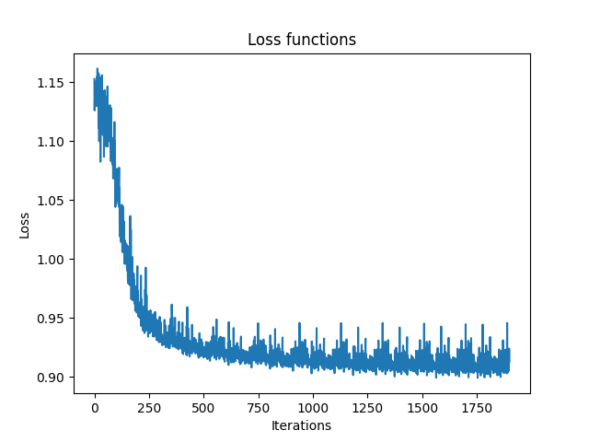
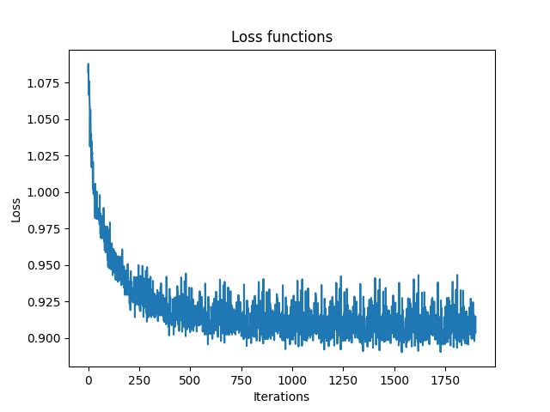
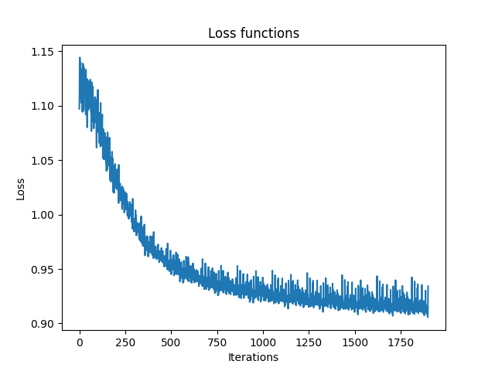
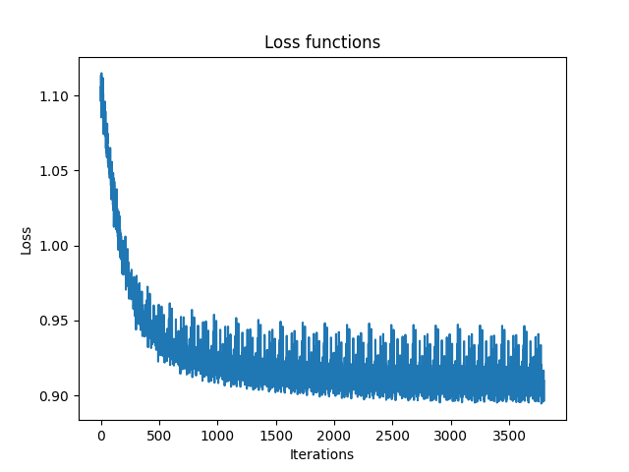
default
feature_nr = 16
feature_nr = 64
feature_nr = 64
Epochs = 20

Slide 4
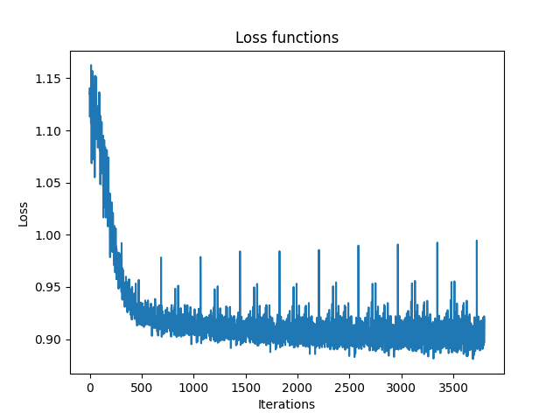
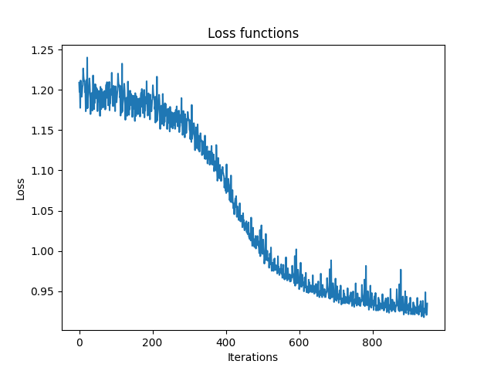
Different batchsizes
Default ( = 64)
Bs =32
Bs =128

Slide 5
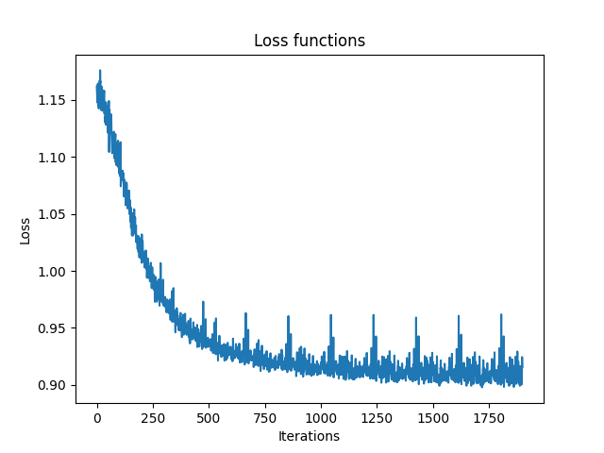
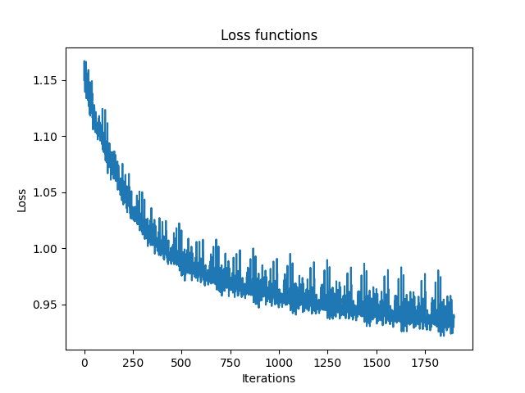
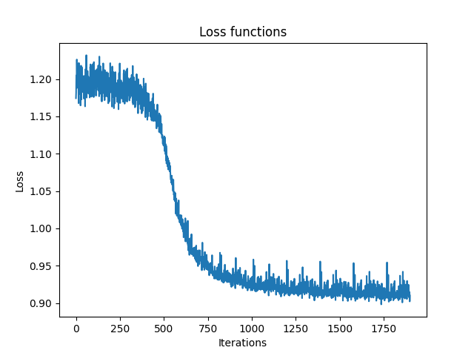
Additional Layer lin→RELU→lin
lin→RELU→Lin looks in forward function like this:
….
x = self.linear_embedding(x)
x = self.activation(x)
x = self.additional_linear_layer(x)
….
Lin-relu-lin
Before
transformer_encoder
default
Lin-relu-lin
after
transformer_encoder
Lin-relu-lin
Before
transformer_encoder
Heads = 4

Slide 6
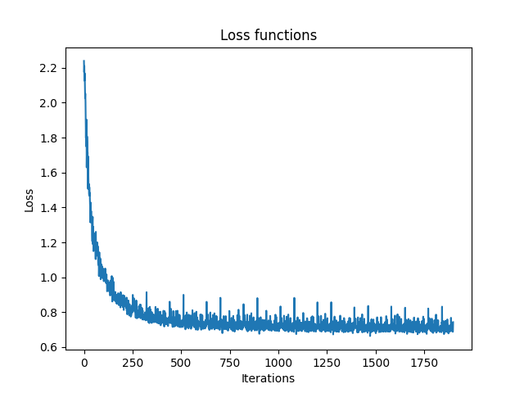
Different Loss Functions
Default with nn.BCEWithLogitsLoss()
Lossfunction = nn.BCELoss()

