Slide 1






Time Stitching and Eventbuilding for Experiment S455 (and S515)
Tobias Jenegger
R3B Collaboration Meeting 2021
First Unpacking Issues
Event Building before/after 2020
Recipe for Time Sorting and Stitching
First Results from S455 (p,2pf) reaction
Supported by BMBF 05P15WOFNA and 05P19WOFN1.
The results presented here are based on the experiment s444/s473, which was performed at the beam line/infrastructure Cave C at the GSI Helmholtzzentrum für Schwerionenforschung, Darmstadt (Germany) in the frame of FAIR Phase-0.
Physics with R³B
CALIFA – Design
TUM Members:
Roman Gernhäuser,Lukas Ponnath,Philipp Klenze,Tobias Jenegger

Slide 2
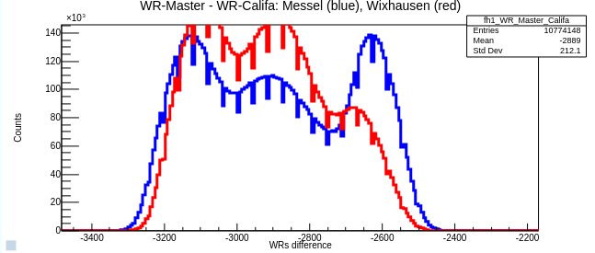
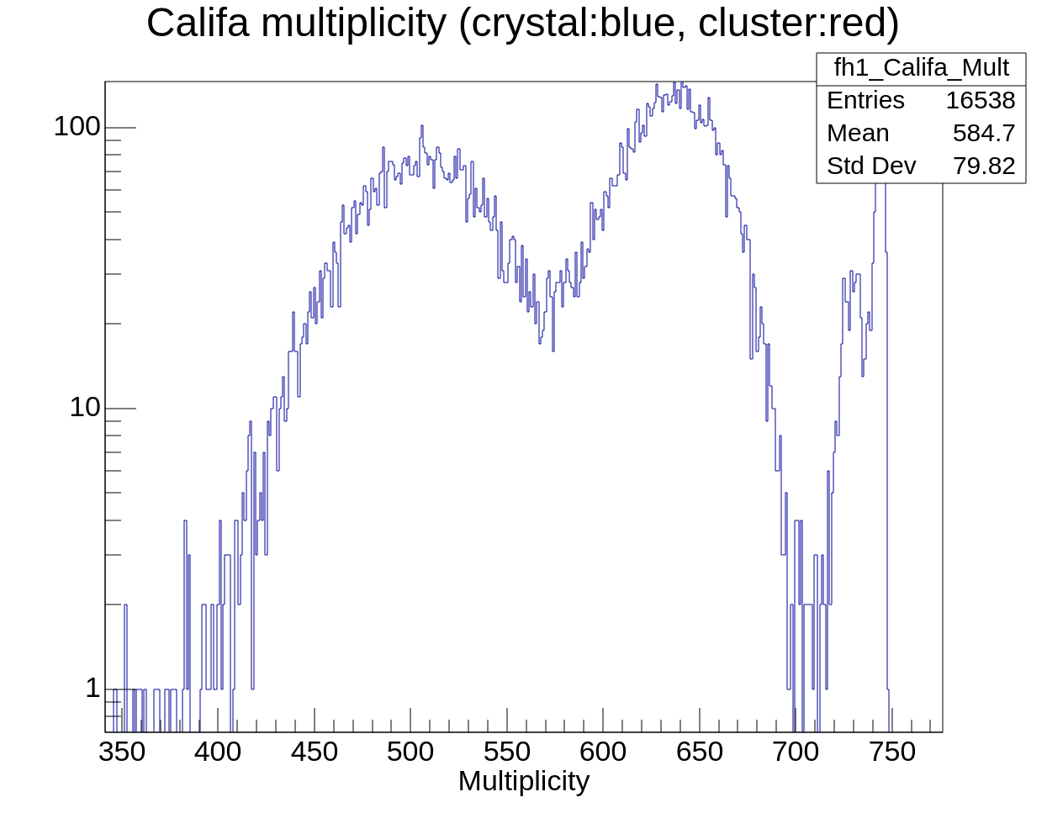
Issues in online/offline Data Analysis starting from S455
When using the known unpacking tools from previous experiment we got:
Events with hit-multiplicities > 500 !?
Sharp peak for strong correlation WRM- WRCalifa expected!
Is the data corrupted? Has something gone wrong during data acquisition?
How is data processed and stored to .lmd file?

Slide 3
Data Acquisition/Event Building until 2020
CALIFA DAQ (Multi Event Readout)
WR Readout
Other Detectors
MAIN DAQ
Hit Block from ME or WIX (not time sorted)
“Häcksler”
Splits up the Hit Block
Time sorting
(Febex time to WR time)
WR
WR
WR
WR
WR
WR
WR
WR
WR
DRASI TO
(time order)
File (LMD)
R3BOnline

Slide 4
Offline Time Stitching until 2020
Ucesb Time Stitcher
File (LMD)
time
Event i
Event i+1
Event i+2
time
Time Stitching Algorithm
time sorted hits
First detected hit opens event window
Time Stitcher does not distinguish between CALIFA, Main DAQ,.. hits
Event window is closed after predefined time (eg. 8 μs)
: main DAQ hit
: CALIFA hit
: other detector hit (e.g. MWPC1, TWIM,...)

Slide 5
Data Acquisition/Event Building since 2021
Other Detectors
MAIN DAQ
CALIFA DAQ (Multi Event Readout)
WR Readout
DRASI TO
(time order)
Hit Block from ME or WIX (not time sorted)
NO HÄCKSLER!
File (LMD)
R3BOnline

Slide 6
Output LMD File since 2021
File (LMD)
WIX
WIX
ME
time
CALIFA Hits are collected to Hit Blocks (Messel or Wixhausen)
Hit Blocks are sorted according to the WR Readout timestamp ( )
Hits inside Block are not time sorted !
CALIFA single hit time sorting needed!

Slide 7
Offline Time Sorting and Stitching since 2021
File (LMD)
Ucesb Time Stitcher
WIX
WIX
ME
time
WR
WR
WR
WR
WR
time
WR
WR
WR
WR
“Häcksler” - Messel
Event i
Event i+1
Event i+2
time sorted
WR
WR
WR
WR
WR
WR
WR
WR
WR
“Häcksler” - Wixhausen
merging both sides
time sorted

Slide 8
Time Sorting and Stitching with Philipp‘s script
califa_merge_stitch.bash¹
Non CALIFA
Hits
WR
WR
WR
WR
WR
WR
Messel
Hit Block
Ucesb Time Stitcher²
sorted &
stitched
File (LMD)
File (LMD)
WR
WR
WR
WR
WR
WR
Merger²
Wixhausen
Hit Block
split califa/non_califa²
“Häcksler”³
¹You can find it: /u/land/lynx.landexp/202105_s494/scripts/califa_merge_stitch.bash
²Unpacker: /u/land/klenze/ucesb_gcc6/empty/empty
³Unpacker: /u/land/landexp/202105_s494/x86l-76/daq_bootstrap/ucesb_wip/empty/empty

Slide 9
How to use the script
Location:
Always use the newest version you find in: /u/land/lynx.landexp/202105_s494/scripts/califa_merge_stitch.bash
Two Output Parameters:
One Input Parameter:
Merged Data
LMD file
“ ” for no output
ucesb –server option
Time Sorting and
Stitching
califa_merge_stitch.bash
LMD file
Stream of trans server
Stitched Data
LMD file
“ ” for no output
ucesb –server option
Example:
califa_merge_stitch.bash run10.lmd “ “ stitched_run10.lmd
Input .lmd file
No output merged data
Output .lmd stitched data

Slide 10
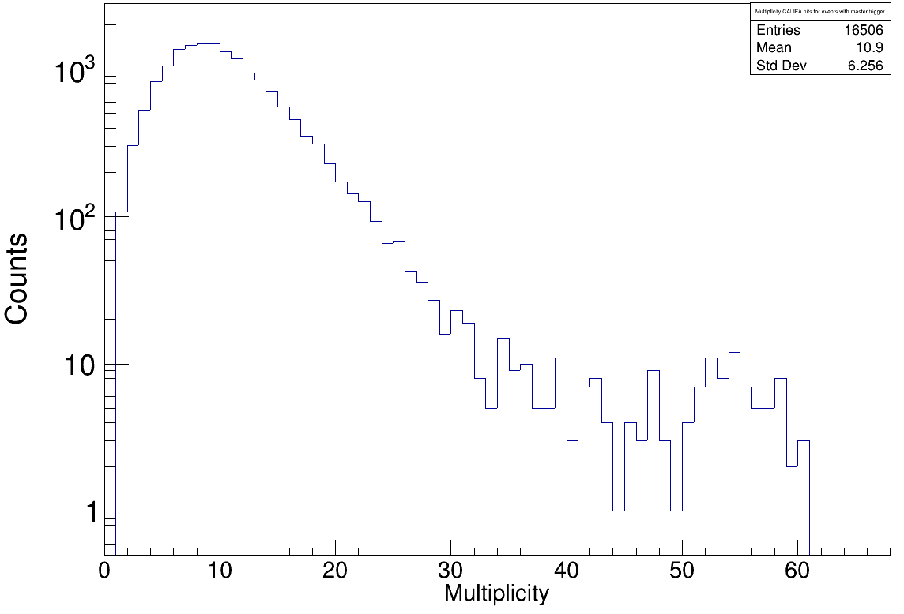


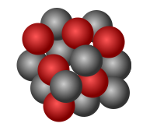
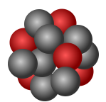
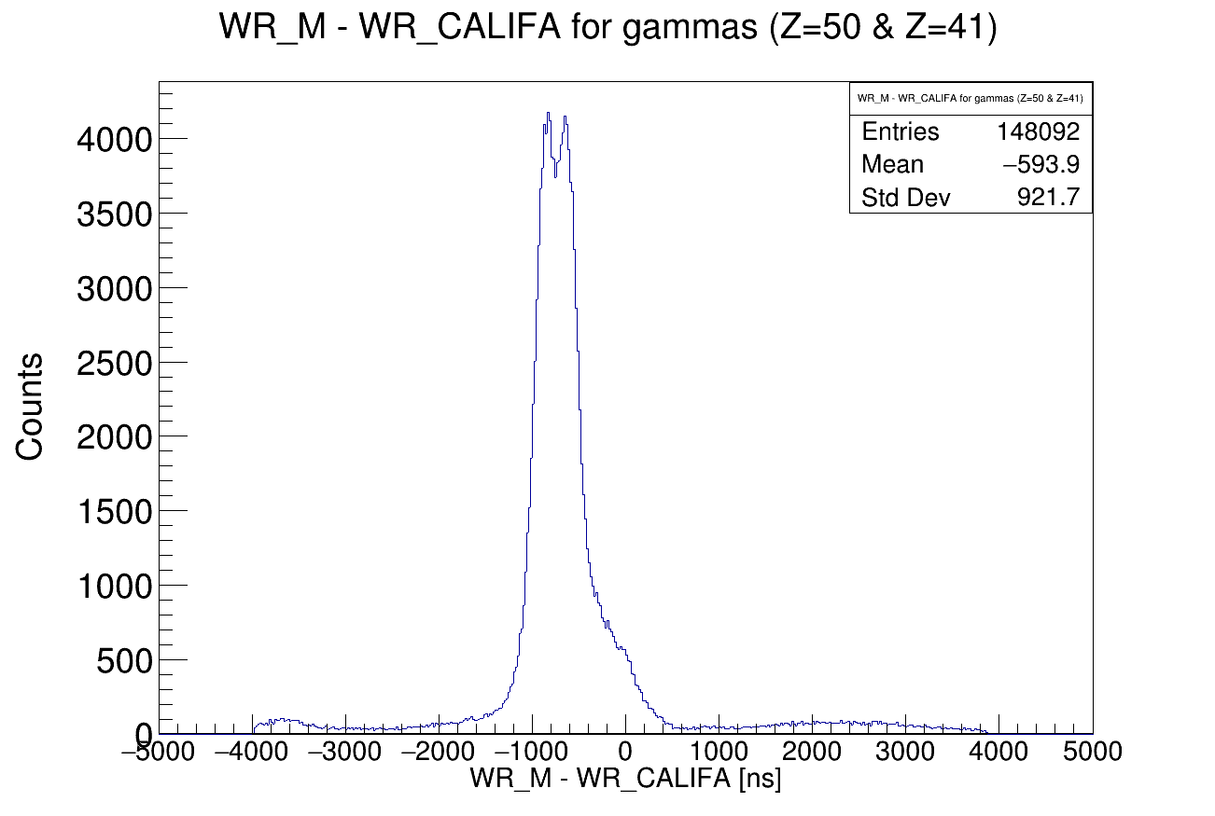
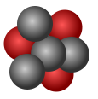
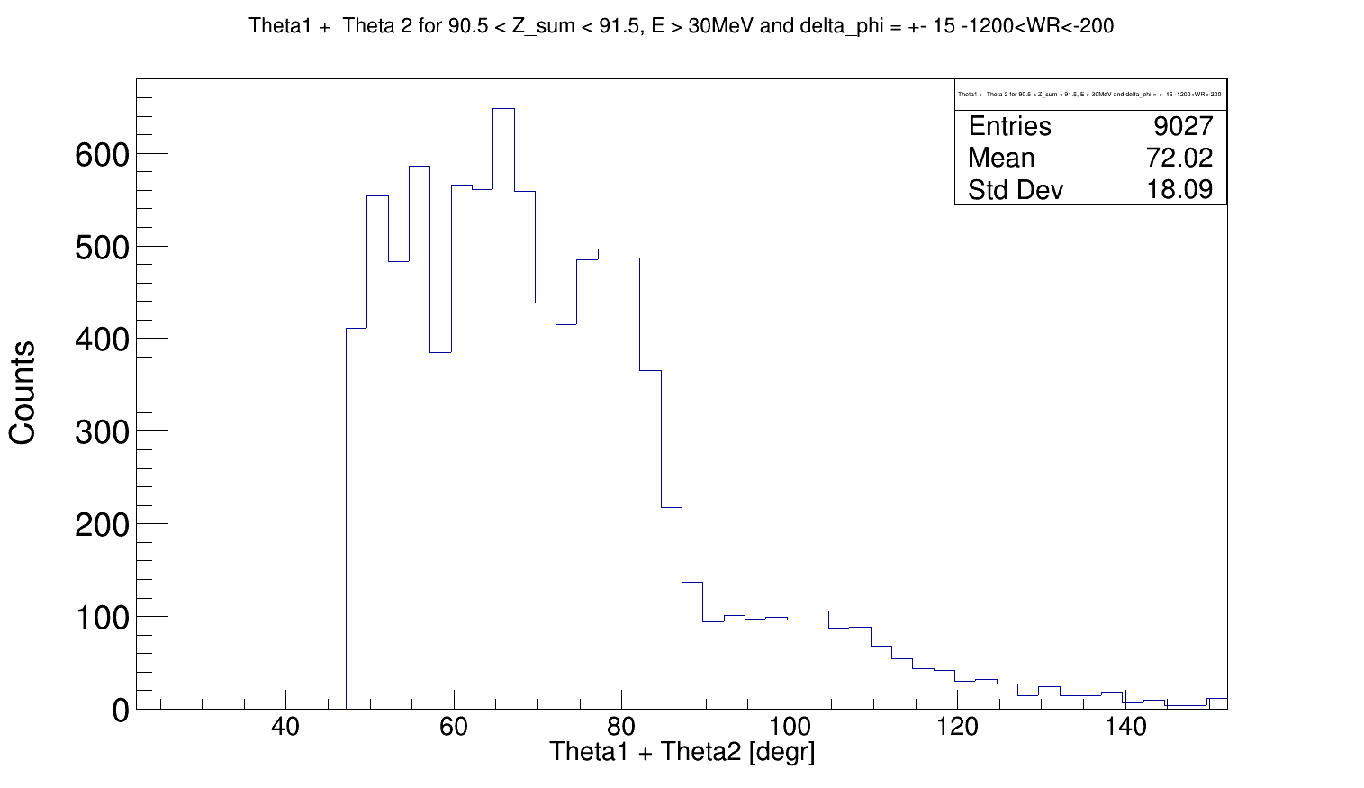
Looking again at S455 Data
Multiplicities:
238U fission via quasi-free-scattering (p,2pf)
238U
LH2 target
Summed θ angle of two protons:

Slide 11
Summary & Outlook
We successfully unpacked the S455 data
Well tested and user friendly Time Sorting and Stitching script is available:
/u/land/lynx.landexp/202105_s494/scripts/califa_merge_stitch.bash
Same procedure for experiments after S455 (e.g. S515)
CALIFA upexps code was recently unified, experiment independent with one mapping file for all experiments

Slide 12



CALIFA @ Technical University of Munich (TUM)
Roman Gernhäuser, Lukas Ponnath, Philipp Klenze, Tobias Jenegger
Thank you!

Slide 13
Backup

