Slide 1
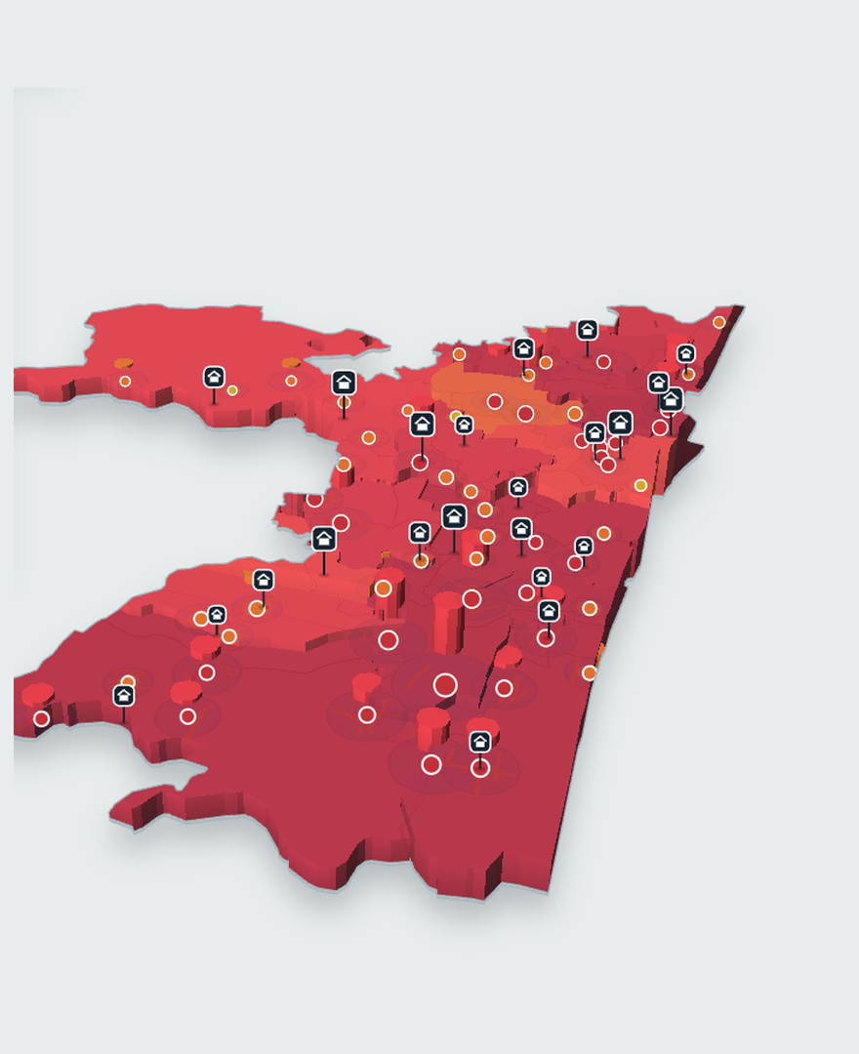
Chennai Relief Control
Flood-relief planning for Chennai
Hazard scoring, A* routing and a genetic algorithm that decide where relief goes first, and by which road.
Jobeson Julius and Pragadeesh S
Department of Computer Science and Engineering, Rajalakshmi Engineering College, Chennai
Notes:
Good morning. This is Chennai Relief Control, a web application that plans flood relief for Chennai using classical AI only: fixed hazard rules, A* search and a genetic algorithm. I will show how the system turns live weather readings into a truck dispatch plan. Then I will show what happened when I audited it against simple baselines, because the audit found two real faults and a one-line repair.

Slide 2
Flood relief asks three questions
Where is the danger?
Which roads still work?
Which truck goes where?
Rule-based hazard scoring
A* on OpenStreetMap roads
Genetic algorithm
Rain, wind and earthquake readings become a 0 to 100 score for each of 19 zones.
Flooding slows or closes roads, and the search finds the fastest open route between two points.
46 trucks from 23 depots are assigned to the relief areas, and each truck's stops are put in order.
Gives zone scores, and relief areas with people and needs
Gives travel times that change with the flood
Gives truck routes with clock-time arrivals
Built on the December 2015 floods and five other events, with no machine learning.
Notes:
Think about a relief officer during a flood. Three questions have to be answered at the same time. Where is the danger worst? Which roads can a truck still use? And which truck should go to which area, in what order? I mapped each question to one classical technique. Rules score the hazard. A star search finds routes on a road network that the flood damages. A genetic algorithm assigns the trucks. There is no machine learning, so every number can be traced to a stated rule. That matters when a duty officer has to trust and explain a plan.

Slide 3
From weather feed to truck route
Data in
Hazard engine
Road model
Dispatch planner
Open-Meteo
Rain, wind and shaking become a score from 0 to 100 for each of 19 zones.
Hotspot intensity slows or closes nearby roads.
A genetic algorithm assigns areas to trucks and orders each run.
rain, wind and waves
USGS
quakes within 600 km
OpenStreetMap
Flood hotspots become relief areas with people and supply needs.
A* finds the fastest open route, and areas with none are flagged as cut off.
Arrival times are clock times in IST.
road network, cached
Depots and fleet
placeholder, editable
Web app
Map, Dispatch, Resources and Reports; plans saved in SQLite and exported as PDF
Classical search: A* and a genetic algorithm
Rule-based arithmetic and data; no machine learning
Notes:
This is the whole pipeline on one slide. Open-Meteo gives rain, wind and wave readings, and the US Geological Survey gives earthquakes within 600 kilometres. Both refresh every 15 minutes. The hazard engine turns those readings into a score for each of 19 zones and turns flood hotspots into relief areas with people and supply needs. The road model uses the same hotspots to slow or close roads on an OpenStreetMap graph. The dispatch planner then uses A star travel times to assign trucks. The two blue boxes are the only places that search. Everything else is fixed arithmetic. The web app shows the result on a map and exports run sheets as PDF.

Slide 4
Live data, with honest placeholders
Source | What it provides | Status
Open-Meteo | Rain, wind gusts, waves, river index | Live, every 15 minutes
USGS earthquake catalogue | Quakes within 600 km in the last 3 days | Live, every 15 minutes
OpenStreetMap via Overpass | 8,044 junctions and 10,474 road segments | Cached
Datameet and Transparent Chennai | Shapes of the 19 zones | Open data (CC BY-SA)
Depots, stock, fleet, hotspots | 23 depots, 46 trucks, 57 flood hotspots | Placeholder, editable
Zone populations | 6.48 million people across 712 km² | Modelled
Public sources
Stand-ins and estimates
Weather, quakes, roads and zone shapes are read from open feeds, not typed in.
Stock, fleet and hotspots are representative, so coverage describes the model, not a real fleet.
Notes:
Here is where every input comes from, and how much of it is real. Weather and earthquakes are live feeds refreshed every 15 minutes. The road network is OpenStreetMap, downloaded once and cached: 8,044 junctions and 10,474 road segments. Zone shapes come from Datameet and Transparent Chennai under an open licence. The bottom two rows are not real data. Depots, stock, the fleet and the list of 57 flood hotspots are representative placeholders that the user can edit on the Resources page, and zone populations are modelled. So every coverage figure in this talk describes the model, not a real fleet. I want to be upfront about that.

Slide 5
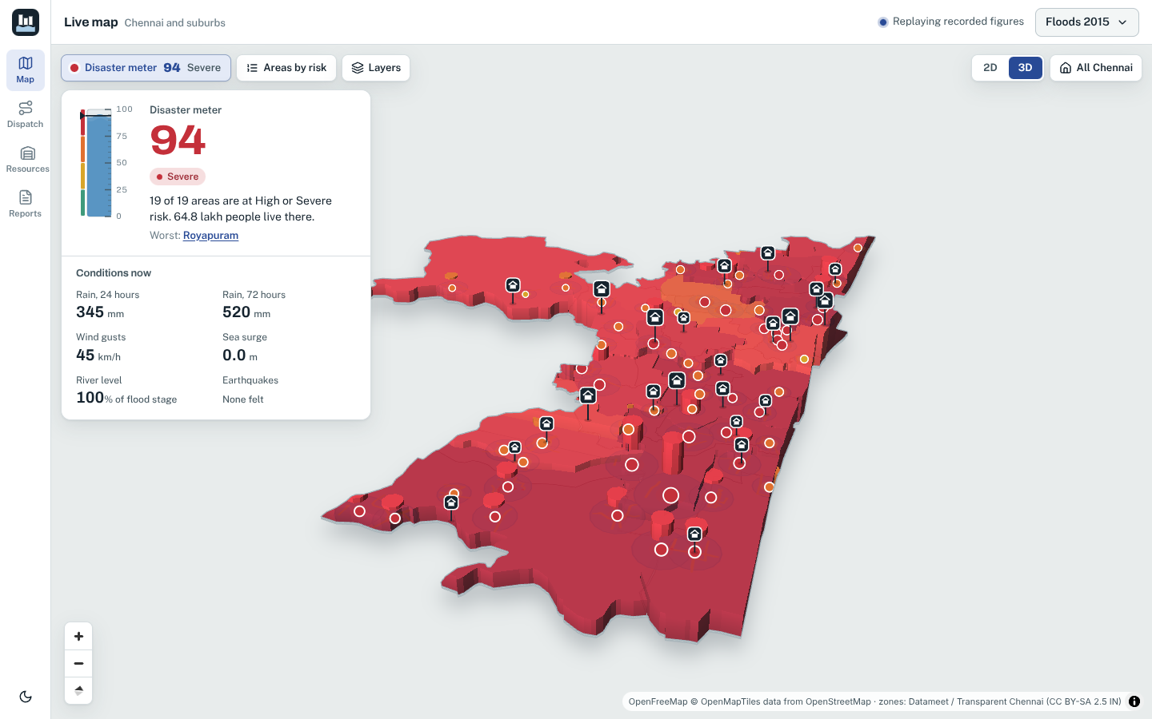
Hazard rules turn weather into a score
Flood score, one zone
100 × rain × susceptibility × (1 + 0.12 × river × low-lying)
Zone score
largest hazard + 0.30 × second largest, capped at 100
City disaster meter
0.55 × worst zone + 0.45 × population-weighted mean
The app's map for the 2015 floods: meter 94, Severe
City disaster meter, 0 to 100
Below 25
Elevated, from 25
High, from 50
Severe, from 75
Notes:
The hazard engine is plain arithmetic. For each zone, the flood score multiplies a rain factor, anchored on the India Meteorological Department rain classes of 64.5, 115.6 and 204.5 millimetres, by how susceptible the zone is: how low-lying it is and how many flood hotspots it has. A river index raises it further. Wind and earthquake scores work on the same 0 to 100 scale. A zone's score is its largest hazard plus 30 percent of the second largest. The city meter blends the worst zone with the population-weighted average, and it reads Elevated from 25, High from 50 and Severe from 75. Each score is shown with its drivers, for example rain, low-lying index and number of hotspots, so nothing is a black box.

Slide 6
Six replayed events, one scale
Event
City disaster meter
Level
Areas (Critical)
People affected
Roads slowed / closed
Chennai floods 2015
94.1
Severe
57 (28)
87,060
1,893 / 219
Cyclone Vardah 2016
90.1
Severe
60 (7)
146,560
1,537 / 0
Cyclone Michaung 2023
96.4
Severe
60 (25)
118,660
1,903 / 209
Cyclone Fengal 2024
75.4
Severe
60 (0)
55,090
2,112 / 0
Cyclone drill
94.7
Severe
60 (13)
198,370
2,112 / 0
Quake M6.6 drill
63.7
High
19 (0)
138,200
0 / 0
The four past events replay rain and wind figures held in the app; the two drills are scenarios. Plans cover at most 60 areas.
Notes:
To test the system I replay six events: the 2015 Chennai floods, Cyclone Vardah in 2016, Cyclone Michaung in 2023, Cyclone Fengal in 2024, and two drills, a severe cyclone and a magnitude 6.6 earthquake. The meter is above 90 for the 2015 floods, Vardah, Michaung and the cyclone drill, and 75.4 for Fengal, which is still Severe. The earthquake drill is High at 63.7 and slows no roads, because earthquake damage to roads is not modelled. The numbers in brackets are Critical areas, and the last column shows how many roads the model slowed and closed. The 2015 floods are the main case from here on: 57 areas, 28 of them Critical, and 87,060 people affected.

Slide 7
Roads slow or close as flooding rises
8,044
10,474
95.9%
junctions in the road graph
road segments from OpenStreetMap
of junctions are in one connected network (153 pieces in all)
How flooding changes a road
How A* finds the route
Slows. Near an intense hotspot a road keeps as little as 18% of its normal speed.
Heuristic. Straight-line distance divided by the fastest road speed. It never overestimates, so A* returns the cheapest route.
Closes. A minor road closes when a severity-3 hotspot reaches intensity 0.82 and the road lies within 65% of its radius.
Checked. Same travel time as Dijkstra's algorithm on all 1,008 reachable routes tested.
Notes:
The road model starts from OpenStreetMap: 8,044 junctions and 10,474 road segments, with 95.9 percent of junctions in the largest connected network. The flood then damages it. Around each hotspot, nearby roads slow down, and a road never keeps less than 18 percent of its normal speed. A minor road closes outright when a severity 3 hotspot is intense enough and the road is close to its centre. Travel time on a road is its length divided by its class speed times the slowdown, with class speeds from 55 down to 15 kilometres an hour. A star searches this graph. Its heuristic is straight-line distance divided by the fastest road speed, which never overestimates, so the route is the cheapest one. I checked this against Dijkstra's algorithm on 1,008 reachable routes and the travel times matched every time. I do not claim A star is faster in my Python code: it expanded about 30 percent fewer junctions but ran 20 to 40 percent slower because of heap overhead.

Slide 8
Flooding changes most best routes
300 depot-to-area pairs in the 2015 replay, compared with their dry-weather routes.
18%
15%
67%
+19.9%
had no open road at all (54 of 300)
had a dry-weather route that crosses a closed road
of the 246 reachable pairs had a different best route
longer mean travel time on the reachable pairs
The same measures for two other events
Event | No open road | Dry route closed | Different best route | Longer travel
Michaung 2023 | 22% | 13% | 65% | +17.2%
Cyclone drill | 3% | 0% | 49% | +11.7%
Notes:
Does the flood model actually matter, or would dry-weather routes do? I took 300 depot-to-area pairs in the 2015 replay and compared the dry-weather route with the flooded one. For 18 percent of pairs, 54 of 300, there is no open road at all. Of the 246 that can still be reached, 15 percent had a dry-weather route that crosses a road now closed, 67 percent need a different best route, and mean travel time is 19.9 percent longer. Michaung and the cyclone drill show the same pattern at lower intensity. So a planner using dry-weather routes would send trucks down roads that are closed, and would give arrival times that are about 20 percent too short.

Slide 9
A genetic algorithm assigns the trucks
1
Score
Fitness term | Weight | Varies
Priority-weighted delivery | +3 | No
Area coverage | +2000 | No
Unserved areas | −300 | No
Distance | −1.5 per km | Yes
Truck overload | −80 per unit | Yes
Fuel beyond tank | −100 per litre | Yes
Cut-off leg | −500 per leg | Yes
Fleet imbalance | −10 × spread | Yes
Eight fitness terms, using A* travel times
2
Select
The best of four random plans becomes a parent
3
Recombine
Order crossover joins two parents in 80% of pairs
4
Mutate
5% of children move a stop, switch truck or reverse a stretch of route
5
Keep
The 2 best plans pass on unchanged
Each cut-off leg costs about 15,500 points: 500 plus a 9,999 km stand-in distance at 1.5 per km.
Balanced mode: 100 plans and 250 generations, starting from 2 seeded plans and random ones.
Notes:
The dispatcher is a genetic algorithm. A plan maps each truck to an ordered list of stops. Each generation scores every plan, picks parents by tournament of four, joins them with order crossover in 80 percent of pairs, mutates 5 percent of children by moving a stop, giving it to another truck or reversing part of a route, and keeps the two best plans unchanged. Balanced mode uses 100 plans and 250 generations. The fitness has eight terms. Delivery, coverage and unserved areas are the same for every plan, because every stop is in some route, so only five terms separate good plans from bad ones. The cut-off leg term matters most. A leg with no open road adds a 9,999 kilometre stand-in distance, so each cut-off leg costs about 15,500 points. Keep that number in mind for the next few slides.

Slide 10
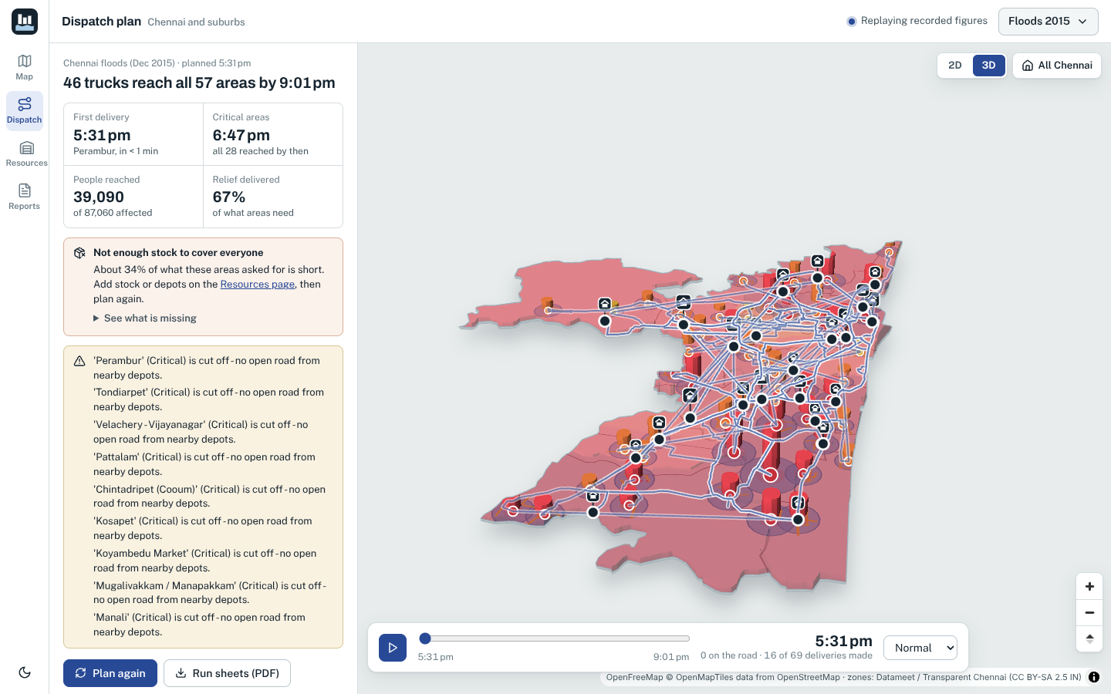
The screen says every area is reached
The headline
46 trucks reach all 57 areas by 9:01 pm
Critical areas
All 28 reached by 6:47 pm
The warnings under it
Perambur (Critical) is cut off, with no open road from nearby depots. It is also listed as the first delivery, at 5:31 pm.
Notes:
This is the Dispatch page for the 2015 floods, as the operator sees it. The headline says 46 trucks reach all 57 areas by 9:01 pm. The Critical-areas box says all 28 are reached by 6:47 pm. Now look at the warnings underneath. Perambur is Critical and is listed as cut off, with no open road from nearby depots, yet it is also the first delivery at 5:31 pm. The screen contradicts itself. That made me stop and audit the planner against simple baselines on all six events, using a stricter measure: the share of areas a truck can really reach by an open road. The audit found two separate faults.

Slide 11
The optimiser never improved the plan
Cut-off legs in the best plan, by generation
genetic.py, line 318
- fitness = max(raw_fitness, 0.01)
+ fitness = raw_fitness
Every plan has about 35 cut-off legs, so every plan scores about −10 to −12 million. The clamp floors all of them to 0.01. Selection cannot tell plans apart, and the first seed comes back unchanged.
All 14 shipped tests still pass after the fix.
At generation 225: shipped 35, floods repaired 22, Michaung repaired 19.
Notes:
The first fault is in the optimiser itself. Every plan in the 2015 replay has about 35 cut-off legs, and each carries the 9,999 kilometre stand-in, so every plan has a raw fitness of about minus 10 to minus 12 million. Line 318 of the genetic module then applies max of raw fitness and 0.01, which floors every plan to 0.01. Tournaments cannot prefer any plan, the best-so-far never changes, and the algorithm returns its first seed, the severity-ranked round robin. The red line is the shipped planner, flat at 35 cut-off legs for all 250 generations. With the line changed to just use the raw fitness, the blue and dashed lines fall to 22 legs for the 2015 floods and 19 for Michaung. The change is one line and all 14 shipped tests still pass. No test had caught this, because the planner still returned a valid, plausible plan.

Slide 12
Cut-off areas counted as reached
A cut-off leg was recorded as 0 km and 0 hours, so the headline counted its area as reached.
24 of 57
areas cut off by closed roads in the 2015 replay
19 of 28
Critical areas reached by road, while the screen says all 28
25%
of depot-to-area pairs have no open route (399 of 1,587)
Notes:
The second fault is in the headline numbers. When a leg has no open road, the plan builder recorded it as 0 kilometres and 0 hours, so the area was counted as reached. The red bars are what the screen reports. The blue bars are what trucks can actually reach by an open road. In the 2015 floods the screen reports 66.5 percent of areas and the road measure gives 43.0 percent, a gap of 23.5 points. Michaung has a gap of 20.7. Fengal, where few roads are closed, has only 4.8. Behind the 2015 gap, 24 of 57 areas are cut off, only 19 of the 28 Critical areas are actually reached, and a quarter of all depot-to-area pairs, 399 of 1,587, have no open route. This is a reporting fault: it makes the plan look better than it is.

Slide 13
The repair raises road coverage
Areas reached by road, %, mean of three runs. The figure in brackets is the gain of the clamp-removed planner over the best baseline, in points.
Notes:
Here is the effect of the one-line repair on all six events, as the mean of three runs. Grey is the shipped planner, light blue is the better of the two baselines, nearest depot or random search, and dark blue is the planner with the clamp removed. The vertical line marks the most that a one-trip fleet could ever reach, because the fleet carries 166,700 units in total. In the 2015 floods road coverage goes from 43.0 percent to 64.8 percent, 17.4 points above the best baseline. For Michaung it is 55.6 against 42.2, a gain of 13.4. The gain follows the headroom. Where the one-trip limit is close to what the baselines already reach, as in the cyclone drill, there is almost nothing to gain, and that result is a tie because the run ranges overlap. Each cell is only three runs, so I report ranges, not confidence intervals. The repair was measured on a patched copy of the project, not yet in the released app.

Slide 14
What was tested, and what held
14 of 14
1,008
43
shipped tests pass with the one-line fix, in 1.8 seconds
routes where A* matched Dijkstra's travel time exactly
rain, wind and quake steps tested; the city meter never fell as a hazard rose
0.16 ms
7–12 s
24 of 24
to score the zones; the whole state builds in 16 ms
for a later plan; the first plan takes 41 to 51 s while routes are cached
page and width combinations with no horizontal overflow
Notes:
Beyond the audit, here is what I checked and what held. The 14 shipped tests pass in 1.8 seconds, including after the one-line fix. A star returned exactly the same travel time as Dijkstra on all 1,008 reachable routes I sampled, though I make no speed claim in Python. I swept rain in 16 steps, wind in 19 and quake magnitude in 8, and the city meter never fell as a hazard rose. Zone scoring takes 0.16 milliseconds and the whole state builds in 16. A first plan takes 41 to 51 seconds while the route cache fills, and later plans take 7 to 12 seconds. And the interface showed no horizontal overflow at six widths on four pages.

Slide 15
Limits, and what comes next
Limits of this version
Next steps
Depots, stock, fleet and hotspots are placeholders, and populations are modelled.
Apply the repair in the app, and show reported and road coverage side by side.
Closure thresholds are not calibrated against real flood depths or observed closures.
Allow several trips per truck, which raises the one-trip ceiling.
Each truck makes one trip, and a plan covers at most 60 areas.
Calibrate closures against observed flood depths and road closures.
Each result is the mean of three runs, and the repair was measured on a patched copy.
Compare against hybrid genetic search, and test the explanations with users.
Notes:
Some limits you should know about. The depots, stock, fleet and hotspot list are placeholders and populations are modelled, so the coverage figures describe the model and not a real fleet. The four past events are replays of rain and wind figures, not reconstructions of the true road state, and the closure thresholds are not calibrated against observed closures. Each truck makes one trip. Every result is the mean of three runs, and the repaired planner and random search both optimise the road-feasibility signal that the road measure counts, which favours methods that share the objective. The repair itself was measured on a patched copy and is not yet in the released app. Next steps: apply it, show reported and road coverage side by side, allow several trips per truck, calibrate closures against real flood depths, and compare against hybrid genetic search.

Slide 16
Thank you
Chennai Relief Control
Every number traces to a rule: classical AI, with no black box.
The audit found two faults that the tests had missed.
Questions are welcome.
One line lifts road coverage in the 2015 floods from 43.0% to 64.8%.
Jobeson Julius and Pragadeesh S
Rajalakshmi Engineering College, Chennai
Notes:
To close, three things. First, every number in this system traces to a rule, so a duty officer can see why a plan was chosen. Second, auditing it against simple baselines on six events found two faults that no test had caught: a fitness clamp that switched off the optimiser, and a coverage headline that counted cut-off areas as reached. Third, the repair is one line, and in the 2015 floods it lifts road coverage from 43.0 to 64.8 percent. Thank you, and I am happy to take questions.

