Slide 1
Traqueur d’effort à domicile
Jennifer FRY
Heda WANG
UJF M2 PGI
2014_2015

Slide 2
Introduction & Applications
Traque les efforts physiques effectués à domicile
  Mesure les efforts physiques & les conditions environnementales
  Corrèle les données de différents capteurs
Notes:
Applications enviseagées:
Health monitor, exercise monitor. We would like the house to keep track of how much you move around during the day. If you arn't moving around enough, the house can send you alerts by email or what not to remind you to move. This could be tailored to each persons goal for movement. Maybe based on the temperate of the house and the outdoor weather it can recommend different types of actives, so on days that are really hot maybe you can do something less vigorous. Or it could turn on or off the homes heating, air conditioning. With the database would could keep track of the activity level, along with the weather, generate reports and maybe find if there is a correlation between the two.

Slide 3
Cartes et Composants Matériels
Intel Galileo
Nucleo F401Re
JawBone bracelet
BMP085 Pressure Sensor
PIR Motion Sensor
DHT11 Temperature & Humidity sensors

Slide 4
Composants et Protocoles
Node-red
InfluxDB
OpenHab
Grafana
MQTT
HTTP/REST
Oauth
Notes:
Composants Logiciels et Protocoles UtilisésNode-red, OpenHab, influxdb, graffana, MQTT,

Slide 5
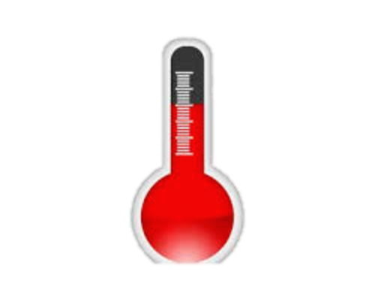



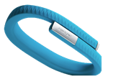

Architecture
MQTT Broker
Galileo
Nucleo
Publish
Galileo
Serial Line
Serial Line
Serial Line
Subscribe
Publish
Node-Red
Node-Red
Publish/Subscribe
HTTP
JawBone

Slide 6
Développement
Langage | LOC | Utilisation
JavaScript | 160 | NodeRed, Oauth et Ajax pour Jawbone
OpenHab script | 150 | Règle OpenHAB
C++/objective C | 87 | Données de Capteurs

Slide 7
Difficultés
Intégration du Jawbone
  Oauth 2.0 : Id application, Id client
  Requête cross-domain : CORS

Slide 8
Difficultés
Serveur MQTT
  Ports bloqués
  Opensensors.io

Slide 9
Evolution
Règles Complexes pour OpenHab
Intégration avec l’environnement
Intégration avec Grafana et Jawbone
Notes:
It would be great if your house could say oh you have been sitting down for 30 min and it blinks a light or beeps or something to remind you

Slide 10
Conclusion
Projet intéressant
  Intégration d’objets connectés
  Utilisation de nombreuses technologies

Slide 11
Démonstration et Questions

