Slide 1





Key generation process
Private key
Saved on user’s device
Generate keys
Patient/Medical Unit/Verifying 3rd party
Saved on app’s database
Public key
Encrypt symmetric key
with public key
Symmetric Key

Slide 2
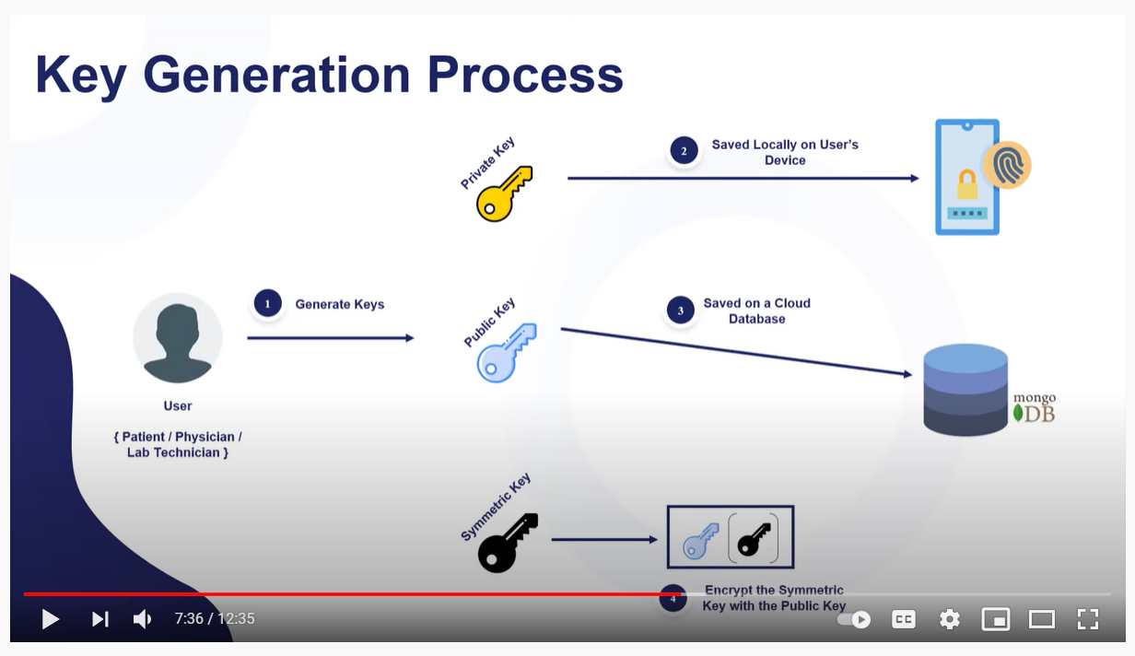

Slide 3
Grant Access Process

Slide 4
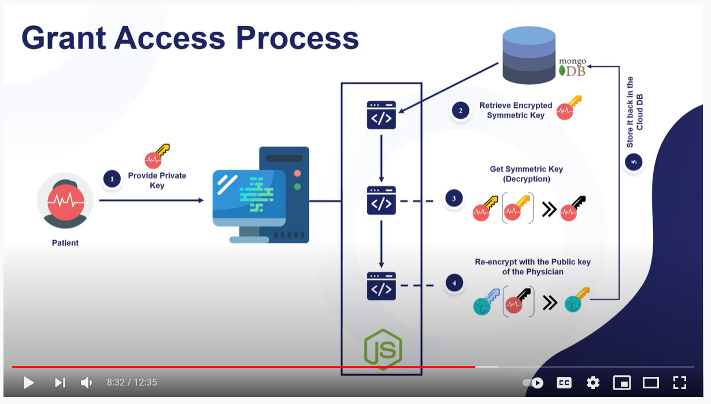

Slide 5
operational
Medical Unit
Patient
Web App
IPFS
Blockchain
Verifying 3rd Party
A. Generates public and
private keys
B.1. Upload files to web app
B.2. Get public key of patient from app db. Encrypt file with key and upload to IPFS
B.3. Update blockchain with latest IPFS details
C.1. Request for records
C.2 Provide private key for access request
C.3. Validate and retrieve requested IPFS file metadata
C.4. Retrieve file requested

Slide 6


Grant Access Process
Retrieve public
key from db
Provide private key
Used retrieved keys
To access ipfs and blockchain metadata and file

Slide 7
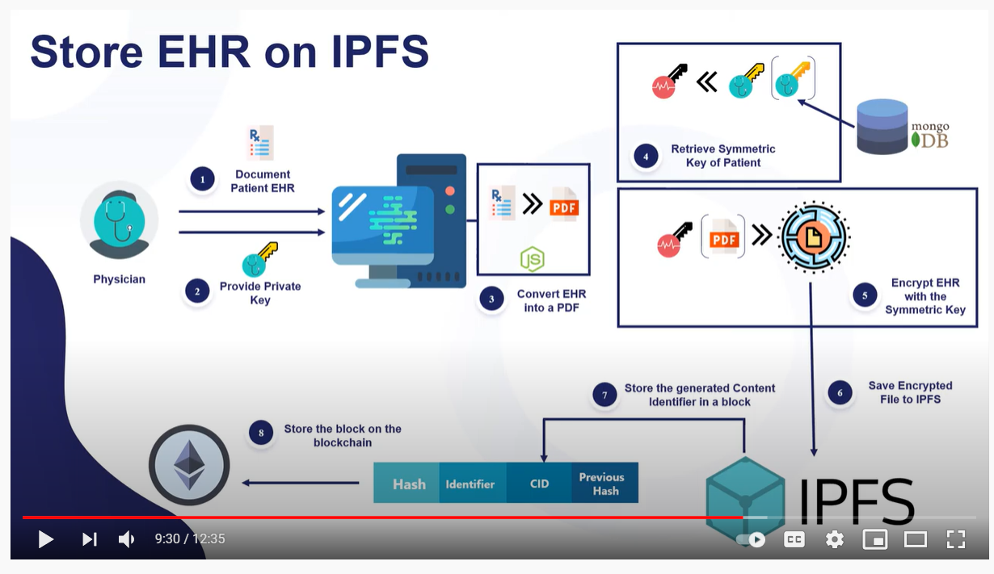

Slide 8
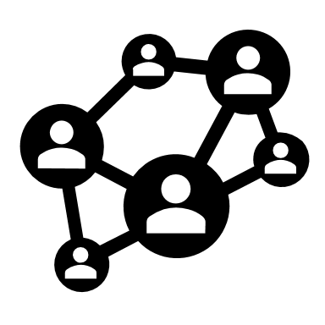


Store file on IPFS and Blockchain

Slide 9
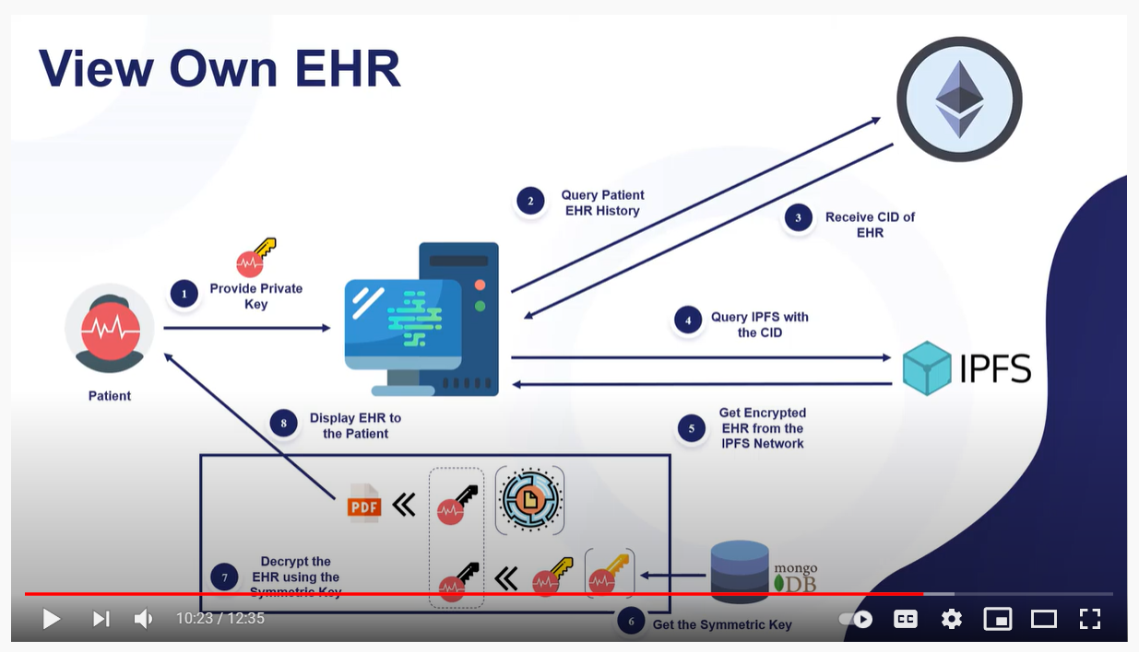

Slide 10
