Slide 1
Pasilla
A keyword-driven test framework for Protractor

Slide 2
Pasilla A Test Framework for Protractor
What is it?
For testing AngularJS web applications
Uses Protractor to run the tests
But Protractor is a framework already – isn’t it?

Slide 3
Pasilla A Test Framework for Protractor
But why?
No need to write Jasmine “describe” and “it” program code
A test is a sequence of actions (keywords) and data
Keywords are reusable (like a set of building-blocks)
Excel is used for productivity during test design and assembly
JavaScript files are generated for run-time execution

Slide 4
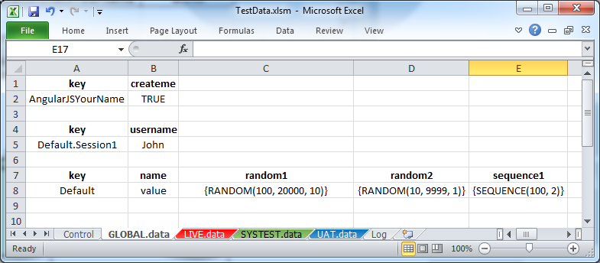
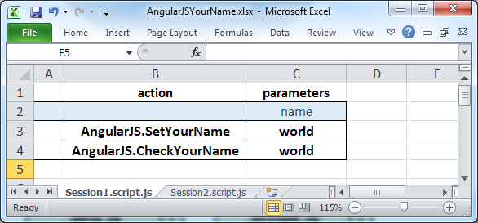
Pasilla A Test Framework for Protractor
Overall view of all the parts
data/TestData.xlsm
tests/AngularJSYourName.xlsx
DESIGN
DESIGN
1. Create/Edit
1. Create/Edit
GENERATE
2. Generate
2. Generate
.pro.js
files
.script.js
files
.data.js
files
3. Push
GitHub
Not really as complicated as it looks
TeamCity Server
TeamCity Agent
4. Run
RUN
Protractor

Slide 5
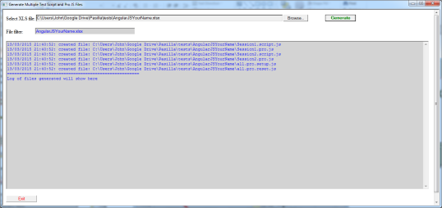
Pasilla A Test Framework for Protractor
tests/AngularJSYourName.xlsx
Session1.pro.js
describe(‘Session1', function () {
automation.using("running Session1 test script", require('./ Session1.script.js'),
function (step) {
var sObject = step.action.substring(0, step.action.indexOf('.'));
for (var property in (step.params)[0]) {
if ((step.params)[0].hasOwnProperty(property)) {
(step.params)[0][property] = automation.resolveParams(dictData, (step.params)[0][property]);
}
}
try { key(require('../../keywords/' + sObject + '.keywords.js')); } catch(err) { }
it("Step " + iStep++ + ": Keyword=" + step.action + ", Data=[" + step.params + "]", function () {
if (step.action.slice(0,1) != '#') {
key.run(step.action, step.params).then(function () { });
}
}, 600000);
});
}, 600000);
.pro.js
files
GenerateScriptnProJS.hta
.script.js
files
Generates JavaScript
Specs and Scripts
Session1.script.js
var Session1 = [
[{action:'AngularJS.SetYourName',params:[{name:'world'}]}],
[{action:'AngularJS.CheckYourName',params:[{name:'world'}]}]
];
module.exports = Session1;
var Session2 = [
[{action:'AngularJS.SetYourName',params:[{name:John'}]}],
[{action:'AngularJS.CheckYourName',params:[{name:‘John'}]}]
];
module.exports = Session2;

Slide 6
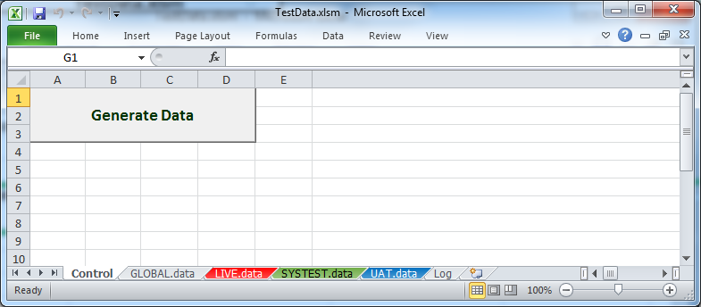
Pasilla A Test Framework for Protractor
Generates JavaScript
Data
TestData.xlsm
LIVE.AngularJSYourName.data.js
var TestData = (function () {
function TestData() {}
TestData.prototype.load = function (dictData) {
dictData.set('#SESSION1.USERNAME#', ‘John');
dictData.set('#NAME#', 'value');
dictData.set('#RANDOM1#', '{RANDOM(100, 20000, 10)}');
dictData.set('#{RANDOM1}#', 'RANDOM(100, 20000, 10)');
dictData.set('#RANDOM2#', '{RANDOM(10, 9999, 1)}');
dictData.set('#{RANDOM2}#', 'RANDOM(10, 9999, 1)');
dictData.set('#SEQUENCE1#', '{SEQUENCE(102, 2)}');
dictData.set('#{SEQUENCE1}#', 'SEQUENCE(102, 2)');
dictData.set('#ENVIRONMENT#', 'LIVE');
dictData.set('#VERSION#', '1');
dictData.set('#CREATEME#', 'True');
};
return TestData;
})();
module.exports = TestData;
var TestData = (function () {
function TestData() {}
TestData.prototype.load = function (dictData) {
dictData.set('#SESSION1.USERNAME#', ‘John');
dictData.set('#NAME#', 'value');
dictData.set('#RANDOM1#', '{RANDOM(100, 20000, 10)}');
dictData.set('#{RANDOM1}#', 'RANDOM(100, 20000, 10)');
dictData.set('#RANDOM2#', '{RANDOM(10, 9999, 1)}');
dictData.set('#{RANDOM2}#', 'RANDOM(10, 9999, 1)');
dictData.set('#SEQUENCE1#', '{SEQUENCE(102, 2)}');
dictData.set('#{SEQUENCE1}#', 'SEQUENCE(102, 2)');
dictData.set('#ENVIRONMENT#', 'LIVE');
dictData.set('#VERSION#', '1');
dictData.set('#CREATEME#', 'True');
};
return TestData;
})();
module.exports = TestData;
GENERATE

Slide 7
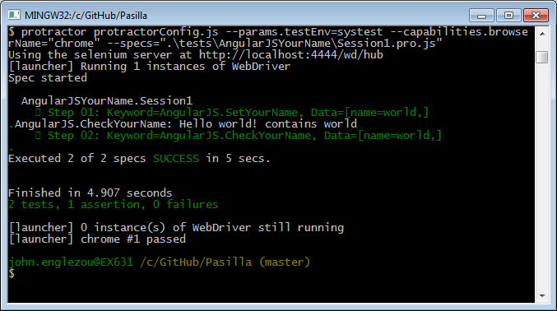
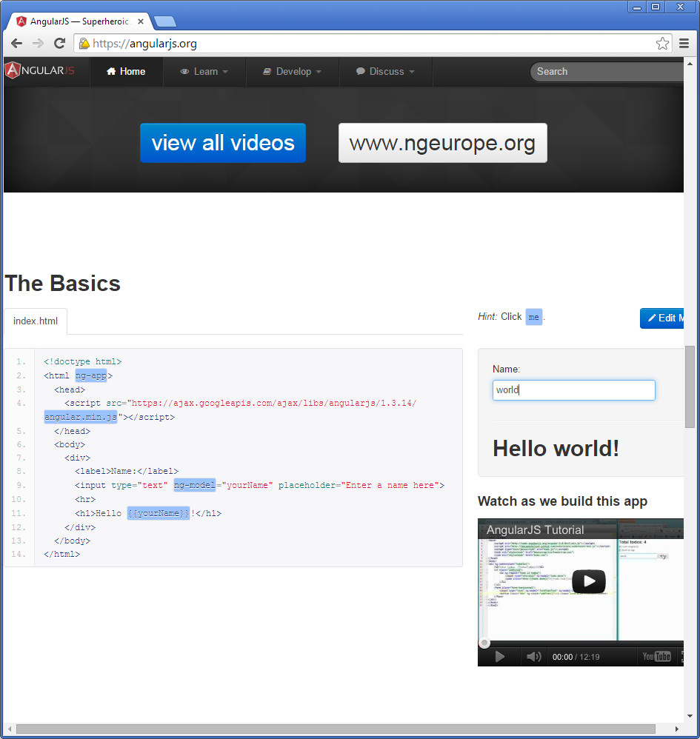
Pasilla A Test Framework for Protractor
protractorConfig.js
myTest.pro.js
Protractor
WebDriver

Slide 8
Pasilla A Test Framework for Protractor
protractorConfig.js
myTest.data.js
(optional)
myTest.pro.js
myTest.script.js
Protractor
WebDriver

Slide 9
Pasilla A Test Framework for Protractor
Files and Folders
pasilla/
AngularJS.keywords.js
keywords/
pages/
helpers/
documentation/
Automation.js
AngularJSHomePage.js
templates/
Vanilla.pro.js
utilities/
GenerateScriptnPro.hta
protractorConfig.js
tests/
AngularJSYourName.xlsx
AngularJSYourName/
Session1.pro.js
Session1.script.js
data/
TestData.xlsm
TestData/
LIVE.AngularJSYourName.data.js
Protractor test specifications
Test scripts with keywords and data
Test data
by environment
by test

Slide 10
Pasilla A Test Framework for Protractor
A developer’s view of a test
// ---------------------------------------------------
// ---------------------------------------------------
describe('template test scenario', function () {
// ---------------------------------------------------
// ---------------------------------------------------
it("DoSomething A", function () {
var dataItem1='DataItem';
// code for functionality goes here
// can use expect().toEqual() for assertions
},120000);
// ---------------------------------------------------
// ---------------------------------------------------
it("DoSomething B", function () {
var dataItem1='DataItem';
// code for functionality goes here
// can use expect().toEqual() for assertions
},120000);
// ---------------------------------------------------
// ---------------------------------------------------
it("DoSomething C", function () {
var dataItem1='DataItem';
// code for functionality goes here
// can use expect().toEqual() for assertions
},120000);
// ---------------------------------------------------
// ---------------------------------------------------
it("DoSomething D", function () {
var dataItem1='DataItem';
// code for functionality goes here
// can use expect().toEqual() for assertions
},120000);
// ---------------------------------------------------
// ---------------------------------------------------
it("DoSomething E", function () {
// code for functionality goes here
// can use expect().toEqual() for assertions
},120000);
}, 60000);
The usual structure of a Jasmine test is a describe() with a sequence of it()s.

Slide 11
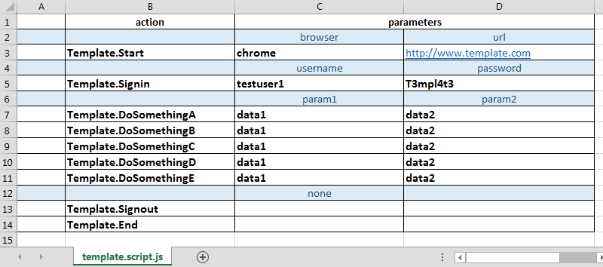
Pasilla A Test Framework for Protractor
A tester’s view of a test?

Slide 12
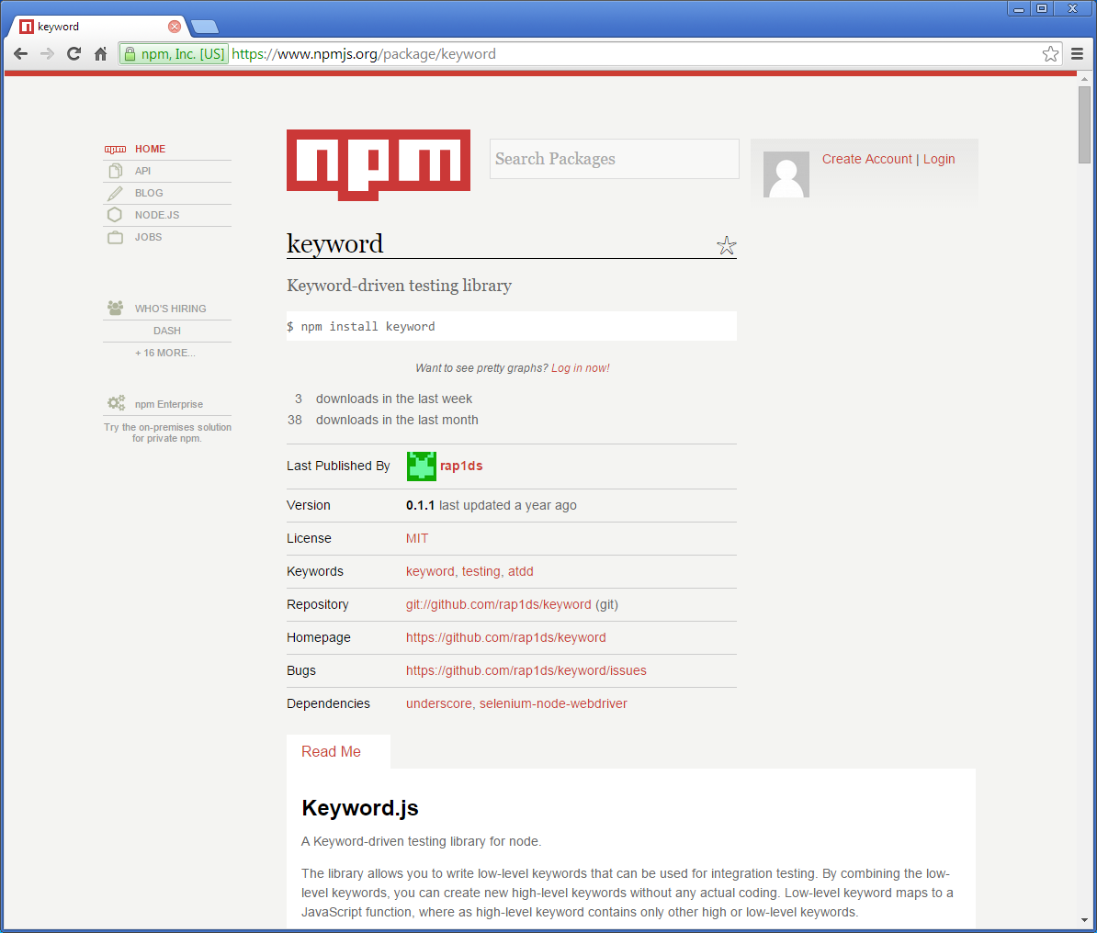
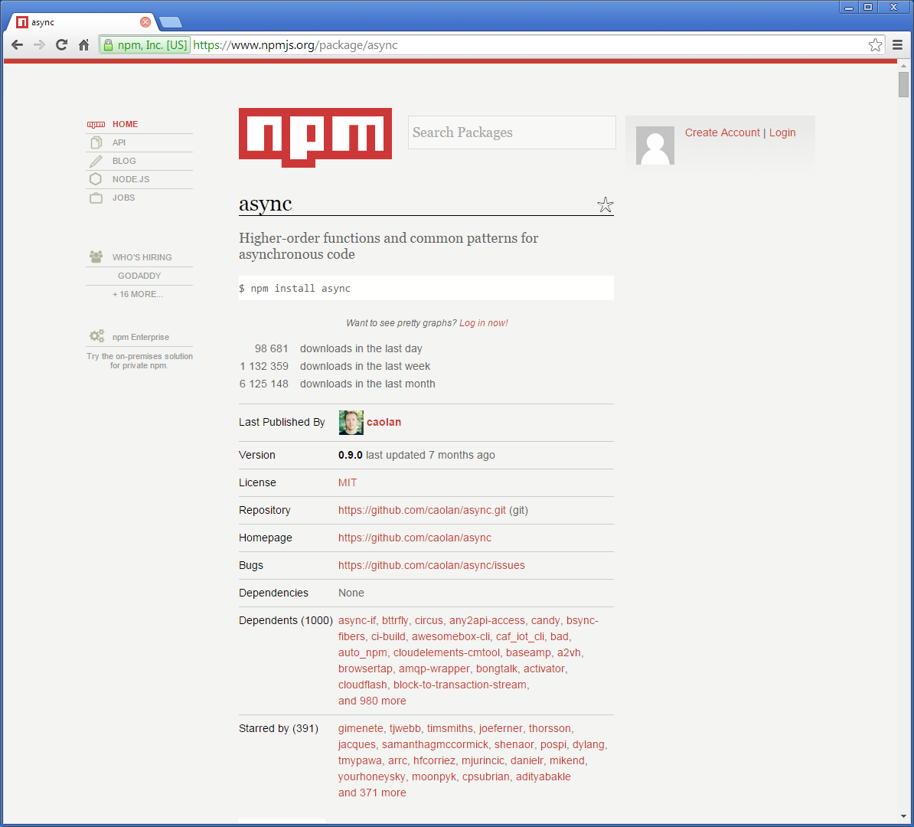
Pasilla A Test Framework for Protractor
Use keyword and async from npm

Slide 13
Pasilla A Test Framework for Protractor
Vanilla test specification template
.\templates\vanilla.pro.js
var Automation = require("../../helpers/automation.js");
var automation = new Automation();
var key = require('keyword'); // keyword functionality
var Dictionary = require('dictionaryjs');
var dictData = new Dictionary();
try {
var TestData = require("../../tests/TestData/" + browser.params.testEnv + ".vanillaTestName.data.js");
var testData = new TestData();
testData.load(dictData);
} catch(err) { }
// -------------------------------------------------------------------------
// -------------------------------------------------------------------------
describe('vanillaScriptName', function () {
automation.using("running vanillaScriptName test script", require('./vanillaScriptName.script.js'),
function (step) {
var sObject = step.action.substring(0, step.action.indexOf('.'));
for (var property in (step.params)[0]) {
if ((step.params)[0].hasOwnProperty(property)) {
(step.params)[0][property] = automation.resolveParams(dictData, (step.params)[0][property]);
}
}
//Load keyword file (name must be in the form 'object.keywords.js'). "try" handles exception when loading same object.keywords.js file
try { key(require('../../keywords/' + sObject + '.keywords.js')); } catch(err) { }
it("Step " + iStep++ + ": Keyword=" + step.action + ", Data=[" + step.params + "]", function () {
if (step.action.slice(0,1) != '#') {
key.run(step.action, step.params).then(function () { });
}
}, 600000);
});
}, 600000);
The data for this test
The test specification is generated by replacing “vanilla…” with the test name.
The test keywords

Slide 14
Pasilla A Test Framework for Protractor
Generated test specification
.\tests\AngularJSYourName\Session1.pro.js
var Automation = require("../../helpers/automation.js");
var automation = new Automation();
var key = require('keyword'); // keyword functionality
var Dictionary = require('dictionaryjs');
var dictData = new Dictionary();
try {
var TestData = require("../../tests/TestData/" + browser.params.testEnv + ".AngularJSYourName.data.js");
var testData = new TestData();
testData.load(dictData);
} catch(err) { }
// -------------------------------------------------------------------------
// -------------------------------------------------------------------------
describe(‘Session1', function () {
automation.using("running Session1 test script", require('./Session1.script.js'),
function (step) {
var sObject = step.action.substring(0, step.action.indexOf('.'));
for (var property in (step.params)[0]) {
if ((step.params)[0].hasOwnProperty(property)) {
(step.params)[0][property] = automation.resolveParams(dictData, (step.params)[0][property]);
}
}
//Load keyword file (name must be in the form 'object.keywords.js'). "try" handles exception when loading same object.keywords.js file
try { key(require('../../keywords/' + sObject + '.keywords.js')); } catch(err) { }
it("Step " + iStep++ + ": Keyword=" + step.action + ", Data=[" + step.params + "]", function () {
if (step.action.slice(0,1) != '#') {
key.run(step.action, step.params).then(function () { });
}
}, 600000);
});
}, 600000);
The data for this test
The test keywords

Slide 15
Pasilla A Test Framework for Protractor
Run a test
> protractor protractorConfig.js
--params.testEnv=live
--capabilities.browserName="chrome"
--specs=".\tests\AngularJSYourName\Session1.pro.js"
live environment (which test data to use)
chrome browser
(alternatively choose firefox or internet explorer)
the test to run

Slide 16
Pasilla A Test Framework for Protractor
Run all tests sequentially
> protractor protractorConfig.js
--params.testEnv=live
--capabilities.browserName="chrome"
--specs=".\tests\AngularJSYourName\*.pro.js"
live environment (which test data to use)
chrome browser
(alternatively choose firefox or internet explorer)
run all the tests in ./tests/AngularJSYourName/

Slide 17
Pasilla A Test Framework for Protractor
Run all tests concurrently
> protractor protractorConfig.js
--params.testEnv=live
--capabilities.browserName="chrome"
--capabilities.shardTestFiles=true
--capabilities.maxInstances=3
--specs=".\tests\AngularJSYourName\*.pro.js"
Session2.pro.js
Session2.script.js
Session3.pro.js
Session3.script.js
Session1.pro.js
Session1.script.js
each of these runs in a separate browser, and they all run concurrently
live environment
chrome browser
3 concurrent instances
run all the tests in ./tests/AngularJSYourName/

Slide 18
Pasilla A Test Framework for Protractor
End

