Slide 1
Part II Introduction to Qiskit Runtime

Slide 2
Variational Quantum Algorithms
Variational Quantum Algorithms (VQA) use a classical optimizer to train a parameterized quantum circuit to approximate solutions for a given problem.
VQA's typically need fewer gates and qubits. In turn, they are more resistant to noise.
Therefore, they are well suited to handle near-term quantum computer constraints.

Slide 3
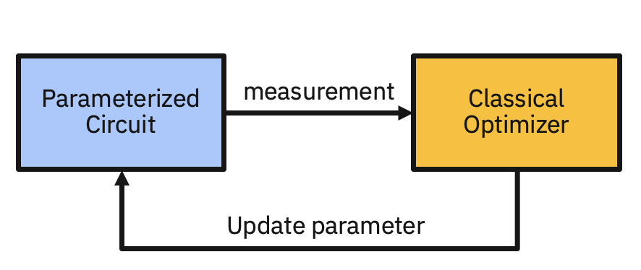
VQAs are iterative
VQA's are typically iterative. Each iteration involves both quantum and classical processing.
Output (a measurement) from one iteration is sent to the classical optimizer which generates input (a parameter) for the next iteration:

Slide 4
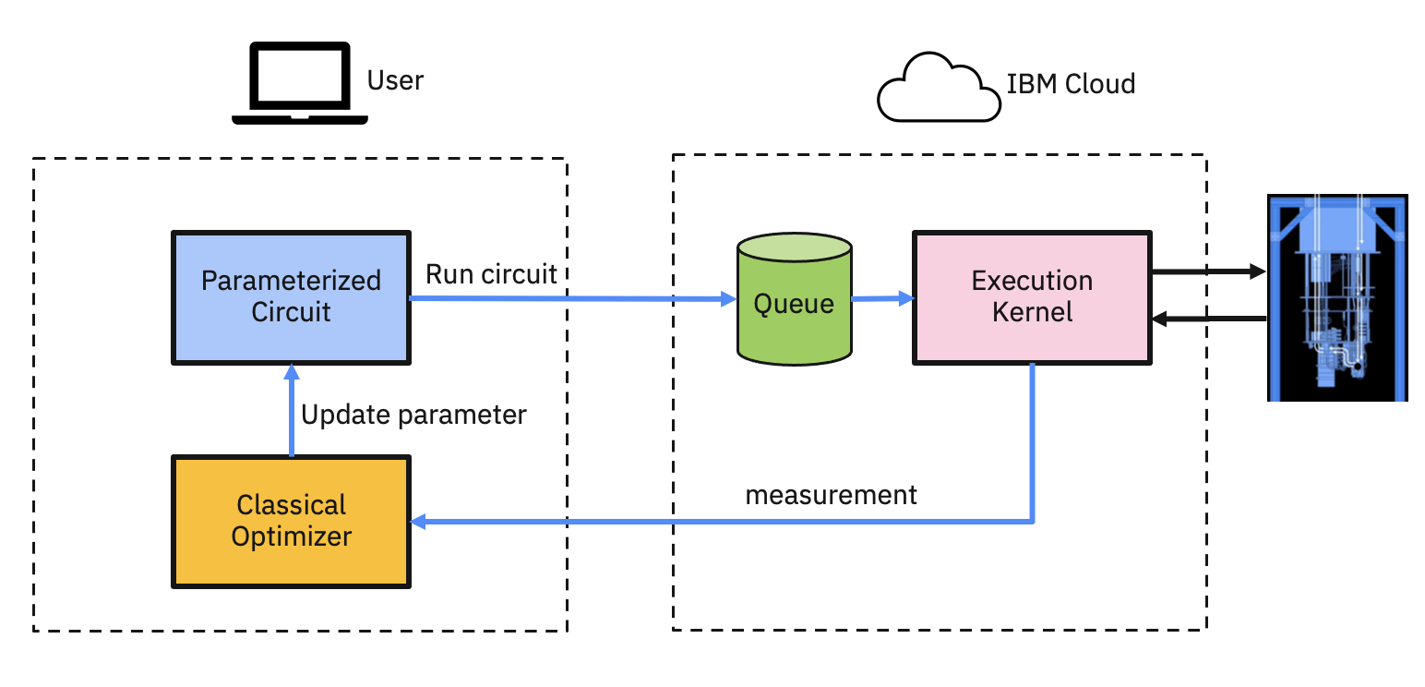
Running a VQA prior to the Qiskit Runtime

Slide 5
Qiskit Runtime
A quantum computing service and programming model to efficiently execute optimized workloads at scale.
Qiskit Runtime sessions reduce I/O overhead for applications, such as VQA's, that need many iterations that use both quantum and classical processing.
Qiskit Runtime primitives provides simplified interfaces to perform foundational quantum computing tasks with built-in optimization.

Slide 6
Qiskit Runtime session
An interactive communication that minimizes artificial latency for iterative VQAs.
Jobs within a session are prioritized by the scheduler.
Data used in a session, such as parameterized circuits, is cached on the server.
Coupled with classical serverless technology enables scalable classical capabilities.

Slide 7
Qiskit Runtime primitives
Predefined programs with simplified interface to perform essential quantum computing tasks.
Constantly updated to use the latest quantum software and hardware capabilities, such as readout error mitigation.

Slide 8
Qiskit Runtime primitives
Sampler
takes circuit(s) as an input
outputs quasi-probability distribution
useful for search algorithms like Grover’s
Estimator
takes circuit(s) and observable(s) as inputs
outputs expectation values
useful for encoding a variety of things, such as electronic structure of a molecule and cost function for an optimization problem

Slide 9
Show me the code!

