Slide 1
#SaveSanDiego
Andy Gross, Justin Huang, Jenhan Tao

Slide 2
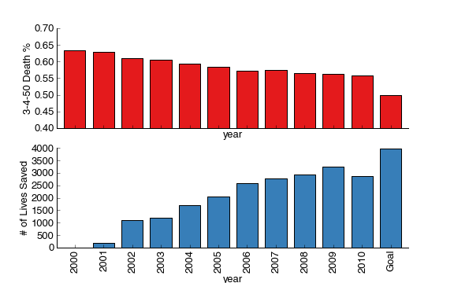
The Message
By reducing chronic disease, we can save lives. In fact, we already have.

Slide 3
The Campaign
An old-school approach…
Connecting constituents and policy-makers
Putting letters on the desk
…With a new-school twist
Email and social media integration
Dynamic health statistics based on constituent location

Slide 4
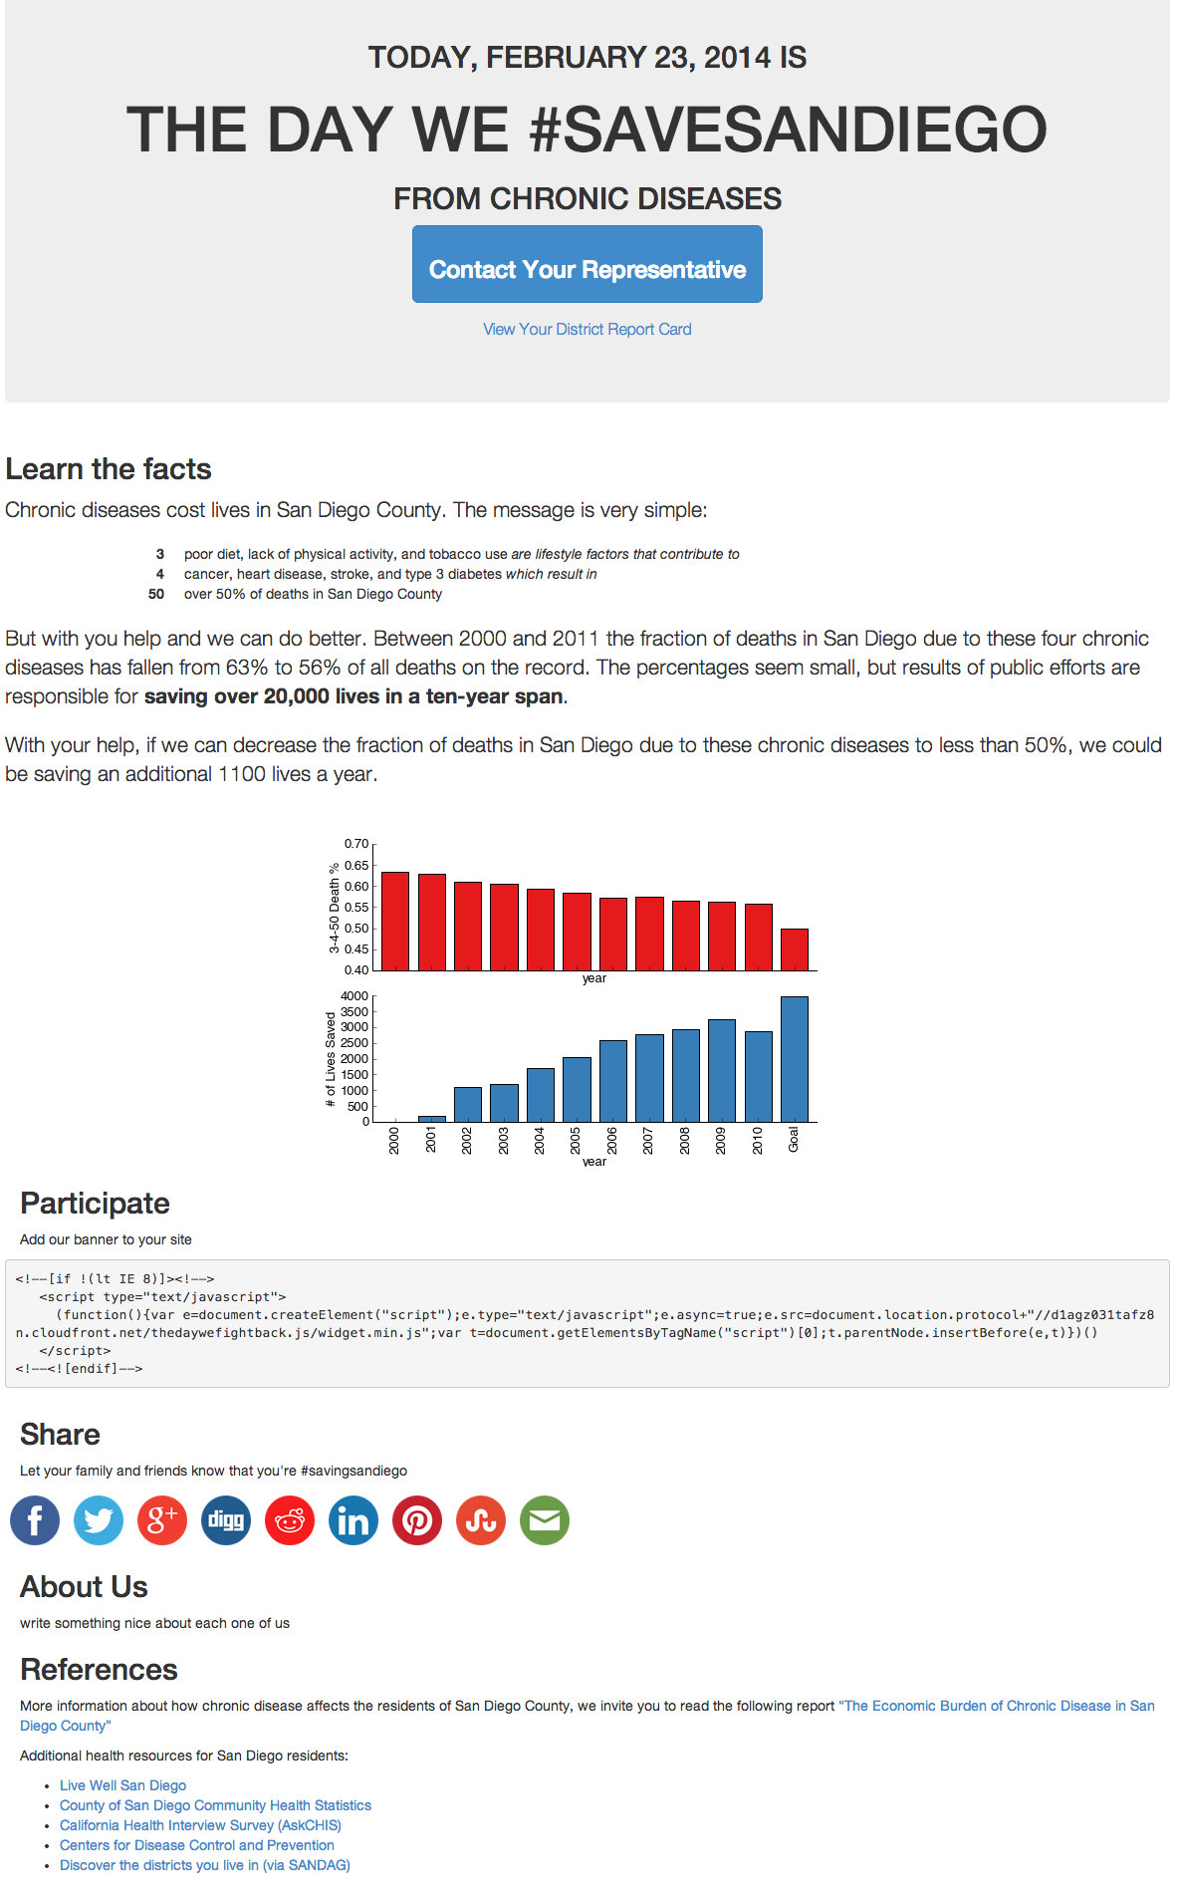
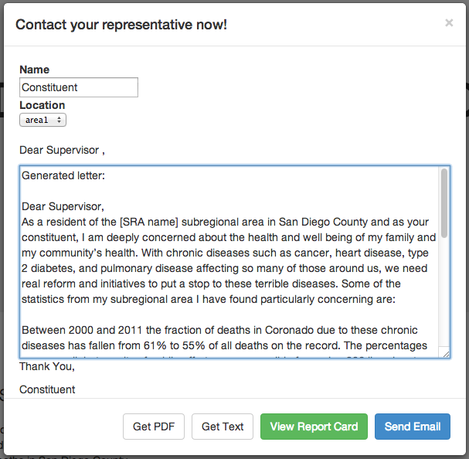
The Interface

Slide 5
Scalability
Data/Report Cards can be converted to aggregate by various geographical setups
Scales well as more data becomes available
Relatively easy implementation, low maintenance
Involves constituents with low barrier-of-entry

