Slide 1
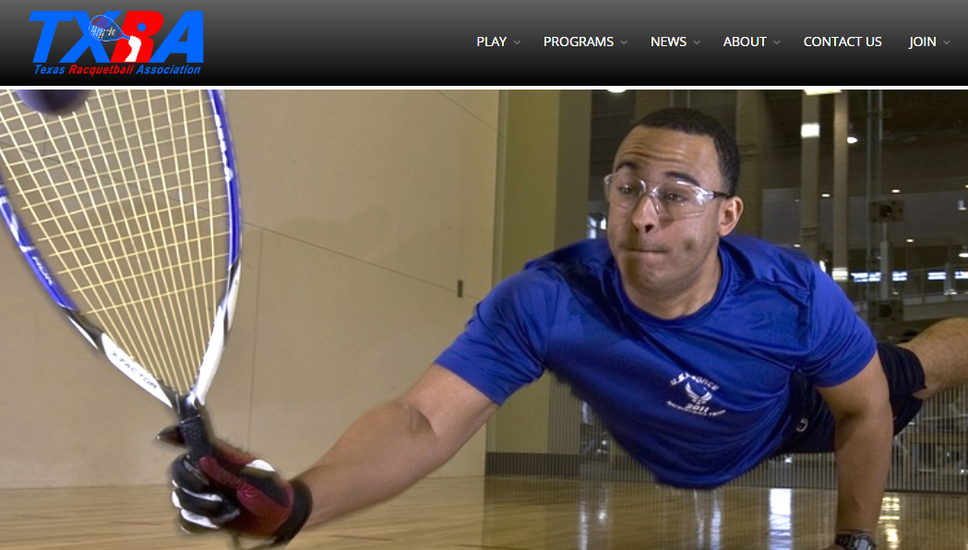
TXRA’s 2017
Membership Feedback Survey
.

Slide 2
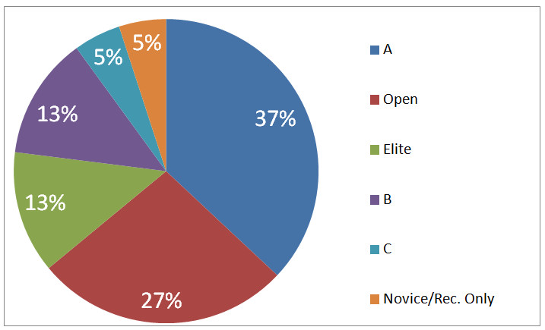
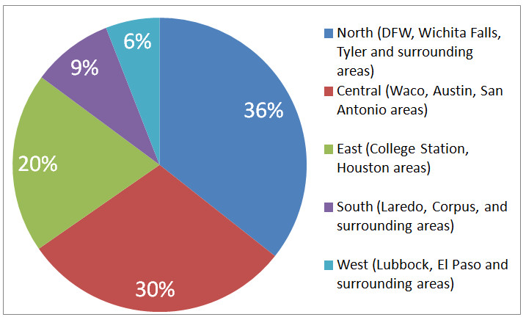
Methodology overview
How did we conduct the survey?
Online survey in Nov and Dec, sent to as many TXRA members as possible, posted to several local racquetball Facebook pages and used the newly redesigned TXRA web site
127 respondents out of 1,100 members (11.5%)
(5) random $25 gift card winners were selected
The data results appear to be a fair and balanced representation of where most players are located and with the skill level.
Great sign of trust, 90% put contact info down for gift card raffle (giving up their anonymity)

Slide 3
Summary: Insights
People have busy lives and there is no shortage of things competing for people’s attention. Racquetball is one, of many, pleasant distractions from; work, family, life, etc., so to keep TXRA members happy, we need to keep the value of tournaments at a high level. Value is defined as an overall experience, with many contributing variables. There is no one-size-fits-all answer to the value formula.
Money alone is not what motivates people to go to tournaments, its the value of their; time + money + personal experience = value.
Time:
Tournament runs on time, follows schedule
<90min drive to the event from my house
1 or 2 days in length
Money:
Reasonable entry fees (cost)
Experience:
Opportunity to watch pro’s
Good hospitality
My friends will be there
Quality opponents
Number of matches to play

Slide 4
Summary: Tournament Detractors
There are clearly things that can ruin the value formula.
“My doubles partner and I drove 250 miles in heavy traffic only to find out we play each other in the first round… WTF?!?!”
“My division got combined with another division with better players so I basically paid $70 for one game and got killed.”
“Is it too much to ask for my start time a couple days in advance, so I know when to leave work? It really pisses me off when I take an entire day off (without pay) and i get to the club to find out I don’t play until Saturday.”
“I really like paying for a tournament so I can get the same shirt as last year, cold bologna sandwiches, a swallow of watered down Gatorade and my match starts 2 hours late. NOT!”

Slide 5
Summary: Data
What did we learn?
Strongest tournament motivator: Knowing the tournament will be well organized
Weakest tournament motivator: Ref your own matches
Quality of players is more important, than overall size of tournament
Motivations are consistent throughout Texas, (location does change motivations)
Our members have a very high interest in getting their kids/grandkids involved in racquetball
What grade did our members give us?
Overall satisfaction, 3.6/5.0 point scale
The demographic data had no surprises and confirmed normal assumptions
Male dominated, 90%
Average to above average income
Majority have been playing for over 10+ yrs.

Slide 6
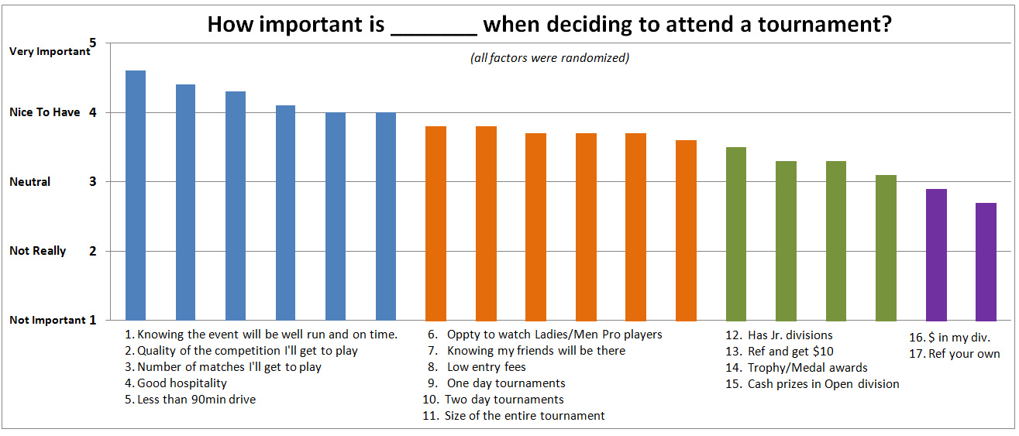
Deciding what makes members attend a tournament

Slide 7
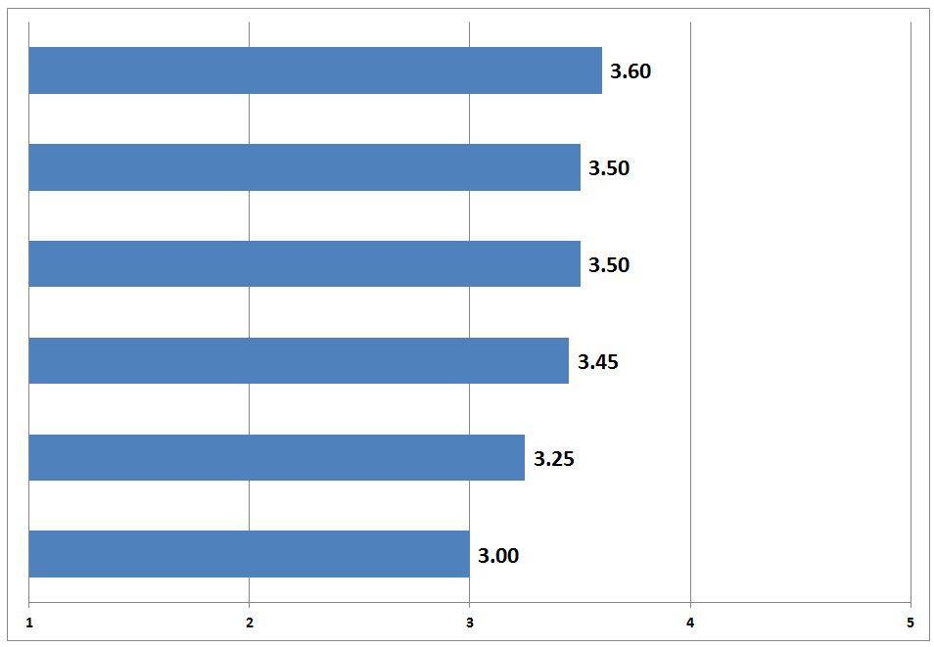
Report Card (using a 5 point scale)
Communication via website or social media? *(over 50% said "pretty good - excellent job")
Overall, how satisfied are you with TXRA?
Spending it’s annual budget wisely?
*(42% responded "N/A" to this question)
Promoting racquetball for kids?
*(received the most "excellent job!" ratings)
Recognizing amature players with awards?
Promoting racquetball in your local area?
*(31% said, "needs a lot of improving - not good)

Slide 8
What stood out as different?
Players in the southern area (Corpus, Laredo,etc.) gave noticeably lower scores to the TXRA for;
Promoting racquetball in my area
Communicating to me through the website and social media
Recognizing amature players
But…. gave the same score for “overall satisfaction” as the other regions
All motivations for attending tournaments was the same except they ranked “cash prizes” higher than any other area in the state

Slide 9
What were we able to confirm?
No surprises in the demographic data;
88% male
54 years of age
On average, started playing over 25 years (14% started <10yrs ago)
72% play 9x/month
69% prefer the ProPenn HD purple ball, while 15% had no preference

Slide 10
What can we do different?
Member trust us and like what we are doing overall, but there are areas for improvement. Attendance for our state Singles and Doubles have struggled to match other less prominent tournaments.
The southern players feel out-of-the-loop.
There is a lot of energy around jr’s and a large coordinated fund drive, or event, would probably gain good support.
Likewise, there is a lot of energy around getting new kids, or grandkids, into playing our sport.
< Board Discussion >

Slide 11
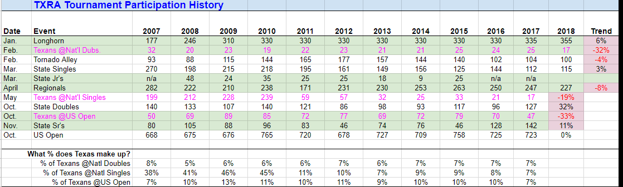
Tournament Participants Over The Past 10 Years
Which tournaments are growing/shrinking over time?
How many TXRA members are traveling to the “Big 3” events?

