Slide 1

Speech Content Analysis
Work-Flow:
Data Collection & Extraction
Data Cleaning
TF-IDF Calculation
Ranking of the importance of Texts
Ranking using Matching Score
Ranking using Cosine Similarity
Comparison between Matching Score Method and Cosine Similarity Method.

Slide 2
Data collection and Extraction
Data in document format(.txt, .html)in folders: Manifestos, Speeches, News Articles, Interviews.
2. Extracting Folder-name and Folder-title from the files using RE to make a folder-list which contain folder-name and path of the folders
3. Reads the Content of the file and stores in a ‘text’ variable after stripping any leading or trailing white spaces.
Data Cleaning :
Converting in lower case and Removing Stop-Words using Stopword Library.( Stop words: the, for, is, on, at, etc.)
Removing Punctuations, apostrophe.
Stemming is done using PorterStemmer library: a method in which words are changed to their basic version.
Changed numbers to corresponding words using num2words library.
Tokenization done with the help of Punkit library.
After all the Preprocessing two lists are created : processed-text[] and processed-title[], and corresponding content will get stored.

Slide 3
Calculation of TF-IDF
TF(term-frequency) = (count of t in d)/ (number of words in d) { ’t’ = term, ‘d’ = document }
TF measures the frequency of word in a document, then divides the frequency by total words in that document.
Final value of normalized TF will be in the range 0 to 1(0,1 inclusive).
IDF(Inverse document frequency) = Log( N/DF(t) ) { ‘N’ = no. of documents }
-> DF(t) = Occrance of ‘t’ in ’N’ documents .
-> IDF is inversely proportional to DF, i.e, If DF value of a term is less, then IDF value of that term
increases, that means that term is rare and more informative across the collection. Similarly
if the DF value of a term is more , then IDF value of that term decreases, i.e, the term is not
rare.
3. The goal of IDF in TF-IDF is to give higher weight. To terms that are Unique and distinctive across
the collection.
TF-IDF(t , d) = TF(t,d) * Log( N/DF(t) )
-> Finally taking the TF-IDF score for Body and Title for all documents and then multiply the TF-IDF of body with ‘alpha’ and TF-IDF of title with (alpha-1), (Alpha is a constant and it is used to adjust the weighting of the body’s TF-IDF score relative to the title’s TF-IDF score, since title gives concise explanation of whole content. This should be done only if token exist in both title and body.

Slide 4
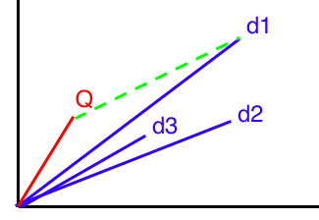
Ranking of the importance of Texts
Ranking with Cosine Similarity:
Cosine Similarity = (A.B)/ ( ||A|| * ||B|| )
A.B = Dot product of vectors A & B ( A & B are vector re[presentation of
documents or text which need to compare.
||A||, ||B|| = magnitude of Vector A, B ( Eucleidian Norm)
Cosine Similarity formula essentially measures the cosine of the angle b/w the two vectors.
If vectors are similar, angle between them will be smaller, resulting in cosine-similarity = 1.
2 If vectors are orthogonal, angle between them will be close to 90 deg, resulting in cosine-similarity = 0.
If vectors are opposite, angle between them will be close to 180 deg, resulting in cosine-similarity = -1.
2. Ranking with Matching Score : Matching Score is simplest way to calculate the similarity. In this need too add TF-IDF value of the tokens that are in query for every document. At the end sorting done and top ‘K’ documents are taken.
Q is the vector with whom
Other vectors d1 d2, and d3
are getting compared

Slide 5
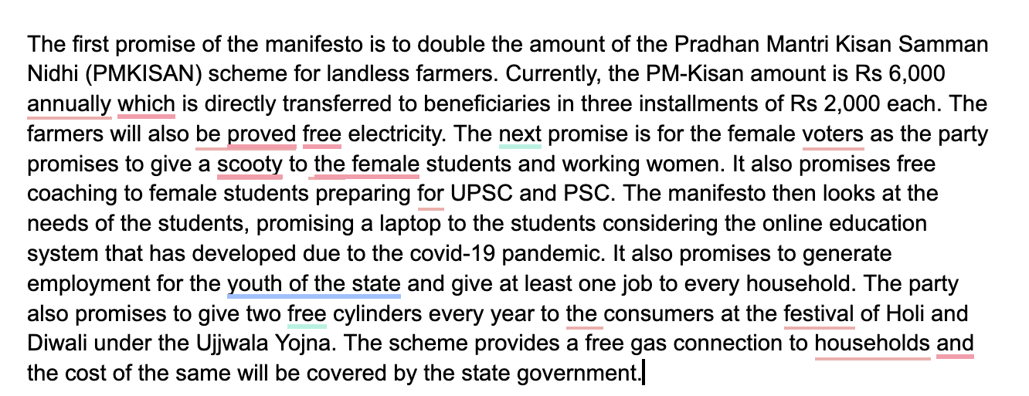
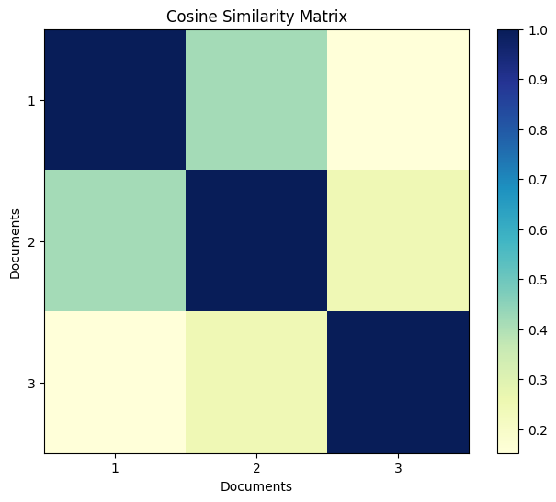
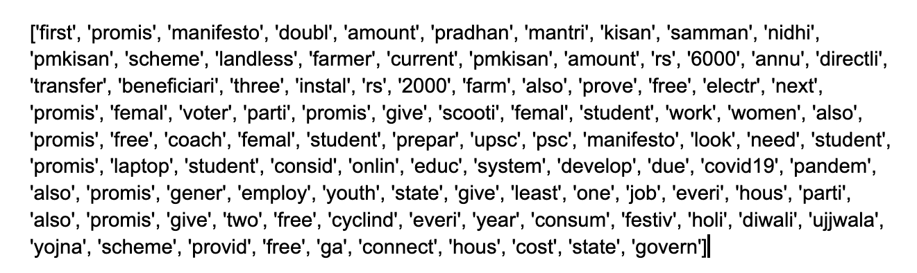
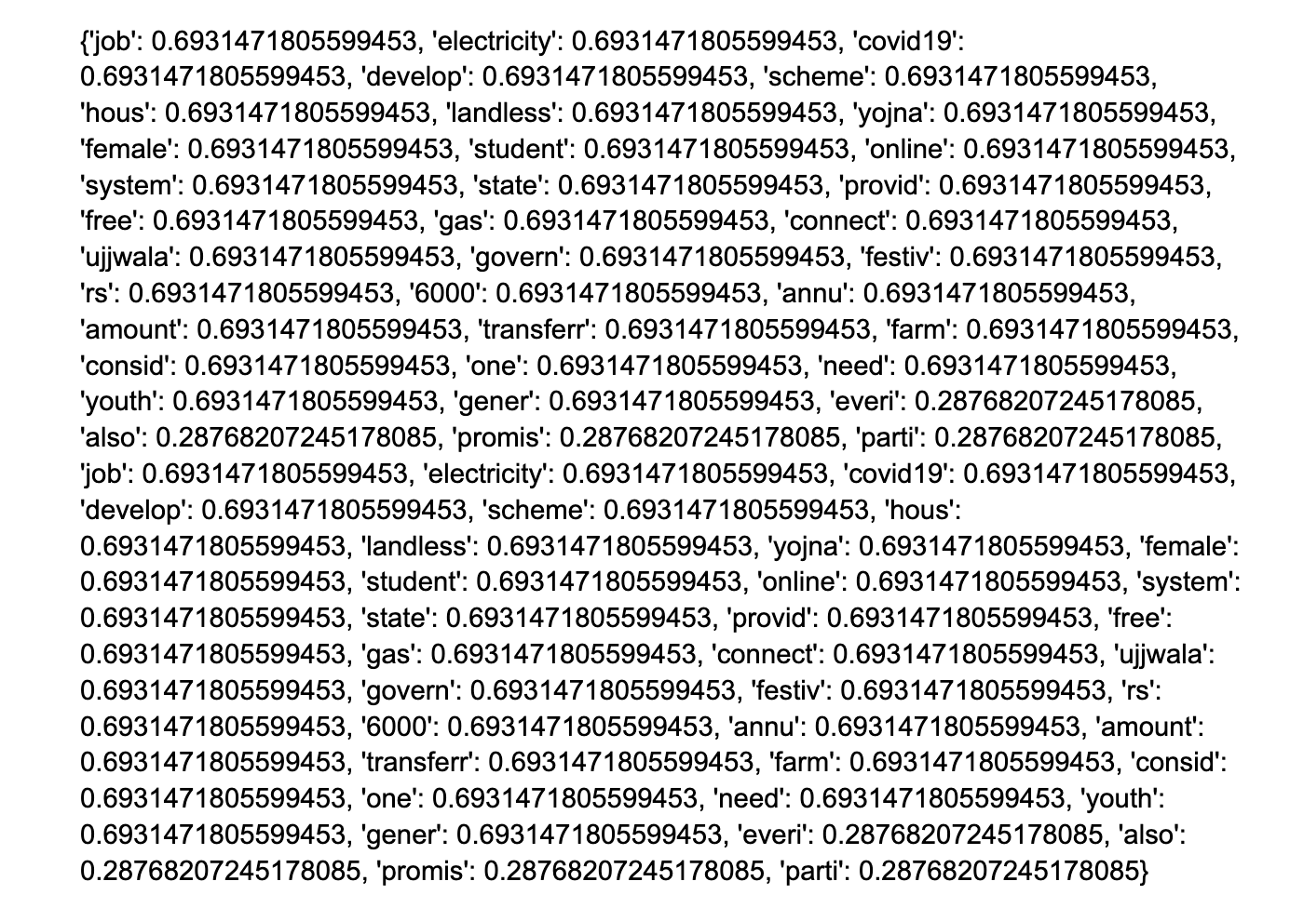
1 : Yogi Aditya Nath, 2: Narendra Modi, 3: Amit shah

