Slide 1

From 2025 to 2026
SKYBOOK
Flight Booking &
Revenue Analytics
End-to-End Cloud-Based Flight Analytics Implementation
PRESENTED BY
Jenifer S

Slide 2
01 / SCOPE
02
Project Overview
SkyBook transforms flight booking data into meaningful business insights using AWS, SQL and Microsoft Power BI.
FOCUS AREAS
Booking volume • Revenue • Airline performance • Routes • Fares
Passenger info • Payment methods • Booking status • Monthly trends • City revenue
RAW FLIGHT
DATA
CLOUD
ANALYSIS
DASHBOARD
SKYBOOK • FLIGHT BOOKING & REVENUE ANALYTICS

Slide 3
02 / CONTEXT
03
Introduction
“Data is not just information —
it is the power behind better decisions.”
SkyBook builds a complete data journey: storing and processing flight records in the cloud, analysing them with SQL, and presenting clear insight through an interactive Power BI dashboard.
FROM RAW DATA TO REAL INSIGHT
Let the data tell the story.
SKYBOOK • FLIGHT BOOKING & REVENUE ANALYTICS

Slide 4
03 / CHALLENGE
04
From complexity to clarity
Flight booking datasets span airlines, routes, cities, fares, payments, dates and booking status. Raw records alone are difficult to interpret for decisions.
LARGE RAW
DATASET
DIFFICULT TO
UNDERSTAND
STRUCTURED
ANALYTICS
CLEAR
INSIGHTS
“SkyBook turns raw records into a clear business story.”
SKYBOOK • FLIGHT BOOKING & REVENUE ANALYTICS

Slide 5
04 / STACK
05
Technologies & Services Used
Amazon S3
AWS IAM
Cloud dataset storage
Access and role management
AWS Glue
Glue Data Catalog
Schema discovery
Metadata & table registration
Amazon Athena
SQL
Serverless SQL analysis
Booking & revenue analysis
Athena ODBC
Power Query
Athena–Power BI bridge
Preparation & transformation
DAX
Power BI
KPI calculations
Interactive dashboard
SKYBOOK • FLIGHT BOOKING & REVENUE ANALYTICS

Slide 6
05 / ARCHITECTURE
06
End-to-End Data Journey
Flight
Dataset
Amazon
S3
AWS
IAM
AWS
Glue
Data
Catalog
Amazon
Athena
SQL
Analysis
SkyBook
Dashboard
Athena
ODBC
Athena
ODBC
Power BI
Power BI
Power
Query
Power
Query
DAX
DAX
SkyBook
Dashboard
SQL
Analysis
Each stage has a specific responsibility — from storing and securing data to analysing and visualising it.
SKYBOOK • FLIGHT BOOKING & REVENUE ANALYTICS

Slide 7
06 / CLOUD PREPARATION
07
AWS Data Preparation
1 AMAZON S3
2 AWS IAM
3 AWS GLUE
4 DATA CATALOG
Stores flight dataset
bucket: new-etl-source-bucket
Controls access
role: new-etl-role
Discovers data structure
database: customer-db
crawler: new-etl-crawler
Registers metadata and tables
The Glue Crawler automatically identifies available fields and data types.
SKYBOOK • FLIGHT BOOKING & REVENUE ANALYTICS

Slide 8
07 / SQL LAYER
08
Amazon Athena — Turning Data into Answers
Athena runs SQL directly on cataloged flight data — without a traditional database.
BUSINESS
QUESTION
SQL
QUERY
RESULT
INSIGHT
20 SQL queries designed to power the SkyBook dashboard
Airline booking volume • Popular routes • Booking status • Payment methods
Departure-city revenue • Average fare • Confirmation status
SKYBOOK • FLIGHT BOOKING & REVENUE ANALYTICS

Slide 9
08 / CONNECTIVITY
09
From Cloud Data to Power BI
AMAZON
ATHENA
ATHENA
ODBC
POWER BI
DESKTOP
POWER
QUERY
POWER BI
DATA MODEL
ATHENA ODBC
Connectivity bridge
POWER QUERY TASKS
Validate data types • check fields • prepare date • standardize values • ready data for reporting
SKYBOOK • FLIGHT BOOKING & REVENUE ANALYTICS

Slide 10
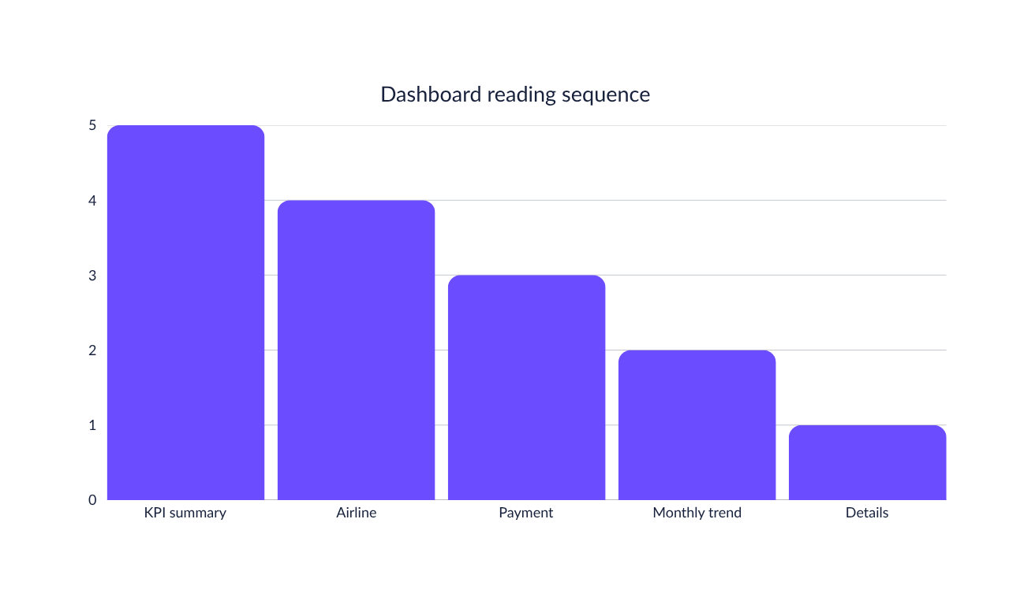
09 / DASHBOARD STORY
10
Flight Booking Overview
What is happening with overall flight bookings?
PAGE 1 ANSWERS
WHAT IS HAPPENING?
FILTERS Airline • Booking Status • Departure City • Flight Date
SKYBOOK • FLIGHT BOOKING & REVENUE ANALYTICS

Slide 11
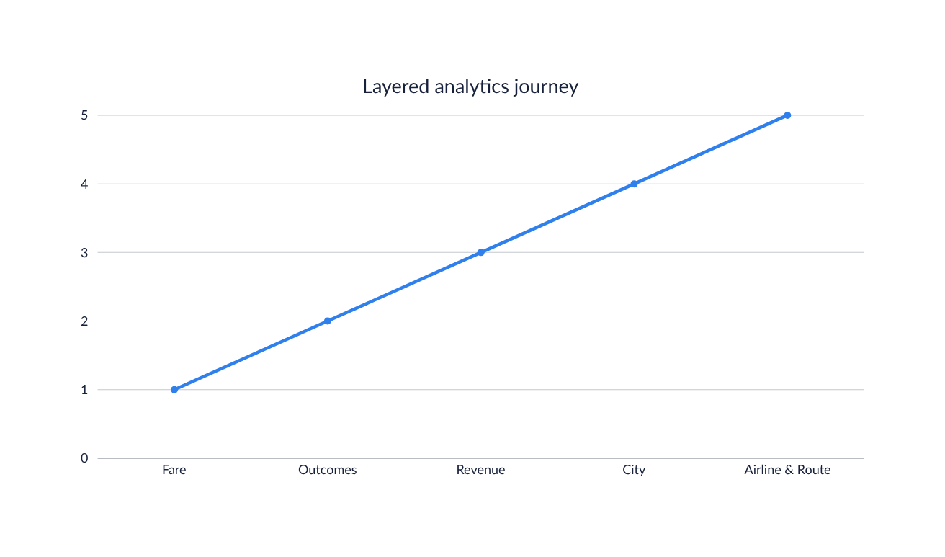
10 / DASHBOARD STORY
11
Revenue & Booking Analytics
Where is the booking and revenue performance coming from?
PAGE 2 ANSWERS
WHERE IS PERFORMANCE
COMING FROM?
Fare → Booking outcomes → Revenue → City performance → Airline & route
SKYBOOK • FLIGHT BOOKING & REVENUE ANALYTICS

Slide 12
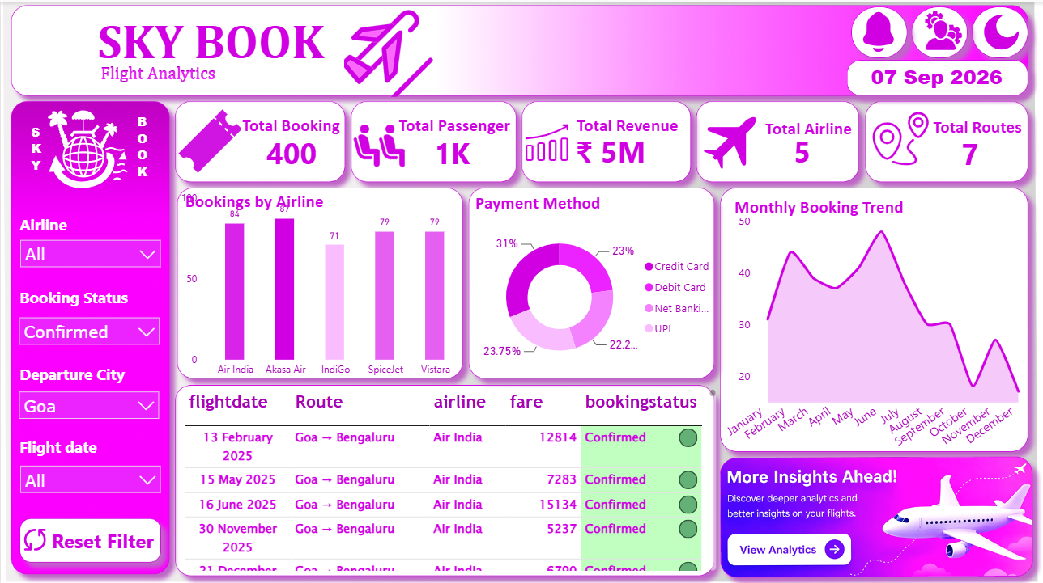
11 / DASHBOARD LIGHT MODE
Flight Booking Overview
12

Slide 13
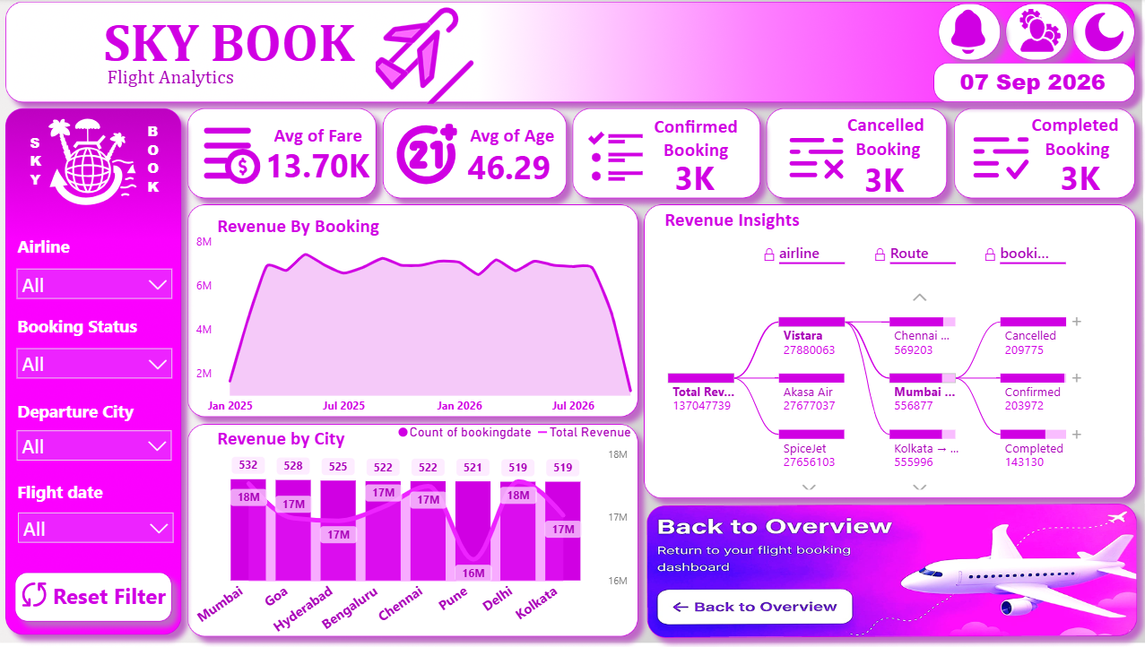
12 / DASHBOARD LIGHT MODE
13
Revenue & Booking Analytics

Slide 14
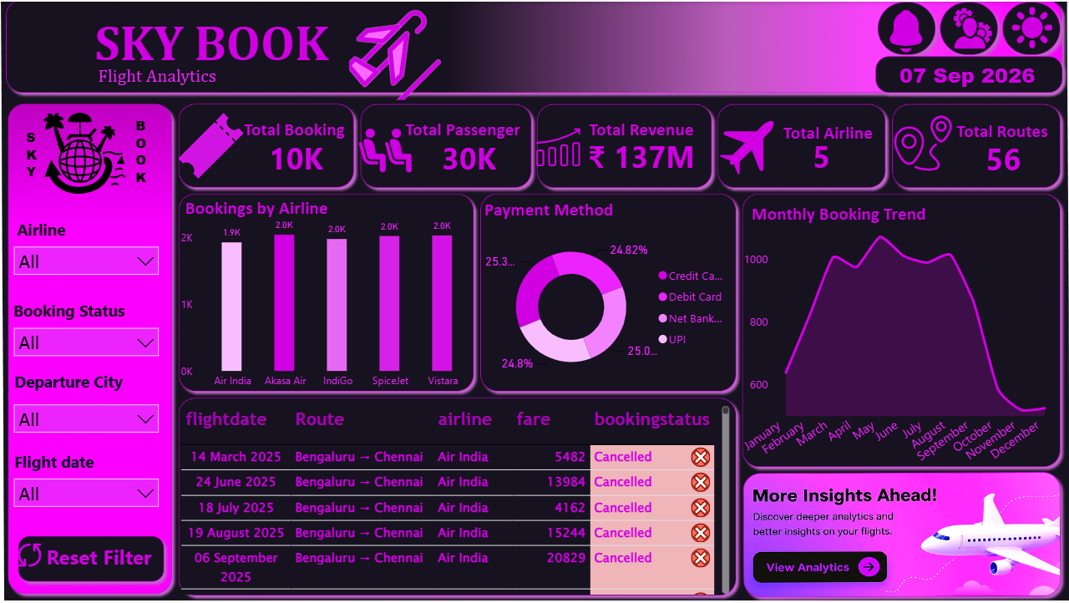
13 / DASHBOARD DARK MODE
Flight Booking Overview
14

Slide 15
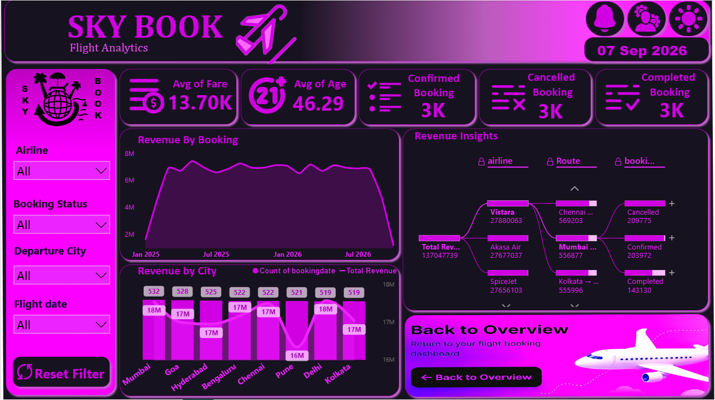
14 / DASHBOARD DARK MODE
15
Revenue & Booking Analytics

Slide 16
15 / VALUE
16
Project Benefits
01 Complete cloud-to-dashboard workflow
02 Cloud-based flight data storage
03 Automated schema discovery
04 SQL analysis with Athena
05 Reduced raw-data inspection
06 Interactive Power BI filtering
07 Compare airlines, routes and cities
08 Faster booking & revenue insight
09 Scalable workflow for larger datasets
From raw data to meaningful business insight.
SKYBOOK • FLIGHT BOOKING & REVENUE ANALYTICS

Slide 17
16 / CLOSING
17
One connected analytics story
SkyBook integrates cloud services, SQL, data preparation and business intelligence into one practical solution.
S3 → IAM → AWS Glue → Data Catalog → Athena → SQL → ODBC → Power Query → DAX → Power BI
“SkyBook does not just show data —
it helps us understand what the data is telling us.”
THANK YOU

