Slide 1
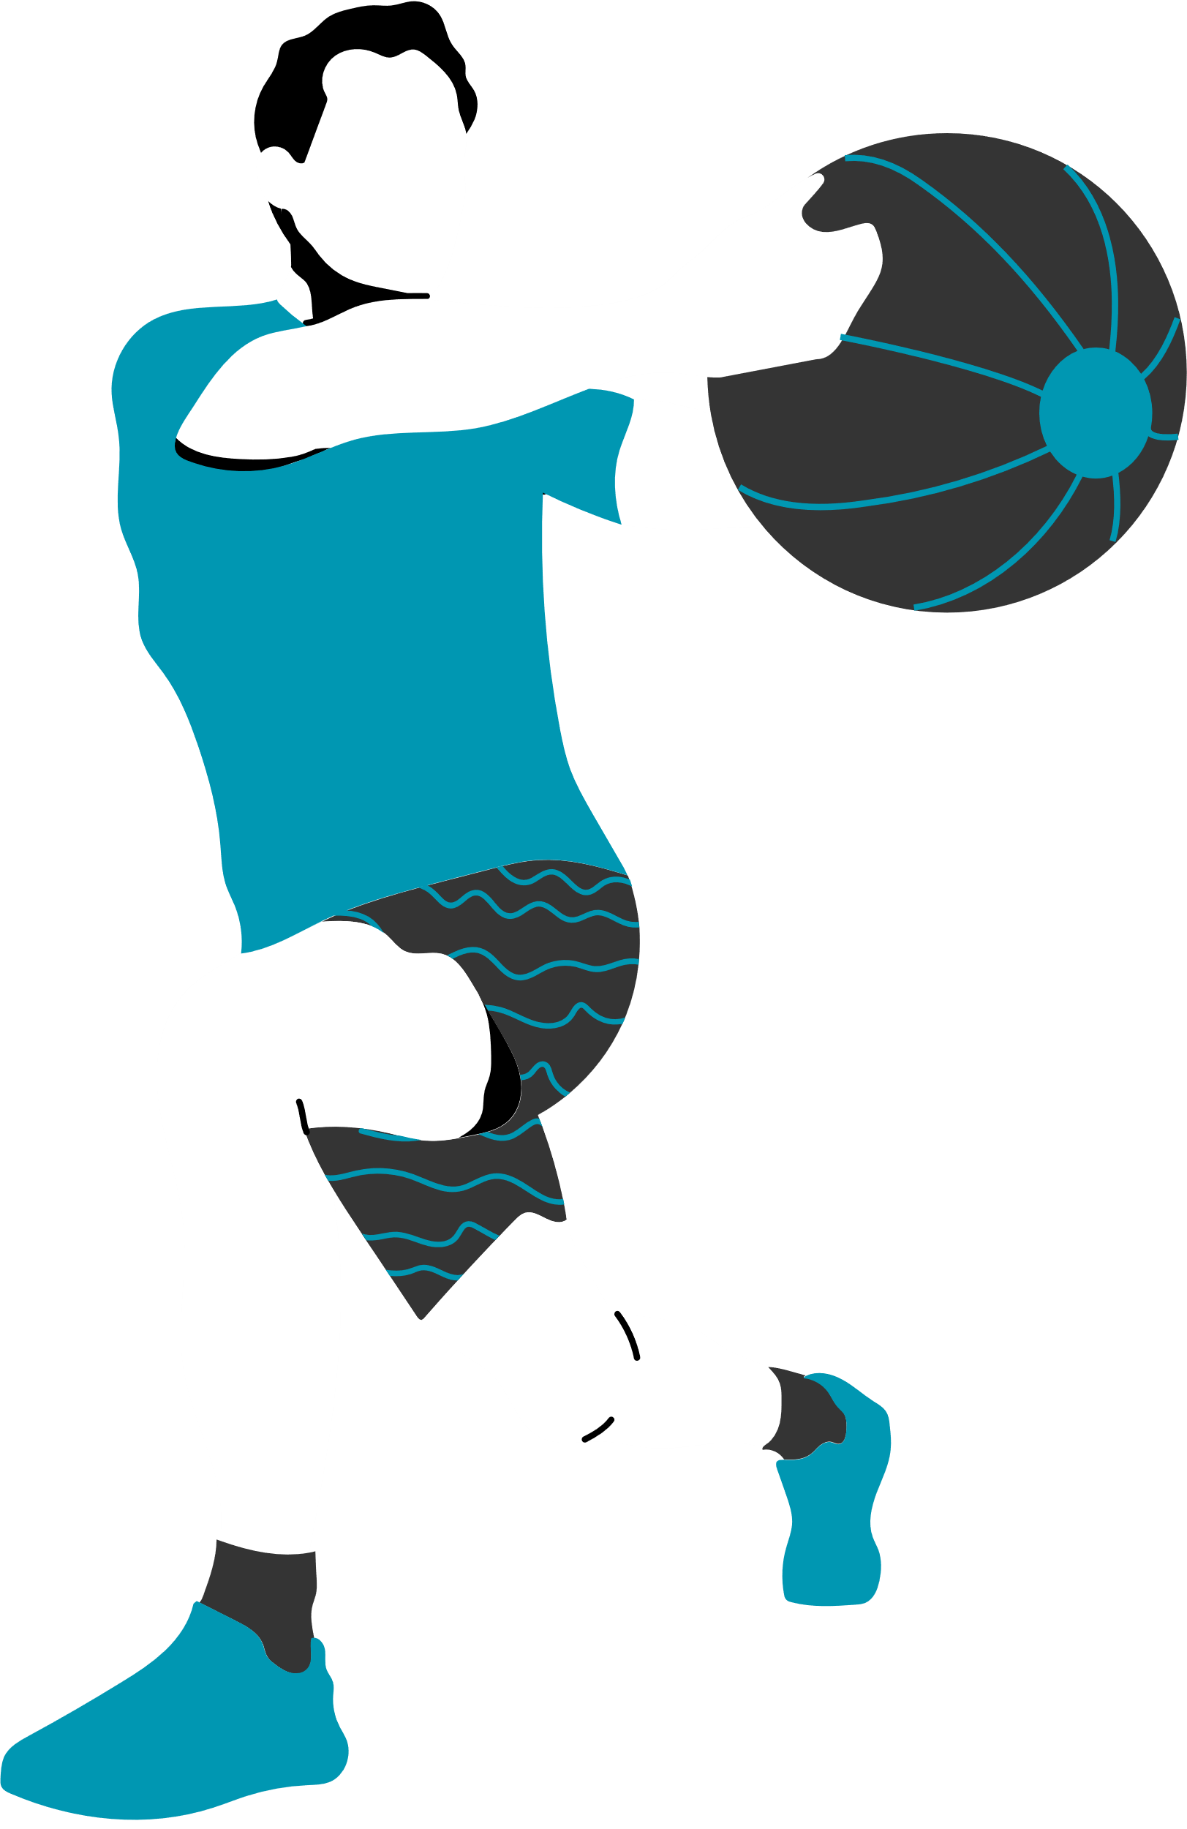
NAME : JENIKA RAJESHBHAI KOTAK
STUDENT ID : JD 153623
SUBJECT NAME : CP5307 – ADVANCED MOBILE TECHNOLOGY
GYMMATTA
PERSONALIZED HEALTH & WELLNESS APP
ONE APP FOR A HEALTHIER YOU!

Slide 2
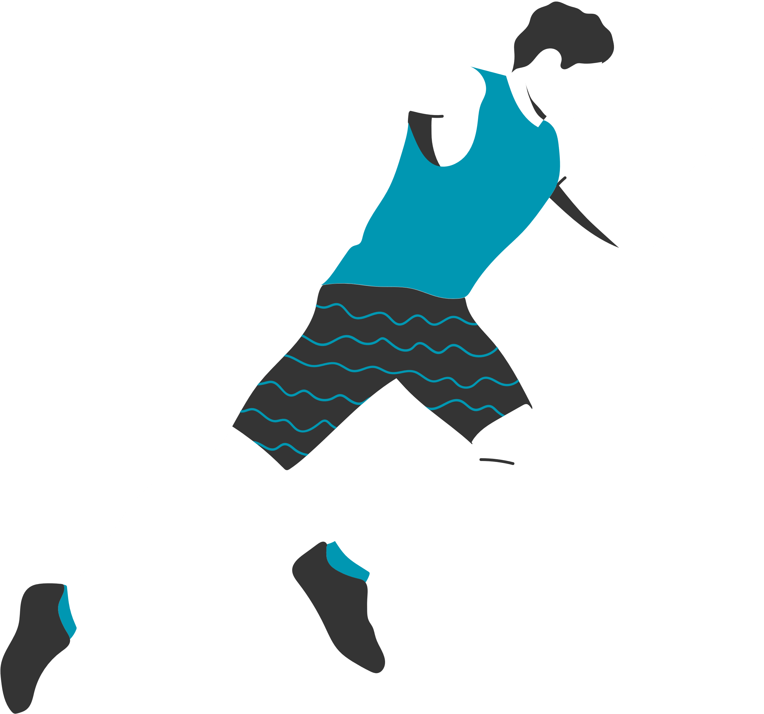
CONTENTS
01/ Problem Statement
02/ Target Audience?
03/ Competitor Analysis
04/ Key Features of App.
05/ UI Mockups & Screens
06/ Dev Timeline & Milestones
07/ GitHub Repo. & Version History
08/ Conclusion

Slide 3
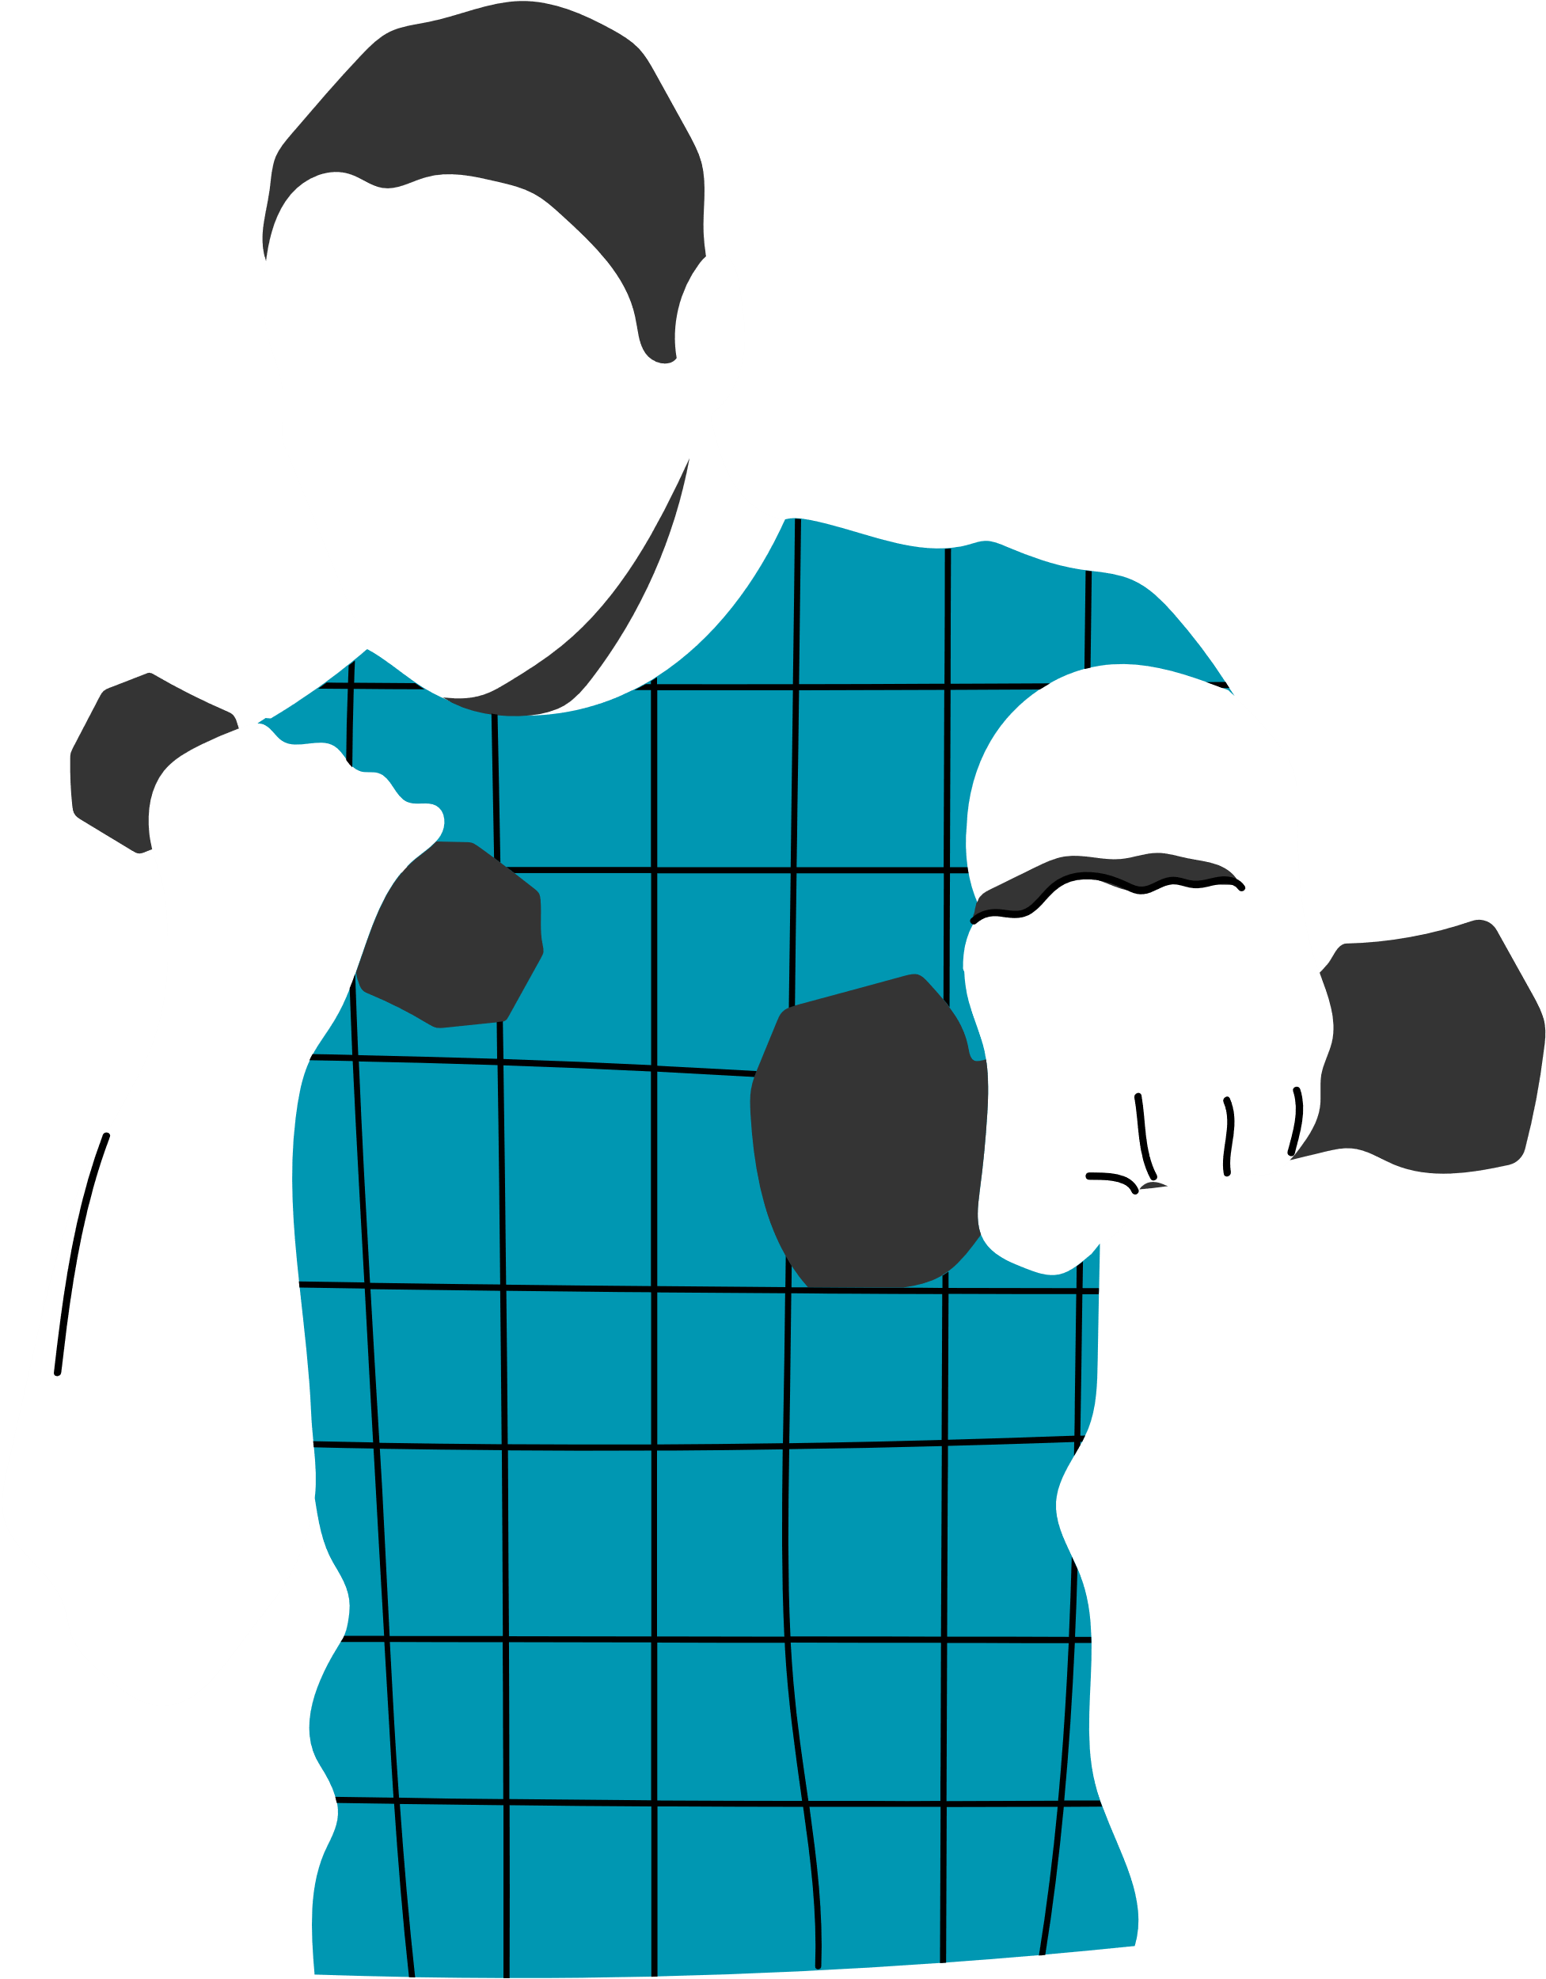
01/ PROBLEM
STATEMENT
It is difficult to manage health and well-being with various apps for fitness, nutrition, and mental well-being. Individuals find it hard to maintain consistency because of fractured solutions. GymMatta makes it easy by bringing together everything related to wellness in one easy-to-use app, allowing users to stay on track easily.

Slide 4
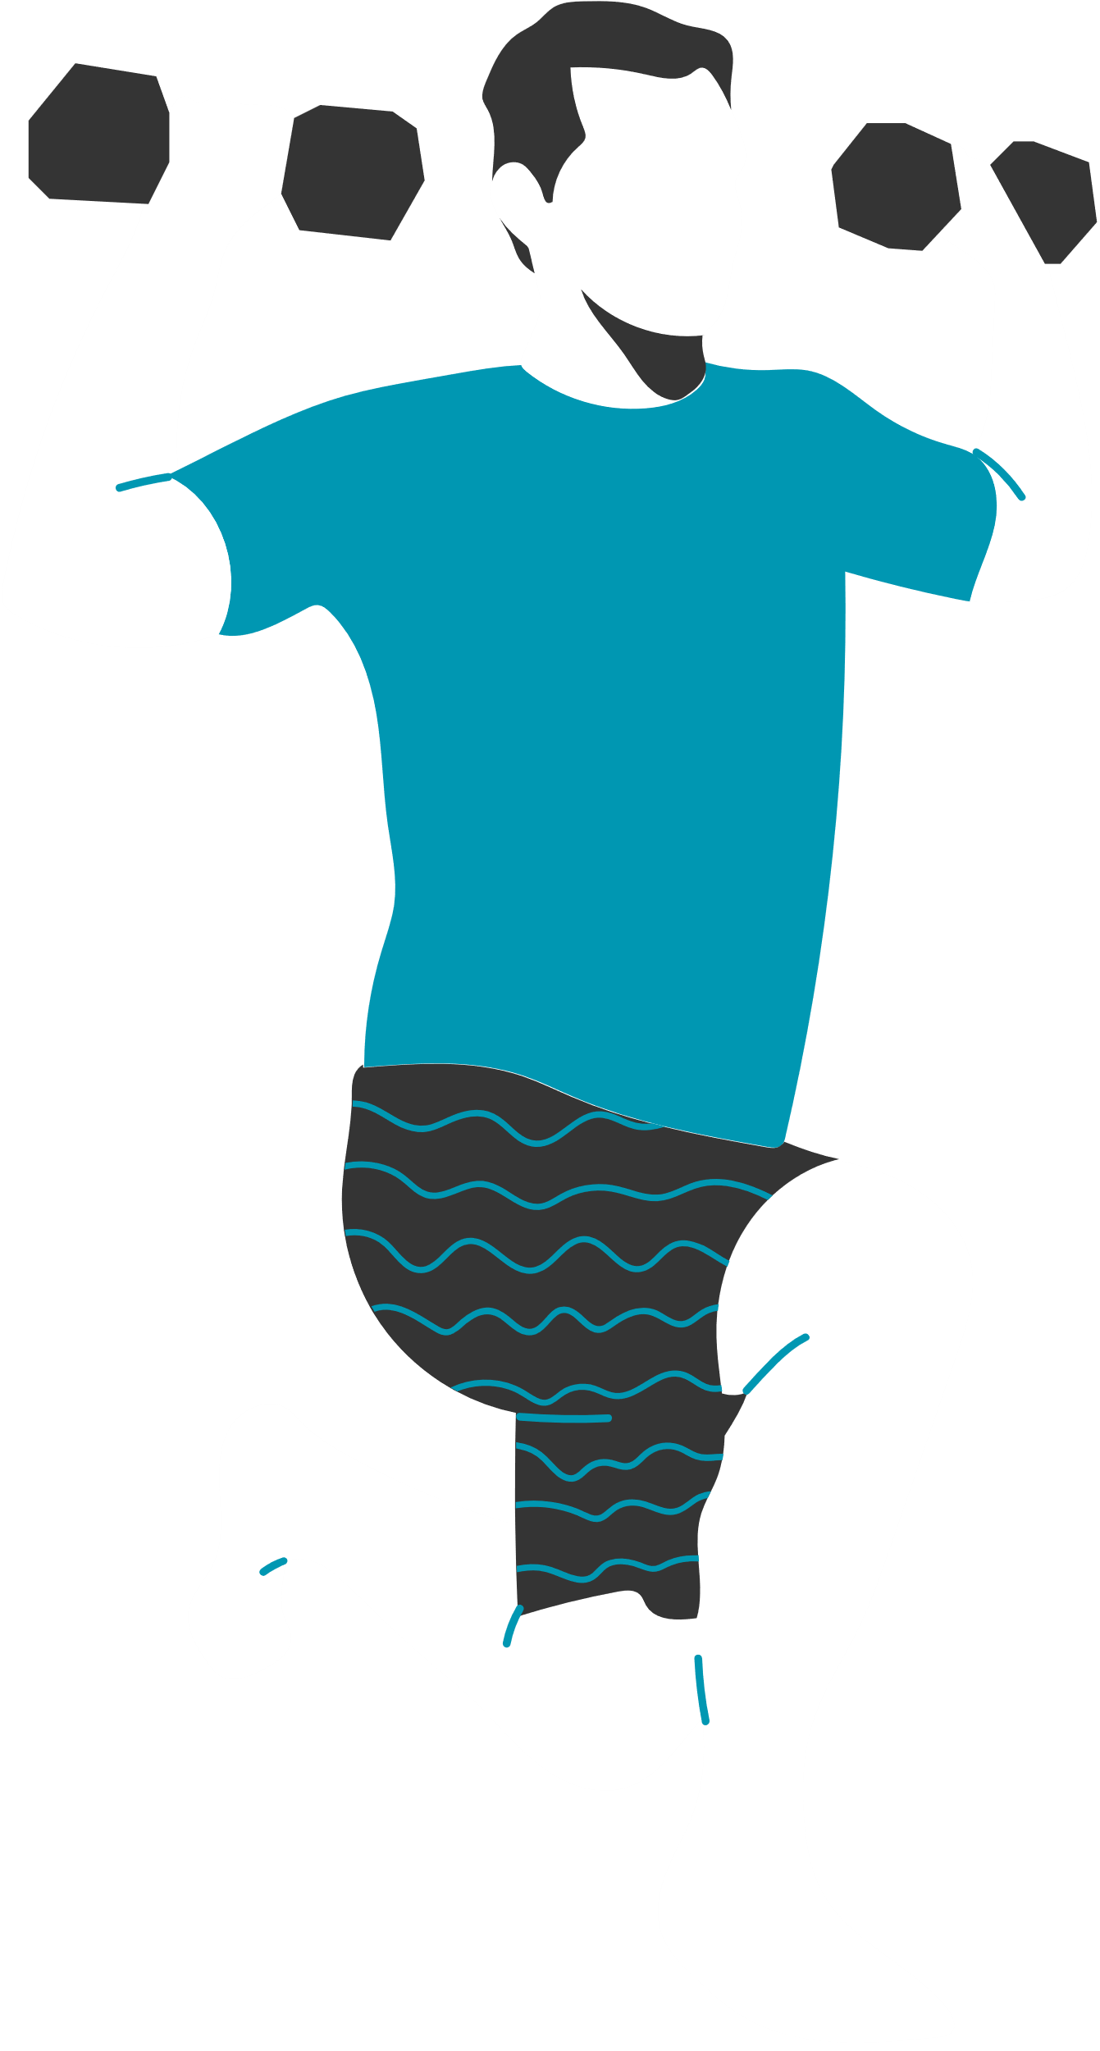
Who is this app for?
Busy professionals balancing work and health.
Fitness enthusiasts needing structured tracking.
Anyone looking for AI-driven personalized wellness plans.
User Persona Example:
-> Jane Doe, 32, Software Engineer
Pain Points: No time, uses multiple apps.
Needs: A simple, all-in-one solution.
02/ TARGET AUDIENCE

Slide 5
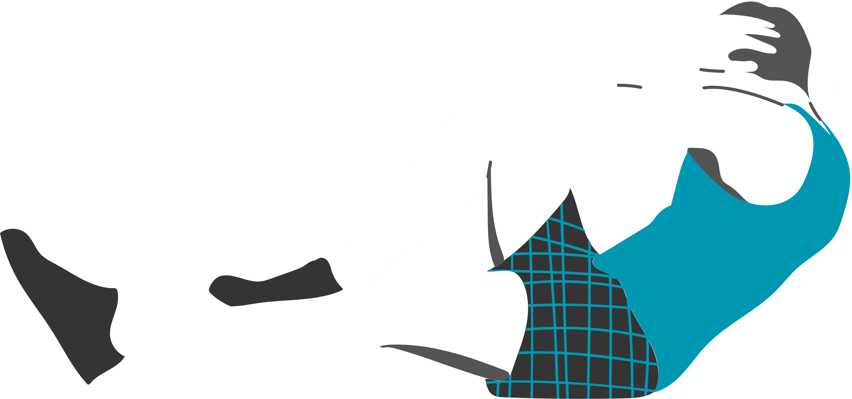
03/ COMPETITOR
ANALYSIS
App | Strengths | Weaknesses
MyFitnessPal | Great for calorie tracking | No workout or mental health integration
Google Fit | Step tracking & wearable sync | No personalized goal setting
GymMatta | All-in-one app for fitness, diet, and mental well-being | No AI-based goal tracking

Slide 6
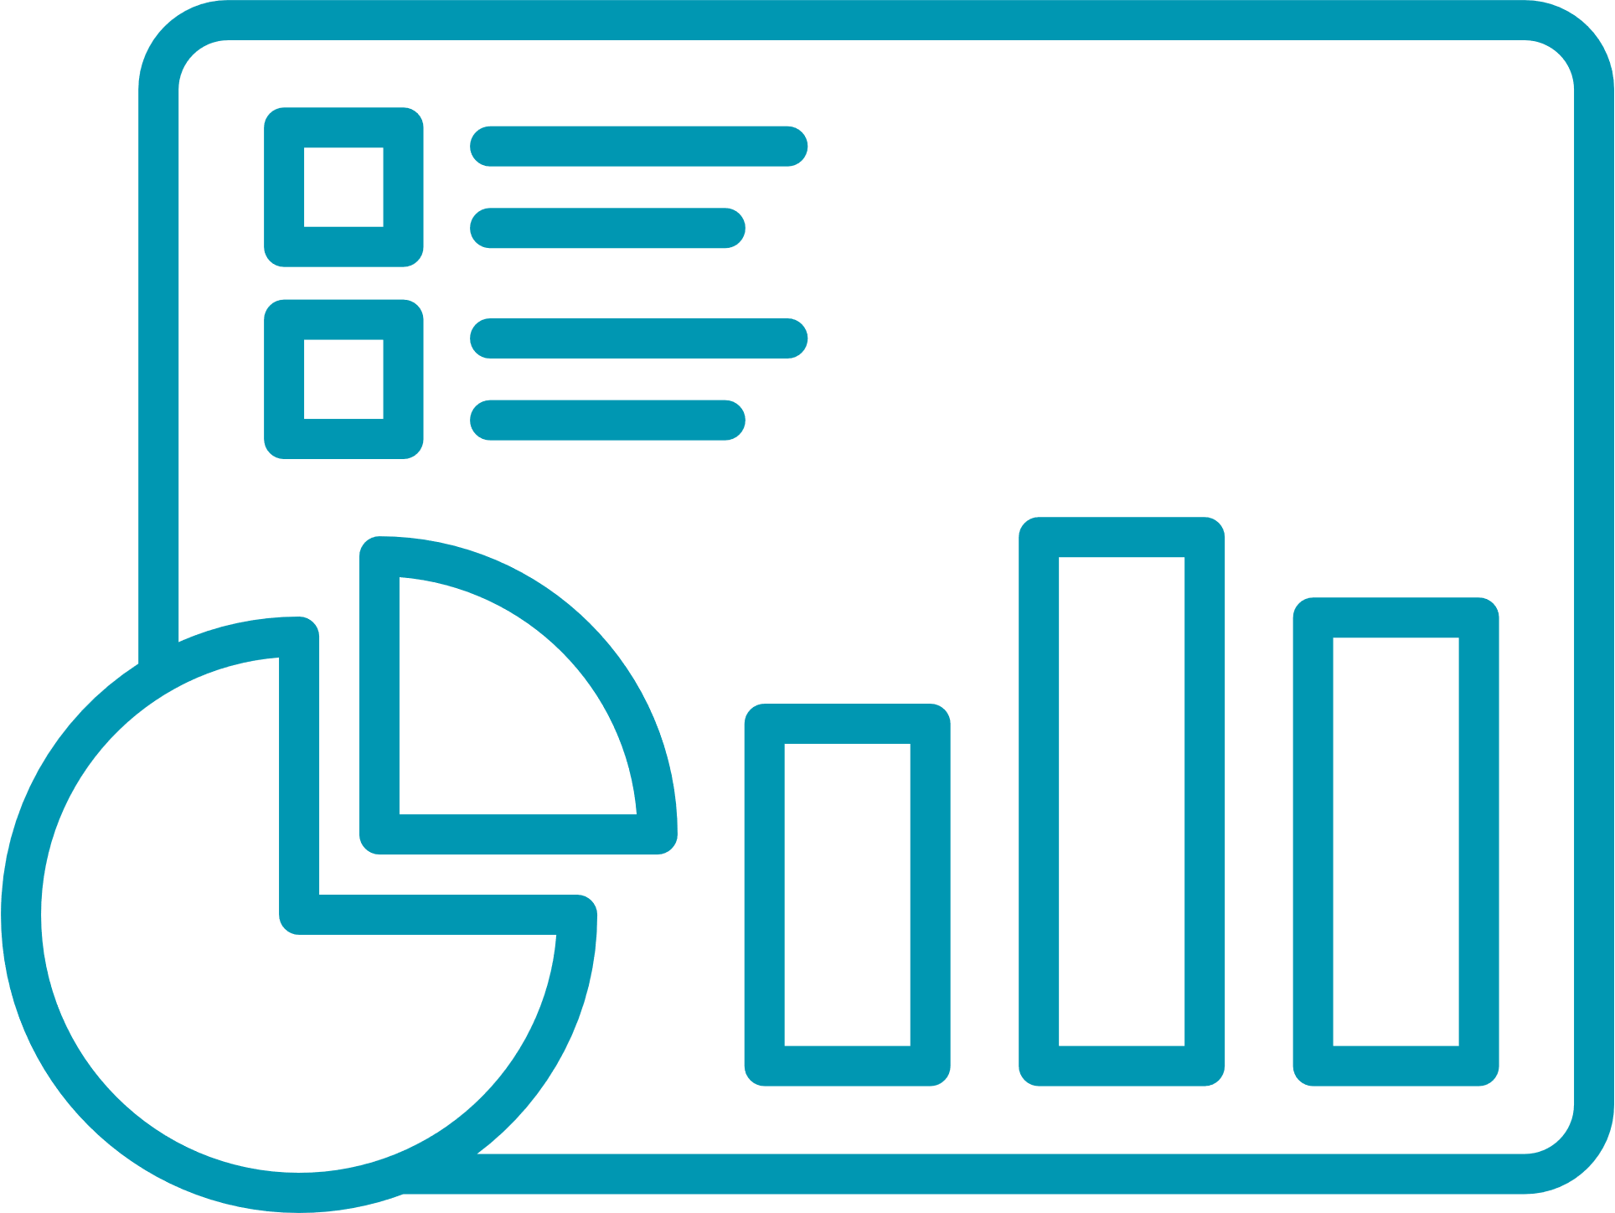
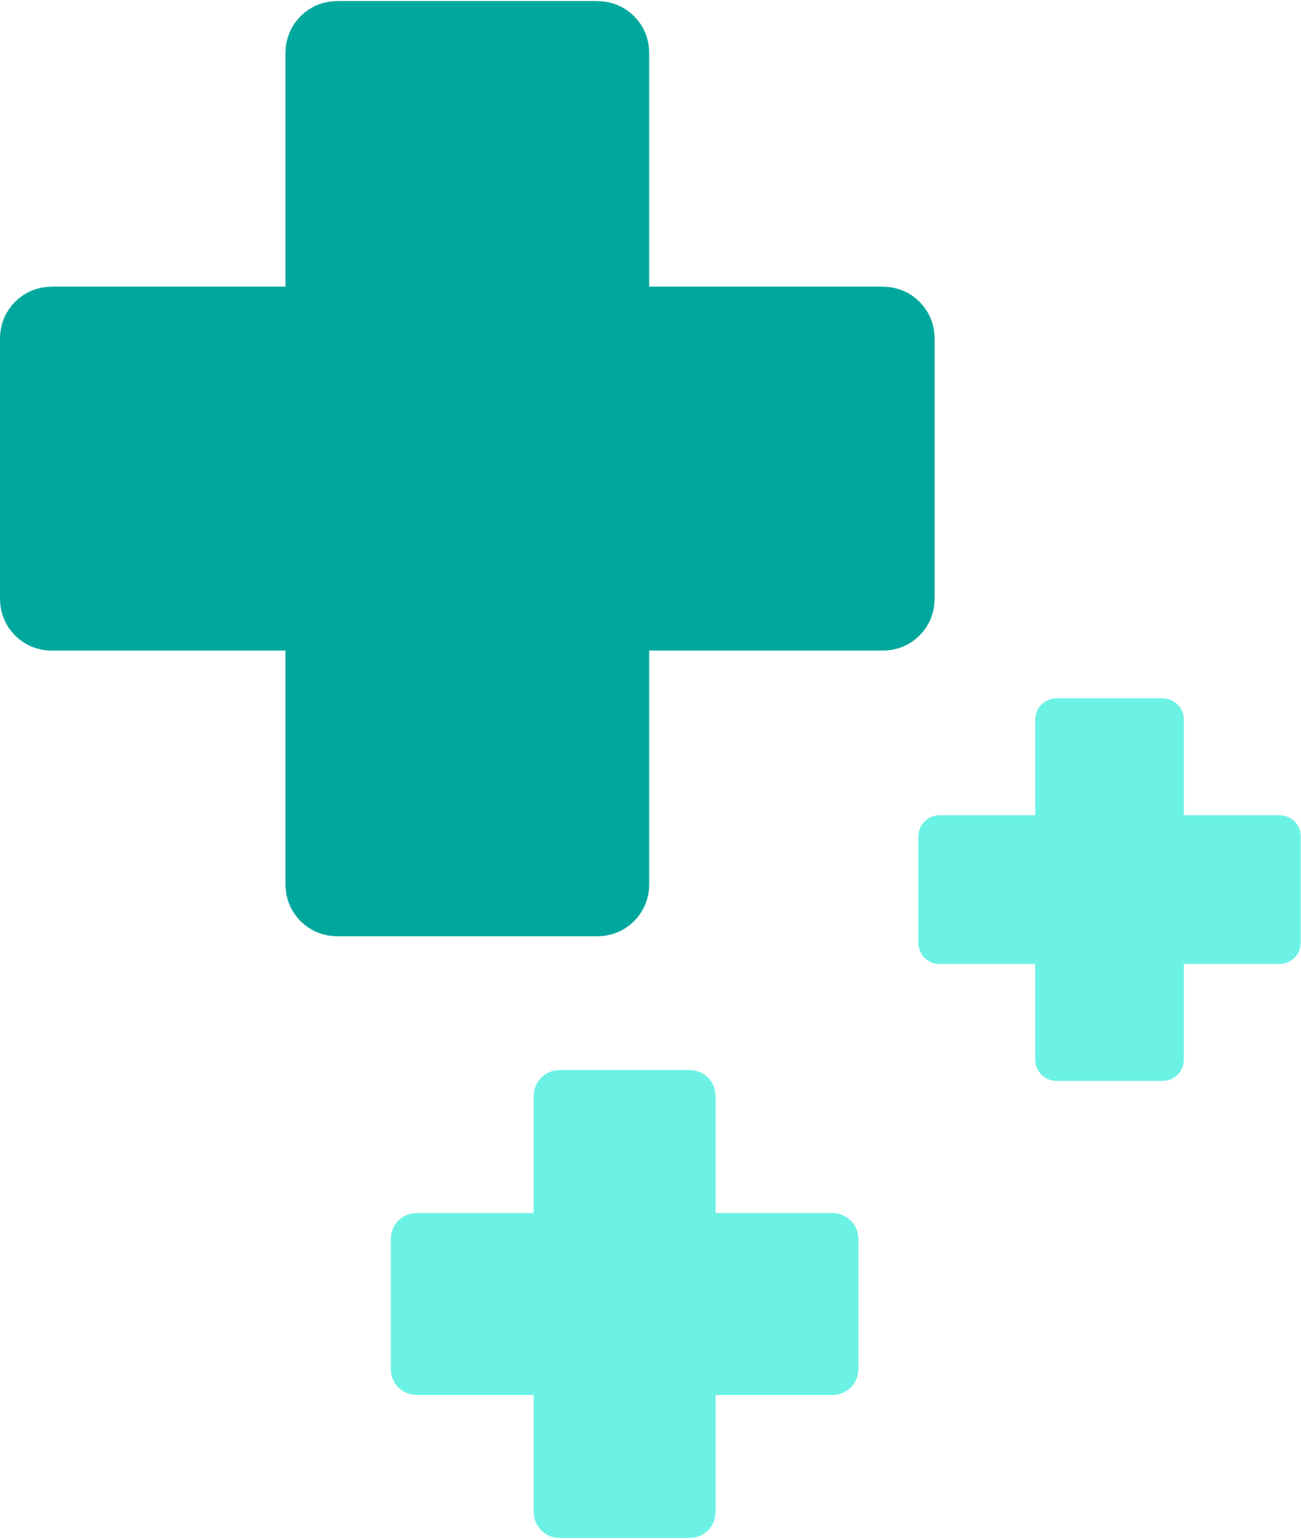
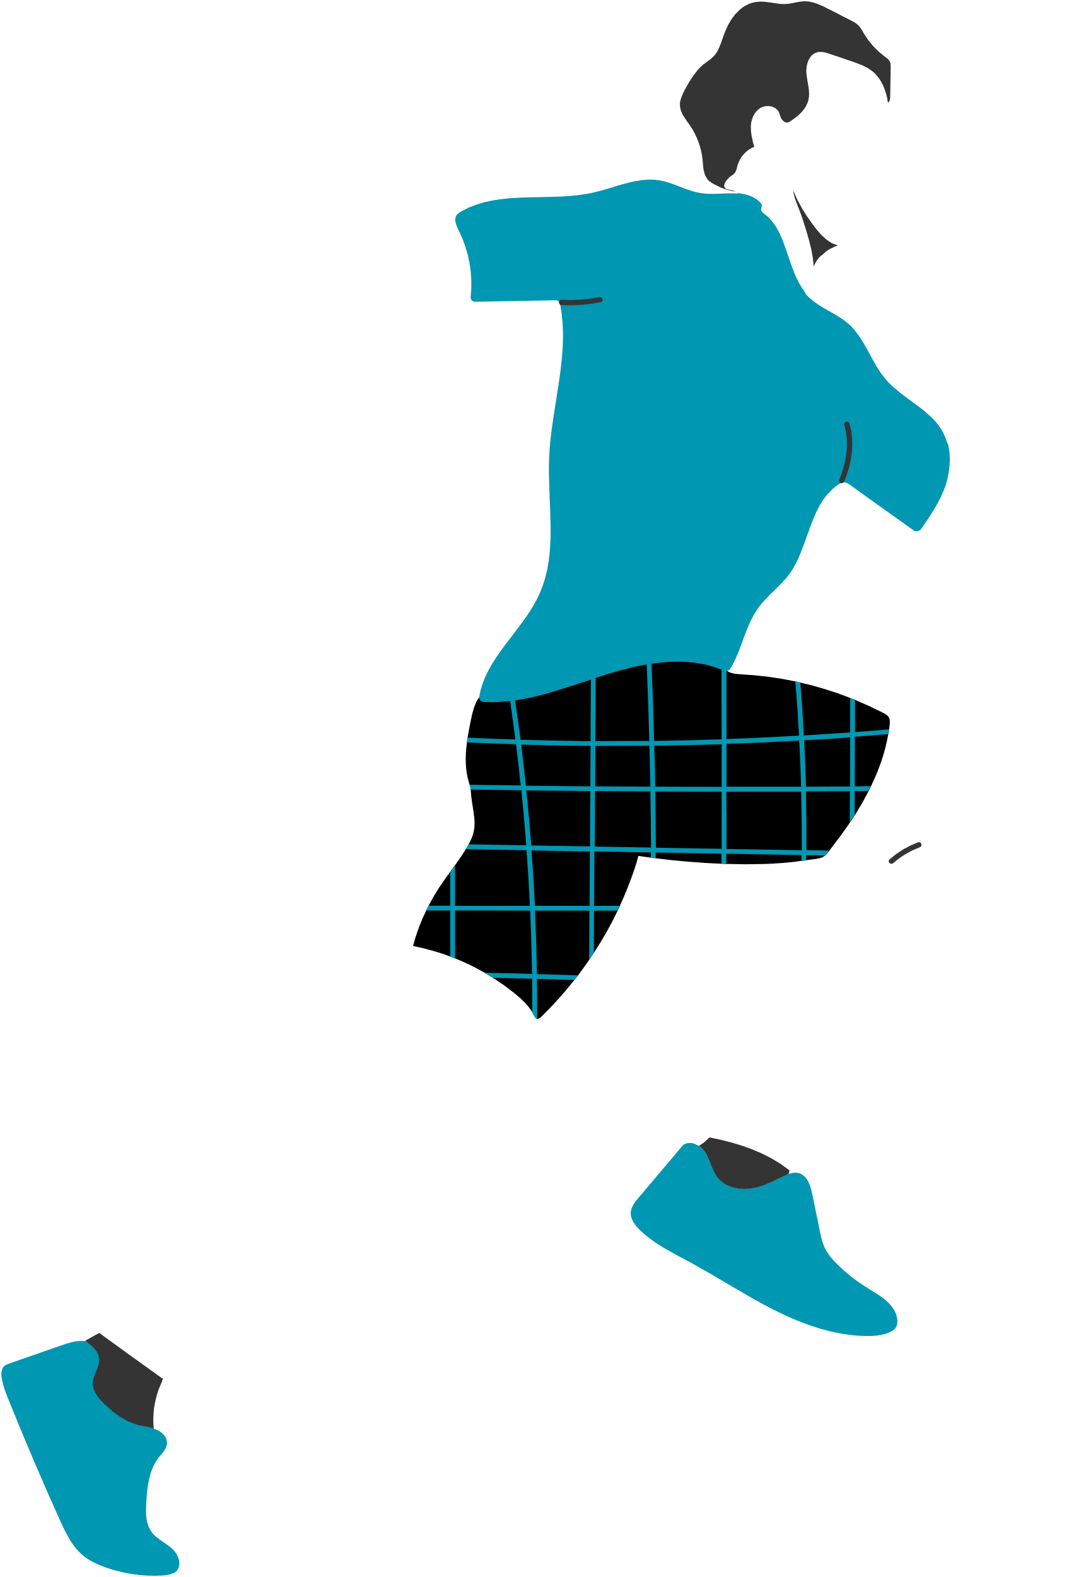
04/ KEY FEATURES OF GYMMATTA
Personalised Dashboard
Personalized Dashboard – Combines workouts, diet, and wellness.
Health Habit Tracking
Tracks water, steps, and mindfulness.

Slide 7
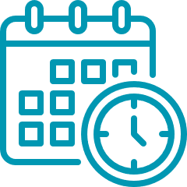
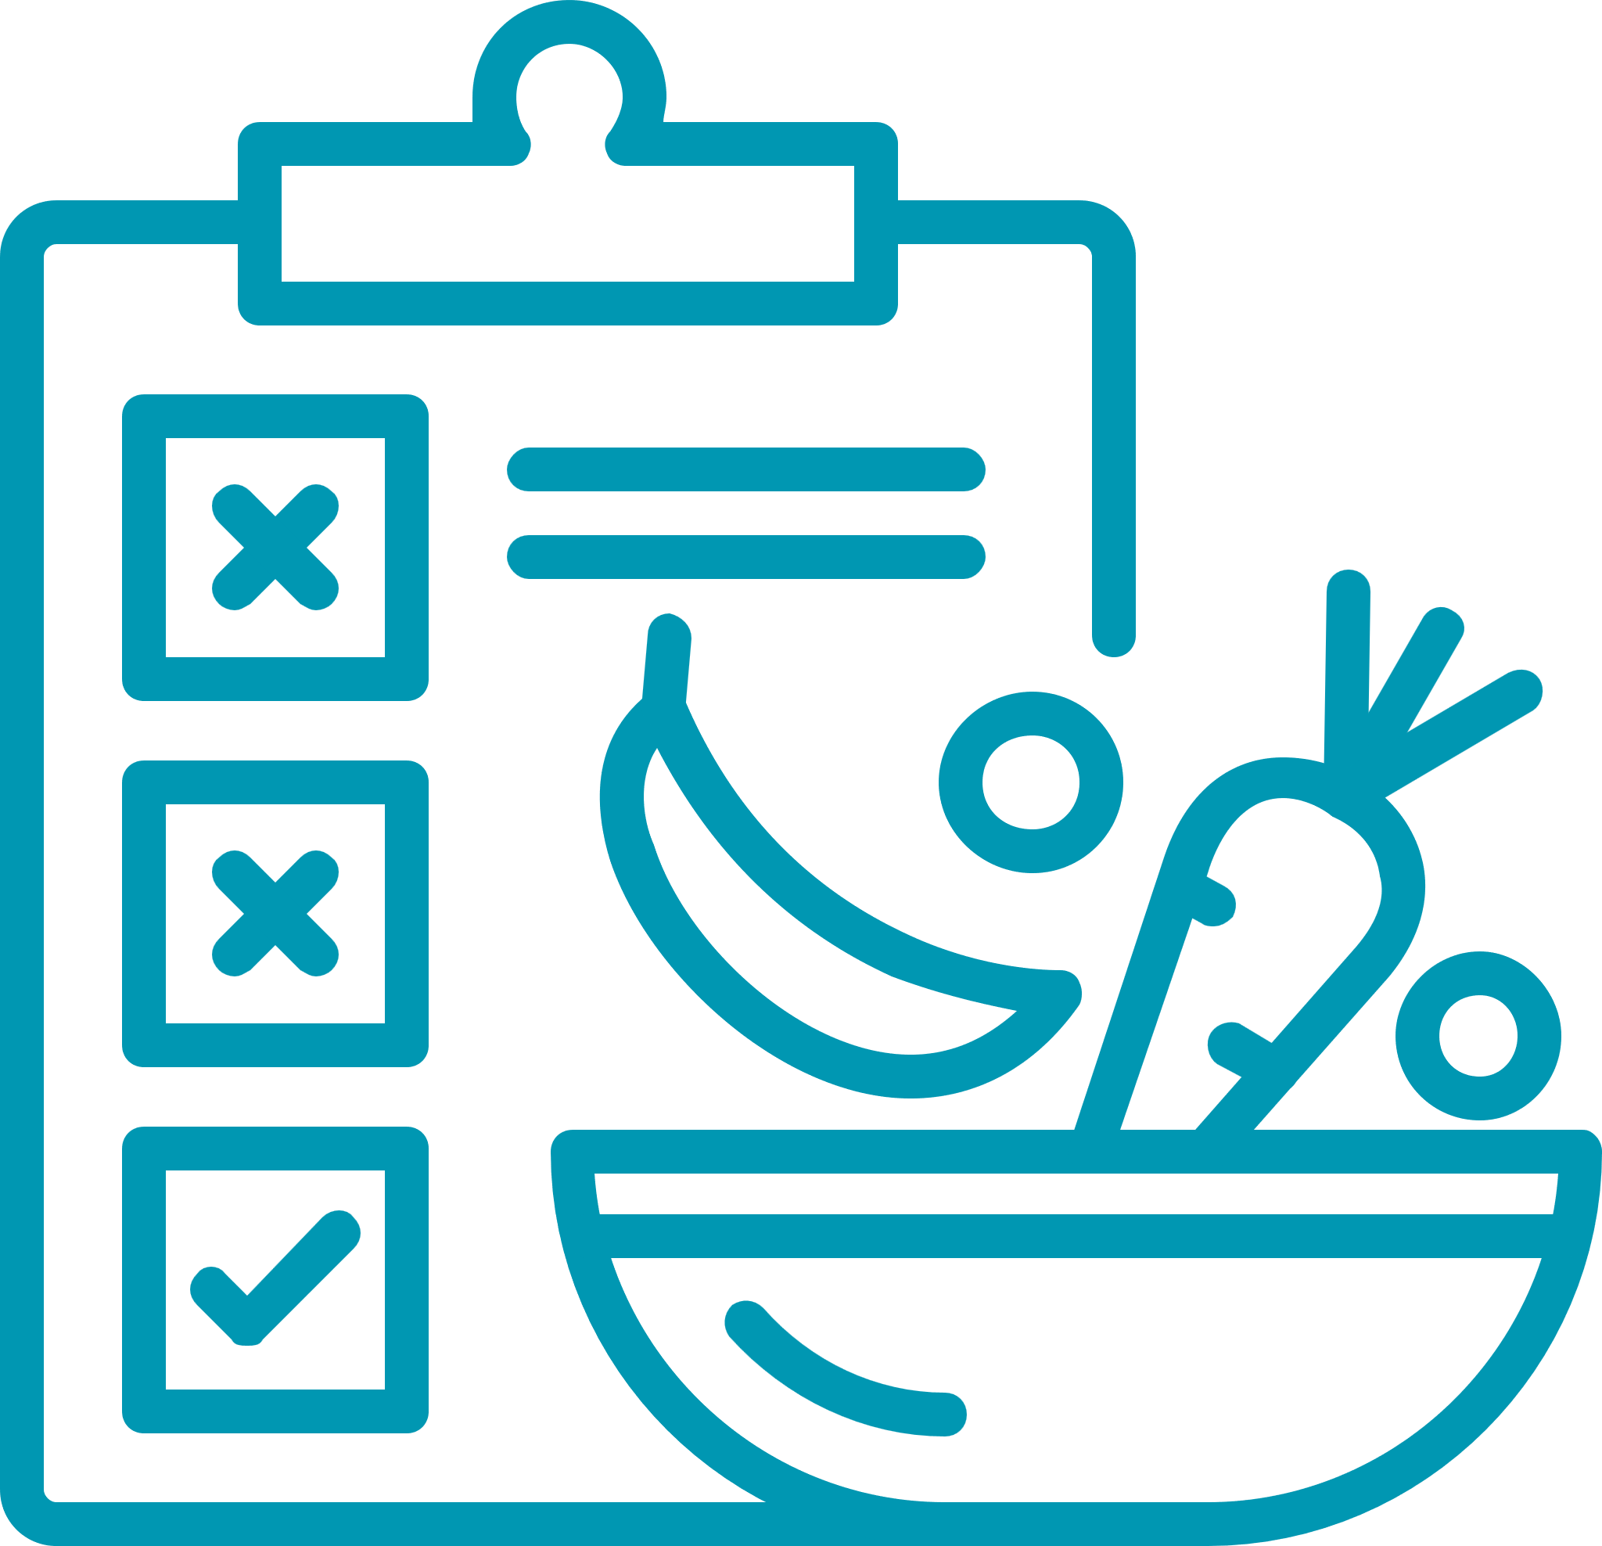
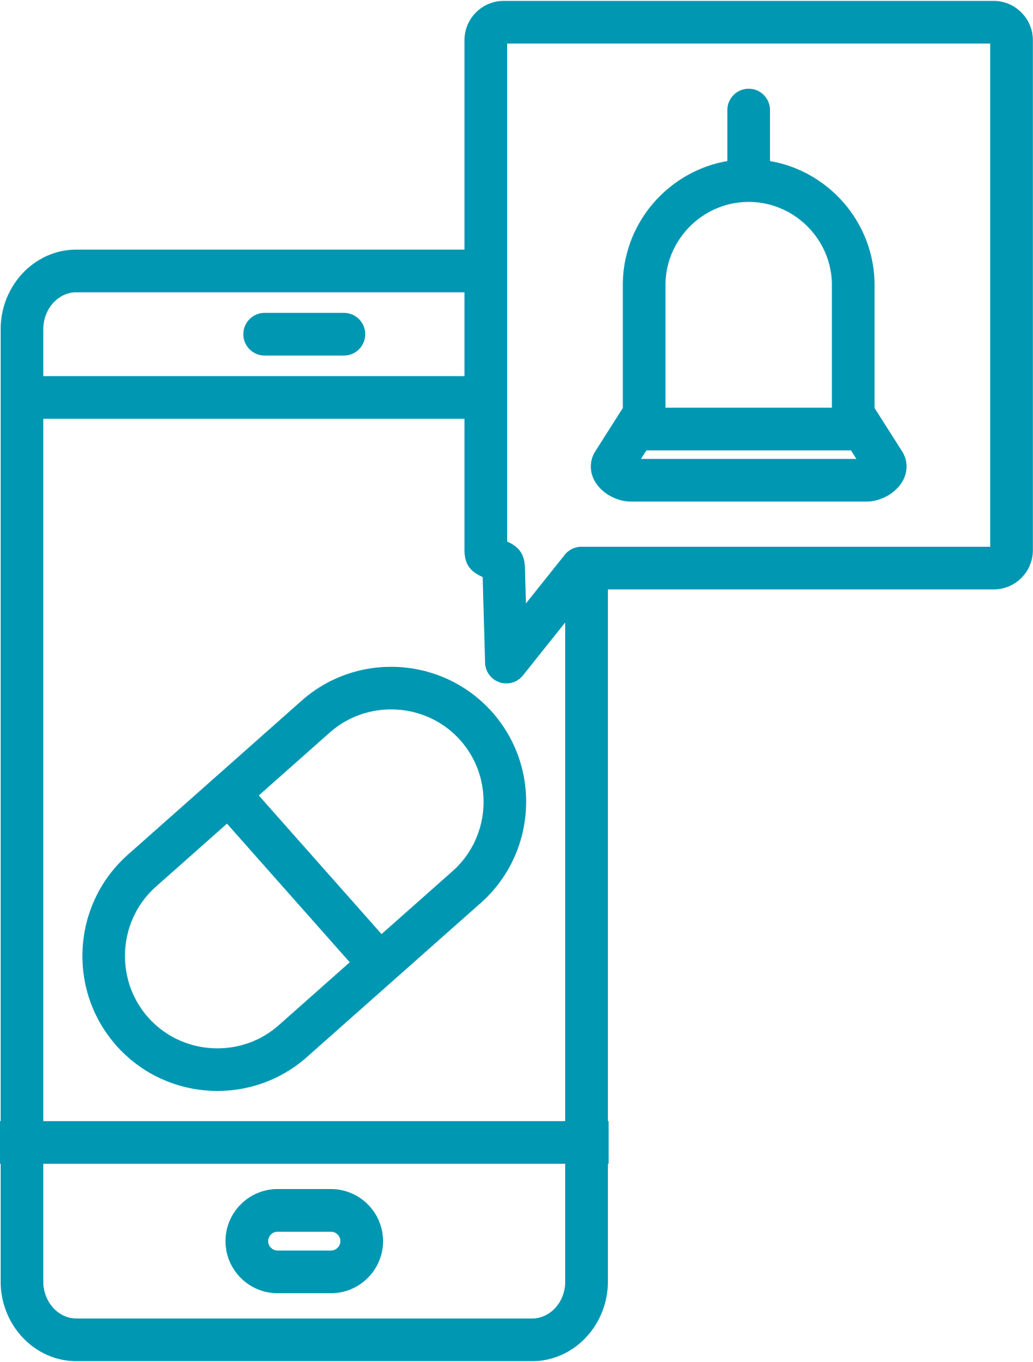
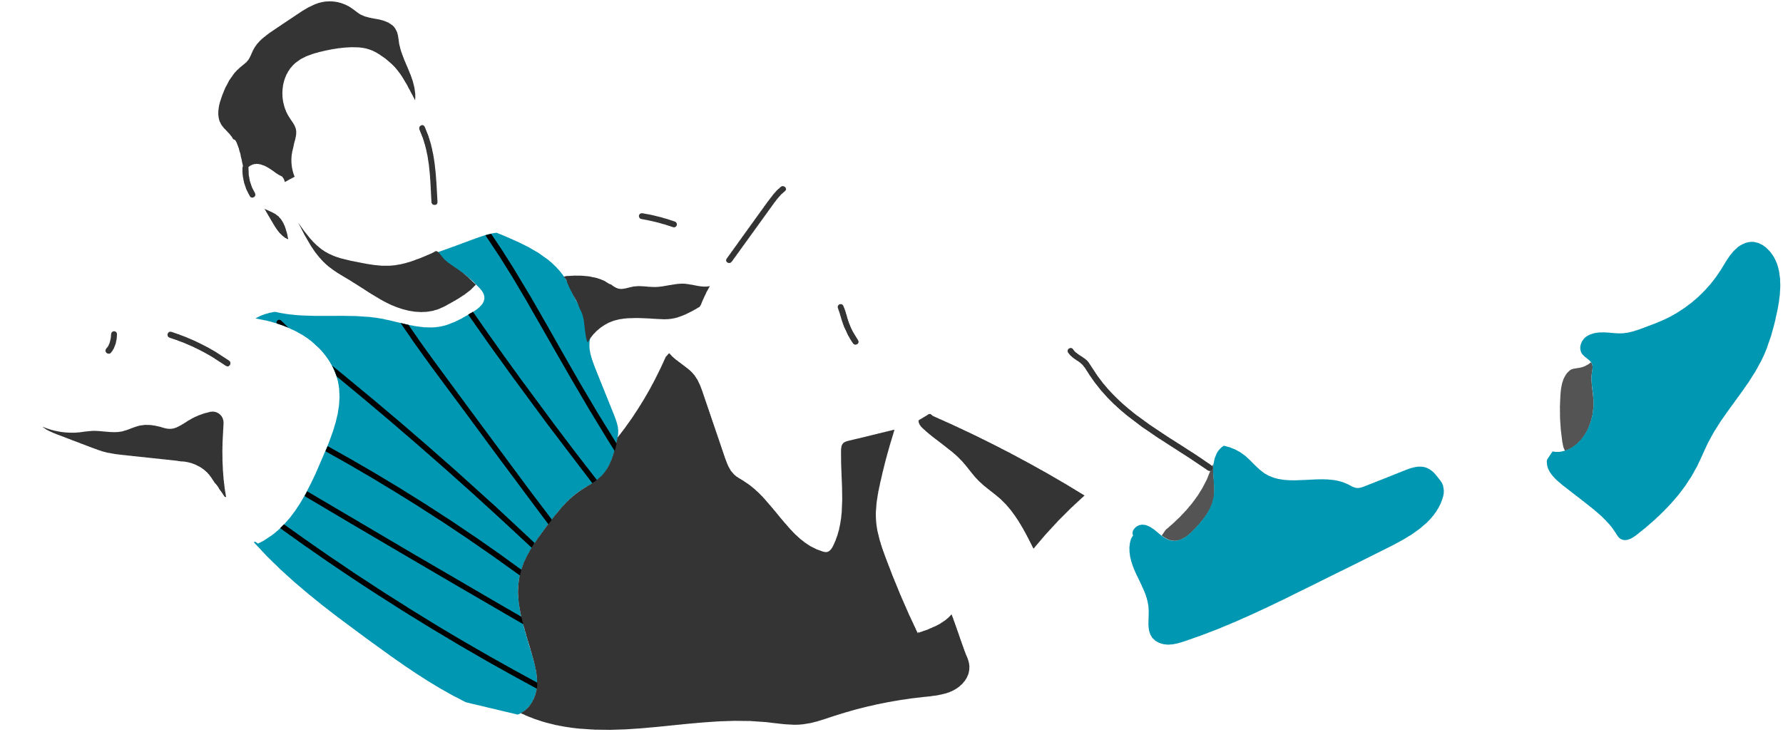
04/ KEY FEATURES OF GYMMATTA
Workout & Diet Planner
Reminder System
Structured schedules & Diet Plan provider
Ensures users maintain habits and stay committed to their wellness goals.

Slide 8
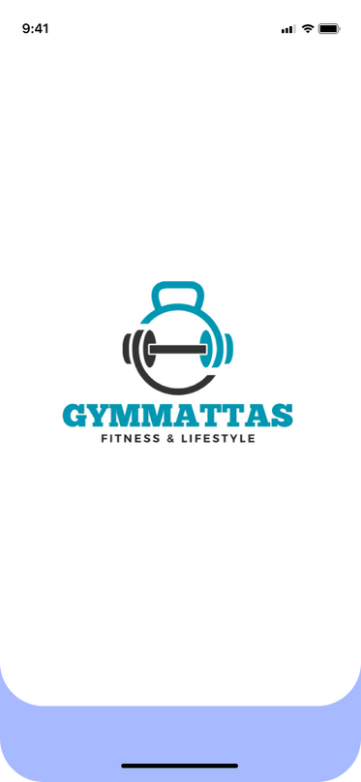
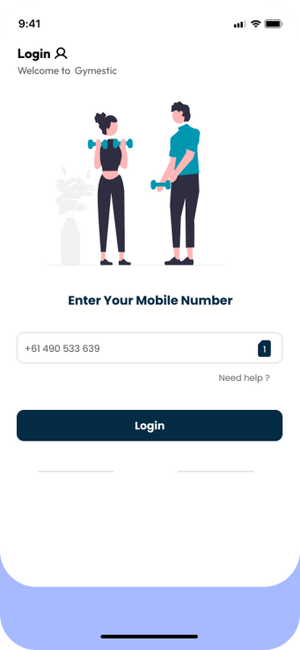
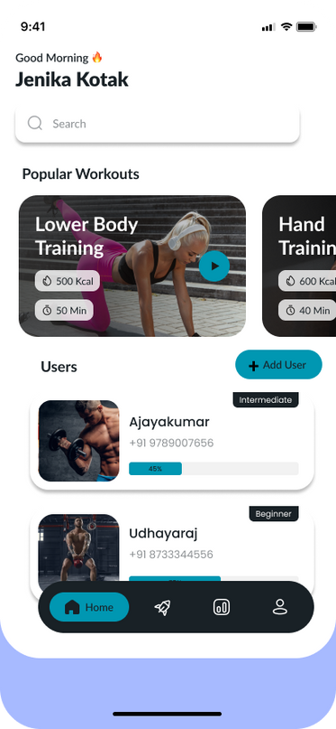
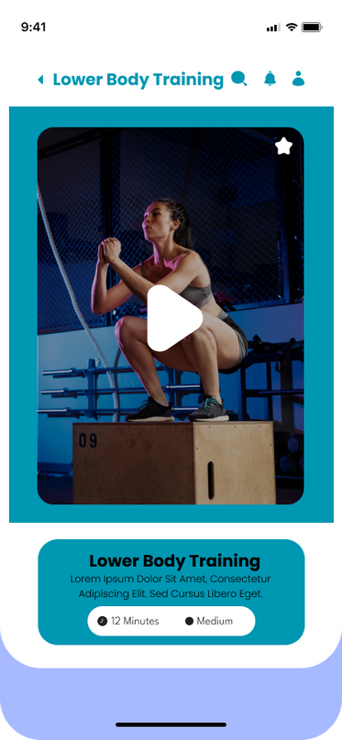
05/ UI MOCKUPS & SCREENS
Startup Loading Banner
Login Page
Home Page
Exercise Section

Slide 9

06/ DEVELOPMENT TIMELINE & MILESTONES
Phase | Task | Deadline
Week 1 | Research & finalize features | ✅ Done
Week 2 | UI Mockups & Jetpack Compose setup | 🔄 Under Review
Week 3 | Implement core features | 📌 In-Progress
Week 4 | Testing & refinement | ⏳ Final Stage
Week 5 | Final Presentation | 🎥 Submission
Completed

Slide 10
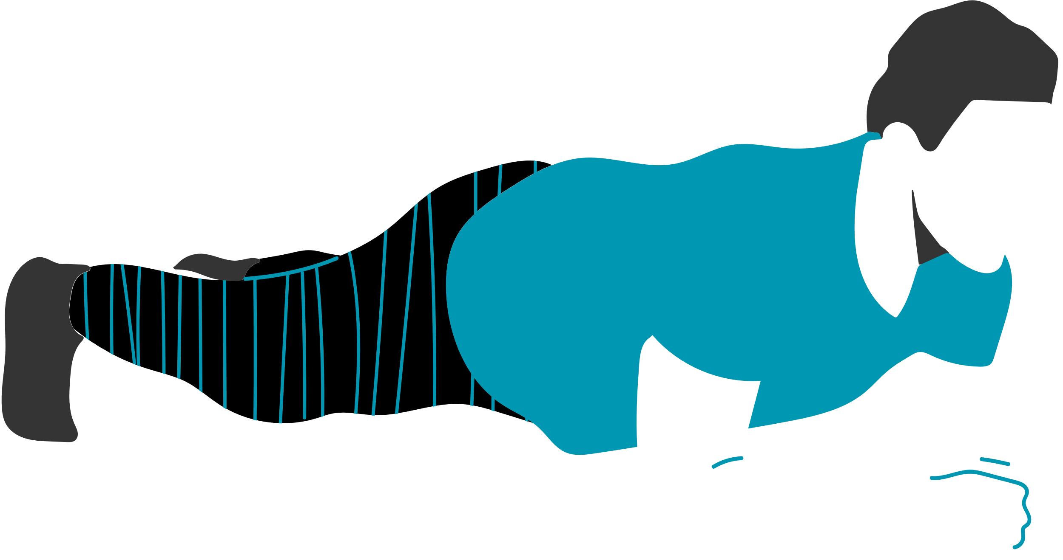
07/ GITHUB REPOSITORY & VERSION CONTROL
A GitHub repository is an online storage location where developers can save and organize their project files. It utilizes Git, a version control system, to monitor changes and facilitate collaboration. Version control helps developers maintain a record of modifications made to a project, enabling easy rollback to earlier versions when necessary. Git allows several developers to work on a project simultaneously by creating branches for different tasks or updates, which can later be combined into the main project.

Slide 11
08/ CONCLUSION & FINAL THOUGHTS
GymMatta is not just a workout app—it's an entire wellness solution. With monitoring, planned routines, and intuitive interface, it keeps users on track with their fitness objectives. Our disciplined development process and GitHub version management make progress seamless. Thanks!

Slide 12
Your Wellness,
Your Way.
Thanks

