Slide 1
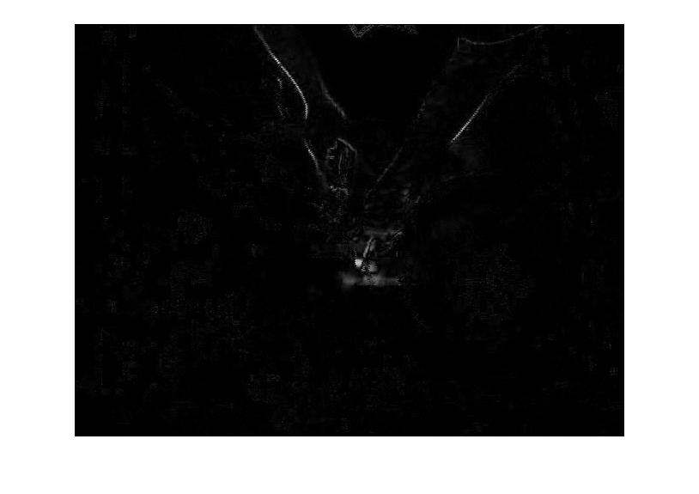

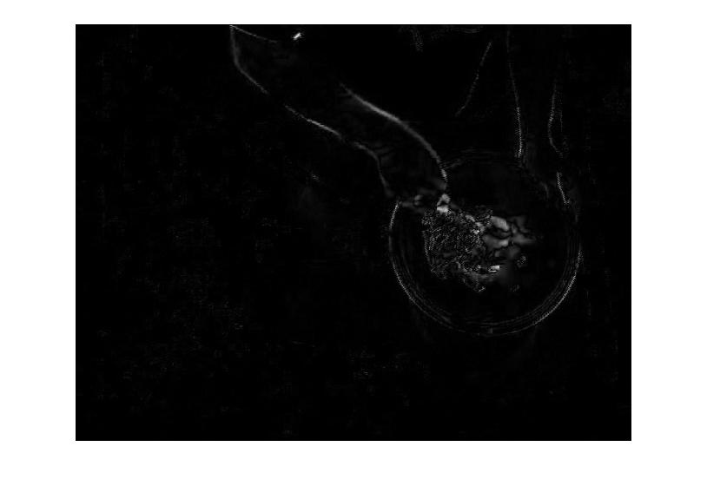
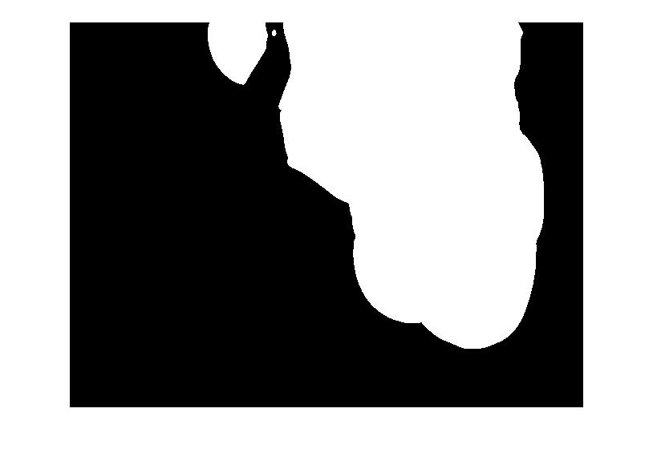
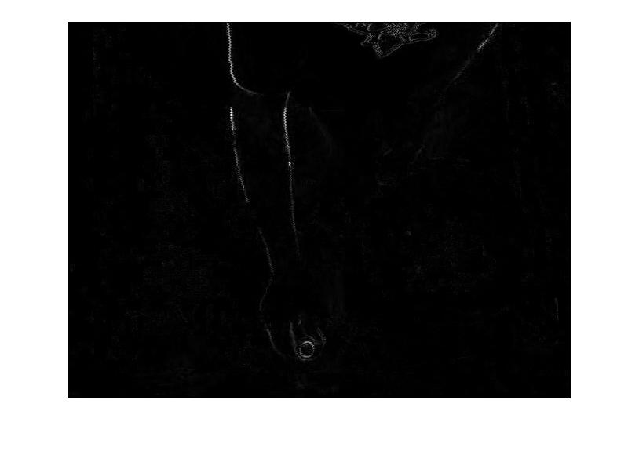
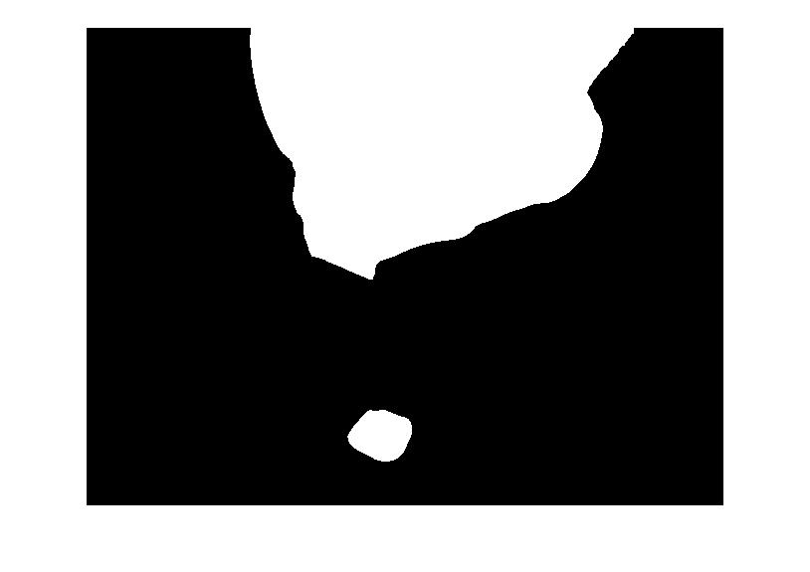


Video Retrieval by Motion Estimation
Digital Video Processing (CSE 509)
Jenil Jain & Jayaram Theegala
Abstract
Motion Estimation
In this work a content based video retrieval system is implemented using the low level features of the video such as motion vectors. A dataset containing set of videos is passed to the training module which first generates the motion vectors using appropriate window size. These generated motion vectors are clustered with a predetermined number of clusters. This trained dataset can now be used for retrieving relevant videos for a given input video. An average motion vector is calculated for each clustered segments and the input video which are then compared using Euclidean distance and Cosine distance. The segment with the least distance in comparison to the input implies they are most similar. Finally, all the calculated comparisons are used to create the ranking system which uses a Heap to store the retrieved videos.
Following images show the difference between consecutive frames and corresponding motion vector after thresholding. As we can see typical cutting, mixing and dressing has distinct shapes and regions.
Cutting
Read Video files to Frames
Extract motion vectors
Motion Segmentation using Thresholding
Mixing
Training
Cluster Motion Segments using K-Means
Split Video based on Clusters
Compare video segments to Input
Rank the segmented videos & present output
Dressing
Retrieval

Slide 2
Video Retrieval by Motion Estimation
Digital Video Processing (CSE 509)
Jenil Jain & Jayaram Theegala
Abstract
In this work a content based video retrieval system is implemented using the low level features of the video such as motion vectors. A dataset containing set of videos is passed to the training module which first generates the motion vectors using appropriate window size. These generated motion vectors are clustered with a predetermined number of clusters. This trained dataset can now be used for retrieving relevant videos for a given input video. An average motion vector is calculated for each clustered segments and the input video which are then compared using Euclidean distance and Cosine distance. The segment with the least distance in comparison to the input implies they are most similar. Finally, all the calculated comparisons are used to create the ranking system which uses a Heap to store the retrieved videos.
Read Video files to Frames
Extract motion vectors
Motion Segmentation using Thresholding
Cluster Motion Segments using K-Means
Split Video based on Clusters
Compare video segments to Input
Rank the segmented videos & present output
Training
Retrieval

Slide 3
Motion Estimation
Following images show the difference between consecutive frames and corresponding motion vector after thresholding. As we can see typical cutting, mixing and dressing has distinct shapes and regions.
Cutting
Mixing
Dressing

Slide 4
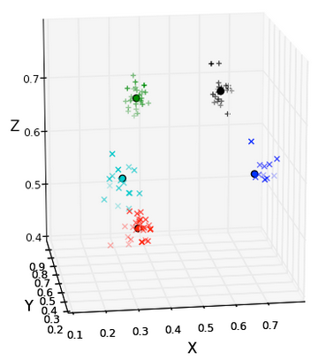
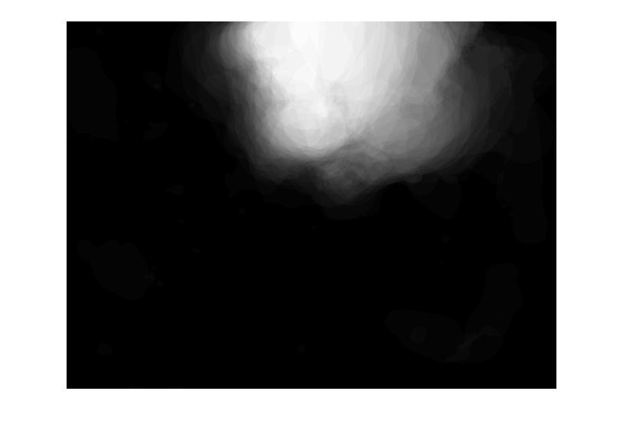
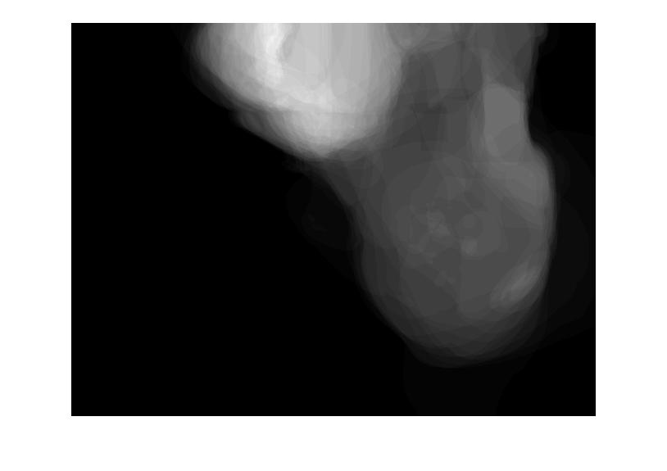
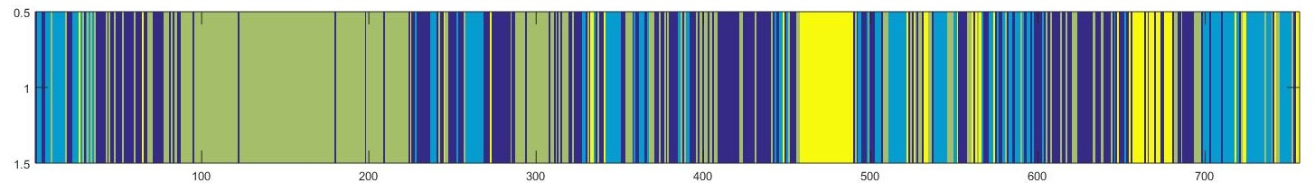
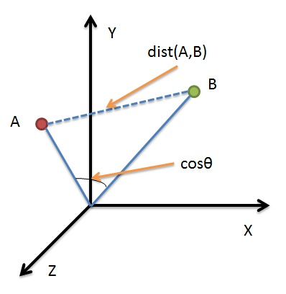
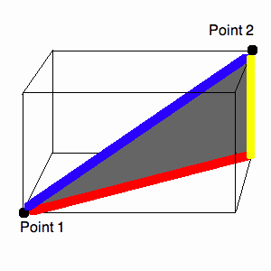
Video Retrieval by Motion Estimation
Digital Video Processing (CSE 509)
Jenil Jain & Jayaram Theegala
Video Segmentation
Comparison
The classification method we used was k-means clustering. k-means clustering aims to partition n observation into k clusters in which each observation belongs to the clusters with the nearest mean.
Comparing this sequences with the input video can show how similar they are. For similarity measure we can use either Euclidean distance or the cosine distance. Rankings can be assigned to these clips based on any of the above measurements.
After clustering the frames in the video, we need to separate the video into sequences of similar k-mean ID. The region with uniform color represents a single activity. Splitting the video into sequences is a onetime process and we can save this information for future iterations.
Averaged motion vector for a cutting clip
Averaged motion vector for a mixing clip
Cutting
Dressing
Mixing
Random
Cosine distance depiction for a two dimensional vectors
Euclidean distance depiction for a two dimensional vectors
Note: blue stripes between regions of yellow and green,
that is because of adding the ingredients into the bowl

Slide 5
Comparison
Comparing this sequences with the input video can show how similar they are. For similarity measure we can use either Euclidean distance or the cosine distance. Rankings can be assigned to these clips based on any of the above measurements.
Averaged motion vector for a mixing clip
Averaged motion vector for a cutting clip
Euclidean distance depiction for a two dimensional vectors
Cosine distance depiction for a two dimensional vectors

Slide 6
Video Segmentation
The classification method we used was k-means clustering. k-means clustering aims to partition n observation into k clusters in which each observation belongs to the clusters with the nearest mean.
After clustering the frames in the video, we need to separate the video into sequences of similar k-mean ID. The region with uniform color represents a single activity. Splitting the video into sequences is a onetime process and we can save this information for future iterations.
Cutting
Dressing
Mixing
Random
Note: blue stripes between regions of yellow and green, that is because of adding the ingredients into the bowl

Slide 7
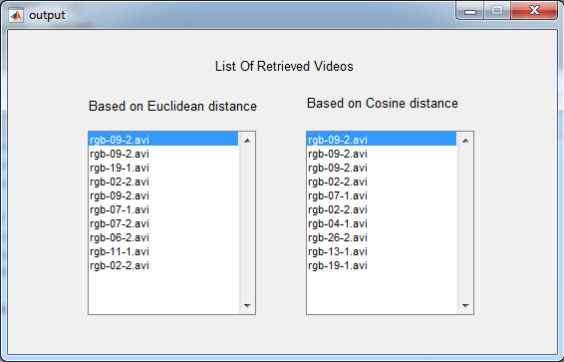
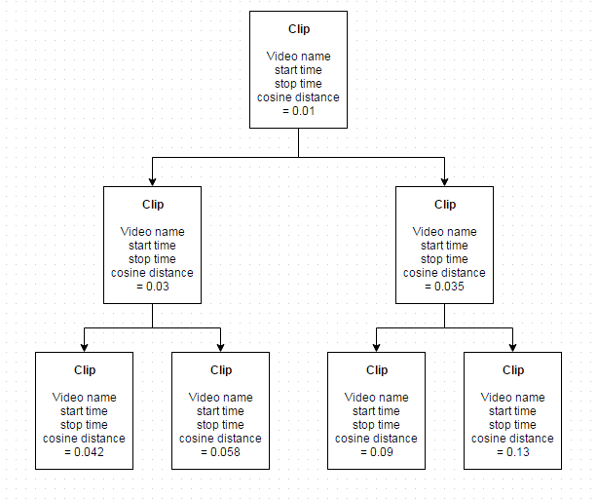
Video Retrieval by Motion Estimation
Digital Video Processing (CSE 509)
Jenil Jain & Jayaram Theegala
Ranking
Results
For ranking the clips we used a simple data structure to store all the clip’s information in ascending order of their respective Euclidean or cosine distance from the input clip. From each video in the dataset, 3 top clips are picked by extracting min from the heap. Once all the videos are processed, top 10 out of the total clips are selected and displayed in a list.
Based on our observations, the retrieved video results has an accuracy of around 70%, in other words if the input video activity is cutting, 70% of the retrieved videos had cutting activity in them. It has also been observed that Cosine distance method has provided better accuracy than Euclidean distance.
Avg time to extract motion vectors per video: 30 min
Avg time for video segmentation per video: 2 min
Avg time to retrieve from existing clips: 30sec
Conclusion
Content based Video Retrieval system using Motion Estimation and Clustering has been implemented. The system also has a loosely coupled user interface which allows to provide input video and watch the retrieved outputs. Motion vectors have been used for estimating a high level activity and also to rank the videos in the dataset with respect to a given input video.

Slide 8
Results
Based on our observations, the retrieved video results has an accuracy of around 70%, in other words if the input video activity is cutting, 70% of the retrieved videos had cutting activity in them. It has also been observed that Cosine distance method has provided better accuracy than Euclidean distance.
Avg time to extract motion vectors per video: 30 min
Avg time for video segmentation per video: 2 min Avg time to retrieve from existing clips: 30sec
Conclusion
Content based Video Retrieval system using Motion Estimation and Clustering has been implemented. The system also has a loosely coupled user interface which allows to provide input video and watch the retrieved outputs. Motion vectors have been used for estimating a high level activity and also to rank the videos in the dataset with respect to a given input video.

Slide 9
Ranking
For ranking the clips we used a simple data structure to store all the clip’s information in ascending order of their respective Euclidean or cosine distance from the input clip. From each video in the dataset, 3 top clips are picked by extracting min from the heap. Once all the videos are processed, top 10 out of the total clips are selected and displayed in a list.

