Slide 1

T.Y. Mini Project Presentation
“YieldVision : Machine Learning For Crop Yield Prediction”
Guide : Dr. Milind Nemade
Group No. : 7
Jenil Jani – 23
Karina Kesur – 26
Yug Mavani - 32
Department of AI&DS, K.J. Somaiya Institute of Technology, Sion, Mumbai 400022
26/06/2026
1

Slide 2
Sr.No. | Content
1. | Introduction
2. | Literature Survey
3. | Primary Objective
4. | Methodology
5. | Programming Tools
6. | Results Obtained
7. | Expected Results
8. | Applications
9. | Future Scope
10. | Conclusion
11. | References
26/06/2026
2

Slide 3
Introduction
Introduction
Sugarcane is among India's most important cash crops, forming the backbone of farmer income and the sugar industries.
Their yield is highly sensitive to climatic stress, particularly rainfall deficits and temperature extremes linked to El Niño events.
Problem Statement
Existing yield-estimation methods rely on single statistical/ML models and rarely account for El Niño (ENSO) climatic stress.
This makes yield forecasts unreliable in anomalous climate years.
Motivation
Build an ensemble ML system combining multiple models to predict sugarcane yield more accurately.
Helps farmers and policymakers plan ahead of adverse climatic seasons.
26/06/2026
3

Slide 4
Literature Survey
Parameter | Paper 1 | Paper 2 | Paper 3 | Paper 4
Title | Crop Yield Prediction Using Machine Learning: A Systematic Literature Review (2020) | Machine Learning for Crop Yield Prediction: A Comprehensive Review (2025) | Sugarcane Yield Prediction Using Machine Learning: A Review (2025) | Assessing the impact of El Niño–Southern Oscillation on sugarcane yield and quality in Brazil’s South-Central Region using the DSSAT-CANEGRO model(2026)
Authors | Van Klompenburg, Kassahun & Catal | Singh et al. | Das et al. | J. G. S. Pedreira, I. M. Fattori Jr., M. S. Vianna & F. R. Marin
Method / Data | Review of ML models (LR, DT, RF, ANN, SVM) + weather/soil data | Review of traditional ML, deep learning & ensemble techniques | ML methods using climatic + soil parameters (sugarcane-specific) | Climate modeling of Indian monsoon rainfall vs. ENSO/El Niño indices
Key Finding | ML models effectively predict yield using weather & soil features | Ensemble & deep learning techniques outperform single ML models | ML improves sugarcane yield forecasting using climate/soil data | El Niño significantly affects sugarcane yield and quality, especially sugar recovery
Limitation | Relies mostly on single ML models; no El Niño consideration | Limited use of ensemble learning and climate anomaly data | Limited model comparison; minimal focus on El Niño climatic stress | Brazil-specific; uses crop simulation rather than ML
Research Gap | Need ensemble models incorporating climate anomaly indices | Need integration of ENSO/El Niño indices with ensemble models | Need multi-model comparison with El Niño-specific features | Need for ML-based prediction combining ENSO with soil/weather factors and comparing multiple models.
26/06/2026
4

Slide 5
Objective
To develop a reliable approach for predicting sugarcane yield under varying climatic conditions.
To assess the influence of climatic stress, particularly El Niño/ENSO conditions, on cash crop yield.
To determine the effectiveness of different machine learning approaches for crop yield prediction.
To investigate whether combining multiple ML models can provide more robust yield predictions than individual models.
26/06/2026
5

Slide 6








Methodology
Data Sources
Crop, Weather, Soil, El Niño (ONI)
Random Forest
Support Vector Regression
Voting Regressor (Ensemble)
Preprocessing
Cleaning • Scaling • Feature Eng.
Ensemble of multiple decision trees. Reduces overfitting, improves accuracy.
Fits prediction within tolerance ε. Minimizes model complexity while bounding error.
Averages predictions from all base models. Reduces variance & improves reliability.
ML Models
LR • DT • RF • SVR
ŷ = (1/N) Σ Ti(x) [N = trees]
min ½‖w‖² s.t. |yi−(w·xi+b)|≤ε
ŷ = (1/M) Σ fm(x) [M = models]
Ensemble & Eval.
Voting Regressor • RMSE/MAE/R²
RMSE
Root Mean Squared Error — lower is better.
MAE
Mean Absolute Error between actual & predicted.
R² Score
Explains variation; closer to 1 is better.
RMSE
MAE
R²
Yield Prediction
Sugarcane output
RMSE = √[(1/n)Σ(yi−ŷi)²]
MAE = (1/n)Σ|yi−ŷi|
R² = 1 − Σ(yi−ŷi)²/Σ(yi−ỳ)²
Web Deployment
FastAPI + PostgreSQL + React
26/06/2026
7

Slide 7
Programming Tools
Programming Languages
Python | JavaScript / TypeScript | SQL
Frontend
React | Tailwind CSS | Chart.js
Backend
FastAPI | Pandas | NumPy | Scikit-learn
Database
PostgreSQL / MySQL
Development Tools
Git & GitHub | Jupyter Notebook | VS Code
Dataset & Feature Description
Agriculture Crop Yield Dataset
• Year and geographical region
• Soil type
• Rainfall and temperature
• season
• Target: Crop yield (tons/hectare)
Sugarcane Prediction Dataset
• Sugarcane-specific cultivation parameters
• Crop-growth and yield-related parameters
• Target: Sugarcane yield
Soil & Weather Dataset
• Soil moisture
• Soil nitrogen (N)
• Soil phosphorus (P)
Soil Ph
• Temperature
• Rainfall
NOAA CPC ONI Dataset
• Year / seasonal period
• Oceanic Niño Index (ONI)
• ENSO phase / climatic condition
• Used as a climatic-stress indicator
26/06/2026
8

Slide 8

Results Obtained
26/06/2026
9

Slide 9
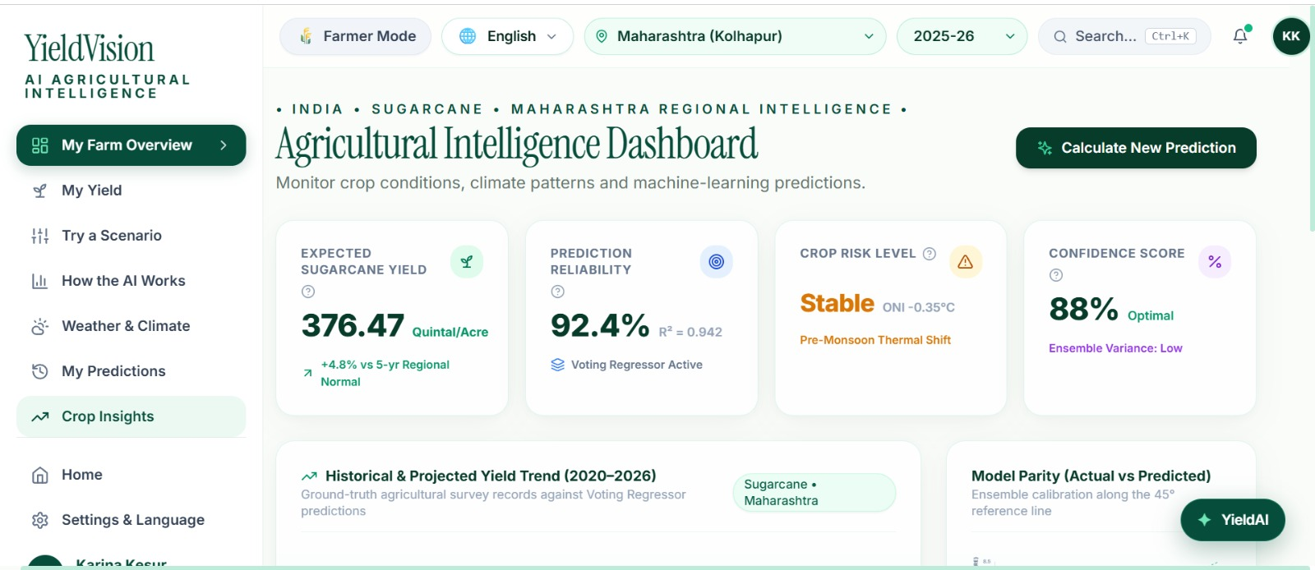
26/06/2026
9

Slide 10
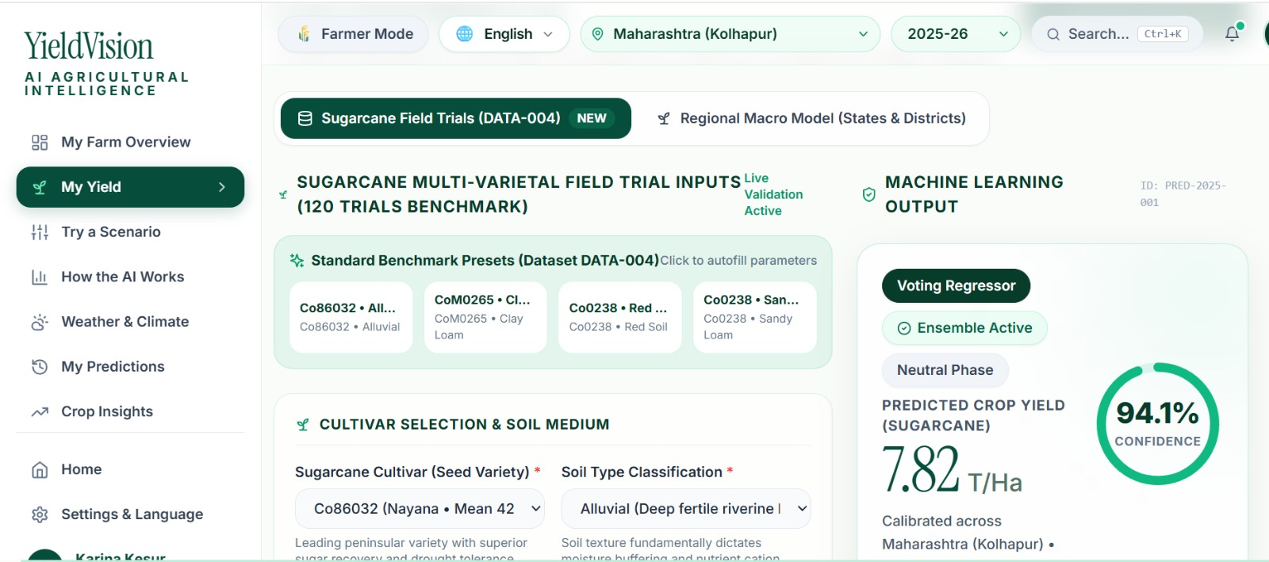
26/06/2026
6

Slide 11
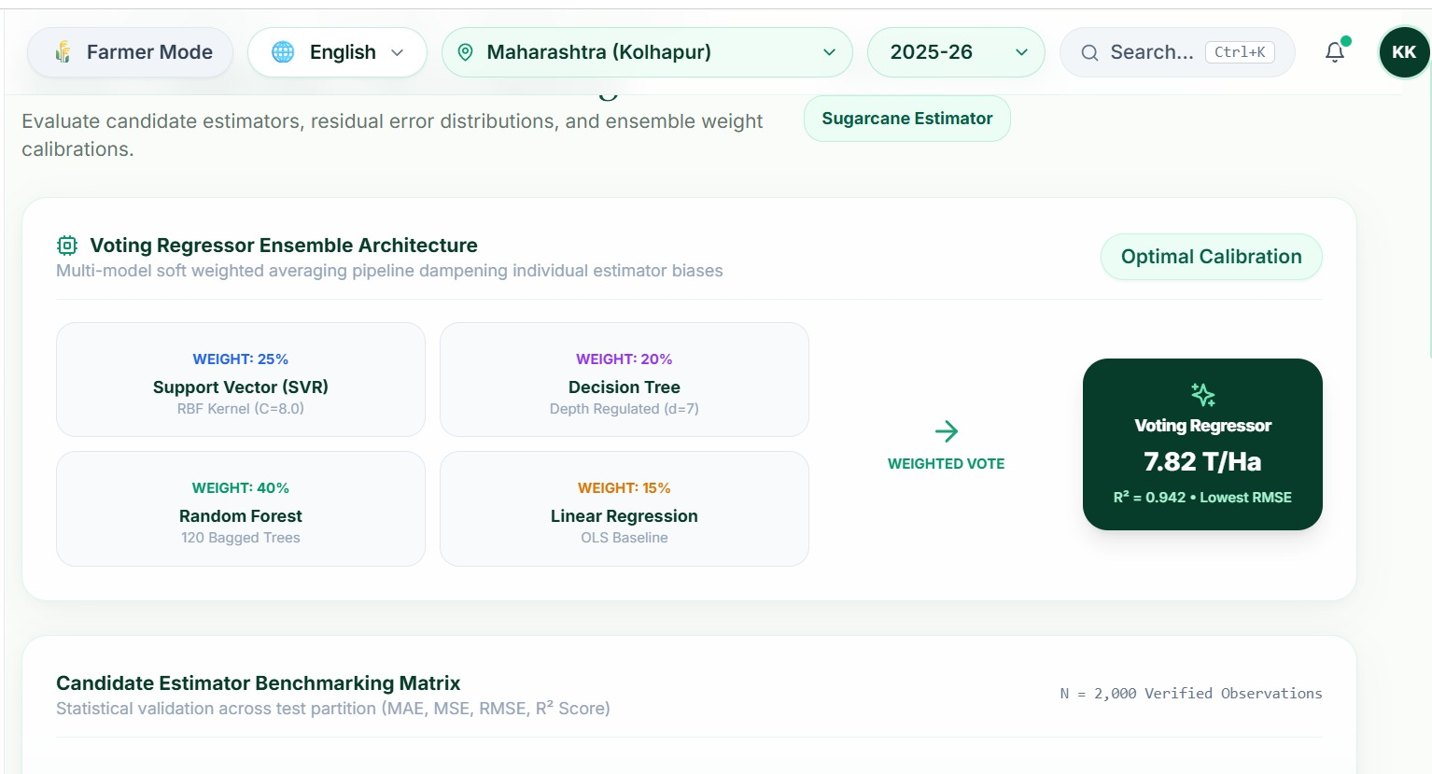
26/06/2026
6

Slide 12
Applications
1) Farm Advisory & Precision Agriculture
Helps farmers plan sowing, irrigation, and input use ahead of El Niño-affected seasons.
2) Crop Insurance
Supports insurers in risk-based premium and payout estimation using predicted yield data.
3) Government & Policy Planning
Assists policymakers in drought preparedness, subsidy planning, and food security assessment.
4) Supply Chain & Agro-Industry
Enables sugar mills processors to plan procurement and processing capacity in advance.
5) Research & Climate Studies
Assists researchers studying the impact of climate variability on cash crop productivity.
26/06/2026
9

Slide 13
Future Scope
IoT & Real-Time Data Integration
Incorporate real-time soil and weather sensor data to improve prediction accuracy.
Additional Crops & Regions
Extend the model to other cash crops and agro-climatic zones.
Advanced Deep Learning Models
Explore LSTM/hybrid deep learning architectures for improved long-term forecasting.
Mobile Application
Develop an Android/iOS app for farmer-friendly access to yield predictions.
Satellite Data Integration
Use remote sensing imagery to monitor crop health alongside climatic data.
Cloud Deployment
Deploy the system on cloud platforms for scalability and wider accessibility.
Early Warning System
Implement automated alerts for anticipated yield loss during El Niño years.
26/06/2026
10

Slide 14
Conclusion
The proposed system integrates crop yield, weather, soil, and El Niño (ONI) climatic data for sugarcane yield prediction.
Linear Regression, Decision Tree, Random Forest, and SVR models are trained and compared.
A Voting Regressor combines the individual models to provide a more robust ensemble prediction.
Model performance is evaluated using RMSE, MAE, and R² Score to assess prediction error and goodness of fit.
The system provides predictions through a web-based dashboard using agricultural and climatic inputs.
The approach demonstrates how ensemble machine learning and ENSO/El Niño information can support data-driven crop planning.
The system can assist farmers, insurers, and policymakers in making more informed decisions under changing climatic conditions.
Overall, the project highlights the potential of machine learning combined with climate indicators for improving agricultural yield prediction and resilience.
26/06/2026
11

Slide 15
References
[1] Van Klompenburg, T., Kassahun, A., & Catal, C., “Crop yield prediction using machine learning: A systematic literature review,” Computers and Electronics in Agriculture, 2020.
[2] Singh et al., “Machine Learning for Crop Yield Prediction: A Comprehensive Review,” 2025.
[3] Das et al., “Sugarcane Yield Prediction Using Machine Learning: A Review,” 2025.
[4] [X] J. G. S. Pedreira, I. M. Fattori Jr., M. dos S. Vianna, and F. R. Marin, “Assessing the impact of El Niño–Southern Oscillation on sugarcane yield and quality in Brazil’s South-Central Region using the DSSAT-CANEGRO model,” Theoretical and Applied Climatology, vol. 157, no. 1, pp. 1–13, 2026, doi: 10.1007/s00704-025-05962-6.
[5] “Advances in artificial intelligence to model the impact of El Niño–Southern Oscillation on crop yield variability,” PMC, National Library of Medicine.
[6] Patel, H. R., Lunagaria, M. M., Pandey, V., Sharma, P. K., Rao, B. B., & Rao, V. U. M., “El Niño episodes and agricultural productivity in Gujarat,” Technical Report No. 01/2014-15, AAU, Anand, Gujarat, 2014.
26/06/2026
12

