Slide 1

Project One: Blood Manganese and Blood Mercury Correlation to Symptoms of Depression
Catherine Sansarricq
Jennifer Ilyayeva
Dhanielle Bermudez

Slide 2
Objective
The primary objective of this analysis is to investigate the possible correlation between Blood Manganese and Mercury levels and feelings of Depression as well as thoughts of Suicide.

Slide 3
Hypotheses
Higher levels of blood mercury may show an increase of reported depressive symptoms and thoughts of suicide.
Higher levels of blood manganese may show decrease of reported depressive symptoms and thoughts of suicide.
Notes:
Depression is a leading cause of disability worldwide, affecting millions of people globally. Many factors can contribute to depression, such as environmental, psychological, genetic factors and more. We wanted to take a look at the effect of some essential elements to our biology and research to see what significance they held in factoring of the human state of depression, if any.

Slide 4
Implications
Understanding the relationship between trace metals like manganese and mercury and mental health can guide future research and clinical practices. If a stronger correlation were found, it could inform dietary recommendations for at risk populations.

Slide 5
Research Q’s
What is the correlation between Blood Manganese and Depression Severity including Suicide Ideation?
What is the correlation between Blood Mercury and Depressioin Severity including suicide ideation?
What are the implications of these findings for Mental Health and Public Health policies?

Slide 6
Key Findings: Blood Manganese lEVELs
Reports based on 2011-2019 NHANES datasets on Blood Manganese levels
Key Groups: Participants were divided into groups based on their blood manganese levels. The lowest group served as a reference point.
Results:
People in the second, third, and fourth groups had slightly lower odds of experiencing depression compared to the lowest group:
Second group: 16% lower odds (not a strong result)
Third group: 7% lower odds (not a strong result)
Fourth group: 9% lower odds (not a strong result)
Continued Analysis:
Doubling manganese levels was linked to a 17% lower risk of depression in women.
In certain ethnic groups, the risk dropped significantly by 70%.
Notes:
Study Overview: Researchers looked at how different levels of manganese (Mn) in the blood relate to the risk of depression among people.
RESULTS
Overall, there was no clear trend indicating that higher manganese levels significantly reduced depression risk (ptrend = 0.640).
CONTINUED ANALYSIS
Women and Different Ethnic Groups
Important Note:
The study found that ethnicity plays a role in how manganese levels affect depression risk, meaning the relationship can vary between different groups of people.

Slide 7
Methodology
Data Source: NHANES
Variables Analyzed
Blood Manganese
Blood Mercury
Depression Indicators
Feeling Depressed- indicated as Depression Severity in the visualization labels
Suicide Ideation
Statistical Analysis
Pearson & Spearman
Anova Tests
Summary statistics

Slide 8
Statistical Analysis – Blood Manganese
,
ANOVA results for Depression Severity Levels: statistic =1.2457, p-value = 0.2915
ANOVA results for Suicidal Ideation Levels: statistic = 0.580, p-value = 0.630
P value high correlations are weak; statistically significant
The statistical analysis revealed a weak negative correlation between blood manganese levels and feelings of depression and thoughts of suicide:
Depression: Spearman Coefficient -0.0267 Pearson Coefficient -0.0168 p-value 0.1291
Suicidal Ideation: Spearman Coefficient –0.0116 Pearson Coefficient 0.0176 p-value 0.6733
This suggests that as blood manganese levels increase, depression severity may decrease slightly, but the correlation is weak and not statistically significant.

Slide 9
Statistical Analysis – Blood Mercury
ANOVA results for Depression Severity Levels: statistic = 4.3907, p-value = 0.0043
ANOVA results for Suicidal Ideation Levels: statistic = 0.8544, p-value = 0.4641
P value high correlations are weak; statistically significant
The statistical analysis revealed a weak negative correlation between blood mercury levels and feelings of depression and thoughts of suicide:
Depression: Spearman Coefficient -0.0542 Pearson Coefficient -0.0611 p-value 0.0020
Suicidal Ideation: Spearmen Coefficient -0.0196 Pearson Coefficient -0.0187 p-value 0.2656
This suggests that as blood manganese levels increase, depression severity may decrease slightly, but the correlation is weak and not statistically significant.

Slide 10
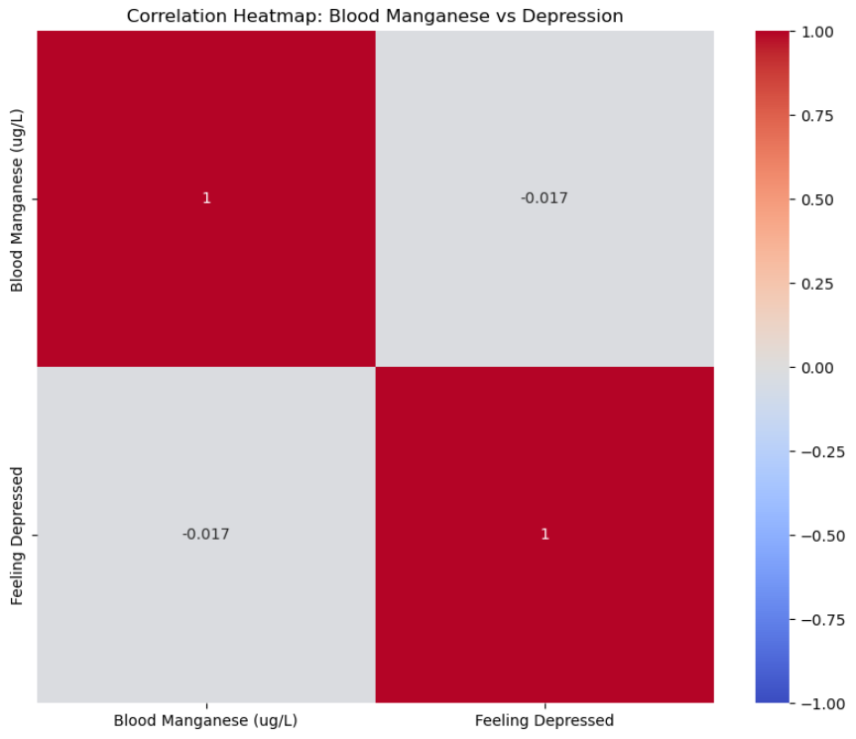
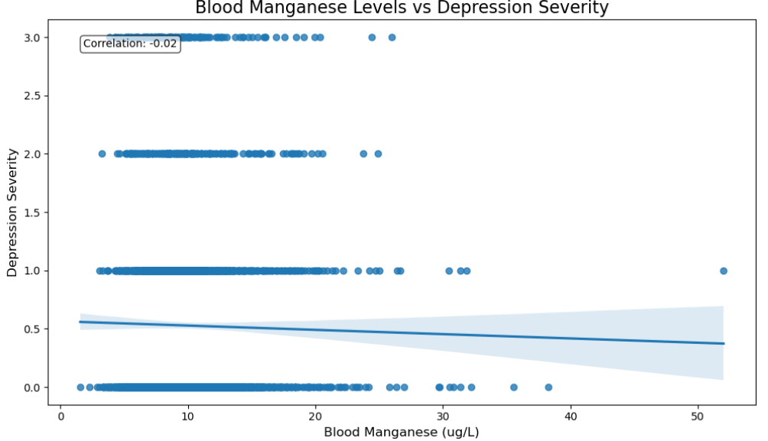
Visual analysis: Blood manganese versus Depression Severity

Slide 11
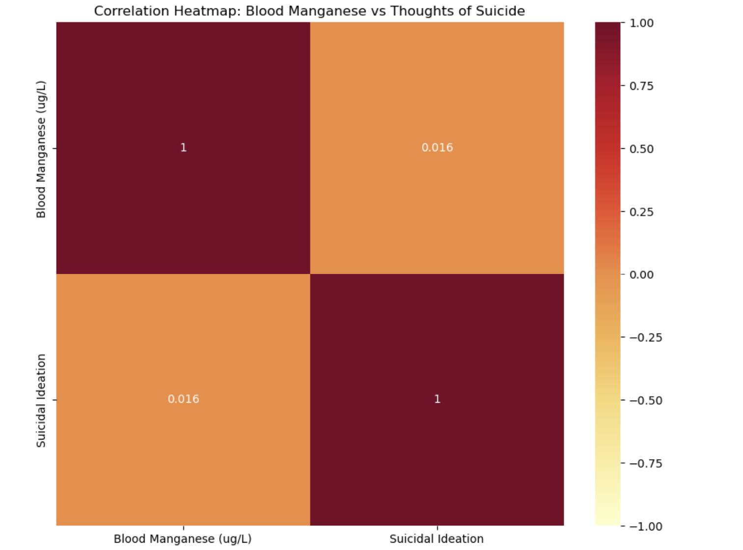
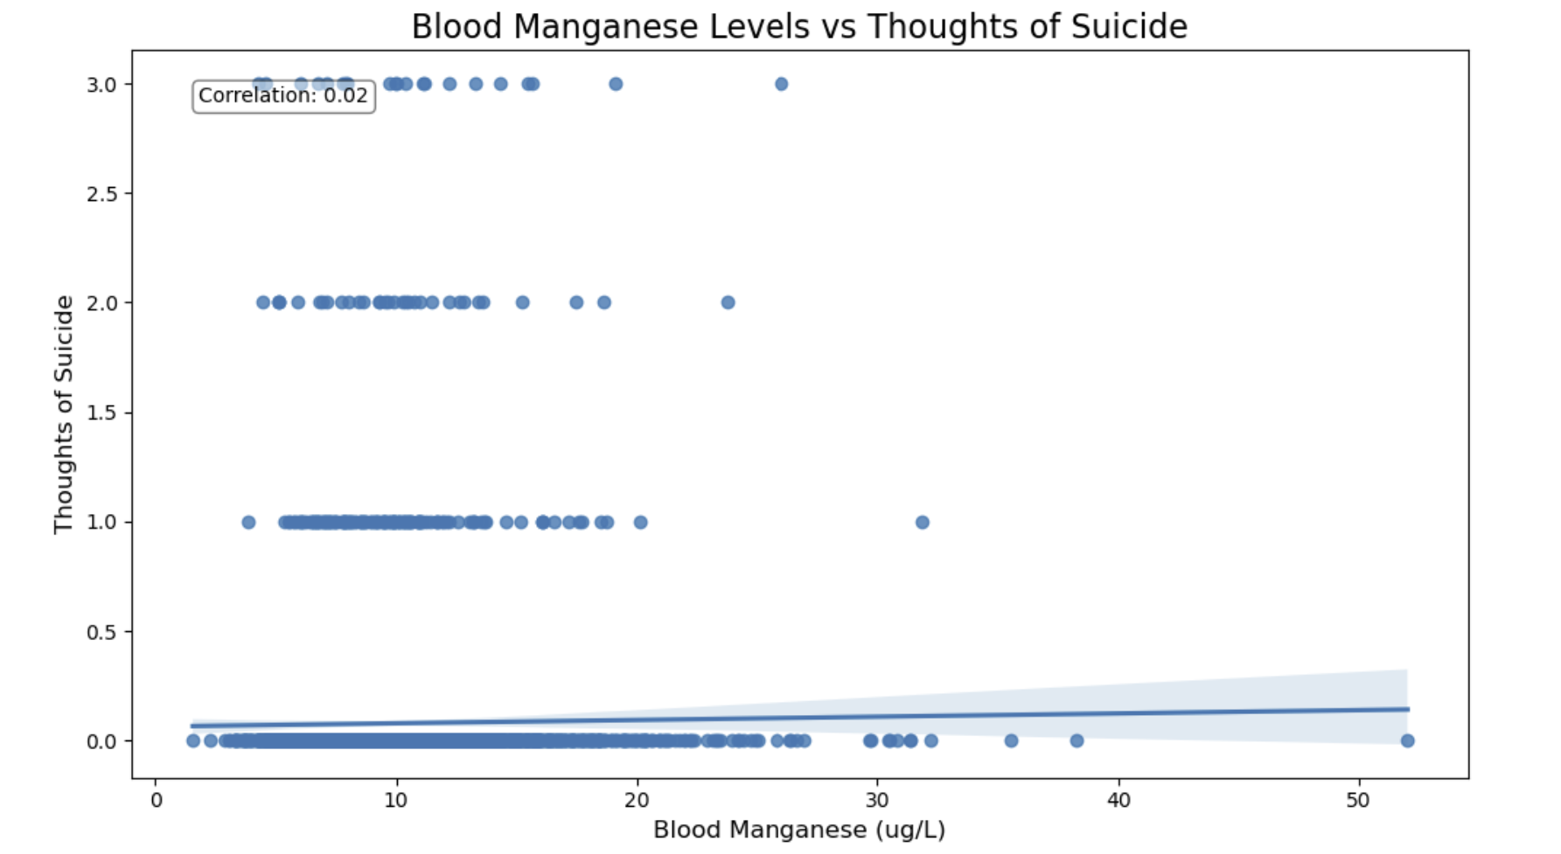
visual analysis: Blood manganese and Suicidal ideation

Slide 12
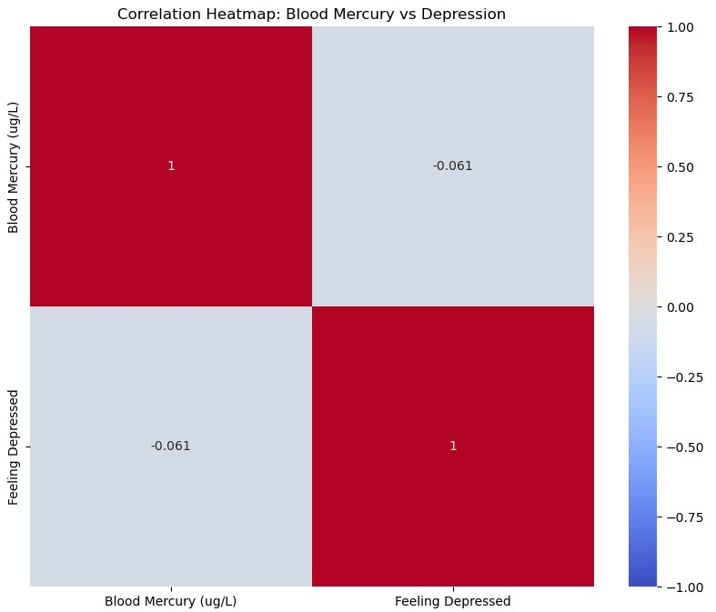
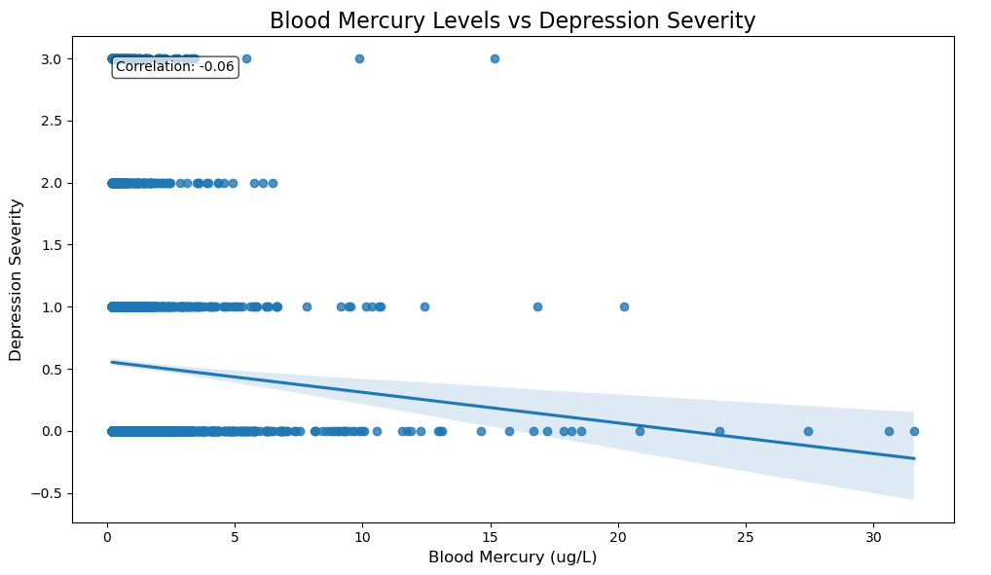
Visual analysis: Blood Mercury versus Depression Severity

Slide 13
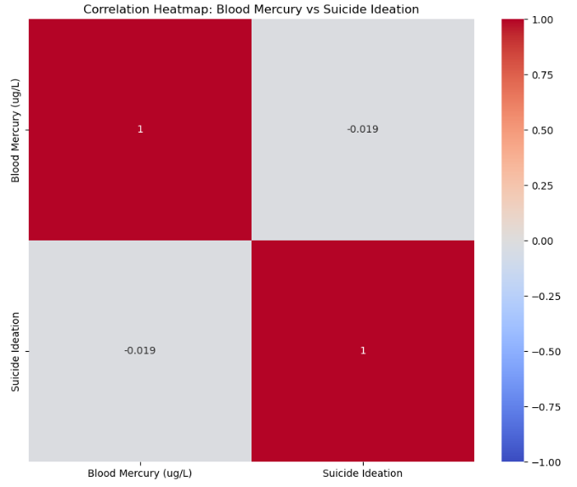
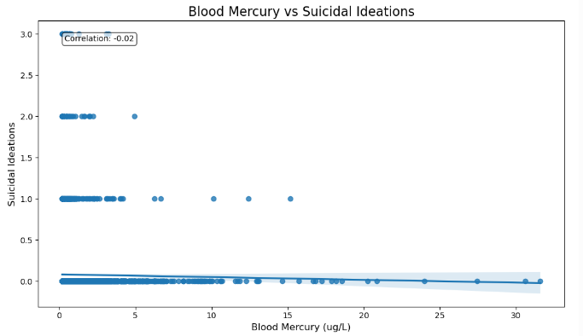
visual analysis: Blood Mercury versus suicide ideation

Slide 14
Answers
What is the relationship between blood manganese levels and feelings of depression?
The analysis shows a weak negative correlation between blood manganese levels and feelings of depression, indicating that higher manganese levels may correlate with lower depression levels, but this finding is not statistically significant
How do blood mercury levels correlate with feelings of depression
A preliminary analysis indicates the need for further research into the correlation between blood mercury levels and depression.
What are the implications of these findings for Mental Health and Public Health policies?
If future studies establish a significant correlation between trace minerals and mental health outcomes, public health initiatives may need to focus on monitoring dietary and environmental exposure to these metals.

Slide 15
Conclusion
Summary: We cannot say with confidence that there is a strong correlation for the level of manganese in the blood and depressive symptoms. There is a strong correlation for the blood mercury levels and less depressive symptoms but both analysis have weak correlations.
Future Research: For future analysis, a much more robust dataset should be sampled. It could also be helpful to have professionals assess the individuals to gather more accurate depression levels. A longitudinal study could also be conducted to see if the changes of manganese and mercury in the blood levels have an effect.

Slide 16
Limitations
Weak negative correlations were observed, although these were not statistically significant, as shown by the p-values obtained from the correlation analysis.
One possible explanation for these results is the sample size it may not be large enough to detect subtle effects that these metals might have.
Depression is a multifactorial condition influenced by biological, psychological, cultural, and environmental factors.
Depressive symptoms were self-reported introducing potential bias into the data.
Blood metal levels were also measured at a single time point, which may not reflect long term exposure.

Slide 17
Questions
Further questions/discussion

Slide 18
References & CITATIONS
https://www.sciencedirect.com/science/article/pii/S0165032723004937?via%3Dihub
https://journals.plos.org/plosone/article/file?id=10.1371/journal.pone.0079339&type=printable
https://wwwn.cdc.gov/Nchs/Nhanes/2017-2018/PBCD_J.htm#SEQN
https://wwwn.cdc.gov/Nchs/Nhanes/2017-2018/DPQ_J.htm#DPQ100

