Slide 1
End to End Data Science Project
Predicting Battery Lifetime
from the first 100 cycles
Jenifar Mazumder · Ironhack Berlin · Data Science & Machine Learning
Severson, K.A., Attia, P.M., Jin, N. et al. Data-driven prediction of battery cycle life before capacity degradation. Nature Energy 4, 383–391 (2019).

Slide 2
THE PROBLEM
2
Testing a battery means killing it
One cycle = one full charge and discharge. To learn a cell's lifetime repeat the cycle until it dies — 148 to 2,300 cycles here.
1.076 Ah
1.080 Ah
0.880 Ah
cycle 1
cycle 100
cycle 636
begin of life
prediction made here
end of life
MODEL SEES
MODEL PREDICTS — 536 cycles, entirely unobserved
The target variable
Why it matters commercially
End of life = the cycle at which discharge capacity falls to 0.88 Ah, i.e. 80% of the 1.1 Ah nominal. Modelled as log₁₀.
A manufacturer screening 50 charging protocols commits years of machine time. Predicting at cycle 100 turns qualification into a ~10× faster screening step.

Slide 3
THE DATA
4
Matlab: three nested levels
2017-05-12_batchdata.mat × 3 files
MATLAB v7.3 = HDF5
scipy.io.loadmat fails outright. h5py required.
cell b1c5 × 46 cells per file
policy · cycle_life
summary → one NUMBER per cycle
Nothing is stored inline
QDischarge · IR · chargetime … 1,073 rows
Every field is an object reference — an address, not data. f1[batch1['summary'][i,0]] follows the pointer.
cycles → one CURVE per cycle
Flattening was step one
Qdlin: 1,000 points, 3.5 V → 2.0 V
plus full V, I, T, t traces
140 records extracted into one table, one row per cell, before any analysis could begin.
~8 GB of raw files · ~96,700 cycles · 1,000 points each
124 commercial LFP cells · 72 fast-charging protocols · identical 4C discharge · MIT / Stanford / TRI
reduced to a table of 122 rows × 8 features
Reference:
Severson, K.A., Attia, P.M., Jin, N. et al. Data-driven prediction of battery cycle life before capacity degradation. Nature Energy 4, 383–391 (2019).
https://doi.org/10.1038/s41560-019-0356-8

Slide 4
DATA QUALITY & CLEANING
5
140 records → 122 usable cells
Batch | Recorded | Raw | Clean
1 | May 2017 | 46 | 36
2 | June 2017 | 48 | 43
3 | April 2018 | 46 | 43
Total |  | 140 | 122
cells that never died
7
Q_last > 0.885 Ah — a cell that crossed the 0.88 threshold cannot finish above it. Their "lifetime" is just where the test stopped.
records that are 5 cells
10
Half the life in batch 1, half in batch 2 under new IDs. Their "cycle 10" comes from a cell already past 1,000 cycles.
Batch 3 is a year later
Manufactured and cycled ~11 months after batches 1 and 2. I treated it as a future production run and sealed it from the start.
broken measurement
1
z = −3.22 on log_var_dQ. Its ΔQ curve claims +1% capacity gain. Cells do not gain capacity — that is instrumentation.
Every exclusion was derived from the data first, then checked against the paper's published list. Where they disagree, I kept mine.

Slide 5
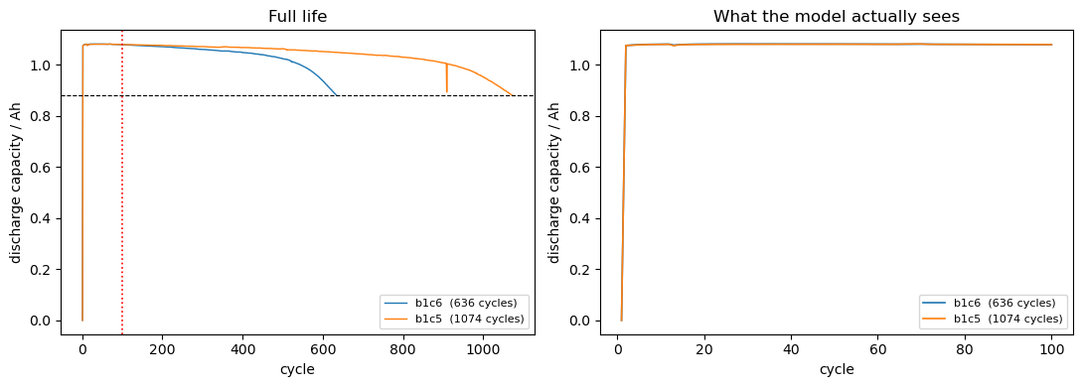
THE CATCH
3
At cycle 100, nothing has happened yet
Two cells from this dataset. Same batch, near-identical start, and both charged hard. One dies at 636 cycles, the other at 1,074.
Capacity goes UP
Both cells gain ~0.3% capacity over the first 100 cycles. There is no fade to measure — the cells are still breaking in.
Starting capacities differ by 0.0005 Ah — five ten-thousandths. Lifetimes differ by 69%.
left = full life · right = first 100 cycles only
Cell | Policy | Q@2 | Q@100 | Change | Cycle life | log_var_dQ
b1c6 | 4.8C(80%)-4.8C | 1.0758 | 1.0792 | +0.32% | 636 | −3.77
b1c5 | 4.4C(80%)-4.4C | 1.0761 | 1.0798 | +0.34% | 1074 | −4.18
The only column that separates them is the last one.
Charging policy explained in the feature section.

Slide 6
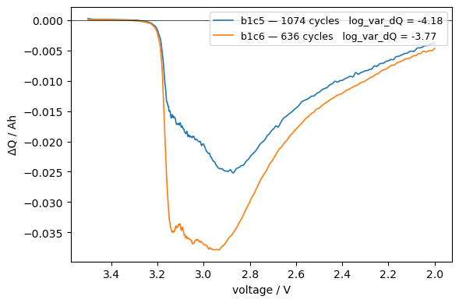
FEATURE ENGINEERING
6
Stop asking "how much". Ask "where".
Q(V) is not a number — it is a 1,000-point curve. Every cycle sits on the same fixed voltage grid, so two cycles can be subtracted point by point:
ΔQ(V) for 2 cell
ΔQ(V) = Q₁₀₀(V) − Q₁₀(V)
The result is another 1,000-point curve. Its LAST point is the capacity difference from slide 3 — the one thing that was useless. The other 999 are new.
Why variance, not mean?
The mean of ΔQ just recovers the capacity difference. Variance measures whether the difference has STRUCTURE — flat curve, low variance; deep localised trough, high variance.
Comparing the two cells: b1c6 (636 cycles) troughs at −0.035 Ah, b1c5 (1074 cycles) at −0.025. The shorter-lived cell has already reorganised more by cycle 100 — while its capacity still reads nominal.

Slide 7
FEATURE ENGINEERING
7
Nine candidates. Three survived.
Candidate | Hypothesis | Rejected on | Evidence
log_var_dQ | Curve distortion precedes capacity loss | — | strongest single predictor | KEEP
Q_initial | More starting capacity = more to lose | — | test r² 0.674 → 0.764, gap 0.090 → 0.054 | KEEP
IR_initial | Worse-formed interface = higher R | measurement noise | test r² → 0.525, gap → 0.317 | reject
ir_delta | Resistance growth tracks SEI growth | physically impossible | 43% of cells negative; scatter 12× the mean | reject
q_slope | Rate of capacity loss | 19/46 positive slope; due to break-in process | median fit r² 0.147 | reject
min_dQ | Trough depth may beat variance | redundant | r = −0.94 with log_var_dQ | reject
dq_skew · dq_kurt | Higher moments carry extra shape | no effect | Δr² of 0.000 and +0.002 — inside noise | reject
charging policy (6) | The only deliberate experimental variable | — | CV r² 0.838 → 0.859, fold σ 0.040 → 0.017 | KEEP
Charging policy decoded
Policy was added last — and I was wrong about it
4.4C(80%)-4.4C = charge at 4.4C to 80% state of charge, then 4.4C. C-rate = fraction of capacity per hour, so 4C fills the cell in 15 minutes.
A single 70/30 split rejected it (0.764 → 0.743). Cross-validation reversed that. At n=79 one split is not a reliable instrument.

Slide 8
FEATURE ENGINEERING
8
The obvious feature does not exist yet
Everyone's first instinct: fit a line to capacity over cycles 2–100 and take the slope.
q_slope
ir_delta
median fit r² = 0.147
53 of 122 negative
The line explains 15% of the variation for the median cell, under 3% for the lowest quartile. And 19 of 46 cells have a POSITIVE slope — capacity rising, which is the cell breaking in, not degrading.
43% of cells show resistance FALLING over 100 cycles. Mean −0.000033, std 0.000411 — the scatter is 12× the signal. A near coin-flip is what pure noise looks like.
Both fail a physical consistency check with no reference to the target.
A feature that reports the wrong direction for half its rows cannot be measuring what it claims to. That rejection holds even on unlabelled data — it is stronger than a poor r².
This is why the project exists: if capacity slope worked, you would extrapolate the fade curve and go home.

Slide 9
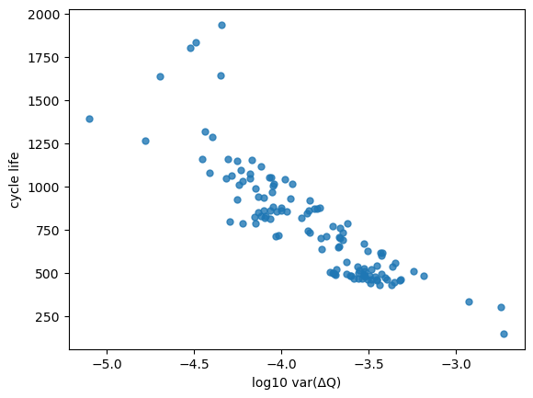
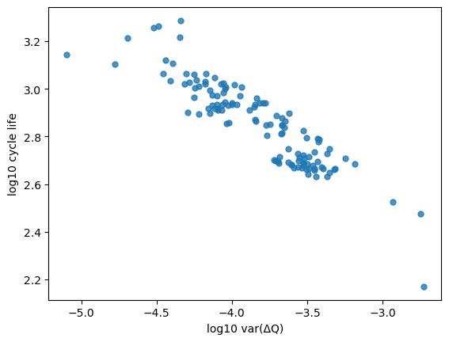
MODELLING TARGET
9
Why both axes are logged
log_var_dQ bin | mean life | CV of raw | σ of log
(−5.10, −4.51] | 1524 | 0.158 | 0.069
(−4.51, −3.91] | 1018 | 0.245 | 0.092
(−3.91, −3.32] | 587 | 0.235 | 0.096
(−3.32, −2.73] | 373 | 0.372 | 0.203
raw cycle_life — curved
log_life — straight
Being honest about this one
Target | r | r²
cycle_life (raw) | −0.867 | 0.751
log₁₀(cycle_life) | −0.905 | 0.818
I ran this to check homoscedasticity — whether residual spread is constant across the feature range, which is what linear regression assumes.
It is not. Both columns rise. Logging does NOT stabilise the variance here, so the justification rests on linearity alone.
Residual variance still grows with the feature. That is exactly why the interval analysis later matters.
The raw scatter is visibly curved; the logged one is straight. log_var_dQ already spans orders of magnitude, so a logged feature against a raw target produces a curve by construction.

Slide 10
METHOD
10
One decision made before any model was fitted
Batch 3 was sealed from the start.
Experiment 1
Metrics, fixed in advance
Train on batches 1 & 2 (2017 data) — 79 cells
Test on sealed batch 3 (2018 data) — 43 cells
r² on log_life the modelling target
MAPE on cycles comparable to the paper's benchmark
Mean absolute percentage error
"Will this work on next year's production run?"
train − test gap overfitting diagnostic
Model selection happens inside the development set only — 70/30 split for screening, then 5-fold CV.
fold-to-fold σ stability. At n=79 this matters more than the mean
Models compared: Linear · Ridge · Random Forest · Gradient Boosting, each inside a StandardScaler pipeline so scaling is refitted within every fold and cannot leak.

Slide 11
EXPERIMENT 1
11
Cross-validation picks Gradient Boosting
Development set only — batches 1 & 2, 5-fold
Then I opened batch 3
Model | Feat | CV r² | σ | Overfitting
GradBoost | 8 | 0.810 | 0.051 | 0.189
Random Forest | 8 | 0.801 | 0.082 | 0.166
Random Forest | 2 | 0.796 | 0.062 | 0.174
GradBoost | 2 | 0.794 | 0.042 | 0.203
Linear | 8 | 0.783 | 0.063 | 0.085
Ridge | 8 | 0.782 | 0.057 | 0.085
Linear | 2 | 0.746 | 0.083 | 0.064
Linear | 1 | 0.660 | 0.121 | 0.088
Model | Feat | r² | MAPE
Linear | 8 | +0.557 | 12.74%
Linear | 2 | +0.499 | 12.91%
Ridge | 8 | +0.458 | 14.17%
GradBoost | 2 | −0.319 | 19.41%
Random Forest | 2 | −0.426 | 19.28%
Random Forest | 8 | −0.978 | 23.79%
GradBoost | 8 | −1.389 | 26.92%
First place → last place.
GridSearchCV over 16 configurations returned the same 0.810. Not a tuning artefact.
Negative r² = worse than predicting the training mean. And monotonically worse with more features: RF 0.080 → −0.426 → −0.978.
0.027 apart, against fold σ of 0.051 and 0.063. CV cannot separate these two.
The trees did not degrade. They inverted.

Slide 12
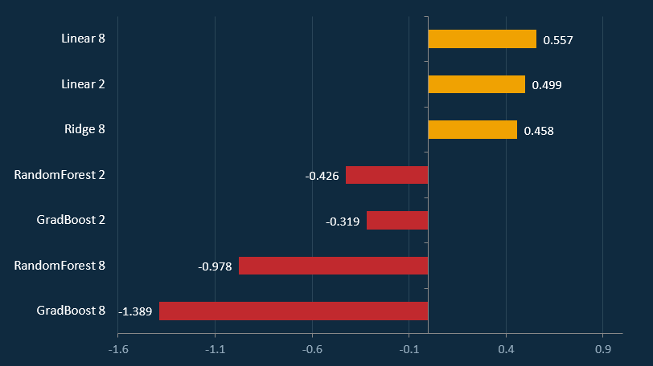
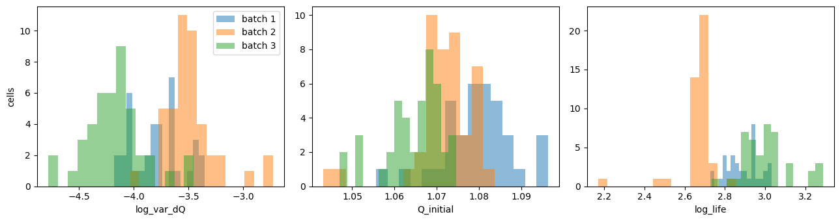
EXPERIMENT 1
Diagnosis and Model performance on batch 3
Observations:
Batch 3’s feature distributions shift strongly (log_var_dQ, Q_initial, log_life).
What does it mean?
log_var_dQ distribution in batch 3 is shifted.
Q_initial is slightly different.
log_life distribution is different different degradation behaviour.

Slide 13
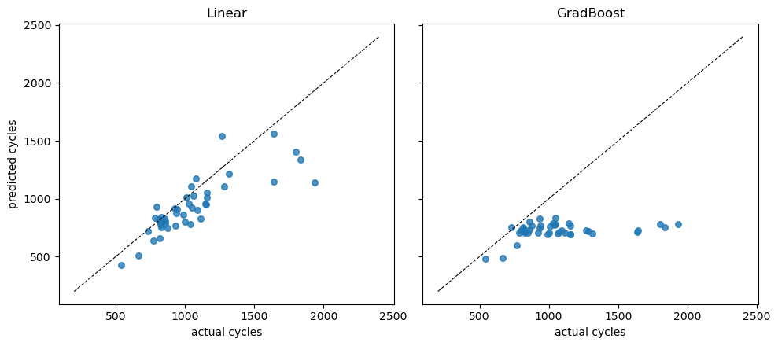
DIAGNOSIS
12
Covariate shift: the inputs moved, not the physics
 | dev (1–2) | batch 3
log_var_dQ mean | −3.618 | −4.173
range | −4.179 to −2.727 | −4.779 to −3.452
log_life mean | 2.768 | 3.006
range | 2.170 to 3.031 | 2.733 to 3.287
Batch 3's MEAN sits at the development set's MINIMUM. Its cells are systematically longer-lived and lower-variance than anything in training.
A tree averages the training samples in a leaf, so beyond the training range it returns a flat band — visible on the right. A linear model continues its fitted slope: offset low, but still tracking direction.
Which leaves a question
Is the feature set weak and only looked good on the development set — or are the features fine and batch 3 simply a different population?
Experiment 1 cannot tell these apart.
Covariate shift: the input distribution moved between production runs. The input–output relationship did not.

Slide 14
METHOD
13
A second question the first experiment cannot answer
Two explanations fit the collapse
Either the feature set is weak and only looked good on the development set — or the features are fine and batch 3 is simply a different population.
Experiment 2
How it separates them
Pool all three batches — 121-122 cells
5-fold cross-validation
If the feature set were weak, it would be weak here too — pooling does not make bad features good.
If the features hold up when populations match, then the problem was the population.
"How much signal do these features carry when training and deployment populations match?"
This is a diagnostic, not a second attempt at the deployment question.
Pooling puts batch-3 cells on both sides of every split — it removes the shift from the evaluation, not from the problem. Same models, same metrics, same seed as Experiment 1, so any difference is attributable to the pooling and nothing else.

Slide 15
EXPERIMENT 2
14
The features are fine
Model | Feat | n | Train r2 | CV r2 | σ | Overfitting
Ridge | 8 | 121 | 0.894 | 0.861 | 0.016 | 0.033
Linear | 8 | 121 | 0.894 | 0.859 | 0.017 | 0.035
Random Forest | 8 | 121 | 0.978 | 0.841 | 0.030 | 0.137
Linear | 2 | 122 | 0.859 | 0.838 | 0.040 | 0.021
Random Forest | 2 | 122 | 0.978 | 0.816 | 0.058 | 0.162
Linear | 1 | 122 | 0.830 | 0.810 | 0.027 | 0.020
GradBoost | 8 | 121 | 0.996 | 0.807 | 0.051 | 0.189
GradBoost | 2 | 122 | 0.992 | 0.797 | 0.112 | 0.195
The gap separates cleanly
Linear & Ridge 0.020 - 0.035
Trees 0.137 - 0.195
No overlap, on 79 cells and on 122. A property of the model families, not of sample size.
Not an improvement
0.557 to 0.859 is a different question, not progress. Pooling puts batch-3 cells on both sides of every split.
And the features degrade too - linear only reached 0.557 there. They degrade gracefully; they do not survive intact.
CV r2 0.859 when populations match, against 0.557 on batch 3.
Weak features would have failed here too. The batch-3 failure was the population, not the feature set.
Notes:
This slide summarizes the second experiment, where we tested whether the feature set itself was responsible for the poor performance on batch 3. The main takeaway is simple: the features are fine. When we train and validate on matching populations, the models perform extremely well. Look at the Ridge and Linear models with 8 features. Both achieve around 0.86 CV R², with very low variance. That’s strong, stable performance, and it shows the feature set is predictive.
Now compare that to batch 3, where the same model drops to 0.557 CV R². That’s a huge gap — and the important part is that the features didn’t suddenly become weak. The population changed. This experiment confirms that the feature engineering is good. The real issue is distribution mismatch, not feature quality.

Slide 16
INTERPRETABILITY
15
Useful features, uninterpretable coefficients
Feature set | n | CV r2
log_var_dQ | 122 | 0.810 +/- 0.027
Q_initial alone | 122 | -0.013 +/- 0.029
policy (6) alone | 121 | 0.240 +/- 0.190
log_var_dQ + Q_initial | 122 | 0.838 +/- 0.040
log_var_dQ + policy | 121 | 0.828 +/- 0.014
all 8 | 121 | 0.859 +/- 0.017
Feature | Effect of +1 sd on log life
log_var_dQ | -0.187 correct, dominant
Q_initial | +0.034 physically sensible
c_max | +0.033 contradicts the physics
soc_switch | +0.026 no clean expectation
c1 | -0.019 right sign, negligible
Standardised: every feature rescaled to mean 0, sd 1 before fitting, so the eight weights are comparable.
c_max positive says harder charging extends life. It does not - that is the premise of the whole dataset.
c_avg, c_max and charge_t are arithmetic functions of c1, c2 and soc_switch: collinear by construction.
Q_initial alone predicts worse than the mean. The six protocol parameters alone reach 0.240 with a spread nearly as large as the score. Together with log_var_dQ they add 0.049 and more than halve the fold variance.
Features that predict nothing alone but help in combination are doing statistical work, not physical work.
I use them because they measurably improve the model. I do not interpret them. Only log_var_dQ and Q_initial carry a defensible physical reading.

Slide 17
MODEL FAMILIES
16
A neural network, and why it lost
Model | Test r2 | MAPE
NN seed 0 | 0.733 | 14.94%
NN seed 7 | 0.738 | 13.91%
NN seed 42 | 0.765 | 12.75%
Linear - same split | 0.822 | 11.81%
217 parameters, 68 training cells
and it surrendered 17 more to early stopping that the linear model was free to use
The relationship is already linear
r = -0.905 once both axes are logged. Little curvature left for extra capacity to exploit
16 -> 8 -> 1, ReLU, Adam, early stopping, two features. 68 cells train, 17 validate, 37 test.
The features combine additively
The seed alone moves the score by 0.032. Identical data, identical architecture - only the random initialisation differs. There is no single number to report.
Slide 15 showed no interactions to find - exactly the structure linear regression assumes
Why only two features?
My first version validated on the test set
An 8-feature version diverged at learning rate 0.01 - r2 between -0.7 and -8.1 across seeds. I dropped it rather than tune: it had already lost at two features, and the features are additive. The comparison shown is like-for-like - same split, same 37 test cells, same two features.
EarlyStopping chose the weights using the data I then scored on. I caught it and rebuilt with a proper validation split carved out of the training data. The honest number is lower.

Slide 18
SELECTION
17
The gap predicted the failure. The score did not.
Same four models, both experiments
SELECTED MODEL
Model | Exp 1 CV r2 | gap | Exp 2 CV r2 | Overfitting
GradBoost 8 | 0.810 1st | 0.189 | 0.807 4th | 0.189
Random Forest 8 | 0.801 2nd | 0.166 | 0.841 3rd | 0.137
Linear 8 | 0.783 3rd | 0.085 | 0.859 2nd | 0.035
Ridge 8 | 0.782 4th | 0.085 | 0.861 1st | 0.033
Linear regression
8 features
CV r2 0.859 +/- 0.017
Batch 3 r2 0.557
Batch 3 MAPE 12.74%
The score reorders. The gap does not.
Why not Ridge?
Ridge leads by 0.002 in pooled cross-validation, against a fold spread of 0.016. That is noise.
Linear leads by 0.099 on sealed batch 3 - the only comparison made on data neither model had seen.
I selected on the sealed result.
GradBoost ranks 1st then 4th. Ridge ranks 4th then 1st. But every tree gaps 0.137-0.189 and every linear model 0.033-0.085 - no overlap, either time.
A train r2 of 0.996 is a warning, however good the CV score looks.
That separation was on screen at slide 11 - before batch 3 was ever opened.
Notes:
This is the part I’d take with me to the next project.
Look at the rank markers. Gradient Boosting is first in Experiment 1 and fourth in Experiment 2. Ridge is fourth and then first. The score reorders depending on how you evaluate.
The gap doesn’t. Every tree model, 0.14 to 0.19. Every linear model, 0.03 to 0.09. Both experiments, both sample sizes.
A training r-squared of 0.996 is a warning, however good the cross-validated score looks
So the selected model is linear regression on eight features. 0.859 cross-validated, 12.74 percent average error.
If you ask me why not Ridge, since it scores 0.861. Two reasons. That lead is 0.002 against a fold spread of 0.016, so it’s noise. And on the sealed batch, Ridge gets 0.458 against linear’s 0.557 — the only comparison made on data neither model had seen. I selected on that.

Slide 19
UNCERTAINTY
18
Every miss was in the same direction
A cell predicted at 1,000 cycles could be anywhere from 730 to 1,270.
For a manufacturer that is the difference between qualifying a protocol and rejecting it. The interval is +/-27%, from a residual spread of 0.0532 in log life.
Interval | 8-feature | 2-feature
+/-1.96 sigma | +/-27% -> 84% | +/-32% -> 84% | same coverage
+/-2.5 sigma | +/-36% -> 93% | +/-43% -> 93% | same coverage
+/-3.0 sigma | +/-44% -> 98% | +/-54% -> 98% | same coverage
Seven cells is a small sample
One-directional errors in seven could occur by chance about once in 64. On its own this is suggestive, not conclusive.
The narrower interval brackets exactly the same cells. That rules out imprecision as the cause.
Cell | Actual | Predicted | Error | log_var_dQ
b3c38 | 1935 | 1139 | -41% | -4.342
b3c42 | 1642 | 1150 | -30% | -4.346
b3c7 | 1836 | 1336 | -27% | -4.489
What makes it convincing
Batch 3 sits distribution-shifted. The trees collapsed exactly as extrapolation predicts. Narrowing the interval changed coverage not at all. Five of seven sit below log_var_dQ -4.0.
Four independent signs, one direction.
3 of the 7 cells outside the interval. All seven were under-predicted, by 22% to 41%. Not one over-predicted.

Slide 20
Conclusions
1
Model architecture matters
Linear models degrade gracefully under drift; tree models collapse when forced to extrapolate.
2
Watch the gap, not just the score
Train r2 0.996 is a warning however good the CV looks. The gap separated the model families before the sealed set was opened.
3
The simplest model won - for a reason
Not because simple is virtuous. Because it was the only family that could extrapolate.
4
Uncertainty must be population‑aware
Confidence intervals only hold inside the measured region; automatic out‑of‑range checks matter more than tighter intervals.
The feature is from Severson et al. The covariate-shift finding, the exclusions and the uncertainty analysis are mine.

Slide 21

19
A tool, not just a notebook
Notes:
[13:55-14:20] Short. If demoing live: click ONE in-range cell and ONE that triggers the out-of-range warning. Nothing else.

