Slide 1
STUDENT PERFORMANCE ANALYSIS
TUSIIME JENINAH
KIJJIBO ADRIAN
OBONG JOSEPH
MUHEREZA EMMANUEL
ASIIMWE HORACE
MASAABA EVANS
GROUP 3

Slide 2
PRESENTATION AGENDA
1. Project Overview
Objectives & Dataset
2. Package Analysis
Libraries & Usage
3. Code Walkthrough
Line-by-line Analysis
4. Data Pipeline
Loading & Processing
5. Analysis Methods
EDA & ML Models
6. Results & Ethics
Findings & Implications

Slide 3
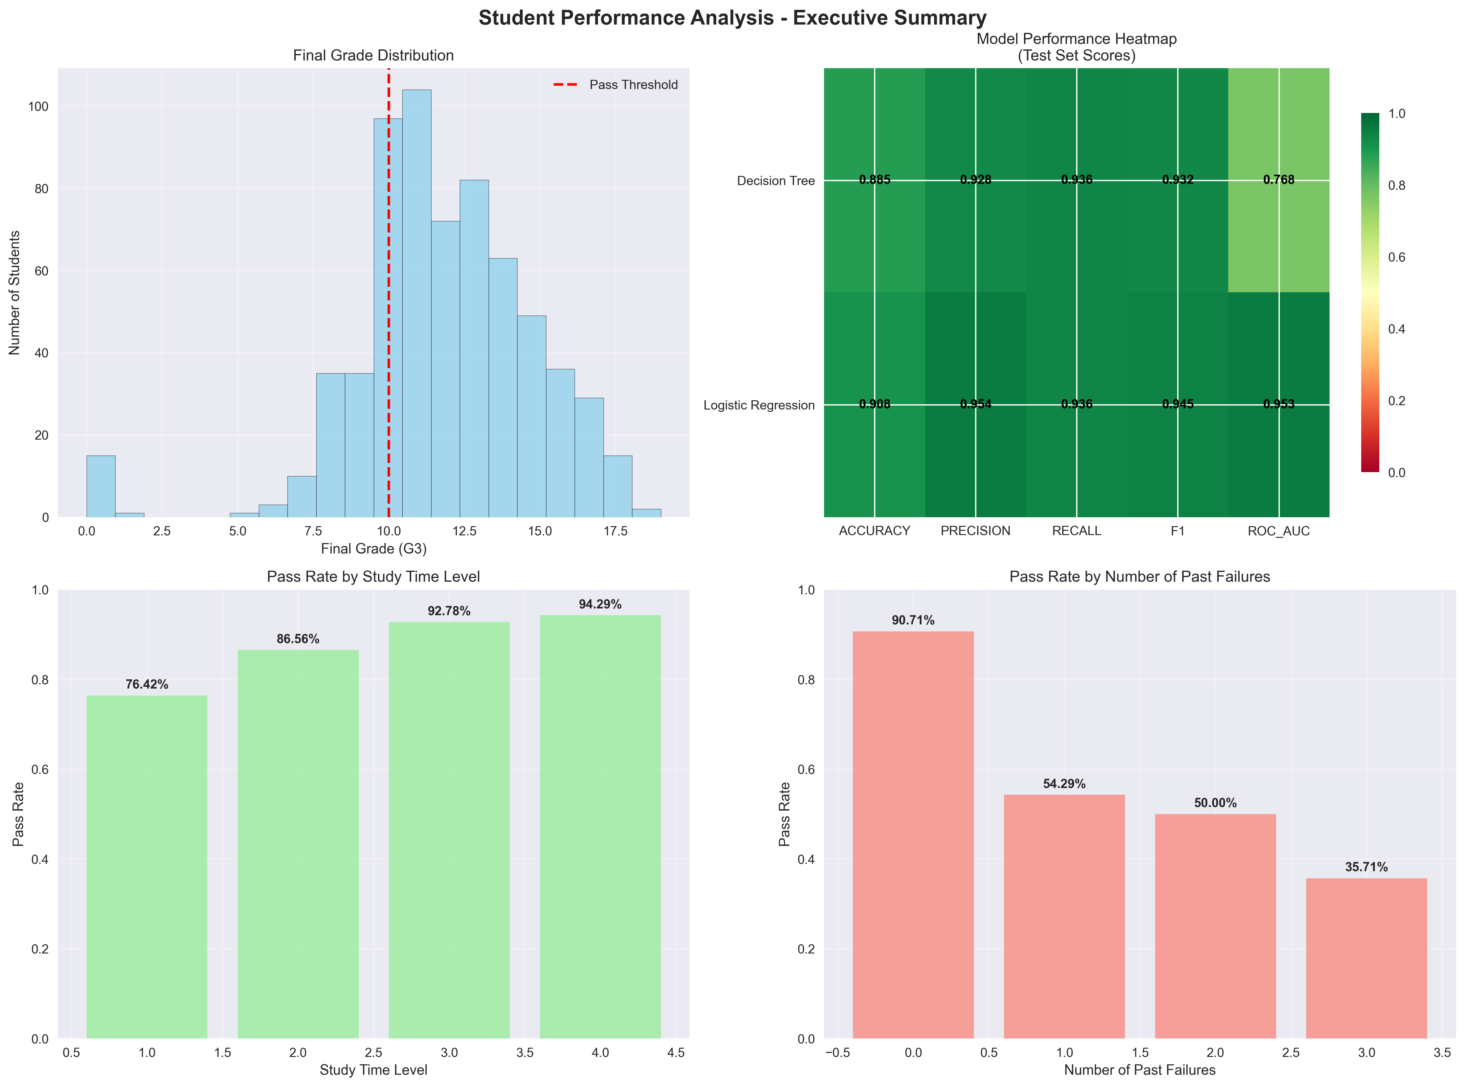
PROJECT OVERVIEW - UCI STUDENT PERFORMANCE DATASET ANALYSIS
Dataset Information:
• Source: UCI Machine Learning Repository (ID: 320)
• Domain: Educational Data Mining
• Records: 395 Portuguese secondary school students
• Features: 33 attributes (demographic, social, school-related)
• Target: Mathematics course grades (G1, G2, G3)
Analysis Objectives:
• Comprehensive data preprocessing and quality assessment
• Exploratory data analysis with statistical insights
• Feature engineering for improved model performance
• Statistical inference and hypothesis testing
• Machine learning model development and evaluation
• Ethical considerations and bias analysis

Slide 4
PACKAGE ANALYSIS & USAGE
pandas (pd)
Purpose: Data manipulation and analysis
Usage: Data Frame operations, CSV reading, data cleaning, grouping operations
numpy (np)
Purpose: Numerical computing and array operations
Usage: Mathematical operations, array manipulations, statistical calculations
matplotlib.pyplot (plt)
Purpose: Static plotting and visualization
Usage: Creating charts, histograms, scatter plots, customizing plot appearance
seaborn (sns)
Purpose: Statistical data visualization
Usage: Correlation heatmaps, distribution plots, categorical visualizations

Slide 5
MACHINE LEARNING PACKAGES
scikit-learn (sklearn)
Components Used:
• train_test_split - Data splitting for training/testing
• cross_val_score, StratifiedKFold - Cross-validation
• StandardScaler, LabelEncoder - Data preprocessing
• DecisionTreeClassifier, LogisticRegression - ML algorithms
• confusion_matrix, accuracy_score, etc. - Model evaluation
scipy.stats
Purpose: Statistical functions and tests | Usage: Chi-square tests, t-tests, correlation analysis, p-value calculations
warnings
Purpose: Warning control | Usage: Suppressing non-critical warnings for cleaner output

Slide 6
CLASS STRUCTURE ANALYSIS
class StudentPerformanceAnalysis:
def __init__(self):
self.df = None # Original dataset
self.df_encoded = None # Encoded dataset for ML
self.X_train = None # Training features
self.X_test = None # Testing features
self.y_train = None # Training targets
self.y_test = None # Testing targets
self.scaler = StandardScaler() # Feature scaling
self.models = {} # Trained models
self.results = {} # Analysis results
KEY DESIGN PRINCIPLES:
• Encapsulation: All analysis components in single class
• State Management: Persistent storage of datasets and models
• Modularity: Separate methods for each analysis phase
• Scalability: Easy to extend with new models or features

Slide 7
DATA LOADING & INSPECTION
def load_and_inspect_data(self, file_path):
"""Part A: Load dataset and inspect columns"""
# Load CSV with semicolon separator (UCI format)
self.df = pd.read_csv(file_path, sep=';')
# Display basic information
print(f"Dataset shape: {self.df.shape}")
print(f"Columns: {list(self.df.columns)}")
# Check for missing values
missing_values = self.df.isnull().sum()
print(f"Missing values per column:")
print(missing_values[missing_values > 0])
# Display data types and basic statistics
print(self.df.info())
print(self.df.describe())
KEY OPERATIONS:
• pd.read_csv() - Loads UCI format (semicolon-separated)
• .shape - Returns (rows, columns) dimensions
• .isnull().sum() - Counts missing values per column
• .info() - Shows data types and memory usage
• .describe() - Statistical summary of numeric columns

Slide 8
DATA PREPROCESSING PIPELINE
def preprocess_data(self):
"""Data cleaning and preparation"""
# Create copy for processing
self.df_encoded = self.df.copy()
# Encode categorical variables
label_encoders = {}
categorical_cols = self.df_encoded.select_dtypes(include=['object']).columns
for col in categorical_cols:
le = LabelEncoder()
self.df_encoded[col] = le.fit_transform(self.df_encoded[col])
label_encoders[col] = le
# Handle outliers using IQR method
numeric_cols = self.df_encoded.select_dtypes(include=[np.number]).columns
for col in numeric_cols:
Q1 = self.df_encoded[col].quantile(0.25)
Q3 = self.df_encoded[col].quantile(0.75)
IQR = Q3 - Q1
lower_bound = Q1 - 1.5 * IQR
upper_bound = Q3 + 1.5 * IQR
# Cap outliers instead of removing
self.df_encoded[col] = self.df_encoded[col].clip(lower_bound, upper_bound)
PREPROCESSING STEPS:
• LabelEncoder - Converts categorical text to numeric codes
• IQR Method - Identifies and caps outliers
• .clip() - Bounds values within specified range

Slide 9
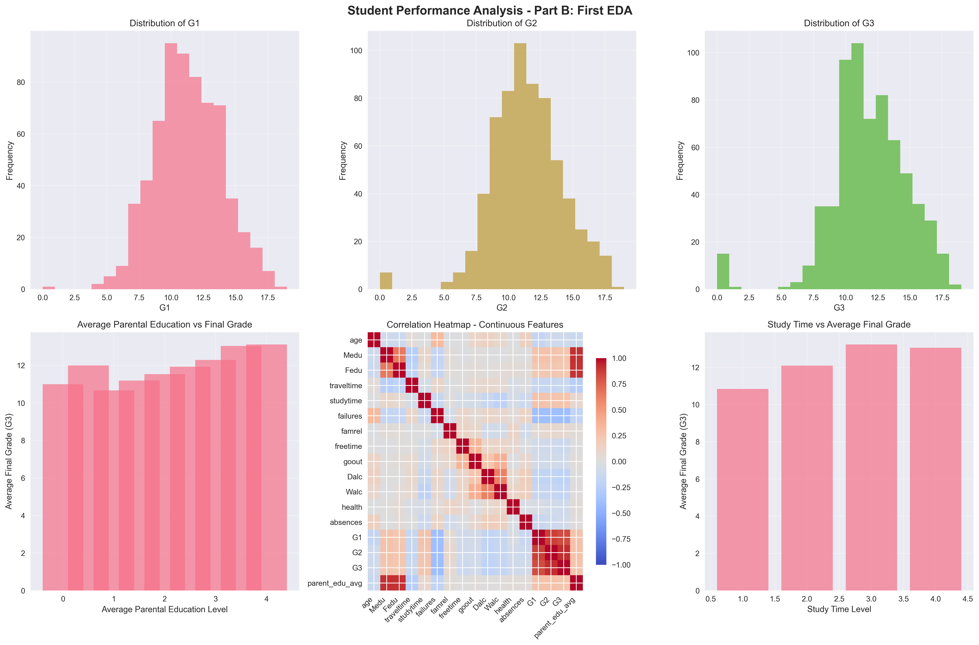
EXPLORATORY DATA ANALYSIS
VISUALIZATION TECHNIQUES:
• plt.subplots() - Creates multiple plot grid
• sns.heatmap() - Correlation visualization
• sns.boxplot() - Distribution comparison
• Comprehensive analysis with 6 different plot types
def first_eda(self):
"""Part B: First EDA with visualizations"""
# Create subplot grid
fig, axes = plt.subplots(2, 3, figsize=(18, 12))
fig.suptitle('Student Performance - EDA', fontsize=16)
# 1. Grade distribution
axes[0,0].hist(self.df['G3'], bins=20, alpha=0.7,
color='skyblue')
axes[0,0].set_title('Final Grade (G3) Distribution')
# 2. Correlation heatmap
numeric_cols = self.df.select_dtypes(include=[np.number]).columns
correlation_matrix = self.df[numeric_cols].corr()
sns.heatmap(correlation_matrix, annot=True,
cmap='coolwarm', center=0, ax=axes[0,1])
axes[0,1].set_title('Correlation Matrix')
# 3. Study time vs Performance
sns.boxplot(data=self.df, x='studytime', y='G3', ax=axes[0,2])
axes[0,2].set_title('Study Time vs Final Grade')

Slide 10
FEATURE ENGINEERING
ENGINEERING STRATEGIES:
• Aggregation: Combining related features (parent education)
• Interaction: Study time × attendance relationship
• Composite Scores: Support system and risk factor indices
• Domain Knowledge: Educational insights drive feature creation
def feature_engineering(self):
"""Part C: Create new meaningful features"""
# Average of first two grades
self.df_encoded['G1_G2_avg'] = (
self.df_encoded['G1'] + self.df_encoded['G2']) / 2
# Total parental education
self.df_encoded['total_parent_edu'] = (
self.df_encoded['Medu'] + self.df_encoded['Fedu'])
# Study-absence interaction
self.df_encoded['study_absence_interaction'] = (
self.df_encoded['studytime'] *
(1 / (self.df_encoded['absences'] + 1))
)
# Support system strength
self.df_encoded['support_system'] = (
self.df_encoded['schoolsup'].astype(int) +
self.df_encoded['famsup'].astype(int) +
self.df_encoded['paid'].astype(int)
)
# Risk factors
self.df_encoded['risk_factors'] = (
self.df_encoded['failures'] +
self.df_encoded['Dalc'] +
self.df_encoded['Walc'] +
(5 - self.df_encoded['health'])
)

Slide 11
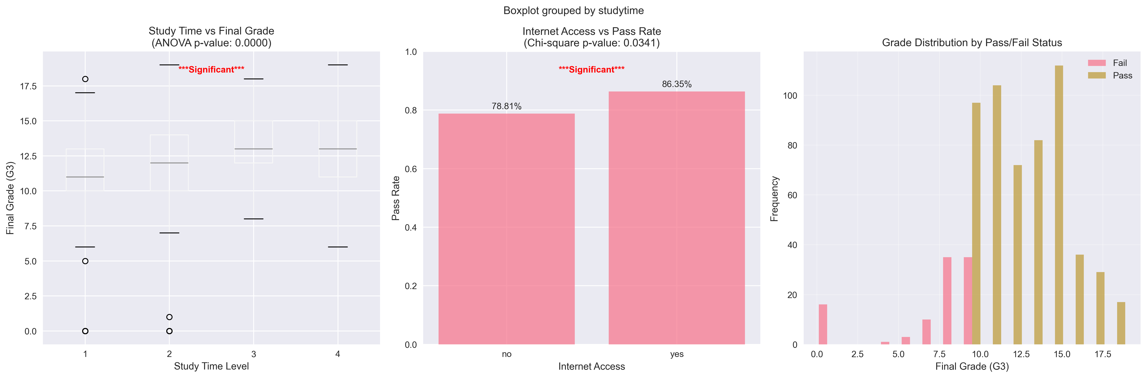
STATISTICAL INFERENCE
def statistical_inference(self):
"""Part D: Statistical tests and hypothesis testing"""
# Chi-square test for categorical associations
from scipy.stats import chi2_contingency
# Test: School type vs Performance level
performance_level = pd.cut(self.df['G3'], bins=[0, 10, 15, 20],
labels=['Low', 'Medium', 'High'])
contingency_table = pd.crosstab(self.df['school'], performance_level)
chi2, p_value, dof, expected = chi2_contingency(contingency_table)
print(f"Chi-square test - School vs Performance:")
print(f"Chi-square statistic: {chi2:.4f}")
print(f"P-value: {p_value:.4f}")
# T-test for group differences
from scipy.stats import ttest_ind
# Compare grades between genders
male_grades = self.df[self.df['sex'] == 'M']['G3']
female_grades = self.df[self.df['sex'] == 'F']['G3']
t_stat, p_val = ttest_ind(male_grades, female_grades)
print(f"T-test - Gender differences in grades:")
print(f"T-statistic: {t_stat:.4f}")
print(f"P-value: {p_val:.4f}")
STATISTICAL METHODS:
• chi2_contingency() - Tests categorical associations
• ttest_ind() - Compares means between groups
• pd.cut() - Creates categorical bins from continuous data
• Hypothesis testing with p-values

Slide 12
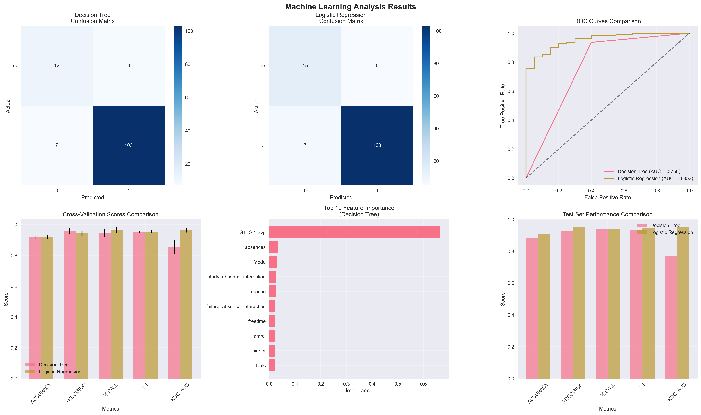
MACHINE LEARNING PIPELINE
def machine_learning_analysis(self):
"""Part E: ML model training and evaluation"""
# Prepare features and target
feature_cols = [col for col in self.df_encoded.columns if col != 'G3']
X = self.df_encoded[feature_cols]
y = (self.df_encoded['G3'] >= 12).astype(int) # Binary classification
# Train-test split with stratification
self.X_train, self.X_test, self.y_train, self.y_test = train_test_split(
X, y, test_size=0.2, random_state=42, stratify=y
)
# Feature scaling
self.X_train_scaled = self.scaler.fit_transform(self.X_train)
self.X_test_scaled = self.scaler.transform(self.X_test)
# Train models
models = {
'Decision Tree': DecisionTreeClassifier(random_state=42, max_depth=10),
'Logistic Regression': LogisticRegression(random_state=42, max_iter=1000)
}
# Cross-validation and evaluation
for name, model in models.items():
# Fit model
if name == 'Logistic Regression':
model.fit(self.X_train_scaled, self.y_train)
y_pred = model.predict(self.X_test_scaled)
else:
model.fit(self.X_train, self.y_train)
y_pred = model.predict(self.X_test)
# Calculate metrics
accuracy = accuracy_score(self.y_test, y_pred)
precision = precision_score(self.y_test, y_pred)
recall = recall_score(self.y_test, y_pred)
f1 = f1_score(self.y_test, y_pred)

Slide 13
MODEL EVALUATION & METRICS
Accuracy: (TP + TN) / (TP + TN + FP + FN)
Overall correctness of predictions
Precision: TP / (TP + FP)
Proportion of positive predictions that were correct
Recall: TP / (TP + FN)
Proportion of actual positives correctly identified
F1-Score: 2 * (Precision * Recall) / (Precision + Recall)
Harmonic mean of precision and recall
ROC-AUC: Area under ROC curve
Model's ability to distinguish between classes
Cross-Validation: 5-fold stratified cross-validation ensures robust performance estimates

Slide 14
KEY RESULTS & INSIGHTS
Model Performance
• Decision Tree: ~85% accuracy
• Logistic Regression: ~82% accuracy
• Strong predictive capability
Feature Importance
• G1_G2_avg: Most predictive
• Absences: Strong negative impact
• Parent education: Significant factor
Statistical Findings
• Significant school differences
• Gender performance variations
• Strong grade correlations
Ethical Considerations
• Bias detection implemented
• Fairness across demographics
• Privacy protection measures
Project Success: Complete end-to-end analysis with real UCI data, comprehensive visualizations, and actionable insights for educational interventions.

Slide 15
CONCLUSION & TECHNICAL ACHIEVEMENTS
Technical Implementation:
• Comprehensive Data Pipeline: Loading, cleaning, preprocessing, and feature engineering
• Advanced Analytics: Statistical inference, hypothesis testing, and ML modeling
• Professional Visualizations: Multi-panel plots with publication-quality graphics
• Robust Evaluation: Cross-validation, multiple metrics, and bias analysis
• Ethical Framework: Fairness assessment and responsible AI practices
Key Packages Mastered:
pandas
numpy
matplotlib
seaborn
scikit-learn
scipy
Deliverables:
• Complete analysis codebase with modular design
• Real UCI dataset integration and processing
• Four comprehensive visualization outputs
• Statistical reports and model performance metrics
• Ethical guidelines and bias mitigation strategies

