Slide 1
UCI Wine: K-means vs Hierarchical
Problem, Methods, Rationale, Results, Visuals, Inference

Slide 2
Problem Statement
Cluster wines by 13 physico-chemical attributes; labels not used for tuning.
Compare K-means vs hierarchical; select k via internal indices.
Interpret clusters via centroids and statistical tests.

Slide 3
Dataset Overview
Samples: 178, Features: 13.
Features: alcohol, malic_acid, ash, alcalinity_of_ash, magnesium, total_phenols, flavanoids, nonflavanoid_phenols, proanthocyanins, color_intensity, hue, od280/od315_of_diluted_wines, proline.
Labels only for external validation; counts: {1: 71, 0: 59, 2: 48}.

Slide 4
Pipeline
Load → Impute (median) → Standardize (Z-score) → EDA
PCA (retain 95% variance) → Feature engineering
K-means & Hierarchical → Validity indices → Inference

Slide 5
Part A: Data Loading & Preprocessing (How & Significance)
How: load UCI Wine, show 10 rows, confirm numeric types.
Impute (median; none missing) and standardize (Z-score).
Save scaled dataset to CSV for reproducibility.

Slide 6
Part A Code
data = load_wine() X = pd.DataFrame(data.data, columns=data.feature_names) imputer = SimpleImputer(strategy='median') X_imputed = pd.DataFrame(imputer.fit_transform(X), columns=X.columns) scaler = StandardScaler(); X_scaled = pd.DataFrame(scaler.fit_transform(X_imputed), columns=X.columns) X_scaled.to_csv(os.path.join(out_dir, 'scaled_wine.csv'), index=False)

Slide 7
Part A: Significance
Numeric consistency and standardization ensure fair distances for clustering.
Imputation avoids bias and enables PCA/clustering without missing-value issues.

Slide 8
Part B: First EDA (How & Significance)
Compute descriptive stats (mean, std, min, max) for key features.
Plot histograms for 4 variables; note skewness (e.g., malic_acid right-skew).
Build PCA scree plot to assess variance explained by components.

Slide 9
Part B Code Snippets
selected = ['alcohol','malic_acid','ash','flavanoids'] desc = X_imputed[selected].describe().T for col in selected: fig, ax = plt.subplots(); sns.histplot(X_imputed[col], kde=True, ax=ax) save_fig(fig, os.path.join(hist_dir, f'{col}_hist.png')) pca = PCA(); pca.fit(X_scaled); evr = pca.explained_variance_ratio_

Slide 10
Part B: Significance
Histograms show spread, shape, outliers; skewness highlights long tails.
Scree plot informs dimension reduction to reduce noise/collinearity.

Slide 11
Part C: Feature Engineering (How & Significance)
Create composite features (acid_index, phenols_ratio) and standardize.
Apply PCA retaining 95% variance to reduce dimensions.
Use transformed features if they improve separation and compactness.

Slide 12
Part C Code
acid_index = X_imputed['malic_acid'] / X_imputed['alcohol'] phenols_ratio = X_imputed['total_phenols'] / (X_imputed['flavanoids'] + 1e-6) comp_scaler = StandardScaler(); comp = comp_scaler.fit_transform(np.c_[acid_index, phenols_ratio]) X_fe = X_scaled.copy(); X_fe['acid_index'] = comp[:,0]; X_fe['phenols_ratio'] = comp[:,1] pca95 = PCA(n_components=0.95, svd_solver='full'); X_pca = pca95.fit_transform(X_scaled)

Slide 13
Part C: Significance
Composite features inject domain insight; PCA reduces redundancy and noise.

Slide 14
Part D: Clustering & Validation (How & Significance)
K-means: run k=2..8; compute Silhouette↑, DB↓, CH↑; select k.
Hierarchical: Ward & average dendrograms; compute cophenetic correlation.
External validation (ARI, NMI): analysis-only; do not tune with labels.

Slide 15
Part D Code Snippets
for k in range(2, 9): km = KMeans(n_clusters=k, n_init=10, random_state=42) labels = km.fit_predict(features) s = silhouette_score(features, labels); db = davies_bouldin_score(features, labels); ch = calinski_harabasz_score(features, labels) Z_ward = linkage(features_for_kmeans, method='ward'); Y = pdist(features_for_kmeans); coph_ward, _ = cophenet(Z_ward, Y)

Slide 16
Part D: Significance
Indices balance cohesion/separation; cophenetic checks dendrogram fidelity.
External metrics contextualize clusters against ground truth without tuning.

Slide 17
Part E: Second EDA & Statistical Inference (How & Significance)
Show centroids in original units; visualize PCA scatter by cluster.
Run ANOVA & Kruskal-Wallis on alcohol, flavanoids; report p-values & effect sizes.
Interpret discrepancies if labels used for validation (ARI/NMI).

Slide 18
Part E Code Snippets
df = X_imputed.copy(); df['cluster'] = kmeans_labels groups = [g['alcohol'].values for _, g in df.groupby('cluster')] f, p = stats.f_oneway(*groups); h, pkw = stats.kruskal(*groups) # eta² and ε² computed from SS and H-statistic

Slide 19
Part E: Significance
Centroids explain cluster profiles; PCA scatter shows overlap/separation.
Effect sizes contextualize practical differences beyond p-values.

Slide 20
Part F: PCA Influence & Suitability
PCA improved indices at k=3 (chosen), clarifying grouping signal.
K-means: fast, interpretable for convex clusters; Hierarchical: linkage-sensitive but reveals structure.
Choose based on data geometry, interpretability needs, and goals.

Slide 21
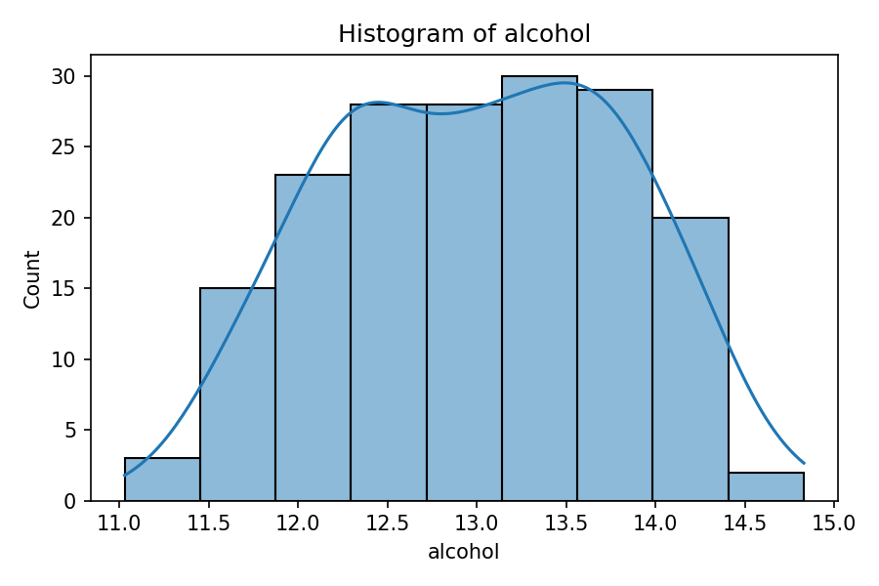
Histogram (Alcohol)

Slide 22
Histogram: Purpose & Insights
Purpose: show the spread and shape of values.
Insight: alcohol values are fairly symmetric; no extreme outliers.
Skewness helps spot long tails (malic_acid is right-skewed).

Slide 23
How We Built the Histogram
fig, ax = plt.subplots(figsize=(6, 4)) sns.histplot(X_imputed['alcohol'], kde=True, ax=ax) ax.set_title('Histogram of alcohol') save_fig(fig, os.path.join(hist_dir, 'alcohol_hist.png'))

Slide 24
Methods & Rationale
Standardization: essential for distance-based clustering and PCA.
PCA: reduce collinearity/noise; retained components: 10
K-means: efficient centroid-based clustering; convex clusters.
Hierarchical: dendrogram structure; Ward vs average linkage.
Indices: Silhouette↑, Davies–Bouldin↓, Calinski–Harabasz↑.

Slide 25
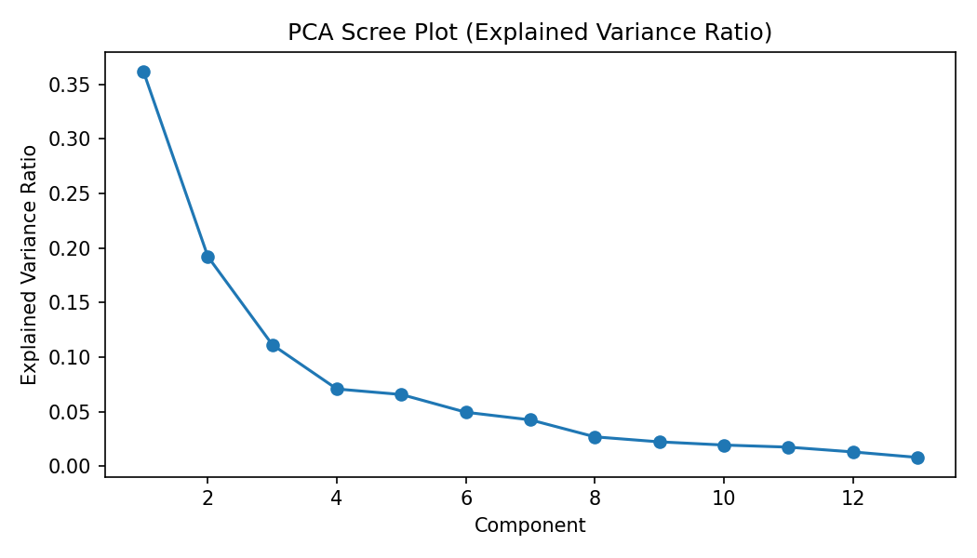
PCA Scree

Slide 26
Scree: Purpose & Insights
Purpose: see how much variance each PCA component explains.
Insight: after early components, added variance drops (diminishing returns).
We keep components covering 95% of variance (10 components).

Slide 27
How We Built the Scree Plot
pca = PCA(); pca.fit(X_scaled) evr = pca.explained_variance_ratio_ fig, ax = plt.subplots() ax.plot(np.arange(1, len(evr)+1), evr, marker='o') save_fig(fig, os.path.join(fig_dir, 'pca_scree.png'))

Slide 28
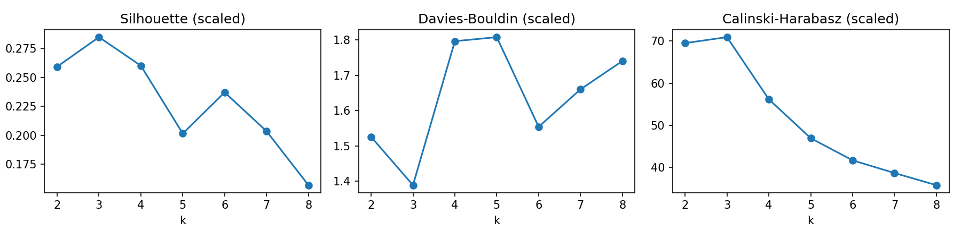
Indices vs k (scaled)

Slide 29
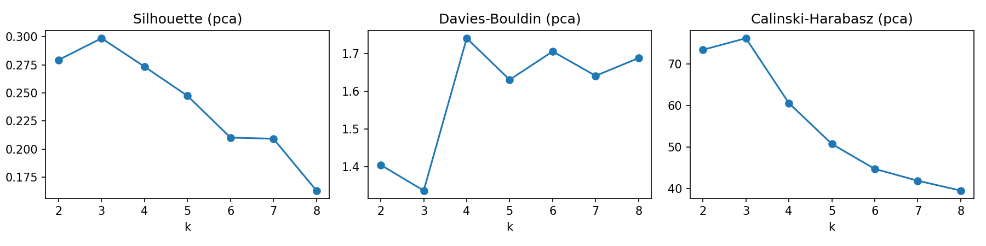
Indices vs k (pca)

Slide 30
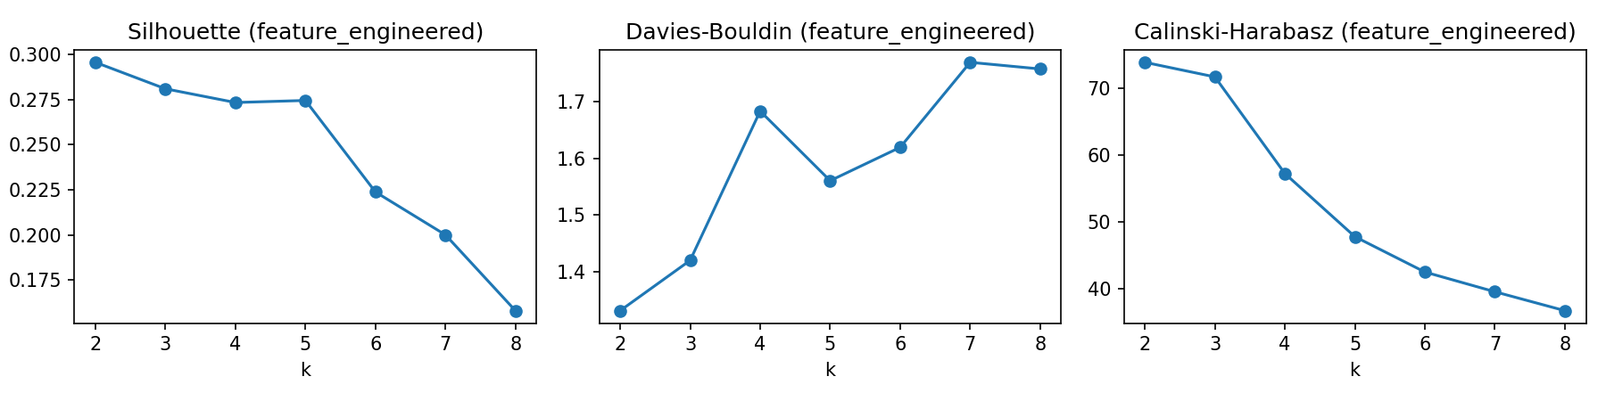
Indices vs k (feature_engineered)

Slide 31
Indices: Purpose & Insights
Purpose: choose the best number of clusters (k).
Silhouette: higher is better; DB: lower is better; CH: higher is better.
We pick the k with good balance across these indices.

Slide 32
How We Built Indices vs k
for k in range(2, 9): km = KMeans(n_clusters=k, n_init=10, random_state=42) labels = km.fit_predict(features) s = silhouette_score(features, labels) db = davies_bouldin_score(features, labels) ch = calinski_harabasz_score(features, labels) # plot s, db, ch for each k and save

Slide 33
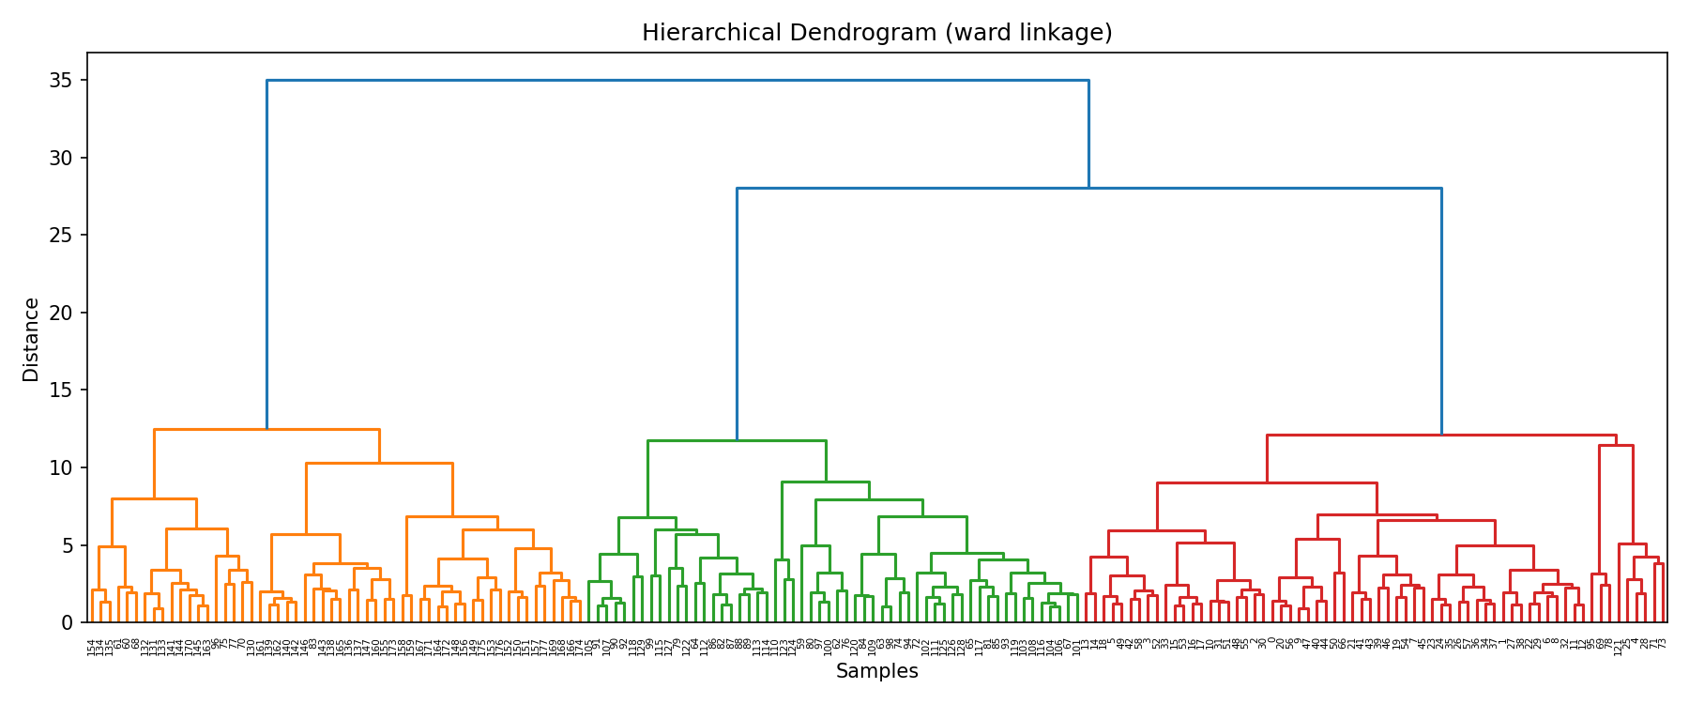
Dendrogram (ward)

Slide 34
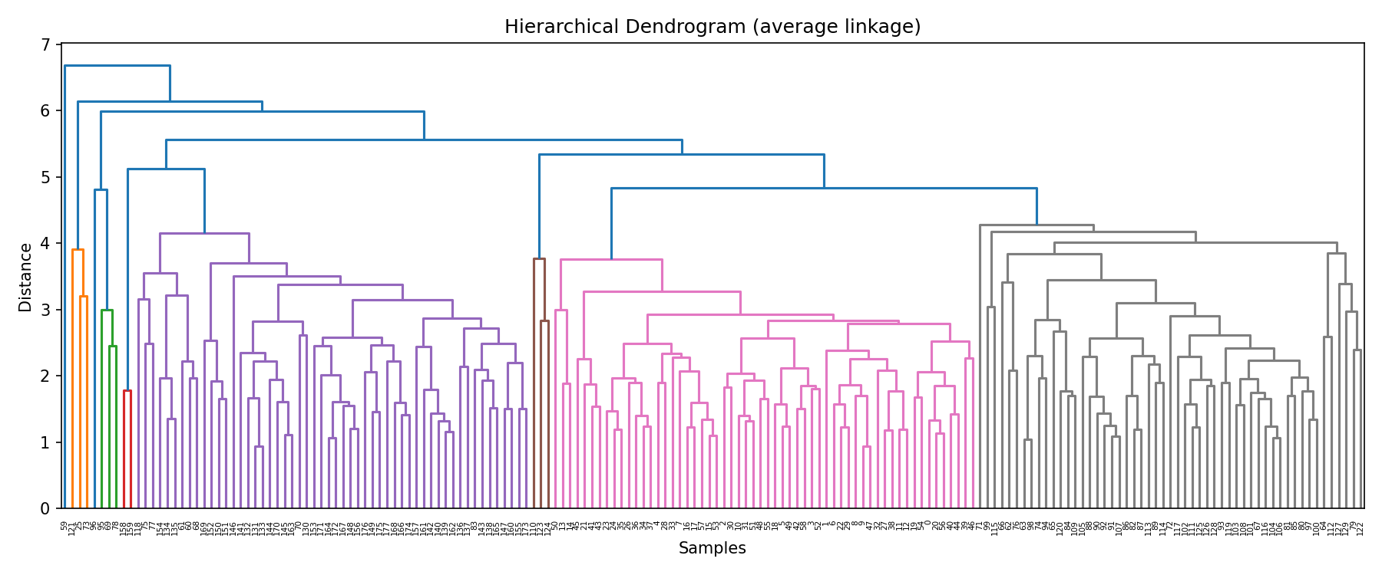
Dendrogram (average)

Slide 35
Dendrograms: Purpose & Insights
Purpose: show how clusters merge step-by-step.
Ward: groups by minimizing variance; Average: uses mean distances.
Cophenetic correlation checks how well tree preserves distances.

Slide 36
How We Built Dendrograms
Z_ward = linkage(features_for_kmeans, method='ward', metric='euclidean') fig, ax = plt.subplots() dendrogram(Z_ward, ax=ax) save_fig(fig, os.path.join(fig_dir, 'dendrogram_ward.png'))

Slide 37
Selection & Key Results
Selected: pca, k=3.
Silhouette=0.299, DB=1.336, CH=76.2.
Cophenetic (Ward)=0.664, (Average)=0.761.
External (optional): ARI=0.897, NMI=0.876.

Slide 38
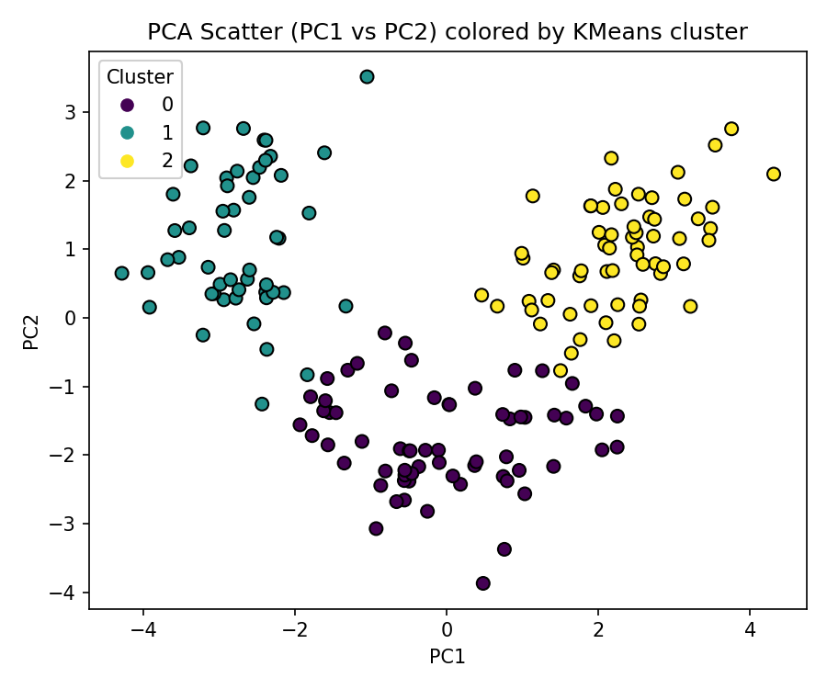
PCA Scatter by Cluster

Slide 39
PCA Scatter: Purpose & Insights
Purpose: visualize clusters in 2D using first two PCs.
Insight: see separation and overlap between groups.
Colors represent K-means cluster assignments.

Slide 40
How We Built PCA Scatter
pca2 = PCA(n_components=2) X_pca2 = pca2.fit_transform(X_scaled) fig, ax = plt.subplots() ax.scatter(X_pca2[:,0], X_pca2[:,1], c=kmeans_labels, cmap='viridis') save_fig(fig, os.path.join(fig_dir, 'pca_scatter_kmeans.png'))

Slide 41
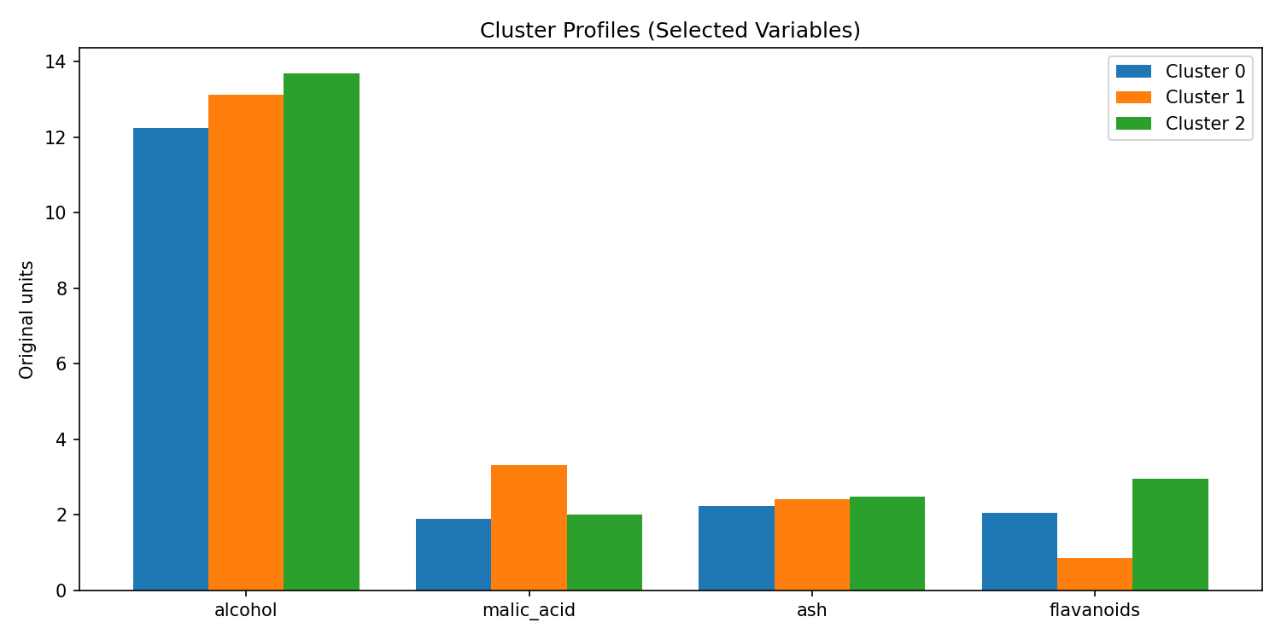
Cluster Profiles (Selected Vars)

Slide 42
Profiles: Purpose & Insights
Purpose: compare typical values of key variables across clusters.
Insight: see which clusters have higher/lower alcohol, acidity, etc.
Helps explain what makes clusters different.

Slide 43
How We Built Cluster Profiles
key_vars = ['alcohol','malic_acid','ash','flavanoids'] fig, ax = plt.subplots() idx = np.arange(len(key_vars)); width = 0.8/ chosen_k for c in range(chosen_k): ax.bar(idx + c*width, centroids_original.loc[c, key_vars], width) save_fig(fig, os.path.join(fig_dir, 'cluster_profiles_bar.png'))

Slide 44
Statistical Inference
Alcohol: ANOVA p=0.0000, eta²=0.564
Alcohol: Kruskal p=0.0000, ε²=0.571
Flavanoids: ANOVA p=0.0000, eta²=0.756
Flavanoids: Kruskal p=0.0000, ε²=0.750

Slide 45
Applications
Quality control: group wines with similar chemistry for consistency.
Product segmentation: design blends or offerings by cluster profiles.
Inventory planning and sourcing: match supply to cluster demand.
Marketing: tailor messaging to cluster characteristics.

Slide 46
Benefits & Limitations
Benefits: fast, interpretable clusters; structure insight via dendrograms; reduces noise with PCA.
Limitations: K-means assumes convex clusters; hierarchical sensitive to linkage.
Needs standardization; PCA components hard to explain directly.

Slide 47
Rationale & Trade-offs
Standardization: fair distances; PCA: reduce noise/collinearity.
K-means: fast, interpretable centroids; convex cluster assumption.
Hierarchical: structure via dendrogram; linkage choice matters.
PCA+K-means often balances compactness and separation on numeric data.

Slide 48
Limitations & Next Steps
Assess stability; try GMM, DBSCAN; add domain-informed features.
Bootstrap validity indices; silhouette per sample; sensitivity analysis.

