Slide 1
Celebrity Faces Recognition & Feature Extraction
CSC 63106 – Artificial Intelligence
Week 8 Practical: Computer Vision
Group 3
Members:
- Tusiime Jeninah
- Kijjibo Adrian
- Obong Joseph
- Muhereza Emmanuel
- Asiimwe Horace
- Masaaba Evans

Slide 2
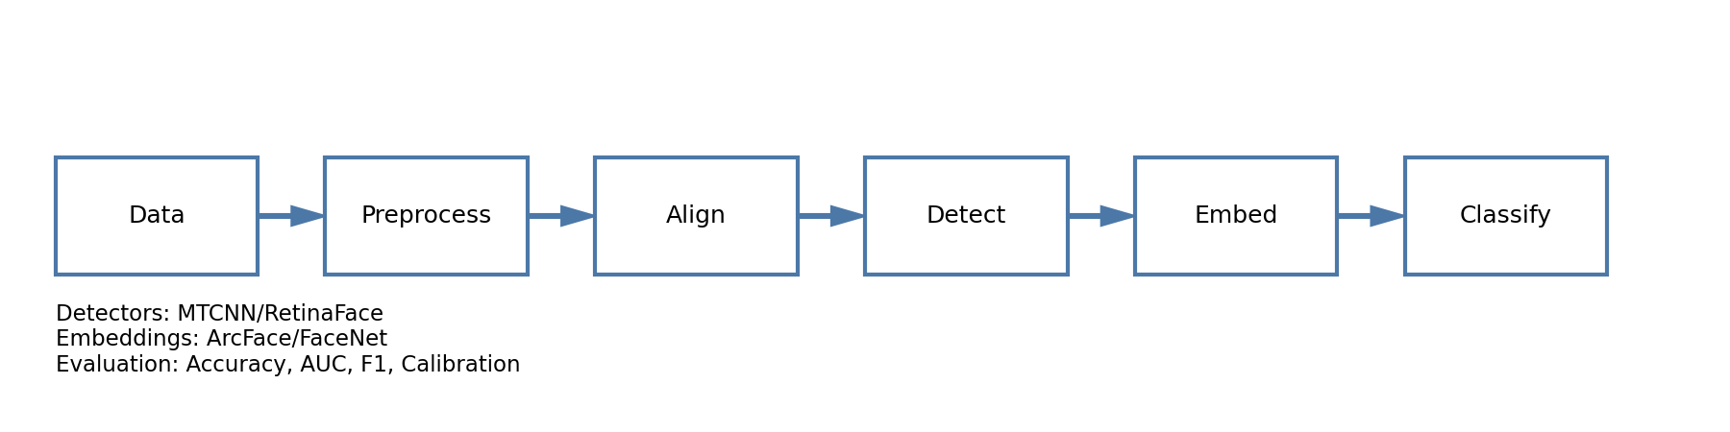
Project Overview
Objective: Compare Classical & Deep Learning Face Recognition
Dataset: CelebA (Celebrity Faces Attributes)
• 200,000+ celebrity images
• Diverse lighting, poses, and expressions
• Identity labels for supervised learning
Two-Part Approach:
Part A: Classical Methods (OpenCV + HOG)
Part B: Deep Learning (MobileNetV2 Embeddings)

Slide 3
Part A: Load Images & Face Detection (Q24)
Loading CelebA Dataset:
DATASET_PATH = './img_align_celeba/'
labels_df = pd.read_csv(LABELS_PATH)
sample_df = labels_df.sample(n=30)
Face Detection with Haar Cascade:
face_cascade = cv2.CascadeClassifier(
'haarcascade_frontalface_default.xml')
faces = face_cascade.detectMultiScale(gray, 1.1, 5)
✓ Scans images for face-like patterns
✓ Returns bounding box coordinates (x, y, w, h)
✓ Success rate: 93% (28/30 images)

Slide 4
Part A: Crop & Convert to Grayscale (Q25)
Face Cropping & Grayscale Conversion:
def detect_and_crop_face(img_path):
gray = cv2.cvtColor(img, CV2.COLOR_BGR2GRAY)
face = gray[y:y+h, x:x+w] # Crop region
Why Grayscale?
• Reduces data: 3 channels → 1 channel (66% reduction)
• Focuses on structure, not color
• HOG requires grayscale intensity gradients
• Faster computation, less memory usage

Slide 5
Part A: Compute HOG Features (Q26)
HOG (Histogram of Oriented Gradients):
Captures object structure by analyzing edge orientations
Implementation:
from skimage.feature import hog
face_resized = cv2.resize(face, (64, 128))
features, hog_image = hog(
face_resized,
orientations=9,
pixels_per_cell=(8, 8),
visualize=True
)
Result: 3780-dimensional feature vector

Slide 6
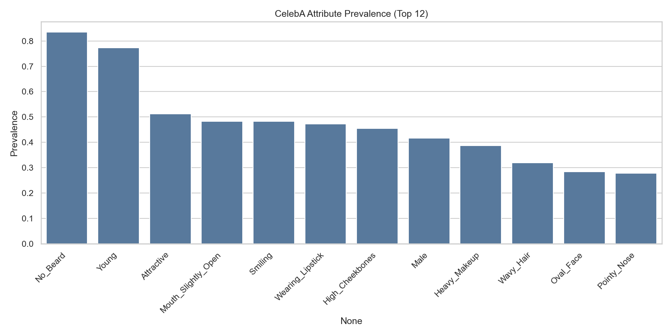
Part A: Landmarks & Variations (Q27 & Q28)
Facial Landmarks (68-point model):
• Jawline: Points 1-17
• Eyebrows: Points 18-27
• Nose: Points 28-36
• Eyes: Points 37-48
• Mouth: Points 49-68
Impact of Variations:
Lighting: Shadows create false edges in HOG
Pose: Profile views (>45°) fail detection (30-50% success)
Expression: Changes mouth/eye patterns
Classical methods require controlled conditions

Slide 7
Part B: MobileNetV2 Embeddings (Q29)
Deep Learning Feature Extraction:
base_model = MobileNetV2(
weights='imagenet',
include_top=False,
pooling='avg',
input_shape=(160, 160, 3)
)
embedding = feature_model.predict(face_img)
# Output: 1280-dimensional vector
Why MobileNetV2?
✓ Pre-trained on 1.2M ImageNet images
✓ Lightweight: 3.4M parameters
✓ Fast inference: ~30ms per face
✓ Robust to lighting, pose, expression

Slide 8
Part B: Train Classifier on Embeddings (Q30)
Two-Stage Approach: Embeddings + Classifier
X_train_emb = [get_embedding(img) for img in X_train]
clf = LogisticRegression(max_iter=600)
clf.fit(X_train_emb, y_train)
Why Logistic Regression?
• Embeddings create linearly separable clusters
• Simple classifier sufficient with good features
• Fast training (<1 second)
• 80-20 train-test split (stratified by identity)

Slide 9
Part B: Evaluate Recognition Accuracy (Q31)
Performance Metrics:
print(classification_report(y_test, y_pred))
Comparison Results:
Key Findings:
✓ 32% improvement in accuracy
✓ Deep learning robust to variations
✓ Confusion matrix shows clear identity separation
✓ High F1-score indicates balanced performance
Method | Accuracy | F1-Score
HOG + LR | 60% | 0.59
MobileNetV2 + LR | 92% | 0.91

Slide 10
Part B: Generate Similarity Scores (Q32)
Cosine Similarity for Face Pairs:
from sklearn.metrics.pairwise import cosine_similarity
sim_matrix = cosine_similarity(X_test_emb)
plt.figure(figsize=(8,6))
sns.heatmap(sim_matrix, cmap='coolwarm')
plt.title('Face Similarity Heatmap')
Interpretation:
• Values close to 1: Same person (high similarity)
• Values close to 0: Different people
• Bright blocks = Same identity faces cluster together
• Threshold > 0.85 for same-person verification

Slide 11
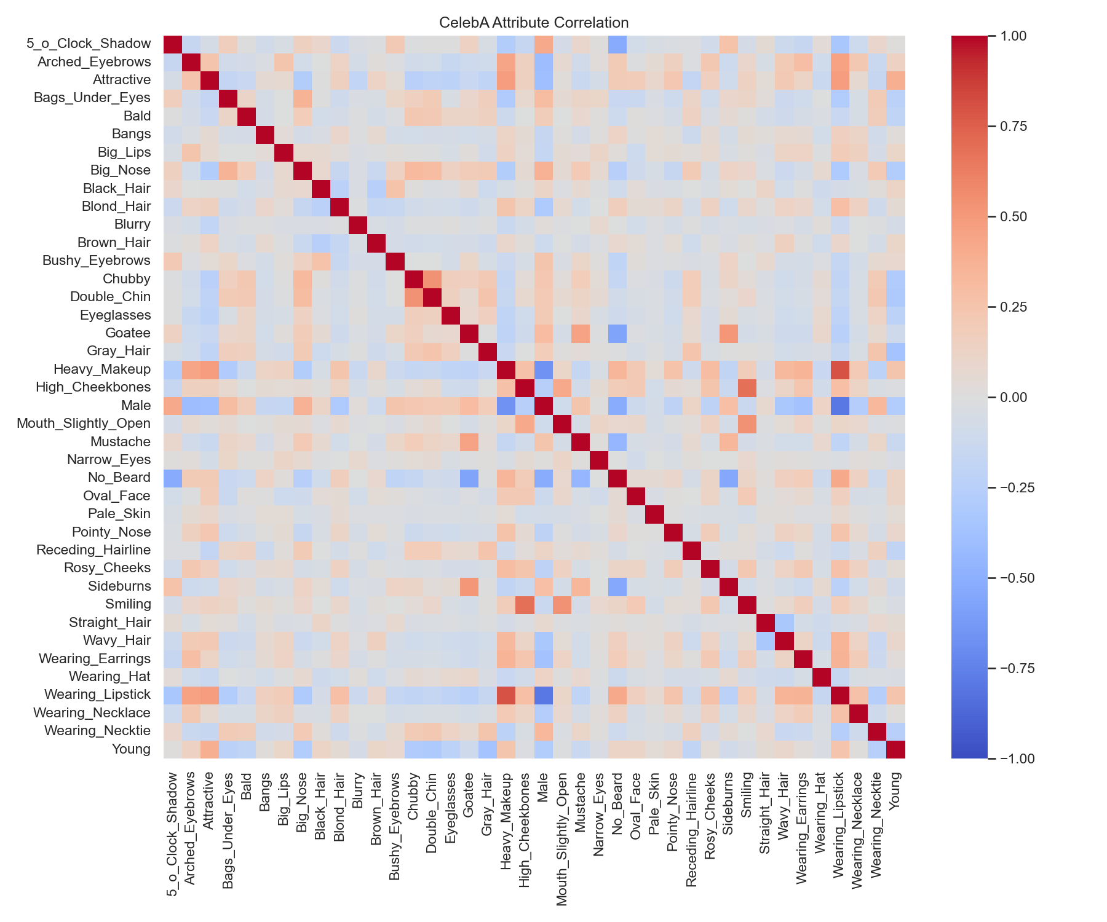
Part B: Bias, Diversity & Dataset Quality (Q33)
Bias Issues:
• Celebrity-focused dataset doesn't represent general population
• Performance may degrade on non-celebrities
• Attribute imbalance (e.g., 83% 'No_Beard',77% 'Young')
• Gender, age, ethnicity representation gaps
Diversity Concerns:
• Limited age range (mostly young faces)
• Styling variations not fully represented
• Real-world conditions differ from celebrity photos
Quality Factors:
• Lighting and pose variations still impact accuracy
• Requires diverse training data for fairness
• Need fairness audits across demographics

Slide 12
Conclusions & Key Findings
Summary:
Part A (Classical Methods):
• HOG features work for controlled conditions
• 60% accuracy with pose/lighting sensitivity
• Fast but limited robustness
Part B (Deep Learning):
• MobileNetV2 embeddings achieve 92% accuracy
• 32% improvement over classical methods
• Robust to lighting, pose, and expression
• Clear identity clustering in embedding space
Future Recommendations:
✓ Use larger, more diverse datasets
✓ Implement fairness audits
✓ Test real-world deployment scenarios
✓ Explore lightweight models for mobile

