Slide 1
Web front-end development
ZhuHua

Slide 2
Overview of HTML
HyperText Markup Language, or HTML, is the standard markup language for describing the structure of documents displayed on the web.

Slide 3
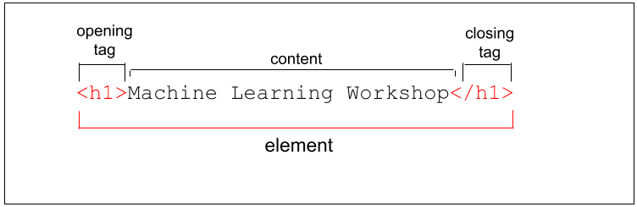
Elements

Slide 4
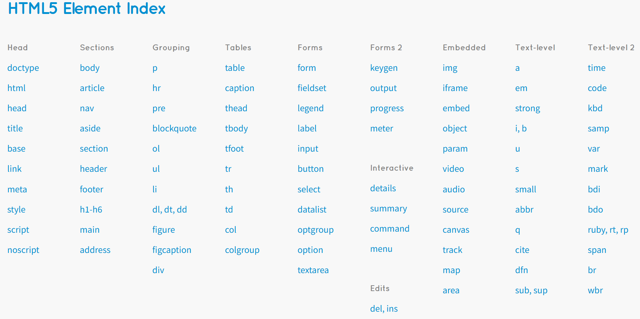
Notes:
https://html5doctor.com/

Slide 5
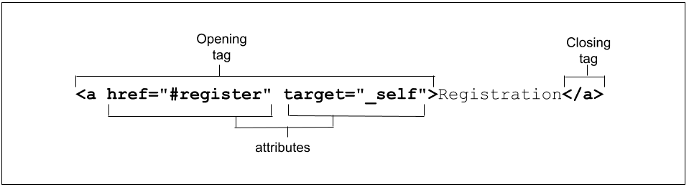
Attributes

Slide 6
questions？
HTML elements are used for styling.
True or False
Select all of the true statements.
Attribute values containing a space or special characters must be contained within quotes.
Attributes describe the styling of HTML elements.
Attributes are added to the opening tag of an element.
HTML is case sensitive.

Slide 7
questions？
HTML elements are used for styling.
True or False
Select all of the true statements.
Attribute values containing a space or special characters must be contained within quotes.
Attributes describe the styling of HTML elements.
Attributes are added to the opening tag of an element.
HTML is case sensitive.

Slide 8
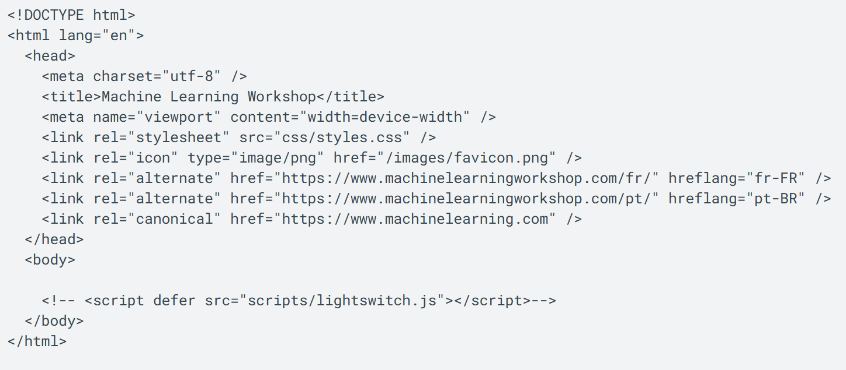
Document structure

Slide 9
Questions？
How do you identify the language of the document?
Add the lang attribute to the HTML tag.
Add the <lang> element to the <head>.
Add the language attribute to the HTML tag.
Select elements that can be included in the <head>.
<p>
<meta>
<title>

Slide 10
Questions？
How do you identify the language of the document?
Add the lang attribute to the HTML tag.
Add the <lang> element to the <head>.
Add the language attribute to the HTML tag.
Select elements that can be included in the <head>.
<p>
<meta>
<title>

Slide 11
Tags
Tags are embedded commands within a document that communicate to the browser.
<opening tag> Content </closing tag>
Any number of white-spaces are compressed into a single one
Examples of Tags
<p>Paragraph Tag</p>
<h2>Heading Tag</h2>
<b>Bold Tag</b> or <strong> Bold Tag </strong>
<i>Italic Tag</i> or <em> Italic Tag </i>

Slide 12
Text-tags
<abbr> Defines an abbreviation or an acronym
<b> Defines bold text
<em> Defines emphasized text
<small> Defines smaller text
<strong> Defines important text
<sub> Defines subscripted text
<sup> Defines superscripted text
<pre> Defines preformatted text
<cite> Defines the title of a work

Slide 13
More HTML tags
Tags Without Closing Tags
They still have the 3 basic parts (opening/closing and content).
do not require a formal </closingtag>
Examples:
<img src="mypic.jpg" /> -- Image Tag
<br /> -- Line Break Tag
<input type="text" size="12" /> -- Input Field

Slide 14
Lists – un-numbered
Unnumbered Lists:
<UL>
<LI> apples </LI>
<LI> bananas </LI>
<LI> grapefruit </LI>
</UL>
Unnumbered Lists with different pointer types:
<UL type="square">
<LI> oranges </LI>
<LI> peaches </LI>
<LI> grapes </LI>
</UL>
type="square"
type="disc"
type="circle"

Slide 15
Lists - numbered
Unnumbered Lists:
<UL>
<LI> apples </LI>
<LI> bananas </LI>
<LI> grapefruit </LI>
</UL>
Numbered Lists:
<OL>
<LI> oranges </LI>
<LI> peaches </LI>
<LI> grapes </LI>
</OL>

Slide 16
Lists - numbered
Numbered Lists that starts with 4:
<OL start="4">
<LI> oranges </LI>
<LI> peaches </LI>
<LI> grapes </LI>
</OL>
Numbered Lists with different ordering:
<OL type="a">
<LI> oranges </LI>
<LI> peaches </LI>
<LI> grapes </LI>
</OL>
type="a": a, b, c
type="A": A, B, C
type="i": i, ii, iii
type="I": I, II, III

Slide 17
Put it all together so far
<HTML>
<HEAD>
<TITLE>The document title</TITLE>
</HEAD>
<BODY>
<H1>Main heading</H1>
<P>A paragraph.</P>
<P>Another paragraph.</P>
<UL> Things that I like </UL>
<LI>A list item.</LI>
<LI>Another list item.</LI>
</UL>
</BODY>
</HTML>

Slide 18
Block vs. Inline Elements
<h2><em>This header will be bold and italicized</em></h2>
OR
<em><h2>This header will be bold and italicized</h2></em>
<em> and <h2> are different kinds of tags.
<h2>: header elements are BLOCK-LEVEL elements.
<em>: is an INLINE-LEVEL element.

Slide 19
Formatting
<p>An example of <b>Bold Text</b> </p> <p>An example of <em>Emphasized Text</em> </p> <p>An example of <strong>Strong Text</strong> </p> <p>An example of <i>Italic Text</i> </p> <p>An example of <sup>superscripted Text</sup> </p> <p>An example of <sub>subscripted Text</sub> </p> <p>An example of <del>struckthrough Text</del> </p> <p>An example of <code>Computer Code Text</code> </p>
<center>Centering of text in page</center>

Slide 20
Hyperlinks
The most important capability of HTML
Both text and image can serve as anchors for the link
<a HREF=http://www.mu.edu>Marquette University</a>
<a HREF=http://www.mu.edu> <IMG SRC="mu.gif"></a>

Slide 21
THANK YOU

