Slide 1
Web front-end development
ZhuHua

Slide 2
Contact
name: zhuhua
Email：21273354@qq.com
zhuhua@tzc.edu.cn
Tel: 19209826779

Slide 3
Course Information
What is Front-End Development?
the practice of building the visual and interactive parts of a website—everything the user sees and experiences in their web browser.

Slide 4
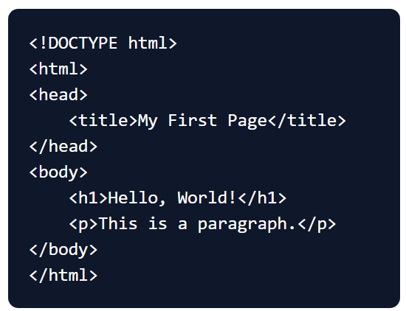
The Three Pillars of Front-End
HTML: The Structure
HTML stands for Hyper Text Markup Language
The foundational language for all web pages. It provides the **skeleton** and defines the content and its organization (headings, paragraphs, lists, links, images).

Slide 5
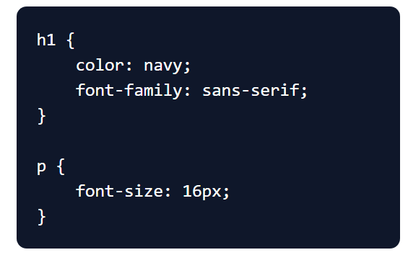
The Three Pillars of Front-End
CSS: The Style
Used to style the HTML elements. It's the **visual layer** that controls colors, fonts, layouts, and the overall design. Without CSS, a website would be plain text on a white background.

Slide 6
The Three Pillars of Front-End
JS: The Behavior
A powerful scripting language that adds interactivity and dynamic functionality. It makes a website come alive by handling user events, updating content, and validating forms.
document.querySelector('h1').addEventListener('click', () => {
alert('You clicked the heading!');
});

Slide 7
Internet and the World Wide Web
Internet
network of globally connected computers
All the computers can communicate with each other
TCP/IP protocol for primary communication
Many Applications, each having own overlay of protocols

Slide 8
What You Will Learn Today
Understand the core concepts and responsibilities of front-end development.
Identify the three fundamental languages of the web: HTML, CSS, and JavaScript.
Recognize essential development tools and integrated development environments (IDEs).
Learn the basics of using browser developer tools for debugging and testing.

Slide 9
Internet and the World Wide Web
World Wide Web(WWW)
A system of global information sharing through Internet
Information represented, shared in Hypertexts, more commonly known as Web Pages
Uses a client-server model of communication
All computers on WWW use a protocol called HTTP to communicate

Slide 10
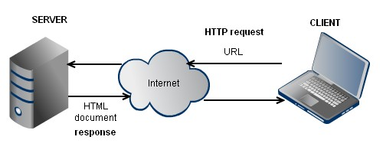
Client-server model in WWW
Web pages are stored in Web Servers
Clients request for web pages through
Web Browsers
Browser makes an HTTP request, specified by a URL/Web Address (i.e.https://www.chinadaily.com.cn/)
Server reads the address, returns corresponding contents through HTTP
Contents received is written in HTML, rendered by browser into a web page

Slide 11
HTML
HTML stands for Hyper Text Markup Language
HTML is a markup language
A markup language is a set of markup tags
The tags describe document content
HTML documents contain HTML tags and plain text

Slide 12
What does HTML stand for?
Hot Typing Markup Language
Home Typing Modern Language
Hyper Text Markup Language
Home Testing Mixed Language

Slide 13
Grading
10% - Quiz/Class participation
20% - Test
20% - Homeworks
50% - Final exam

Slide 14

learning APP
Method 1: mobile application market search "learning", find the icon for the super star Learn App, download and install.
Method 2: scan the qr code with WeChat to download, please choose to open it in the browser, Download and install:

Slide 15
Login authenticated user
Method 1 (school registration user) : after entering the login interface, select "other" in the lower right corner, select the login method of "institution account", enter the full name of the school, select the school name, the teacher enters the work number, the initial password is 123456, and click login.
Method 2 (new user) : after entering the login interface, select "new user registration" in the lower left corner, set the user name and password according to the system prompts, and complete the user registration.

Slide 16
Log on to the network teaching platform by computer
Open the generic network teaching platform (https://tzc.fanya.chaoxing.com/) in your PC, or if your school has exclusive portal site, according to clew "login" or "registered" into the user interface, enter the home page

Slide 17

class ID 39596291

Slide 18
Essential Development Tools
https://code.visualstudio.com/Download
https://www.google.cn/chrome/index.html
Live Preview - VS Code Extension

Slide 19
Useful Links
TML5 Specifications: Latest published version from the World Wide Web Consortium(W3C)
W3Schools: Popular website with tutorials on web technologies. Suitable for beginners
MDN Web Docs (developer.mozilla.org) - The best reference

Slide 20
THANK YOU

