Slide 1
A.V. PAREKH TECHNICAL INSTITUTE-RAJKOT
COMPUTER ENGINEERING
5th SEMESTER
Internship Project
(4350704)
Name Of Student: Vasani Jenisa k.
Enrollment No: 216020307080
Division: B
Academic Year: 2023-2024(ODD)

Slide 2
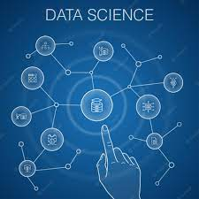

Data science and machine learning
Data Science: Data science is a multidisciplinary field that combines various techniques, algorithms, processes, and systems to extract valuable insights and knowledge from data. It involves collecting, cleaning, analyzing, and interpreting data to solve complex problems and make informed decisions. Data scientists utilize statistical methods, programming skills, and domain expertise to uncover patterns, trends, and correlations in data, ultimately enabling organizations to optimize processes, predict outcomes, and gain a competitive edge.
Machine Learning: Machine learning is a subset of artificial intelligence that focuses on developing algorithms and models that enable computers to learn from and make predictions or decisions based on data. It involves training algorithms on large datasets to recognize patterns and relationships, allowing them to improve their performance over time. Machine learning techniques include supervised learning (learning from labeled data), unsupervised learning (finding patterns in unlabeled data), and reinforcement learning (learning through trial and error). Applications of machine learning range from image and speech recognition to recommendation systems and autonomous vehicles.

Slide 3
Daily Tasks and Activities
Date: 27/07/2023
Day: Thursday
Task1:Brush up all basic python concepts
1. Variables and Data Types: Introduction to variables, numeric (integers, floats), strings, and boolean data types.
2. Operators: Arithmetic, comparison, logical, and assignment operators for calculations and decision-making.
3. Control Structures: Usage of if statements for conditional execution, loops (for and while) for repetitive tasks.
4. Functions: Creating and using functions to encapsulate code, improve modularity, and promote reusability.
5. Data Structures: Lists, tuples, and dictionaries for storing and managing collections of data.
6. Strings and String Manipulation: String methods, slicing, concatenation, and formatting.
7. Input and Output: Handling user input and displaying output using print statements.
8. Exception Handling: Using try-except blocks to handle errors gracefully.
9. File Handling: Reading from and writing to files, managing file objects.
10. Modules and Libraries: Importing and using external modules and libraries to extend Python's capabilities.
11. Lists and List Comprehensions: Creating lists, iterating through them, and using list comprehensions for concise operations.
12. Dictionaries and Sets: Creating dictionaries, accessing values, and using sets for unique collections.
13. Classes and Objects: Object-oriented programming basics, defining classes, creating objects, and using methods and attributes.
14. Inheritance and Polymorphism: Creating class hierarchies using inheritance and implementing polymorphic behaviour.
15. Packages and Modules: Structuring code into packages and modules for better organization and maintainability.
16. Scope and Lifetime: Understanding variable scope and lifetime, global and local variables.
17. Lambda Functions: Creating small, anonymous functions using lambda expressions.
18. List Manipulation: Using methods like append, remove, sort, and reverse to modify lists.
19. Iterators and Iterables: Understanding iterable objects and using iterators for looping.
20. Comprehensions: List comprehensions, dictionary comprehensions, and set comprehensions for concise data creation.

Slide 4
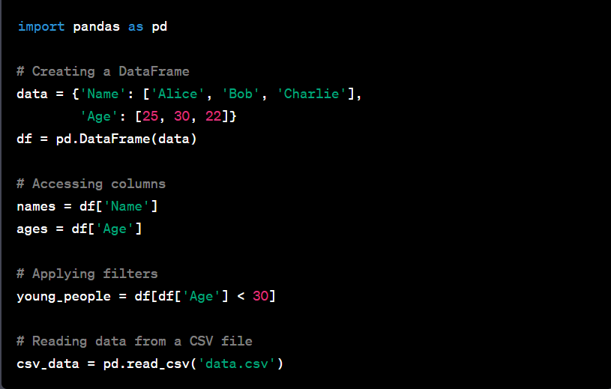
Date: 28/07/2023
Day: Friday
Task2: Introduction to python libraries
Certainly! Pandas, NumPy, and Matplotlib are essential libraries in Python for data manipulation, numerical operations, and data visualization, respectively.
1.Pandas:
Pandas is a powerful library for data manipulation and analysis. It provides data structures like DataFrame and Series that make it easy to work with structured data and perform various data operations such as filtering, grouping, and merging.
-> Common operations in Pandas include:
  Loading and saving data from/to various file formats (CSV, Excel, SQL, etc.).
  Indexing, slicing, and subsetting data.
  Filtering and sorting data.
  Grouping and aggregation.
  Handling missing values.
ex:

Slide 5
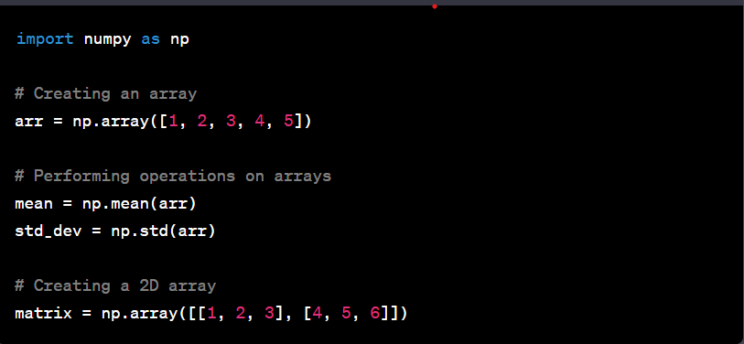
2.NumPy (Numerical Python):
NumPy is a fundamental package for scientific computing in Python. It provides support for arrays, which are more efficient and convenient than Python's built-in lists for numerical operations. NumPy also offers a wide range of mathematical functions to operate on these arrays.
Ex:

Slide 6
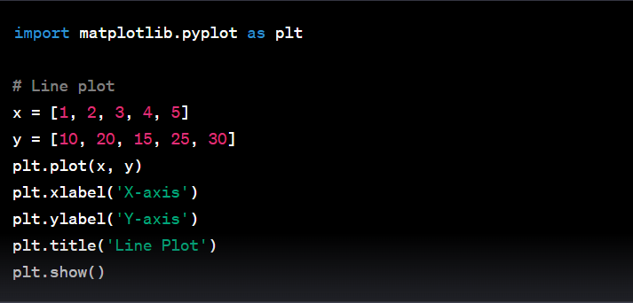
3.Matplotlib:
Matplotlib is a widely used library for creating visualizations in Python. It provides a variety of plotting functions to create line plots, bar charts, scatter plots, histograms, and more.
Ex:

Slide 7
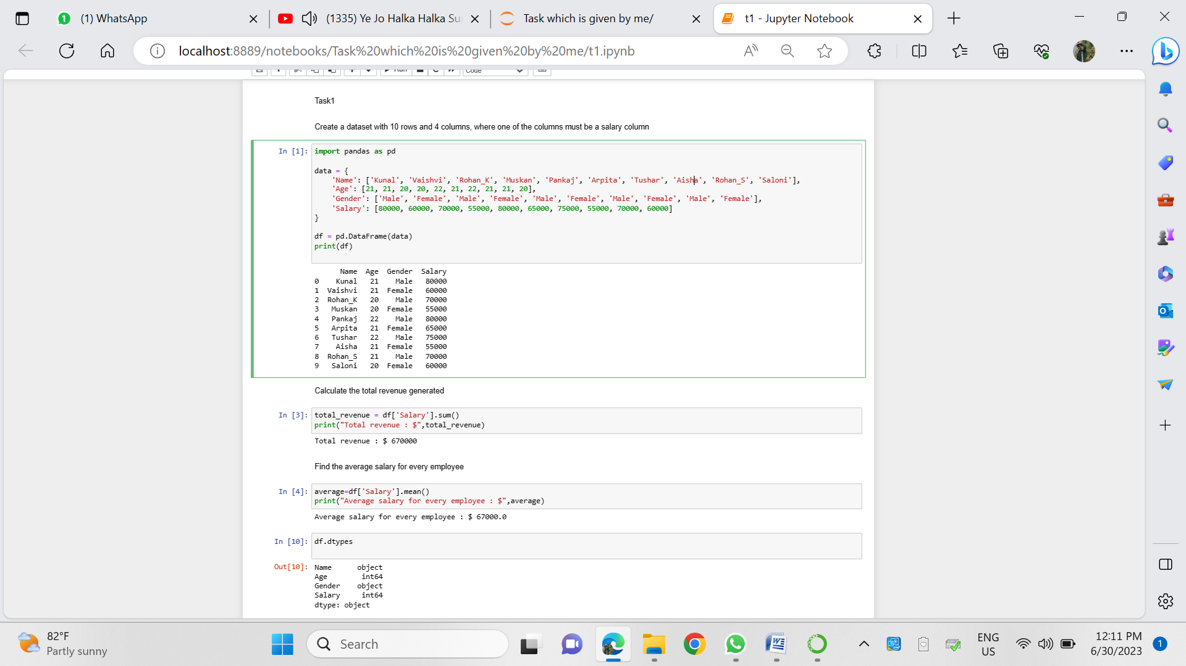
Date: 31/07/2023
Day: Monday
Task 3.1: To Create a dataset with 10 rows and 4 columns, where one of the columns must be a salary column.

Slide 8
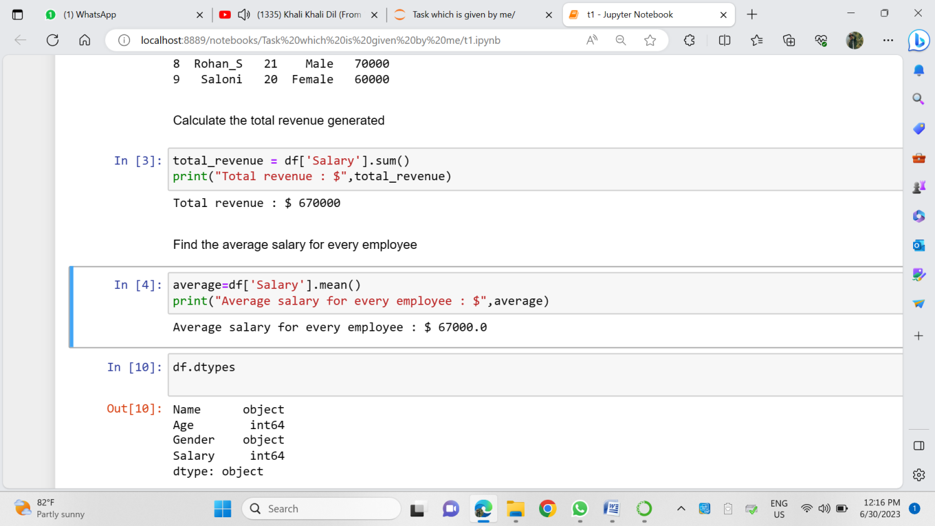
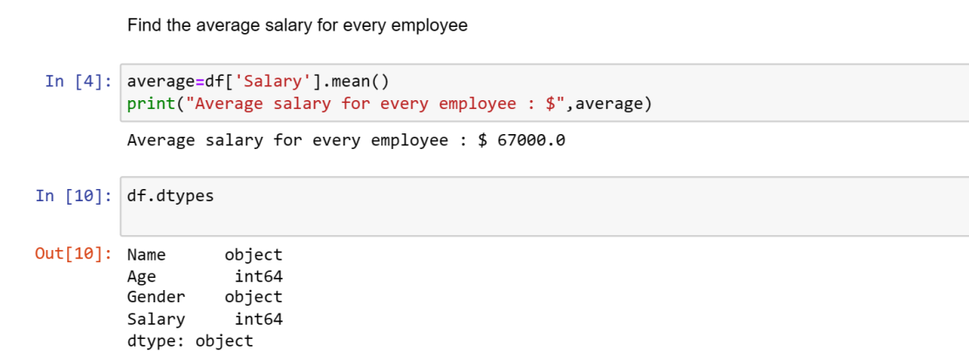
Task 3.2: Calculate the total revenue generated
Task 3.3: Find the average salary for every employee

Slide 9
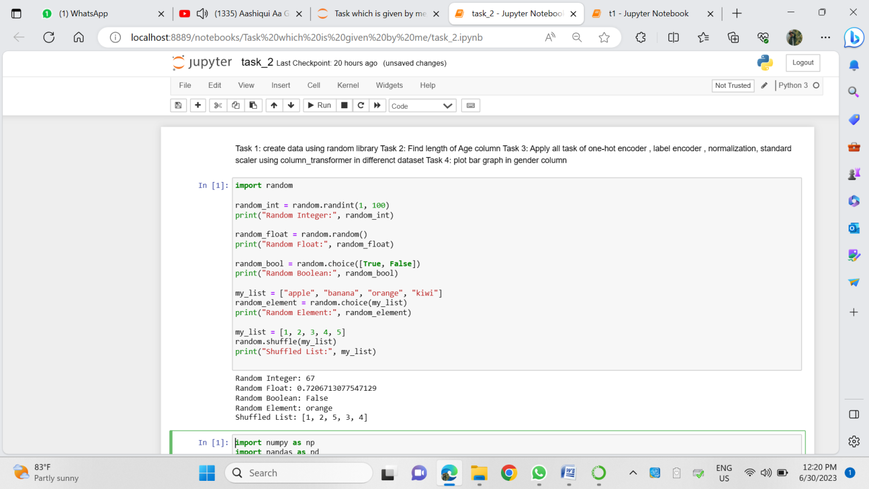
Date: 01/08/2023
Day: Tuesday
Task 4: Create data using random library

Slide 10
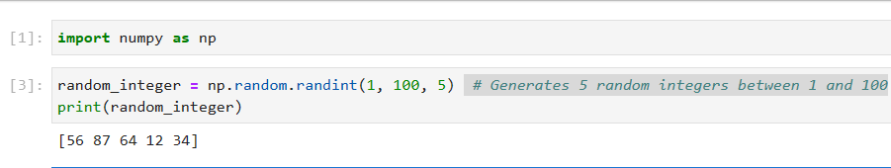
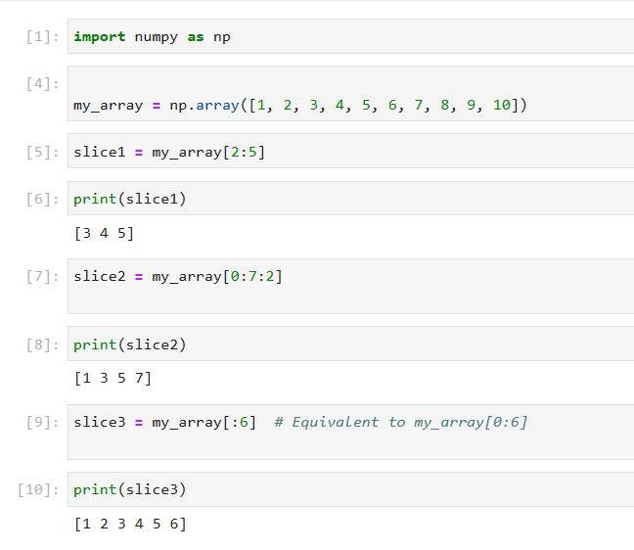
Date: 02/08/2023
Day: Wednesday
Task 4.1: generating random number using numpy
Task 4.2: generate array and slicing numpy array

Slide 11
Task 4.2: generate array and slicing numpy array

Slide 12
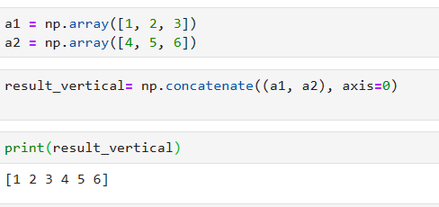
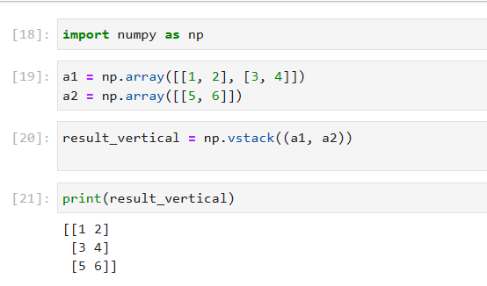
Task 4.2: concatenating two numpy array
1.Using np.concatenate() function
2.Using np.vstack() and np.hstack() methods

Slide 13
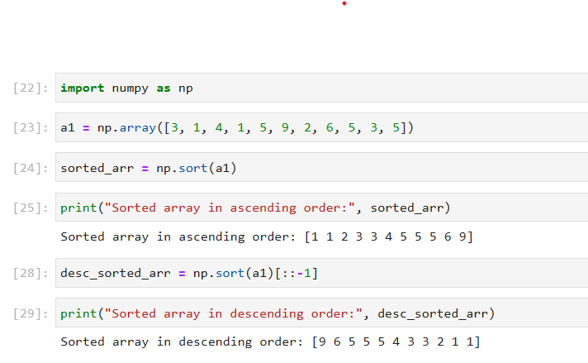
Task 4.3: sorting a numpy array

Slide 14
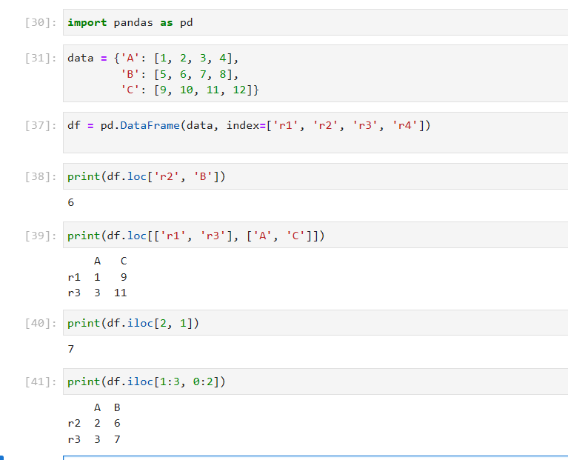
Date: 03/08/2023
Day: Thursday
Task 5: basic of loc and iloc method
loc and iloc are two important methods in pandas, a popular data manipulation library in Python, used for indexing and selecting data from a DataFrame or Series.
1.loc: It is primarily label-based indexing. we use this method to select rows and columns by their labels (names).
Syntax: df.loc[row_label, column_label]
It also allows boolean indexing using conditionals.
2.iloc: This is primarily integer-based indexing. It is used to select rows and columns by their integer positions.
Syntax: df.iloc[row_index, column_index]
Ex:

Slide 15
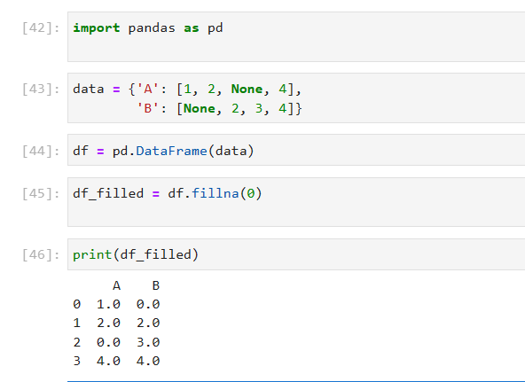
Date: 04/08/2023
Day: Friday
Task 5: fillna() function in pandas
The fillna() function in the Pandas library is used to fill missing or NaN(Not a Number) values in a DataFrame or Series with specified values.
It's a powerful tool for data cleaning and preparation, as missing data can often lead to issues when performing analyses or creating visualizations
The fillna() function allows you to replace missing values with desired values, making your data more complete and ready for further processing.
1.Replacing with a Constant Value

Slide 16
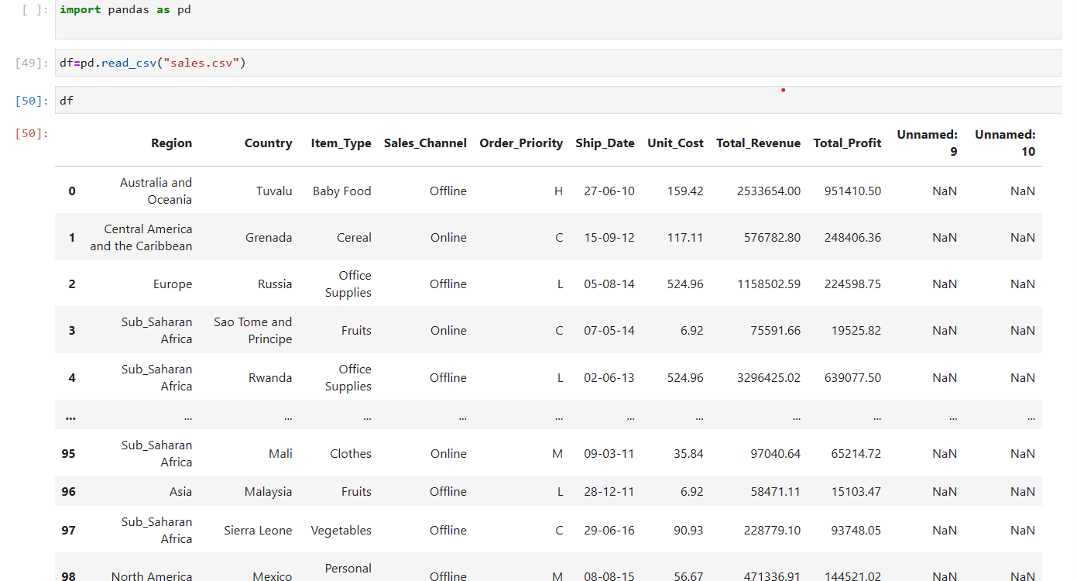
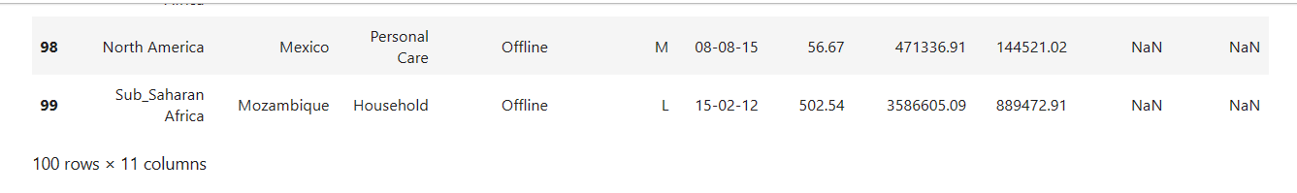
Date: 07/08/2023
Day: Monday
Task 5.1: Introduction to Kaggle
Kaggle is the world's largest data science community with powerful tools and resources to help to achieve our data science goals.
Kaggle is a popular online platform that hosts data science competitions, provides datasets for practice, and offers a community for data scientists, machine learning enthusiasts, and researchers to collaborate and share knowledge. It was founded in 2010 and has since become a hub for individuals interested in honing their data science skills, participating in real-world challenges, and staying up-to-date with the latest developments in the field.
Task 5.2: upload csv file from folder

Slide 17
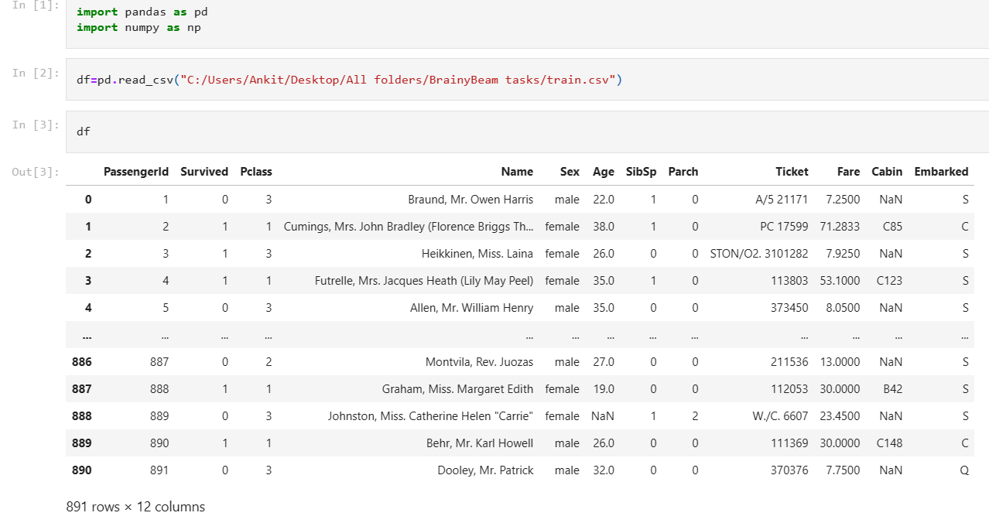
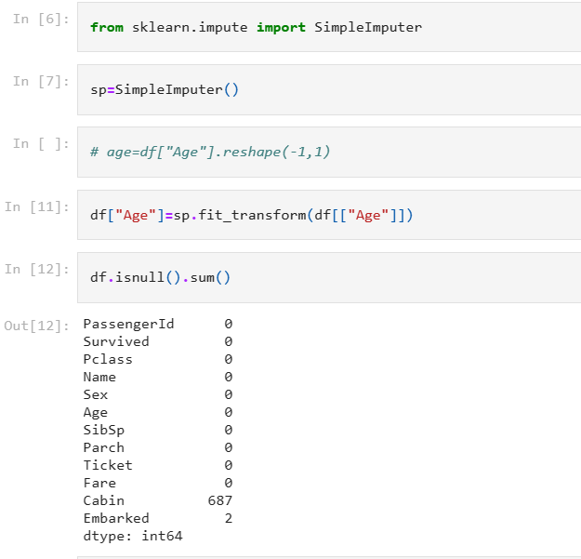
Date: 08/08/2023
Day: Tuesday
Task 6.1: Simple imputer
In machine learning, missing data is a common issue that can affect the performance of models. The SimpleImputer class from the scikit-learn library provides a straightforward way to handle missing data by replacing missing values with either a constant or statistics like mean, median, or most frequent value. This helps to ensure that the dataset is suitable for training machine learning models.

Slide 18
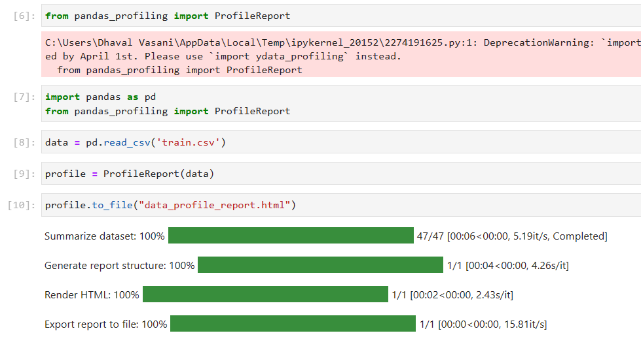
Task 6.2: pandas profiling
"pandas-profiling" is a popular library used to create an exploratory data analysis report for a Pandas DataFrame This report includes various statistics, visualizations, and insights about the data, which can be incredibly helpful during the initial stages of data analysis.
Task 6.3: Importing and Creating a Profile Report

Slide 19
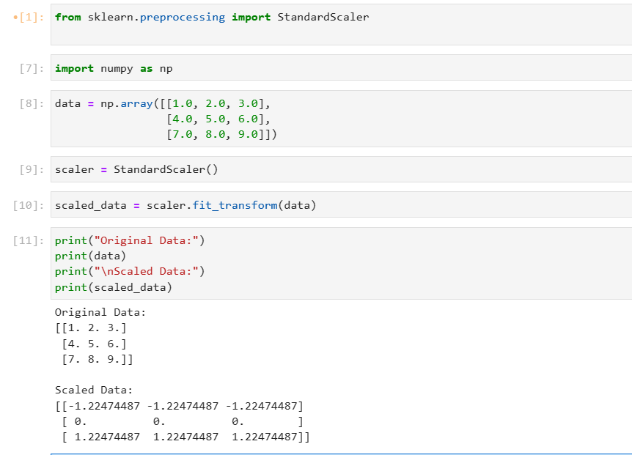
Date: 09/08/2023
Day: Wednesday
Task 7: fit_transform method
The fit_transform method is commonly used in Python libraries such as scikit-learn (sklearn) and is typically associated with data preprocessing and feature engineering tasks, especially when working with machine learning models.
It's a combination of two fundamental steps:
1.Fit: In this step, the method "learns" something from the data.
2.Transform: Once the method has learned from the data, it then applies this knowledge to the data.
Ex:

Slide 20
Date: 10/08/2023
Day: Thursday
Task 7: Data transformation: Standardization and normalization
Data transformation is a crucial step in the data preprocessing phase of data analysis and machine learning. It involves changing the format, structure, or values of data to make it more suitable for analysis or modeling. There are various data transformation methods, and the choice of method depends on the specific characteristics of the data and the goals of the analysis.
There are two types of data transformation method:
1.standardization:
Standardization is a data transformation method used in data preprocessing to rescale features or variables to have a mean of 0 and a standard deviation of 1. This process makes it easier to compare and work with data that may have different scales, ensuring that all features contribute equally to the analysis.
The standardization formula for a feature x is:
Standardized Value (z)=σx/μ​
Where:
  x is the original value of the feature.
  μ is the mean (average) value of the feature.
  σ is the standard deviation of the feature.

Slide 21
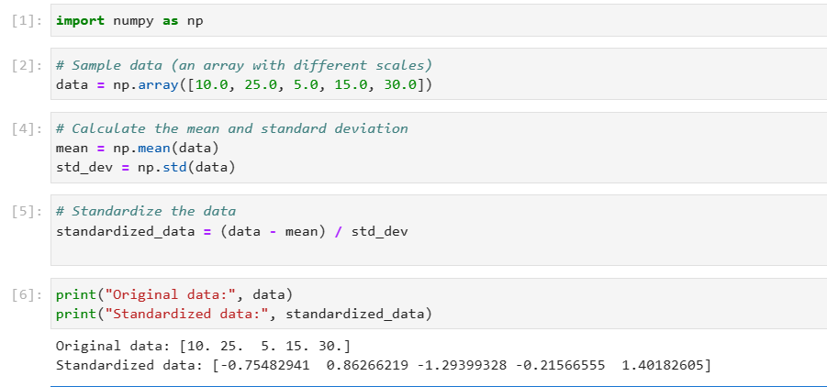
Ex:

Slide 22
2.normalization:
Normalization is a data transformation technique used to scale numerical data features to a standard range, typically between 0 and 1.
Normalization ensures that all features have equal weight during model training and prevents some features from dominating others due to their larger scales.
The most common form of normalization is Min-Max scaling, which transforms data to a specific range.
The formula for Min-Max scaling is:
Xn​ormalized=X-X_{min}/X_{max-}X_{min}
Where:
Xn​ormalized is the normalized value of the feature.
      X is the original value of the feature.
      Xm​in is the minimum value of the feature in the dataset.
      Xm​ax is the maximum value of the feature in the dataset.

Slide 23
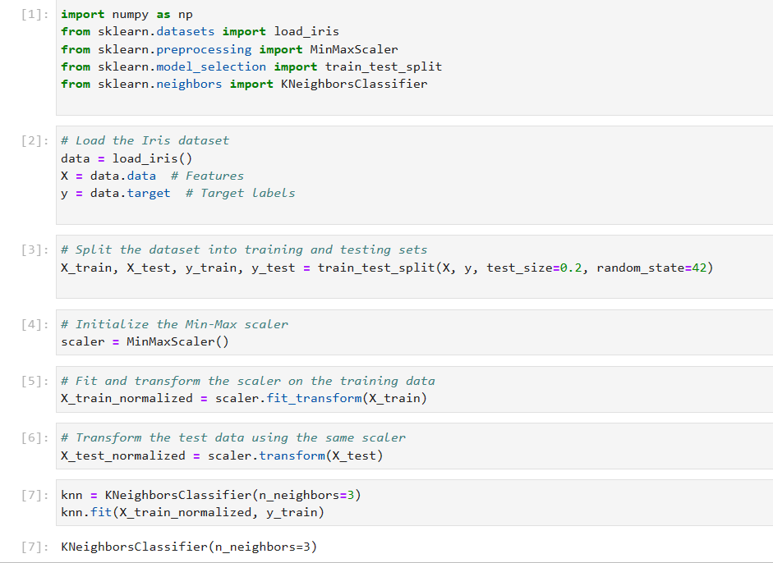
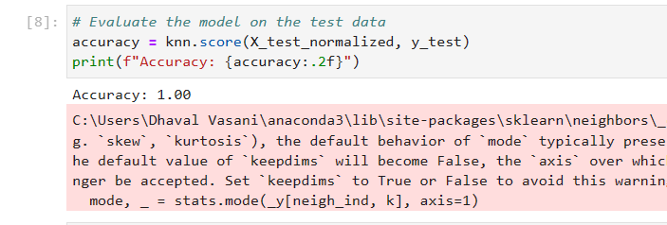
Ex:

Slide 24
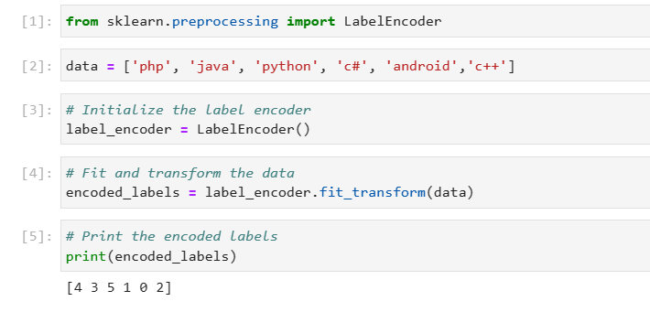
Date: 11/08/2023
Day: Friday
Task 8: label encoding in python
Label encoding is a technique used in machine learning and data preprocessing to convert categorical data (text-based labels) into numerical values, which can be used by machine learning algorithms(because machine learning models require numerical inputs).
Ex:

Slide 25
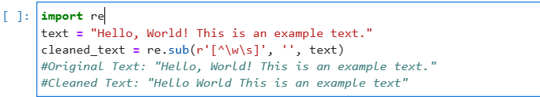
Date: 14/08/2023
Day: Monday
Task 8: Data Cleaning using NLP
Data cleaning, also known as data cleansing or data scrubbing, is the process of identifying and correcting or removing errors, inconsistencies, and inaccuracies in datasets to improve data quality and reliability. Data cleaning is a crucial step in data preprocessing, as the quality of our data can significantly impact the results of any data analysis, machine learning, or NLP tasks.
NLP (Natural Language Processing) can be used for text data cleaning.
NLP is interaction between human natural language & computers.
Ex:

Slide 26
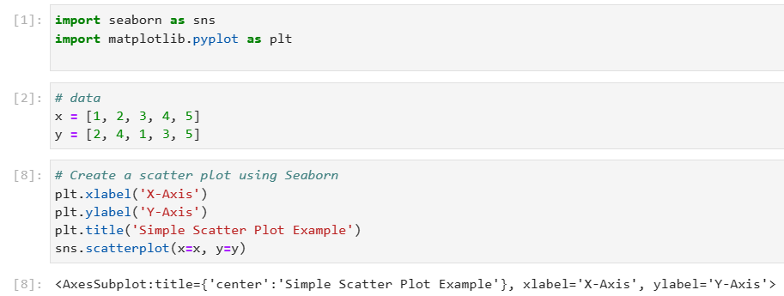
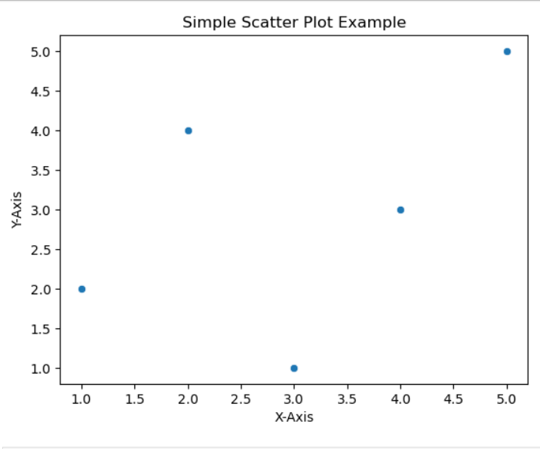
Date: 15/08/2023
Day: Tuesday
Task 9: Visualization libraries in ML: Seaborn & Matplolib
Seaborn and Matplotlib are popular Python libraries used for data visualization, including in machine learning (ML) tasks. These libraries help you create informative and visually appealing plots to explore your data, understand relationships between variables, and communicate your findings effectively.
Using this libraries we can create different graphs like scatterplot,pie,sub-plot,hist,boxplot,c-plot,disc-plot etc.
We can also generate pivot-table and heatmap using seaborn.
ex:

Slide 27
Date: 18/08/2023
Day: Friday
Task 9.1: Basic types of machine learning and algorithm
Machine learning can be categorized into several types based on the learning style, task, and the nature of the data.
Types of machine learning:
  Supervised Learning:
  Unsupervised Learning
  Semi-Supervised Learning
  Reinforcement Learning
  Deep Learning
Task 9.2: categories of supervised machine learning
  1. Logistic Regression:
    Commonly used for binary and multi-class classification problems.
    Models the probability of an input belonging to a specific class using a logistic function.
  2. Decision Trees:
    Suitable for both binary and multi-class classification.
    Divide the feature space into regions and assign a class label to each region.
  3. Random Forest:
    An ensemble of decision trees that can handle both binary and multi-class problems.
    Combats overfitting and improves accuracy through aggregation.

Slide 28
Task 9.3: Types of classification algorithm
  Logistic Regression:
    Commonly used for binary and multi-class classification problems.
    Models the probability of an input belonging to a specific class using a logistic function.
  Decision Trees:
    Suitable for both binary and multi-class classification.
    Divide the feature space into regions and assign a class label to each region.
  Random Forest:
    An ensemble of decision trees that can handle both binary and multi-class problems.
    Combats overfitting and improves accuracy through aggregation.

Slide 29
Task 9.4: Types of regression algorithm
1. Linear Regression:
  Used for predicting a continuous numeric value (e.g., house prices).
  Fits a linear relationship between input features and the target variable.
2. Decision Trees for Regression:
  Applies decision trees to predict continuous values instead of class labels.
  Divides the feature space into regions and assigns a numeric value to each region.
3. Random Forest for Regression:
  An ensemble of decision trees that can handle regression tasks.
  Reduces overfitting and improves accuracy through aggregation.

Slide 30
Date: 23/08/2023
Day: Monday
Task10: Column Transformation
Column transformation in machine learning refers to the process of applying various operations or transformations to the features (columns) of a dataset to prepare them for model training. These transformations can help improve the performance of machine learning models by making the data more suitable for analysis. Common column transformations include scaling, encoding categorical variables, feature extraction, and feature engineering.
1.Scaling: Scaling is used to bring all numerical features to a similar scale, which is important for algorithms that are sensitive to the magnitude of features. The two most common methods are Min-Max scaling and Standardization (Z-score scaling).
  Min-Max Scaling: This scales the feature values to a specific range, typically between 0 and 1.
Ex: Original feature: [10, 20, 30, 40, 50] After Min-Max Scaling: [0.0, 0.25, 0.5, 0.75, 1.0]
  Standardization: This scales the feature values to have a mean of 0 and a standard deviation of 1.
Ex: Original feature: [10, 20, 30, 40, 50] After Standardization: [-1.414, -0.707, 0.0, 0.707, 1.414]
2.Encoding Categorical Variables: Categorical variables are non-numeric, and many machine learning algorithms require numeric inputs. Common techniques for encoding categorical variables include one-hot encoding and label encoding.

Slide 31
2.Encoding Categorical Variables: Categorical variables are non-numeric, and many machine learning algorithms require numeric inputs. Common techniques for encoding categorical variables include one-hot encoding and label encoding.
    One-Hot Encoding: This creates binary columns for each category in a categorical feature.
Ex: Original feature: ["Red", "Green", "Blue"]
After one-hot encoding: Red Green Blue 1 0 0 0 1 0 0 0 1
    Label Encoding: This assigns a unique numeric label to each category.
Ex: Original feature: ["Red", "Green", "Blue"]
After label encoding: [0, 1, 2]

Slide 32
Date: 24/08/2023
Day: Tuesday
Task11: Power Transformation Technique
Power transformation:
Power transformation is a technique used in machine learning to modify the distribution of a numerical feature, making it more closely resemble a normal or Gaussian distribution. This can be particularly useful for certain machine learning algorithms that assume the input features are normally distributed.
Types of power transformation:
1.Square Root Transformation: The square root transformation is used to reduce the skewness in a positively skewed feature by taking the square root of each data point. It is particularly effective when dealing with data where the values are concentrated towards the higher end.
Ex:
Original Income Data: [100, 150, 200, 3000, 5000, 10000]
After Square Root Transformation: [10.00, 12.25, 14.14, 54.77, 70.71, 100.00]
2.Logarithmic Transformation: The logarithmic transformation, specifically the natural logarithm (base e), is used to reduce the skewness in positively skewed data. It compresses large values and expands small values, making the distribution more symmetrical.
Ex:
Original Price Data: [10, 15, 20, 100, 500, 1000]
After Logarithmic Transformation: [2.30, 2.71, 2.99, 4.61, 6.21, 6.91]

Slide 33
Date: 25/08/2023
Day: Wednesday
Task12: Feature Selection in ML
  Feature selection:
Feature selection in machine learning is the process of choosing a subset of the most relevant and informative features (variables or columns) from the original set of features in a dataset. The goal of feature selection is to improve the performance of a machine learning model by reducing dimensionality, increasing model interpretability, and potentially mitigating issues like overfitting
techniques for feature selection:
  1.Filter Methods: Filter methods evaluate the relevance of each feature independently of the machine learning model. These methods use statistical tests or scoring functions to rank or select features.
      Correlation Coefficient: Features that are highly correlated with the target variable are selected.
      Chi-Squared Test: Measures the dependence between a feature and the target variable for categorical features.
      Mutual Information: Measures the amount of information shared between a feature and the target variable.
      ANOVA (Analysis of Variance): Identifies significant differences between the means of groups created by the values of a categorical feature.
    2.Wrapper Methods: Wrapper methods evaluate feature subsets by training and testing machine learning models. They consider feature combinations and evaluate their impact on model performance.
      Forward Selection: Features are added one by one, and the model's performance is evaluated at each step.
      Backward Elimination: Features are removed one by one, and the model's performance is evaluated at each step.
      Recursive Feature Elimination (RFE): Features are recursively removed based on their importance to the model.
      Genetic Algorithms: Evolutionary algorithms are used to search for an optimal feature subset.

Slide 34
3.Embedded Methods: Embedded methods incorporate feature selection as part of the model training process. These methods select features during the model's training based on their importance.
      Lasso Regression: Applies L1 regularization, which encourages some feature coefficients to be exactly zero, effectively selecting features.
      Decision Trees and Random Forests: These models can provide feature importances, and you can select features based on their importance scores.
      Regularized Linear Models: Models like Ridge and Elastic Net include feature selection as part of their optimization process.
    4.Dimensionality Reduction Techniques: Dimensionality reduction methods like Principal Component Analysis (PCA) and Singular Value Decomposition (SVD) reduce the number of features by transforming the original features into a lower-dimensional space. While they don't select specific features, they can be used as a form of feature selection when the focus is on reducing dimensionality.
    5.Feature Importance Scores: Some machine learning models, such as Random Forests and Gradient Boosting Machines, provide feature importance scores.

Slide 35
Conclusion:
In conclusion, my internship experience in the field of data science and machine learning has been incredibly enriching and impactful. Through hands-on projects, collaboration with experts, and exposure to real-world datasets, I have gained a comprehensive understanding of the intricacies of these fields.

Slide 36
Thank You

