Slide 1

Unit-1 Introduction to Machine Learning
Machine Learning (ML)
2301CS621
Prof. Jayesh D. vagadiya
Computer Engineering Department
jayesh.vagadiya@darshan.ac.in
9537133260

Slide 2

Looping
Topics to be covered
Motivation
Machine Learning - Statistic/Insight
Machine Learning - Big Picture
Traditional Programing Vs Machine Learning
Why Use Machine Learning?
When to Use Machine Learning ?
ML Terminology
Machine Learning Project life cycle
Classification of ML Techniques
Type of Machine Learning Algorithms
Main Challenges of Machine Learning

Slide 3
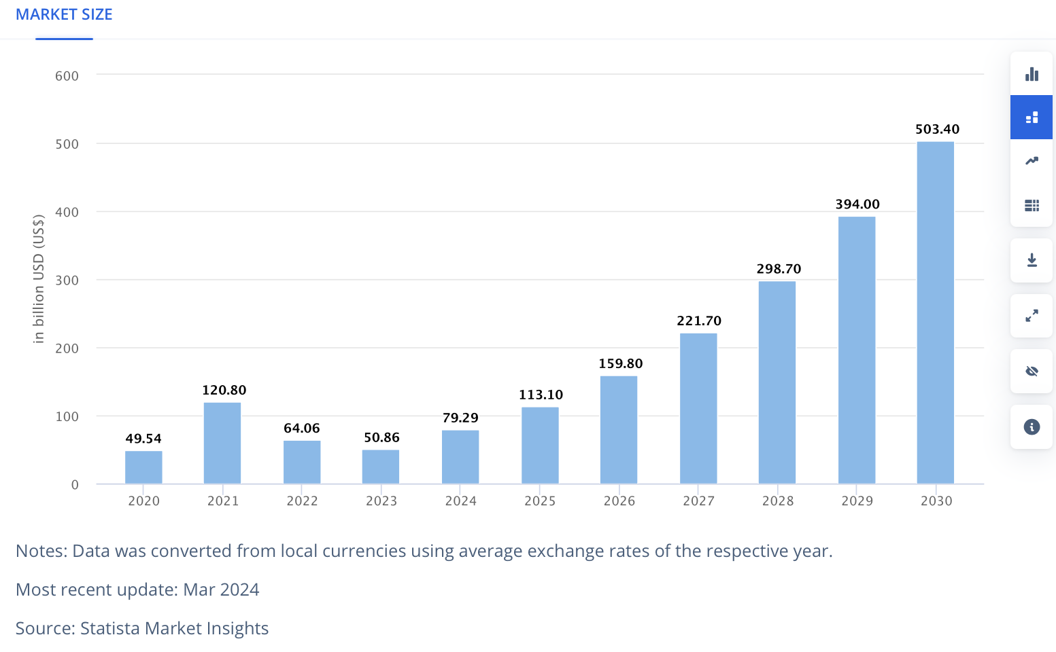
ML – Market size
Ref:https://www.statista.com/outlook/tmo/artificial-intelligence/machine-learning/worldwide#global-comparison

Slide 4
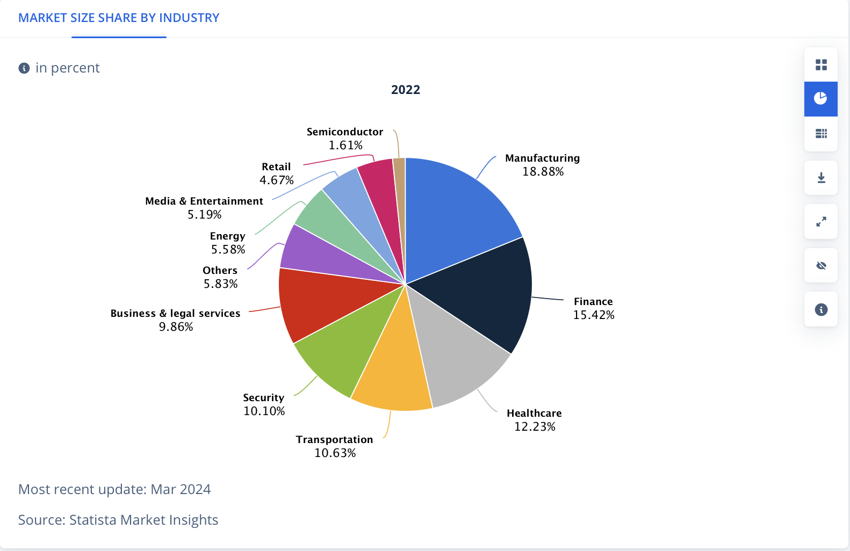
ML – Market size share by industry
Ref:https://www.statista.com/outlook/tmo/artificial-intelligence/machine-learning/worldwide#global-comparison

Slide 5
Machine Learning - Statistic/Insight
Category | Statistic/Insight
Adoption | 48% of businesses globally use machine learning.
Use Cases | - 57% of companies use machine learning to improve the consumer experience. - 49% use it for marketing and sales.
Market Growth | The machine learning market is expected to grow at a CAGR of 38.8% from 2022 to 2029.
Employment | Employment opportunities for machine learning engineers are expected to grow at a rate of 22% globally from 2020 to 2030.
AI Adoption | 91.5% of top companies invest in artificial intelligence.
AI in Financial Services | IBM identifies financial services as the leading sector for AI adoption.
Process Automation | Process automation is the most common application for AI and machine learning.
Ref: https://learn.g2.com/machine-learning-statistics#:~:text=57%25%20of%20companies%20and%20businesses,businesses%20globally%20use%20machine%20learning.

Slide 6
Big Picture
Artificial intelligence
A technique which enables machines to mimic human behaviour
Artificial intelligence
Machine Learning
Subset of Al technique which use statistical methods to enable machines to improve with experience
Machine Learning
Deep Learning
Subset of ML which make the computation of multi-layer neural network feasible
Deep Learning

Slide 7

Traditional Programing Vs Machine Learning
Data
Output
Traditional Programing
Computer
Program
Data
Computer
Program
Machine Learning
Output

Slide 8

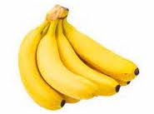
Machine learning
Input Data
???
Apple
Banana
Apple
Prediction
Algorithm
Its an Apple
Banana
Banana
Apple
Apple
Apple
Apple
Input Data Set
for Learning

Slide 9
Definition
Tom M. Mitchell (1997)
A computer program is said to learn from experience E with respect to some class of tasks and performance measure P, if its performance at tasks in T, as measured by P, improves with experience E
Arthur Samuel (1959)
Machine learning is the field of study that gives computers the ability to learn without being explicitly programmed.
Ian Goodfellow, Yoshua Bengio, and Aaron Courville (2016):
Machine learning is the science of getting computers to act without being explicitly programmed, by extracting patterns and insights from data
Ethem Alpaydin (2004):
Machine learning develops algorithms that can learn from and make predictions on data.
Kevin P. Murphy (2012)
Machine learning is a set of methods that can automatically detect patterns in data and then use the uncovered patterns to predict future data or other outcomes of interest

Slide 10
Why Use Machine Learning?
SPAM FILTER -> Traditional Programming Techniques.
Task Done
Hard-coded rules
Rules are static, requires manual updates.
Moderate, prone to errors
High Maintenance of rules.
Poor for large datasets
Start
No Error
Evaluate
Study the problem
Write rules
Error
Analyze
Error

Slide 11
Why Use Machine Learning?
SPAM FILTER -> The Machine Learning approach
Task Done
Data-driven patterns
Dynamic, learns from data
Accuracy High, especially with quality data.
Lower Maintenance (after initial setup)
Scales well with more data
Data
Start
No Error
Evaluate
Study the problem
Train ML Algo
Error
Analyze
Error

Slide 12
When to Use Machine Learning ?
When the Problem Is Too Complex for Coding
In a situation where the problem is so complex or big that you cannot hope to write all the rules to solve it and where a partial solution is viable and interesting, you can try to solve the problem with machine learning.
When the Problem Is Constantly Changing
Some problems may continuously change with time so that the programming code must be regularly updated.
That results in the frustration of software engineers working on the problem, an increased chance of introducing errors, diﬃculties of combining “previous” and “new” logic, and significant overhead of testing and deploying updated solutions.
When It Is a Perceptive Problem
Today, it’s hard to imagine someone trying to solve perceptive problems such as speech, image, and video recognition without using machine learning

Slide 13
When to Use Machine Learning
When It Is an Unstudied Phenomenon
If we need to be able to make predictions of some phenomenon that is not well-studied scientifically, but examples of it are observable, then machine learning might be an appropriate.
When It Is Cost-Eﬀective
The cost of training the model includes human labor and, in some cases, the expensive hardware needed to train deep models. Model maintenance includes continuously monitoring the model and collecting additional data to keep the model up to date

Slide 14
When Not to Use Machine Learning
Every action of the system or a decision made by it must be explainable.
Every change in the system’s behavior compared to its past behavior in a similar situation must be explainable.
The cost of an error made by the system is too high.
Getting the right data is too hard or impossible.
You can solve the problem using traditional software development at a lower cost.
A simple heuristic would work reasonably well.
You build a system that will not have to be improved frequently over time.

Slide 15
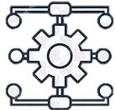


ML Terminology
A method, function, or series of instructions used to generate a machine learning model.
Examples: include linear regression, decision trees, support vector machines, and Naïve Bayes.
A mathematical representation of a real-world process learned from data.
A model defines the relationship between features and label.
Models are created/learned when you train an algorithm on a dataset.
Example: A spam filter
Algorithm
Model

Slide 16


ML Terminology
With respect to a dataset, a feature represents an attribute and value combination.
A Feature is the input used for prediction or classification.
Input variables for the model
Example : "email length" and "presence of keywords”
In supervised learning, a label is the "answer" or "result" portion of an Model.
Target outcomes.
Example: "Spam" or "Not Spam"
Feature
Label

Slide 17


ML Terminology
Data used to teach the model .
Training means creating or learning the model.
During training the model is given labeled examples.
Training enables the model to gradually learn the relationships between features and label.
Example: set of emails labeled as spam or not for training.
Data used to evaluate the model.
Testing means applying the trained model to unlabeled examples.
That is, you use the trained model to make useful predictions.
Example: unseen emails
Training
Testing

Slide 18
Machine Learning Project life cycle
business analyst & data analyst
data engineer & data labeler
data analyst
Goal Definition
Data collection & preparation
Feature engineering
Model training
Model evaluation
Business problem
Model maintenance
Model monitoring
Model serving
Model Deployment
data analyst & data labeler
DevOps
Machine Learning

Slide 19
Machine Learning Project life cycle
Problem Definition
Define the business or research problem.
Identify objectives, success metrics, and constraints.
Understand the potential impact of ML on solving the problem.
Data Collection & Preparation
Gather relevant data from various sources (databases, APIs, web scraping, etc.).
Ensure data aligns with the problem's needs in terms of scope, quality, and scale.
Clean the data: Handle missing values, remove duplicates, and address inconsistencies.
Normalize or standardize features to ensure compatibility with ML algorithms.
Split the dataset into training, validation, and testing subsets.
Perform exploratory data analysis (EDA) to understand data distributions and patterns.
Feature Engineering
Select or create meaningful features from raw data to improve model performance.
Techniques include: Feature selection , Feature transformation , Feature creation

Slide 20
Machine Learning Project life cycle
Model Training
Train the model using the training dataset.
Optimize model parameters using techniques like gradient descent.
Monitor performance using metrics like accuracy, precision, recall, etc.
Model Evaluation
Evaluate the model on the validation dataset to tune hyperparameters.
Assess performance using appropriate metrics accuracy, precision, recall, etc.
Perform cross-validation for robust evaluation.
Model Deployment
Integrate the trained model into production environments.
Options for deployment:
Batch processing (offline).
Real-time inference (APIs, cloud services).

Slide 21
Machine Learning Project life cycle
Model Serving
Ensures the model is operational and accessible to users.
Serving in Batch Mode - In batch serving, predictions are generated for a large dataset all at once and stored for later use.
In on-demand serving, predictions are generated dynamically in response to a specific user request.
Model Monitoring
Model Monitoring detects performance issues or changing data distributions.
The process of tracking a deployed model’s performance, accuracy, and reliability in production.
Model Maintenance
Model Maintenance addresses issues found during monitoring and improves the model's accuracy and reliability.
Activities aimed at ensuring the model remains accurate, relevant, and efficient over time.

Slide 22
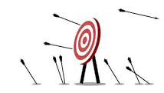

Classification of ML Techniques
Machine Learning
Supervised Learning
Unsupervised Learning
Reinforcement Learning
Task driven / predict value
Data driven / identify clusters
Learn from mistakes

Slide 23
Supervised Learning
Labeled data
???
Apple
Banana
Apple
Prediction
Algorithm
Its an Apple
Banana
Banana
Apple
Apple
Apple
Apple
Training Data Set
Here we Use Label Data to train Classifier (Supervised Learning)

Slide 24
Machine Learning Process for Supervised Learning
Test Data
Model Testing
Collecting data
Cleaning data
Splitting data
Update Parameters
Model Deployment
Train Data
Model Training

Slide 25
Supervised Learning
Also called predictive learning. A machine predicts the class of unknown objects based on prior class-related information of similar objects.
The major motivation of supervised learning is to learn from past information.
A machine needs the basic information to be provided to it. This basic input, or the experience in the paradigm of machine learning, is given in the form of training data.
Example:
Predicting the results of a game
Predicting whether a tumour is malignant or benign
Predicting the price of domains like real estate, stocks, etc.
Classifying texts such as classifying a set of emails as spam or non-spam

Slide 26
Supervised Learning
in predictive (supervised) learning, the goal is to approximate the true function f(x), which maps input x to output y.
This is achieved by learning a hypothesis function h(x) that is as close as possible to f(x). Here's how this works:
Given:
Goal:
A training dataset of N examples:
{(x1,y1),(x2,y2),…,(xN,yN)}{(x1​,y1​),(x2​,y2​),…,(xN​,yN​)}
where each yj​ is generated from the (unknown) function y=f(x) possibly with noise.
Find a hypothesis h(x) (also called a model) such that h(x)≈f(x).
This means that h(x) predicts y accurately for both seen and unseen examples.

Slide 27
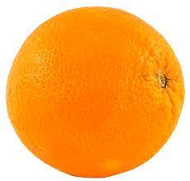
Unsupervised Learning
Input Data
Clustering
Algorithm
Here we don’t use Label Data to train Classifier(Unsupervised Learning)
Finding similarities between data according to the characteristics found in the data and grouping similar data objects into clusters

Slide 28
Unsupervised Learning
Also called descriptive learning. A machine finds patterns in unknown objects by grouping similar objects together.
In unsupervised learning, the objective is to take a dataset as input and try to find natural groupings or patterns within the data elements or records.
Therefore, unsupervised learning is often termed as descriptive model and the process of unsupervised learning is referred as pattern discovery or knowledge discovery.
One critical application of unsupervised learning is customer segmentation.
Clustering is the main type of unsupervised learning. It intends to group or organize similar objects together.
For that reason, objects belonging to the same cluster are quite similar to each other while objects belonging to different clusters are quite dissimilar.
Clustering, Dimensionality Reduction, Density Estimation, Association Rule Learning are the type of unsupervised learning.

Slide 29
Reinforcement Learning
Input Data
Environment
Reward
Best
Action
State
Algo
Selection
Agent
Reinforcement Learning Model

Slide 30
Reinforcement Learning
It use feedback is called a reward, or reinforcement.
1) The agent(decision-maker) observes the current state of the environment(The system or scenario with which the agent interacts.).
2) Based on the state, the agent chooses an action according to its policy(The agent's strategy, mapping states to actions.).
3) The environment responds to the action by:
Transitioning to a new state
Providing a reward.
4) The agent updates its policy using the feedback.
Steps 1–4 repeat, with the goal of maximizing the total reward over time.
Reinforcement learning is like training a dog, where the agent (dog) learns to take actions based on rewards from interacting with its environment.
The key components include the agent (dog), environment (surroundings), state (current situation), action (behavior), and reward (feedback).

Slide 31
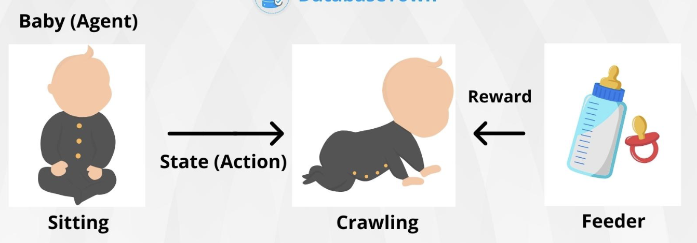
Reinforcement Learning
The dog learns through trial and error, associating positive rewards like treats with correct actions and negative rewards with incorrect ones.
Initially, the dog explores various actions to identify what yields rewards, then exploits this knowledge to consistently perform rewarding actions.
Concepts like positive reinforcement (rewarding good behavior) and shaping (rewarding gradual improvements) are central to both dog training and reinforcement learning.
Ref: https://databasetown.com/basics-of-reinforcement-learning/

Slide 32
Supervised vs. Unsupervised vs. Reinforcement
Supervised Learning | Unsupervised Learning | Reinforcement
Input data is labeled | Input data is unlabeled | Sequential interaction data
Has a feedback mechanism | Has no feedback mechanism | Reward signals
Data is classified based on the training dataset | Assigns properties of given data to classify it | The model learn and updates itself through reward.
Divided into Regression & Classification | Divided into Clustering & Association | No Types
Used for prediction | Used for analysis | Used for Maximize rewards
Algorithms include: decision trees, logistic regressions, support vector machine | Algorithms include: k-means clustering, hierarchical clustering, apriori algorithm | Algorithms include:Q-Learning, Sarsa
A known number of classes | A unknown number of classes | A unknown number of classes

Slide 33
Type of Machine Learning Algorithms
Machine Learning
Supervised Learning
Unsupervised Learning
Classification
Regression
Clustering
Association

Slide 34

Classification and Regression
Regression
Classification
What will be the next increment?
Is the employee "eligible for promotion" or "not eligible” ?
3.9%
Eligible
Employee
Employee

Slide 35
Classification and Regression
Regression is used when you want to predict a numerical value (e.g., predicting salary, sales, temperature).
Classification is used when you want to assign a category label to data (e.g., classifying emails as spam or not, identifying diseases, or segmenting customers).
Regression | Classification
- Predict Continuous numerical value (real number) | - Predict Discrete class label (category)
- Predicting house price - Forecasting, trend analysis, estimating quantities | - Spam email detection - Categorizing data, identifying patterns, classification tasks
quantitative | qualitative

Slide 36
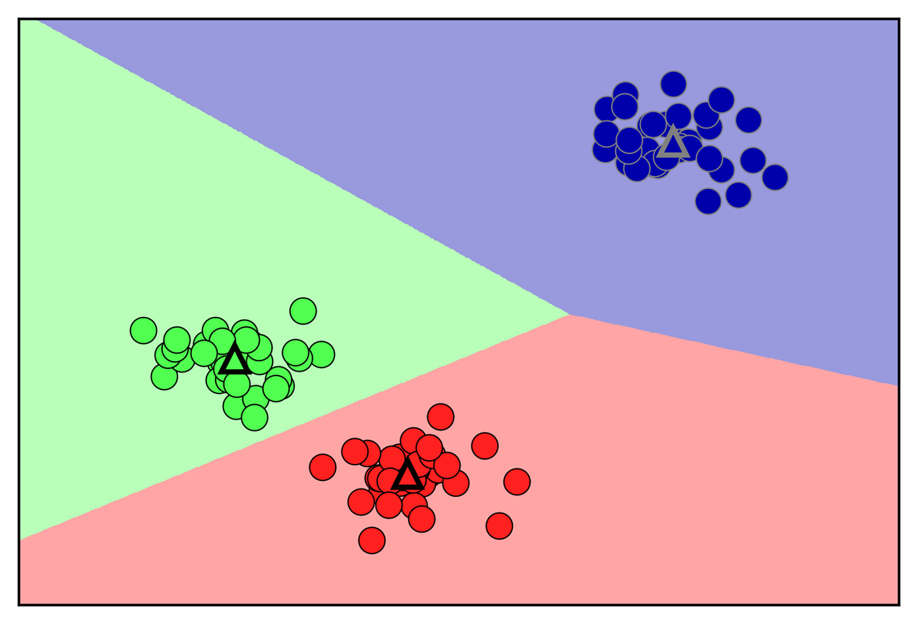
Clustering
Cluster is a group of similar data points.
Points in the same cluster are more similar to each other than to those in other clusters.
Clustering often uses distance measures to group points.
Common metrics: Euclidean Distance, Manhattan Distance:, Cosine Similarity

Slide 37
Clustering
Minimize intra-cluster distance (points within the same cluster are close).
Maximize inter-cluster distance (clusters are distinct).
Cluster analysis or simply clustering is the process of partitioning a set of data objects (or observations) into subsets.
Each subset is a cluster.
The set of clusters resulting from a cluster analysis can be referred to as a clustering.
Cluster analysis (or clustering, data segmentation, …)
Finding similarities between data according to the characteristics found in the data and grouping similar data objects into clusters
Clustering is useful in that it can lead to the discovery of previously unknown groups within the data.

Slide 38
Association Rule Mining
Given a set of transactions, we need rules that will predict the occurrence of an item based on the occurrences of other items in the transaction.
Market-Basket transactions
TID | Items
1 | Bread, Milk
2 | Bread, Chocolate, Pepsi, Eggs
3 | Milk, Chocolate, Pepsi, Coke
4 | Bread, Milk, Chocolate, Pepsi
5 | Bread, Milk, Chocolate, Coke
Example of Association Rules
{Chocolate} → {Pepsi},
{Milk, Bread} → {Eggs, Coke},
{Pepsi, Bread} → {Milk}

Slide 39

Market Basket Analysis
Market Basket Analysis is a modelling technique to find frequent itemset.
It is based on, if you buy a certain group of items, you are more (or less) likely to buy another group of items.
For example, if you are in a store and you buy a car then you are more likely to buy insurance at the same time than somebody who don't buy insurance also.
The set of items that a customer buys it referred as an itemset.
Market basket analysis seeks to find relationships between purchases (Items).
E.g. IF {Car, Accessories} THEN {Insurance}
{Car, Accessories} → {Insurance}

Slide 40
Model-Based vs. Instance-Based Learning
Model-Based
Most supervised learning algorithms are model-based.
Model-based learning algorithms use the training data to create a model with parameters learned from the training data.
After the model is trained, it can be saved on disk while the training data can be discarded.

Slide 41
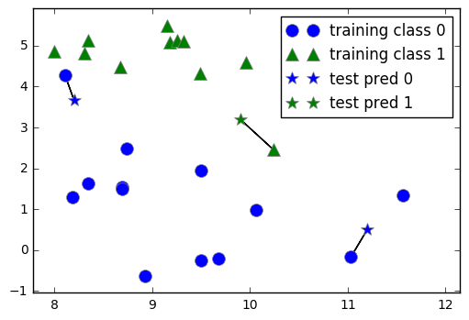
Model-Based vs. Instance-Based Learning
Instance-based
Instance-based learning algorithms use the whole dataset as the model.
In instance-based learning, the algorithm doesn't explicitly learn a model but instead memorizes the training data.
Predictions for new data are made by comparing them directly to the stored instances.

Slide 42
Shallow vs. Deep Learning
A shallow learning algorithm learns the parameters of the model directly from the features of the training examples.
Most machine learning algorithms are shallow.
specifically those that build neural networks with more than one layer between input and output. Such neural networks are called deep neural networks. In deep neural network learning (or, simply, deep learning),

Slide 43
Application of ML
Image Recognition
Speech Recognition
Recommender Systems
Fraud Detection
Self Driving Cars
Medical Diagnosis
Stock Market Trading

Slide 44
Main Challenges of Machine Learning
Insufficient Quantity of Training Data
it takes a lot of data for most Machine Learning algorithms to work properly.
Even for very simple problems you typically need thousands of examples, and for complex problems such as image or speech recognition you may need millions of examples.
Non representative Training Data
In order to generalize well, it is crucial that your training data be representative of the new cases you want to generalize to. This is true whether you use instance-based learning or model-based learning.
Poor-Quality Data
Obviously, if your training data is full of errors, outliers, and noise (e.g., due to poor quality measurements), it will make it harder for the system to detect the underlying patterns, so your system is less likely to perform well.

Slide 45
Main Challenges of Machine Learning
Irrelevant Features
As the saying goes: garbage in, garbage out. Your system will only be capable of learning if the training data contains enough relevant features and not too many irrelevant ones.
A critical part of the success of a Machine Learning project is coming up with a good set of features to train on.
Overfitting the Training Data
It means that the model performs well on the training data, but it does not generalize well. Not learn generalized.
Underfitting the Training Data
Underfitting is the opposite of overfitting: it occurs when your model is too simple to learn the underlying structure of the data.

Slide 46
Bias and Variance in Machine Learning
Bias
Bias is one type of error that occurs due to wrong assumptions about data such as assuming data is linear when in reality, data follows a complex function.
Bias is a systematic error that occurs due to wrong assumptions in the machine learning process.
Low Bias
In this case, the model will closely match the training dataset.
High Bias
the model will not match the training dataset closely.
For example, a linear regression model may have a high bias if the data has a non-linear relationship.
The high-bias model will not be able to capture the dataset trend. It is considered as the underfitting model which has a high error rate. It is due to a very simplified algorithm.

Slide 47
Bias and Variance in Machine Learning
Variance
Variance is the variability of the model that how much it is sensitive to another subset of the training dataset.
In machine learning variance is the amount by which the performance of a predictive model changes when it is trained on different subsets of the training data.
how much it can adjust on the new subset of the training dataset.
Low variance:
Low variance means that the model is less sensitive to changes in the training data and can produce consistent estimates of the target function with different subsets of data from the same distribution
High variance:
High variance means that the model is very sensitive to changes in the training data and can result in significant changes in the estimate of the target function when trained on different subsets of data from the same distribution.

Slide 48
Bias-Variance Trade-Off
The goal is to achieve a balance where the model generalizes well on unseen data.
This involves minimizing the combined error from bias and variance.
Optimal Complexity
Total Error = Bias² + Variance + Irreducible Error
Error
Increasing model complexity typically decreases bias but increases variance.
Decreasing model complexity typically increases bias but decreases variance.
High Bias and Low Variance - Underfitting
Low Bias and High Variance – Overfitting
Bias²
Total Error
Variance
Model Complexity

Slide 49
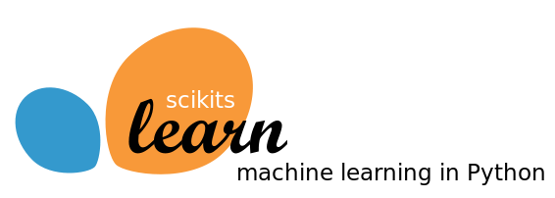
Tools used for Machine Learning : Scikit-learn
The Scikit-learn library is one of many Scikit libraries that build on the capabilities provided by NumPy and SciPy to allow Python developers to perform domain specific tasks.
Scikit-learn library focuses on data mining and data analysis, it provides access to following sort of functionality:
Classification
Regression
Clustering
Dimensionality reduction
Model selection
Pre-processing
Scikit-learn is the most important library we are going to learn in this subject

Slide 50

Tools used for Machine Learning : Keras and TensorFlow
Keras is an application programming interface (API) that is used to train deep learning models.
An API often specifies a model for doing something, but it doesn’t provide an implementation.
TensorFlow is an implementation for the keras, there are many other implementations for the keras like
Microsoft’s cognitive Toolkit, CNKT
Theano

Slide 51
Classes in Scikit-learn
Understanding how classes work is an important prerequisite for being able to use the Scikit-learn package appropriately.
Scikit-learn is the package for machine learning and data science experimentation favored by most data scientists.
It contains wide range of well-established learning algorithms, error functions and testing procedures.
Install : conda install scikit-learn
There are four class types covering all the basic machine-learning functionalities,
Classifying
Regressing
Grouping by clusters
Transforming data

Slide 52
Choosing a correct algorithm in Scikit-learn
Get more data
>50
samples
Start
Predicting a category?
Predicting a Quantity?
No
Yes
Not working
Do you have Labeled data?
Clustering
Regression
<100K
samples
<100K
samples
no. of category known
Randomized
PCA
No Algo
SGD
Regressor
Few features are important
Linear SVC
SGD
Classifier
<10K
samples
<10K
samples
<10K
samples
Text data?
KMeans
RidgeRegressor
kernel
approximation
Mini Batch
KMeans
Lasso
Kernel
approximation
Isomap
SVR(kernel=‘linear’)
Spectral
Embedding
ElasticNet
Spectral
Clustering
Mean Shift
Dimensionality
Reduction
Naïve
Bayes
Kneighbors
Classifier
SVC
EnsembleRegressor
Ensemble
Classifiers
GMM
VBGMM
Classification
SVR(kernel=‘rbf’)
LLE

Slide 53
Basic Structure of Scikit-Learn
Step – 01 (import)
Step – 02 (create object)
from sklearn.family import Model
Example
from sklearn.linear_model import LinearRegression
m = Model(parameters)
Example
lr = LinearRegression()
Step – 03 (split data) (Only For Supervised Learning)
from sklearn.model_selection import train_test_split
X_train, X_test, y_train, y_test = train_test_split(X,y,test_size=0.3)
Step – 04 (Train Model)
Step – 06 (Evaluate Model)
m.fit(X_train,y_train) #For Supervised Learning
OR
m.fit(X_train) #For Unsupervised Learning
Evaluate the model and update the parameters if required.
Evaluating technique will be different for regression, classification and clustering.
We will explore all the techniques in later sessions.
Example Model Evaluation for Regression
from sklearn import metrics
print(metrics.mean_squared_error(ytest,predictions))
Step – 05 (Predict) (Only For Supervised Learning)
predictions = m.predict(X_train)

Slide 54
train_test_split()
Split arrays or matrices into random train and test subsets.
The output of the train_test_split function is X_train, X_test, y_train, and y_test, which are all NumPy arrays. X_train contains 75% of the rows of the dataset, and X_test contains the remaining 25%
Before making the split, the train_test_split function shuffles the dataset using a pseudorandom number generator.
we provide the pseudorandom number generator with a fixed seed using the random_state parameter. This will make the outcome deterministic, so this line will always have the same outcome.
Demo.py
1
2
from sklearn.model_selection import train_test_split
X_train, X_test, y_train, y_test = train_test_split(iris_dataset['data'], iris_dataset['target'], random_state=0)

