Slide 1

Unit-02 Regression
Machine Learning (ML)
2301CS621
Prof. Jayesh D. vagadiya
Computer Engineering Department
jayesh.vagadiya@darshan.ac.in
9537133260

Slide 2

Looping
Topics to be covered
Introduction
Simple linear regression
Multiple linear regression
Polynomial regression
Support vector regression
Logistic regression
Ridge regression

Slide 3


Introduction
Regression is used when you want to predict a numerical value (e.g., predicting salary, sales, temperature).
Regression is a statistical method used to examine the relationship between a dependent variable (target) and one or more independent variables (features).
House Size (sq ft) | Price ($)
1000 | 300,000
1500 | 400,000
2000 | 500,000
2500 | 600,000
3000 | 700,000
House Size
Price

Slide 4
Simple Linear Regression
Simple Linear Regression is a statistical method used to model the relationship between a dependent variable Y and a single independent variable X. The goal is to find a linear equation that predicts Y based on X.
Y= b₀ + b₁X₁
Dependent
Variable
Independent
Variable
Y intercept
(constant)
Slop

Slide 5

Simple Linear Regression
Y
Product sales(Unit)
Advertising budget
Product sales
Y = b₀ + b₁X₁
b₀ -> 7 unit
b₁ -> 20[units/thousand]
+20 units
7 unit
X
+1
Advertising budget
(thousands)
Product sales(Unit) = b₀ + b₁* Advertising budget(thousands)

Slide 6



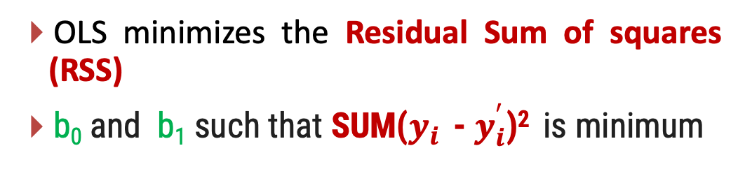
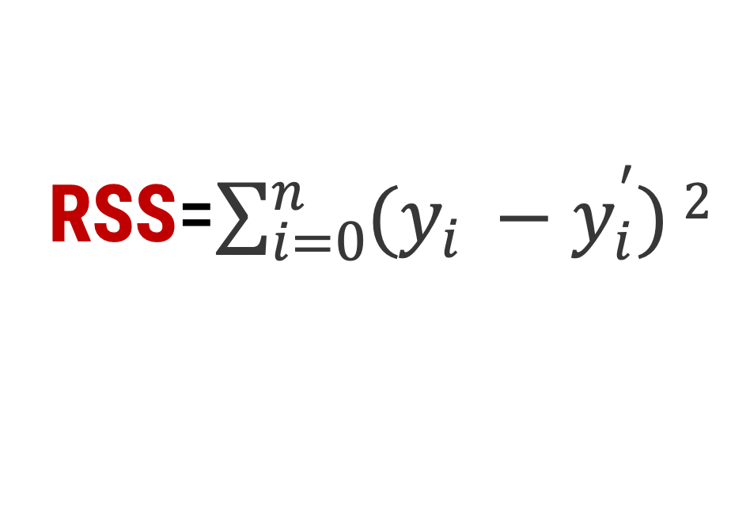


Ordinary Least Squares (OLS)
$$y_{i}$$
Y
Residual =
=
$E_{i}$= $y_{i}$ - $y_{i}^{′}$
Product sales(Unit)
$$y_{i}^{′}$$
OLS minimizes the Residual Sum of squares (RSS)
b₀ and b₁ such that SUM($y_{i}$ - $y_{i}^{′}$)² is minimum
$y_{i}$
$$y_{i}^{′}$$
RSS=​$\sum_{i=0}^{n}{(y_{i} −y_{i}^{′})}2$
X
advertising budget
(thousands)

Slide 7
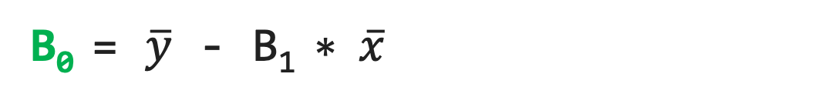
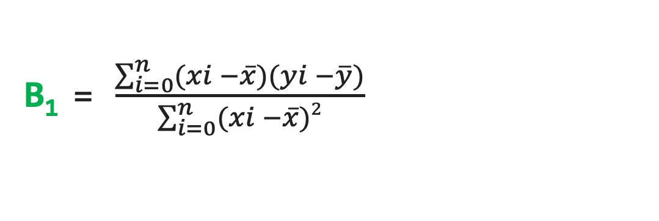
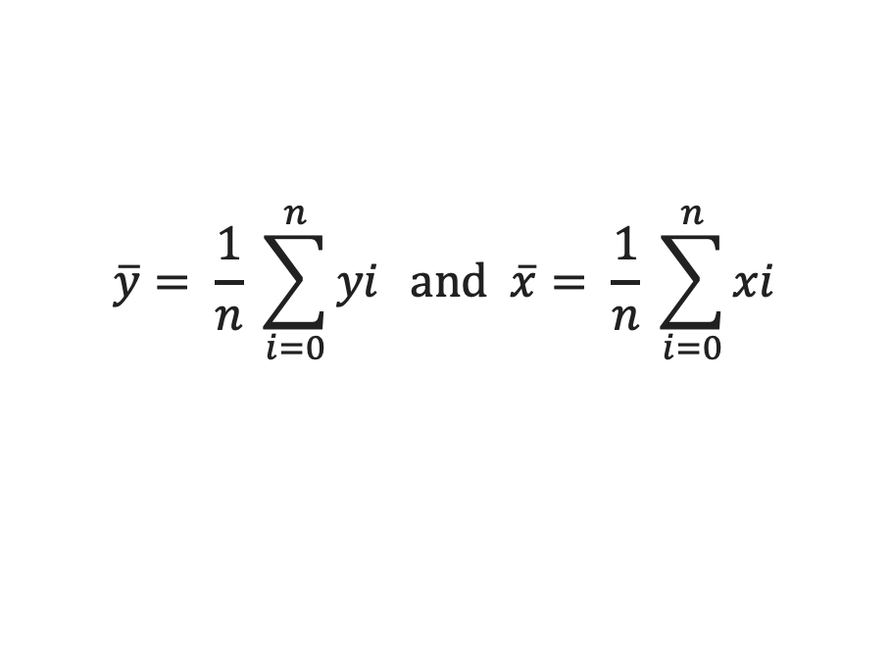
Ordinary Least Squares (OLS)
(OLS) method is a fundamental technique in linear regression used to estimate the parameters (b₀,b₁,..,b_{n}) of a linear model by minimizing the sum of the squared differences between observed values and predicted values.
B₁ = $\frac{\sum_{i=0}^{n}{(xi −\overline{x})}(yi −\overline{y})}{\sum_{i=0}^{n}{(xi −\overline{x})}2}$
B₀ = $\overline{y}$ - B₁ $∗ \overline{x}$
Where,
$$\overline{y}= \frac{1}{n} \sum_{i=0}^{n}{yi} and \overline{x}= \frac{1}{n} \sum_{i=0}^{n}{xi}$$

Slide 8
Gradient Descent
Gradient Descent is an optimization algorithm used to minimize the loss function in machine learning models, such as linear regression and neural networks.
It iteratively adjusts model parameters to find the best-fit solution.
Applications: Used in models like Linear Regression, Logistic Regression, and Neural Networks.
Loss Function: A measure of how far the model's predictions are from the actual values.
Example: Mean Squared Error (MSE) for regression.
Goal: Minimize the loss function by finding optimal parameters (weights and bias).

Slide 9
How Does Gradient Descent Work?
1) Start with random initial values for parameters (weights).
2) Compute the gradient (slope of the loss function).
3) Adjust parameters in the opposite direction of the gradient.
4) Repeat until the loss converges to a minimum value.
Y
Total Loss
Steep slop: so take large steps
Slop is less steep: so take small steps
X
W

Slide 10
The Gradient Descent Formula
Parameter Update Rule:
w = w - α * ∂Loss/∂w
w: Weight (parameter)
α: Learning rate (step size) -> Determines step size. Too large overshoots; too small converges slowly.
∂Loss/∂w: Gradient of the loss function

Slide 11
Residual Sum of squares
If RSS is very close to zero. it means the model fits the data almost perfectly.
However, a small RSS does not guarantee a good model in general. For example, overfitting might lead to a near-zero RSS on training data but poor generalization on unseen data.
RSS allows you to compare the performance of different regression models on the same dataset. A model with a lower RSS is generally preferred.
We can fund RSS using scikit-learn’s mean_squared_error function.
Residual.py
1
2
3
4
from sklearn.metrics import mean_squared_error
rss = mean_squared_error(y, y_pred) * len(y)
print("Residual Sum of Squares (RSS):", rss)

Slide 12
Properties of Linear Regression
For the regression line where the regression parameters b₀ and b₁ are defined, the properties are given as:
The line reduces the sum of squared differences between observed values and predicted values.
The regression line passes through the mean of X and Y variable values
Linear regression constant (b₀) is equal to the y-intercept of the linear regression.
Linear regression coefficient (b₁) is the slope of the regression line.

Slide 13


Assumptions of Linear Regression
Regression is a parametric approach. ‘Parametric’ means it makes assumptions about data for the purpose of analysis.
It fails to deliver good results with data sets which doesn’t fulfill its assumptions.
Therefore, for a successful regression analysis, it’s essential to validate these assumptions.
Linearity:
The relationship between the dependent and independent variables is linear.
The expected value of the dependent variable is a linear function of the independent variable(s).

Slide 14
Assumptions of Linear Regression
Homoscedasticity:
The variance of residuals (errors) is constant across all levels of the independent variable(s)
If the variance changes (heteroscedasticity), it can lead to inefficient estimates and affect hypothesis tests.
Normality of Residuals(Error)
The residuals (errors) are normally distributed.
This assumption is important for hypothesis testing and constructing confidence intervals.

Slide 15
Assumptions of Linear Regression
Independence:
Observations are independent of each other.
There should be no correlation between residuals (errors).
This is particularly important in time series data, where autocorrelation can occur.
No Perfect Multicollinearity(for multiple regression)
If you are using multiple independent variables, they should not be perfectly correlated with each other.
Perfect multicollinearity occurs when one independent variable is a perfect linear function of another.
X1 !~ X2
X1 ~ X2

Slide 16
Assumptions of Linear Regression
Outlier check:
Outlier might effect the prediction.

Slide 17
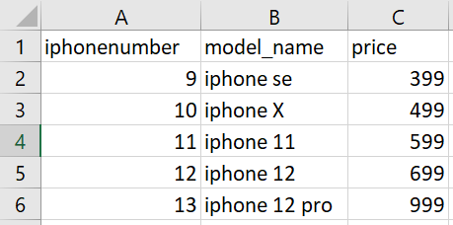
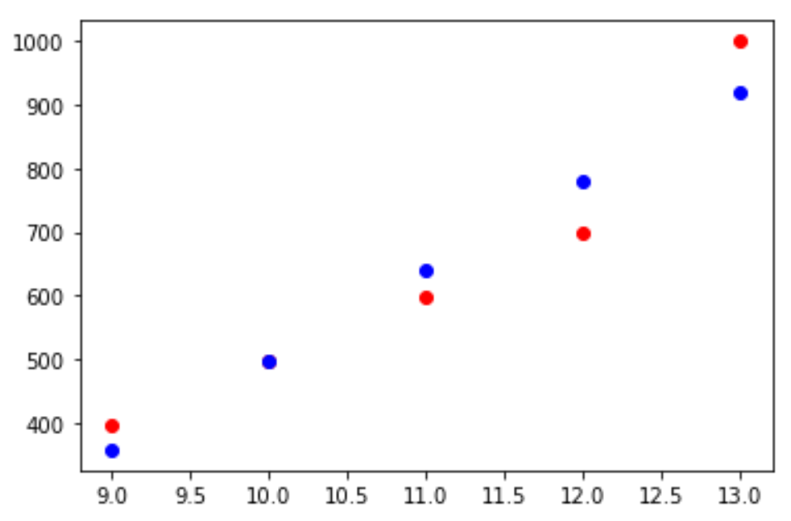
Linear Regression (Example) (iPhone Prices)
iPhoneLinReg.py
1
2
3
4
5
6
7
8
9
10
11
12
13
14
15
16
17
18
19
import pandas as pd
df = pd.read_csv('iphones.csv')
from sklearn.linear_model import LinearRegression
lr = LinearRegression()
X = df['iphonenumber'].values.reshape(-1,1)
y = df['price']
lr.fit(X,y)
lr.predict([[14]]) # price for the next iphone
predicted = lr.predict(X)
import matplotlib.pyplot as plt
%matplotlib inline
plt.scatter(df['iphonenumber'],df['price'],c='r')
plt.scatter(df['iphonenumber'],predicted,c='b')
iphones.csv
Output

Slide 18
R Squared
R-squared is a goodness-of-fit measure for linear regression models
R-squared (R2) is defined as a number that tells you how well the independent variable(s) in a statistical model explains the variation in the dependent variable.
R² values range from 0 to 1.
0: Indicates that the model does not explain any of the variance in the dependent variable.
1: Indicates that the model explains all the variance in the dependent variable.
Intermediate Values: The closer to 1, the better the model fits the data.
An R² of 0.7 means 70% of the variance in the dependent variable is explained by the model.
it doesn’t tell you whether your chosen model is good or bad, nor will it tell you whether the data and predictions are biased.
A high or low R-squared isn’t necessarily good or bad—it doesn’t convey the reliability of the model or whether you’ve chosen the right regression. You can get a low R-squared for a good model, or a high R-squared for a poorly fitted model, and vice versa.

Slide 19
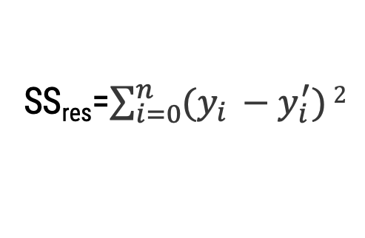

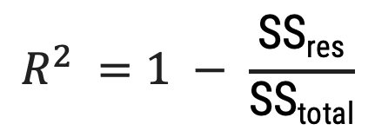
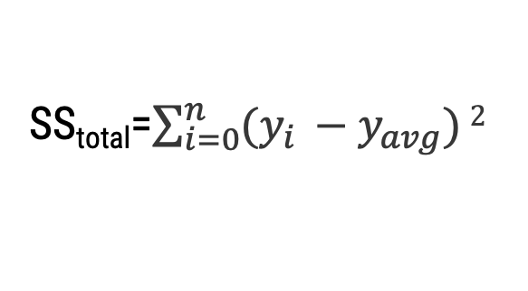

R Squared
Y
Y
Product sales(Unit)
Product sales(Unit)
Y_{avg}
Y_{i}
$$y_{i}^{′}$$
$$y_{i}^{}$$
X
X
advertising budget
(in thousands)
advertising budget
(in thousands)
SS_{total}=​$\sum_{i=0}^{n}{(y_{i} −y_{avg}^{})}2$
SS_{res}=​$\sum_{i=0}^{n}{(y_{i} −y_{i}^{′})}2$
$$R^{2} =1 − \frac{\text{SS}\text{res}}{\text{SS}\text{total}}$$
Unexplained Variance
Total Variance

Slide 20
Multiple Linear Regression
Multiple linear regression is a simple extension of linear regression, but instead of relating one dependent outcome variable y to one independent variable x, one tries to explain the outcome value y as the weighted sum of influences from multiple independent variables x1, x2, x3,….
Y= b₀ + b₁X₁ + b₂X₂+ … + b_{n}X_{n}
Dependent
Variable
Independent
Variable 1
Independent
Variable 2
Independent
Variable n
Y intercept
(constant)
Slop -1
Slop -2
Slop -n

Slide 21
Multiple Linear Regression
If you want to model CO₂ emissions (Y) based on volume (X1​) and weight (X2​),
Volume (L) | Weight (kg) | CO₂
1.8 | 1300 | 125
2.0 | 1400 | 145
1.5 | 1280 | 115
2.5 | 1500 | 165
- | 1625 | 0

Slide 22
Multiple Linear Regression (Example) (Emissions)
Emissions.py
1
2
3
4
5
6
7
8
9
10
11
12
13
14
15
16
17
18
19
import pandas as pd
from sklearn.linear_model import LinearRegression
from sklearn.model_selection import train_test_split
from sklearn.metrics import mean_squared_error
df = pd.read_csv("car_data.csv") X = df[['Volume (L)', 'Weight (kg)']]
y = df['CO₂ Emissions (g/km)']
model = linear_model.LinearRegression() X_train, X_test, y_train, y_test = train_test_split(X, y, test_size=0.2, random_state=42)
model.fit(X_train, y_train) y_pred = model.predict(X_test) mse = mean_squared_error(y_test, y_pred)
print("Mean Squared Error (MSE):", mse)
#predict the CO2 emission of a car where the weight is 1000kg, and the volume is 1.2:
model.predict([[1.2, 1000]])

Slide 23
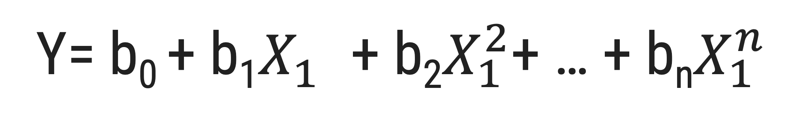
Polynomial Regression
Polynomial regression is an extension of linear regression that models the relationship between a dependent variable and one or more independent variables as an nth-degree polynomial.
This approach is especially useful when the data exhibits a non-linear relationship, as it allows the model to capture complex trends and curvatures.
Y= b₀ + b₁$X_{1}^{}$ + b₂$X_{1}^{2}$+ … + b_{n}$X_{1}^{n}$
Dependent
Variable
Independent
Variable 1
Independent
Variable 2
Independent
Variable n
Y intercept
(constant)
Slop -1
Slop -2
Slop -n

Slide 24
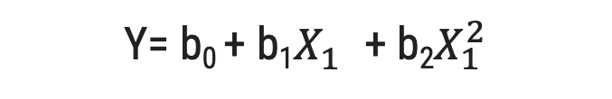
Polynomial Regression
Y= b₀ + b₁X₁
Y= b₀ + b₁$X_{1}^{}$ + b₂$X_{1}^{2}$

Slide 25
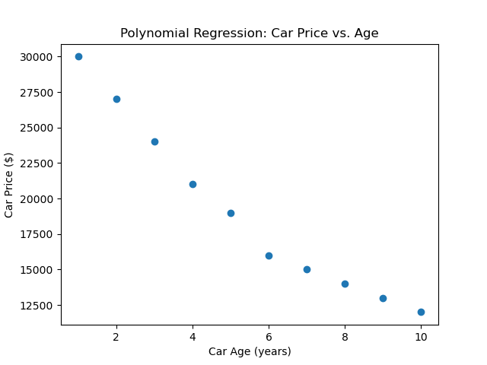
Example
Car Age (Years) | Car Price ($)
1 | 30,000
2 | 27,000
3 | 24,000
4 | 21,000
5 | 19,000
6 | 16,000
7 | 15,000
8 | 14,000
9 | 13,000
10 | 12,000

Slide 26
Example
CarPrice.py
1
2
3
4
5
6
7
8
9
10
11
12
13
14
15
16
17
18
19
import numpy as np
import matplotlib.pyplot as plt
from sklearn.preprocessing import PolynomialFeatures
from sklearn.linear_model import LinearRegression
from sklearn.metrics import mean_squared_error
X = np.array([1, 2, 3, 4, 5, 6, 7, 8, 9, 10]).reshape(-1, 1)
y = np.array([30000, 27000, 24000, 21000, 19000, 16000, 15000, 14000, 13000, 12000])
degree = 2
poly = PolynomialFeatures(degree=degree)
X_poly = poly.fit_transform(X)
model = LinearRegression()
model.fit(X_poly, y)
y_pred = model.predict(X_poly)
mse = mean_squared_error(y, y_pred)
print(f"Mean Squared Error: {mse:.2f}")

Slide 27
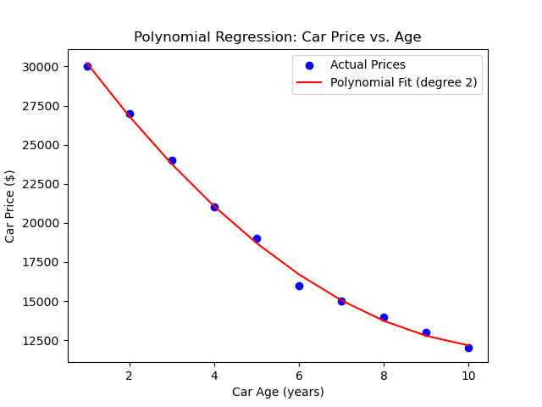
Example
CarPrice.py
21
22
23
24
25
26
27
plt.scatter(X, y, color='blue', label='Actual Prices')
plt.plot(X, y_pred, color='red', label='Polynomial Fit (degree 2)')
plt.xlabel('Car Age (years)')
plt.ylabel('Car Price ($)')
plt.title('Polynomial Regression: Car Price vs. Age')
plt.legend()
plt.show()

Slide 28


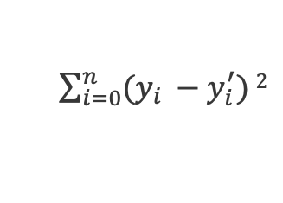




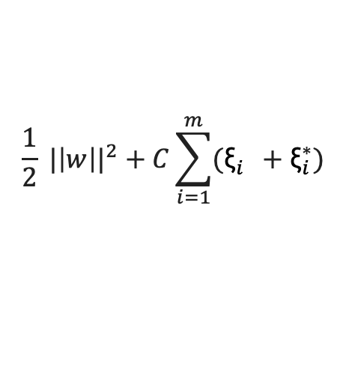
Support Vector Regression
ε - Insensitive Tube
Y
$\sum_{i=0}^{n}{(y_{i} −y_{i}^{′})}2$
Y
Slack Variables ${\text{ξ}}_{1}^{}$ and ${\text{ξ}}_{1}^{∗}$
Min
Support Vector
$${\text{ξ}}_{5}^{}$$
ε
ε
$${\text{ξ}}_{3}^{}$$
$${\text{ξ}}_{2}^{}$$
$${\text{ξ}}_{4}^{∗}$$
$${\text{ξ}}_{1}^{∗}$$
X
X
$$\frac{1}{2} {|\left|w\right||}^{2}+C\sum_{i=1}^{m}{({\text{ξ}}_{i}^{}+{\text{ξ}}_{i}^{∗})}$$
Min

Slide 29
Support Vector Regression
Support Vector Regression (SVR) is a supervised machine learning algorithm that applies the principles of Support Vector Machines (SVM) to regression problems.
Terminology in SVR:
Hyperplane:
In SVR, we try to find a hyperplane that best fits the data points.
C (Regularization parameter): Controls the trade-off between the model's complexity and the slack variable penalty for outliers.
Margin (ε-insensitive loss):
margin of tolerance (denoted as ϵ) level within which predictions are considered accurate.
Deviations within this margin are ignored, focusing the model only on errors that exceed ϵ.
Support Vectors:
Data points that lie on the margin boundaries or outside of them.
Kernel Trick:
Used to transform the data into a higher-dimensional space if it's not linearly separable in
the original space.

Slide 30
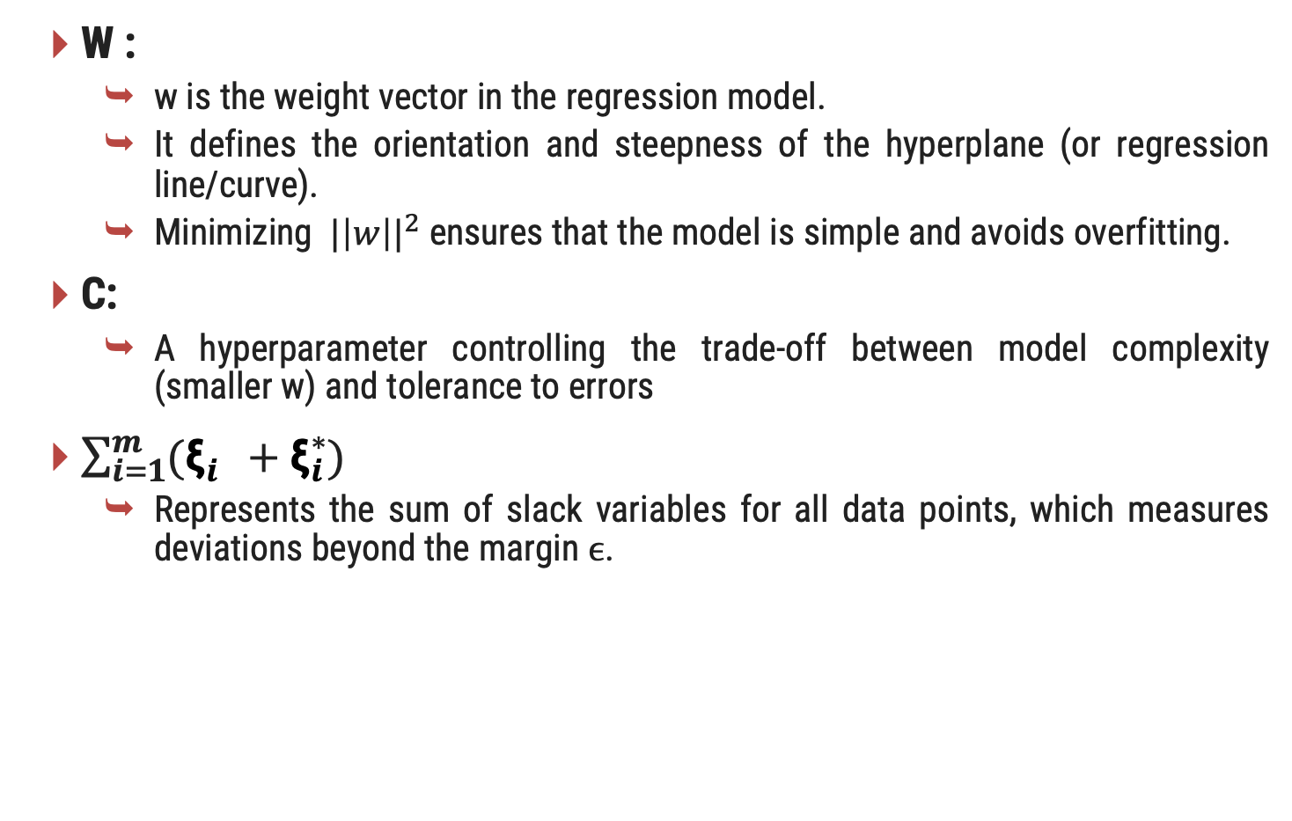

Support Vector Regression
W :
w is the weight vector in the regression model.
It defines the orientation and steepness of the hyperplane (or regression line/curve).
Minimizing ${|\left|w\right||}^{2}$ensures that the model is simple and avoids overfitting.
C:
A hyperparameter controlling the trade-off between model complexity (smaller w) and tolerance to errors
$\sum_{i=1}^{m}{({\text{ξ}}_{i}^{}+{\text{ξ}}_{i}^{∗})}$
Represents the sum of slack variables for all data points, which measures deviations beyond the margin ϵ.
$$\frac{1}{2} {|\left|w\right||}^{2}+C\sum_{i=1}^{m}{({\text{ξ}}_{i}^{}+{\text{ξ}}_{i}^{∗})}$$

Slide 31
Kernel Trick
Linear SVR can only model relationships that are linear in the input space.
However, if the data is not linearly separable, the kernel trick can be used to map the data to a higher dimensional space where it becomes linearly separable.
Common Kernel:-
Linear Kernel:
No mapping is needed as the data is already assumed to be linearly separable.
Polynomial Kernel:
Maps inputs into a polynomial feature space, enhancing the classifier's ability to capture interactions between features.
Radial Basis Function (RBF) Kernel:
Also known as the Gaussian kernel, it is useful for capturing complex regions by considering the distance between points in the input space.

Slide 32
Kernel Trick
Sigmoid Kernel:
Mimics the behaviour of neural networks by using a sigmoid function as the kernel.

Slide 33
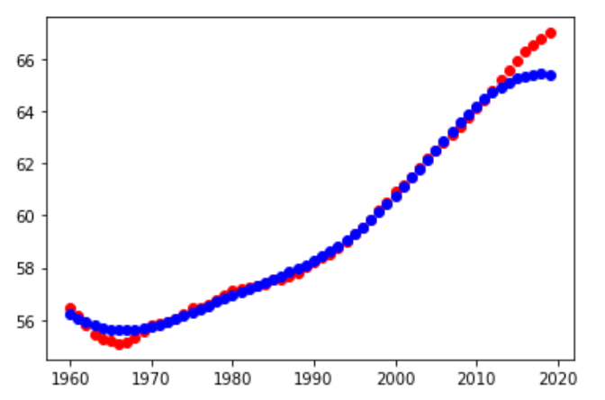
Support Vector Regression (SVR) (Example)
PolyReg.py
1
2
3
4
5
6
7
8
9
10
11
12
13
14
15
16
17
18
19
import pandas as pd
df = pd.read_csv('WorldBank.csv')
pop15 = df[df['Indicator Name']=='Population ages 15-64 (% of total population)']
X = np.arange(1960,2020)
y = pop15.values[0][4:-1]
from sklearn.svm import SVR
model = SVR()
model.fit(X.reshape(-1,1),y)
predictPoly = model.predict(X.reshape(-1,1))
import matplotlib.pyplot as plt
%matplotlib inline
plt.scatter(X,y,c='r')
plt.scatter(X,predictPoly,c='b')
WorldBank.csv
Download link
Output

Slide 34
Logistic Regression
Logistic regression is a supervised learning algorithm that makes use of logistic functions to predict the probability of a binary outcome.
Instead of predicting a continuous output like in linear regression, it predicts the probability of an outcome belonging to one of two classes.
It predict the categorical dependent variable from a number of independent variables.
YES/NO
Age
Salary
buys the product

Slide 35
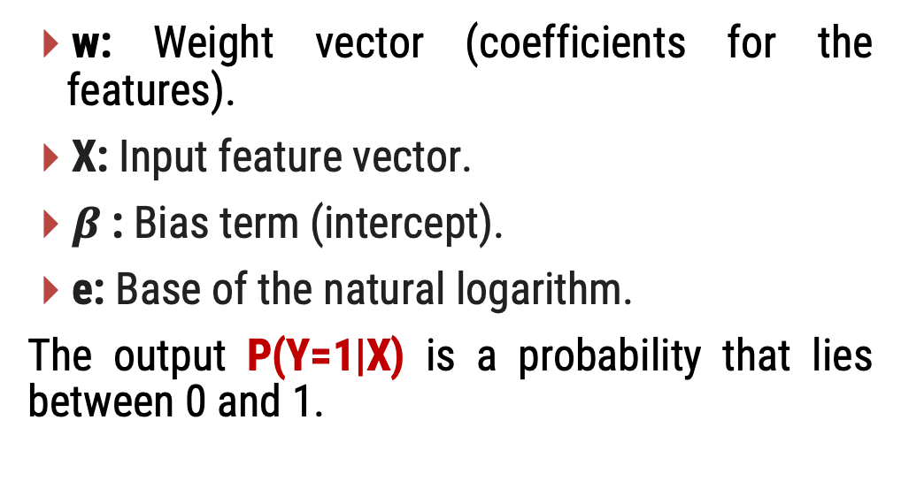
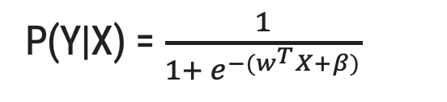
Logistic Regression
Y
P(Y|X) = $\frac{1}{1+ e^{−(w^{T}X+β)}}$
Buy
Yes
w: Weight vector (coefficients for the features).
X: Input feature vector.
$β$: Bias term (intercept).
e: Base of the natural logarithm.
The output P(Y=1|X) is a probability that lies between 0 and 1.
75%
>=50%
< 50%
34%
No
X
18
35
45
60
Age

Slide 36
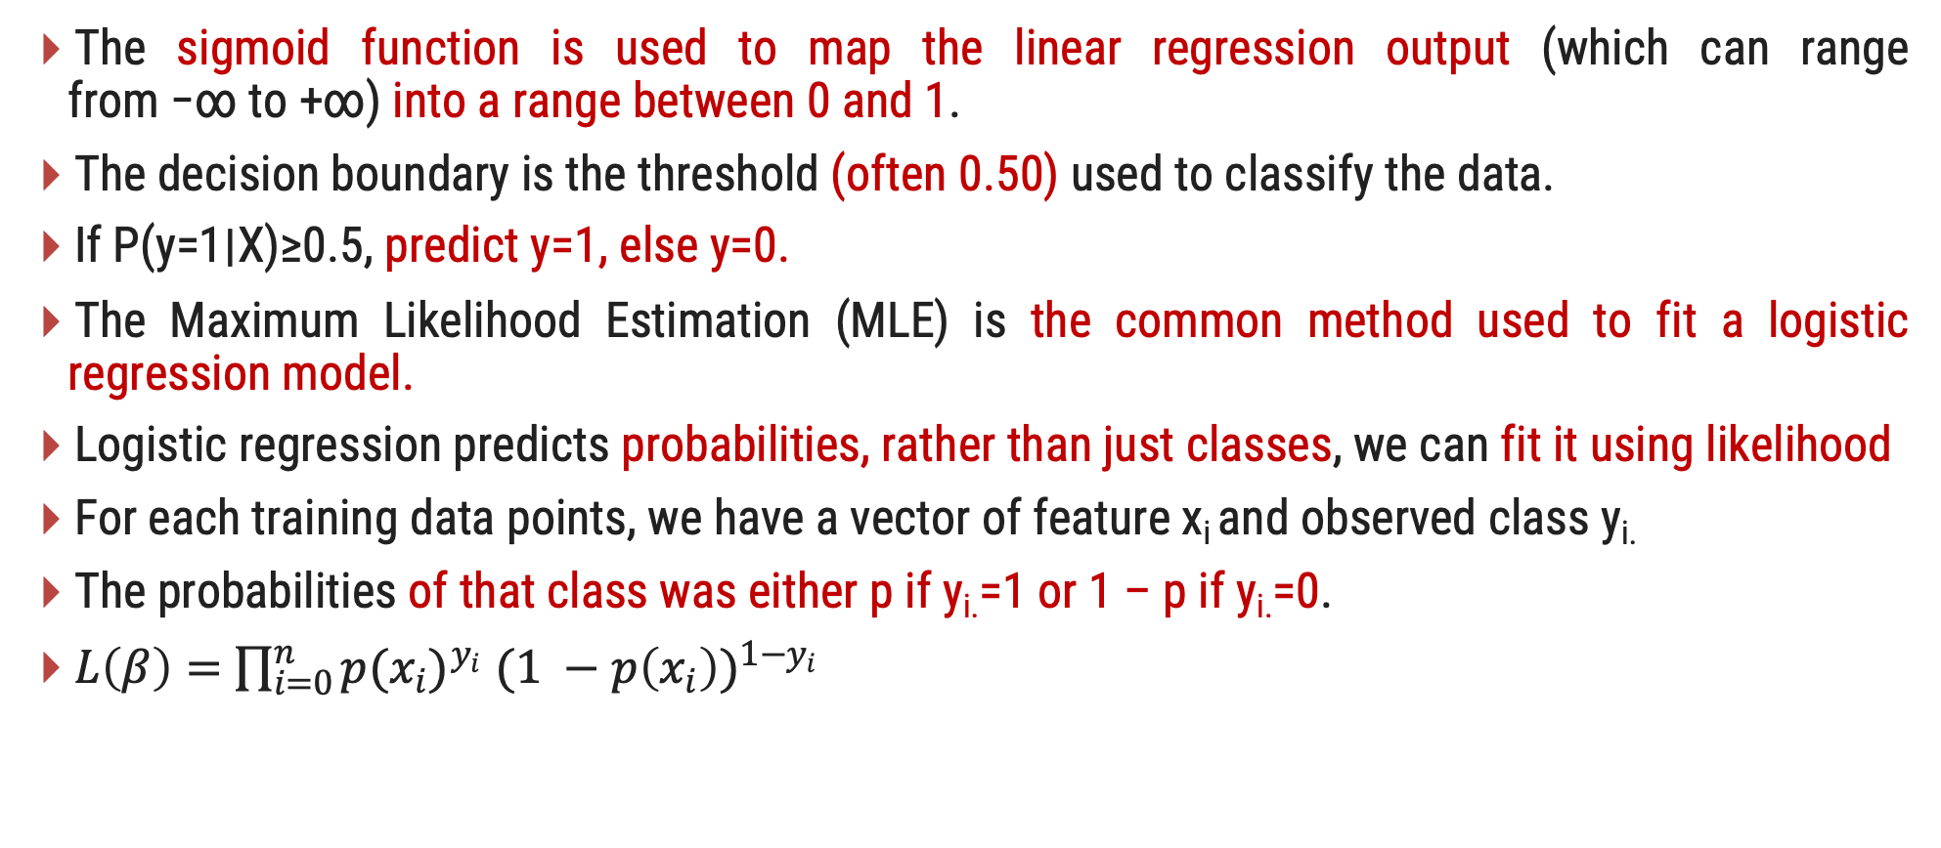
Logistic Regression
The sigmoid function is used to map the linear regression output (which can range from −∞ to +∞) into a range between 0 and 1.
The decision boundary is the threshold (often 0.50) used to classify the data.
If P(y=1∣X)≥0.5, predict y=1, else y=0.
The Maximum Likelihood Estimation (MLE) is the common method used to fit a logistic regression model.
Logistic regression predicts probabilities, rather than just classes, we can fit it using likelihood
For each training data points, we have a vector of feature x_{i} and observed class y_{i.}
The probabilities of that class was either p if y_{i.}=1 or 1 – p if y_{i.}=0.
$L\left(β\right)=$ $\prod_{i=0}^{n}{{p(x_{i})}^{y_{i}} {(1 −p\left(x_{i}\right))}^{1−y_{i}}}$

Slide 37
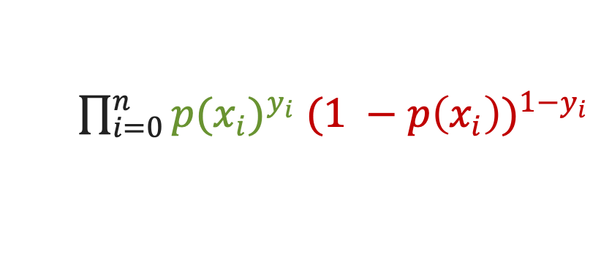
Likelihood
Y
Buy
$\prod_{i=0}^{n}{{p(x_{i})}^{y_{i}} {(1 −p\left(x_{i}\right))}^{1−y_{i}}}$
MAX
Yes
75%
probability of YES = 0.75
probability of Yes =0.34
Logistic Regression gives probability of Yes
So to calculate probability of
No = 1 – 0.34 = 0.66
34%
No
X
18
35
45
60
Age

Slide 38
Likelihood
The likelihood in logistic regression refers to a measure of how well the model explains the observed data.
Logistic regression uses Maximum Likelihood Estimation (MLE) to find the parameters that maximize the likelihood of observing the given data.
The goal of logistic regression is to find the parameters that maximize the likelihood function. This is done using optimization algorithms like gradient descent

Slide 39
Logistic Regression
Logistic.py
1
2
3
4
5
6
7
8
9
10
11
12
13
14
15
16
17
18
import numpy as np
import matplotlib.pyplot as plt
from sklearn.linear_model import LogisticRegression
from sklearn.model_selection import train_test_split
np.random.seed(42)
income = np.random.uniform(20, 80, 100)
purchase = (income > 50).astype(int)
X = income.reshape(-1, 1)
y = purchase
X_train, X_test, y_train, y_test = train_test_split(X, y, test_size=0.2, random_state=42)
model = LogisticRegression()
model.fit(X_train, y_train)
y_pred = model.predict(X_test)

Slide 40
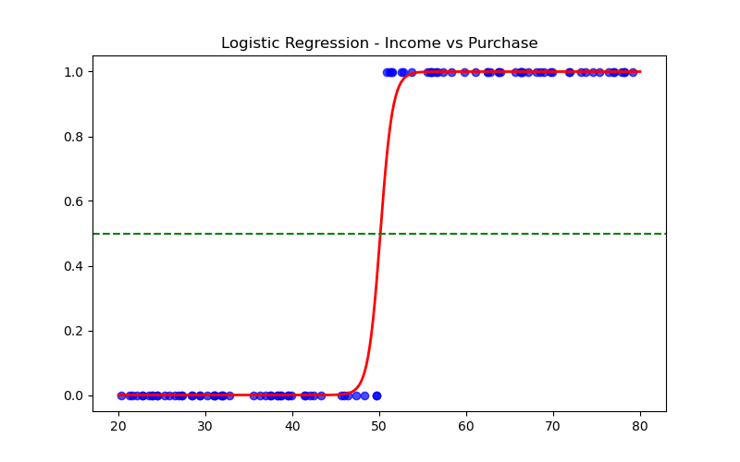
Logistic Regression
Logistic.py
19
20
21
22
23
24
25
26
26
X_range = np.linspace(20, 80, 300).reshape(-1, 1)
y_prob = model.predict_proba(X_range)[:, 1]
plt.figure(figsize=(8, 5))
plt.scatter(X, y, label="Data", color="blue", alpha=0.7)
plt.plot(X_range, y_prob, label="Sigmoid Curve", color="red", linewidth=2)
plt.axhline(.5, linestyle="--", color="green", label="Decision Boundary")
plt.title("Logistic Regression - Income vs Purchase")
plt.savefig('Logistic.png')

Slide 41
Linear Regression vs Logistic Regression
Linear Regression | Logistic Regression
It is used to predict numeric values. | It is used to predict categorical values
In Linear Regression, we predict the value by an integer number. | In Logistic Regression, we predict the value by 1 or 0.
Here no activation function is used. | Here activation function is used to convert a linear regression equation to the logistic regression equation
Here no threshold value is needed. | Here a threshold value is added. Example 50%
It is based on the least square estimation. | It is based on maximum likelihood estimation.
Linear regression assumes the normal or gaussian distribution of the dependent variable. | Logistic regression assumes the binomial distribution of the dependent variable.

Slide 42
Regularization
The term “regularization” means to deploy control over something.
However, this term has an important role to play in machine learning as well.
Training a machine learning model can sometimes lead to overfitting which renders to bad predictions in the long run.
It is used in linear regression to address multicollinearity and overfitting by adding a penalty term to the loss function.
This penalty term shrinks the magnitude of the regression coefficients, which helps stabilize the estimates and improve model generalization.
Regularization's main objective is to simplify the model so that it may be applied to fresh data more broadly and perform better on datasets that haven't been seen before.
Regularized Loss = Original Loss + (λ×Penalty)
λ (lambda) is the regularization strength, which controls the trade-off between fitting the data well and keeping the model parameters small.

Slide 43
Regularization
Regularization
Lasso Regularization
Ridge Regularization
L1 - Regularization
L2 - Regularization

Slide 44
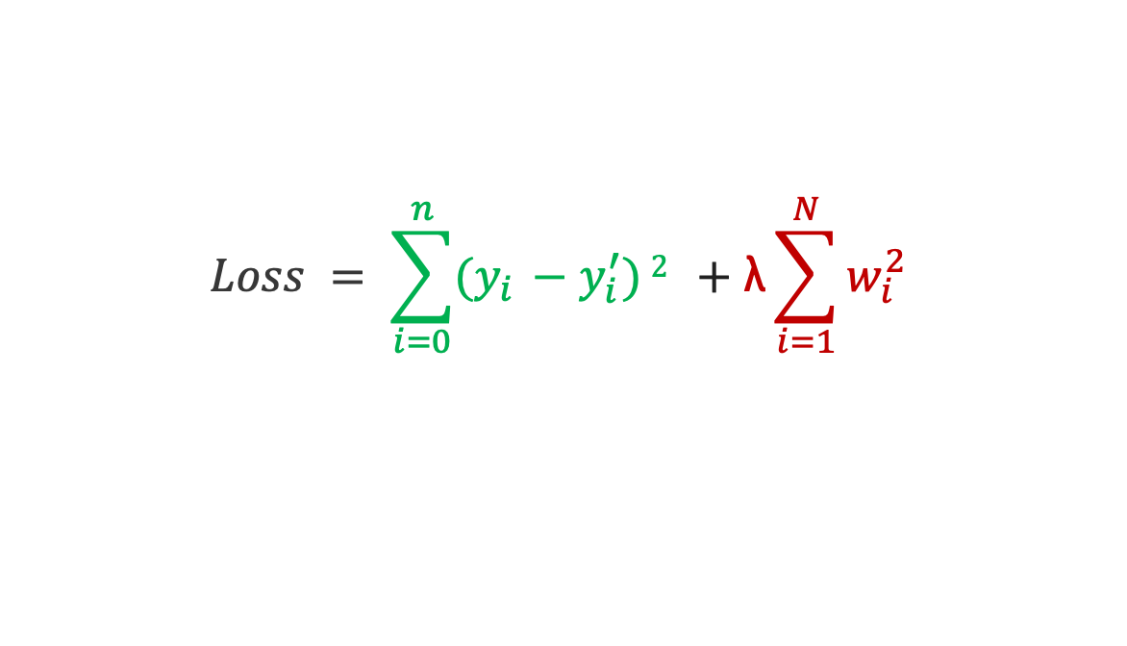
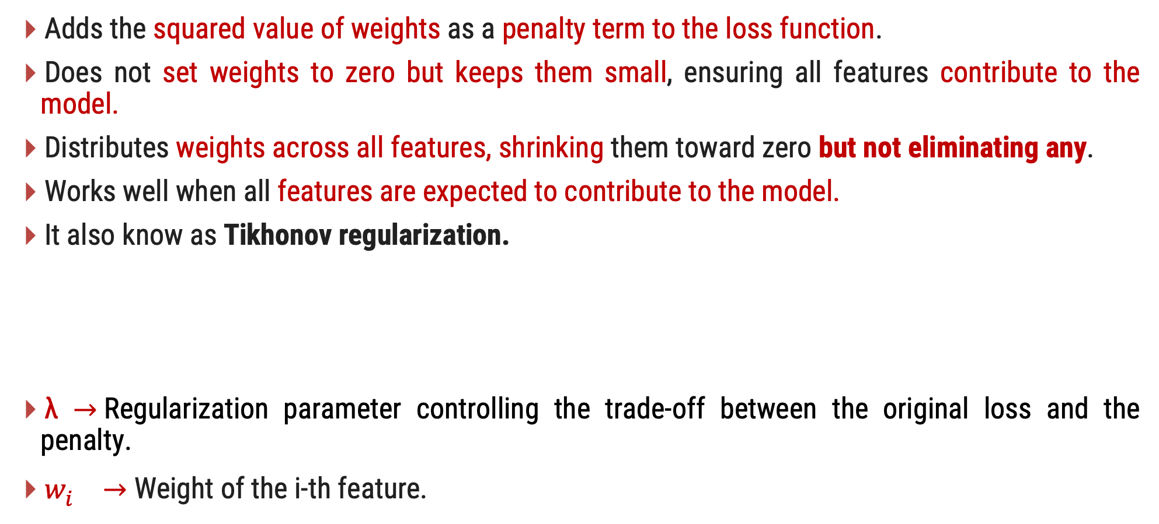
Ridge Regression (L2 Regularization)
Adds the squared value of weights as a penalty term to the loss function.
Does not set weights to zero but keeps them small, ensuring all features contribute to the model.
Distributes weights across all features, shrinking them toward zero but not eliminating any.
Works well when all features are expected to contribute to the model.
It also know as Tikhonov regularization.
λ $→$Regularization parameter controlling the trade-off between the original loss and the penalty.
$w_{i}^{} →$ Weight of the i-th feature.
$$Loss = \sum_{i=0}^{n}{(y_{i} −y_{i}^{′})}2 +\text{λ}\sum_{i=1}^{N}{w_{i}^{2}}$$

Slide 45
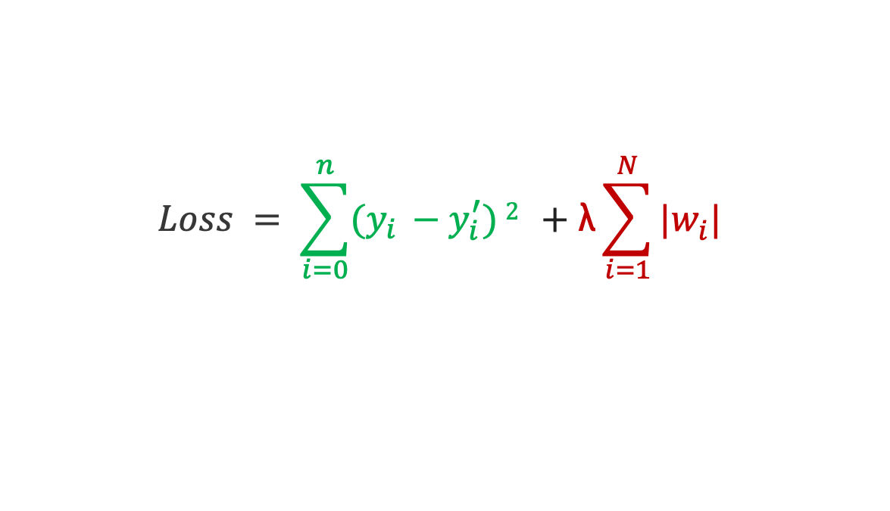
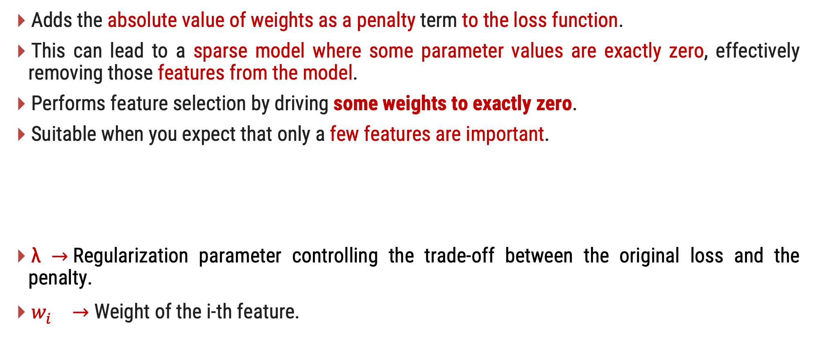
Lasso Regression (L1 Regularization)
Adds the absolute value of weights as a penalty term to the loss function.
This can lead to a sparse model where some parameter values are exactly zero, effectively removing those features from the model.
Performs feature selection by driving some weights to exactly zero.
Suitable when you expect that only a few features are important.
λ $→$Regularization parameter controlling the trade-off between the original loss and the penalty.
$w_{i}^{} →$ Weight of the i-th feature.
$$Loss = \sum_{i=0}^{n}{(y_{i} −y_{i}^{′})}2 +\text{λ}\sum_{i=1}^{N}{|w_{i}^{ }|}$$

Slide 46
Regularization
Choosing the right value of λ is crucial task
Too high a value can make the model too simple and fail to capture important patterns in the data (underfitting).
Too low a value might not sufficiently penalize large coefficients, leading to a model that captures too much noise from the training data (overfitting).
the optimal value of λ and the type of regularization (L1 and L2) are often selected through cross-validation.

Slide 47
Benefits of Regularization
Preventing Overfitting:
Regularization minimizes the risk of overfitting by penalizing large weights.
Improving Model Generalization:
Helps models perform well on both training and unseen data.
Handling Multicollinearity:
L2 regularization (Ridge) stabilizes coefficient estimates in cases of multicollinearity.
Feature Selection:
L1 regularization (Lasso) promotes sparsity by shrinking some coefficients to zero.
Improving Robustness to Noise:
Reduces sensitivity to noise and outliers by discouraging excessive fitting.

