Slide 1

Unit-04 Clustering
Machine Learning (ML)
2301CS621
Prof. Jayesh D. vagadiya
Computer Engineering Department
jayesh.vagadiya@darshan.ac.in
9537133260

Slide 2

Looping
Topics to be covered
Introduction
Distance based Clustering
Hierarchical Clustering
Outlier detection
Density based Clustering
Outlier Detection Methods
Feature Selection techniques
Dimensionality Reduction techniques

Slide 3
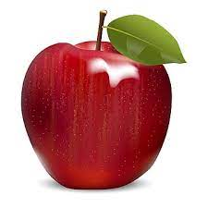
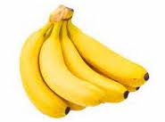
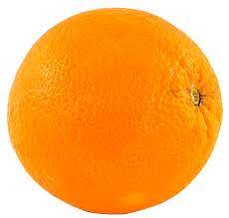
Clustering (Grouping)
Input Data
Clustering
Algorithm
Here we don’t use Label Data to train Classifier(Unsupervised Learning)
Finding similarities between data according to the characteristics found in the data and grouping similar data objects into clusters

Slide 4
Clustering
Cluster analysis or simply clustering is the process of partitioning a set of data objects (or observations) into subsets.
Each subset is a cluster.
Cluster is a collection of data objects.
Similar (or related) to one another within the same group
Dissimilar (or unrelated) to the objects in other groups
The set of clusters resulting from a cluster analysis can be referred to as a clustering.
Cluster analysis (or clustering, data segmentation, …)
Finding similarities between data according to the characteristics found in the data and grouping similar data objects into clusters
Clustering is useful in that it can lead to the discovery of previously unknown groups within the data.

Slide 5
Clustering
Unsupervised Learning: no predefined classes. (i.e., learning by observations)(Clustering).
Supervised Learning: Predefined classes available. (i.e., learning by examples) (Classification).
Clustering can also be used for outlier detection.
where outliers (values that are “far away” from any cluster) may be more interesting than common cases.
Applications of outlier detection include the detection of credit card fraud and the monitoring of criminal activities in electronic commerce.

Slide 6
Applications of Clustering
Real life examples where we use clustering:
Marketing
Finding group of customers with similar behavior given a large data-base of customers.
Data containing their properties and past buying records.
Biology
Classification of Plants and Animals Based on the properties under observation.
Insurance
Identifying groups of car insurance policy holders with a high average claim cost.
City-Planning
Groups of houses according to their house type, value and geographical location.
Libraries
It is used in clustering different books on the basis of topics and information.
Earthquake studies
By learning the earthquake-affected areas we can determine the dangerous zones.

Slide 7
Good clustering Algorithm
A good clustering method will produce high quality clusters
high intra-class similarity: cohesive within clusters
low inter-class similarity: distinctive between clusters

Slide 8
Overview of Basic Clustering Methods : Partitioning methods
Partitioning Methods:
Given a set of n objects, a partitioning method constructs k partitions of the data, where each partition represents a cluster and k ≤ n.
It divides the data into k groups such that each group must contain at least one object.
It will find mutually exclusive clusters of spherical shape(each object must belong to exactly one group ).
Most partitioning methods are distance-based.
Given k, the number of partitions to construct, a partitioning method creates an initial partitioning.
It then uses an iterative relocation technique that attempts to improve the partitioning by moving objects from one group to another.
May use mean or medoid (etc.) to represent cluster center.
Effective for small- to medium-size data sets.

Slide 9
Hierarchical methods
Hierarchical Methods:
A hierarchical method creates a hierarchical decomposition of the given set of data objects.
A hierarchical method can be classified as being either agglomerative or divisive, based on how the hierarchical decomposition is formed.
Agglomerative approach:
It also called bottom-up approach.
It starts with each object forming a separate group.
It successively merges the objects or groups close to one another, until all the groups are merged into one (the topmost level of the hierarchy), or a termination condition holds.
Divisive approach:
It also called top-down approach.
It starts with all the objects in the same cluster.
In each successive iteration, a cluster is split into smaller clusters, until eventually each object is in one cluster, or a termination condition holds.

Slide 10
Hierarchical methods
Step 0
Step 1
Step 2
Step 3
Step 4
agglomerative
(AGNES)
a
a b
b
a b c d e
c
c d e
d
d e
e
divisive
(DIANA)
Step 4
Step 3
Step 2
Step 1
Step 0

Slide 11
Density-based methods
Density-based methods:
Distance based method only find spherical-shaped cluster and encounter difficulty in discovering clusters of arbitrary shapes.
It can find arbitrarily shaped clusters.
Clusters are dense regions of objects in space that are separated by low-density regions.
Cluster density: Each point must have a minimum number of points within its “neighborhood”.
May filter out outliers.

Slide 12
Grid-based methods
Grid-based methods:
Grid-based methods quantize the object space into a finite number of cells that form a grid structure.
All the clustering operations are performed on the grid structure.
The main advantage of this approach is its fast processing time, which is typically independent of the number of data objects and dependent only on the number of cells in each dimension in the quantized space.

Slide 13
Partitioning Methods: k-Means : A Centroid-Based Technique
The k-means algorithm defines the centroid of a cluster as the mean value of the points within the cluster.
First, it randomly selects k of the objects in D, each of which initially represents a cluster mean or center.
For each of the remaining objects, an object is assigned to the cluster to which it is the most similar, based on the Euclidean distance between the object and the cluster mean.
For each cluster, it computes the new mean using the objects assigned to the cluster in the previous iteration.
The iterations continue until the assignment is stable, that is, the clusters formed in the current round are the same as those formed in the previous round.

Slide 14
k-Means : Algorithm
INPUT:
k: the number of clusters, D: a data set containing n objects.
Output:
A set of k clusters.
arbitrarily choose k objects from D as the initial cluster centers;
repeat
(re)assign each object to the cluster to which the object is the most similar, based on the mean value of the objects in the cluster;
update the cluster means, that is, calculate the mean value of the objects for each cluster;
until no change;

Slide 15
k-Means : Algorithm Cont..
The initial partitioning can be done in a variety of ways.
Dynamically Chosen
This method is good when the amount of data is expected to grow.
The initial cluster means can simply be the first few items of data from the set.
For instance, if the data will be grouped into 3 clusters, then the initial cluster means will be the first 3 items of data.
Randomly Chosen
Almost self-explanatory, the initial cluster means are randomly chosen values within the same range as the highest and lowest of the data values.
Choosing from Upper and Lower Bounds
Depending on the types of data in the set, the highest and lowest of the data range are chosen as the initial cluster means.

Slide 16
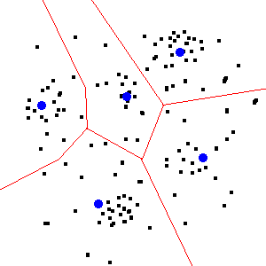
Clustering
A clustered scatter plot.
The black dots are data points.
The red lines illustrate the partitions created by the k-means algorithm.
The blue dots represent the centroids which define the partitions.

Slide 17
K-Mean Example
Sr. | X | Y
1 | 1.0 | 1.0
2 | 1.5 | 2.0
3 | 3.0 | 4.0
4 | 5.0 | 7.0
5 | 3.5 | 5.0
6 | 4.5 | 5.0
7 | 3.5 | 4.5
Here K = 2, and we assume Cluster 1 center is (1,1) and Cluster 2 center is (5,7)
K2
K1
(1,1)
(5,7)
Initial Centroid
K1 = (1,1)
K2 = (5,7)

Slide 18
K-Mean Example
Data Points |  | Distance To Center |  |  |  | Cluster | New Cluster
 |  | 1 | 1 | 5 | 7
1.0 | 1.0 | 0 |  | 7.2 |  | 1
1.5 | 2.0 | 1.11 |  | 6.10 |  | 1
3.0 | 4.0 | 3.6 |  | 3.6 |  | 1
5.0 | 7.0 | 7.2 |  | 0 |  | 2
3.5 | 5.0 | 4.7 |  | 2.5 |  | 2
4.5 | 5.0 | 5.3 |  | 2.06 |  | 2
3.5 | 4.5 | 4.3 |  | 2.9 |  | 2
Initial Centroid
K1 = (1,1)
K2 = (5,7)
New Centroid
K1 = (1.83,2.33)
K2 = (4.12,5.37)
$$ED= \sqrt{{\left(X_{o}−X_{c}\right)}^{2}+{\left(Y_{o}−Y_{c}\right)}^{2}}$$

Slide 19
K-Mean Example
Data Points |  | Distance To Center |  |  |  | Cluster | New Cluster
 |  | 1.83 | 2.3 | 4.12 | 5.37
1.0 | 1.0 | 1.54 |  | 5.36 |  | 1 | 1
1.5 | 2.0 | 0.44 |  | 4.26 |  | 1 | 1
3.0 | 4.0 | 2.06 |  | 1.76 |  | 1 | 2
5.0 | 7.0 | 5.66 |  | 1.8 |  | 2 | 2
3.5 | 5.0 | 3.17 |  | 0.72 |  | 2 | 2
4.5 | 5.0 | 3.79 |  | 0.53 |  | 2 | 2
3.5 | 4.5 | 2.762 |  | 1.06 |  | 2 | 2
Old Centroid
K1 = (1.83,2.33)
K2 = (4.12,5.37)
New Centroid
K1 = (1.25,1.5)
K2 = (3.9,5.1)

Slide 20
K-Mean Example
Data Points |  | Distance To Center |  |  |  | Cluster | New Cluster
 |  | 1.25 | 1.5 | 3.9 | 5.1
1.0 | 1.0 | 0.55 |  | 5.02 |  | 1 | 1
1.5 | 2.0 | 0.55 |  | 3.92 |  | 1 | 1
3.0 | 4.0 | 3.05 |  | 1.42 |  | 2 | 2
5.0 | 7.0 | 6.65 |  | 2.19 |  | 2 | 2
3.5 | 5.0 | 4.16 |  | 0.41 |  | 2 | 2
4.5 | 5.0 | 4.77 |  | 0.60 |  | 2 | 2
3.5 | 4.5 | 3.75 |  | 0.72 |  | 2 | 2
Old Centroid
K1 = (1.25,1.5)
K2 = (3.9,5.1)
Here no Change in Cluster so we terminate the Algorithm

Slide 21
K-Means Example
K-means.py
1
2
3
4
5
6
7
8
9
10
11
12
13
14
15
16
17
18
import numpy as np
import matplotlib.pyplot as plt
from sklearn.cluster import KMeans
from sklearn.datasets import make_blobs
X, y = make_blobs(n_samples=300, centers=3, random_state=42)
kmeans = KMeans(n_clusters=3, random_state=42, n_init=10)
kmeans.fit(X)
labels = kmeans.labels_
centroids = kmeans.cluster_centers_
plt.scatter(X[:, 0], X[:, 1], c=labels, cmap='viridis', alpha=0.6, edgecolors='k')
plt.scatter(centroids[:, 0], centroids[:, 1], c='red', marker='X', s=200, label='Centroids')
plt.legend()
plt.show()

Slide 22
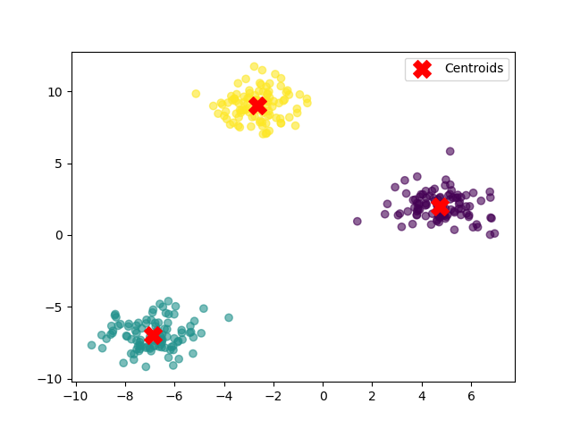
K-Mean Example

Slide 23
k-Medoids: A Representative Object-Based Technique
The k-means algorithm is sensitive to outliers because such objects are far away from the majority of the data
when assigned to a cluster, they can dramatically distort the mean value of the cluster.
K-Medoids: Instead of taking the mean value of the object in a cluster as a reference point, medoids can be used, which is the most centrally located object in a cluster
The Partitioning Around Medoids (PAM) algorithm is a popular realization of k-medoids clustering.
Like the k-means algorithm, the initial representative objects (called seeds) are chosen arbitrarily.
We consider whether replacing a representative object by a nonrepresentative object would improve the clustering quality.
All the possible replacements are tried out.
The iterative process of replacing representative objects by other objects continues until the quality of the resulting clustering cannot be improved by any replacement. This quality is m

Slide 24
k-medoids : Algorithm
INPUT:
k: the number of clusters, D: a data set containing n objects.
Output:
A set of k clusters.
arbitrarily choose k objects from D as the initial representative objects or seeds;
repeat
assign each remaining object to the cluster with the nearest representative object;
randomly select a nonrepresentative object, O_{random};
compute the total cost, S, of swapping representative object, Oj, with O_{random}; if S < 0 then swap o_{j} with o_{random} to form the new set of k representative objects.
until no change;

Slide 25
K-Medoids Clustering Algorithm - Example
Step 1: Let the randomly selected 2 medoids, so select k = 2 and let C1 -(4, 5) and C2 -(8, 5) are the two medoids.
Sr. | X | Y
0 | 8 | 7
1 | 3 | 7
2 | 4 | 9
3 | 9 | 6
4 | 8 | 5
5 | 5 | 8
6 | 7 | 3
7 | 8 | 4
8 | 7 | 5
9 | 4 | 5
The dissimilarity of each non-medoid point with the medoids is calculated and tabulated:
Sr. | X | Y | Dissimilarity From C1 | Dissimilarity From C2
0 | 8 | 7 | |(8-4)|+|(7-5)| = 6 | |(8-8)|+|(7-5)| = 2
1 | 3 | 7 | 3 | 7
2 | 4 | 9 | 4 | 8
3 | 9 | 6 | 6 | 2
5 | 5 | 8 | 4 | 6
6 | 7 | 3 | 5 | 3
7 | 8 | 4 | 5 | 1
8 | 7 | 5 | 3 | 1

Slide 26
K-Medoids Clustering Algorithm – Example Cont..
Sr. | X | Y | Dissimilarity From C1 | Dissimilarity From C2
0 | 8 | 7 | 6 | 2
1 | 3 | 7 | 3 | 7
2 | 4 | 9 | 4 | 8
3 | 9 | 6 | 6 | 2
5 | 5 | 8 | 4 | 6
6 | 7 | 3 | 5 | 3
7 | 8 | 4 | 5 | 1
8 | 7 | 5 | 3 | 1
Each point is assigned to the cluster of that medoid whose dissimilarity is less.
The points 1, 2, 5 go to cluster C1 and 0, 3, 6, 7, 8 go to cluster C2.
The Cost = (3 + 4 + 4) + (2 + 2 + 3 + 1 + 1) = 20

Slide 27
K-Medoids Clustering Algorithm – Example Cont..
Sr. | X | Y | Dissimilarity From C1 | Dissimilarity From C2
0 | 8 | 7 | 6 | 3
1 | 3 | 7 | 3 | 8
2 | 4 | 9 | 4 | 9
3 | 9 | 6 | 6 | 3
4 | 8 | 5 | 4 | 1
5 | 5 | 8 | 4 | 7
6 | 7 | 3 | 5 | 2
8 | 7 | 5 | 3 | 2
Step 3: randomly select one non-medoid point and recalculate the cost.
Let the randomly selected point be (8, 4).
The dissimilarity of each non-medoid point with the medoids – C1 (4, 5) and C2 (8, 4) is calculated and tabulated.

Slide 28
K-Medoids Clustering Algorithm – Example Cont..
Sr. | X | Y | Dissimilarity From C1 | Dissimilarity From C2
0 | 8 | 7 | 6 | 3
1 | 3 | 7 | 3 | 8
2 | 4 | 9 | 4 | 9
3 | 9 | 6 | 6 | 3
4 | 8 | 5 | 4 | 1
5 | 5 | 8 | 4 | 7
6 | 7 | 3 | 5 | 2
8 | 7 | 5 | 3 | 2
Each point is assigned to that cluster whose dissimilarity is less. So, the points 1, 2, 5 go to cluster C1 and 0, 3, 4, 6, 8 go to cluster C2.
The New cost,
= (3 + 4 + 4) + (3 + 3 + 1 + 2 + 2) = 22
Swap Cost = New Cost – Previous Cost
= 22 – 20
= 2
So, 2>0 that is positive, now our previous medoid is best.
The total cost of Medoid (8,4) > the total cost when (8,5) was the medoid earlier & it generates the same clusters as earlier.
If you get negative then you have to take new medoid and recalculate again.

Slide 29
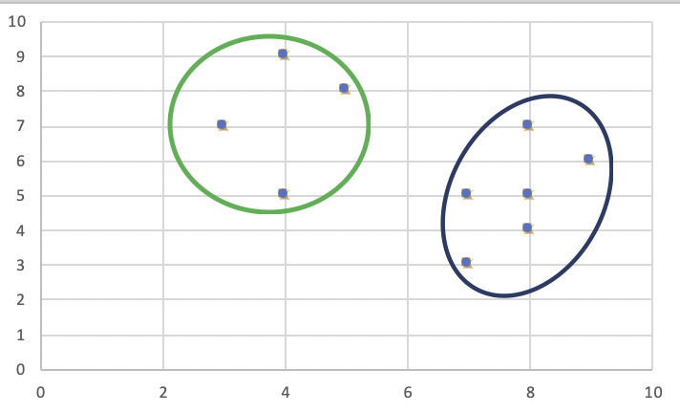
K-Medoids Clustering Algorithm – Example Cont..
Sr. | X | Y
0 | 8 | 7
1 | 3 | 7
2 | 4 | 9
3 | 9 | 6
4 | 8 | 5
5 | 5 | 8
6 | 7 | 3
7 | 8 | 4
8 | 7 | 5
9 | 4 | 5
As the swap cost is not less than zero, we undo the swap.
Hence (4, 5) and (8, 5) are the final medoids.
The clustering would be in the following way

Slide 30
K-Medoids Example
K-Medoids.py
1
2
3
4
5
6
7
8
9
10
11
12
13
14
15
16
17
18
import numpy as np
import matplotlib.pyplot as plt
from sklearn.datasets import make_blobs
from sklearn_extra.cluster import KMedoids
X, y = make_blobs(n_samples=300, centers=3, random_state=42)
kmedoids = KMedoids(n_clusters=3, random_state=42)
kmedoids.fit(X)
labels = kmedoids.labels_
medoids = X[kmedoids.medoid_indices_]
# Plot results
plt.scatter(X[:, 0], X[:, 1], c=labels, cmap='viridis', alpha=0.6, edgecolors='k')
plt.scatter(medoids[:, 0], medoids[:, 1], c='red', marker='.', s=200, label='Medoids')
plt.legend()
plt.savefig("abc.png")

Slide 31
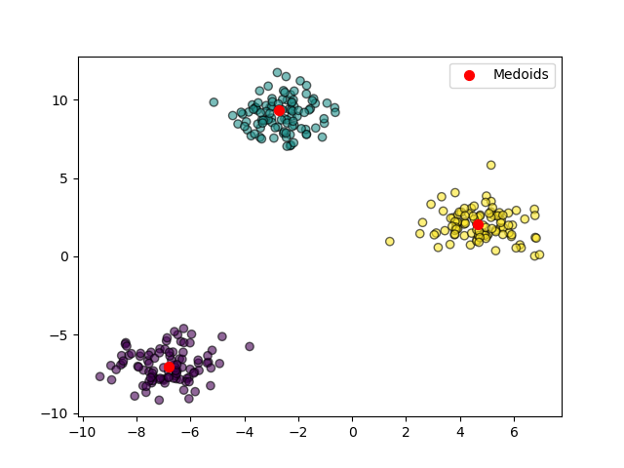
K-Medoids Example

Slide 32
Hierarchical methods
A hierarchical method creates a hierarchical decomposition of the given set of data objects.
A hierarchical clustering method works by grouping data objects into a hierarchy or “tree” of clusters.
Representing data objects in the form of a hierarchy is useful for data summarization and visualization.
A hierarchical method can be classified as being either agglomerative or divisive, based on how the hierarchical decomposition is formed.
Hierarchical clustering methods can face challenges when it comes to deciding when to combine or separate groups of objects.
This choice is vital because once this action is taken, it sets the stage for subsequent clustering steps.
Importantly, these methods cannot reverse previous actions or swap objects between clusters.
Therefore, if the decisions to combine or separate are not made wisely.

Slide 33
Agglomerative approach vs Divisive approach
Agglomerative approach(AGNES):
It also called bottom-up approach.
It starts with each object forming a separate group.
It successively merges the objects or groups close to one another, until all the groups are merged into one (the topmost level of the hierarchy), or a termination condition holds.
Divisive approach(DIANA):
It also called top-down approach.
It starts with all the objects in the same cluster.
In each successive iteration, a cluster is split into smaller clusters, until eventually each object is in one cluster, or a termination condition holds.
Step 0
Step 1
Step 2
Step 3
Step 4
agglomerative
(AGNES)
a
a b
b
a b c d e
c
c d e
d
d e
e
divisive
(DIANA)
Step 4
Step 3
Step 2
Step 1
Step 0

Slide 34
Dendrogram: Shows How Clusters are Merged
Decompose data objects into a several levels of nested partitioning (tree of clusters), called a dendrogram
A clustering of the data objects is obtained by cutting the dendrogram at the desired level, then each connected component forms a cluster
Step= - 0
Step= - 2
Step= - 3
Step= - 4
Step= - 5
Step= - 6
Step= - 7
34

Slide 35
Distance Measures in Algorithmic Methods
Whether using an agglomerative method or a divisive method, a core need is to measure the distance between two clusters, where each cluster is generally a set of objects.
Single link:
Smallest distance between an element in one cluster and an element in the other, i.e.,
dist(K_{i}, K_{j}) = min(t_{ip}, t_{jq})
Complete link:
largest distance between an element in one cluster and an element in the other, i.e.,
dist(K_{i}, K_{j}) = max(t_{ip}, t_{jq})

Slide 36
Distance Measures in Algorithmic Methods
Average link:
Average distance between an element in one cluster and an element in the other, i.e.,
dist(K_{i}, K_{j}) = Avg(t_{ip}, t_{jq})
Centroid link:
distance between the centroids of two clusters, i.e.,
dist(Ki, Kj) = dist(Ci, Cj)

Slide 37
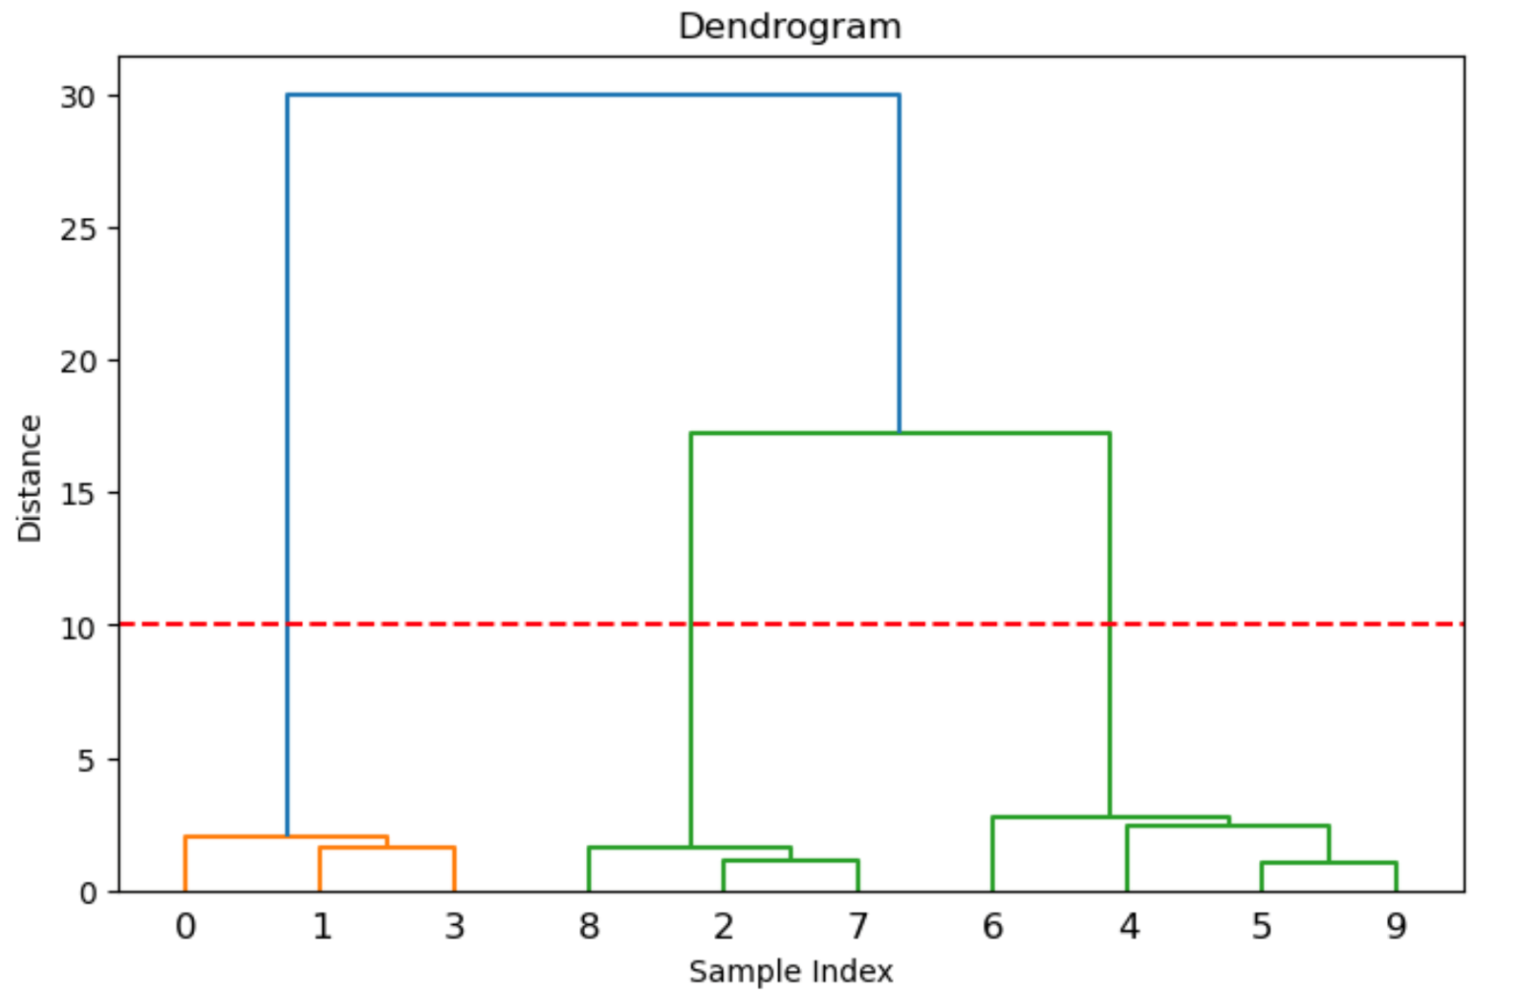
Example
Agglomerative.py
1
2
3
4
5
6
7
8
9
10
11
12
13
14
15
16
import numpy as np
import matplotlib.pyplot as plt
from scipy.cluster.hierarchy import dendrogram, linkage
from sklearn.datasets import make_blobs
from sklearn.cluster import AgglomerativeClustering
X, _ = make_blobs(n_samples=10, centers=3, random_state=42) linked = linkage(X, method='ward')
plt.figure(figsize=(8, 5))
dendrogram(linked)
plt.axhline(y=10, color='r', linestyle='--')
plt.title("Dendrogram")
plt.xlabel("Sample Index")
plt.ylabel("Distance")
plt.show()

Slide 38
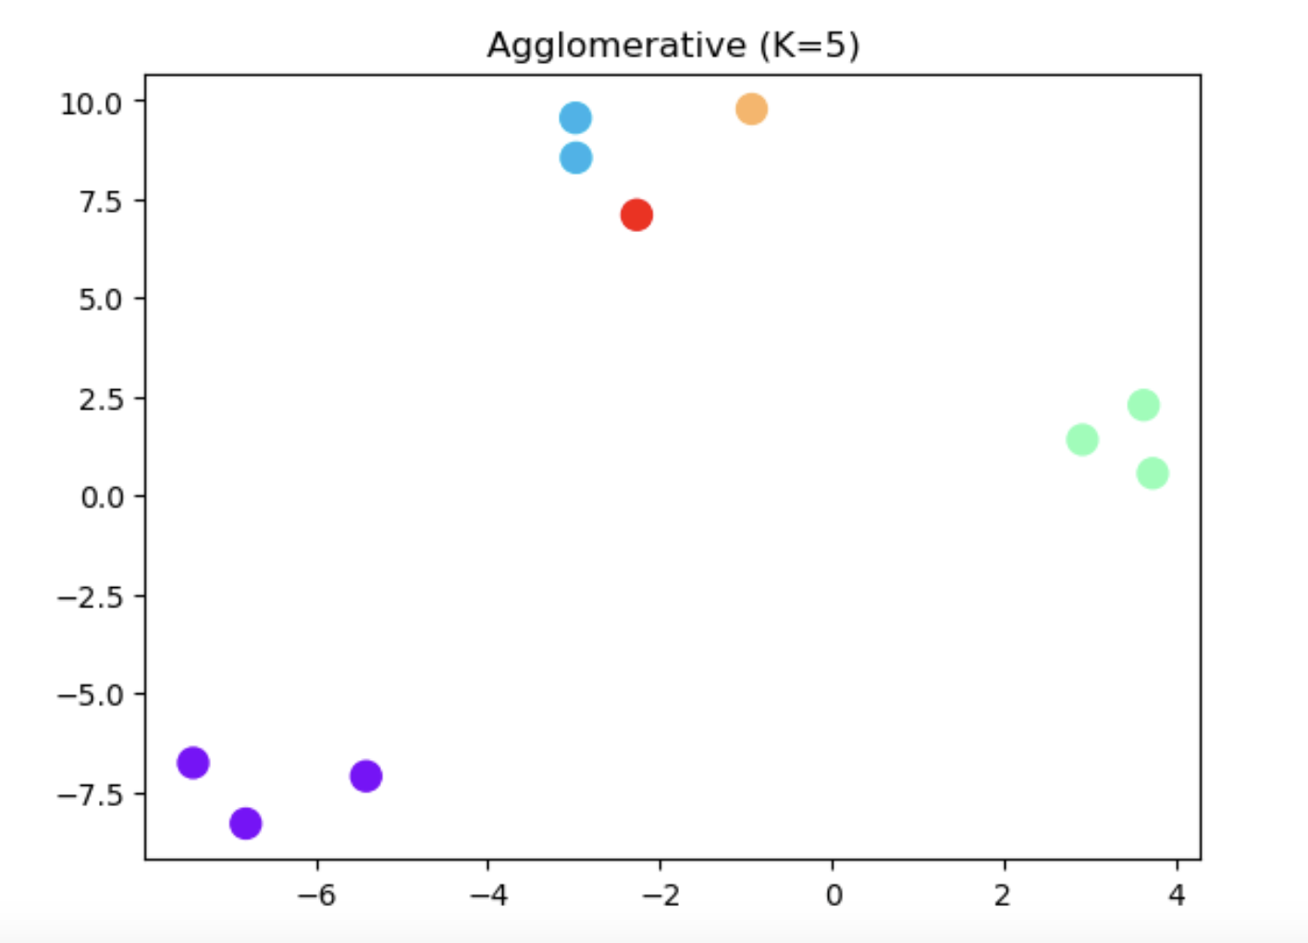
Example
Agglomerative.py
17
18
19
20
21
22
23
24
25
num_clusters = 5
model = AgglomerativeClustering(n_clusters=num_clusters, linkage="ward")
pred_labels = model.fit_predict(X)
plt.scatter(X[:, 0], X[:, 1], c=pred_labels, cmap='rainbow', s=100)
plt.title(f"Agglomerative (K={num_clusters})")
plt.show()

Slide 39
Weakness of agglomerative clustering methods
Can never undo what was done previously
Do not scale well: time complexity of at least O(n²), where n is the number of total objects
Integration of hierarchical & distance-based clustering
BIRCH: uses CF-tree and incrementally adjusts the quality of sub-clusters.
CHAMELEON: hierarchical clustering using dynamic modeling

Slide 40
BIRCH (Balanced Iterative Reducing and Clustering Using Hierarchies)
Balanced Iterative Reducing and Clustering using Hierarchies (BIRCH) is designed for clustering a large amount of numeric data by integrating hierarchical clustering and other clustering methods such as iterative partitioning.
Incrementally construct a CF (Clustering Feature) tree, a hierarchical data structure for multiphase clustering
Phase 1: scan DB to build an initial in-memory CF tree (a multi-level compression of the data that tries to preserve the inherent clustering structure of the data)
Phase 2: use an arbitrary clustering algorithm to cluster the leaf nodes of the CF-tree.
Scales linearly: finds a good clustering with a single scan and improves the quality with a few additional scans
Weakness: handles only numeric data, and sensitive to the order of the data record

Slide 41

Clustering Feature Vector in BIRCH
Clustering Feature (CF): CF = (N, LS, SS)
Where,
N: Number of data points
LS: linear sum of N points : $\sum_{i=1}^{N}{Xi}$
SS: square sum of N points : $\sum_{i=1}^{N}{X2i}$
(3,4)
(2,6)
(4,5)
CF = (3, (9,15),(29,77))

Slide 42
CF Tree structure
A CF tree is a height-balanced tree that stores the clustering features for a hierarchical clustering.
By definition, a nonleaf node in a tree has descendants or "children.”
The nonleaf nodes store sums of the CFs of their children, and thus summarize clustering information about their children.
A CF tree has two parameters: branching factor, B, and threshold, T.
The branching factor specifies the maximum number of children per non leaf node.
The threshold parameter specifies the maximum diameter of subclusters stored at the leaf nodes of the tree.
These two parameters influence the size of the resulting tree.

Slide 43
The CF Tree Structure
B = 3
T = 1.5
CF12
CF3
CFN
CF1
CF2
CF3
……………………..

Slide 44
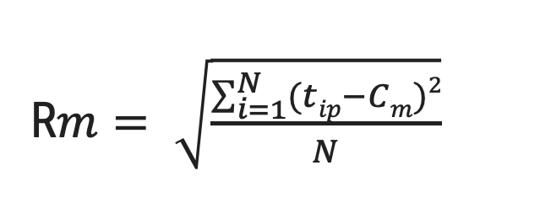
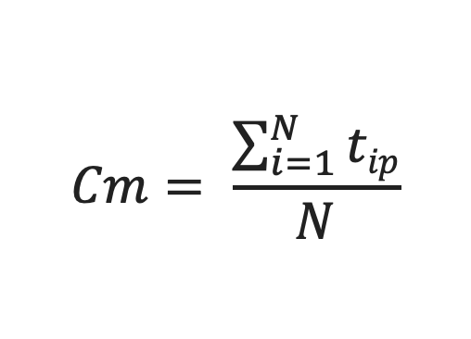
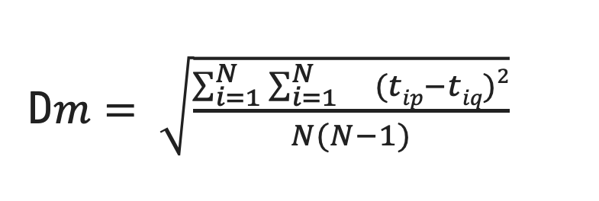
Centroid, Radius and Diameter of a Cluster
Centroid: the “middle” of a cluster
Radius: square root of average distance from any point of the cluster to its centroid
Diameter: square root of average mean squared distance between all pairs of points in the cluster
$$Cm= \frac{\sum_{i=1}^{N}{tip}}{N}$$
R$m= \sqrt{\frac{\sum_{i=1}^{N}{(tip}−Cm)2}{N}}$
D$m= \sqrt{\frac{\sum_{i=1}^{N}{\sum_{i=1}^{N}{}(tip}−tiq)2}{N(N−1)}}$

Slide 45
BIRCH
For each point in the input
Find closest leaf entry
Add point to leaf entry and update CF
If entry diameter > max_diameter, then split leaf, and possibly parents
Algorithm is O(n)
Sensitive to insertion order of data points
Since we fix the size of leaf nodes, so clusters may not be so natural
Clusters tend to be spherical given the radius and diameter measures

Slide 46
CHAMELEON: Hierarchical Clustering Using Dynamic Modeling
Chameleon is a hierarchical clustering algorithm that uses dynamic modeling to determine the similarity between pairs of clusters.
In Chameleon, cluster similarity is assessed based on
Interconnectivity: How well connected objects are within a cluster.
Proximity: How they are close together.
Algorithm:
Chameleon uses a k-nearest-neighbor graph approach to construct a sparse graph
where each vertex of the graph represents a data object, and there exists an edge between two vertices (objects) if one object is among the k-most similar objects to the other.
Chameleon uses a graph partitioning algorithm to partition the k-nearest-neighbor graph into a large number of relatively small subclusters
Chameleon then uses an agglomerative hierarchical clustering algorithm that iteratively merges subclusters based on their similarity.

Slide 47
CHAMELEON: Hierarchical Clustering Using Dynamic Modeling
Construct (K-NN)
Sparse Graph
Step - 2
Step - 1
Partition the Graph
Data Set
K-NN Graph
P and q are connected if q is among the top k closest neighbors of p
Step - 3
Merge Partition

Slide 48
Density-Based Clustering Methods
Clusters are dense regions of objects in space that are separated by low-density regions.
It can discover clusters of arbitrary shape
It can handle noise in dataset.
It required one scan.
Need density parameters as termination condition
Several density based algorithm.
DBSCAN:(Density-Based Clustering Based on Connected Regions with High Density )
OPTICS:(Ordering Points to Identify the Clustering Structure)
DENCLUE: (Clustering Based on Density Distribution Functions )

Slide 49
DBSCAN
The density of an object O can be measured by the number of objects close to O.
DBSCAN (Density-Based Spatial Clustering of Applications with Noise) finds core objects, that is, objects that have dense neighborhoods.
It connects core objects and their neighborhoods to form dense regions as clusters.
A user-specified parameter Eps > 0 is used to specify the radius of a neighborhood.
the density of a neighborhood can be measured simply by the number of objects in the neighborhood
DBSCAN uses another user-specified parameter, MinPts, which specifies the density threshold of dense regions.
Two parameters:
Eps: Maximum radius of the neighbourhood
MinPts: Minimum number of points in an Eps-neighbourhood of that point

Slide 50
DBSCAN
An object is a core object if the Eps-neighborhood of the object contains at least MinPts objects.
Directly density-reachable.
For a core object q and an object p.
we say that p is directly density-reachable from q (with respect to ε and MinPts) if p is within the ε-neighborhood of q
p
MinPts = 5
Eps = 1 cm
q

Slide 51
DBSCAN
Density-reachable
A point p is density-reachable from a point q w.r.t. Eps, MinPts if there is a chain of points p₁, …, p_{n}, p₁ = q, p_{n} = p such that p_{i+1} is directly density-reachable from p_{i}
Density-connected:
A point p is density-connected to a point q w.r.t. Eps, MinPts if there is a point o such that both, p and q are density-reachable from o w.r.t. Eps and MinPts
p
p₁
q
p
q
o

Slide 52
DBSCAN
INPUT:
D: a data set containing n objects, ε: the radius parameter, and
MinPts: the neighborhood density threshold.
Output:
A set of density-based clusters.

Slide 53
DBSCAN
mark all objects as unvisited;
do
randomly select an unvisited object p; mark p as visited;
if the ε-neighborhood of p has at least MinPts objects;
create a new cluster C, and add p to C; let N be the set of objects in the ε-neighborhood of p;
for each point p′ in N
if p′ is unvisited
mark p′ as visited;
if the ε-neighborhood of p′ has at least MinPts points, add those points to N;
if p′ is not yet a member of any cluster, add p′ to C;
end for
output C;
else mark p as noise;
until no object is unvisited;

Slide 54
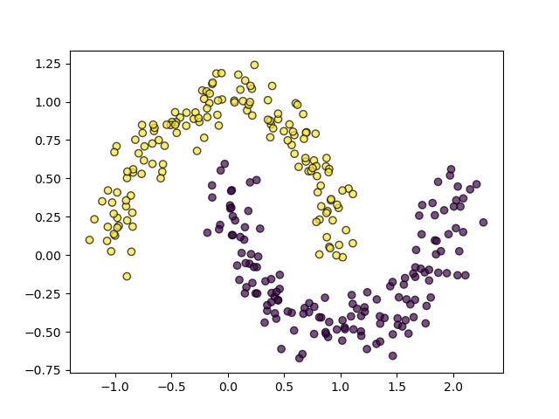
DBSCAN Example
DBSCAN.py
1
2
3
4
5
6
7
8
9
10
11
12
import numpy as np
import matplotlib.pyplot as plt
from sklearn.datasets import make_moons
from sklearn.cluster import DBSCAN
X, y = make_moons(n_samples=300, noise=0.1, random_state=42)
dbscan = DBSCAN(eps=0.2, min_samples=5)
labels = dbscan.fit_predict(X)
plt.scatter(X[:, 0], X[:, 1], c=labels, cmap='viridis', edgecolors='k', alpha=0.7)
plt.savefig("abc.png")

Slide 55
What Are Outliers ?
Assume that a given statistical process is used to generate a set of data objects.
An outlier is a data object that deviates significantly from the rest of the objects, as if it were generated by a different mechanism.
Outliers are different from noisy data.
noise is a random error or variance in a measured variable.
Noise should be removed before outlier detection
In general, noise is not interesting in data analysis, including outlier detection.
Outliers are interesting because they are suspected of not being generated by the same mechanisms as the rest of the data.
Outliers are interesting: It violates the mechanism that generates the normal data

Slide 56
What Are Outliers ?
Applications
Credit card fraud detection
Telecom fraud detection
Customer segmentation
Medical analysis

Slide 57
Types of Outliers
Three kinds: global, contextual and collective outliers
Global outlier (or point anomaly)
In a given data set, a data object is a global outlier if it deviates significantly from the rest of the data set.
Global outliers are sometimes called point anomalies, and are the simplest type of outliers
Most outlier detection methods are aimed at finding global outliers.
Issue: Find an appropriate measurement of deviation
Contextual outlier (or conditional outlier)
Object is O_{c} if it deviates significantly based on a selected context.
“The temperature today is 28 C. Is it exceptional (i.e., an outlier)?” It depends, for example, on the time and location! If it is in winter in Toronto, yes, it is an outlier. If it is a summer day in Toronto, then it is normal.

Slide 58
Types of Outliers
In a given data set, a data object is a contextual outlier if it deviates significantly with respect to a specific context of the object
Contextual outliers are also known as conditional outliers because they are conditional on the selected context.
Attributes of data objects should be divided into two groups
Contextual attributes: defines the context, e.g., time & location
Behavioral attributes: characteristics of the object, used in outlier evaluation, e.g., temperature
An object in a data set is a local outlier if its density significantly deviates from the local area in which it occurs.

Slide 59
Types of Outliers
Collective Outliers
A subset of data objects collectively deviate significantly from the whole data set, even if the individual data objects may not be outliers
Detection of collective outliers
Consider not only behavior of individual objects, but also that of groups of objects
Need to have the background knowledge on the relationship among data objects, such as a distance or similarity measure on objects.
A data set may have multiple types of outlier
One object may belong to more than one type of outlier
Collective Outlier

Slide 60
Challenges of Outlier Detection
Modeling normal objects and outliers properly
Hard to enumerate all possible normal behaviors in an application
The border between normal and outlier objects is often a gray area
Application-specific outlier detection
Choice of distance measure among objects and the model of relationship among objects are often application-dependent
E.g., clinic data: a small deviation could be an outlier; while in marketing analysis, larger fluctuations
Handling noise in outlier detection
Noise may distort the normal objects and blur the distinction between normal objects and outliers. It may help hide outliers and reduce the effectiveness of outlier detection
Understandability
Understand why these are outliers: Justification of the detection
Specify the degree of an outlier: the unlikelihood of the object being generated by a normal mechanism

Slide 61
Outlier Detection Methods
Two ways to categorize outlier detection methods:
Based on whether user-labeled examples of outliers can be obtained:
Supervised, semi-supervised vs. unsupervised methods
Based on assumptions about normal data and outliers:
Statistical, proximity-based, and clustering-based methods
Supervised Methods
Modeling outlier detection as a classification problem
The task is to learn a classifier that can recognize outliers
Samples examined by domain experts used for training & testing
Methods for Learning a classifier for outlier detection effectively:
Model normal objects & report those not matching the model as outliers, or
Model outliers and treat those not matching the model as normal

Slide 62
Outlier Detection Methods
Supervised Methods
Challenges
Imbalanced classes, i.e., outliers are rare: Boost the outlier class and make up some artificial outliers
Catch as many outliers as possible, i.e., recall is more important than accuracy (i.e., not mislabeling normal objects as outliers)
Unsupervised Methods
Assume the normal objects are somewhat ``clustered'‘ into multiple groups, each having some distinct features
An outlier is expected to be far away from any groups of normal objects
Weakness: Cannot detect collective outlier effectively
Normal objects may not share any strong patterns, but the collective outliers may share high similarity in a small area

Slide 63
Outlier Detection Methods
Unsupervised Methods
Many clustering methods can be adapted for unsupervised methods
Find clusters, then outliers: not belonging to any cluster
Problem 1: Hard to distinguish noise from outliers
Problem 2: Costly since first clustering: but far less outliers than normal objects
Semi-Supervised Methods
Situation: In many applications, the number of labeled data is often small: Labels could be on outliers only, normal objects only, or both
Semi-supervised outlier detection: Regarded as applications of semi-supervised learning
If some labeled normal objects are available
Use the labeled examples and the proximate unlabeled objects to train a model for normal objects
Those not fitting the model of normal objects are detected as outliers

Slide 64
Outlier Detection Methods
If only some labeled outliers are available, a small number of labeled outliers many not cover the possible outliers well
To improve the quality of outlier detection, one can get help from models for normal objects learned from unsupervised methods
Statistical Methods:
Statistical methods (also known as model-based methods) make assumptions of data normality. They assume that normal data objects are generated by a statistical (stochastic) model, and that data not following the model are outliers.
Example (right figure): First use Gaussian distribution to model the normal data
For each object y in region R, estimate gD(y), the probability of y fits the Gaussian distribution
If gD(y) is very low, y is unlikely generated by the Gaussian model, thus an outlier
Effectiveness of statistical methods: highly depends on whether the assumption of statistical model holds in the real data

Slide 65
Outlier Detection Methods
Proximity-Based Methods
An object is an outlier if the nearest neighbors of the object are far away, i.e., the proximity of the object is significantly deviates from the proximity of most of the other objects in the same data set
Example (right figure):
Model the proximity of an object using its 3 nearest neighbors
Objects in region R are substantially different from other objects in the data set.
Thus the objects in R are outliers
The effectiveness of proximity-based methods highly relies on the proximity measure.
In some applications, proximity or distance measures cannot be obtained easily.
Often have a difficulty in finding a group of outliers which stay close to each other
Two major types of outlier detection Distance-based vs. density-based

Slide 66
Outlier Detection Methods
Clustering-Based Methods
Normal data belong to large and dense clusters, whereas outliers belong to small or sparse clusters, or do not belong to any clusters
Example (right figure): two clusters
All points not in R form a large cluster
The two points in R form a tiny cluster, thus are outliers
there are many clustering-based outlier detection methods are available.
Clustering is expensive: straightforward adaption of a clustering method for outlier detection can be costly and does not scale up well for large data sets

Slide 67
Feature Selection, Extraction and Engineering
Feature
Selection
Feature
Extraction
Feature
Engineering
Subsetting the features
Create new features when we could NOT have used row features
Create new features when we could have used row features
Ex: Use Correlation with the dependent variable
Ex: from image to RGB value. Automatic methods such as PCA
Ex: Creating a new dummy variable for working days

Slide 68
Feature Selection
Feature selection is the process of choosing the most relevant features from the dataset while removing irrelevant or redundant ones.
The goal is to improve model performance by reducing overfitting, speeding up training, and improving interpretability.
Full Feature Set
1
2
3
4
5
6
7
8
Useful Feature
1
2
3
4
5
6
7
8
Selected Feature set
1
3
6

Slide 69
Feature Selection Methods
Feature Selection Methods
Filter Methods
Wrapper Methods
Embedded Methods
Independent of the model
Use model performance to select features
Feature selection happens during model training

Slide 70
Filter Methods
Filter methods evaluate the relevance of features independently of any machine learning model.
These methods rely on statistical tests to measure the correlation between input features and the target variable.
Filter method generally used as a preprocessing step.
Some of the common filter methods are correlation metrics(Pearson, chi-squared test, anova etc.
Steps to Apply Filter Methods
Calculate the statistical measure (e.g., correlation, chi-square) for each feature.
Sort features based on their scores in descending order.
Choose the top k features or features above a threshold.
This method Ignores feature interactions

Slide 71
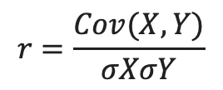
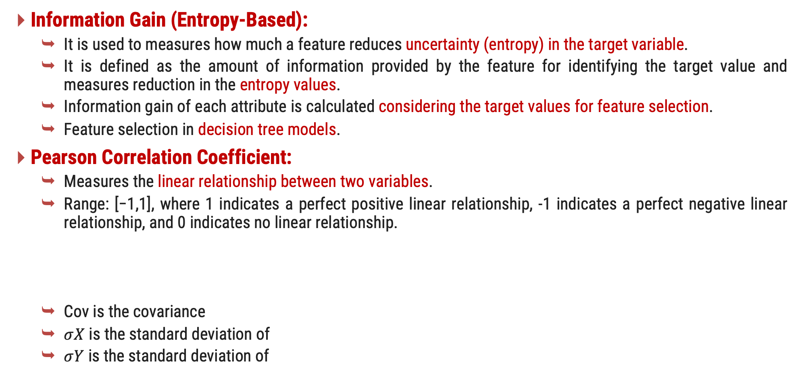
Filter Methods - Techniques
Information Gain (Entropy-Based):
It is used to measures how much a feature reduces uncertainty (entropy) in the target variable.
It is defined as the amount of information provided by the feature for identifying the target value and measures reduction in the entropy values.
Information gain of each attribute is calculated considering the target values for feature selection.
Feature selection in decision tree models.
Pearson Correlation Coefficient:
Measures the linear relationship between two variables.
Range: [−1,1], where 1 indicates a perfect positive linear relationship, -1 indicates a perfect negative linear relationship, and 0 indicates no linear relationship.
Cov is the covariance
$σX$ is the standard deviation of
$σY$ is the standard deviation of
$$r=\frac{Cov(X,Y)}{σXσY}$$

Slide 72
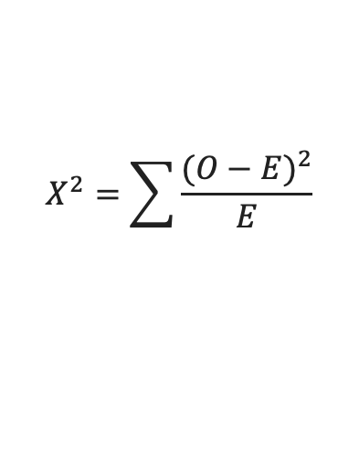
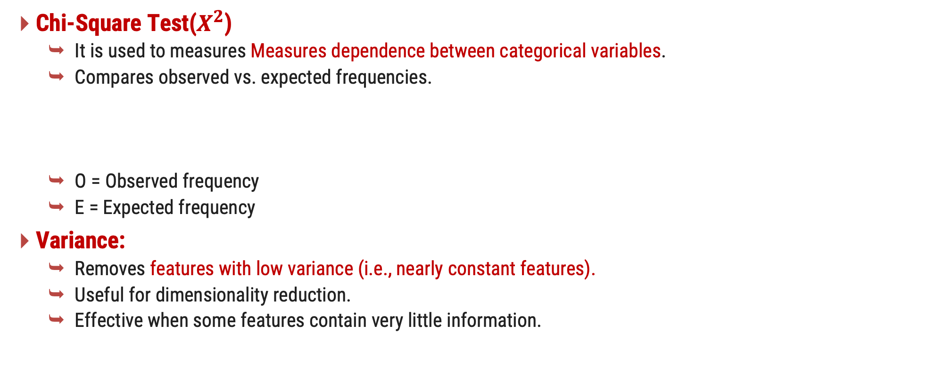
Filter Methods - Techniques
Chi-Square Test($X^{2}$)
It is used to measures Measures dependence between categorical variables.
Compares observed vs. expected frequencies.
O = Observed frequency
E = Expected frequency
Variance:
Removes features with low variance (i.e., nearly constant features).
Useful for dimensionality reduction.
Effective when some features contain very little information.
$$X^{2}=\sum{\frac{{(O−E)}^{2}}{E}}$$

Slide 73
Chi-Square Test($X^{2}$) - Example
Person | Gender | Education | Buys Product
P1 | Male | Graduate | Yes
P2 | Female | Graduate | Yes
P3 | Male | Graduate | Yes
P4 | Female | Graduate | No
P5 | Male | Non-Grad | No
P6 | Female | Non-Grad | No
P7 | Male | Non-Grad | No
P8 | Female | Non-Grad | No

Slide 74
Chi-Square Test($X^{2}$) - Example
Step1: Define Null and Alternative Hypothesis.
First we will check for education column with buy product.
Null Hypothesis(H0):
There no significate association between two categorical variable.
Alternative Hypothesis(H0):
There significate association between two categorical variable.
Step2: Create the Contingency Tables (Observed frequency)
Education | Buys (Yes) | Does Not Buy (No) | Total
Graduate | 3 | 1 | 4
Non-Grad | 0 | 4 | 4
Total | 3 | 5 | 8

Slide 75
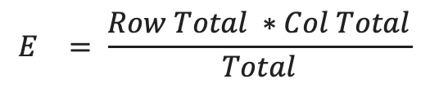
Chi-Square Test($X^{2}$) - Example
Step 3 : Calculate Expected Frequency
Observed Frequency
Education | Buys (Yes) | Does Not Buy (No) | Total
Graduate | 3 | 1 | 4
Non-Grad | 0 | 4 | 4
Total | 3 | 5 | 8
$$E^{}= \frac{Row Total ∗Col Total}{Total}$$
For Graduate, Buys (Yes):
E = (4 × 3) / 8 = 1.5
For Graduate, Does Not Buy (No):
E = (4 × 5) / 8 = 2.5
For Non-Grad, Buys (Yes):
E = (4 × 3) / 8 = 1.5
For Non-Grad, Does Not Buy (No):
E = (4 × 5) / 8 = 2.5
Expected Frequency
Education | Buys (Yes) | Does Not Buy (No)
Graduate | 1.5 | 2.5
Non-Grad | 1.5 | 2.5

Slide 76

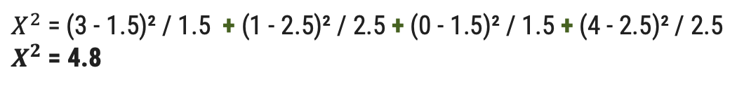
Chi-Square Test($X^{2}$) - Example
Step 4 : Calculate Chi-square value
Observed Frequency
Education | Buys (Yes) | Does Not Buy (No) | Total
Graduate | 3 | 1 | 4
Non-Grad | 0 | 4 | 4
Total | 3 | 5 | 8
$$X^{2}=\sum{\frac{{(O−E)}^{2}}{E}}$$
$X^{2}$= (3 - 1.5)² / 1.5 + (1 - 2.5)² / 2.5 + (0 - 1.5)² / 1.5 + (4 - 2.5)² / 2.5
$X^{2}$= 4.8
Expected Frequency
Education | Buys (Yes) | Does Not Buy (No)
Graduate | 1.5 | 2.5
Non-Grad | 1.5 | 2.5

Slide 77
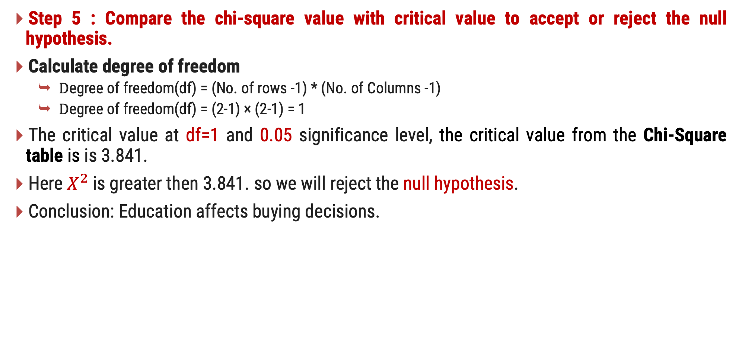
Chi-Square Test($X^{2}$) - Example
Step 5 : Compare the chi-square value with critical value to accept or reject the null hypothesis.
Calculate degree of freedom
$\text{D}\text{egree} \text{of} \text{freedom}$(df) = (No. of rows -1) * (No. of Columns -1)
$\text{D}\text{egree} \text{of} \text{freedom}$(df) = (2-1) × (2-1) = 1
The critical value at df=1 and 0.05 significance level, the critical value from the Chi-Square table is is 3.841.
Here $X^{2}$is greater then 3.841. so we will reject the null hypothesis.
Conclusion: Education affects buying decisions.

Slide 78
Wrapper Method
Wrapper methods use machine learning models to evaluate feature subsets.
They iteratively train models with different feature combinations and select the subset that performs best.
Forward Selection and Backward Elimination are some of the example of wrapper method.
Small datasets, accurate subset.
Computationally expensive

Slide 79
Wrapper Methods - Techniques
Forward Selection
Backward Elimination
Start with no features → Add one feature at a time.
At each step, train and evaluate the machine learning model using the selected features.
Continue until a predefined stopping criterion is met, such as a maximum number of features or a significant drop in performance.
Start with all features → Remove one feature at a time.
In each iteration, remove the least important feature and evaluate the model.
Continue until a predefined stopping criterion is met, such as a maximum number of features or a significant drop in performance.

Slide 80
Wrapper Methods - Techniques
Recursive feature elimination (RFE)
Start with all features and rank them based on their importance or contribution to the model.
In each iteration, remove the least important feature(s).
Continue until a predefined stopping criterion is met, such as a maximum number of features or a significant drop in performance.

Slide 81
Embedded Methods
Embedded methods perform feature selection as part of the model training process.
They combine the advantages of filter and wrapper methods by considering feature importance during model training.
Uses model coefficients or importance scores to select features.
These methods are often based on regularization techniques.
Lasso (L1 regularization):
Adds a penalty term to the loss function, forcing some feature coefficients to zero.
Ridge (L2 regularization):
Shrinks feature coefficients but does not eliminate them.

Slide 82
Filter vs Wrapper vs Embedded
Filter | Wrapper | Embedded
Not depend on model | Depend on model. | Depend on model.
Computational cost is low. | Computational cost is High. | Computational cost is Moderate.
Feature Interactions ignored | Feature Interactions Considered | Feature Interactions Considered
Good for preprocessing | High (optimal subsets) | High (efficient and effective)
Example: Correlation, Chi-square | Example: Forward selection | Example: Lasso

Slide 83
Feature Extraction
Feature extraction is a process of transforming raw data into a reduced set of features that capture the most important information for a given task.
Unlike feature selection, which selects a subset of existing features, feature extraction creates new features by combining or transforming the original ones.
This is particularly useful for high-dimensional data, such as images, text, or signals, where the number of features can be very large.

Slide 84
Curse of Dimensionality
Model Performance
Dimensionality(number of features)
Optimal no. of
features

Slide 85
Dimensionality Reduction Techniques - PCA
PCA is an unsupervised machine learning technique.
It is used for dimensionality reduction and feature extraction.
PCA finds new principal components that capture the most variance in data.
Helps in visualization and speeding up computations.
Simplify data while retaining maximum variance (information).
Why PCA?
Reduces complexity in high-dimensional data.
Reducing dimensions removes redundancy while keeping essential information.
Data compression
Noise reduction
Faster machine learning models

Slide 86
Steps in PCA
1) Standardize the Data
Mean center each feature (subtract mean from each value).
Scale data to unit variance.
Standardized data ensures fair comparison across features.
2) Compute Covariance Matrix
This matrix shows how the variables in our data set vary.
It helps us understand the relationships between different features.
3) Calculate Eigenvalues and Eigenvectors
We then calculate the eigenvalues and eigenvectors of the covariance matrix.
Eigenvalues indicate the amount of variance captured by each principal component.
Eigenvectors determine the direction of these components.
4) Sort Eigenvalues
The eigenvalues are sorted in descending order.
We select the top eigenvalues and their corresponding eigenvectors as our principal components.

Slide 87
Steps in PCA
These components capture the most significant variance in the data.
5) Construct the principal component matrix.
Using the selected eigenvectors, we construct the principal component matrix.
This matrix transforms the original data into a new coordinate system defined by the principal components.
6) Transform the original data:
This step transforms the original data using the principal component matrix.
It creates a new data set with reduced dimensions but retains most of the original variance.

Slide 88
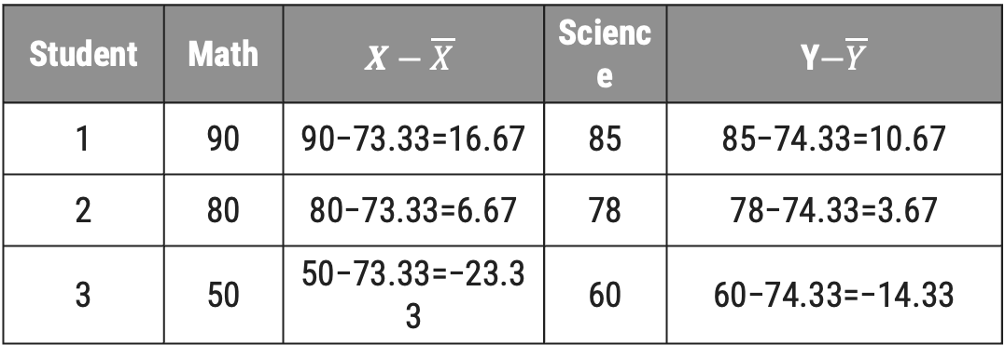
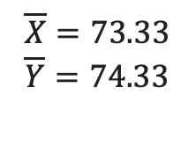
PCA Example
Given Data
1) Standardize the Data
Student | Math | Science
1 | 90 | 85
2 | 80 | 78
3 | 50 | 60
$$\overline{X}=73.33$$
$$\overline{Y}=74.33$$
Student | Math | $$X−\overline{X}$$ | Science | Y$−\overline{Y}$
1 | 90 | 90−73.33=16.67 | 85 | 85−74.33=10.67
2 | 80 | 80−73.33=6.67 | 78 | 78−74.33=3.67
3 | 50 | 50−73.33=−23.33 | 60 | 60−74.33=−14.33

Slide 89

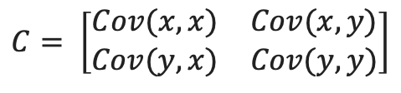

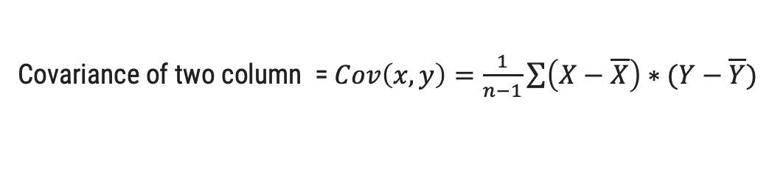

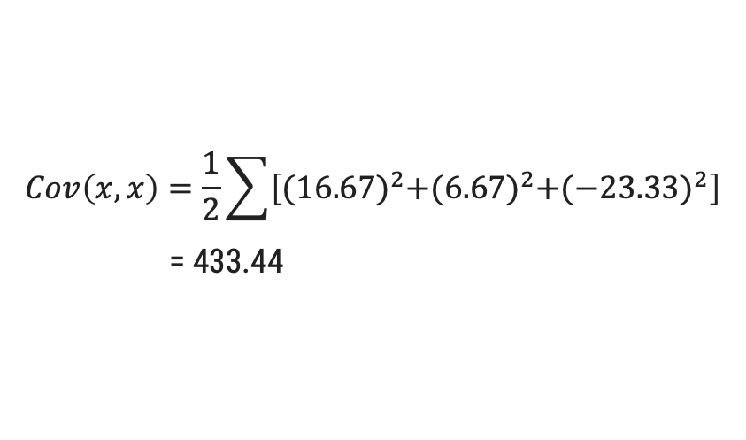
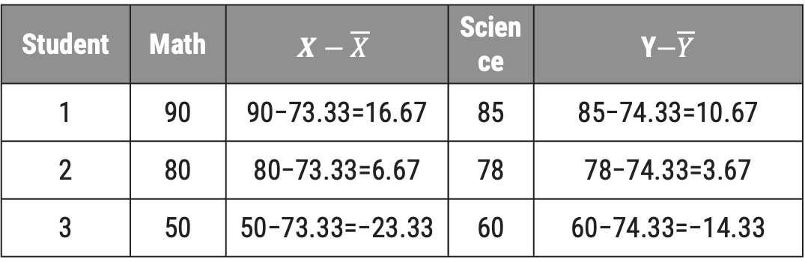

PCA Example
2) Compute the Covariance Matrix
Covariance of two column = $Cov\left(x,y\right)=\frac{1}{n−1}\sum{\left(X−\overline{X}\right)∗(Y−\overline{Y})}$
Covariance Matrix
$$C= \left[\begin{matrix}Cov(x,x) & Cov(x,y) \\ Cov(y,x) & Cov(y,y)\end{matrix}\right]$$
$$Cov\left(x,x\right)=\frac{1}{2}\sum{\left[{(16.67)}^{2}+{(6.67)}^{2}+{(−23.33)}^{2}\right]}$$
= 433.44
Student | Math | $$X−\overline{X}$$ | Science | Y$−\overline{Y}$
1 | 90 | 90−73.33=16.67 | 85 | 85−74.33=10.67
2 | 80 | 80−73.33=6.67 | 78 | 78−74.33=3.67
3 | 50 | 50−73.33=−23.33 | 60 | 60−74.33=−14.33
$$Cov\left(x,y\right)=268.39$$
$$Cov\left(y,x\right)=268.39$$
$$Cov\left(y,y\right)=166.41$$
$$C= \left[\begin{matrix}433.44 & 268.30 \\ 268.30 & 166.41\end{matrix}\right]$$

Slide 90
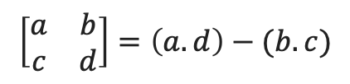


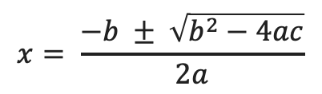
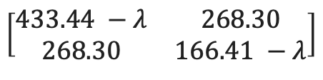
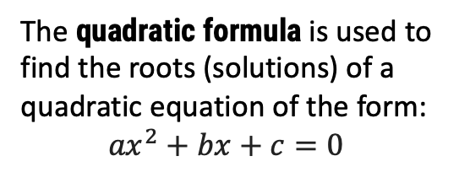

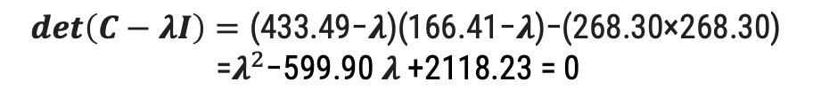
PCA Example
3) Compute Eigenvalues and Eigenvectors
The vector x is an eigenvector of the matrix C with eigenvalue $λ$ (lambda) if the following equation holds:
C$x=Cx or,$ C$x−λx$ = 0 or, $\left(C−λI\right)x=0, where I is identity matrix.$
$$C= \left[\begin{matrix}433.44 & 268.30 \\ 268.30 & 166.41\end{matrix}\right]$$
$λI=λ\left[\begin{matrix}1 & 0 \\ 0 & 1\end{matrix}\right]$ = $\left[\begin{matrix}λ & 0 \\ 0 & λ\end{matrix}\right]$
$\left(C−λI\right)$ =
$$\left[\begin{matrix}433.44 −λ & 268.30 \\ 268.30 & 166.41 −λ\end{matrix}\right]$$
Compute the Determinant of matrix
$$\left[\begin{matrix}a & b \\ c & d\end{matrix}\right]=\left(a.d\right)−(b.c)$$
$$det\left(C−λI\right)=\text{(433.49−}λ\text{)(166.41−}λ\text{)−(268.30×268.30)}$$
=$λ^{2}$−599.90 $λ$+2118.23 = 0
The quadratic formula is used to find the roots (solutions) of a quadratic equation of the form:
$${ax}^{2}+bx+c=0$$
The solutions for x (also called the roots of the equation) are given by:
$$x= \frac{−b ± \sqrt{b^{2}−4ac}}{2a}$$

Slide 91



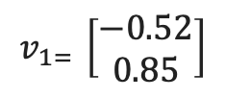
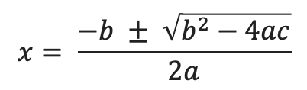
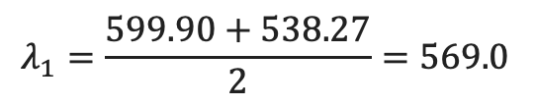
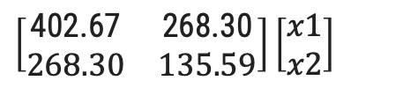
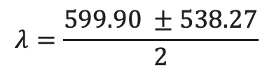
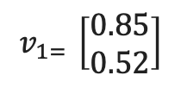
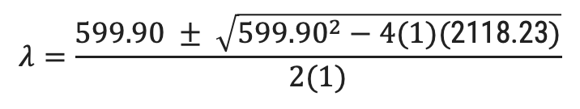
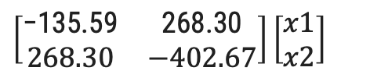
PCA Example
3) Compute Eigenvalues and Eigenvectors
$$x= \frac{−b ± \sqrt{b^{2}−4ac}}{2a}$$
$λ^{2}$−599.90 $λ$+ 2118.23=0
$$λ=\frac{599.90 ± \sqrt{{599.90}^{2}−4(1)(\text{2118.23})}}{2(1)}$$
$$λ=\frac{599.90 ±538.27}{2}$$
$$λ_{1}=\frac{599.90+538.27}{2}=569.0$$
$λ_{1}=\frac{599.90 − 538.27}{2}$ = 30.82
Eigenvectors
$$\left(C−λI\right)x=0$$
For λ = 569.08
For λ = 30.82
$\left[\begin{matrix}\text{−135.59} & \text{268.30} \\ 268.30 & −402.67\end{matrix}\right]\left[\begin{matrix}x1 \\ x2\end{matrix}\right]$
$\left[\begin{matrix}\text{402.67} & \text{268.30} \\ 268.30 & 135.59\end{matrix}\right]\left[\begin{matrix}x1 \\ x2\end{matrix}\right]$
$$v_{1= }\left[\begin{matrix}0.85 \\ 0.52\end{matrix}\right]$$
$$v_{1= }\left[\begin{matrix}−0.52 \\ 0.85\end{matrix}\right]$$

Slide 92


PCA Example
4) Sort Eigenvalues – We select the top 569.08 and their corresponding eigenvectors as our principal components
5) Transform the original data
Z=$X_{centered} ∗ V_{1}$
Z1​=(16.67×0.85)+(10.67×0.52)=19.94
Z2​=(6.67×0.85)+(3.67×0.52)=8.02
Z3​=(−23.33×0.85)+(−14.33×0.52)=−27.96
Student | Math | $$X−\overline{X}$$ | Science | Y$−\overline{Y}$
1 | 90 | 90−73.33=16.67 | 85 | 85−74.33=10.67
2 | 80 | 80−73.33=6.67 | 78 | 78−74.33=3.67
3 | 50 | 50−73.33=−23.33 | 60 | 60−74.33=−14.33
Student | PCA Value
1 | 19.94
2 | 8.02
3 | -27.96

Slide 93
LDA(Linear Discriminant Analysis)
It is also know as Normal Discriminant Analysis or Discriminant function Analysis.
Linear discriminant analysis (LDA) is an approach used in supervised machine learning to solve multi-class classification problems.
It is used to project the features in higher dimension space into a lower dimension space.
LDA separates multiple classes with multiple features through data dimensionality reduction.
This technique is important in data science as it helps optimize machine learning models.
To create this new axis and reduce dimensionality, LDA follows these criteria:
Maximize the distance between the means of two classes.
Minimize the variance within individual classes.

Slide 94
LDA(Linear Discriminant Analysis)
1) Compute the class means of dependent variable.
2) Derive the covariance matrix of the class variable.
3) Compute the within class – Scatter Matrix
4) Compute between class scatter matrix
5) Compute the eigen values and eigen vector from within class and between class scatter matrix.
6) Sort eigen values and select the top most.
7) Find the eigen vector correspond to the top k eigen vectors.
8) Obtain LDA by taking dot product of eigen vector and original data.

Slide 95
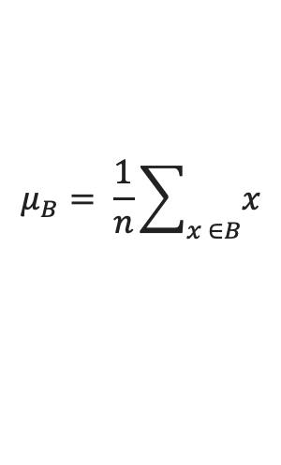
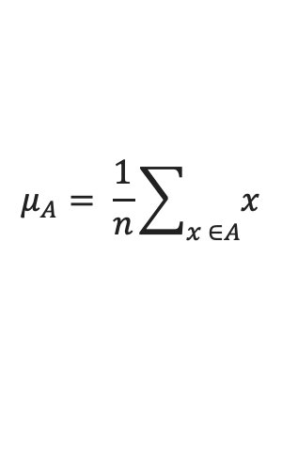
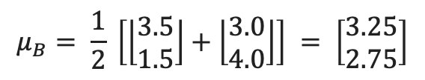
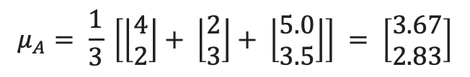
LDA - Example
Given Data
1) Compute Class Means
Feature 1 | Feature 2 | Class
4 | 2 | A
2 | 3 | A
3.5 | 1.5 | B
3.0 | 4 | B
5.0 | 3.5 | A
$$μ_{A}= \frac{1}{n}\sum_{x ∈A}{x}$$
$$μ_{B}= \frac{1}{n}\sum_{x ∈B}{x}$$
$$μ_{A}= \frac{1}{3} \left[\left\lfloor \begin{matrix}4 \\ 2\end{matrix}\right\rfloor + \left\lfloor \begin{matrix}2 \\ 3\end{matrix}\right\rfloor + \left\lfloor \begin{matrix}5.0 \\ 3.5\end{matrix}\right\rfloor \right] = \left[\begin{matrix}3.67 \\ 2.83\end{matrix}\right]$$
$$μ_{B}= \frac{1}{2} \left[\left\lfloor \begin{matrix}3.5 \\ 1.5\end{matrix}\right\rfloor +\left\lfloor \begin{matrix}3.0 \\ 4.0\end{matrix}\right\rfloor \right] = \left[\begin{matrix}3.25 \\ 2.75\end{matrix}\right]$$

Slide 96

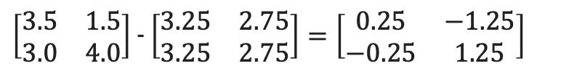


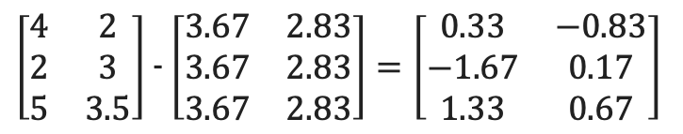

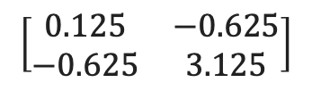


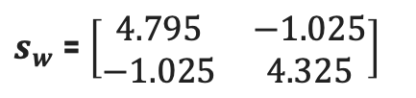


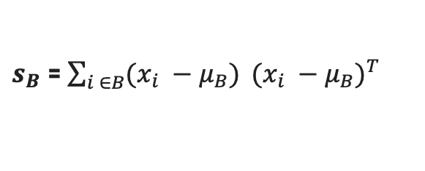
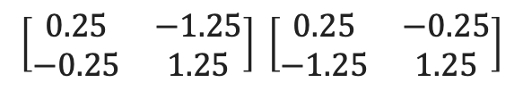





LDA - Example
2) Compute Within-Class Scatter Matrix $s_{w}$​
$s_{w}$​ = $s_{A}$​ + $s_{B}$​
$s_{A}$​ = $\sum_{i ∈A}{(x_{i} −μ_{A})} {(x_{i} −μ_{A})}^{T}$
$s_{B}$​ = $\sum_{i ∈B}{(x_{i} −μ_{B})} {(x_{i} −μ_{B})}^{T}$
$\left[\begin{matrix}3.5 & 1.5 \\ 3.0 & 4.0\end{matrix}\right]$ - $\left[\begin{matrix}3.25 & 2.75 \\ 3.25 & 2.75\end{matrix}\right]=\left[\begin{matrix}0.25 & −1.25 \\ −0.25 & 1.25\end{matrix}\right]$
$\left[\begin{matrix}4 & 2 \\ 2 & 3 \\ 5 & 3.5\end{matrix}\right]$ - $\left[\begin{matrix}3.67 & 2.83 \\ 3.67 & 2.83 \\ 3.67 & 2.83\end{matrix}\right]=\left[\begin{matrix}0.33 & −0.83 \\ −1.67 & 0.17 \\ 1.33 & 0.67\end{matrix}\right]$
$(x_{i} −μ_{B})$ =
$(x_{i} −μ_{A})$ =
$$\left[\begin{matrix}0.25 & −1.25 \\ −0.25 & 1.25\end{matrix}\right] \left[\begin{matrix}0.25 & −0.25 \\ −1.25 & 1.25\end{matrix}\right]$$
$$\left[\begin{matrix}0.33 & −0.83 \\ −1.67 & 0.17 \\ 1.33 & 0.67\end{matrix}\right] \left[\begin{matrix}0.33 & −1.67 & 1.33 \\ −0.83 & 0.17 & 0.67\end{matrix}\right]$$
$s_{B}$ = ​
$s_{A}$ = ​
$s_{B}$ = ​
$$\left[\begin{matrix}0.125 & −0.625 \\ −0.625 & 3.125\end{matrix}\right]$$
$s_{A}$ = ​
$$\left[\begin{matrix}4.67 & −0.40 \\ −0.40 & 1.20\end{matrix}\right]$$
$s_{w}$​ =
$\left[\begin{matrix}4.67 & −0.40 \\ −0.40 & 1.20\end{matrix}\right]$ + $\left[\begin{matrix}0.125 & −0.625 \\ −0.625 & 3.125\end{matrix}\right]$
$s_{w}$​ = $\left[\begin{matrix}4.795 & −1.025 \\ −1.025 & 4.325\end{matrix}\right]$

Slide 97





LDA - Example
3) Compute the Optimal Projection Vector w
W = $S_{w}^{−1}(μ_{A}−μ_{B})$
W = $\left[\begin{matrix}3.67 \\ 2.83\end{matrix}\right]$ - $\left[\begin{matrix}3.25 \\ 2.75\end{matrix}\right]$ = $\left\lfloor \begin{matrix}0.42 \\ 0.08\end{matrix}\right\rfloor$
$S_{w}^{−1}$ = $\left\lfloor \begin{matrix}0.217 & 0.051 \\ 0.051 & 0.241\end{matrix}\right\rfloor$
W = $\left\lfloor \begin{matrix}0.217 & 0.051 \\ 0.051 & 0.241\end{matrix}\right\rfloor$ $\left\lfloor \begin{matrix}0.42 \\ 0.08\end{matrix}\right\rfloor$
W = $\left\lfloor \begin{matrix}\text{0.1025} \\ 0.0407\end{matrix}\right\rfloor$

Slide 98
Thank You

