Slide 1

Unit-05 Artificial Neural Network
Machine Learning (ML)
2301CS621
Prof. Jayesh D. vagadiya
Computer Engineering Department
jayesh.vagadiya@darshan.ac.in
9537133260

Slide 2

Looping
Topics to be covered
Introduction
Artificial Neural Network
History of ANN
How ANN works
Multilayer Perceptron
Activation Function
Hyperparameter
Back Propagation
Multilayer neural network

Slide 3


Brain vs Computer
Brain
The Machine
Pattern Recognition
Association
Complexity
Noise Tolerance
Calculation
High Precision
Logic

Slide 4

Features of the Brain
Ten billion (${10}^{10}$) neurons
On average, several thousand connections
Hundreds of operation per second.
Compensates for problems by massive parallelism.

Slide 5
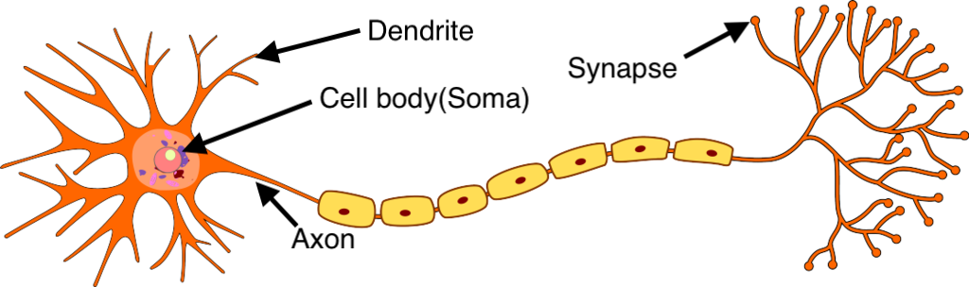
Biological Neurons
A neuron has a cell body, a branching input structure (the dendrIte) and a branching output structure (the axon).
Axons connect to dendrites via synapses
Electro-chemical signals are propagated from the dendritic input, through the cell body, and down the axon to other neurons
A neuron only fires if its input signal exceeds a certain amount (the threshold) in a short time period.
Synapses vary in strength
﻿﻿Good connections allowing a large signal
﻿﻿Slight connections allow only a weak signal
﻿﻿Synapses can be either excitatory or inhibitory
Ref:https://www.google.co.in/url?sa=i&url=https%3A%2F%2Fsaurabhnativeblog.medium.com%2Fwhat-is-the-relation-between-artificial-and-biological-neuron-18b05831036&psig=AOvVaw3aGnAj7eK-CjHZ4PrPC19u&ust=1741006389878000&source=images&cd=vfe&opi=89978449&ved=0CBcQjhxqFwoTCJiK4K2464sDFQAAAAAdAAAAABAI

Slide 6
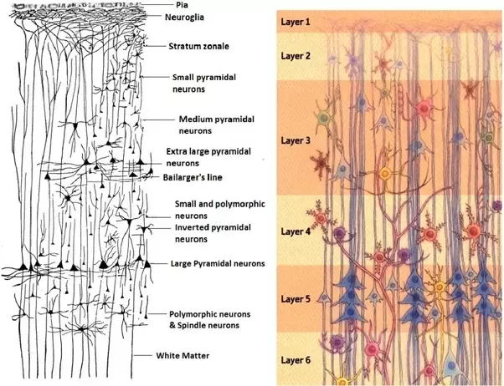
Biological Neurons
biological neurons are organized in a vast network of billions, with each neuron typically connected to thousands of other neurons.
Highly complex computations can be performed by a network of fairly simple neurons, much like a complex anthill can emerge from the combined efforts of simple ants.
The architecture of biological neural networks (BNNs) is still the subject of active research, but some parts of the brain have been mapped, and it seems that neurons are often organized in consecutive layers, especially in the cerebral cortex.
Multiple layers in a biological neural network (human cortex)

Slide 7
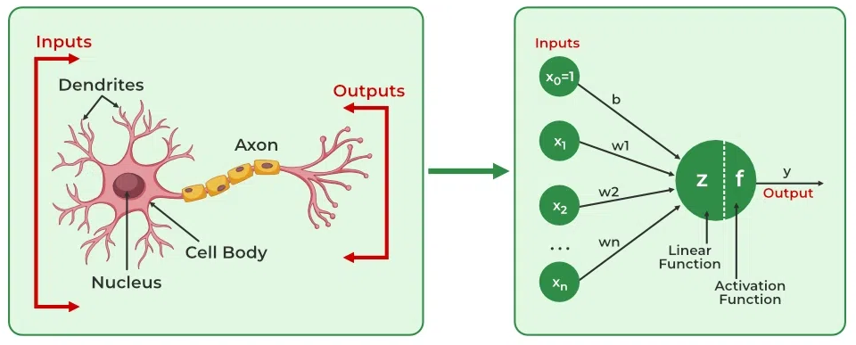
Artificial Neurons vs Biological Neurons
Biological Neuron | Artificial Neuron
Dendrite | Inputs
Cell nucleus or Soma | Nodes
Synapses | Weights
Axon | Output
Image reference : https://www.geeksforgeeks.org/artificial-neural-networks-and-its-applications/

Slide 8








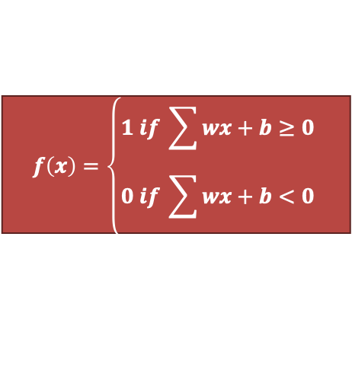

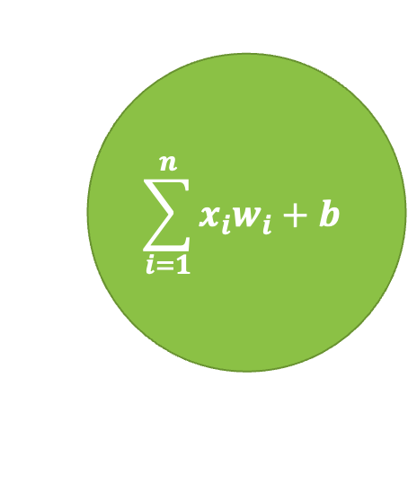

Artificial Neurons - Perceptron
$$x_{1}$$
$${ w}_{1}$$
$$x_{2}$$
$$\sum_{i=1}^{n}{x_{i}w_{i}}+b$$
$${ w}_{2}$$
$$f\left(x\right)=\left\{\begin{aligned}1 if \sum{wx}+b≥0 \\ 0 if \sum{wx+b<0}\end{aligned}\right.$$
$$x_{3}$$
$${ w}_{3}$$
$$\hat{y}$$
$$∙$$
$$∙$$
$$∙$$
Output
$${ w}_{n}$$
Activation
$$x_{n}$$
Summation and bias
Input

Slide 9
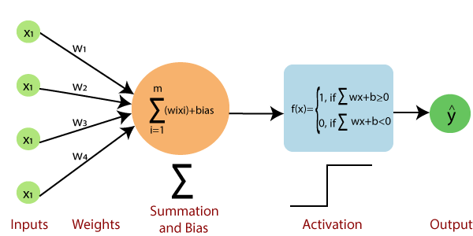
Basic Components of a Single Layer Perceptron
Input layer of the perceptron is made of artificial input neurons and takes the initial data into the system for further processing.
Activation Function: A neuron can be activated or not, is determined by an activation function. The activation function determines the output of the perceptron based on the weighted sum of the inputs and the bias term.
The perceptron is typically trained using a supervised learning algorithm such as the perceptron learning algorithm or back-propagation. During training, the weights and biases of the perceptron are adjusted to minimize the error between the predicted output and the true output for a given set of training examples.
Weight represents the strength of the connection between units. Each input neuron is associated with a weight.
Net sum calculates the total sum. A Bias term is added to the input layer to provide the perceptron with additional flexibility in modelling complex patterns in the input data.
Output: The output of the perceptron is a single binary value, either 0 or 1, which indicates the class or category to which the input data belongs.

Slide 10
Artificial Neural Networks
Computational models inspired by the human brain.
Algorithms that try to mimic the brain.
Massively parallel, distributed system, made up of simple processing units (neurons)
Synaptic connection strengths among neurons are used to store the acquired knowledge.
Knowledge is acquired by the network from its environment through a learning process

Slide 11
History of ANN
Year | Researcher(s) | Contribution
1943 | Warren McCulloch & Walter Pitts | Modeled neurons using electrical circuits.
1949 | Donald Hebb | Introduced Hebbian learning—neural pathways strengthen with use.
1950s | Nathanial Rochester (IBM) | First attempt to simulate a neural network (failed).
1959 | Bernard Widrow & Marcian Hoff | Developed ADALINE & MADALINE for binary pattern recognition and echo cancellation.
1962 | Widrow & Hoff | Developed a weight-adjusting learning rule for perceptrons.
1972 | Kohonen & Anderson | Independently developed similar networks using matrix mathematics.
1975 | - | First multilayered neural network (unsupervised learning).
1982 | John Hopfield | Introduced bidirectional connections in neural networks.

Slide 12
History of ANN
Year | Researcher(s) | Contribution
1982 | Reilly & Cooper | Developed a 'Hybrid network' with multiple layers using different strategies.
1982 | US-Japan Conference | Japan announced its Fifth Generation computing effort, leading to renewed US interest and funding.
1986 | David Rumelhart & others | Developed backpropagation networks, enabling multilayered learning.
Present | - | Neural networks are widely used, with ongoing research into specialized hardware (digital, analog, and optical chips) for efficiency.
Ref:https://cs.stanford.edu/people/eroberts/courses/soco/projects/neural-networks/History/history1.html

Slide 13
Different Network Topologies
1) Single Layer feed-forward networks:
Single layer
network
Input Record : x_{i}
w_{ij}
Input Layer
Output Layer

Slide 14
Different Network Topologies
2) Multi-layer feed-forward networks(Multilayer Perceptron):
Multilayer Perceptron
Input Record : x_{i}
w_{ij}
Input Layer
Hidden Layer
Output Layer

Slide 15
Multi-layer feed-forward networks
The inputs are fed simultaneously into the input layer.
The weighted outputs of these units are fed into hidden layer.
The weighted outputs of the last hidden layer are inputs to units making up the output layer.
A network containing two hidden layers is called a three-layer neural network, and so on.
The network is feed-forward in that none of the weights cycles back to an input unit or to an output unit of a previous layer.
INPUT – Records without class attribute with normalized attributes values.
INPUT VECTOR – X = { x1, x2, …. xn} where n is the number of (non class) attributes.
INPUT LAYER – There are as many nodes as non-class attributes i.e. as the length of the input vector.
HIDDEN LAYER – the number of nodes in the hidden layer and the number of hidden layers depends on implementation.
OUTPUT LAYER – corresponds to the class attribute.(There are as many nodes as classes )

Slide 16
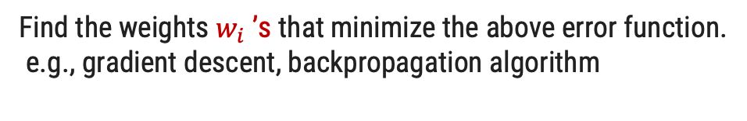
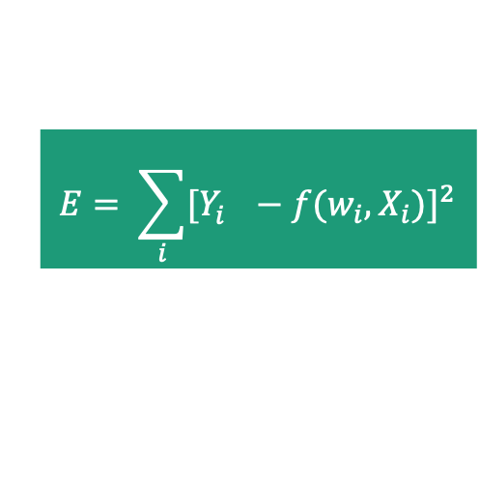
How ANN Works ? – Learning in ANN
Learn values of weights from input and output pairs.
Start with random weights.
Load training example's input
Observe computed input
Modify weights to reduce difference
Iterate over all training examples
Terminate when weights stop changing OR when error is very small
$$E= \sum_{i}{{[Y_{i}^{}−f(w_{i},X_{i})]}^{2}}$$
Error function
Find the weights $w_{i}$ ’s that minimize the above error function.
e.g., gradient descent, backpropagation algorithm

Slide 17
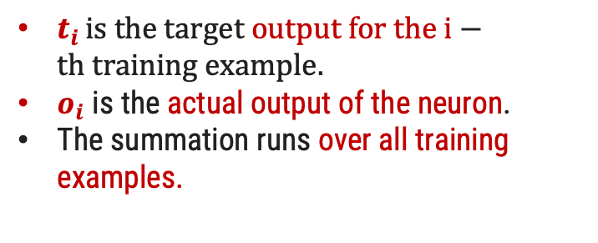
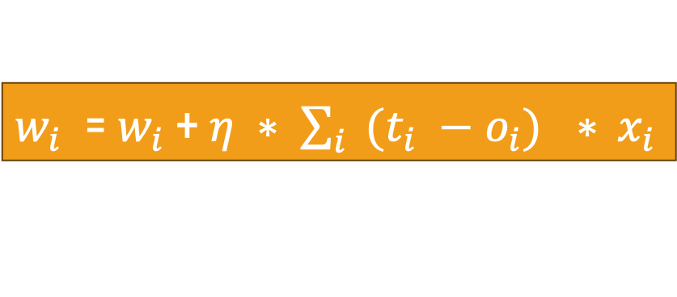
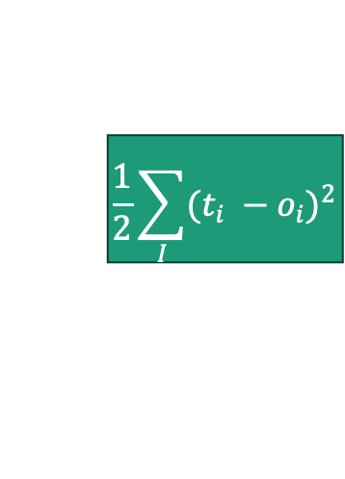
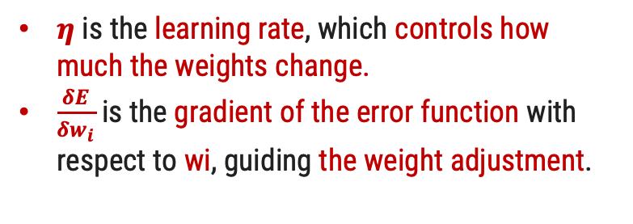


Delta Rule
It is fundamental learning rule in neural networks, particularly in single-layer perceptrons.
The error for a perceptron with i outputs can be measured as:
Weight Update Rule (Delta Rule):
$$\frac{1}{2}\sum_{I}{{(t_{i} −o_{i})}^{2}}$$
Error Function E =
$w_{i}$​= $w_{i}$​+Δ $w_{i}$​
Δ $w_{i}$​ = -$η\frac{δE}{δw_{i}}$
$t_{i }is the target output for the i−th training example.$
$o_{i}$ is the actual output of the neuron.
The summation runs over all training examples.
$η$ is the learning rate, which controls how much the weights change.
$\frac{δE}{δw_{i}}$ is the gradient of the error function with respect to wi​, guiding the weight adjustment.
$w_{i}$​ = $w_{i}$​+ $η ∗ \sum_{i}{{(t_{i} −o_{i})}^{}∗ }x_{i}$

Slide 18
Backpropagation algorithm
Forward Propagation:
initialize the weights and biases.
The weights AND bias in the network are initialized to random numbers from the interval [-1,1].
feed the training sample.
Propagate the inputs forward and Compute output and loss.
Backward Propagation:
1) back propagate the error.
2) update weights and biases to reflect the propagated errors.
Repear until the model learns the optimal weights.

Slide 19
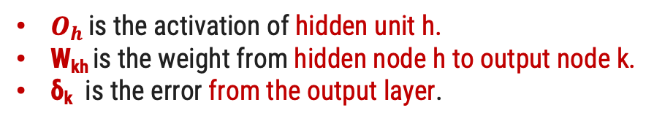
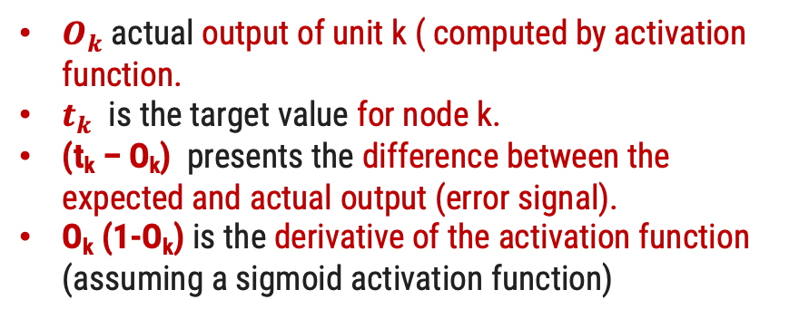
Backpropagation algorithm
1) For each output node k compute the error:
2) For each hidden unit h, calculate the error:
δ_{k} = O_{k} (1-O_{k})(t_{k} – O_{k})
δ_{h} = O_{h} (1-O_{h}) Σ_{k} W_{kh} δ_{k}
$O_{h }\text{is} \text{the} \text{activation} \text{of} \text{hidden} \text{unit} \text{h}\text{.}$
W_{kh} is the weight from hidden node h to output node k.
δ_{k} ​ is the error from the output layer.
$O_{k}$actual output of unit k ( computed by activation function.
$t_{k}$ is the target value for node k.
(t_{k} – O_{k}) presents the difference between the expected and actual output (error signal).
O_{k} (1-O_{k}) is the derivative of the activation function (assuming a sigmoid activation function)
3) Update each network weight:
W_{ji} = W_{ji} + Δw_{ji}
(W_{ji} and X_{ji} are the input and weight of node i to node j)
where Δw_{ji} = η δ_{j} X_{ji}

Slide 20
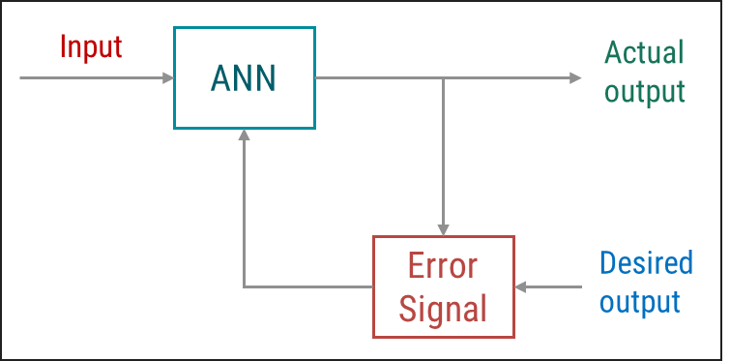
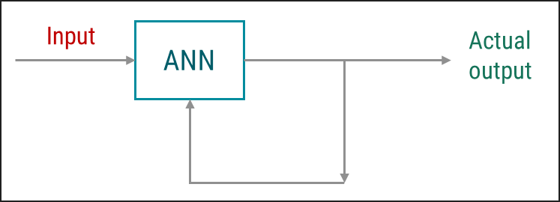
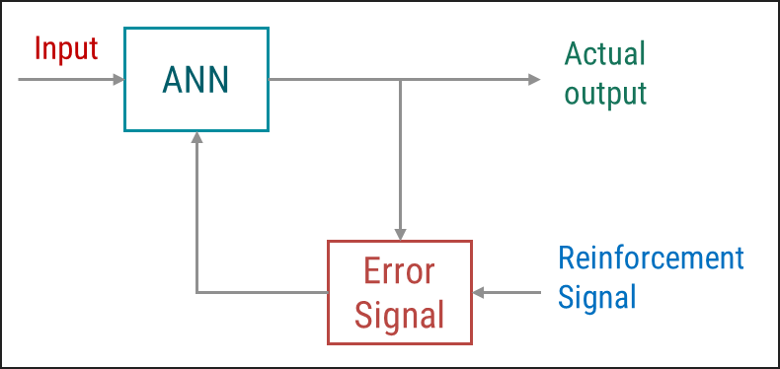
Supervised Learning
Unsupervised Learning
Reinforcement Learning
Supervised learning takes place under the supervision of a teacher.
During the training, the input vector is presented to the network, which will produce an output vector.
This output vector is compared with the desired/target output vector.
An error signal is generated if there is a difference between the actual output and the desired/target output vector.
On the basis of this error signal, the weights would be adjusted until the actual output is matched with the desired output.
In unsupervised learning there is no external teacher to oversee the learning process.
During the training, the input vectors of similar type are combined to form clusters.
When a new input pattern is applied, then the neural network gives an output response indicating the class to which the input pattern belongs.
In this type of learning, the network itself must discover the patterns and features from the input data, and the relation for the input data over the output.
Reinforcement learning is a type of learning that is based on the interaction with environments.
The learner is not told which actions to take, but instead must discover which actions yield the most reward by trying them.
RL models consist of algorithms that use the estimated errors as rewards or penalties.
If the error is big, then the penalty is high and the reward low. If the error is small, then the penalty is low and the reward high.
Types of Learning

Slide 21
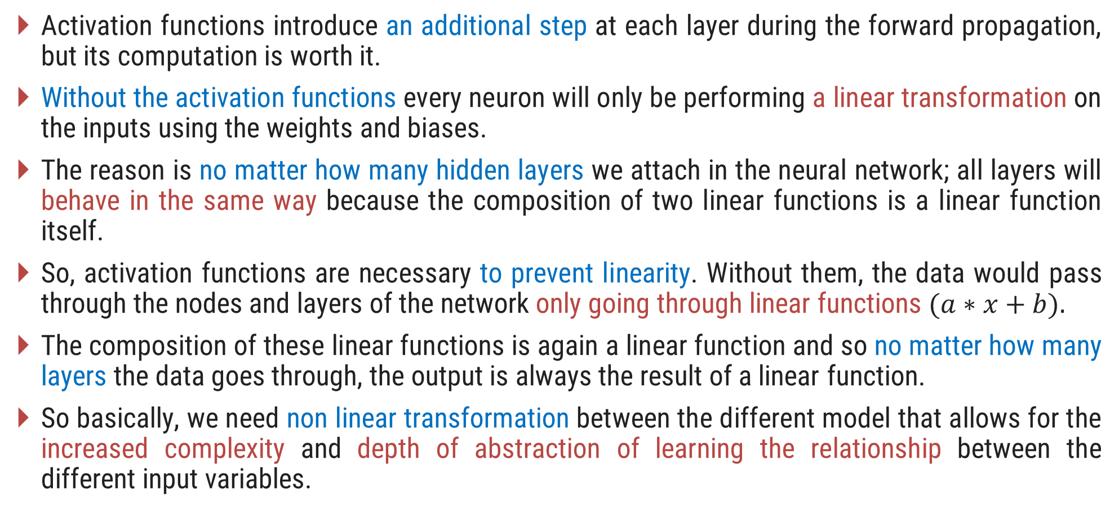
Activation Functions
Activation functions introduce an additional step at each layer during the forward propagation, but its computation is worth it.
Without the activation functions every neuron will only be performing a linear transformation on the inputs using the weights and biases.
The reason is no matter how many hidden layers we attach in the neural network; all layers will behave in the same way because the composition of two linear functions is a linear function itself.
So, activation functions are necessary to prevent linearity. Without them, the data would pass through the nodes and layers of the network only going through linear functions $(a∗x+b).$
The composition of these linear functions is again a linear function and so no matter how many layers the data goes through, the output is always the result of a linear function.
So basically, we need non linear transformation between the different model that allows for the increased complexity and depth of abstraction of learning the relationship between the different input variables.

Slide 22
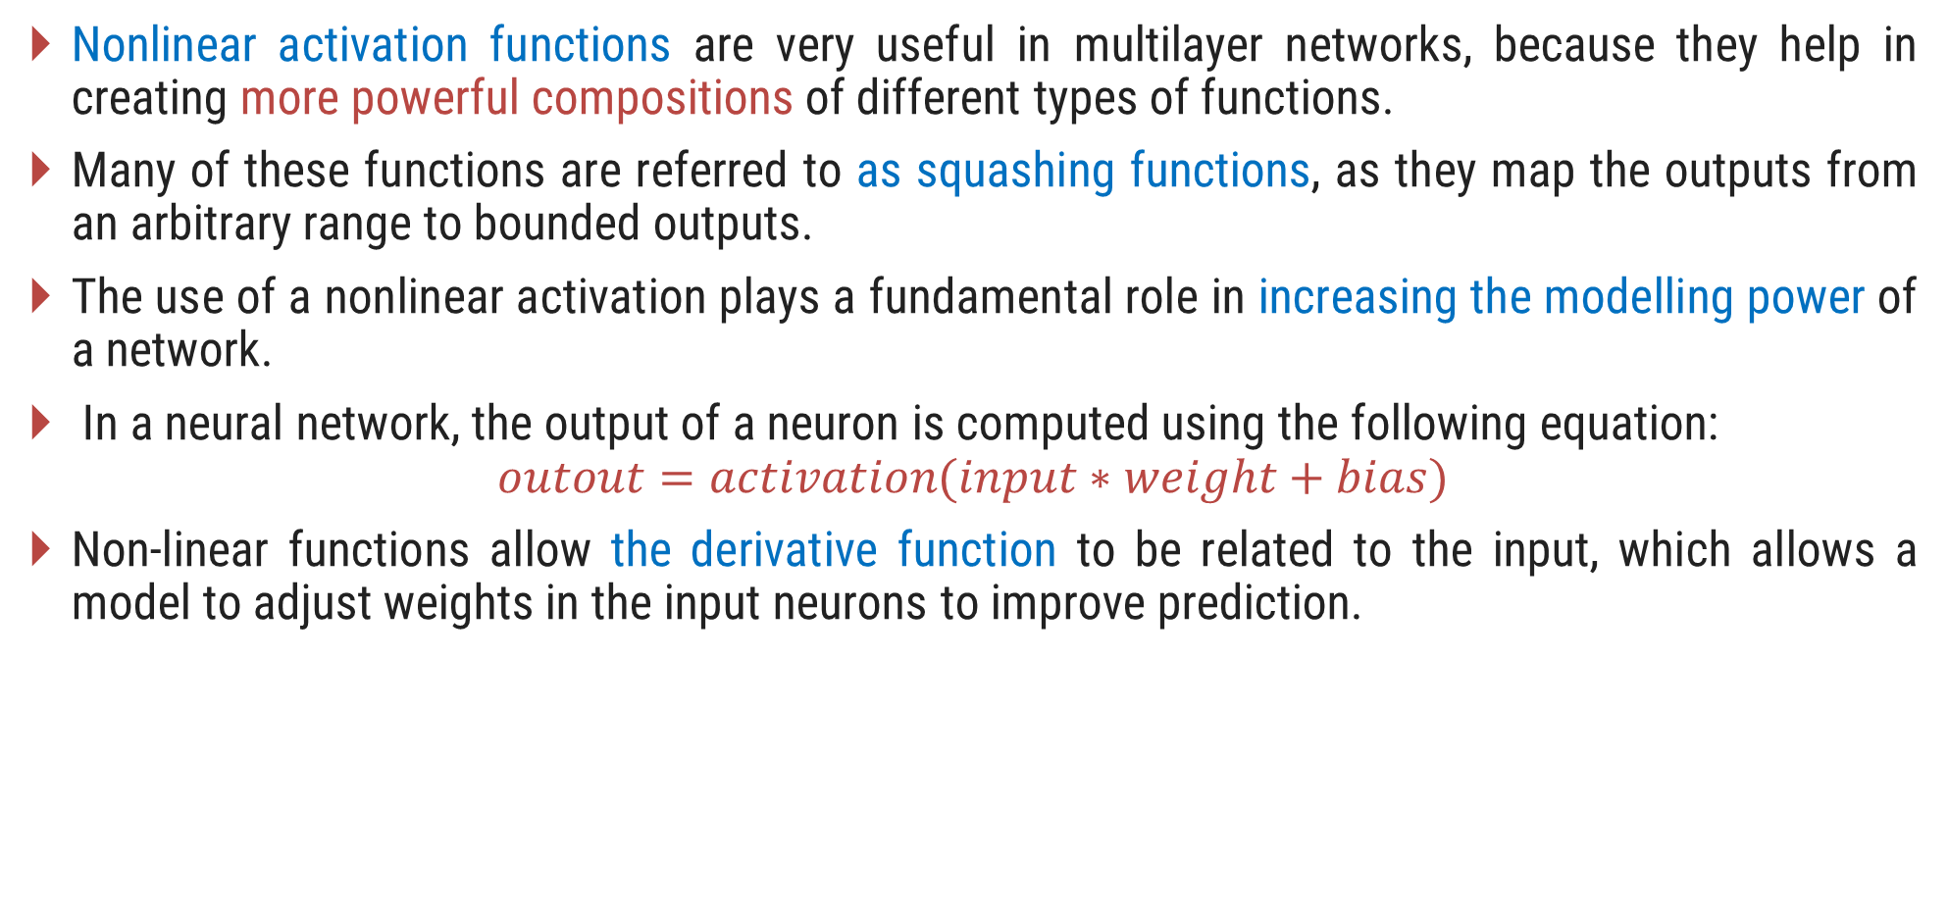
Non-Linear Activation Functions
Nonlinear activation functions are very useful in multilayer networks, because they help in creating more powerful compositions of different types of functions.
Many of these functions are referred to as squashing functions, as they map the outputs from an arbitrary range to bounded outputs.
The use of a nonlinear activation plays a fundamental role in increasing the modelling power of a network.
In a neural network, the output of a neuron is computed using the following equation:
$$outout=activation(input∗weight+bias)$$
Non-linear functions allow the derivative function to be related to the input, which allows a model to adjust weights in the input neurons to improve prediction.

Slide 23
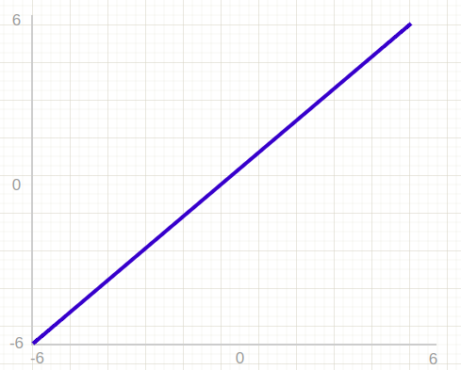
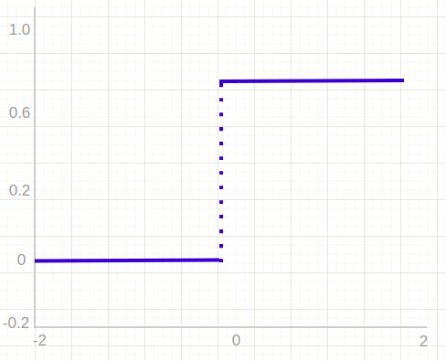
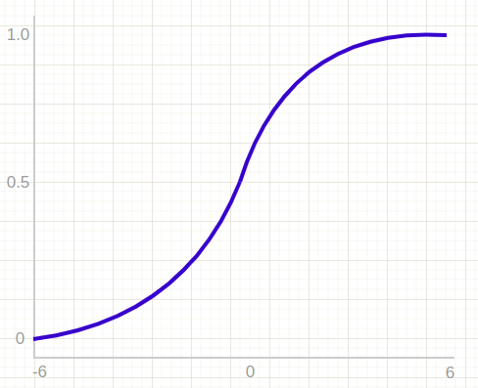
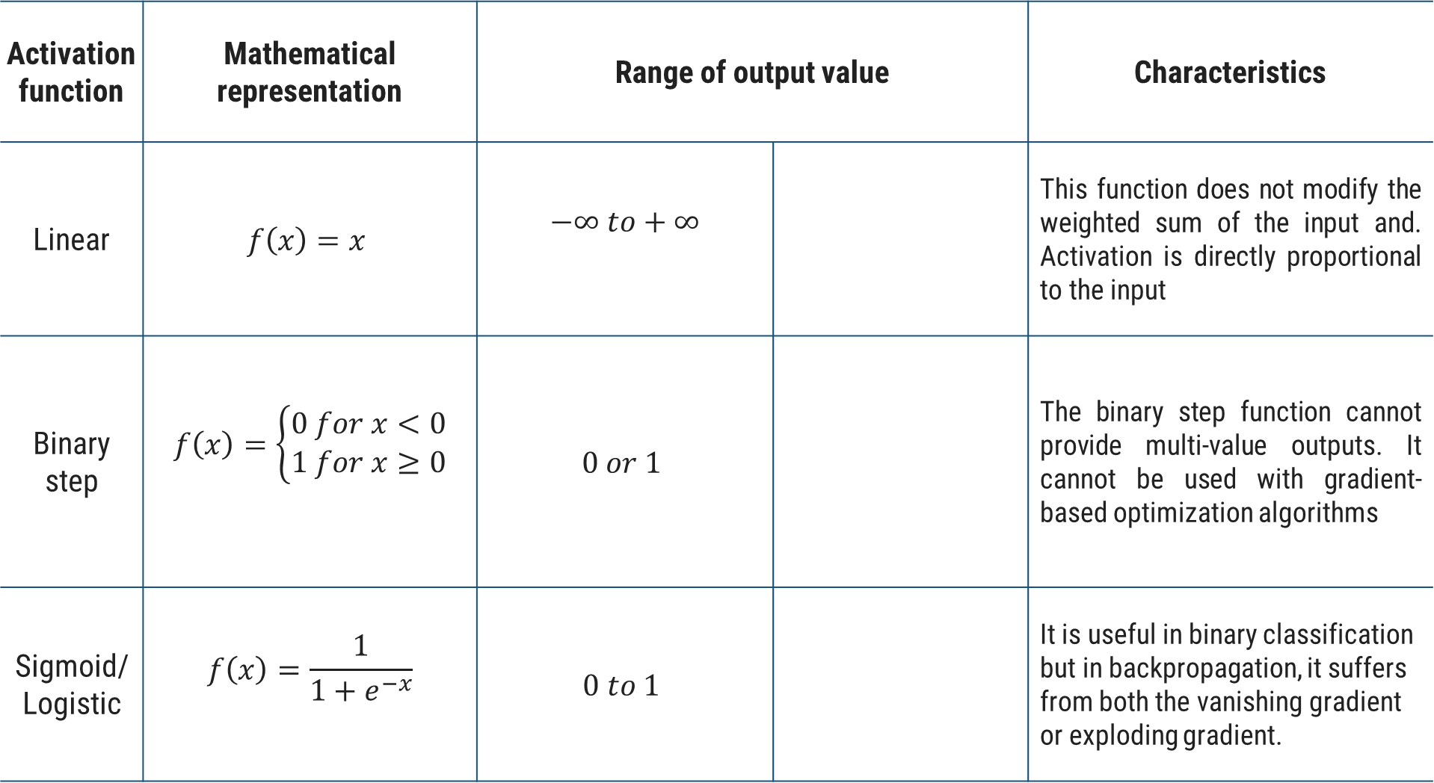
Activation function | Mathematical representation | Range of output value |  | Characteristics
Linear | $$f\left(x\right)=x$$ | $$−∞ to+∞$$ |  | This function does not modify the weighted sum of the input and. Activation is directly proportional to the input
Binary step | $$f\left(x\right)=\left\{\begin{aligned}0 for x<0 \\ 1 for x≥0\end{aligned}\right.$$ | $$0 or 1$$ |  | The binary step function cannot provide multi-value outputs. It cannot be used with gradient-based optimization algorithms
Sigmoid/Logistic | $$f\left(x\right)=\frac{1}{1+e^{−x}}$$ | $$0 to 1$$ |  | It is useful in binary classification but in backpropagation, it suffers from both the vanishing gradient or exploding gradient.

Slide 24
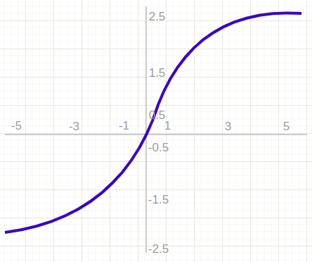
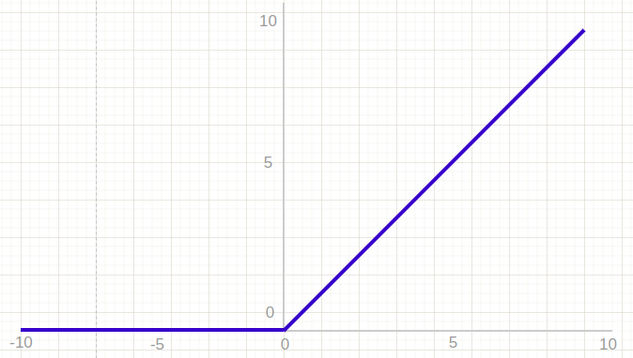
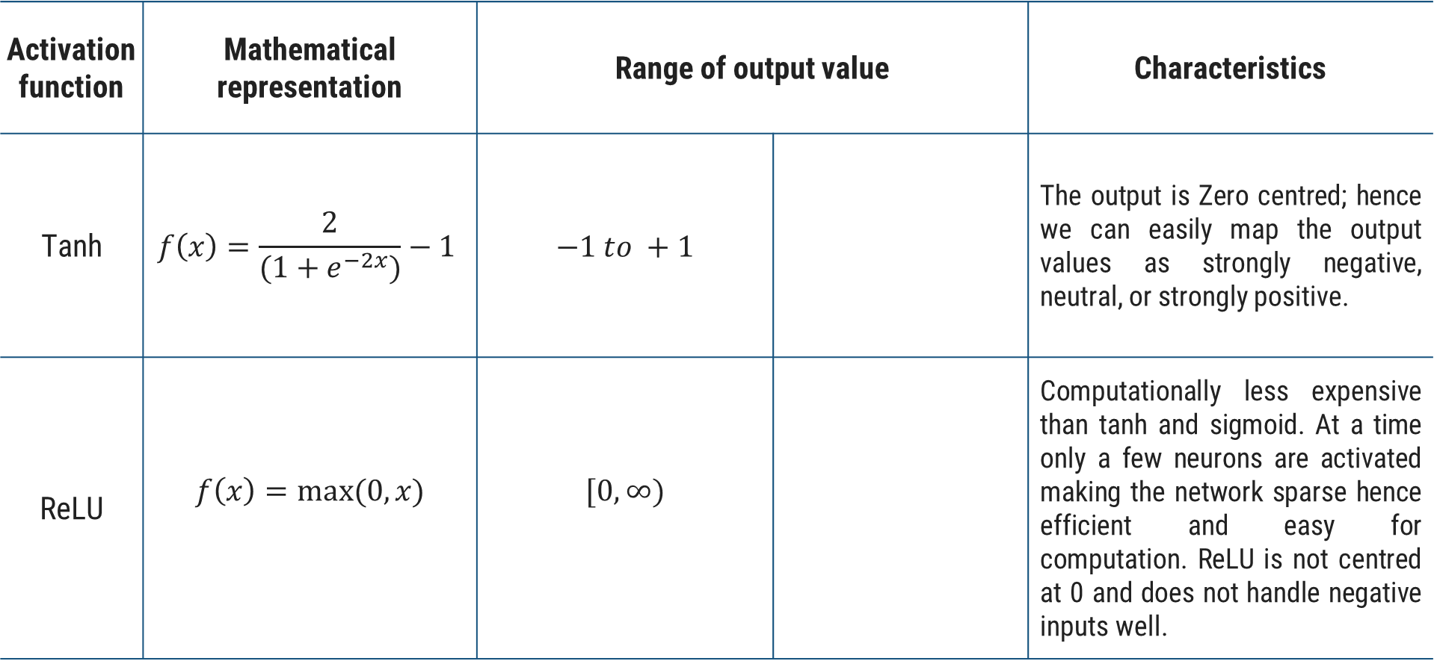
Activation function | Mathematical representation | Range of output value |  | Characteristics
Tanh | $$f\left(x\right)=\frac{2}{(1+e^{−2x})}−1$$ | $$−1 to +1$$ |  | The output is Zero centred; hence we can easily map the output values as strongly negative, neutral, or strongly positive.
ReLU | $$f\left(x\right)=max⁡(0,x)$$ | $$[0,∞)$$ |  | Computationally less expensive than tanh and sigmoid. At a time only a few neurons are activated making the network sparse hence efficient and easy for computation. ReLU is not centred at 0 and does not handle negative inputs well.

Slide 25
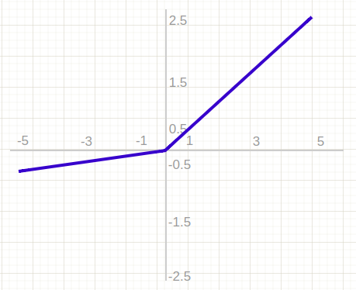
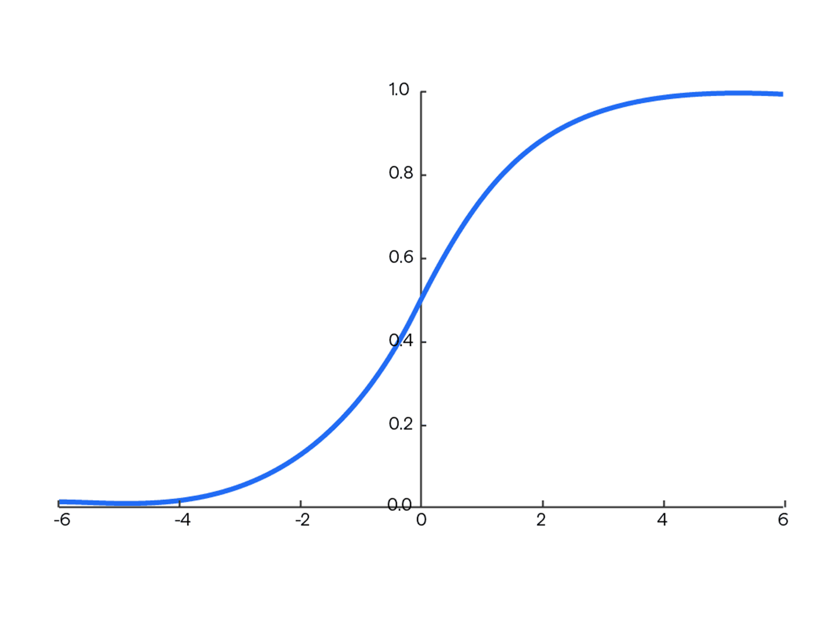
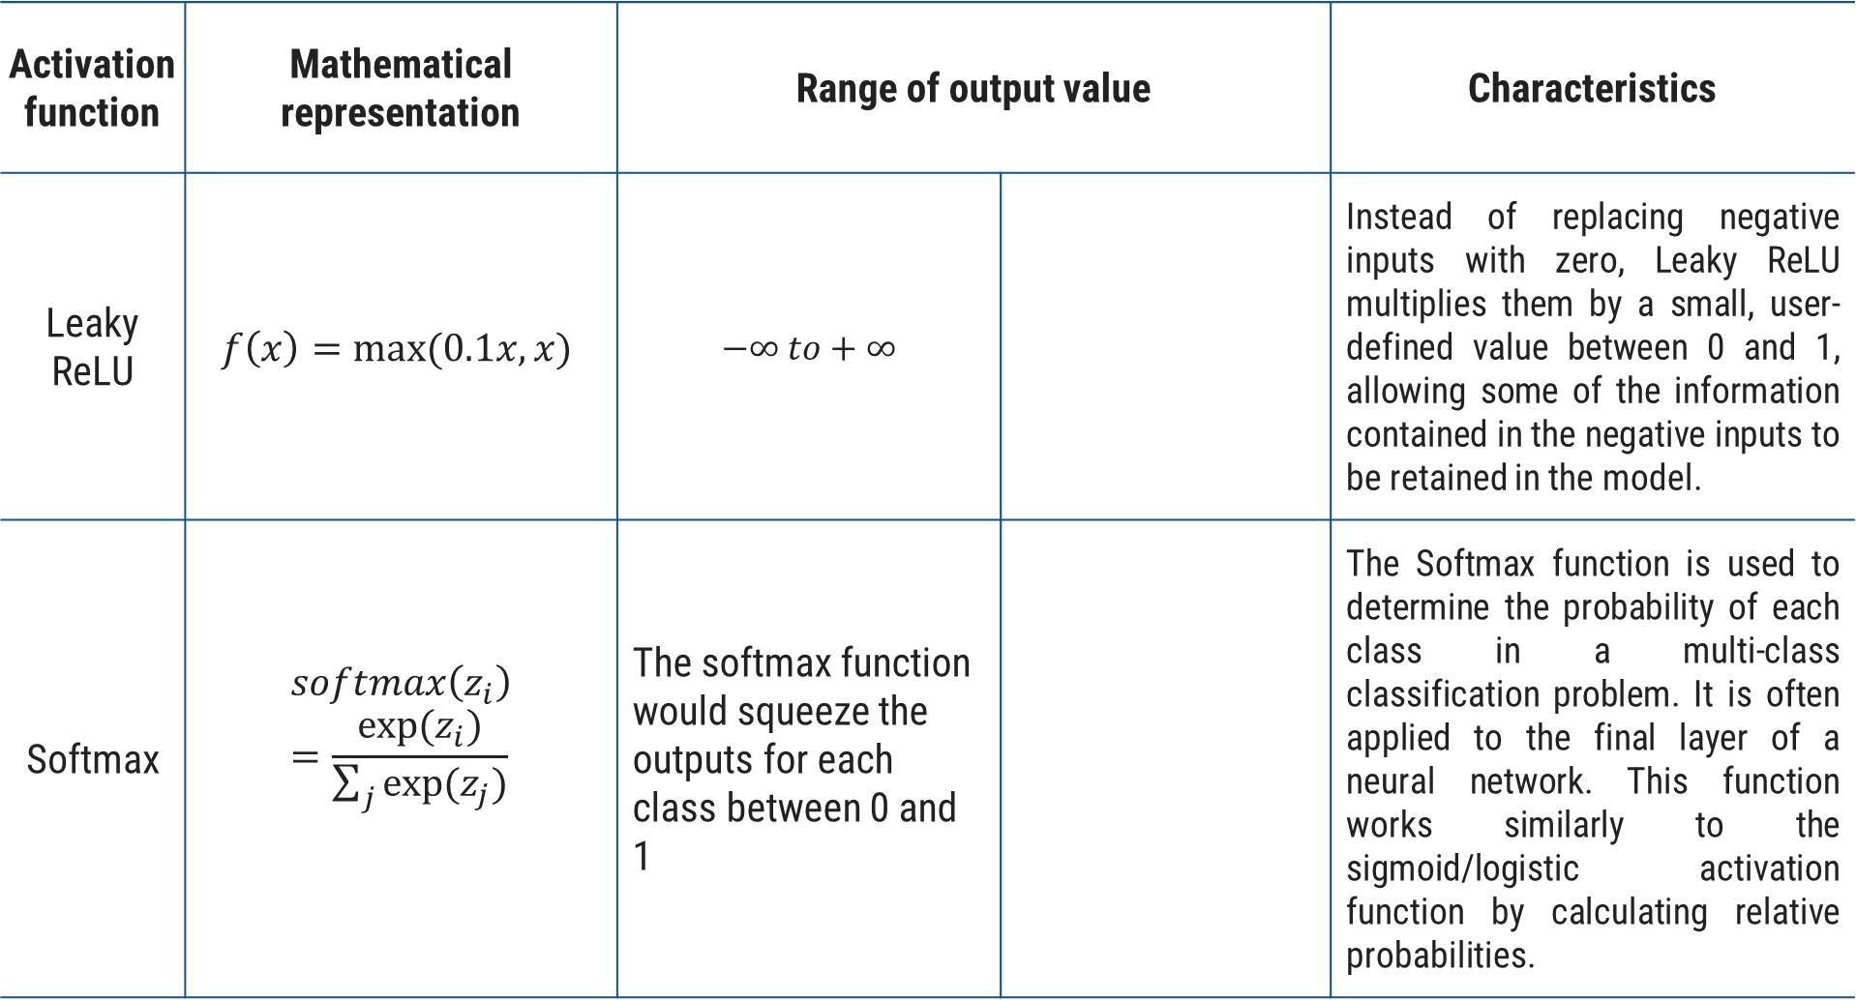
Activation function | Mathematical representation | Range of output value |  | Characteristics
Leaky ReLU | $$f\left(x\right)=max⁡(0.1x,x)$$ | $$−∞ to+∞$$ |  | Instead of replacing negative inputs with zero, Leaky ReLU multiplies them by a small, user-defined value between 0 and 1, allowing some of the information contained in the negative inputs to be retained in the model.
Softmax | $$softmax\left(z_{i}\right)=\frac{exp⁡(z_{i})}{\sum_{j}{exp⁡(z_{j})}}$$ | The softmax function would squeeze the outputs for each class between 0 and 1 |  | The Softmax function is used to determine the probability of each class in a multi-class classification problem. It is often applied to the final layer of a neural network. This function works similarly to the sigmoid/logistic activation function by calculating relative probabilities.

Slide 26
Introduction to Hyperparameters
A Machine Learning model is defined as a mathematical model with several different important parameters.
Some parameters need to be learned by training a model with existing data, generally referred as Model Parameters, e.g., weights and bias.
While the other type of parameters known as Hyperparameters that cannot be directly learned from the regular training process.
They are usually fixed before the actual training process begins.
In the context of machine learning, hyperparameters are configuration variables that are set before the training process of a model begins.
Hyperparameters are specific to the algorithm itself, these are external to the model, and their values cannot be changed during the training process.

Slide 27
Introduction to Hyperparameters
They control the learning process itself, rather than being learned from the data.
These parameters express important properties of the model such as its complexity or how fast it should learn.
The value of Hyperparameters affect the results of the model effectively.
They are often used to tune the performance of a model, and they can have a significant impact on the model’s accuracy, generalization, and other metrics.
So, to obtain the best results, the optimal values for these parameters should be found.
Finding the most optimal combination is called Hyperparameter Tuning.

Slide 28
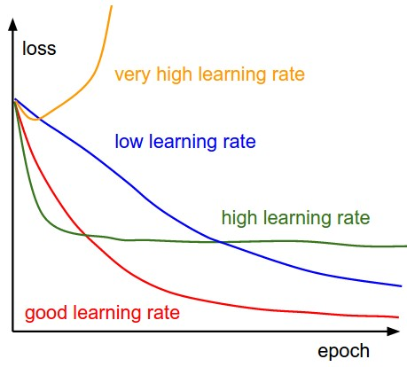
Hyperparameters in Neural Networks
Learning rate:
This hyperparameter controls the step size taken by the optimizer during each iteration of training.
The learning rate can significantly impact the model's performance, as a lower learning rate may result in slower convergence but a more accurate model.
In comparison, a larger learning rate may result in faster convergence but can lead to instability and divergence..
Image reference: https://cs231n.github.io/neural-networks-3/

Slide 29
Hyperparameters in Neural Networks
Epochs & Batch size:
Epoch represents the number of times the entire training dataset is passed through the model during training.
An epoch is a complete iteration through the entire training dataset in one cycle for training the machine learning model.
During an epoch, every training sample in the dataset is processed by the model, and its weights and biases are updated in accordance with the computed loss or error.
Increasing the number of epochs can improve the model’s performance but may lead to over fitting if not done carefully.
In deep learning, the training dataset is generally divided into smaller groups called batches, and during each epoch, the model analyses each batch in sequence, one at a time.
The number of batches in an epoch is determined by the batch size, which is also a hyperparameter that can be tuned to optimize the performance of the model.
After each epoch, the model performance can be evaluated on the validation dataset. This helps to monitor the progress of the model.

Slide 30
One forward pass and one backward pass of all (1000) training examples
Batch size = 1000 samples
Batch size = 500 samples
Batch size = 200 samples
1 iteration per Epoch
2 iterations per Epoch
5 iterations per Epoch

Slide 31
Hyperparameters in Neural Networks
Number of layers & Number of nodes per layer
The number of hidden layers and the number of neurons in each hidden layer define the architecture of a neural network.
The depth of a network refers to the number of hidden layers it contains, while the width refers to the number of neurons in each hidden layer.
The number of hidden layers can have a significant impact on its complexity and learning ability.
Deeper networks with more hidden layers can learn more complex representations, but they also require more data and computational power to train.
Conversely, wider networks with more neurons can capture more information about the input data but may also lead to over-fitting if not managed properly.
There are many rule-of-thumb methods for determining the correct number of neurons to use in the hidden layers, such as the following:
The number of hidden neurons should be between the size of the input layer and the size of the output layer.
The number of hidden neurons should be 2/3 the size of the input layer, plus the size of the output layer.
The number of hidden neurons should be less than twice the size of the input layer.

Slide 32
Hyperparameters in Neural Networks
Activation function:
This hyperparameter introduces non-linearity into the model, allowing it to learn complex decision boundaries.
Common activation functions include sigmoid, tanh, and Rectified Linear Unit (ReLU).
Momentum
Momentum helps us avoid falling into local minima by resisting rapid changes to parameter values.
It encourages parameters to keep changing in the direction they were already changing, which helps prevent zig-zagging on every iteration. Aim to start with low momentum values and adjust upward as needed.
Momentum: This accelerates gradient descent optimization by adding a fraction of the previous update vector to the current update. It helps smooth out the optimization path and can prevent the model from getting stuck in local minima. The momentum hyperparameter typically ranges between 0 and 1. A common starting point is 0.9, but this can be adjusted based on the behavior of the model during training. Proper tuning of momentum can lead to faster convergence and improved model accuracy.

Slide 33
Deep Learning Libraries
2007
Theano
2010
Caffe
2015
TensorFlow
2015
Keras
2016
MXNet
2017
PyTorch
2023
JAX

Slide 34
TensorFlow & Keras
TensorFlow
Developed by Google, TensorFlow is an open-source machine learning framework.
It is highly optimized for numerical computation using data flow graphs.
Supports GPU acceleration and distributed computing for handling large-scale ML models.
TensorFlow has both low-level control and high-level APIs (like Keras) for building neural networks.
Keras
Originally an independent library, Keras is now integrated into TensorFlow as tf.keras.
It provides a user-friendly, high-level API for building deep learning models quickly.
Offers modular and extensible components, making it easy to build complex networks.

Slide 35
Mnist - Example
mnist.py
1
2
3
4
5
6
7
8
9
10
11
12
13
14
15
16
17
18
19
20
21
import tensorflow as tf
from tensorflow import keras
import matplotlib.pyplot as plt
(x_train, y_train), (x_test, y_test) = keras.datasets.mnist.load_data() x_train, x_test = x_train / 255.0, x_test / 255.0
model = keras.Sequential([
keras.layers.Flatten(input_shape=(28, 28)),
keras.layers.Dense(128, activation='relu'),
keras.layers.Dense(10, activation='softmax')
])
model.compile(optimizer='adam',
loss='sparse_categorical_crossentropy',
metrics=['accuracy'])
model.fit(x_train, y_train, epochs=50)
test_loss, test_acc = model.evaluate(x_test, y_test)
print(f"Test Accuracy: {test_acc:.4f}")

Slide 36
Deep Learning Architectures
Some of the popular Deep Learning architectures include:
Convolutional Neural Networks (CNNs)
Recurrent Neural Networks (RNNs)
Long Short-Term Memory (LSTM)

Slide 37
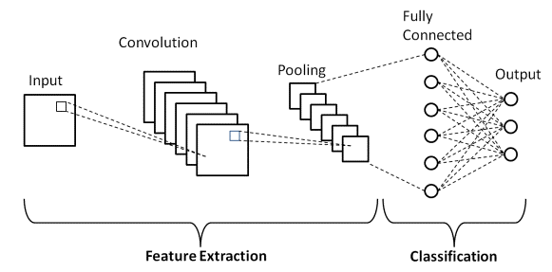
1. Convolutional Neural Networks (CNNs)
CNNs are a deep learning algorithm that processes structured grid data like images.
This architecture is commonly used for image processing, image recognition, video analysis, and NLP.
The name ‘convolutional’ derives from a mathematical operation involving the convolution of different functions.
CNNs consist of an input and an output layer, as well as multiple hidden layers. The CNN’s hidden layers typically consist of a series of convolutional layers.
Image reference: https://www.upgrad.com/blog/basic-cnn-architecture/

Slide 38
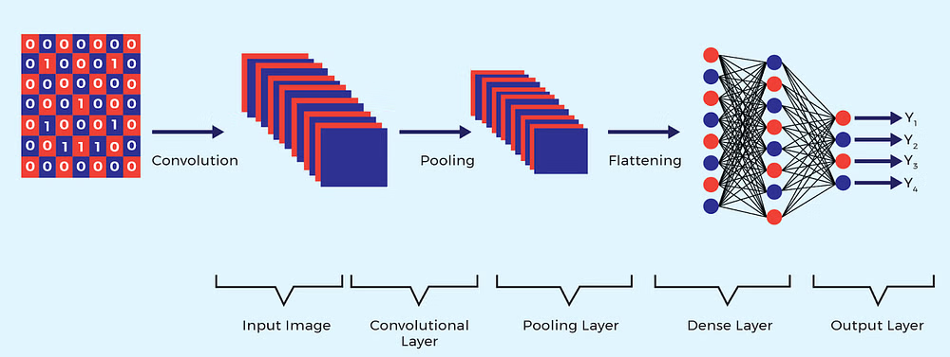
How CNN works?
The input is received by the network. Each input (for instance, image) will pass through a series of convolution layers with various filters.
Convolutional Layer: This layer applies a set of filters (kernels) to the input image, where each filter slides (convolves) across the image to produce a feature map.
This helps detect various features such as edges, textures, and patterns.
The convolutional layer incorporates non-linear activation functions, with Rectified Linear Unit (ReLU) being the most widely used.
Image reference: https://www.projectpro.io/article/deep-learning-architectures/996

Slide 39
How CNN works?
Pooling Layer: This layer reduces the dimensionality of the feature maps while retaining the most essential information. Common types include max pooling and average pooling.
These operations are repeated over tens or hundreds of layers, with each layer learning to identify different features.
Fully Connected Layer: After several convolutional and pooling layers, the output is flattened and fed into one or more fully connected (dense) layers, culminating in the output layer that makes the final classification or prediction
Image reference: https://www.projectpro.io/article/deep-learning-architectures/996

Slide 40
2. Recurrent Neural Networks (RNNs)
RNNs are designed to recognize patterns in data sequences, such as time series or natural language.
They maintain a hidden state that captures information about previous inputs.
RNNs can use their internal state (memory) to process variable-length sequences of inputs.
Every processed information is captured, stored, and utilized to calculate the final outcome.
This makes them useful when it comes to, for instance, speech recognition.
Moreover, the recurrent network might have connections that feedback into prior layers (or even into the same layer).
This feedback allows them to maintain the memory of past inputs and solve problems in time.

Slide 41
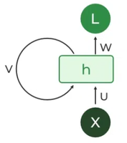
How RNN Works?
RNNs have the same input and output architecture as any other deep neural architecture.
However, differences arise in the way the information flows from input to output.
The fundamental processing unit in a Recurrent Neural Network (RNN) is a Recurrent Unit.
Each unit has an internal state which is called the hidden state of the unit.
This hidden state signifies the past knowledge that the network currently holds at a given time step.
Unlike Deep neural networks, where we have different weight matrices for each Dense network in RNN, the weight across the network remains the same.
Recurrent Unit

Slide 42
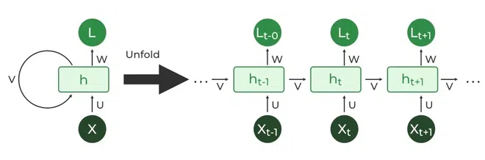
How RNN Works?
A Recurrent Unit has the unique ability to maintain a hidden state, allowing the network to capture sequential dependencies by remembering previous inputs while processing.
Hidden State: At each time step, the hidden state is updated based on the current input and the previous hidden state. This allows the network to maintain a memory of past inputs.
Output: The hidden state generates an output at each time step. The network is trained using backpropagation through time (BPTT) to minimize prediction error.
The Recurrent Neural Network consists of multiple fixed activation function units, one for each time step.
Image reference: https://www.geeksforgeeks.org/introduction-to-recurrent-neural-network/

Slide 43
3. Long Short-Term Memory (LSTM)
The LSTM are different from typical neuron-based neural network architectures and they are a special kind of RNN capable of learning long-term dependencies.
However, LSTM has feedback connections. This means that it can process not only single data points (such as images) but also the entire sequences of data (such as audio or video files)
A typical LSTM architecture is composed of a memory cell, an input gate, an output gate, and a forget gate.
The memory cell can retain its value for a short or long time as a function of its inputs, which allows the cell to remember what’s essential and not just its last computed value.
The three gates regulate the flow of information into and out of the cell.
LSTMs are commonly used in such fields as text compression, handwriting recognition, speech recognition, gesture recognition, and image captioning.

Slide 44
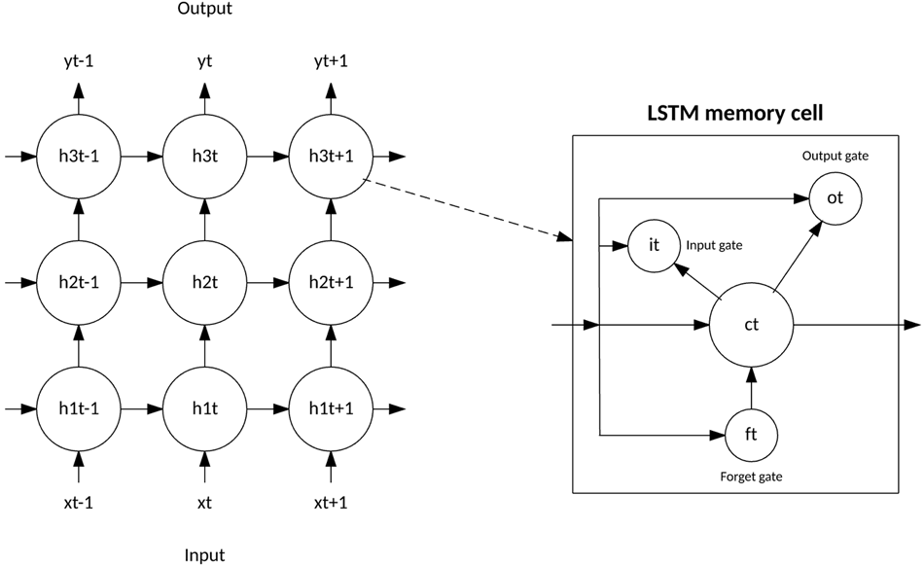
How LSTM works?
LSTMs have a cell state that runs through the entire sequence and can carry information across many steps.
The LSTM memory cell contains three gates that control how information flows into or out of the cell.
The input gate controls when new information can flow into the memory.
Image reference: https://developer.ibm.com/articles/cc-machine-learning-deep-learning-architectures/

Slide 45
How LSTM works?
The forget gate controls when an existing piece of information is forgotten, allowing the cell to remember new data. Finally, the output gate controls when the information that is contained in the cell is used in the output from the cell.
The cell also contains weights, which control each gate. The training algorithm, commonly BPTT, optimizes these weights based on the resulting network output error.
Image reference: https://developer.ibm.com/articles/cc-machine-learning-deep-learning-architectures/

