Slide 1
Architectural Design
Project for SOEN 6441
Team 22

Slide 2
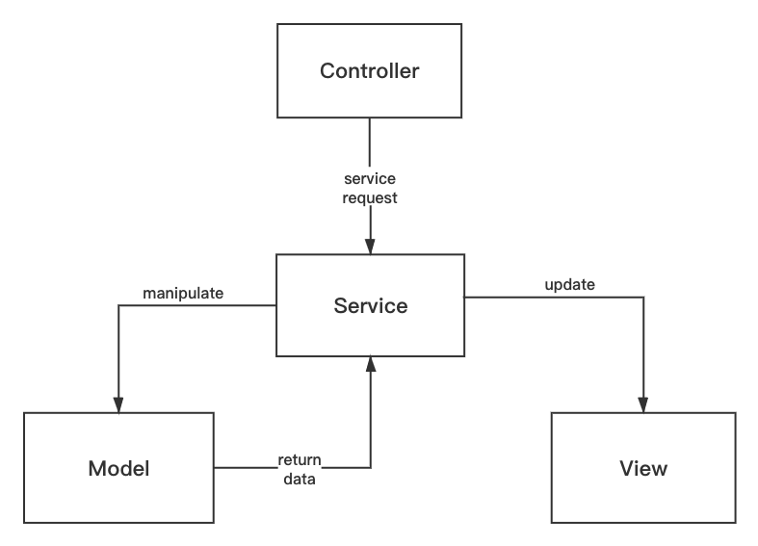
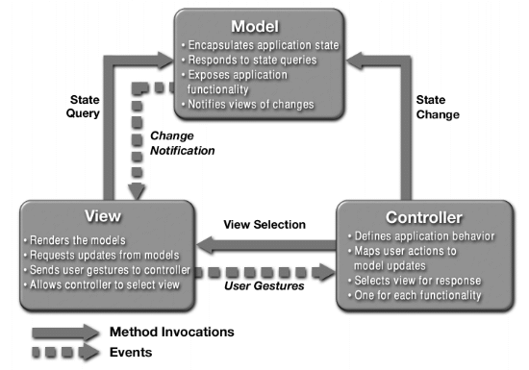
MVC Structure
Our Structure in Project
Origion MVC Structure

Slide 3
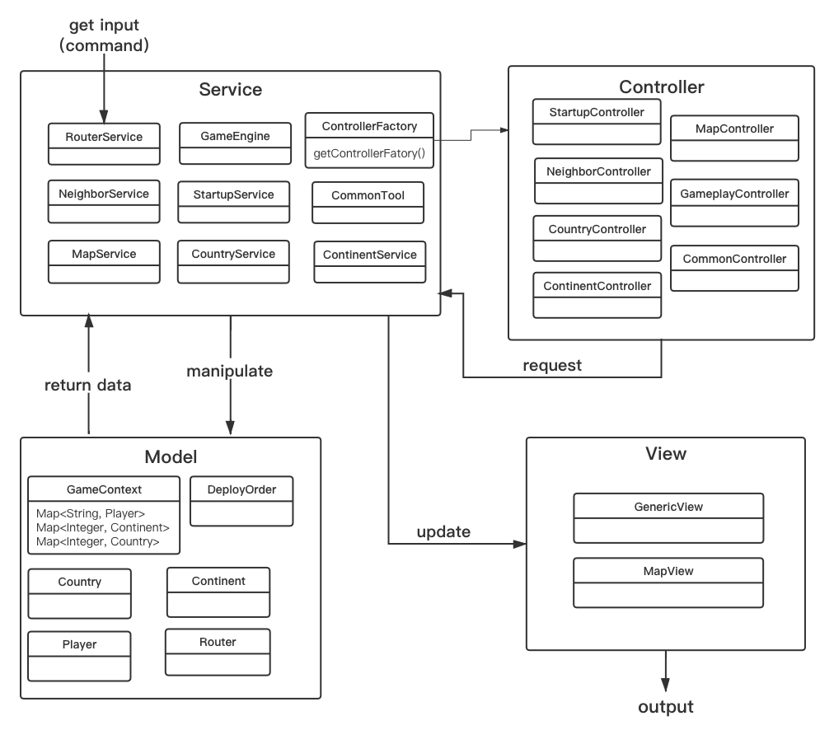
Architectural Design

Slide 4
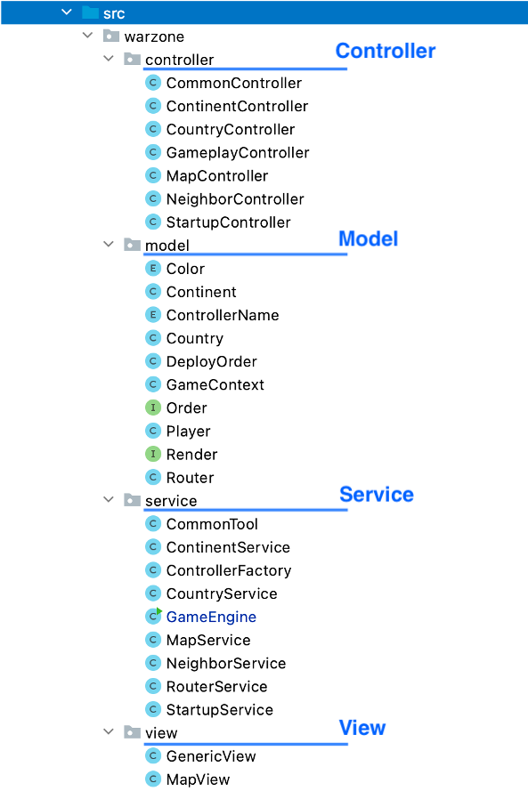
File Structure

