Slide 1



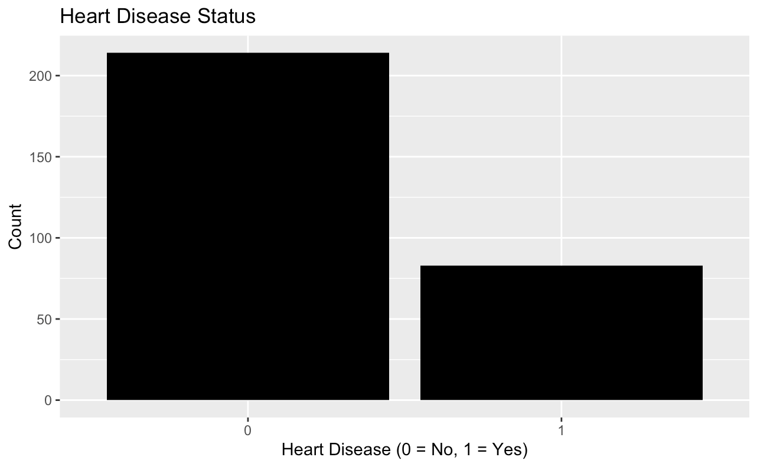
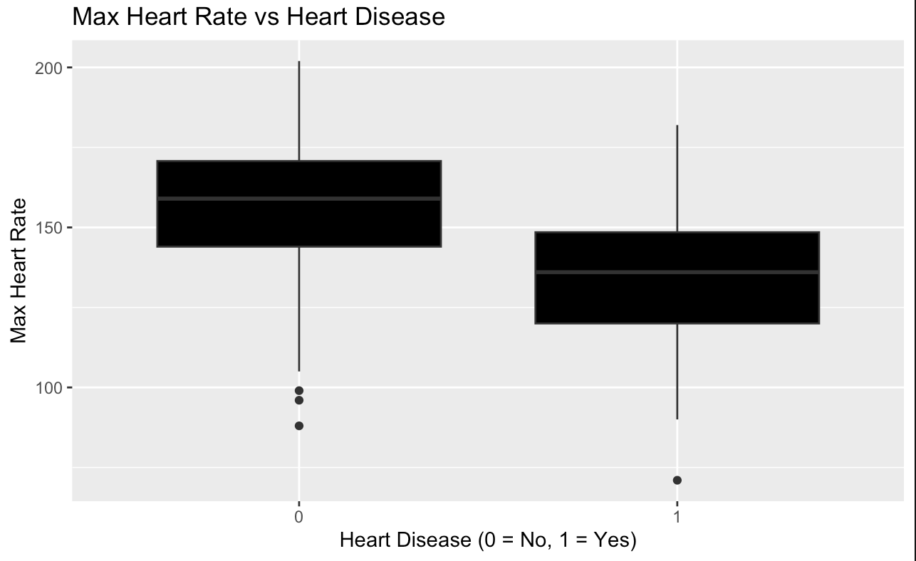
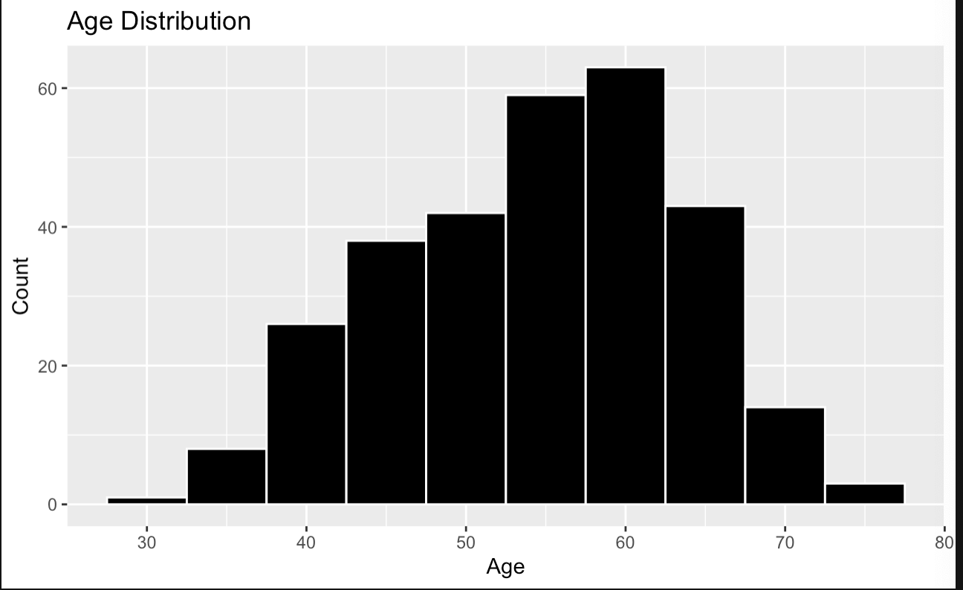
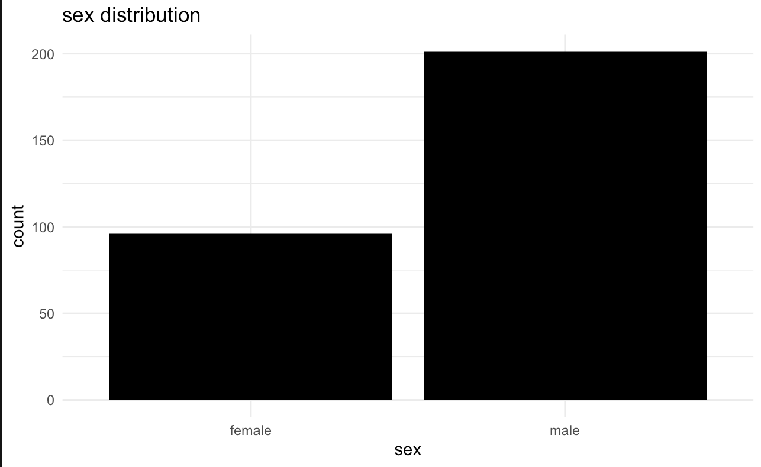
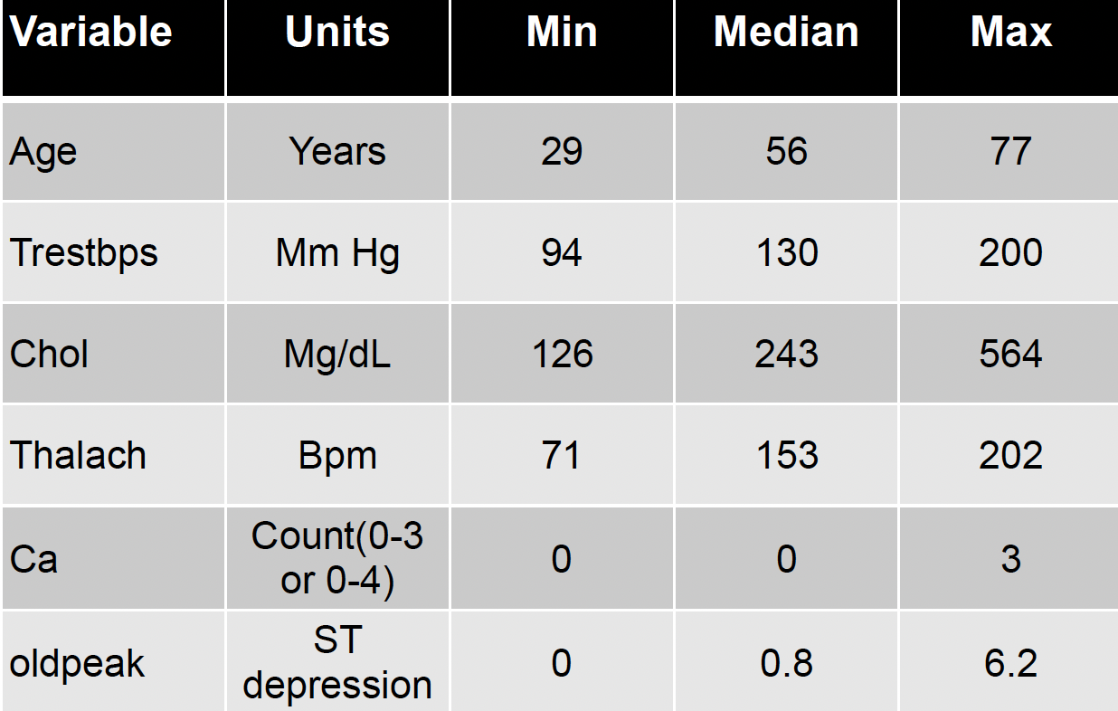
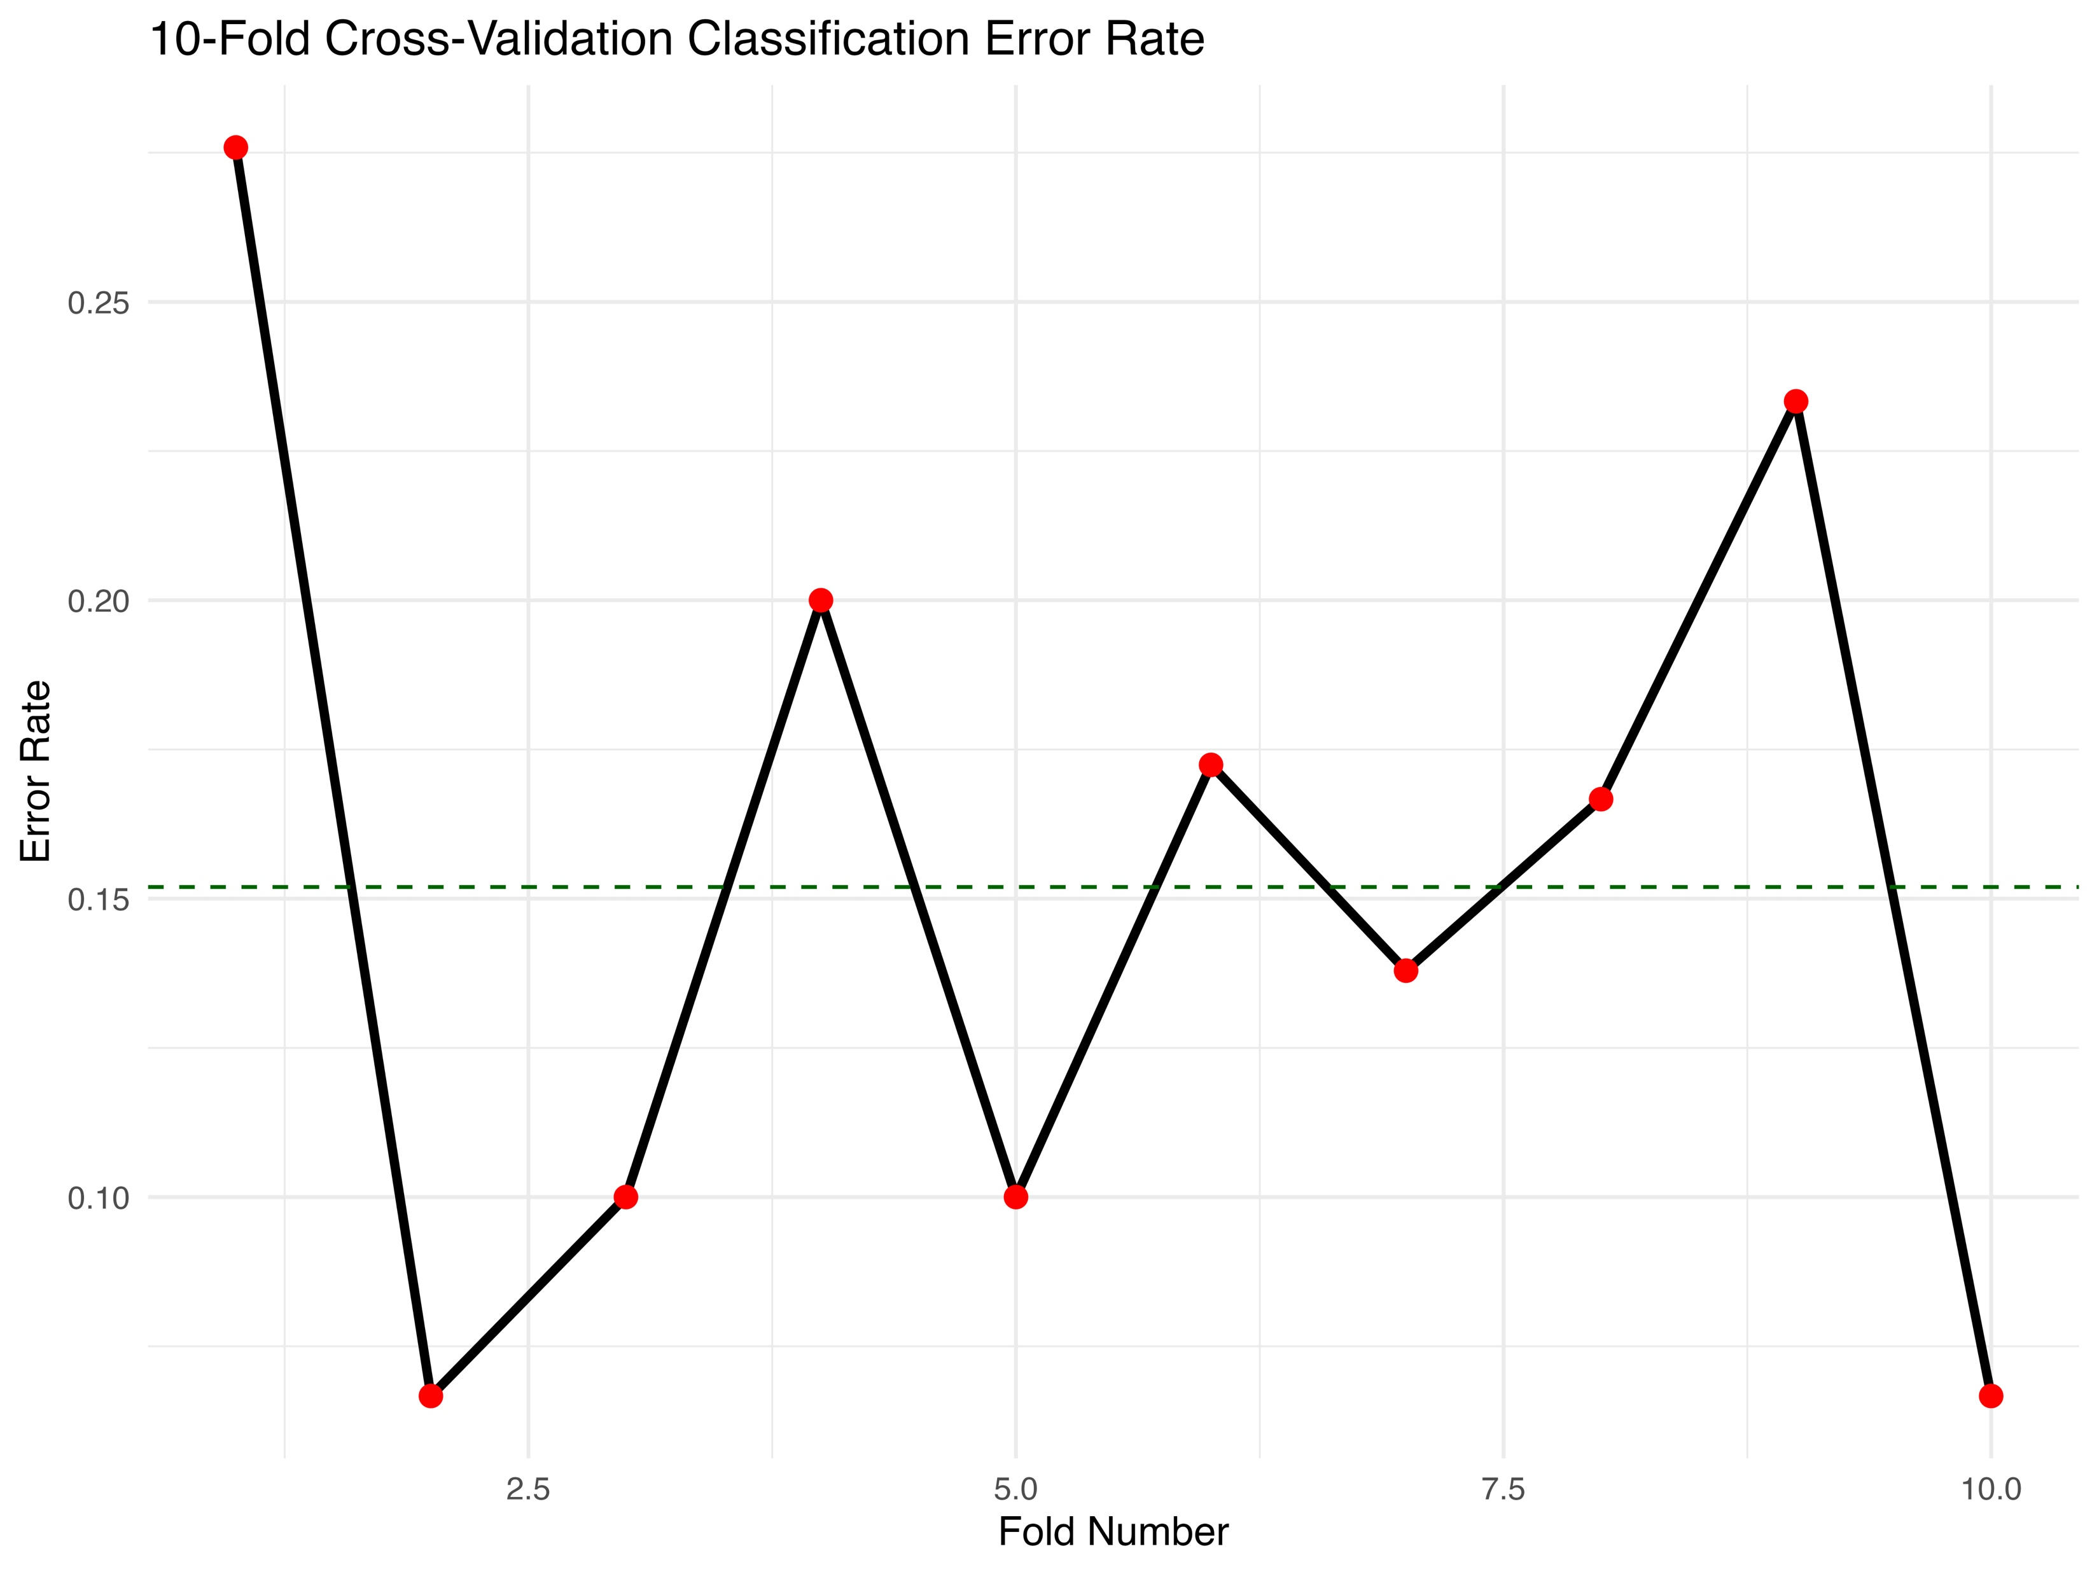
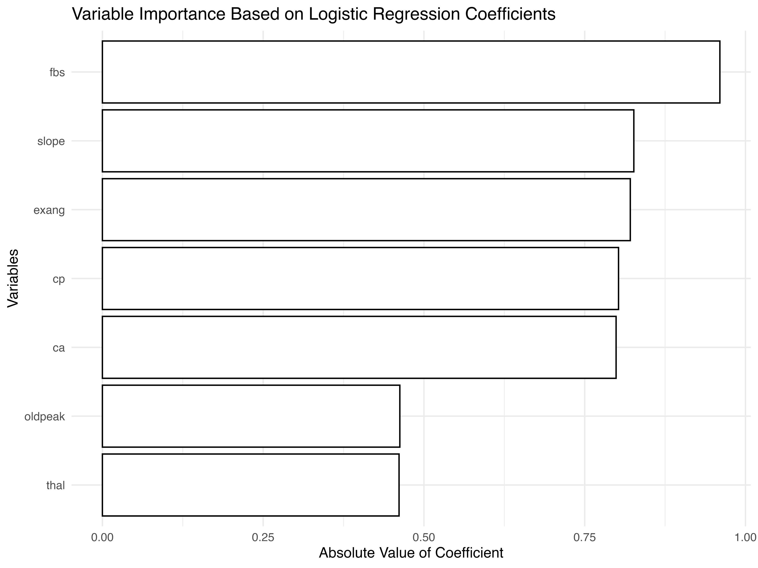
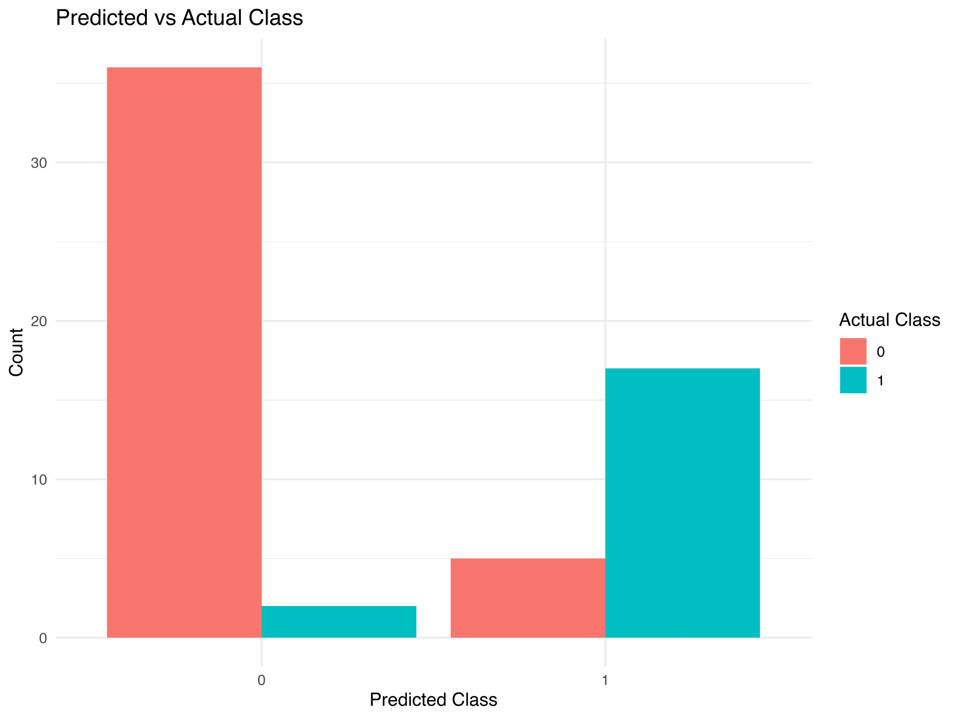
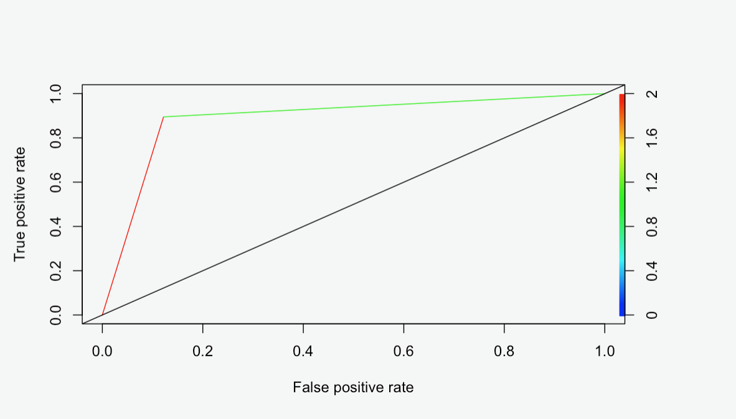
Heart Disease prediction
Jenisha Shrestha
University of Colorado - Boulder
Introduction
Exploratory Results
Discussion
Heart disease is a major cause of death worldwide, so finding it early is very important. This project studies how medical and personal factors are related to heart disease. The main outcome shows if a person has heart disease (1) or not (0). Key factors we looked at include age, gender, blood pressure, cholesterol, and maximum heart rate. Understanding these patterns may help find people at higher risk and improve heart disease prediction in the future.
Our dataset contains more observations of patients who don’t have heart disease (target = 0) than those who do (target = 1), making early prediction critical. The age distribution shows that most patients are between the ages of 40 -65 years old, mostly around 60, indicating that heart disease mostly occurs in middle-aged and older adults. When comparing heart disease status to maximum heart rate, it showed that patients with heart disease tend to have lower maximum heart rates, while those without heart disease have higher ones. There appeared to be a negative correlation between maximum heart rate and the likelihood of having heart disease. Also, there are more male patients than female ones, which is common in heart disease studies and may mean that men and women have different levels of risk.
Our fitted logistic model performed far better than the null model.
We achieved a very small cross-validation error rate
Of 0.152 compared to 0.317 of the null model and pseudo
R-squared of 0.48 and a much smaller residual deviance of
143.79.
  The ANOVA P-value of 0.000165 tells us that this improvement
  It was statistically significant. In practice, the model helped us
  Identify individuals with heart disease with better accuracy than
  Randomly guessing them. The challenges that we dealt with
  were the imbalance of class and careful variable selection to
  avoid overfitting. We ended up with 7 variables for our final
  model. Ethically, it is important to consider how this prediction
  might affect patients, especially if used in such a way to
  discriminate or increase insurance costs.
Methods
The data for this project came from the UCI Machine Learning Repository, a trusted source for research datasets. The dataset includes medical records from four institutions. While the original dataset had 76 variables, the providers selected 14 key variables most relevant to heart disease prediction. We used these 14 variables, removed missing values, combined similar categories, and converted categorical variables into numeric form. The response variable was simplified to indicate the presence (1) or absence (0) of heart disease. No duplicate records were found. Each row represents one patient, and the cleaned dataset contains 303 observations(rows) & 14 variables(columns).
Metric | Null Model | Fitted Model
Psuedo R-Squared | 0 | 0.48
Residual Deviance | 276.48 | 143.79
ANOVA P-value | NA | 0.000165
Cross-Validated Error | 0.317 | 0.152
Predictive Results
Conclusions
We selected a logistic regression model
for binary classification of heart disease
risk, assuming a linear relationship
between predictors and log-odds, and
independence of observations.A ROC
curve confirmed strong model
performance with a high true positive
rate, indicating effective class separation.
Variable selection was done using best
subset selection, and a variable
importance plot based on logistic
coefficients highlighted key predictors
like fasting blood sugar (fbs), slope,
and chest pain type (cp).A 10-fold
cross-validation showed stable
performance with an average:
error rate of around 15%. Finally, a
predicted vs. actual class bar plot
demonstrated good classification
across both classes, confirming that the
model fits well and meaningful medical
Predictors.
In this project, we developed a logistic regression model to predict
heart disease presence using a variety of clinical and demographic
features. We used variable selections, CV, and diagnostic
Analysis to identify key predictors, which we used to build a model
With strong classification and interpretability. Our approach
Was the first to change the sex variable into binary, assuming 0
was female, and 1 was male, and we also changed our response
variable into binary, where we assigned 0 to a range of 0-1 and 1
to a range of 2-4. Our approach significantly improves upon
the null model interms of deviance, Pseudo R-squared, and
prediction accuracy for future using a large and more diverse
dataset and using more advanced classification methods could
further improve performance and generalizability. Using our
model, we can gauge the people who are at risk and help
who are already taking preventive measures. From our model, we
Can say that a healthy lifestyle goes a long way in preventing
Heart disease. Because our dataset was so small, it compromises
our results, even though we got a high accuracy. There are
ethical concerns, like the possibility of health insurance companies
Charging a higher rate to the people who are at risk of heart
disease by using our model. This raises concerns about
whether people at risk should pay higher rates.
Variables and their meanings:
Age: Years. Sex: Male (1), Female (0)
Cp: Chest pain type (0–3) Trestbps: Resting blood pressure
Chol: Cholesterol Fbs: High fasting blood sugar (1 = yes)
Restecg: ECG results Thalach: Max heart rate
Exang: Exercise-induced angina (1 = yes)
Oldpeak: ST depression
Slope: ST-segment slope
Ca: Major vessels (0–3)
Thal: Thalassemia test
Target: Heart disease (1 = yes)

