Slide 1
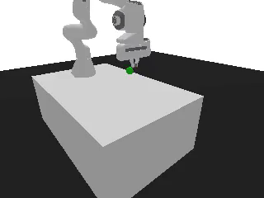
VULTR AGENT RUSH · BLAST RADIUS ZERO
AutoLab
Your own autonomous research lab — on your cloud, with your data.
Notes:
AutoLab gives every company its own autonomous research lab. The robot on the right was trained by our agents today, inside sandboxes on Vultr.

Slide 2
THE OPPORTUNITY
Frontier AI labs pull ahead by letting agents run the research loop.
01
02
03
Try hundreds of ideas
Keep what works
Repeat, nonstop
Agents propose experiments and run them in parallel.
Weak runs are cut early; strong ones get more compute.
Humans set the goal; the loop does the grinding.
Notes:
The edge of a frontier lab is not one genius model. It is a loop: agents try many experiments, keep what works and repeat.

Slide 3
THE PROBLEM
Fortune 500 companies can’t run that loop.
 | Frontier AI lab | Typical enterprise
Research team | Dedicated ML researchers | Few or none
Infrastructure | Clusters, schedulers, evals | Spreadsheets and one-off scripts
Data | Used freely in-house | Can’t leave the company
The best model | Owned | Rented from a vendor
Notes:
The gap is not ambition. Enterprises lack the specialised people, the experiment infrastructure, and a safe way to use their private data with AI.

Slide 4
THE PROBLEM
Four blockers keep the loop out of reach.
No specialised team
No experiment infrastructure
ML researchers are scarce, and expensive to hire and keep.
Running hundreds of trials needs schedulers, tracking and evaluation.
Data can’t leave
Agents that run code are risky
Privacy rules and contracts forbid sending it to outside AI vendors.
Security teams won’t let AI execute code next to company systems.
Notes:
Three blockers are about capacity. The fourth is about trust: an autonomous agent writes and runs code, and without containment nobody will allow it near company data.

Slide 5
THE SOLUTION
AutoLab gives every company its own autonomous research lab — on its own cloud and its own data — so the best model for its problem is one it owns.
Notes:
One sentence to remember: own lab, own cloud, own data, own model.

Slide 6
HOW IT WORKS
One question in, a verified model out.
1
2
3
4
5
Ask
Plan
Train
Steer
Verify
State the goal in plain English.
Agents pick candidates and bet on outcomes first.
Each run in its own locked sandbox.
Cut weak runs, rescue or branch strong ones.
Re-test the winner on situations it never saw.
Notes:
Every step except Ask is done by agents. The LLM only plans and decides; training code runs in sandboxes, and the numbers come from code, not the LLM.

Slide 7
ARCHITECTURE · THE AGENTS
One lead agent, many sandboxed training runs.
Vultr VM · gVisor sandboxes
Lead agent
Scheduler
Run A · baseline
You
Plans runs, places bets
Watches every curve
Cuts, rescues, branches
Verifies, writes report
trains, films checkpoints
Queues runs
1 sandbox per run
Streams results
Ask one question in plain English.
Run B · faster learning
trains, films checkpoints
Vultr Serverless Inference
Verifier
re-tests the winner, fresh box
metrics · videos · checkpoints flow back
Each sandbox: 2 CPUs · 3 GB · read-only · no internet · destroyed after the run. The lead agent never runs code itself.
Notes:
The lead agent is an LLM on Vultr Serverless Inference. It only plans and decides; it never executes code. The scheduler turns each experiment into its own gVisor sandbox on a Vultr VM, so runs are isolated from each other and from the company. Results stream back so the lead can cut weak runs, rescue promising ones or branch a leader. A separate fresh sandbox re-tests the winner.

Slide 8
BUILT FOR TRUST
Safe to switch on, easy to audit.
Sandboxed by default
Data stays home
gVisor isolation, no internet, read-only system, CPU and memory caps.
Runs in the company’s own cloud account; agents see scores, not raw data.
Verified, not lucky
Every number traceable
Several runs per finalist, re-tested on unseen situations, ranges reported.
Bets written before training, a full decision log, model fingerprints.
Notes:
Each result in the report links to the run that produced it and to a SHA-256 fingerprint of the saved model. Predictions are written before training and scored afterwards.

Slide 9
ARCHITECTURE
Everything runs on Vultr.
Serverless Inference
AutoLab control
Sandboxed VM
The agents’ reasoning: plans, bets, decisions.
Schedules runs, verifies results, writes the report.
gVisor containers, no network, 3 experiments at once.
Measured: ~950 training steps per second per sandbox · 8 vCPU worker · about $0.13 per hour
Notes:
Three parts. Vultr Serverless Inference is the brain. The control plane schedules and verifies. A Vultr VM runs each experiment in its own gVisor sandbox with no network access. No GPUs are needed.

Slide 10
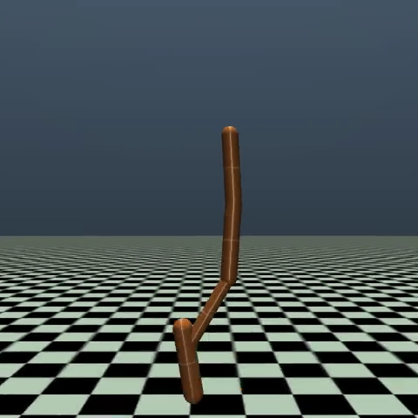
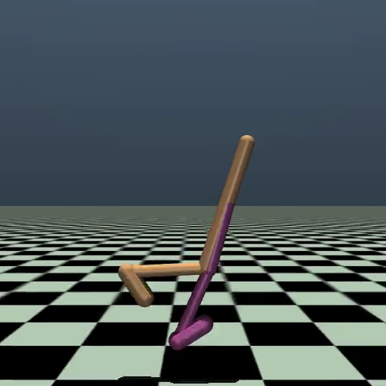
OUTPUT · ONE STUDY
Agents taught two robots to move.
Hopper
Walker2d
2,850
1,439
typical reward on unseen tests
typical reward on unseen tests
Clip: best run, 3,366
Clip: best run, 3,198
3 agent setups × 2 robots × 3 runs each · 42 sandboxed jobs · 4.2M training steps · 2.7 vCPU-hours · no GPU
Notes:
One plain-English question produced this study: 3 setups, 2 robots, 3 runs each, re-tested on new situations. The clips play in PowerPoint; each is the best run.

Slide 11
OUTPUT · ROBOT ARM
90%
of reaches hit a target the arm had never seen.
2 agents, about 4 minutes. The agent without input normalisation managed 40%.
Notes:
A Franka Panda arm. Two agents trained side by side; the winner succeeded 9 times out of 10 on new targets.

Slide 12
OUTPUT · BLAST RADIUS ZERO
We attacked our own lab mid-study.
Malicious code tried to
Sandbox result
Reach the internet
Blocked — “Network is unreachable”
Write outside its sandbox
Blocked — “Permission denied”
Everything else
Capped: 3 GB memory, 256 processes, 2 CPUs
The code check was switched off on purpose, so the sandbox had to hold alone. The study kept training.
Notes:
We fed the sandbox code that tries to exfiltrate data and escape. gVisor blocked both, live, while the real experiments kept running.

Slide 13
OUTPUT · WHAT YOU KEEP
Not a demo. A model you own.
The winning model
Proof you can watch
A file in your cloud, with its fingerprint.
Video of every agent at every checkpoint.
A plain-English report
A full audit trail
The answer, its likely range, which bets held.
Every agent decision, with its reason.
Notes:
The company walks away with an asset, not a subscription: the model file, the evidence, and the record of how it was chosen.

Slide 14
Every company, its own research lab.
Today: robots learning to move. The same engine fits any model a company should own — support routing, predictive maintenance, forecasting.
AutoLab · built on Vultr Serverless Inference and Vultr Cloud Compute
Notes:
Close on the vision: the loop that frontier labs run, available to every company, inside its own walls.

