Slide 1
CS-226
Mini Project
Arduino Ping Pong Console
Jenish Monpara
1901cs28

Slide 2
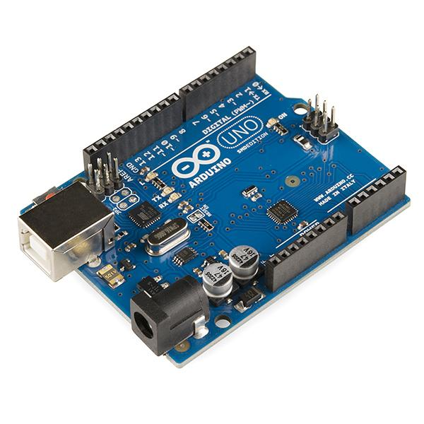
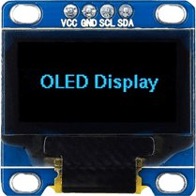
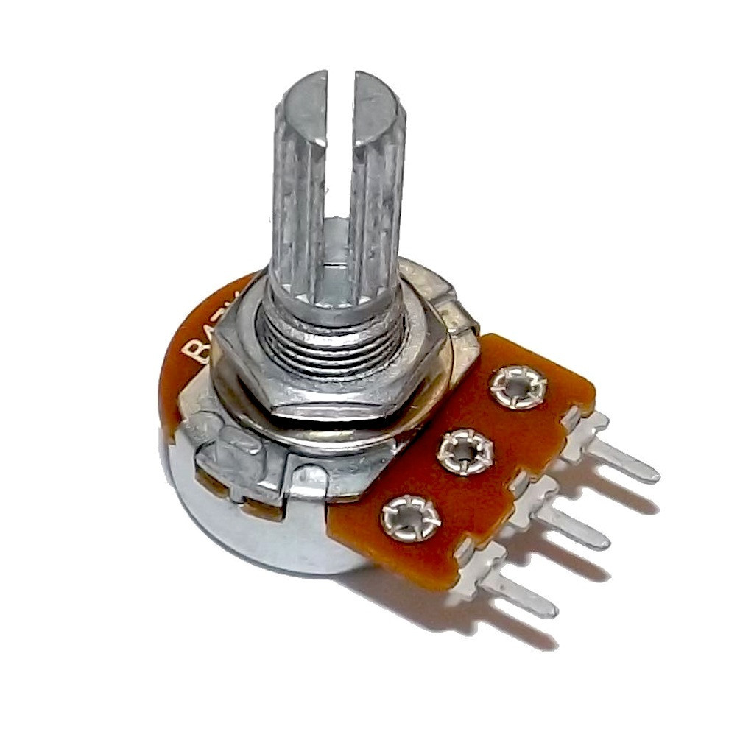
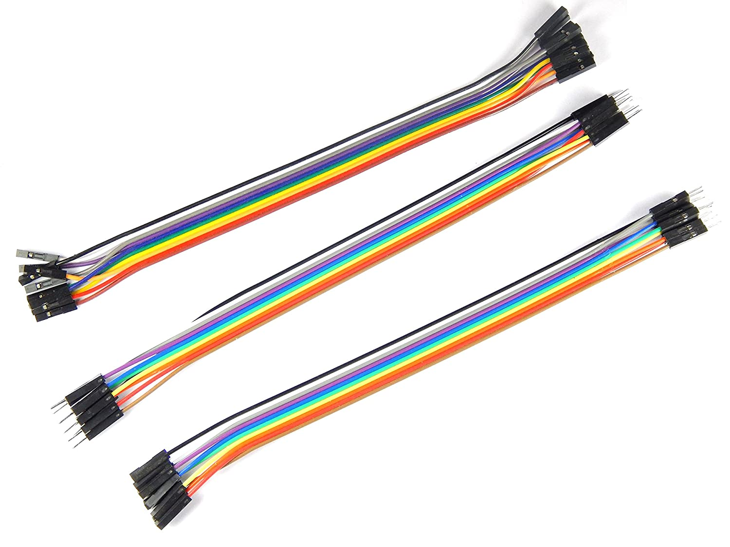
Objective:
Things Used:
To build a fun retro ping pong gaming console .
Arduino Uno microcontroller
SSD1306 OLED display
Potentiometer (100 ㏀)
Jumper wires

Slide 3
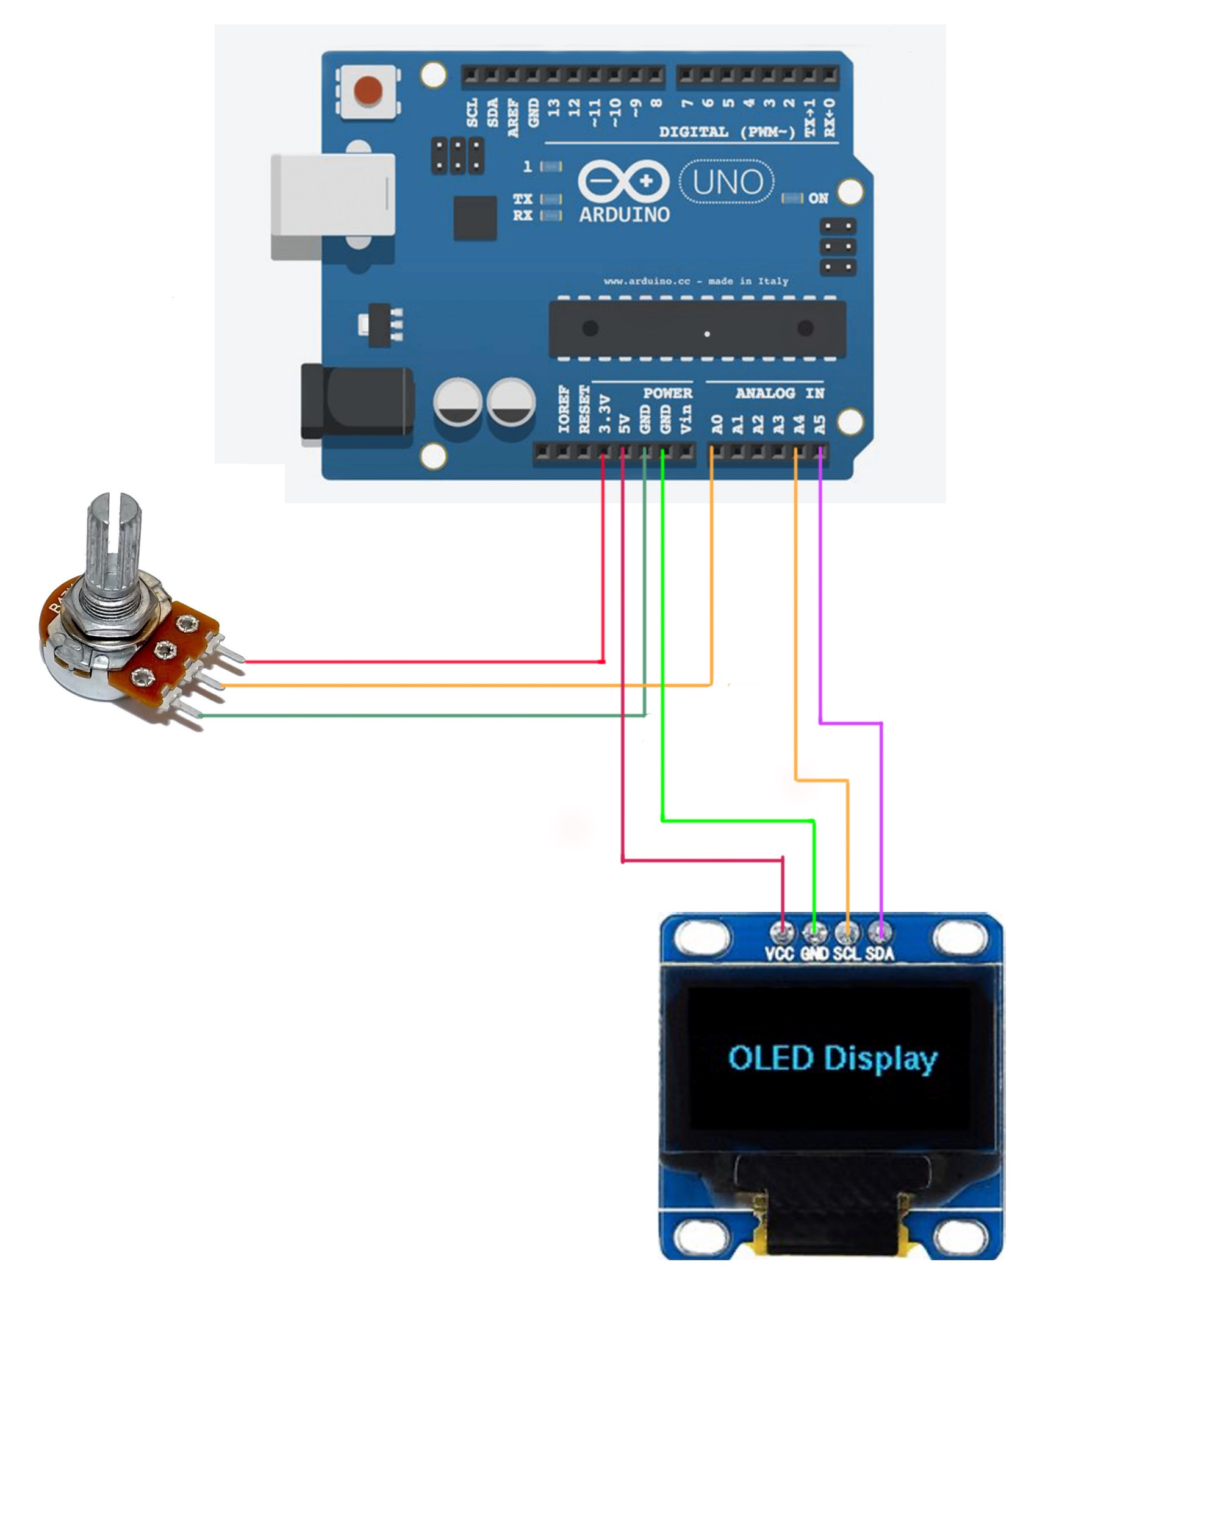
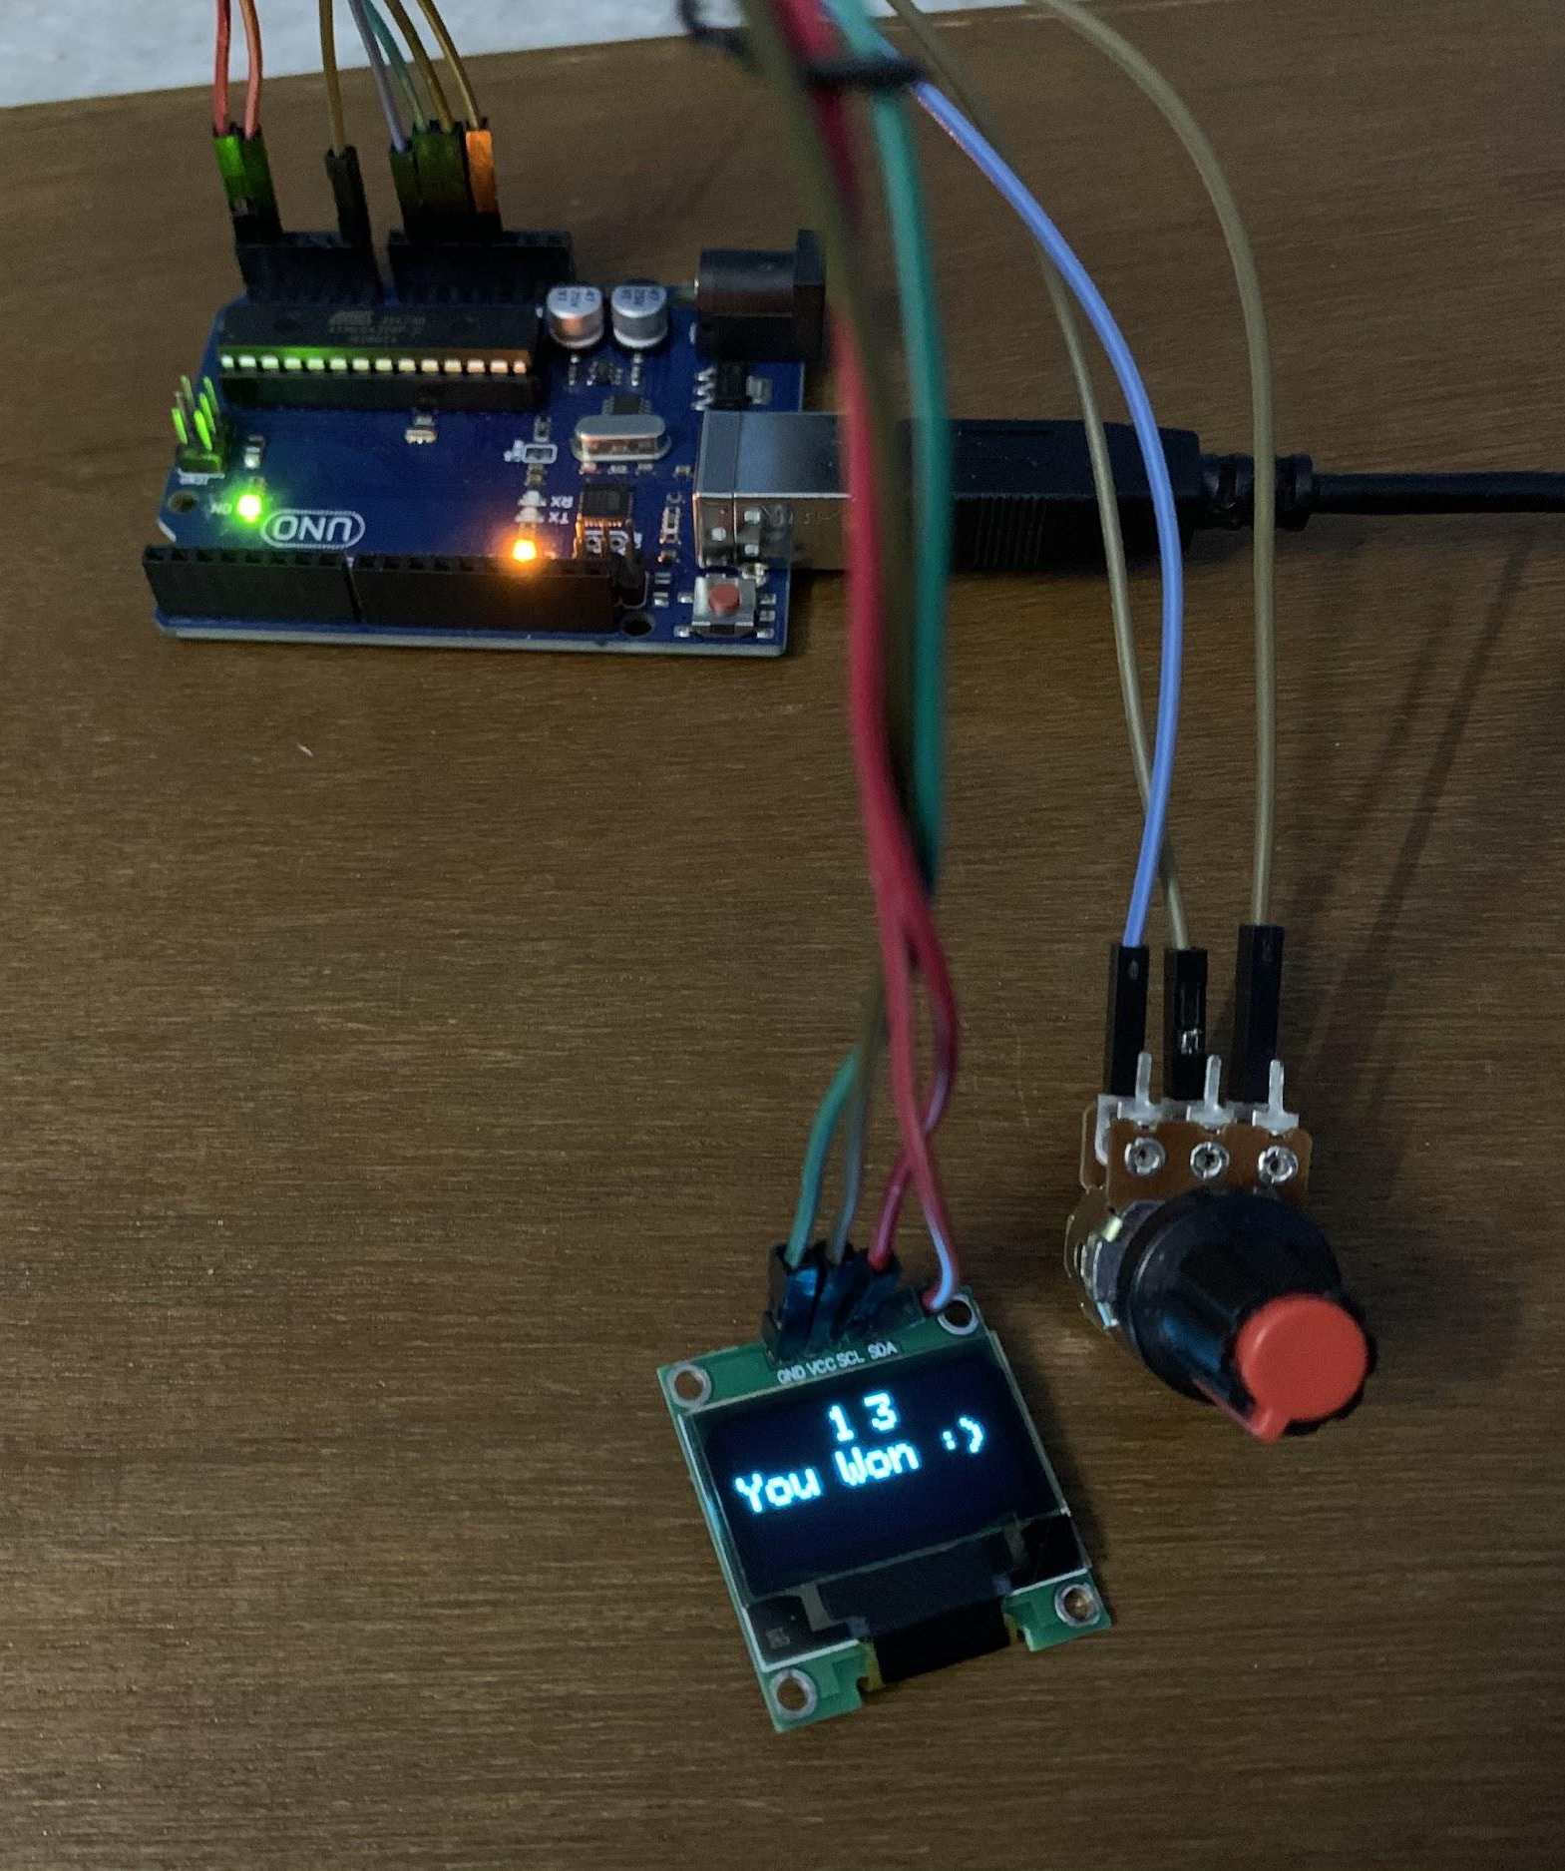

Slide 4
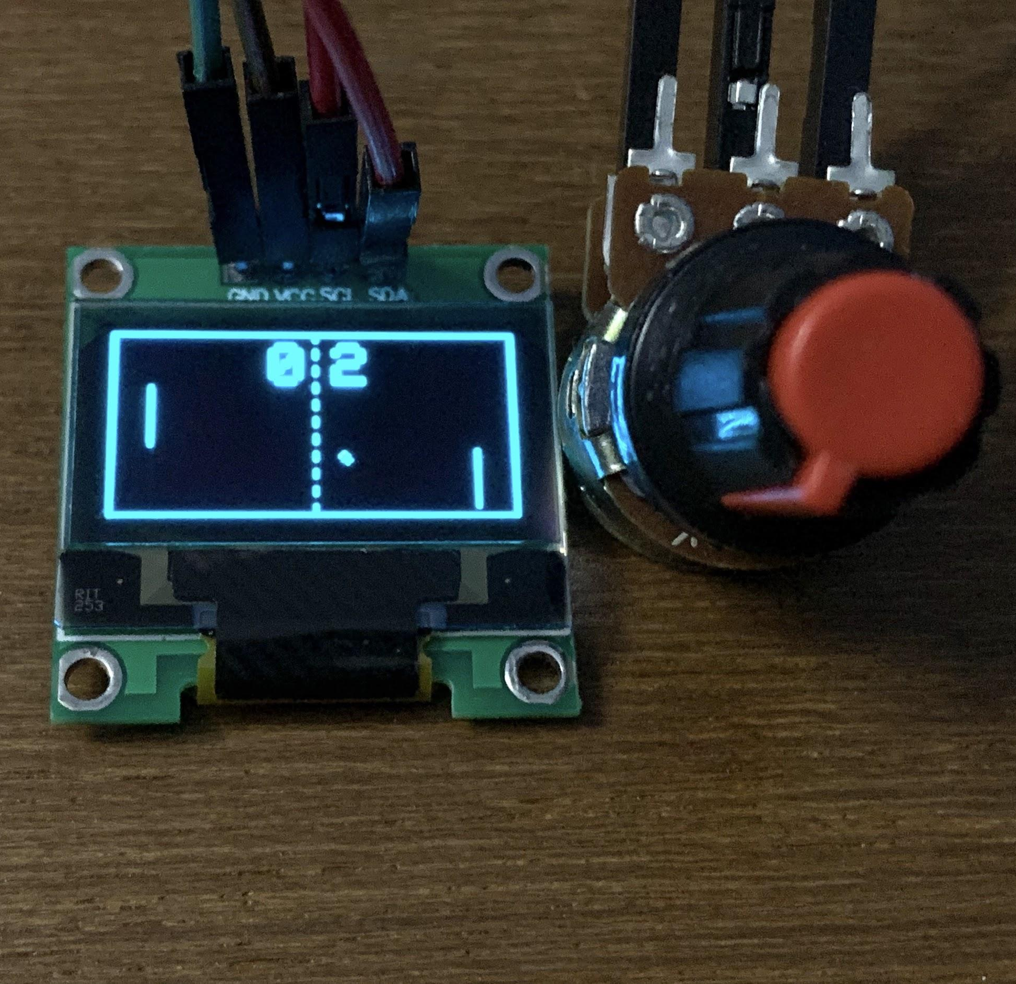
Gameplay:
You play against a CPU. The main objective is to achieve winning score before the CPU.
Your paddle is on the right. Each time the ball collides the vertical borders, the player other than the side on which ball collided gets one point.
You can control your paddle with the dial(potentiometer) in order to dodge the ball or score a point.

Slide 5
You can also modify the following features of game easily inside the code :
Speed of CPU player
Speed of ball
Score required to win
Width of the paddle
Messages displayed at the end of the game

Slide 6
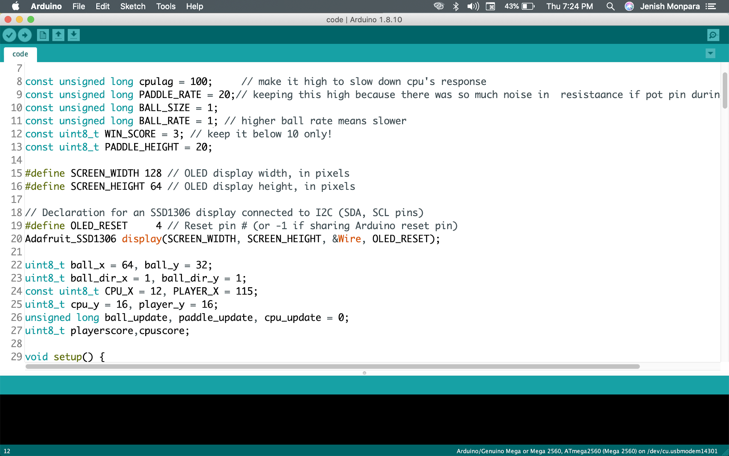
Values of various constants visible in this screenshot can be modified to alter the gameplay.

Slide 7
What next?
A proper pocket sized gaming console can be made using Arduino Uno, batteries, multi-color display, concise wiring and a good manufactured housing. Various games from 90’s can be loaded inside it. Such consoles gives a sense of nostalgia and people might wish to buy them.

Slide 8
It was a nice learning experience working on this project.
Thank You!

