Slide 1
Animal Detection in Road Safety
Presented By:
Jenitta M

Slide 2
Problem Statement
Road crossings in forest and rural areas experience frequent wildlife–vehicle accidents, leading to loss of animal lives, human injuries, and property damage.
Most existing wildlife monitoring methods rely on manual observation or periodic surveys, which cannot provide continuous real-time detection of animals near roads.
Conventional camera traps only record data but require manual inspection of footage, making the process time-consuming, labor-intensive, and prone to human error.
Environmental factors such as moving leaves, shadows, rain, and vehicles often trigger false alerts, reducing system reliability and trustworthiness.
Current systems do not provide instant alerts to road users and forest officials, resulting in delayed reactions and increased risk of accidents and animal fatalities.

Slide 3
Abstract
Wildlife crossing the road represent a life-threatening and common problem in many countries worldwide Traditionally, wildlife monitoring has relied on manual efforts, which can be time-consuming, costly and limited in scope.
AI-powered solutions have significantly enhanced wildlife monitoring capabilities, enabling real-time data collection and analysis for more extensive coverage and greater accuracy.
The aim of the project is to design and design and develop AI-powered camera traps can identify and classify species from Video frames making it easier to monitor wildlife and detect rare or endangered species while crossing the roads and sent reliable early warning alert to the ranger and roadways population.
AI algorithms Temporal Convolutional Network(TCN) can distinguish between animals and non-target objects.

Slide 4
Introduction
Background
Wildlife crossing roads causes frequent accidents, and traditional monitoring methods are slow and manual.
Motivation
There is a need for an automated system that can detect animals in real time and warn people before accidents happen.
Objective
To develop an AI-based system that detects and classifies animals from video frames and sends early warning alerts.
Outcome
The system helps reduce wildlife–vehicle collisions and improves safety for both animals and road users.

Slide 5
Aim and Objective
Aim
The aim of the project is to address the life-threatening issue of wildlife crossing roads by leveraging AI-powered camera traps and Temporal Convolution Network algorithms. The primary focus is on enhancing the efficiency of wildlife monitoring, detecting rare and endangered species during road crossings, and issuing early warnings to ensure the safety of both wildlife and the human population.
Objective
To develop AI-powered camera traps for real-time wildlife monitoring.
To implement AI algorithms, especially TCN, for accurate species identification.
To establish an early warning system to reduce false positives and issue alerts.
To minimize manual efforts by relying on automated AI-powered monitoring.
To send early warnings to rangers and passersby through SMS in real-time.
To focus on rare and endangered species detection during road crossings.
To enhance road safety by proactively addressing wildlife-related threats.

Slide 6
Literature Survey
S.No | Paper Title | Author(s), Year | Methodology | Merits | Demerits
1 | Real-Time Wildlife Detection Using Deep Learning | A. Mughal, R. Khan, A. Rehman, 2025 | YOLO-based CNN model for real-time wildlife detection from video frames | High detection accuracy, supports real-time processing | Performance drops in low-light and foggy conditions
2 | Intelligent Wildlife Monitoring System Using AI | S. Li, H. Zhang, F. Xu, 2024 | Improved YOLO architecture with feature optimization for animal detection | Reduced false positives, better background separation | Computationally expensive for edge devices
3 | Automated Animal Classification Using Camera Trap Images | C. Chalmers et al., 2023 | Faster-RCNN model trained on camera trap datasets | High classification accuracy, reduces manual effort | Works mainly on still images, not optimized for video
4 | Deep Learning Based Wildlife Detection and Alert System | K. Li, Y. Wang, Z. Chen, 2024 | CNN model with cloud-based processing and alert generation | Good for rare species detection, scalable system | Requires continuous internet connectivity
5 | Explainable AI for Wildlife Image Classification | G. Moallem et al., 2023 | Two-stage CNN with explainable AI (Grad-CAM) | Improves model transparency and trust | Not suitable for real-time roadside deployment
6 | Vision-Based Animal Detection for Road Safety | R. Kumar, P. Singh, 2024 | Transfer learning with ResNet and MobileNet models | Lightweight model, suitable for embedded devices | Limited species classification capability

Slide 7
Summary of Related IEEE Papers
Recent IEEE papers use deep learning models (YOLO, CNNs) for detecting wildlife from camera trap images and videos.
These systems provide real-time or near real-time monitoring and improve detection accuracy compared to manual methods.
Research shows that AI can reduce false positives by distinguishing animals from background objects like trees and shadows.
Some studies focus on species classification, while others emphasize road safety and accident prevention.
Limitations found in existing works include poor performance in low light, occlusion, and high computational cost for field deployment.

Slide 8
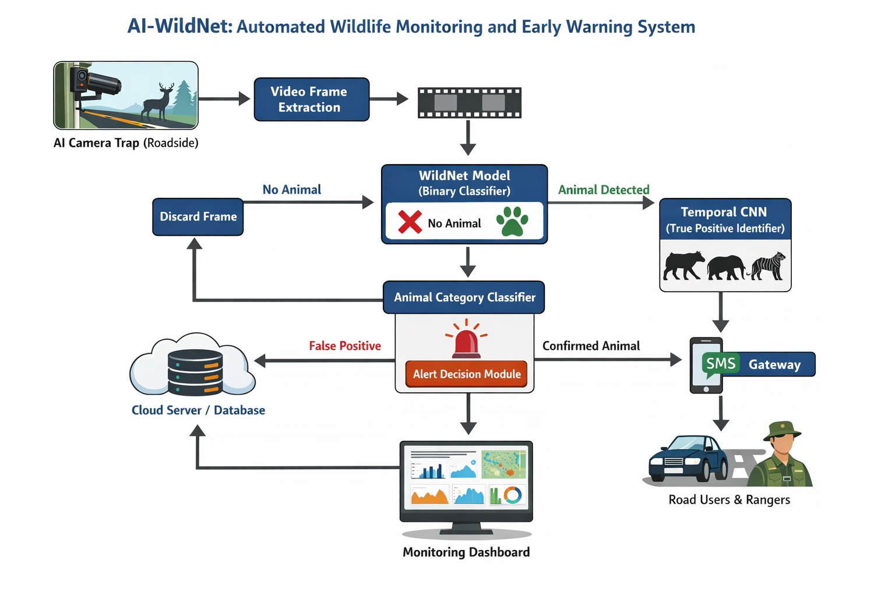
System Architecture

Slide 9
Tools and Technologies
Language : Python 3.7.4(64-bit) or (32-bit)
Web Design : HTML, CSS, Bootstrap
Web Framework : Flask 1.1.1
Database : MySQL 5.
Server : Wampserver 2i
Packages : TensorFlow, Keras, Pandas, Sickit Learn, Matplotlib

Slide 10
Existing System
Manual Monitoring
Wildlife near roads is monitored by forest staff or volunteers through patrolling and visual observation.
Traditional Camera Traps
Camera traps are installed near forest areas to capture animal images or videos.
Sensor-Based Systems
Infrared or motion sensors are used to detect animal movement near roads. These sensors detect motion but cannot identify animal type, leading to many false alarms.

Slide 11
Drawbacks
No real-time animal detection
High false alarm rate
Requires continuous human involvement
Time-consuming data analysis
Cannot identify animal species
Expensive maintenance
Limited coverage area
Poor performance at night or bad weather

Slide 12
Proposed System
AI-Based Animal Detection
Video frames captured from roadside cameras are processed using a trained deep learning model (WildNet) to detect the presence of animals and classify them into species categories.
Temporal Verification
A Temporal Convolutional Neural Network (TCNN) verifies detections across multiple frames to reduce false positives caused by shadows, vehicles, or vegetation movement.
Alert and Communication
When an animal crossing is confirmed, the system automatically triggers an alert and sends warning messages to nearby road users and forest authorities through SMS.
Data Storage and Monitoring
All detected animal data, time, and location details are stored in a cloud database and displayed on a monitoring dashboard for analysis and decision-making.

Slide 13
Advantages
Reduces wildlife–vehicle accidents
Provides real-time early warning
Minimizes human effort
Helps protect endangered species
Improves road safety
Supports conservation research
Works continuously (24/7)
Cost-effective in the long term
Easy to scale to new locations

Slide 14
Modules List
Wildlife Defense Web Control Panel
End User Interface
WildNet Model: Build and Train
3.1. Import Dataset
3.2. Preprocessing
3.3. Segmentation
3.4. Feature Extraction
3.5. Classification
3.6. WildNet Model:Build and Train
3.7. Deploy Model

Slide 15
Modules List
4. Wild Animal Crossing Predictor
4.1. Input Image
4.2. Live Feed
4.3. Video
4.4. Prediction using TCN
5. Alert Generator
5.1. SMS Alert
5.2. Alarm
5.3. Species Image Forwarder

Slide 16
1. Wildlife Defense Web Control Panel
This module serves as the centralized interface for the entire system, providing essential tools for management and control.
This module is designed and developed using Python, Flask, MySQL, and Bootstrap to provide an efficient and user-friendly interface for managing and controlling the wildlife monitoring and alert system.
Admins can configure alert settings, including SMS notifications and audible alarms. The integration ensures seamless communication with the Alert Generator module.

Slide 17
2. End User Interface
2.1. Admin
Facilitates login and dataset upload.
Allows training of the WildNet Model.
Enables the addition and management of forest rangers.
2.2. User
Accepts input from images, live feeds, or videos.
Executes predictions regarding animal presence.

Slide 18
3. WildNet Model: Build and Train:
Import Dataset: Gathers relevant data for training.
Preprocessing: Conducts tasks such as resizing, grayscale conversion, noise filtering, binarization, and segmentation using RPN.
Feature Extraction: Utilizes Convolution, Activation, and Pooling layers.
Classification: Applies Fully Connected layers.
WildNet Model Building and Training: Deploys Convolutional Neural Network (CNN) for training.
Deploy Model: Integrates the trained model into the Wildlife Defense Web Control Panel.

Slide 19
4. Wild Animal Crossing Predictor
Accepts input from various sources such as images, live feeds, or videos.
Utilizes Temporal Convolutional Network (TCN) for accurate predictions.

Slide 20
5. Alert Generator:
SMS Alert: Sends real-time alerts via SMS.
Alarm: Raises audible alarms in response to potential threats.
Species Image Forwarder: Forwards images of detected species for further analysis.

Slide 21
Work Done So Far
Studied existing wildlife monitoring and detection systems.
Collected animal images and video datasets for training.
Preprocessed data by resizing and cleaning images.
Designed the system architecture of AI-WildNet.
Selected suitable deep learning models for detection and classification.
Implemented initial animal detection model using transfer learning.
Tested the model with sample images and video frames.
Prepared project documentation and diagrams.

Slide 22
Conclusion
In conclusion, this project presents an AI-based automated wildlife monitoring and early warning system for road crossings. By using deep learning models for animal detection and classification, the system can identify wildlife presence in real time and send instant alerts to road users and forest officials. This approach helps in reducing wildlife–vehicle collisions, protecting endangered species, and improving overall road safety. The proposed system minimizes human intervention and provides an efficient, reliable, and scalable solution for wildlife conservation and public safety.

Slide 23
Future Enhancement
The system can be connected to traffic signals and warning boards to stop vehicles when animals are detected.
A mobile app can be developed to send alerts directly to drivers and forest officers.
Thermal and night-vision cameras can be added for better detection at night and in fog.
GPS can be used to track animal movement and identify accident-prone zones.
More animal species can be included for better classification accuracy.

Slide 24
References
S. Giordano, I. Seitanidis, M. Ojo, D. Adami, and F. Vignoli, ``IoT solutions for crop protection against wild animal attacks,'' in Proc. IEEE Int. Conf. Environ. Eng. (EE), Mar. 2018, pp. 1-5.
J. H. Muribø, ``Locating sheep with YOLOv3,'' M.S. thesis, Fac. Inf. Technol. Elect. Eng., Dept. Comput. Sci., NTNU, Trondheim, Norway, 2019.
R. Y. Aburasain, E. A. Edirisinghe, and A. Albatay, ``Drone-based cattle detection using deep neural networks,'' in Intelligent Systems and Applications, K. Arai, S. Kapoor, and R. Bhatia, Eds. Cham, Switzerland: Springer, 2021, pp. 598-611.
E. S. Kalhagen and Ø. L. Olsen, ``Hierarchical species detection in real-time video using YOLO,'' M.S thesis, Fac. Eng. Sci., Dept. Inf Commun. Technol., Univ. Agder, Kristiansand, Norway, 2020.
A. Roihan, M. Hasanudin, and E. Sunandar, ``Evaluation methods of bird repellent devices in optimizing crop production in agriculture,'' J. Phys.Conf. Ser., vol. 1477, Mar. 2020, Art. no. 032012.

