Slide 1
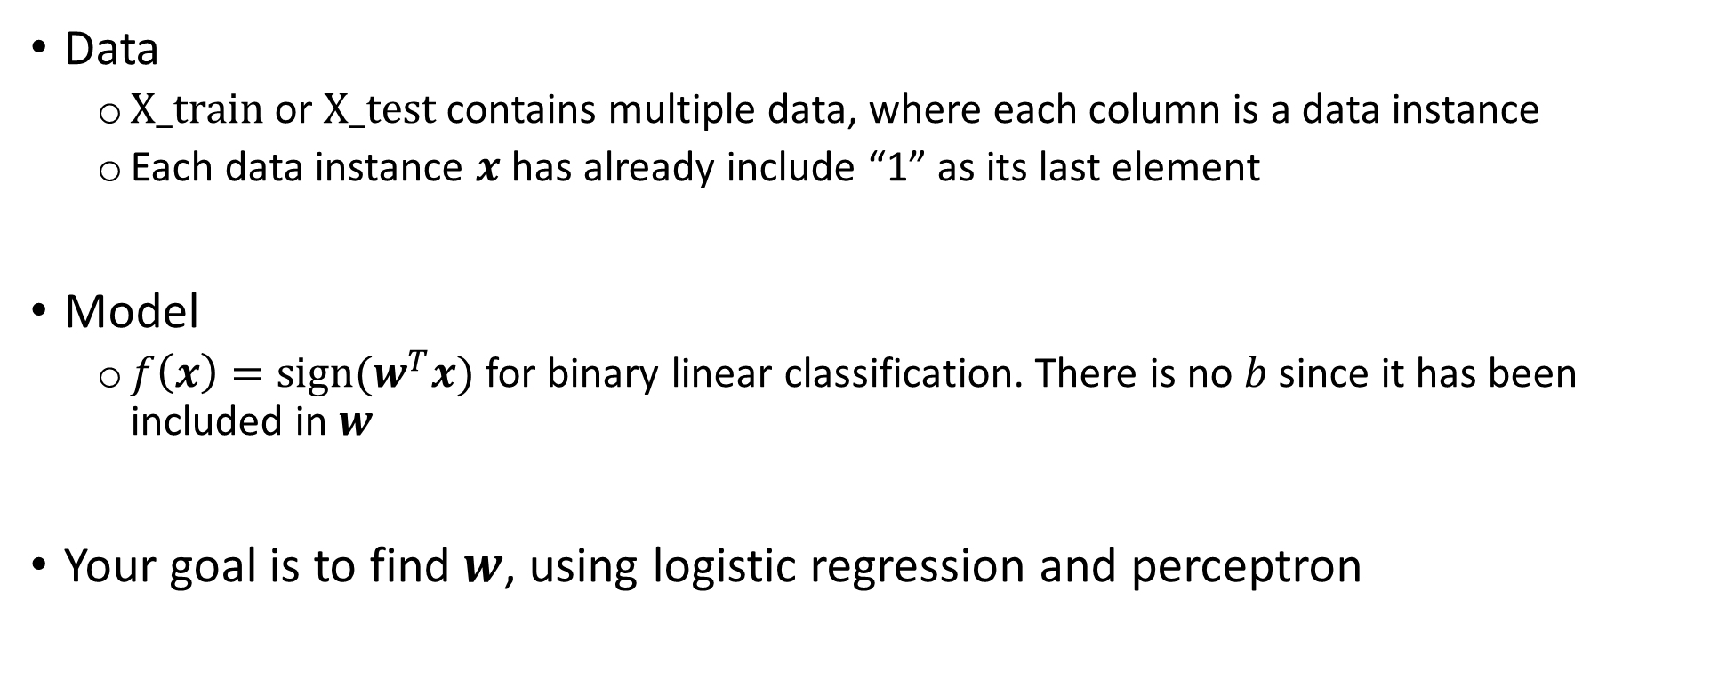
Data and model
Data
$X_train$ or $X_test$ contains multiple data, where each column is a data instance
Each data instance $x$ has already include “1” as its last element
Model
$f\left(x\right)=sign(w^{T}x)$ for binary linear classification. There is no $b$ since it has been included in $w$
Your goal is to find $w$, using logistic regression and perceptron

Slide 2

Logistic Regression
Training data: $\left\{\left(x_{1},y_{1}\right),…,(x_{N},y_{N})\right\}$; $y_{n}∈\left\{0,1\right\}$
Model: $f\left(x\right)=sign(w^{T}x)$
Logistic loss:
$p_{n}=p\left(1 | x_{n};w\right)=ρ\left(w^{T}x_{n}\right)=\frac{1}{1+e^{−(w^{T}x_{n})}}$
Minimize $−\frac{1}{N}\sum_{n=1}^{N}{log p\left(y_{n} | x_{n};w\right)}=−\frac{1}{N}\sum_{n=1}^{N}{\left\{y_{n}×logp_{n}+\left(1−y_{n}\right)×\log\left(1−p_{n}\right)\right\}}$

Slide 3

Logistic Regression
How to optimize w.r.t. $w$?
Gradient descent!
Loss =$−\frac{1}{N}\sum_{n=1}^{N}{\left\{y_{n}×logp_{n}+\left(1−y_{n}\right)×\log\left(1−p_{n}\right)\right\}}$
For t = 1:T
$w←w−η×∇_{w}$Loss
$η$ is the learning rate
This is the what you need to implement!
See the next slide.

Slide 4
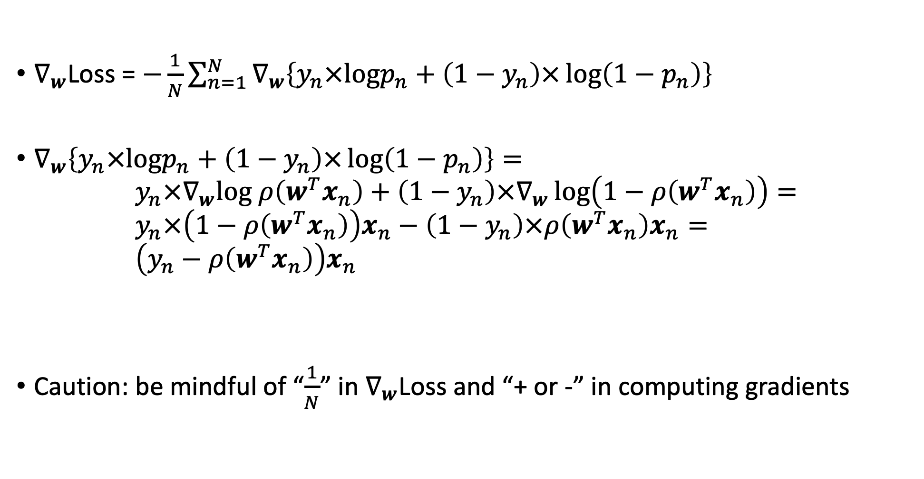
Logistic Regression
$∇_{w}$Loss = $−\frac{1}{N}\sum_{n=1}^{N}{∇_{w}\left\{y_{n}×logp_{n}+\left(1−y_{n}\right)×\log\left(1−p_{n}\right)\right\}}$
$∇_{w}\left\{y_{n}×logp_{n}+\left(1−y_{n}\right)×\log\left(1−p_{n}\right)\right\}=$ $y_{n}×∇_{w}log ρ\left(w^{T}x_{n}\right)+\left(1−y_{n}\right)×∇_{w}\log\left(1−ρ\left(w^{T}x_{n}\right)\right)=$ $y_{n}×\left(1−ρ\left(w^{T}x_{n}\right)\right)x_{n}−\left(1−y_{n}\right)×ρ\left(w^{T}x_{n}\right)x_{n}=$ $\left(y_{n}−ρ\left(w^{T}x_{n}\right)\right)x_{n}$
Caution: be mindful of “$\frac{1}{N}$” in $∇_{w}$Loss and “+ or -” in computing gradients
This is the main thing you need to compute

Slide 5

Perceptron
Training data: $\left\{\left(x_{1},y_{1}\right),…,(x_{N},y_{N})\right\}$; $y_{n}∈\left\{−1,1\right\}$
Model: $f\left(x\right)=sign(w^{T}x)$
For t = 1 : T
Loop for all training examples $x_{n}$
Predict ${\hat{y}}_{n}=sign\left(w^{T}x_{n}\right)$
If ${\hat{y}}_{n}≠y_{n}$
Update: $w←w+η(y_{n}x_{n})$

