Slide 1
ATOC4500 Data Science Laboratory Application Lab 2
Instructor:
Prof. Jennifer Kay
Jennifer.E.Kay@colorado.edu
Spring 2022
T/Th 11:30 am-12:45 pm

Slide 2
Plan this week….
Application Lab #2
Start Homework #3
You should finish Application Lab #2 and have started Homework #3 by the end of class on Thursday.
Let Prof. Kay and Giovanni know how it is going…Ask lots of questions! Coding, science, etc. – We are here to help and will be roaming around…

Slide 3
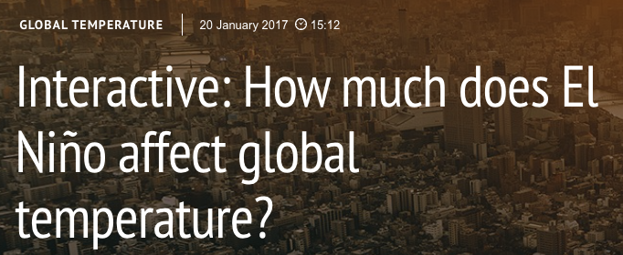
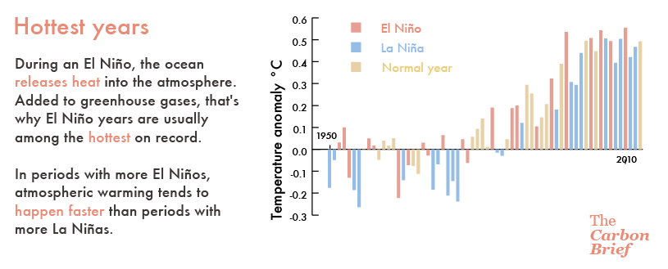
https://www.carbonbrief.org/interactive-much-el-nino-affect-global-temperature

Slide 4
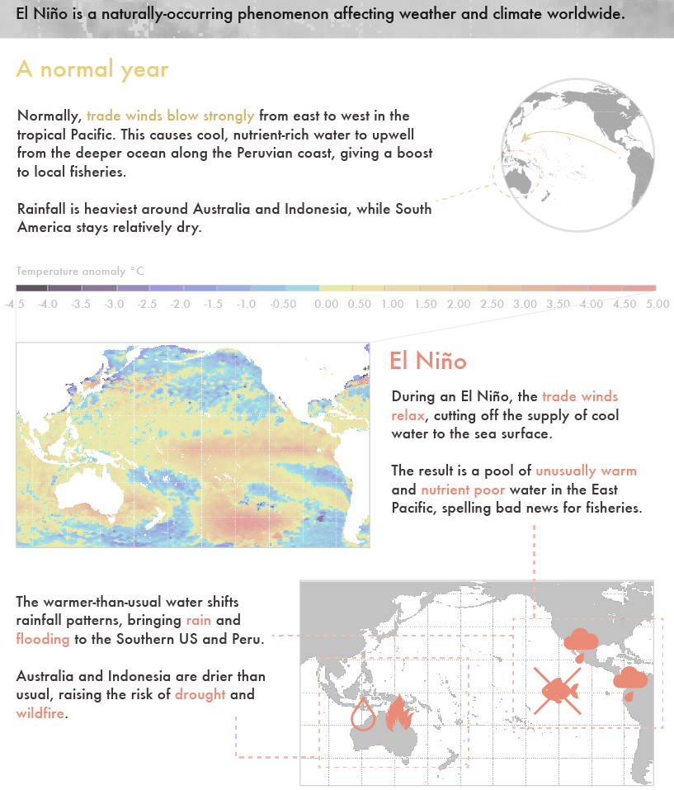

Slide 5
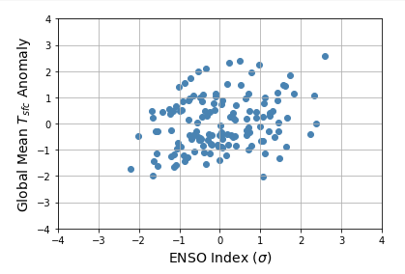
Application Lab #2 – Linear Regression: Can Pacific Ocean sea surface temperatures (i.e., ENSO) anomalies (X) be used to predict global mean surface temperature anomalies (Y)?

Slide 6
Looking forward:
Homework #3 is due next Thursday March 3.
Next week we’ll start machine learning – Unit #3.
Contact Prof. Kay or Giovanni if you have any questions or concerns. Office hours are on this week:
Giovanni Monday 3-4 pm https://cuboulder.zoom.us/j/96536534549 Passcode: letscode!
Prof. Kay Wednesday 4-6 pm https://cuboulder.zoom.us/j/99769486583 Passcode: help

Slide 7
Assigned Groups - ATOC4500:
Application Lab #2, Homework #3
Group #1: Laura, Jackie, Gillian, Erica
Group #2: Sean, Sam, Sydney, Alyssa
Group #3: Daphne, Devon, Fergus
Group #4: Rachel, Victoria, Ania
Group #5: Ben, Jacob, Nate

