Slide 1
ATOC4500 Data Science Laboratory Application Lab 1
Instructor:
Prof. Jennifer Kay
Jennifer.E.Kay@colorado.edu
Spring 2022
T/Th 11:30 am-12:45 pm

Slide 2
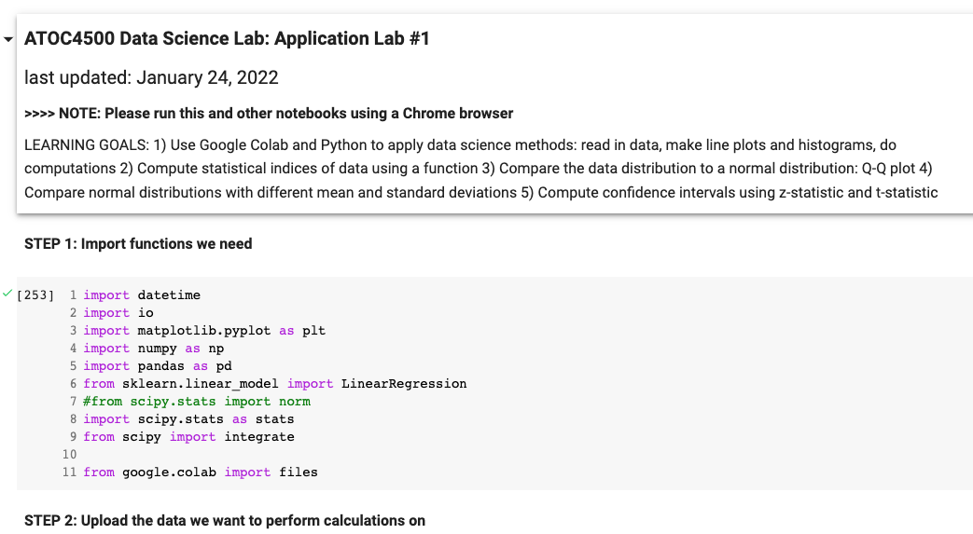
How to execute python code in ATOC4500:
Open your CU Google Drive in Chrome
Navigate to your folder for this class: “ATOC4500_Spring2022”
Copy file called “ATOC4500_applicationlab1.ipynb” to your folder.
Open it in Collaboratory, Execute cells using shift+return

Slide 3
Plan this week…. Application Lab #1
1) Complete Hello World Script (part of Homework #1, to be submitted by each student independently).
2) Start into Application Lab #1. We will work on this lab in class today and Thursday in assigned groups of 3.
You should be done with Application Lab #1 by the end of class on Thursday. Let Prof. Kay and Giovanni know how it is going…Ask lots of questions! Coding, science, etc. – We are here to help and will be roaming around…

Slide 4
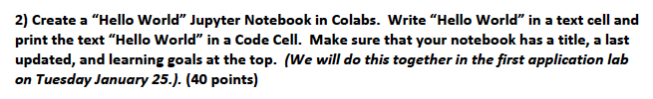
Hello World Script
We’ll all do this together with Prof. Kay.
Use helloworld.ipynb to start to figure out how to work/collaborate with your assigned group. Will you share screens and have one person work? Will you have a scribe? What will you do if someone is unavailable?
Zoom and Colab should help you work together but what is your plan?

Slide 5
Assigned Groups - ATOC4500:
Application Lab #1 and Homework #2
Group #1: Laura, Fergus, Ania
Group #2: Sean, Devon, Victoria
Group #3: Daphne, Alyssa, Nate, Erica
Group #4: Rachel, Jacob, Gillian
Group #5: Ben, Jackie, Sydney, Sam

Slide 6
Hello World Script
Use helloworld.ipynb to start to figure out how to work/collaborate with your assigned group. Will you share screens and have one person work? Will you have a scribe? How will you save the best answers for the entire group to submit? What will you do if someone is unavailable?
Zoom and Colab -- lots of options for tech help.

Slide 7
Reminders this Week
Homework #1 is due this Thursday. Submit individually on Canvas as a .pdf. You can work together but everyone should submit their own assignment in their own words.
Looking ahead – next week you will work on Homework #2 in your group. Same group as this week.

