Slide 1
Tissue Specific Aging

Slide 2
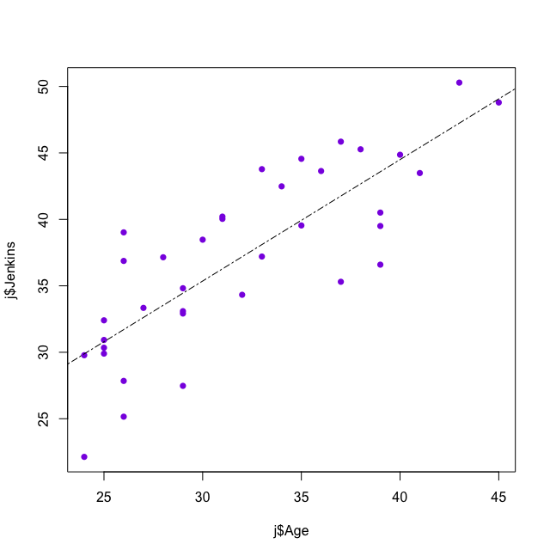
Jenkins Predicted Age
Predicted Age
Actual Age
p value: 1.869e-09

Slide 3
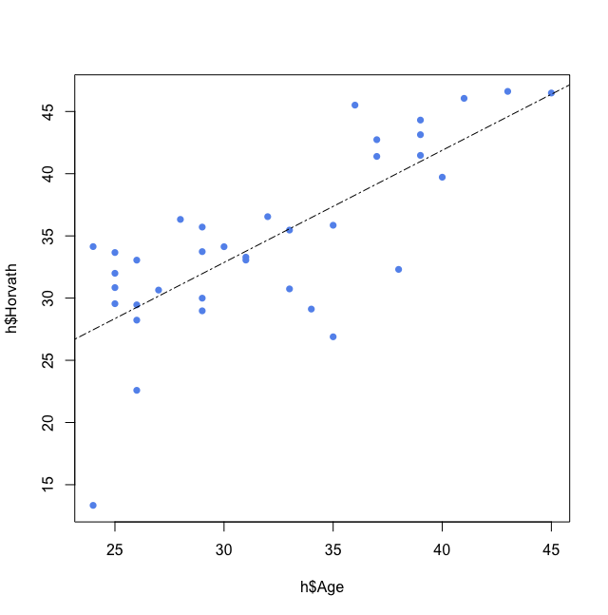
Horvath Predicted Age
Predicted Age
Actual Age
p value: 1.039e-07

Slide 4
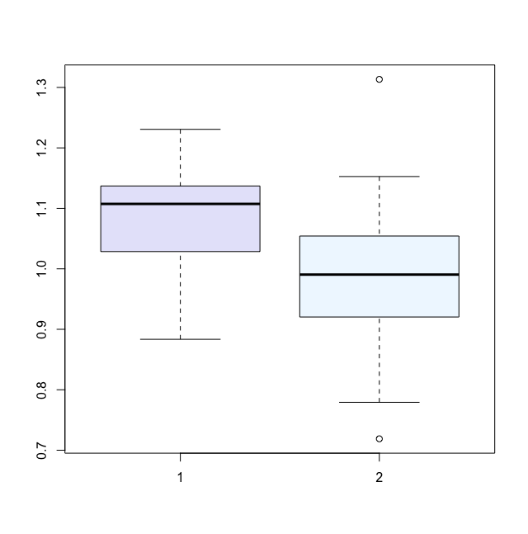
Sperm GLAD Values
Oligozoospermic
Normozoospermic
p value: 0.03795

Slide 5
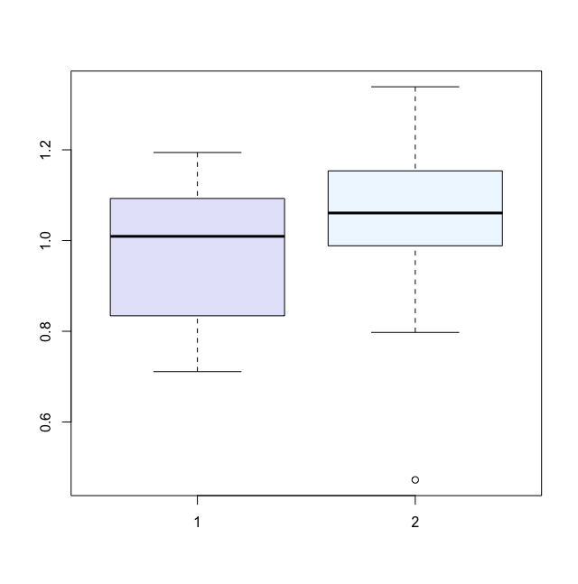
Blood GLAD Equivalent Values
Blood GLAD Equivalent Values
Oligozoospermic
Normozoospermic
p value: 0.2063

Slide 6
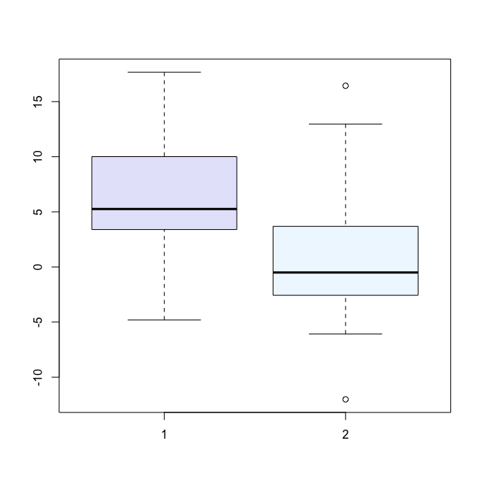
Difference in Predicted Age
Oligozoospermic
Normozoospermic
p value: 0.02721

Slide 7
Difference in Predicted Age: Normozoospermic

Slide 8
Difference in Predicted Age: Oligozoospermic

